Slide 1
Basic Principles of Process Calculations in Chemical Engineering (ChEg2106)
Prerequisites: No prerequisite for this course
Lecture 8: Energy Balances without Chemical Reaction for Closed Systems
Week 8
Lecturer: Adamu Esubalew (PhD, ChEg)
Addis Ababa, Ethiopia
1

Slide 2
Lecture learning outcomes
At the end of the lecture, you will be able to:
explain forms of energy, and key terms for energy balance calculations,
identify problem-solving techniques for energy balances, and
determine energy balances without chemical reaction for closed systems.
2

Slide 3
Presentation outlines
Introduction to energy balances
The key terms for energy balances
Energy balances problem-solving techniques
Energy balances without chemical reaction for closed systems
Summary
3

Slide 4
8.1. Introduction to energy balances
Energy is a defined as the capacity to do work or produce change.
It exists in various forms and can be transformed from one form to another but cannot be created or destroyed, according to the law of conservation of energy.
Energy conservation law states that energy is neither created nor destroyed (Coulson & Richardson’s, 1999, pg. 60).
The standard unit of energy in the International System of Units (SI) is the joule (J).
Other units include calories, kilojoule, megajoule and terajoule.
4

Slide 5
Cont’d
Energy can change from one form to another (e.g., potential energy can be converted to kinetic energy), but the total amount of energy in a closed system remains constant.
Energy is crucial in various fields such as engineering, biology, environmental science, and economics.
The rate of energy is called power, which has units of energy per time.
The SI unit of power is watt (W); 1 J/ s= 1 W
Energy can power vehicles, heat homes, fuel industrial processes, and initiate biological functions.
5

Slide 6
Cont’d
Energy can be sourced from renewable resources (solar, wind, biofuels, and hydroelectric power) and non-renewable resources (fossil fuels and nuclear power).
Energy can be obtained in several forms.
Some of the types of energy that are of major interest to engineers and scientists are mechanical (kinetic, potential) energy, thermal energy, chemical energy, electrical energy, and nuclear energy.
6

Slide 7
Cont’d
Process industries have always recognized that wasting energy leads to reduced profits.
If a process industry uses more energy than its competitors, its products can be priced out of the marketplace.
As an engineer for designing processes, one of your principal jobs would be to account carefully for the energy that flows into and out of each process unit, and determine the overall energy requirement for the whole processes.
7

Slide 8
8.2. The key terms for energy balances
System property: A characteristic of material that can be measured, or calculated.
The properties of a system are dependent on its condition at any given time and not on what has happened to the system in the past.
There are two types of system properties. These are extensive properties and intensive properties.
Extensive properties: Physical variables or parameters are that values are the sum of the values of each of the sub systems comprising the whole system.
8

Slide 9
Cont’d
For example, mass and volume are extensive properties.
Intensive properties: Physical variables or parameters are whose values are not additive, and do not vary with quantity of the material in the subsystems.
For example, temperature, pressure, density, specific volume and specific energy are intensive properties.
Intensive properties do not change if the system is sliced in half or if halves are put together.
9

Slide 10
Cont’d
Energy can be obtained in several forms (Coulson & Richardson’s, 1999, pg. 60-62).
Some forms of energy are the followings:
Kinetic energy: It is the energy of an object due to its motion.
e.g. translational kinetic energy and rotational kinetic energy
Potential energy: It is the stored energy in an object due to its position or configuration. e.g. gravitational potential energy and elastic potential energy.
Thermal energy: It is the energy associated with the temperature of an object, related to the motion of its particles.
10

Slide 11
Cont’d
Chemical energy: It is the energy stored in the bonds of chemical compounds, released or absorbed during chemical reactions.
For exothermic reaction, energy is released from a system to the surroundings.
For endothermic reaction, energy is absorbed by a system from the surroundings.
Electrical energy: It is the energy due to the flow of electric charge in a conductor.
Nuclear energy: It is the energy released during nuclear reactions, such as fission (division/splitting of nucleus) or fusion (combination of nucleus).
11

Slide 12
Cont’d
Internal energy: Internal energy of a system depends almost entirely on the chemical composition, state of aggregation (solid, liquid, or gas), and temperature of the system materials.
It is independent of pressure for ideal gases, and nearly independent of pressure for liquids and solids.
If there are no temperature changes, phase changes, or chemical reactions occur in a closed system and if pressure changes are less than a few atmospheres, the change in internal energy will be zero.
12

Slide 13
Cont’d
In a closed system, there is no mass entering or leaving the system.
Energy changes occur solely due to heat transfer and work done on or by the system.
In a closed system, energy balance can be analyzed using the first law of thermodynamics, which states that energy cannot be created or destroyed, only transformed from one form to another.
For a closed system without any chemical reactions, the energy balance can be expressed in terms of internal energy, work, and heat transfer.
13

Slide 14
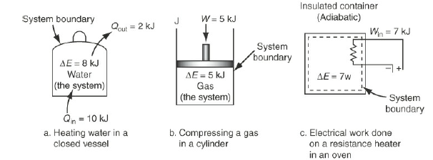
Cont’d
Closed systems that involve energy changes as shown in Figure 8.1 (Himmelblau, 2023, pg. 491).
Figure 8.1 Closed systems that involve energy changes (a) heating water in a closed vessel, (b) compressing a gas in a cylinder, and (c) electrical work done on a resistance heater in an oven
14

Slide 15
Cont’d
In closed systems, energy can transfer across system boundaries, but no mass transfer across system boundaries.
To determine energy balances for closed systems, it is required to identify how closed systems that involve energy changes.
Closed systems that involve energy changes by heating water in a closed vessel, compressing a gas in a cylinder, and electrical work done on a resistance heater in an oven.
For closed systems, energy can be transferred across system boundaries in the form of heat energy and work done.
15

Slide 16
Activity 8.1
1. Describe the differences between closed systems and open systems.
2. Identify the forms of energy which can transfer across system boundaries for closed systems.
3. Explain the differences between extensive properties and intensive properties.
4. Justify how closed systems that involve energy changes.
16

Slide 17
Cont’d
#Q₁, Answer:
Open systems: both mass and energy transfer across system boundaries.
Energy transfer can occur in the form of flow energy (due to flow of fluids), heat and work.
They can receive inputs from the environment and send outputs back.
They tend to exhibit more complex behaviors to analyze processes due to the interactions with external factors.
Open systems allow for the exchange of both mass and energy, leading to greater adaptability and complexity.
17

Slide 18
Cont’d
Closed systems: In which there is energy transfer across system boundaries in the form of heat and work done, but no mass transfer across system boundaries.
Closed systems are often more isolated from external influences, simpler to analyze.
Closed systems allow only energy exchange with the surroundings, leading to simpler to analyze but less adaptability to external changes.
Therefore, identifying and understanding the clear differences between open and closed systems is crucial to analyze processes under different conditions.
18

Slide 19
Cont’d
#Q₂, Answer:
For closed systems, energy can be transferred in the form of heat energy (thermal energy) and work done.
Heat energy is the energy transferred between systems due to temperature difference between closed systems and the surroundings.
Work can be done by the system or on the system by the surroundings .
Heat energy and work energy transfer across system boundaries for closed systems can cause the change in internal energy of the systems.
19

Slide 20
Cont’d
#Q₃, Answer:
Intensive properties and extensive properties are two fundamental classifications of physical properties in thermodynamics.
Intensive properties: They are physical properties that do not depend on the amount of substance or size of the system.
They remain constant regardless of how much material is present.
Intensive properties are inherent to the material itself. i.e. they do not change when the size of the sample changes.
e.g. Temperature, pressure, density, color, melting point and boiling point.
20

Slide 21
Cont’d
Extensive properties: They are physical properties that depend on the amount of substance or size of the system.
If you combine two systems, the extensive properties will be the sum of the properties of the individual systems. i.e. extensive properties are additive.
e.g. mass, volume, total energy, enthalpy and entropy.
Hence, identifying and understanding the differences between intensive and extensive properties is crucial for analyzing and describing materials behaviors under various conditions.
21

Slide 22
Cont’d
#Q₄, Answer:
Closed systems that involve energy changes by heating water in a closed vessel, heating a gas in a sealed container, compressing a gas in a cylinder, cooling a process, and electrical work done on a resistance heater in an oven.
When water is heated in a closed vessel, heat is transferred across system boundaries and the internal energy of the system is increased.
When heat is added to a gas in a closed container, its temperature and internal energy increase at constant volume of a gas.
22

Slide 23
Cont’d
When a gas is compressed in a closed vessel and work is done on a gas, this work adds energy to the closed system which increases a gas temperature and internal energy.
When cooling a process is carried out, a closed system loses heat to its surroundings which may result in a drop in temperature, and its internal energy decreases.
When electrical work done on a resistance heater in an oven, the system temperature increases, which causes the change internal energy in the system.
Using the first law of thermodynamics, you can understand how energy transfer occurs for closed systems and predict the behavior of systems under various conditions.
23

Slide 24
8.3 Energy balances problem-solving techniques
Energy balance problem-solving procedures typically involve a systematic approach to analyze the energy interactions within a system.
There are several problem-solving techniques for energy balances.
Some of the problem-solving techniques are:
Read the problem carefully and understand it,
Identify the type of energy involved in the problem,
Draw the process flow sheet, label the diagram and define symbols,
24

Slide 25
Cont’d
Identify the system boundaries,
Identify the appropriate energy balance equation,
Check the unit consistency,
Gather relevant data if it is required
State the assumptions to solve the problem,
Solve the problem using appropriate energy balance equation, and
Analyze results and write your conclusion on your results.
(Richard M. Felder, 2005, pg. 329-330).
25

Slide 26
8.4. Energy balances without chemical reaction for closed systems
A system is termed closed or open according to whether or not mass crosses the system boundary during the period of time.
A batch process is a closed system, whereas semi-batch and continuous are open systems.
For a closed process system, there is no mass transfer across its boundary.
Energy can be transferred between a system and its surroundings in the form of heat and work.
Heat energy can transfer as a result of temperature difference between a system and its surroundings.
26

Slide 27
Cont’d
The direction of heat energy flow is always from a higher temperature to a lower one.
Heat energy is positive when it is transferred to the system from the surroundings, whereas heat energy is negative when it is transferred to the surrounding from the system.
Work done form of energy flows in response to any driving force other than a temperature difference, such as a force, a pressure, or a voltage.
For example, if a gas in a cylinder expands and moves a piston against a restraining force, the gas does work on the piston (energy is transferred as work from the gas to its surroundings, which include the piston).
27

Slide 28
Cont’d
Work done is considered as positive when it is done by the system on the surroundings, whereas work done is negative when it is done on the system by the surroundings.
Since energy can neither be created nor destroyed, the generation/consumption terms of the general balance are ignored.
An integral energy balance may be derived for a closed system between two instants of time.
In deriving the integral mass balance for a closed system, you eliminated the input and output terms since no mass crosses the boundaries of a closed system.
28

Slide 29
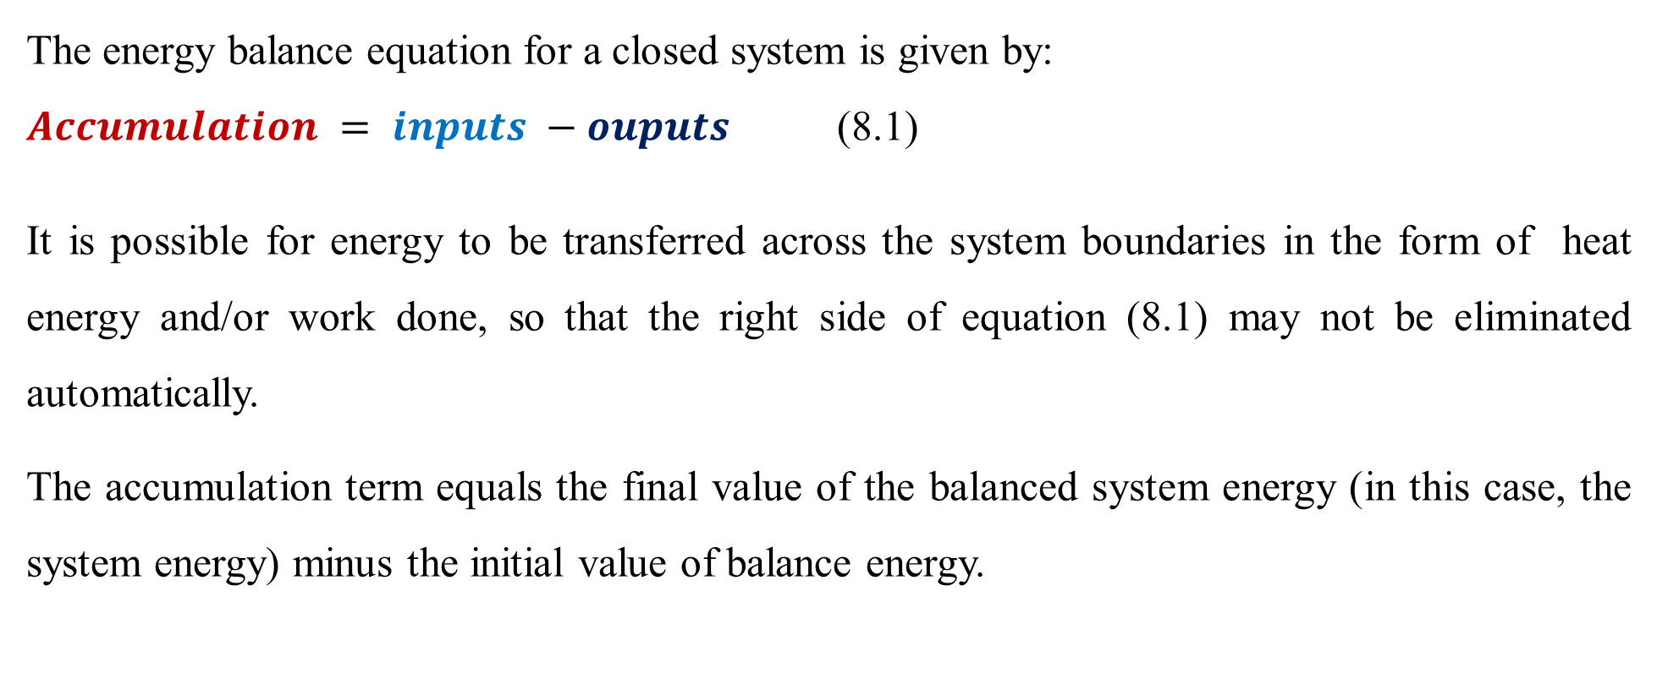
Cont’d
The energy balance equation for a closed system is given by:
$Accumulation = inputs −ouputs$ (8.1)
It is possible for energy to be transferred across the system boundaries in the form of heat energy and/or work done, so that the right side of equation (8.1) may not be eliminated automatically.
The accumulation term equals the final value of the balanced system energy (in this case, the system energy) minus the initial value of balance energy.
29

Slide 30
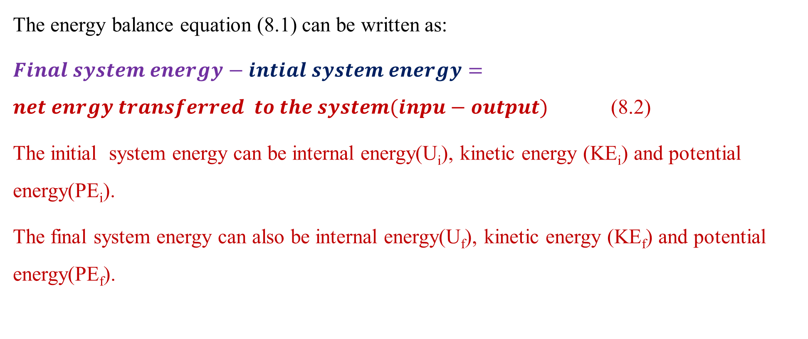
Cont’d
The energy balance equation (8.1) can be written as:
$Final system energy−intial system energy=net enrgy transferred to the system(inpu−output)$ (8.2)
The initial system energy can be internal energy(U_{i}), kinetic energy (KE_{i}) and potential energy(PE_{i}).
The final system energy can also be internal energy(U_{f}), kinetic energy (KE_{f}) and potential energy(PE_{f}).
30

Slide 31
Cont’d
The net energy transfer to the system can be heat added to the system (Q) and work done by the system (W).
Where the subscripts i and f refer to the initial and final states of the system and U, KE, PE, Q and W represent internal energy, kinetic energy, potential energy, heat transferred to the system from its surroundings, and work done by the system on its surroundings, respectively.
The change in energy for internal, kinetic and potential energy is the difference between the final energy and the initial energy.
31

Slide 32
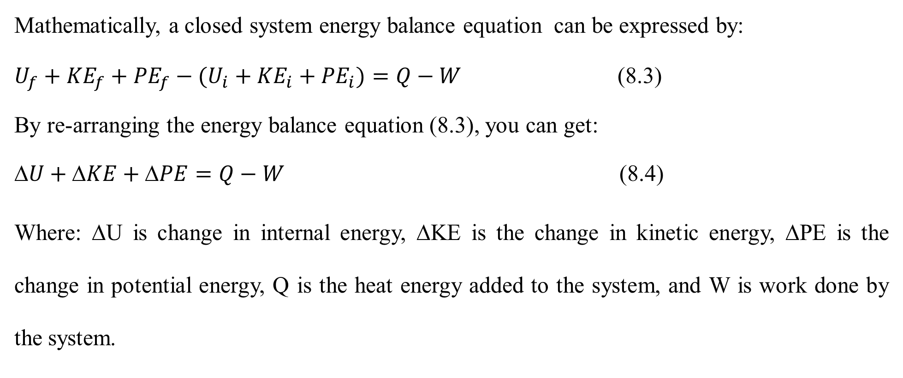
Cont’d
Mathematically, a closed system energy balance equation can be expressed by:
$U_{f}+{KE}_{f}+{PE}_{f}−(U_{i}+{KE}_{i}+{PE}_{i})=Q−W$ (8.3)
By re-arranging the energy balance equation (8.3), you can get:
$U+KE+PE=Q−W$ (8.4)
Where: ΔU is change in internal energy, ΔKE is the change in kinetic energy, ΔPE is the change in potential energy, Q is the heat energy added to the system, and W is work done by the system.
32

Slide 33
Cont’d
The energy balance equation (8.4) is the basic form of the first law of thermodynamics for a closed system (Himmelblau, 2023, pg. 476).
When applying the first law of thermodynamics equation to a given process, you should be aware of the following points:
If a system is not accelerating (moving with constant velocity), the change in kinetic energy will be zero.
If a system is not rising or falling, the change in potential energy will be zero.
33

Slide 34
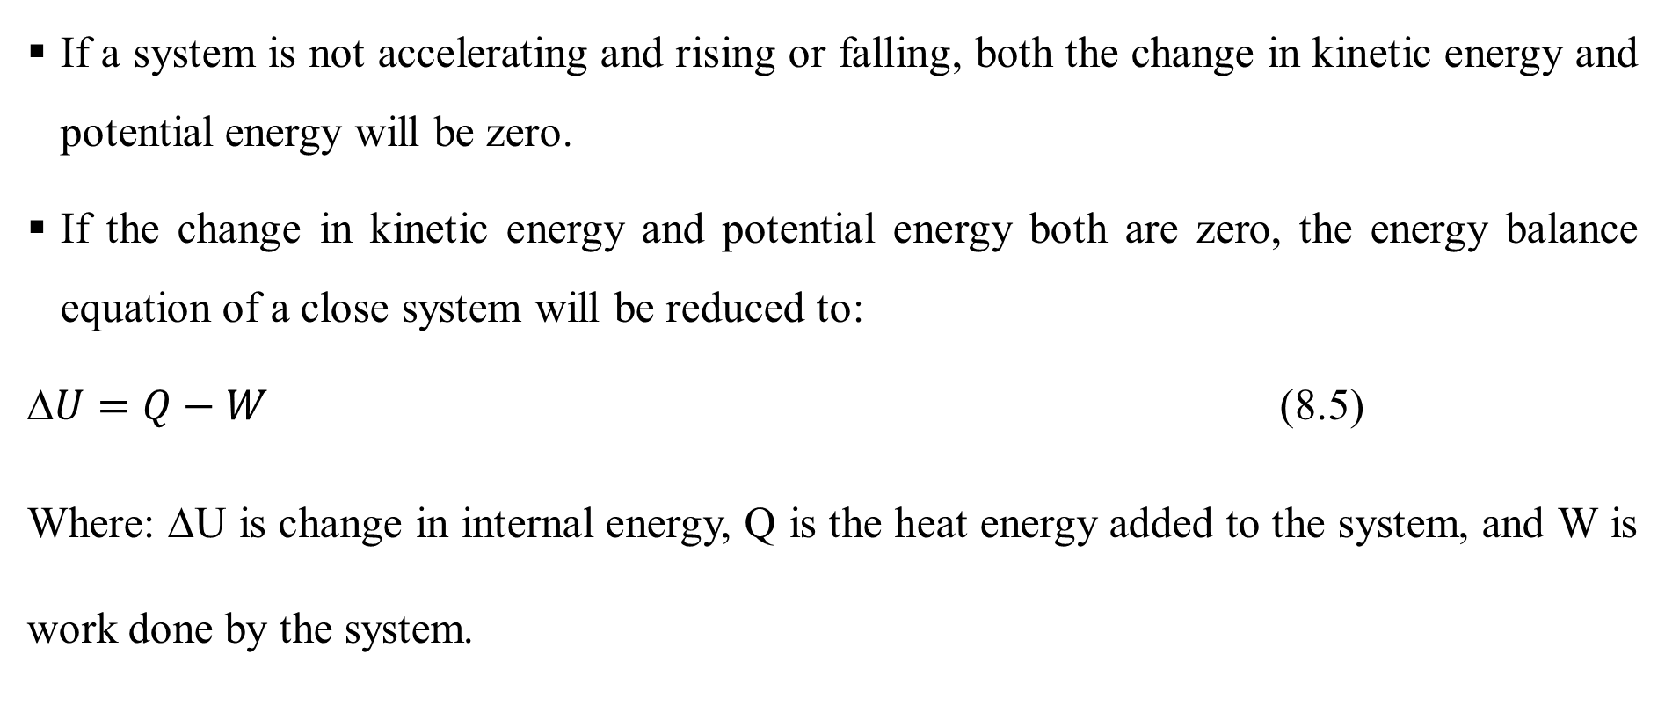
Cont’d
If a system is not accelerating and rising or falling, both the change in kinetic energy and potential energy will be zero.
If the change in kinetic energy and potential energy both are zero, the energy balance equation of a close system will be reduced to:
$U=Q−W$ (8.5)
Where: ΔU is change in internal energy, Q is the heat energy added to the system, and W is work done by the system.
34

Slide 35
Cont’d
For a closed system, the first law of thermodynamics states that the change in internal energy of the system (ΔU) is occurred due to the heat added to the system (Q) and the work done (W) by the system on the surroundings.
This equation (8.5) also states that the change in internal energy of a system for a period of time is equal to the heat transferred into the system plus the work done on the system by the surroundings for that time period.
35

Slide 36
Cont’d
Heat transfer (Q) in the energy balance equation as a single term is the net amount of heat transferred to or from the system over a fixed time interval.
A process may involve more than one specified form of heat transfer, of course, the sum of which is Q.
Heat transfer (Q) is part of the total energy flow across a system boundary that is caused by a temperature difference (potential) between the system and the surroundings (or between two systems).
36

Slide 37
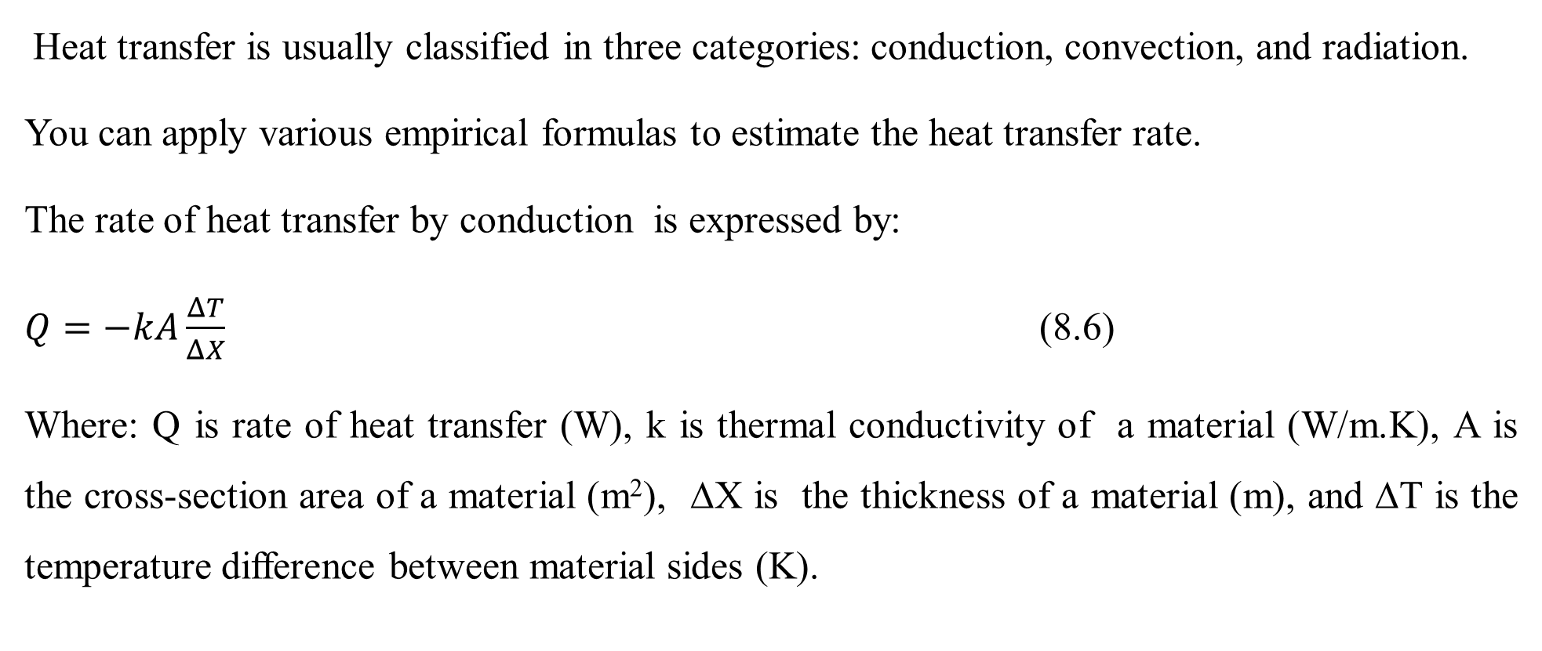
Cont’d
Heat transfer is usually classified in three categories: conduction, convection, and radiation.
You can apply various empirical formulas to estimate the heat transfer rate.
The rate of heat transfer by conduction is expressed by:
$Q=−kA\frac{ΔT}{ΔX}$ (8.6)
Where: Q is rate of heat transfer (W), k is thermal conductivity of a material (W/m.K), A is the cross-section area of a material (m²), ΔX is the thickness of a material (m), and ΔT is the temperature difference between material sides (K).
37

Slide 38
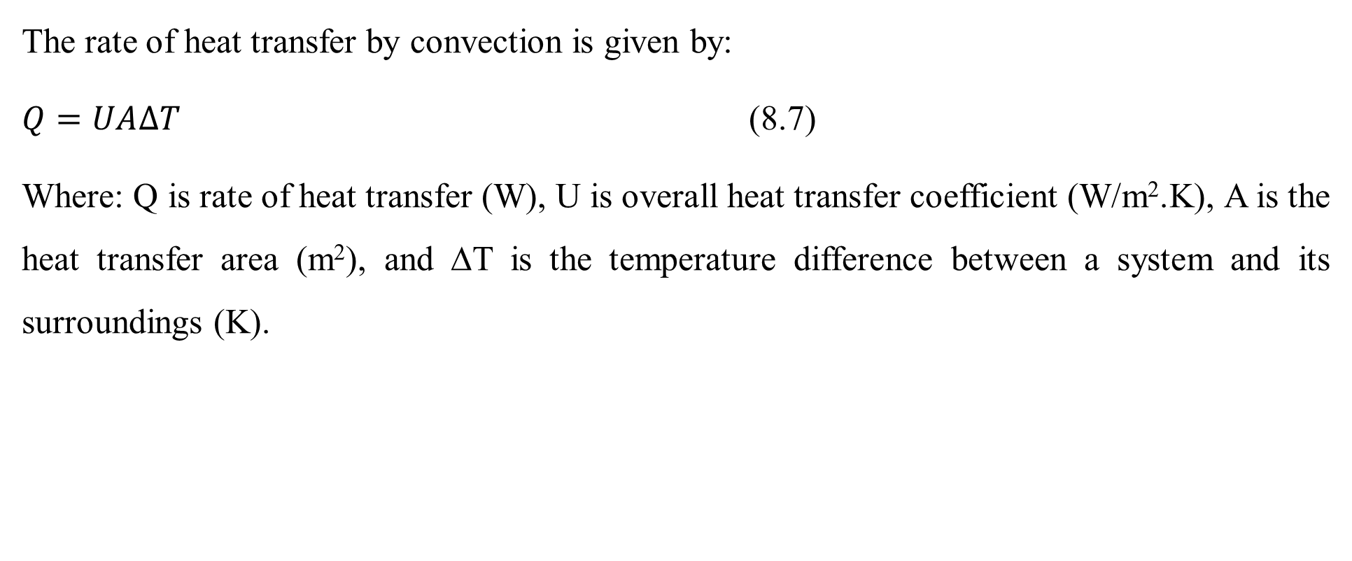
Cont’d
The rate of heat transfer by convection is given by:
$Q=UA∆T$ (8.7)
Where: Q is rate of heat transfer (W), U is overall heat transfer coefficient (W/m².K), A is the heat transfer area (m²), and ΔT is the temperature difference between a system and its surroundings (K).
38

Slide 39
Activity 8.2
1. A closed system with volume of 2L of water is heated with a heat supply of 2, 000kJ/s. What will be the total change in internal energy of water in a system if work done by the surrounding is 400 kJ/s?
2. A gas in closed system is heated with a heat supply of 500kJ/s. What will be the change in internal energy of a gas in a system if the work done by the gas is 100 kJ/s?
3. A closed system contains gas inside in it. The work done by the surrounding on a closed system is 200 kJ/s. What will be the required heat to be supplied to a system if the change in internal energy of a closed system is 1, 000 kJ/s?
39

Slide 40
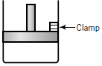
Cont’d
4. A gas is contained in a cylinder fitted with a movable piston as shown in Figure 8.2 (Richard M. Felder, 2005, pg. 319).
Figure 8. 2 A closed system with a movable piston
40

Slide 41
Cont’d
The initial gas temperature is 25ºC. The cylinder is placed in boiling water with the piston held in a fixed position. Heat in the amount of 8, 000 J is transferred to the gas, which equilibrates at 100ºC (and a higher pressure). The piston is then released, and the gas does 200 J of work in moving the piston to its new equilibrium position. The final gas temperature is 100ºC. Considering that the gas in the cylinder to be the system, neglect the change in potential energy of the gas as the piston moves vertically, and assume the gas behaves ideally.
Write the energy balance equation for each of the two stages of this process, and in each case solve for the unknown energy term in the equation.
41

Slide 42
Cont’d
#Q₁, Answer:
Given: A closed system, heat is added to a system, Q = 2, 000 kJ/s; work is done by the surrounding (work done by the system is negative, W = -400 kJ/s)
Required: The change in internal energy, ΔU = ?
Assumptions: There is no other heat source inside a closed system; there is no accelerating of a closed system; there is no heat loss due to a closed system material resistance, and there is no rising or falling of a closed system.
42

Slide 43
Cont’d
A closed system of energy transfer across system boundary is depicted in Figure 8.3.
W = 400 kJ/s
ΔU
Q = 2, 000 kJ/s
Figure 8.3 A closed system with energy transfer for activity 8.2 #Q₁
43

Slide 44
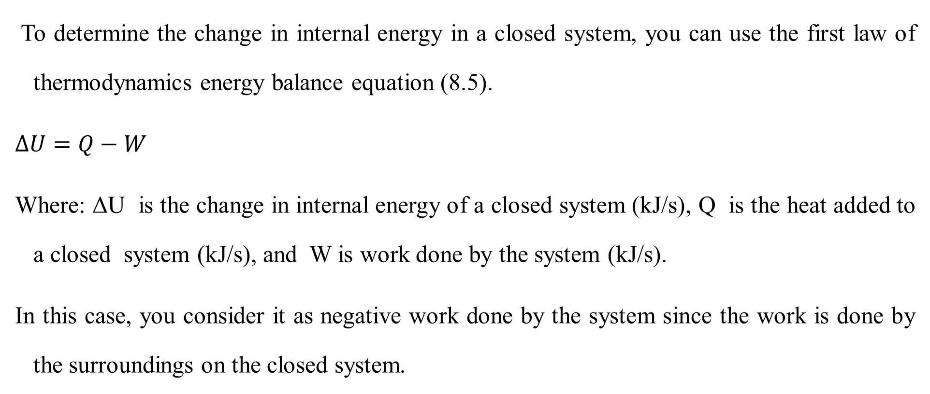
Cont’d
To determine the change in internal energy in a closed system, you can use the first law of thermodynamics energy balance equation (8.5).
$∆U=Q−W$
Where: ΔU is the change in internal energy of a closed system (kJ/s), Q is the heat added to a closed system (kJ/s), and W is work done by the system (kJ/s).
In this case, you consider it as negative work done by the system since the work is done by the surroundings on the closed system.
44

Slide 45
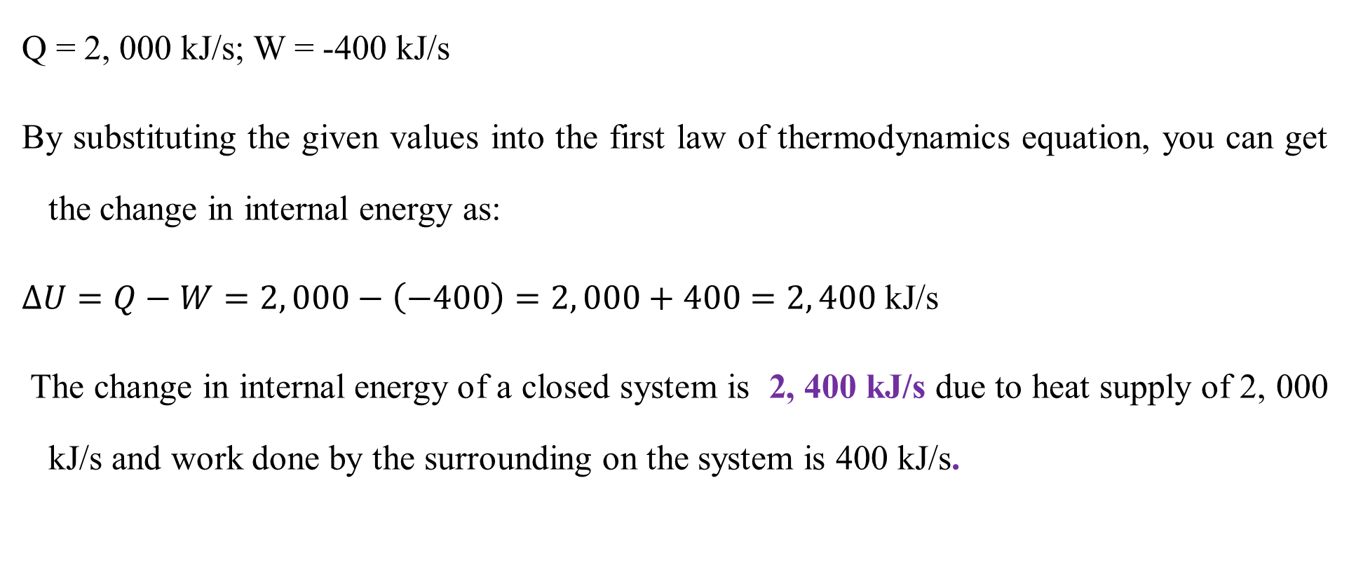
Cont’d
Q = 2, 000 kJ/s; W = -400 kJ/s
By substituting the given values into the first law of thermodynamics equation, you can get the change in internal energy as:
$∆U=Q−W=2, 000−\left(−400\right)=2, 000+400=2, 400$ kJ/s
The change in internal energy of a closed system is 2, 400 kJ/s due to heat supply of 2, 000 kJ/s and work done by the surrounding on the system is 400 kJ/s.
45

Slide 46
Cont’d
#Q₂, Answer:
Given: A closed system, heat is added to a system, Q = 500 kJ/s; work done by the system is positive, W = 100 kJ/s
Required: The change in internal energy, ΔU = ?
Assumptions: There is no other heat source inside a closed system; there is no accelerating of a closed system; there is no heat loss due to a closed system material resistance, and there is no rising or falling of a closed system.
46

Slide 47
Cont’d
A closed system of energy transfer is depicted in Figure 8.4.
W = 100 kJ/s
ΔU
Q = 500 kJ/s
Figure 8.4 A closed system with energy transfer for activity 8.2 #Q₂
47

Slide 48
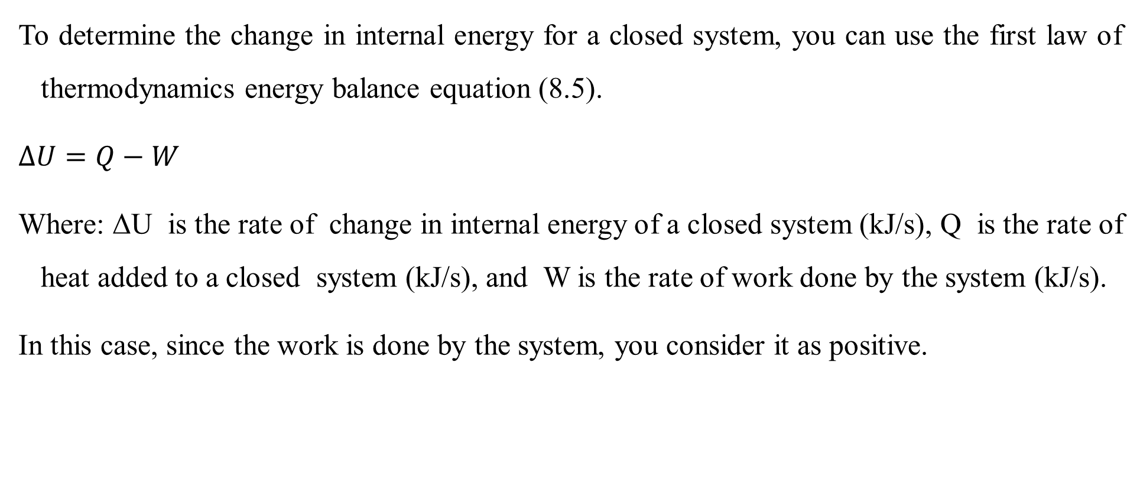
Cont’d
To determine the change in internal energy for a closed system, you can use the first law of thermodynamics energy balance equation (8.5).
$∆U=Q−W$
Where: ΔU is the rate of change in internal energy of a closed system (kJ/s), Q is the rate of heat added to a closed system (kJ/s), and W is the rate of work done by the system (kJ/s).
In this case, since the work is done by the system, you consider it as positive.
48

Slide 49
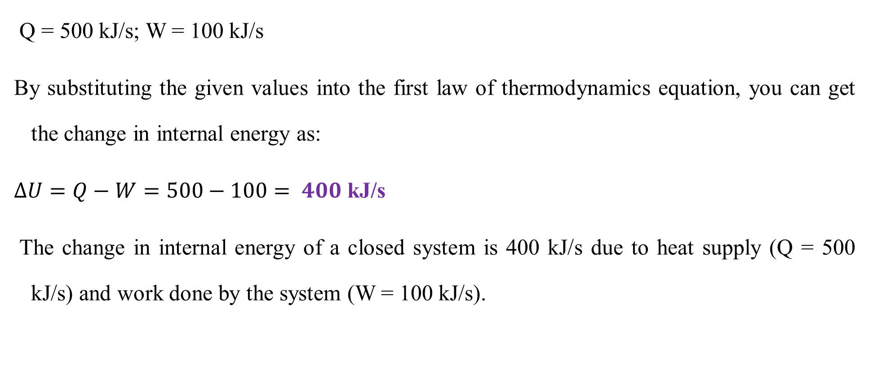
Cont’d
Q = 500 kJ/s; W = 100 kJ/s
By substituting the given values into the first law of thermodynamics equation, you can get the change in internal energy as:
$∆U=Q−W=500−100= 400$ kJ/s
The change in internal energy of a closed system is 400 kJ/s due to heat supply (Q = 500 kJ/s) and work done by the system (W = 100 kJ/s).
49

Slide 50
Cont’d
#Q₃, Answer:
Given: A closed system, the change in internal energy, ΔU = 1, 000 kJ/s; work is done by the surrounding (work done by the system is negative, W = -200 kJ/s)
Required: The required heat to be supplied, Q= ?
Assumptions: There is no other heat source inside a closed system; there is no accelerating of a closed system; there is no heat loss due to a closed system material resistance, and there is no rising or falling of a closed system.
50

Slide 51
Cont’d
A closed system of energy transfer across system boundary is shown in Figure 8.5.
W = -200 kJ/s
ΔU = 1,000 kJ/s
Q = ?
Figure 8.5 A closed system with energy transfer for activity 8.2 #Q₃
51

Slide 52
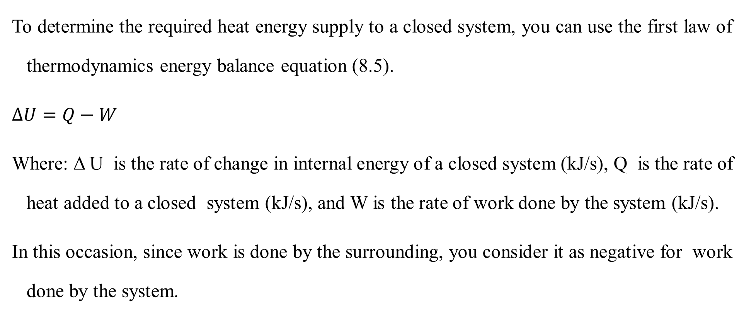
Cont’d
To determine the required heat energy supply to a closed system, you can use the first law of thermodynamics energy balance equation (8.5).
$∆U=Q−W$
Where: Δ U is the rate of change in internal energy of a closed system (kJ/s), Q is the rate of heat added to a closed system (kJ/s), and W is the rate of work done by the system (kJ/s).
In this occasion, since work is done by the surrounding, you consider it as negative for work done by the system.
52

Slide 53
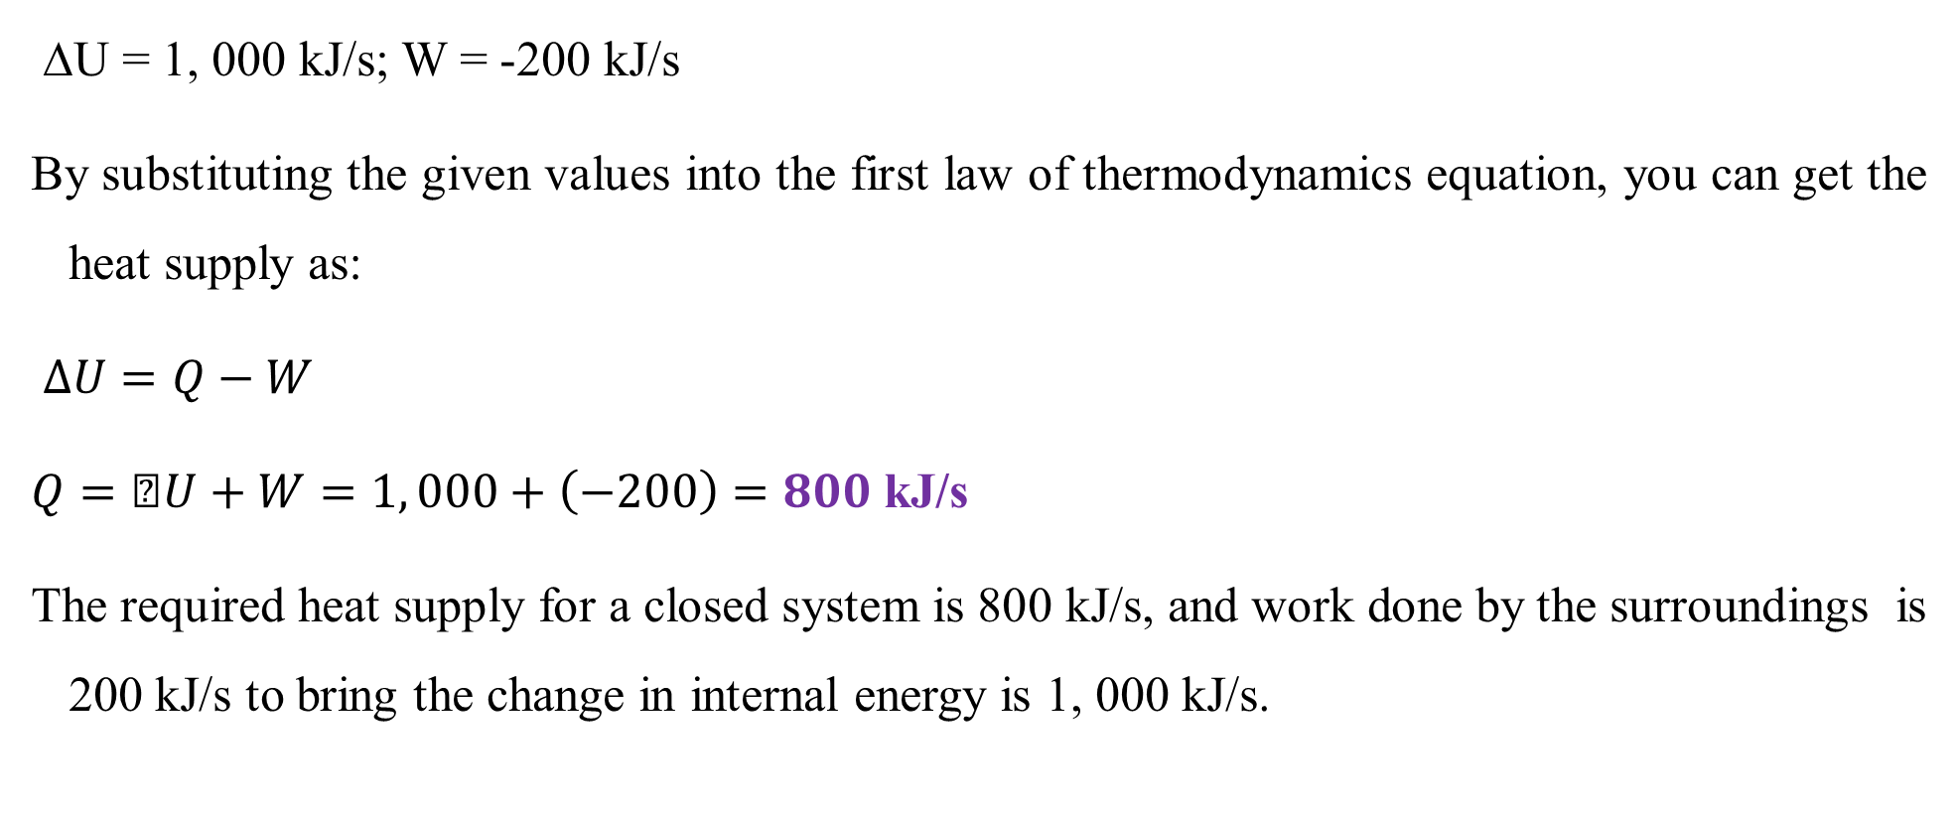
Cont’d
ΔU = 1, 000 kJ/s; W = -200 kJ/s
By substituting the given values into the first law of thermodynamics equation, you can get the heat supply as:
$∆U=Q−W$
$Q=ΔU+W=1, 000+\left(−200\right)=800$ kJ/s
The required heat supply for a closed system is 800 kJ/s, and work done by the surroundings is 200 kJ/s to bring the change in internal energy is 1, 000 kJ/s.
53

Slide 54
Cont’d
#Q₄, Answer:
Given: A closed system has two stages: first stage and second stage.
The first stage is the system is headed by supplying of 8, 000J to rise the gas temperature from 25ºC to 100ºC (the system gains internal energy).
The system has no moving boundary in this stage (work done by the system is zero.)
The gas temperature is increased from 25ºC to 100ºC; and the piston is in its initial position.
54

Slide 55
Cont’d
In the second stage, the piston is released to move at constant temperature of 100ºC (the change in internal energy is zero); and the work done by the system is 200 J.
Required: For the first stage, determine the change in internal energy, and for the second stage, determine the heat added to the system.
Assumptions:
There is no other heat source inside a closed system; there is no accelerating of a closed system; there is no heat loss due to a closed system material resistance, and there is no rising or falling of a closed system.
55

Slide 56
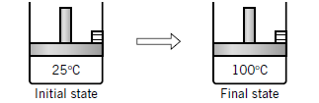
Cont’d
For the first stage: The temperature changes from 25ºC to 100ºC.
A gas in a cylinder fitted with a movable piston, the first stage initial state and final state change in the system is shown in Figure 8.6 (Richard M. Felder, 2005, pg. 320).
Figure 8.6 A gas in a cylinder fitted with a movable piston for the first stage initial and final states
56

Slide 57
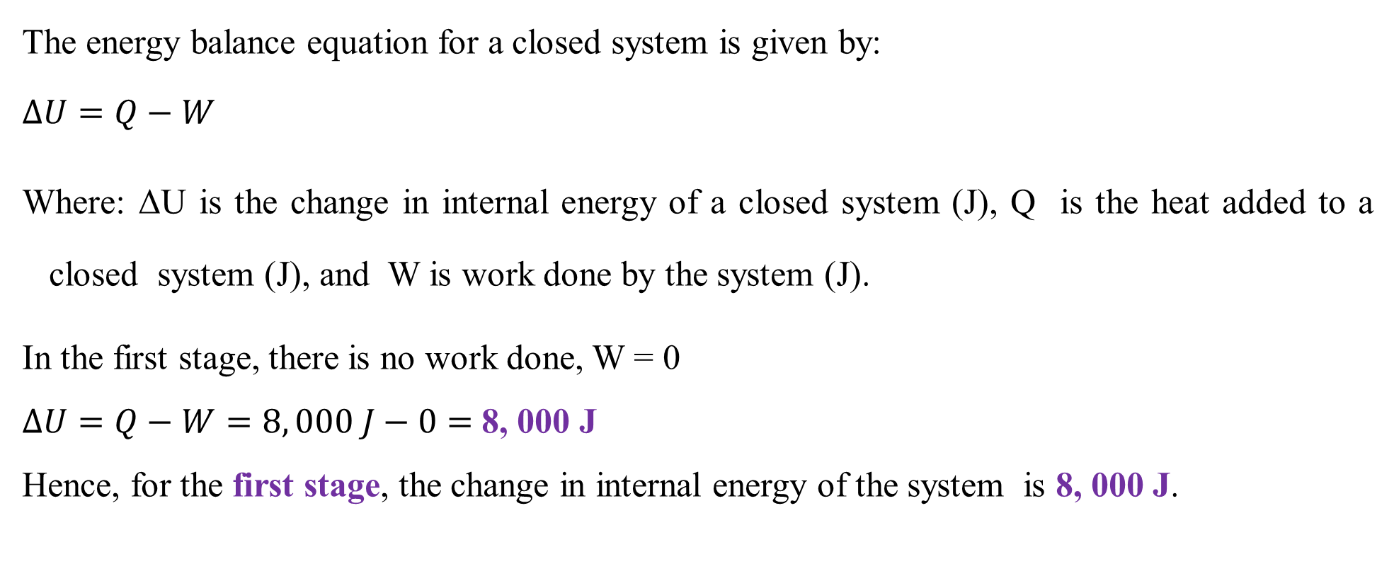
Cont’d
The energy balance equation for a closed system is given by:
$∆U=Q−W$
Where: ΔU is the change in internal energy of a closed system (J), Q is the heat added to a closed system (J), and W is work done by the system (J).
In the first stage, there is no work done, W = 0
$∆U=Q−W=8, 000 J−0=$ 8, 000 J
Hence, for the first stage, the change in internal energy of the system is 8, 000 J.
57

Slide 58
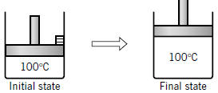
Cont’d
For the second stage: The temperature is constant at100ºC; and the piston is released to move.
A gas in a cylinder fitted with a movable piston, the second stage initial state and final state change in the system is shown in Figure 8.7 (Richard M. Felder, 2005, pg. 320).
Figure 8.7 A gas in a cylinder fitted with a movable piston for the second stage initial and final states
58

Slide 59
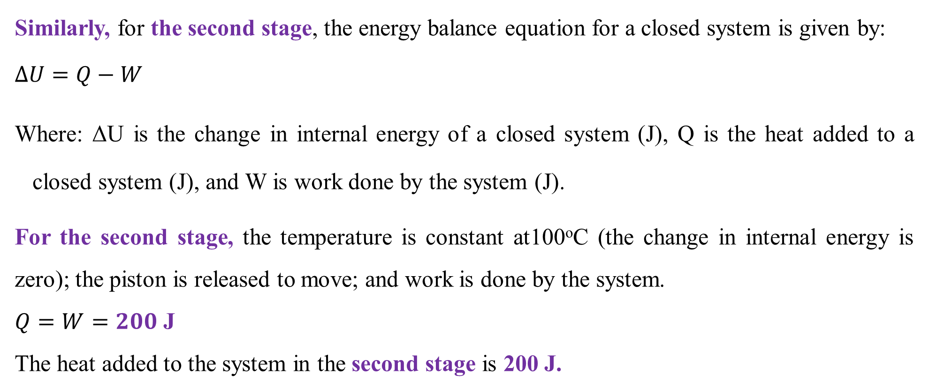
Cont’d
Similarly, for the second stage, the energy balance equation for a closed system is given by:
$∆U=Q−W$
Where: ΔU is the change in internal energy of a closed system (J), Q is the heat added to a closed system (J), and W is work done by the system (J).
For the second stage, the temperature is constant at100ºC (the change in internal energy is zero); the piston is released to move; and work is done by the system.
$Q=W=200$ J
The heat added to the system in the second stage is 200 J.
59

Slide 60
8.5. Summary
For closed systems, there is energy transfer across system boundaries in the form of heat energy (thermal energy) and work done.
The direction of heat energy flow is always from a higher temperature to a lower temperature.
Work energy flows in response to any driving force other than a temperature difference.
Closed systems that involve energy changes by heating water in a closed vessel, heating a gas in a sealed container, compressing a gas in a cylinder or cooling a process.
The energy balance of closed systems is determined using the first law of thermodynamics.
60

Slide 61
References
Basic Principles and Calculations in Chemical Engineering, Himmelblau, Pearson Education Inc, 9th edition, 2023.
Chemical Engineering Design, Volume 6, Coulson & Richardson’s, R. K. Sinnott, 3rd edition, 1999.
Elementary Principles of Chemical Processes, Richard M. Felder, John Wiley & Sons, 3rd edition, 2005.
Thank you!
61

