Slide 1
Basic Principles of Process Calculations in Chemical Engineering (ChEg2106)
Prerequisites: No prerequisite for this course
Lecture 10: Energy Balances with Chemical Reactions
Week 10
Lecturer: Adamu Esubalew (PhD, ChEg)
Addis Ababa, Ethiopia
1

Slide 2
Lecture learning outcomes
At the end of the lecture, you will be able to:
explain the characteristics of energy balances with chemical reactions,
develop equations for energy balances with chemical reactions, and
determine energy balances with chemical reactions.
2

Slide 3
Presentation outlines
Introduction to energy balances with chemical reaction
Problem-solving techniques for energy balances with chemical reactions
Energy balances with chemical reactions
Summary
3

Slide 4
10.1. Introduction to energy balances with chemical reactions
Chemical reactions are at the heart of many industrial processes.
Energy balances involving chemical reactions are essential for understanding and designing chemical processes.
The internal energy and enthalpy changes commonly associated with chemical reactions can play major roles in the design and operation of chemical processes.
Heat of reaction is the enthalpy change associated with chemical reaction, energy absorbed or released during a reaction (Richard M. Felder, 2005, pg. 440-445).
4

Slide 5
Cont’d
Heat of reaction can be determined from standard enthalpy values of reactants and products.
The energy balances with chemical reaction can be determined to treat the effects of energy generation or consumption due to chemical reaction using two methods:
All of the energy effects are consolidated into one term in the energy balance, which is called the heat of reaction.
The reaction energy effects are merged with the enthalpies associated with each stream flowing in and out of the system.
Both methods are based on a quantity known as the heat of formation.
5

Slide 6
Cont’d
The standard heat of formation: It is observed heat transfer that occurs to or from a system in which a reaction takes place.
The energy change is associated with the rearrangement of the bonds of reacting molecules.
For an exothermic reaction, heat is removed from a reactive system.
For an endothermic reaction, heat is added to a reactive system to enhance a reaction.
To include energy changes caused by a chemical reaction in the energy balance equation, you can use the standard heat of formation, which is denoted by the symbol H_{f}º.
6

Slide 7
Cont’d
The superscript “o” denotes the standard state (reference state) for reaction of 25°C and 1 atm, and the subscript “f” denotes formation.
The standard heat of formation is the special enthalpy change associated with the formation of 1mol of a compound from its constituent elements and products in their standard state of 25°C and 1 atm.
The heat of formation is zero in the standard state for each stable element (Himmelblau, 2023, pg. 570-574).
7

Slide 8
Cont’d
The heat of reaction: The heat of reaction is the enthalpy change that occurs when reactants react at various temperatures and pressures to form products.
The standard heat of reaction (ΔHº_{rxn}) is the heat of reaction when stoichiometric quantities of reactants in the standard state (25°C and 1atm) react completely to produce products in the standard state.
If a process involves chemical reaction, heat will normally have to be added or removed.
The amount of heat added or given out in a chemical reaction depends on the reaction conditions.
8

Slide 9
Cont’d
The standard heat of reaction is the heat added or removed when the reaction is carried out under standard conditions (25°C & 1 atm).
The standard heat of reaction can be converted to other reaction temperatures by making a heat balance over a hypothetical process, in which the reactants are at the standard temperature, the reaction carried out, and the products at the required reaction temperature (Coulson & Richardson’s, 1999, pg. 75-76).
The change in standard heat of reaction of species is the difference between the standard heat of reactions of products and reactants.
9

Slide 10
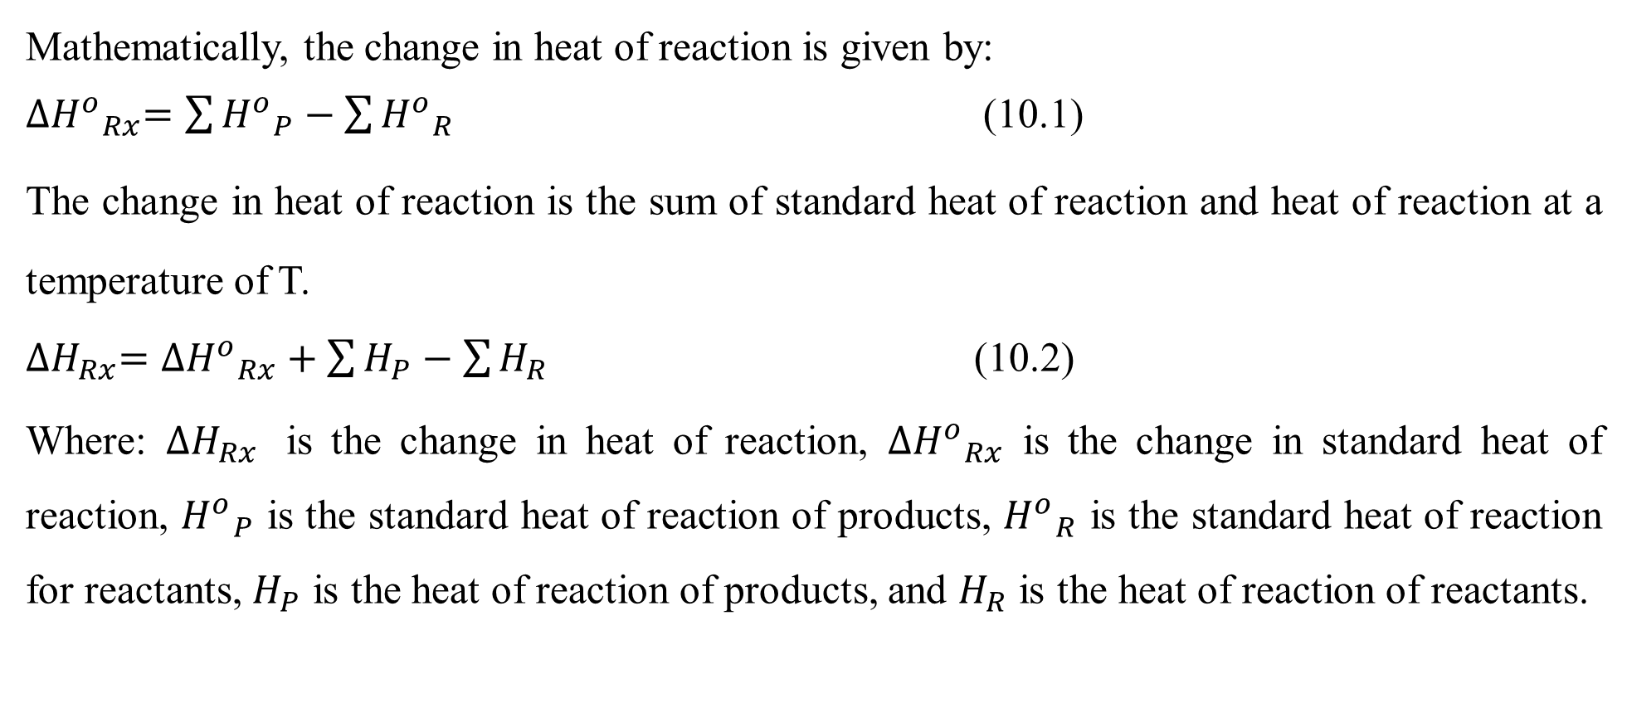
Cont’d
Mathematically, the change in heat of reaction is given by:
${{∆H}^{o}}_{Rx}=\sum{{H^{o}}_{P}}−\sum{{H^{o}}_{R}}$ (10.1)
The change in heat of reaction is the sum of standard heat of reaction and heat of reaction at a temperature of T.
${∆H}_{Rx}={{∆H}^{o}}_{Rx}+\sum{H_{P}}−\sum{H_{R}}$ (10.2)
Where: ${∆H}_{Rx}$ is the change in heat of reaction, ${{∆H}^{o}}_{Rx}$ is the change in standard heat of reaction, ${H^{o}}_{P}$ is the standard heat of reaction of products, ${H^{o}}_{R}$ is the standard heat of reaction for reactants, $H_{P}$ is the heat of reaction of products, and $H_{R}$ is the heat of reaction of reactants.
10

Slide 11
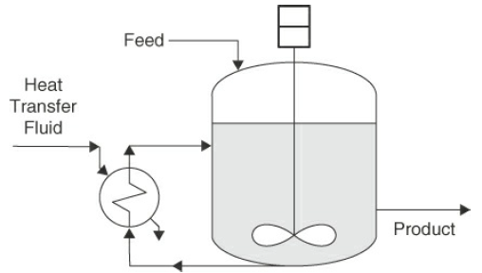
Cont’d
To understand energy balances with chemical reaction, let’s consider a reactor where chemical reaction is carried out in it as shown in Figure 10.1 (Himmelblau, 2023, pg. 570).
The reaction can require heat addition to a reactor or heat removal from a reactor.
Figure 10.1 A reactor with energy flows (open system)
11

Slide 12
Cont’d
If a chemical reaction takes place in a reactor and the reaction liberates heat (thermal energy), the cooling fluid will remove the heat so that the reactor will operate at a desired temperature.
Chemical reactions usually have a dominant effect on energy balance for a reactive system.
To determine the energy balances with chemical reaction, it is required to identify the type of chemical reactions, type of energy forms, the characteristics reactants and possible products (Himmelblau, 2023, pg. 568-571).
12

Slide 13
10.2. Problem-solving techniques for EBs with chemical reactions
For open systems, energy balance problem-solving techniques may have several procedures (Richard M. Felder, 2005, pg. 329-330).
The common problem-solving techniques for energy balances with chemical reaction are described as follows:
Read carefully the given problem and understand it.
Identify the reactants and products involve in the chemical reaction, and the types of chemical reactions (endothermic reaction or exothermic reaction).
Identify the type of energy flows what enters and exits the system.
13

Slide 14
Cont’d
Draw the process flow diagram with appropriate flow directions, given values and symbols to represent flows.
Identify the system boundary to determine energy balance on the process flow diagram.
Identify the unknows in the given problem, and count how many unknowns are there in the given problem.
Identify the appropriate energy balance equations with chemical reaction.
Write balanced chemical reaction equation.
Check units’ consistency, and the numbers of degree of freedom.
14

Slide 15
Cont’d
Collect relevant additional tabulated data of specific heat capacity, specific standard heat of reaction, and specific enthalpy.
State assumptions to simplify the problem-solving procedures by eliminating less effect energy forms from energy balance equations.
Perform energy balance calculations using the identified appropriate energy balance equations to find the unknowns.
Analyze the results and write the conclusion based on the results analysis.
15

Slide 16
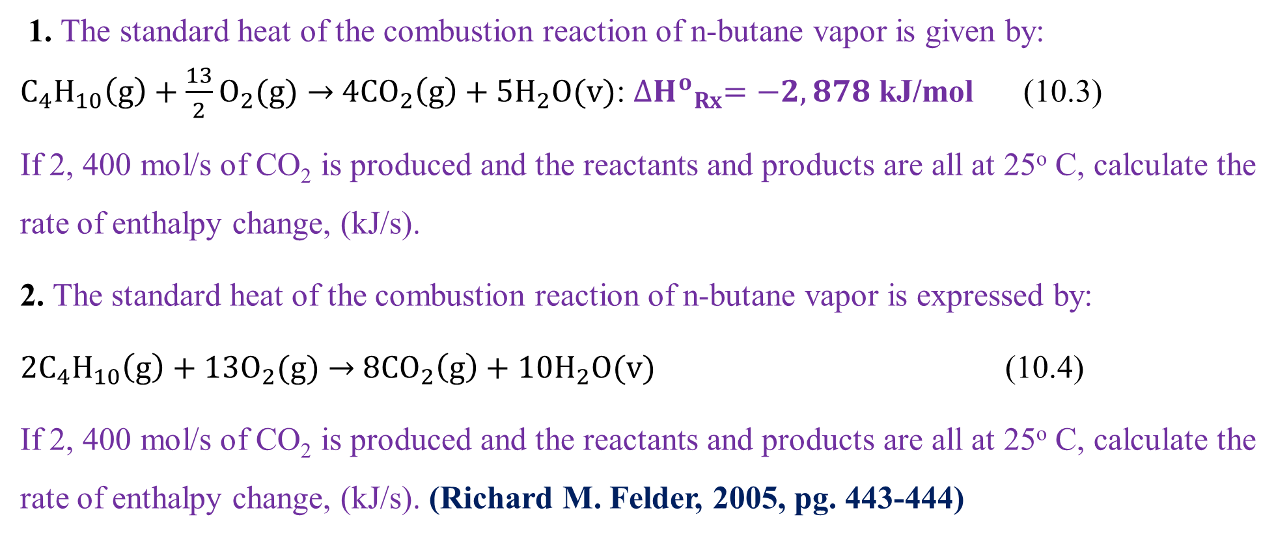
Activity 10.1
1. The standard heat of the combustion reaction of n-butane vapor is given by:
$C_{4}H_{10}\left(g\right)+\frac{13}{2}O_{2}(g)→$ $4CO_{2}\left(g\right)+5H_{2}O(v)$: ${{∆H}^{o}}_{Rx}=−2, 878$ kJ/mol (10.3)
If 2, 400 mol/s of CO₂ is produced and the reactants and products are all at 25º C, calculate the rate of enthalpy change, (kJ/s).
2. The standard heat of the combustion reaction of n-butane vapor is expressed by:
${2C}_{4}H_{10}\left(g\right)+13O_{2}(g)→$ $8CO_{2}\left(g\right)+10H_{2}O(v)$ (10.4)
If 2, 400 mol/s of CO₂ is produced and the reactants and products are all at 25º C, calculate the rate of enthalpy change, (kJ/s). (Richard M. Felder, 2005, pg. 443-444)
16

Slide 17
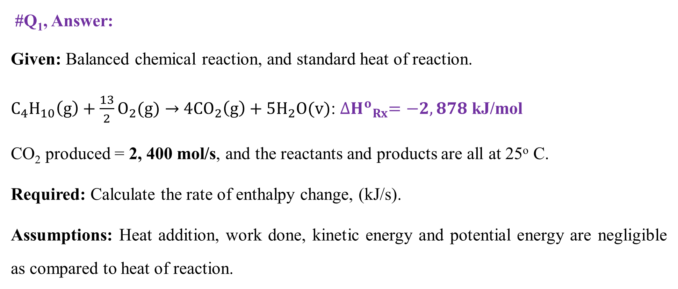
Cont’d
#Q₁, Answer:
Given: Balanced chemical reaction, and standard heat of reaction.
$C_{4}H_{10}\left(g\right)+\frac{13}{2}O_{2}(g)→$ $4CO_{2}\left(g\right)+5H_{2}O(v)$: ${{∆H}^{o}}_{Rx}=−2, 878$ kJ/mol
CO₂ produced = 2, 400 mol/s, and the reactants and products are all at 25º C.
Required: Calculate the rate of enthalpy change, (kJ/s).
Assumptions: Heat addition, work done, kinetic energy and potential energy are negligible as compared to heat of reaction.
17

Slide 18
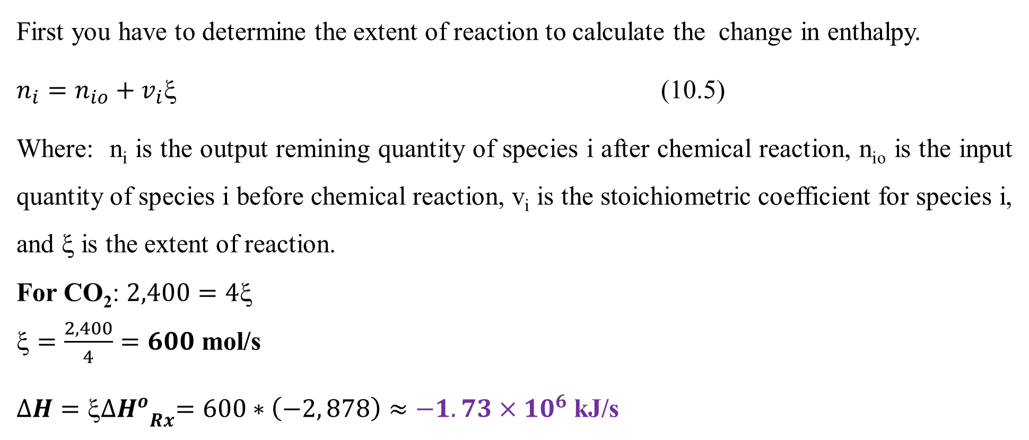
Cont’d
First you have to determine the extent of reaction to calculate the change in enthalpy.
$n_{i}=n_{io}+v_{i}$ (10.5)
Where: n_{i} is the output remining quantity of species i after chemical reaction, n_{io} is the input quantity of species i before chemical reaction, v_{i} is the stoichiometric coefficient for species i, and ξ is the extent of reaction.
For CO₂: $2,400=4$
$=\frac{2, 400}{4}=600$ mol/s
$∆H={ξ{∆H}^{o}}_{Rx}=600∗\left(−2, 878\right)≈−1.73×{10}^{6}$ kJ/s
18

Slide 19
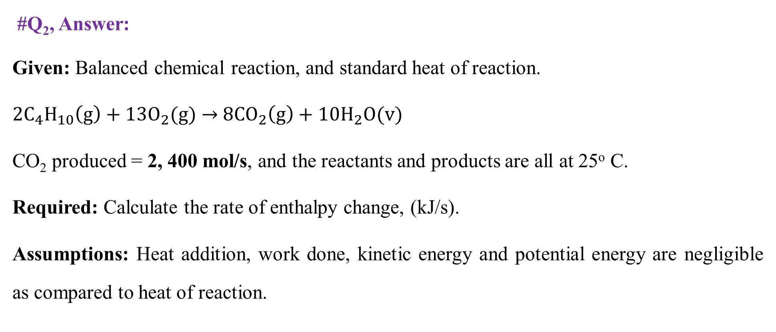
Cont’d
#Q₂, Answer:
Given: Balanced chemical reaction, and standard heat of reaction.
${2C}_{4}H_{10}\left(g\right)+13O_{2}(g)→$ $8CO_{2}\left(g\right)+10H_{2}O(v)$
CO₂ produced = 2, 400 mol/s, and the reactants and products are all at 25º C.
Required: Calculate the rate of enthalpy change, (kJ/s).
Assumptions: Heat addition, work done, kinetic energy and potential energy are negligible as compared to heat of reaction.
19

Slide 20
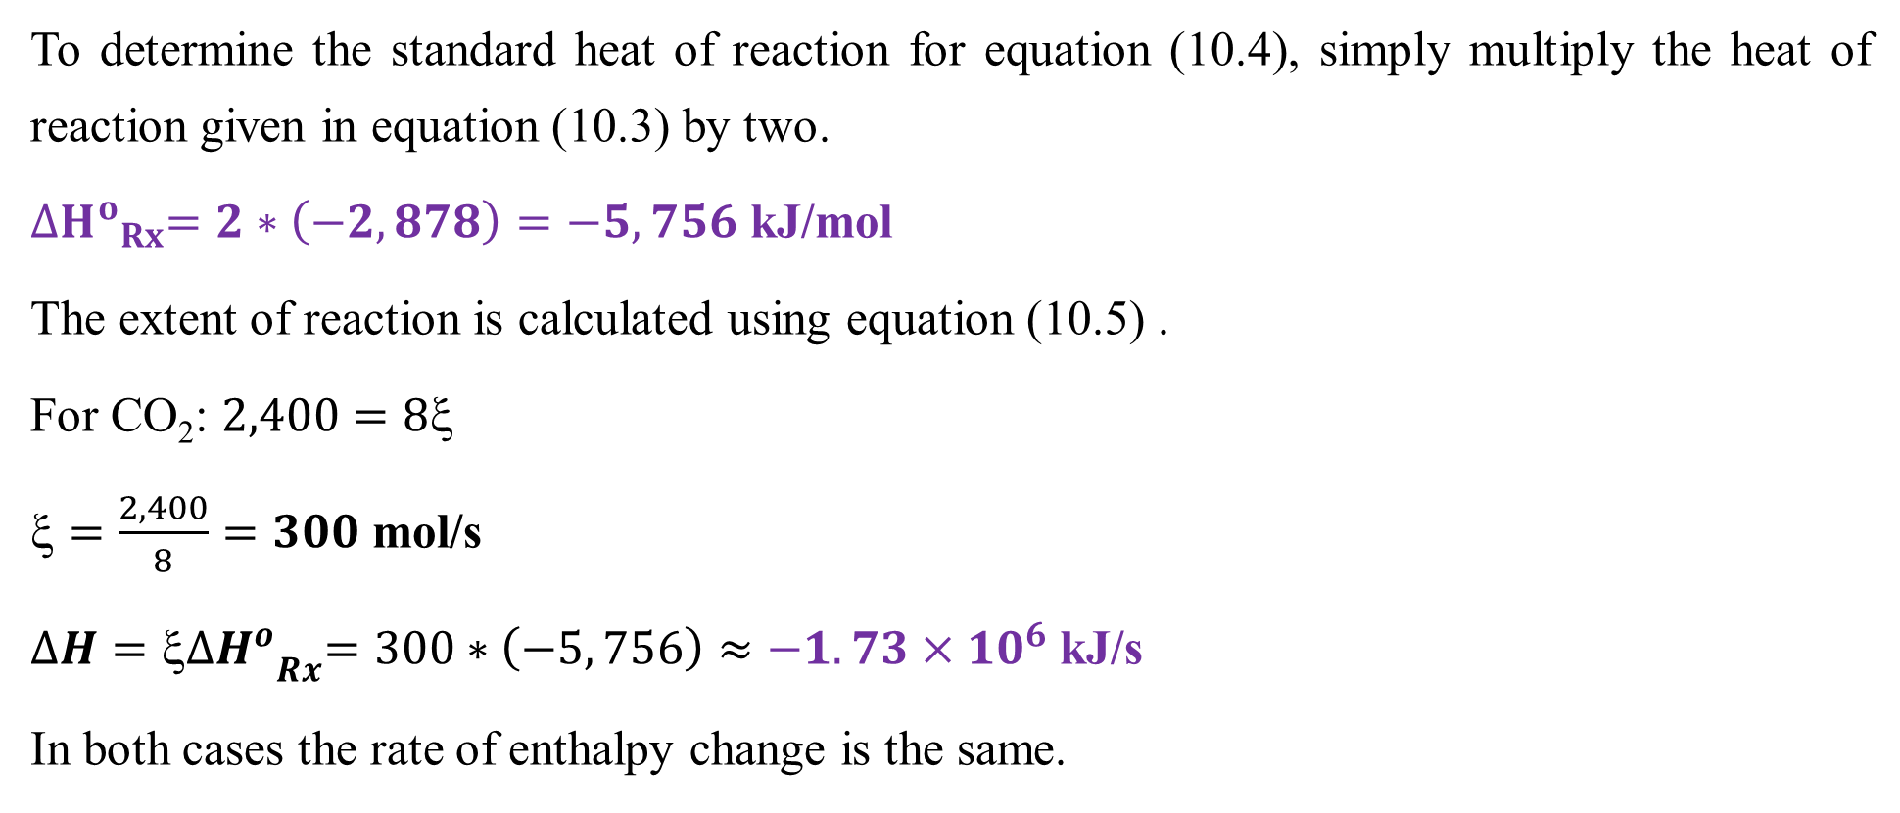
Cont’d
To determine the standard heat of reaction for equation (10.4), simply multiply the heat of reaction given in equation (10.3) by two.
${{∆H}^{o}}_{Rx}=2∗\left(−2, 878\right)=−5, 756$ kJ/mol
The extent of reaction is calculated using equation (10.5) .
For CO₂: $2,400=8$
$=\frac{2, 400}{8}=300$ mol/s
$∆H={ξ{∆H}^{o}}_{Rx}=300∗\left(−5, 756\right)≈−1.73×{10}^{6}$ kJ/s
In both cases the rate of enthalpy change is the same.
20

Slide 21
10.3. Energy balances with chemical reactions
For reactive systems, the temperature of the reacting mixture can vary inside the reactor due to heat generation from exothermic reactions or absorption of heat from external source for endothermic reactions.
For exothermic reactions, heat energy is generated from chemical reactions.
For endothermic reactions, heat energy is added to start and enhance chemical reactions.
The energy balance for an open system takes into account the heat generated by the exothermic reactions, and heat exchange with any heating jackets for endothermic reactions.
21

Slide 22
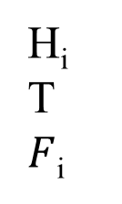


Cont’d
To develop energy balance equations for a reactive system, an open system of energy balances with chemical reaction is depicted in Figure 10.2.
$${\dot{W}}_{s}$$
Reactor
H_{io}
T_{o}
F_{io}
H_{i}
T
$F$_{i}
$$\dot{Q}$$
Figure 10.2 An open system of energy balances with chemical reaction
22

Slide 23
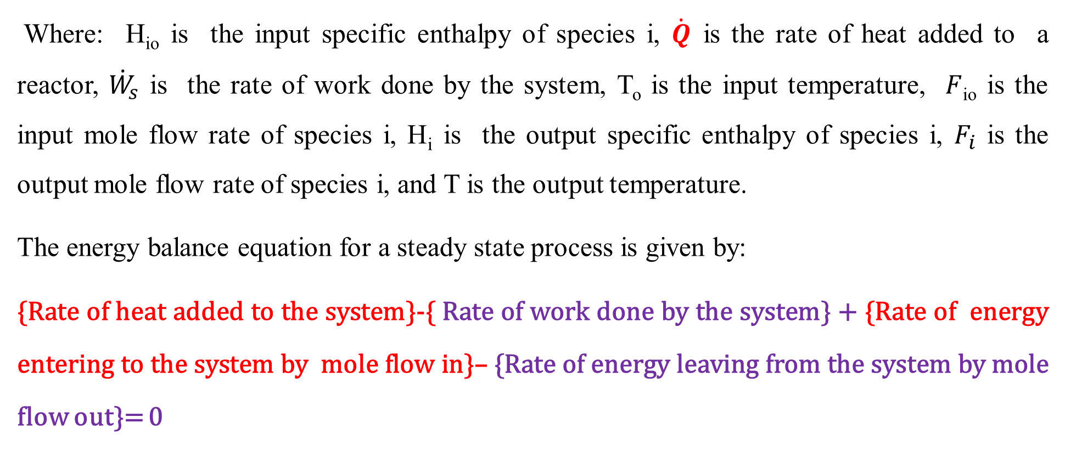
Cont’d
Where: H_{io} is the input specific enthalpy of species i, $\dot{Q}$ is the rate of heat added to a reactor, ${\dot{W}}_{s}$ is the rate of work done by the system, T_{o} is the input temperature, $F$_{io} is the input mole flow rate of species i, H_{i} is the output specific enthalpy of species i, $F_{i}$ is the output mole flow rate of species i, and T is the output temperature.
The energy balance equation for a steady state process is given by:
{Rate of heat added to the system}-{ Rate of work done by the system} + {Rate of energy entering to the system by mole flow in}– {Rate of energy leaving from the system by mole flow out}= 0
23

Slide 24
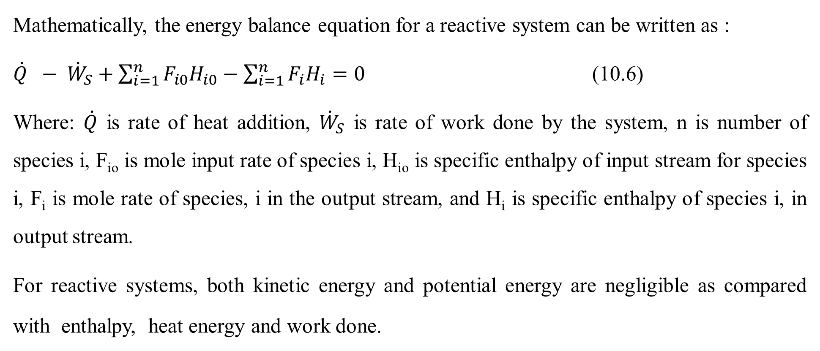
Cont’d
Mathematically, the energy balance equation for a reactive system can be written as :
$\dot{Q} − {\dot{W}}_{S}+\sum_{i=1}^{n}{F_{i0}H_{i0}}−\sum_{i=1}^{n}{F_{i}H_{i}=0}$ (10.6)
Where: $\dot{Q}$ is rate of heat addition, ${\dot{W}}_{S}$ is rate of work done by the system, n is number of species i, F_{io} is mole input rate of species i, H_{io} is specific enthalpy of input stream for species i, F_{i} is mole rate of species, i in the output stream, and H_{i} is specific enthalpy of species i, in output stream.
For reactive systems, both kinetic energy and potential energy are negligible as compared with enthalpy, heat energy and work done.
24

Slide 25
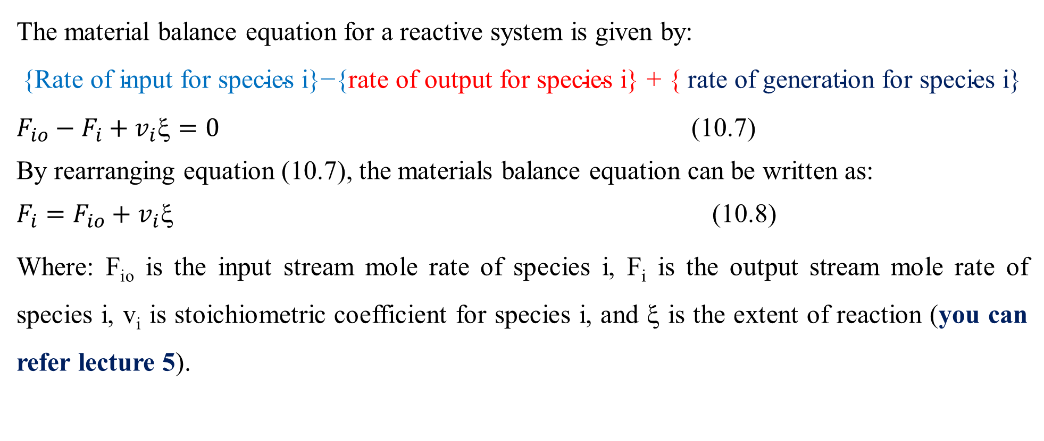
Cont’d
The material balance equation for a reactive system is given by:
$$\text{\{}\text{Rate} \text{of} \text{input} \text{for} \text{species} \text{i}\text{\}−\{}\text{rate} \text{of} \text{output} \text{for} \text{species} \text{i}\text{\} + \{ }\text{rate} \text{of} \text{generation} \text{for} \text{species} \text{i}\text{\}}$$
$F_{io}−F_{i}+v_{i}\text{ξ}=0$ (10.7)
By rearranging equation (10.7), the materials balance equation can be written as:
$F_{i}=F_{io}+v_{i}\text{ξ}$ (10.8)
Where: F_{io} is the input stream mole rate of species i, F_{i} is the output stream mole rate of species i, v_{i} is stoichiometric coefficient for species i, and ξ is the extent of reaction (you can refer lecture 5).
25

Slide 26
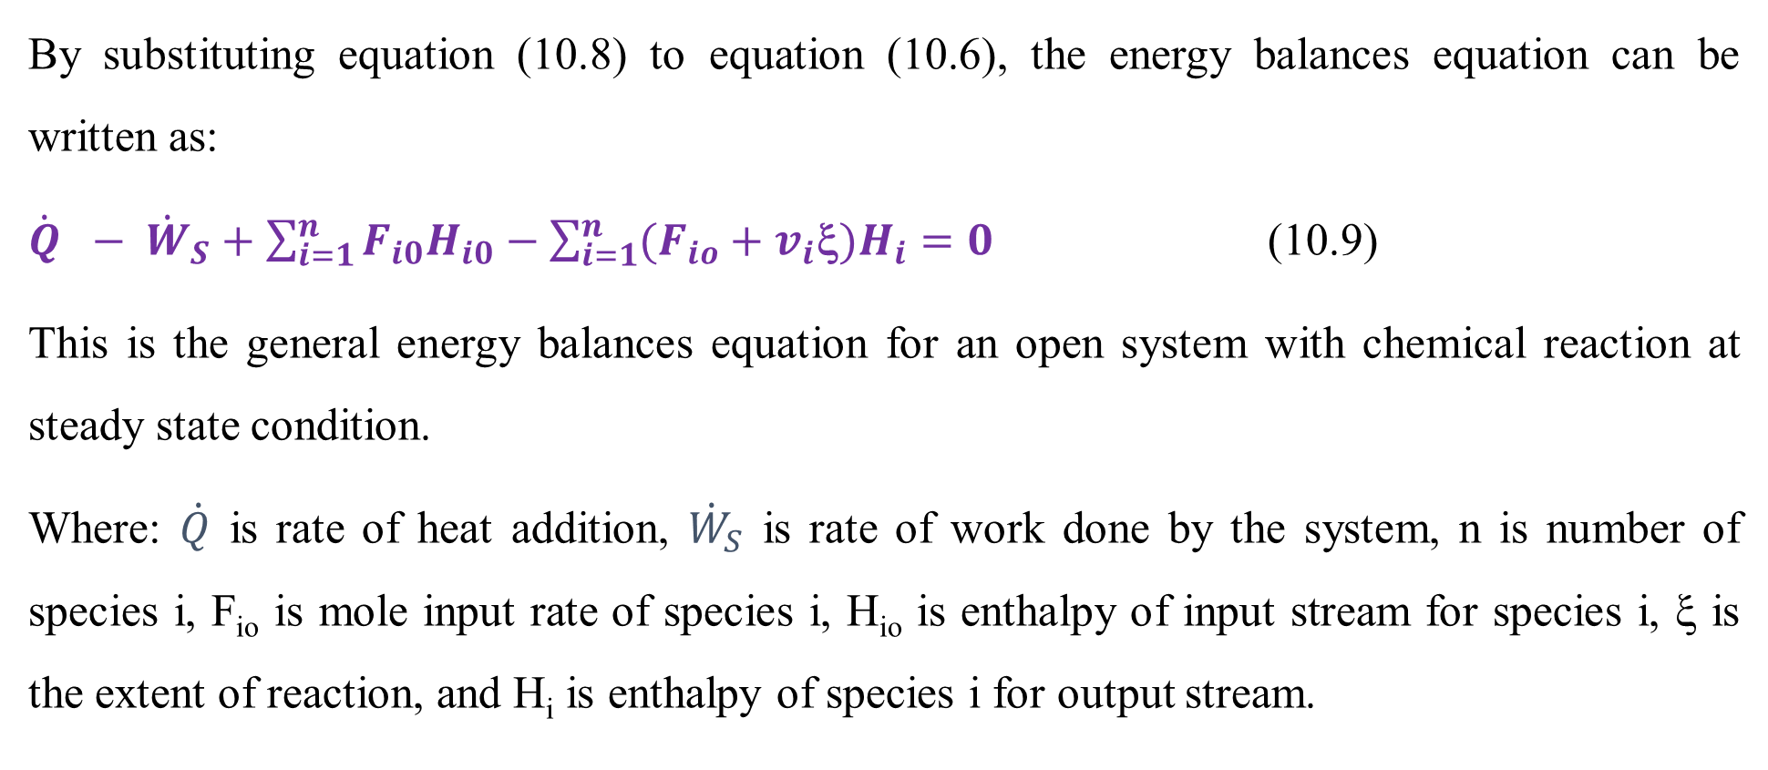
Cont’d
By substituting equation (10.8) to equation (10.6), the energy balances equation can be written as:
$\dot{Q} − {\dot{W}}_{S}+\sum_{i=1}^{n}{F_{i0}H_{i0}}−\sum_{i=1}^{n}{(F_{io}+v_{i}\text{ξ}{)H}_{i}=0}$ (10.9)
This is the general energy balances equation for an open system with chemical reaction at steady state condition.
Where: $\dot{Q}$ is rate of heat addition, ${\dot{W}}_{S}$ is rate of work done by the system, n is number of species i, F_{io} is mole input rate of species i, H_{io} is enthalpy of input stream for species i, ξ is the extent of reaction, and H_{i} is enthalpy of species i for output stream.
26

Slide 27
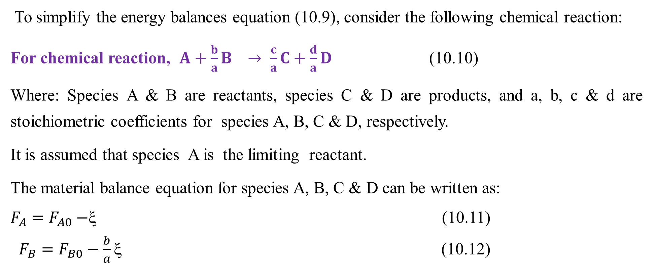
Cont’d
To simplify the energy balances equation (10.9), consider the following chemical reaction:
For chemical reaction, $A+\frac{b}{a}B → \frac{c}{a}C+\frac{d}{a}D$ (10.10)
Where: Species A & B are reactants, species C & D are products, and a, b, c & d are stoichiometric coefficients for species A, B, C & D, respectively.
It is assumed that species A is the limiting reactant.
The material balance equation for species A, B, C & D can be written as:
$F_{A}=F_{A0}−$ξ (10.11)
$F_{B}=F_{B0}−\frac{b}{a}\text{ξ}$ (10.12)
27

Slide 28
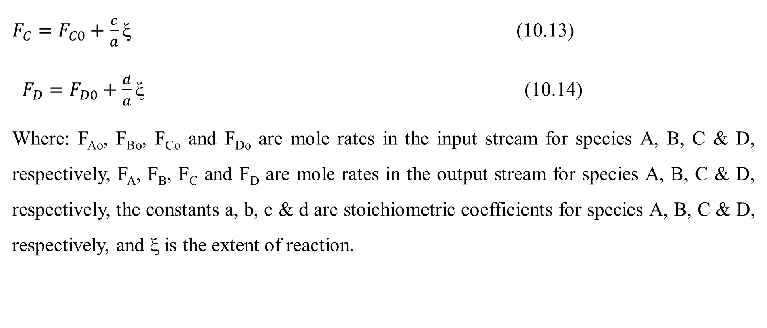
Cont’d
$F_{C}=F_{C0}+\frac{c}{a}\text{ξ}$ (10.13)
$F_{D}=F_{D0}+\frac{d}{a}\text{ξ}$ (10.14)
Where: F_{Ao}, F_{Bo}, F_{Co} and F_{Do} are mole rates in the input stream for species A, B, C & D, respectively, F_{A}, F_{B}, F_{C} and F_{D} are mole rates in the output stream for species A, B, C & D, respectively, the constants a, b, c & d are stoichiometric coefficients for species A, B, C & D, respectively, and ξ is the extent of reaction.
28

Slide 29
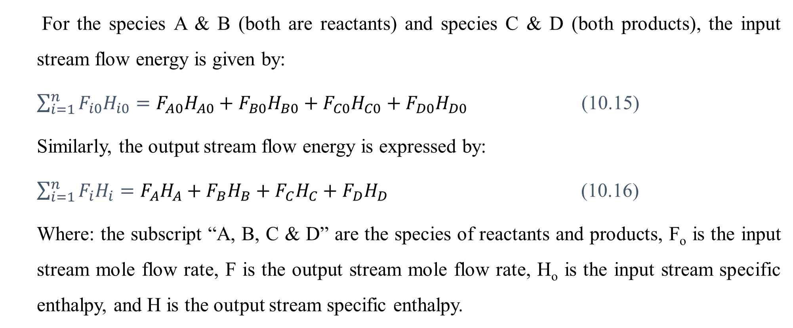
Cont’d
For the species A & B (both are reactants) and species C & D (both products), the input stream flow energy is given by:
$\sum_{i=1}^{n}{F_{i0}H_{i0}}=F_{A0}H_{A0}+F_{B0}H_{B0}+F_{C0}H_{C0}+F_{D0}H_{D0}$ (10.15)
Similarly, the output stream flow energy is expressed by:
$\sum_{i=1}^{n}{F_{i}H_{i}}=F_{A}H_{A}+F_{B}H_{B}+F_{C}H_{C}+F_{D}H_{D}$ (10.16)
Where: the subscript “A, B, C & D” are the species of reactants and products, F_{o} is the input stream mole flow rate, F is the output stream mole flow rate, H_{o} is the input stream specific enthalpy, and H is the output stream specific enthalpy.
29

Slide 30
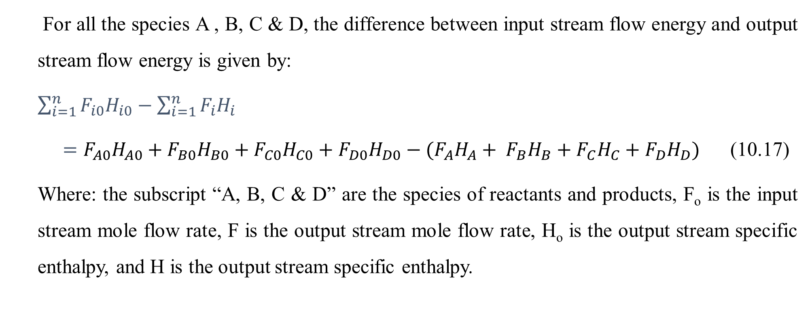
Cont’d
For all the species A , B, C & D, the difference between input stream flow energy and output stream flow energy is given by:
$\sum_{i=1}^{n}{F_{i0}H_{i0}}−\sum_{i=1}^{n}{F_{i}H_{i}}$
$=F_{A0}H_{A0}+F_{B0}H_{B0}+F_{C0}H_{C0}+F_{D0}H_{D0}−(F_{A}H_{A}+ F_{B}H_{B}+F_{C}H_{C}+F_{D}H_{D})$ (10.17)
Where: the subscript “A, B, C & D” are the species of reactants and products, F_{o} is the input stream mole flow rate, F is the output stream mole flow rate, H_{o} is the output stream specific enthalpy, and H is the output stream specific enthalpy.
30

Slide 31
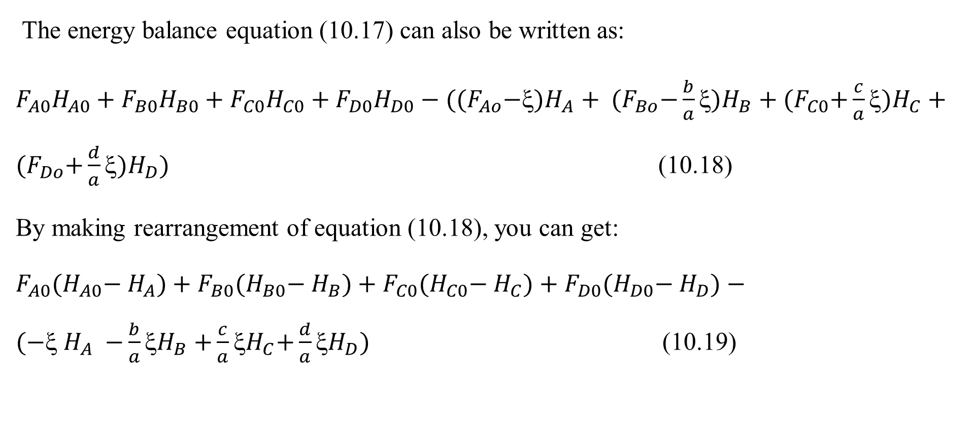
Cont’d
The energy balance equation (10.17) can also be written as:
$F_{A0}H_{A0}+F_{B0}H_{B0}+F_{C0}H_{C0}+F_{D0}H_{D0}−({(F}_{Ao}{−ξ)H}_{A}+ {(F}_{Bo}{−\frac{b}{a}ξ)H}_{B}+{(F}_{C0}{+\frac{c}{a}ξ)H}_{C}+{(F}_{Do}{+\frac{d}{a}ξ)H}_{D})$ (10.18)
By making rearrangement of equation (10.18), you can get:
$F_{A0}{(H}_{A0}−{ H}_{A})+F_{B0}{(H}_{B0}−{ H}_{B})+F_{C0}{(H}_{C0}−{ H}_{C})+F_{D0}{(H}_{D0}−{ H}_{D})−({−ξ H}_{A} {−\frac{b}{a}ξH}_{B}{+\frac{c}{a}ξH}_{C}{+\frac{d}{a}ξH}_{D})$ (10.19)
31

Slide 32
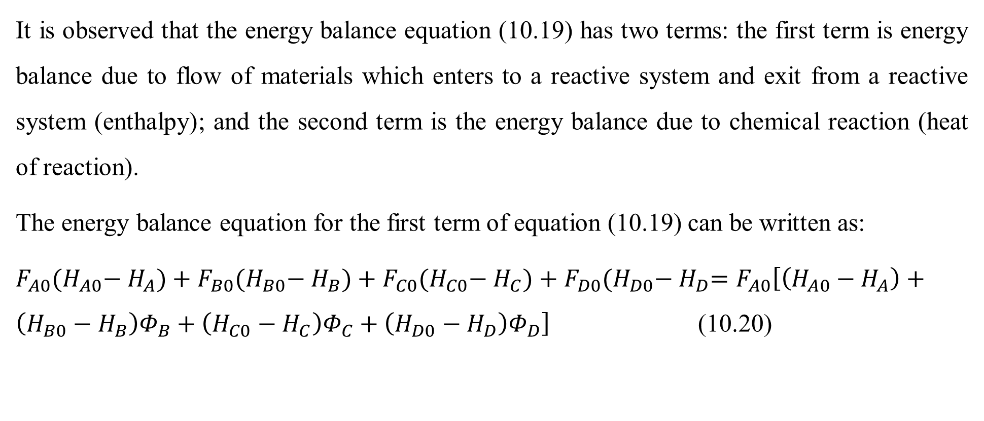
Cont’d
It is observed that the energy balance equation (10.19) has two terms: the first term is energy balance due to flow of materials which enters to a reactive system and exit from a reactive system (enthalpy); and the second term is the energy balance due to chemical reaction (heat of reaction).
The energy balance equation for the first term of equation (10.19) can be written as:
${F_{A0}{(H}_{A0}−{ H}_{A})+F_{B0}{(H}_{B0}−{ H}_{B})+F_{C0}{(H}_{C0}−{ H}_{C})+F_{D0}{(H}_{D0}−{ H}_{D}=F}_{A0}\left[\left(H_{A0}−H_{A}\right)+\left(H_{B0}−H_{B}\right)Φ_{B}+\left(H_{C0}−H_{C}\right)Φ_{C}+\left(H_{D0}−H_{D}\right)Φ_{D}\right]$ (10.20)
32

Slide 33
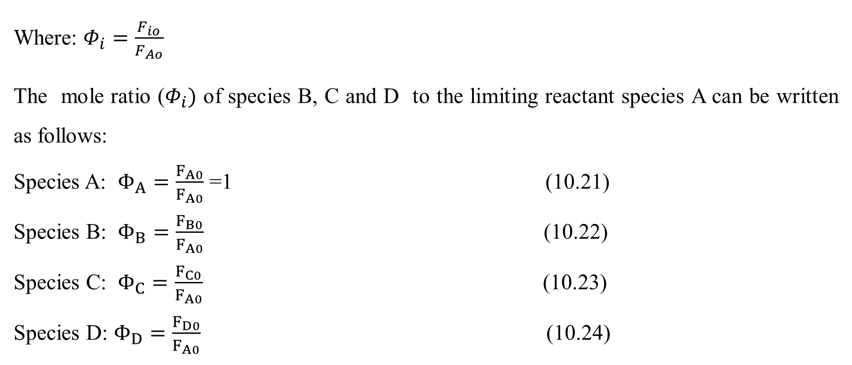
Cont’d
Where: $Φ_{i}=\frac{F_{io}}{F_{Ao}}$
The mole ratio ($Φ_{i})$ of species B, C and D to the limiting reactant species A can be written as follows:
Species A: $Φ_{A}=\frac{F_{A0}}{F_{A0}}$ =1 (10.21)
Species B: $Φ_{B}=\frac{F_{B0}}{F_{A0}}$ (10.22)
Species C: $Φ_{C}=\frac{F_{C0}}{F_{A0}}$ (10.23)
Species D: $Φ_{D}=\frac{F_{D0}}{F_{A0}}$ (10.24)
33

Slide 34
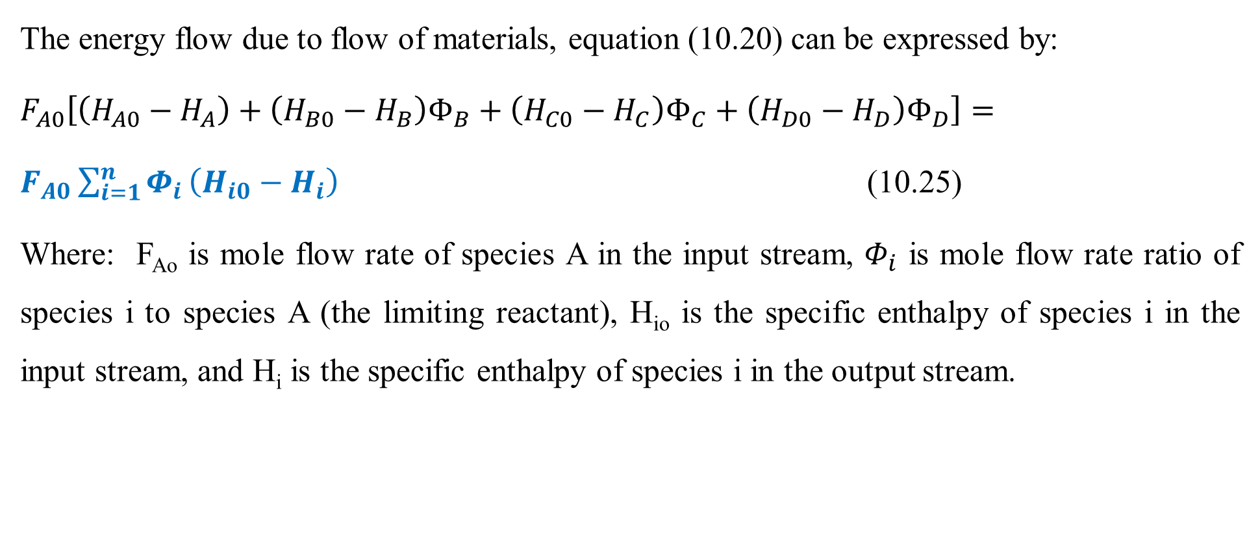
Cont’d
The energy flow due to flow of materials, equation (10.20) can be expressed by:
$F_{A0}\left[\left(H_{A0}−H_{A}\right)+\left(H_{B0}−H_{B}\right)Φ_{B}+\left(H_{C0}−H_{C}\right)Φ_{C}+\left(H_{D0}−H_{D}\right)Φ_{D}\right]=$
$F_{A0}\sum_{i=1}^{n}{Φ_{i}}\left(H_{i0}−H_{i}\right)$ (10.25)
Where: F_{Ao} is mole flow rate of species A in the input stream, $Φ_{i}$ is mole flow rate ratio of species i to species A (the limiting reactant), H_{io} is the specific enthalpy of species i in the input stream, and H_{i} is the specific enthalpy of species i in the output stream.
34

Slide 35
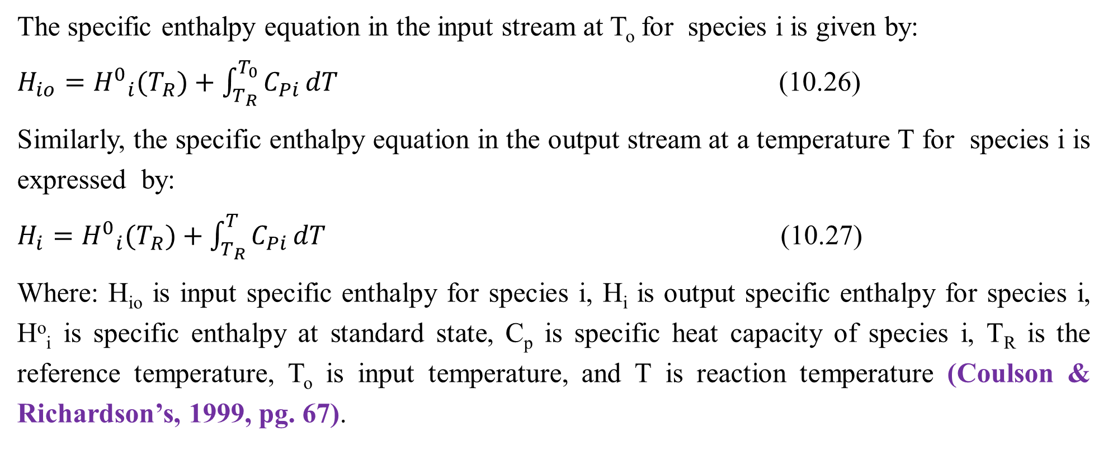
Cont’d
The specific enthalpy equation in the input stream at T_{o} for species i is given by:
$H_{io}={H^{0}}_{i}(T_{R})+\int_{T_{R}}^{T_{0}}{C_{Pi}}dT$ (10.26)
Similarly, the specific enthalpy equation in the output stream at a temperature T for species i is expressed by:
$H_{i}={H^{0}}_{i}(T_{R})+\int_{T_{R}}^{T}{C_{Pi}}dT$ (10.27)
Where: H_{io} is input specific enthalpy for species i, H_{i} is output specific enthalpy for species i, Hº_{i} is specific enthalpy at standard state, C_{p} is specific heat capacity of species i, T_{R} is the reference temperature, T_{o} is input temperature, and T is reaction temperature (Coulson & Richardson’s, 1999, pg. 67).
35

Slide 36
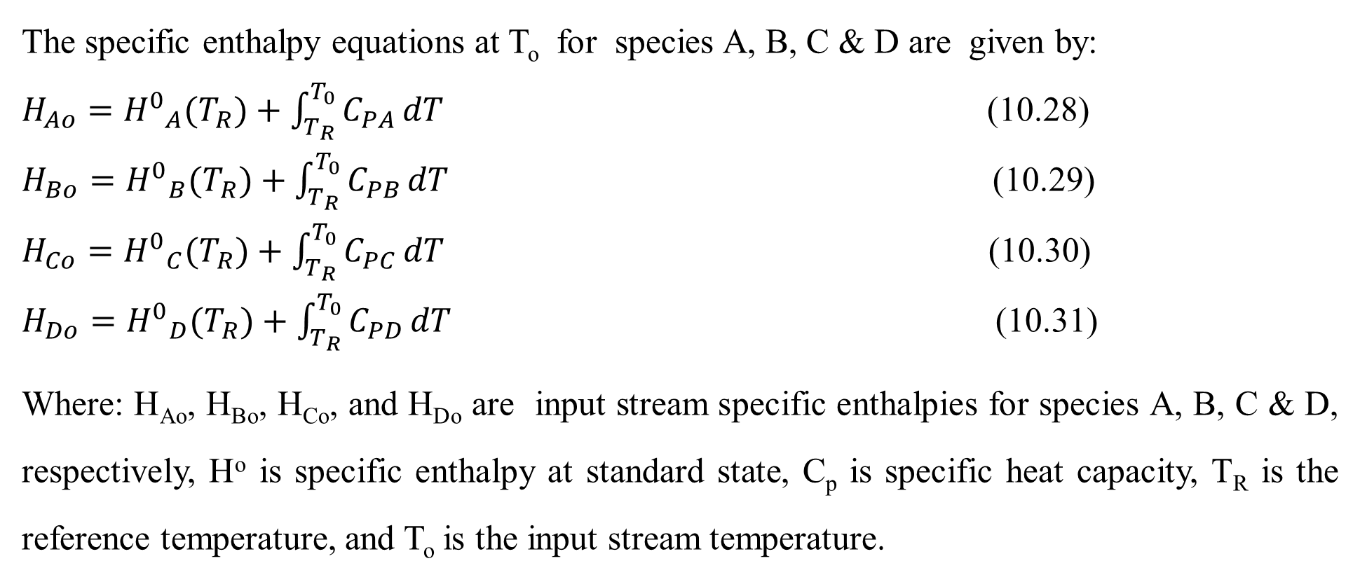
Cont’d
The specific enthalpy equations at T_{o} for species A, B, C & D are given by:
$H_{Ao}={H^{0}}_{A}(T_{R})+\int_{T_{R}}^{T_{0}}{C_{PA}}dT$ (10.28)
$H_{Bo}={H^{0}}_{B}(T_{R})+\int_{T_{R}}^{T_{0}}{C_{PB}}dT$ (10.29)
$H_{Co}={H^{0}}_{C}(T_{R})+\int_{T_{R}}^{T_{0}}{C_{PC}}dT$ (10.30)
$H_{Do}={H^{0}}_{D}(T_{R})+\int_{T_{R}}^{T_{0}}{C_{PD}}dT$ (10.31)
Where: H_{Ao}, H_{Bo}, H_{Co}, and H_{Do} are input stream specific enthalpies for species A, B, C & D, respectively, Hº is specific enthalpy at standard state, C_{p} is specific heat capacity, T_{R} is the reference temperature, and T_{o} is the input stream temperature.
36

Slide 37
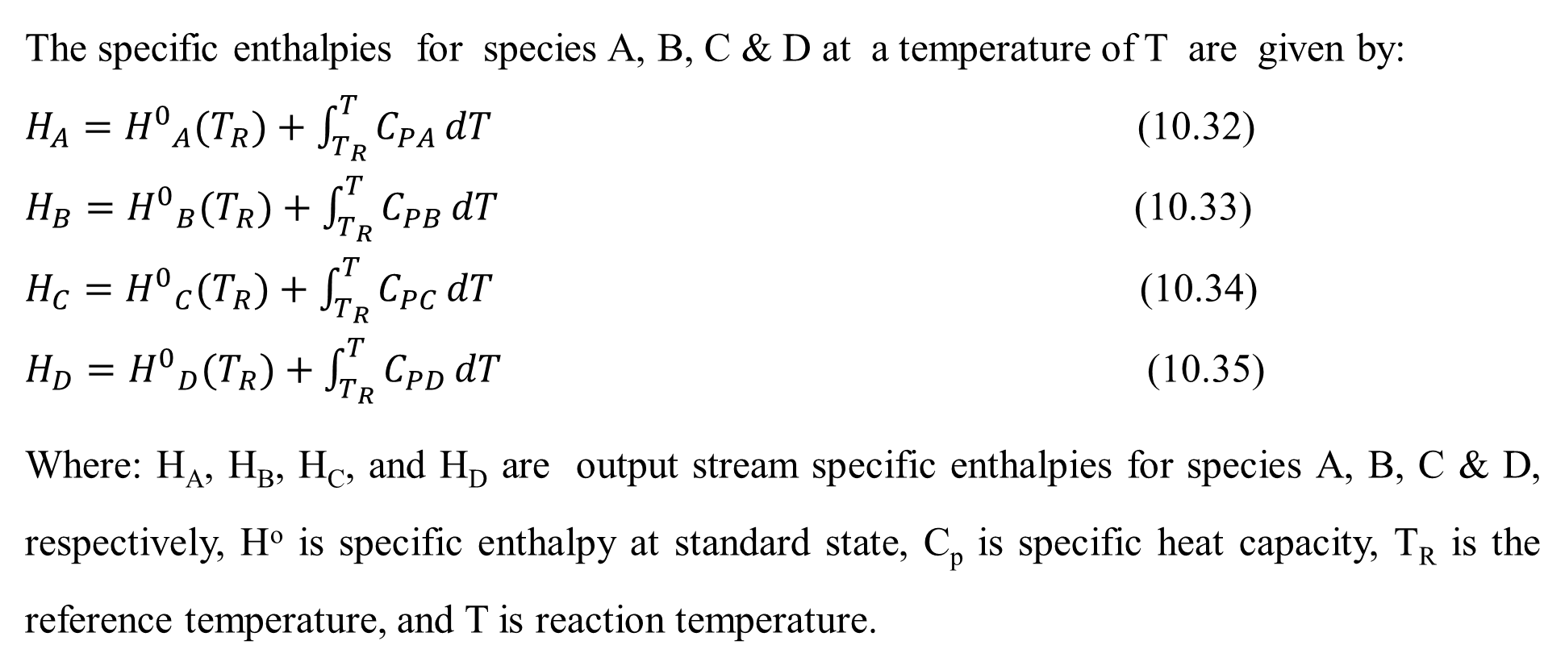
Cont’d
The specific enthalpies for species A, B, C & D at a temperature of T are given by:
$H_{A}={H^{0}}_{A}(T_{R})+\int_{T_{R}}^{T}{C_{PA}}dT$ (10.32)
$H_{B}={H^{0}}_{B}(T_{R})+\int_{T_{R}}^{T}{C_{PB}}dT$ (10.33)
$H_{C}={H^{0}}_{C}(T_{R})+\int_{T_{R}}^{T}{C_{PC}}dT$ (10.34)
$H_{D}={H^{0}}_{D}(T_{R})+\int_{T_{R}}^{T}{C_{PD}}dT$ (10.35)
Where: H_{A}, H_{B}, H_{C}, and H_{D} are output stream specific enthalpies for species A, B, C & D, respectively, Hº is specific enthalpy at standard state, C_{p} is specific heat capacity, T_{R} is the reference temperature, and T is reaction temperature.
37

Slide 38
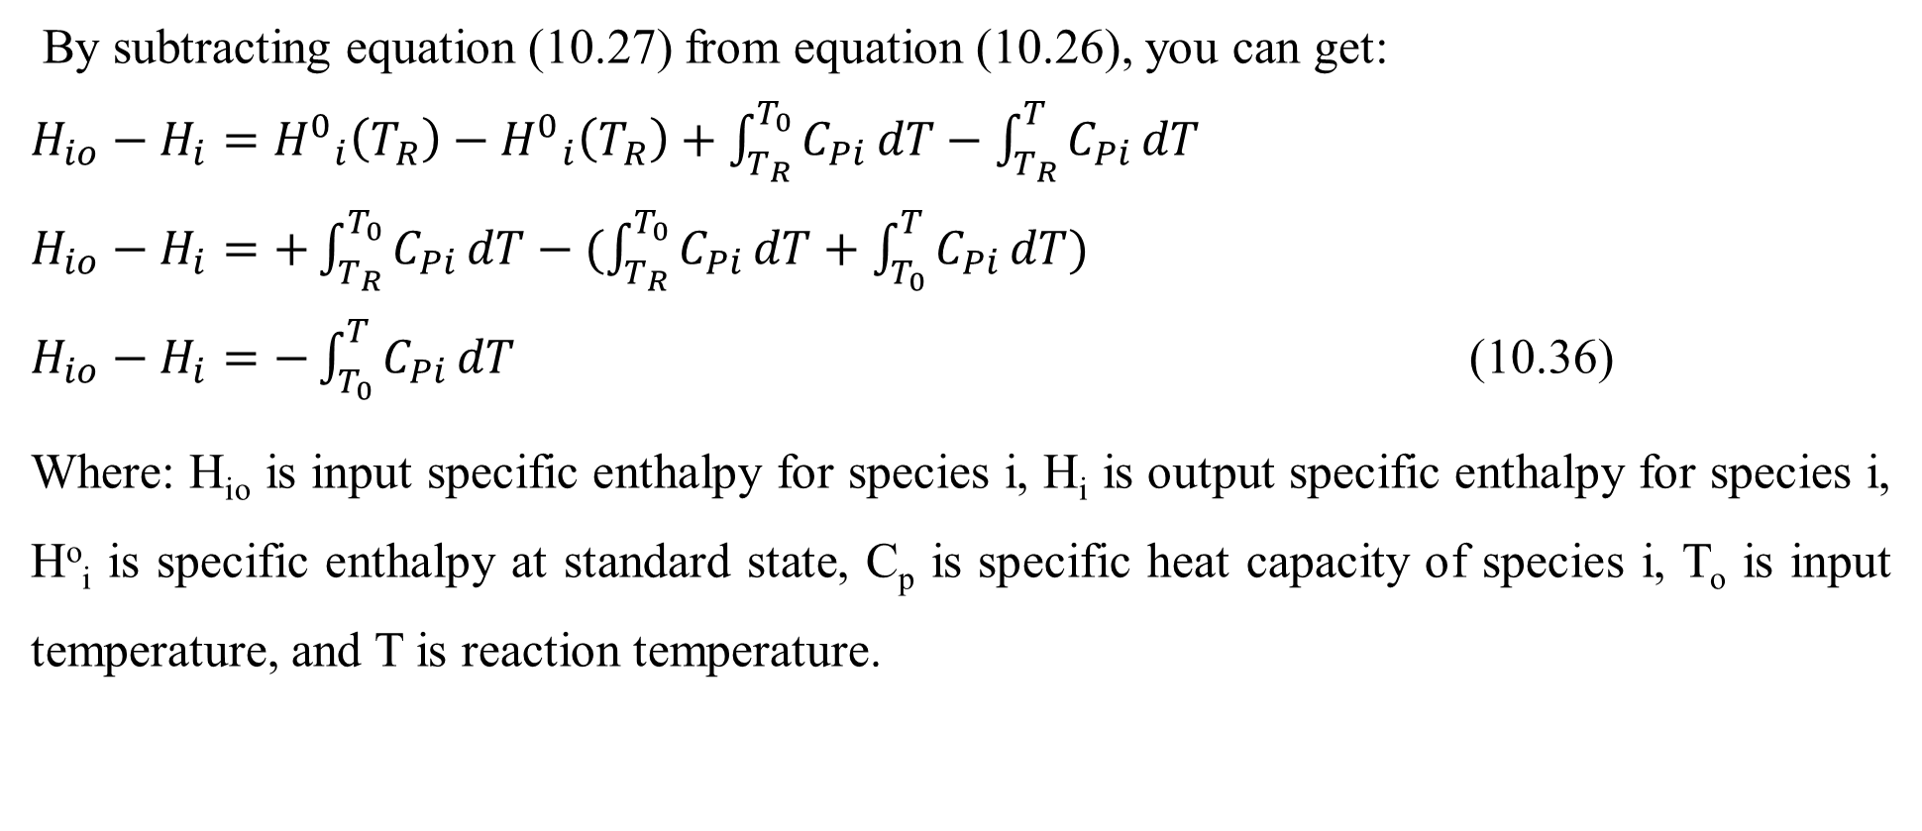
Cont’d
By subtracting equation (10.27) from equation (10.26), you can get:
$H_{io}−H_{i}={H^{0}}_{i}\left(T_{R}\right)−{H^{0}}_{i}\left(T_{R}\right)+\int_{T_{R}}^{T_{0}}{C_{Pi}}dT−\int_{T_{R}}^{T}{C_{Pi}}dT$
$H_{io}−H_{i}=+\int_{T_{R}}^{T_{0}}{C_{Pi}}dT−(\int_{T_{R}}^{T_{0}}{C_{Pi}}dT+\int_{T_{0}}^{T}{C_{Pi}}dT)$
$H_{io}−H_{i}=−\int_{T_{0}}^{T}{C_{Pi}}dT$ (10.36)
Where: H_{io} is input specific enthalpy for species i, H_{i} is output specific enthalpy for species i, Hº_{i} is specific enthalpy at standard state, C_{p} is specific heat capacity of species i, T_{o} is input temperature, and T is reaction temperature.
38

Slide 39
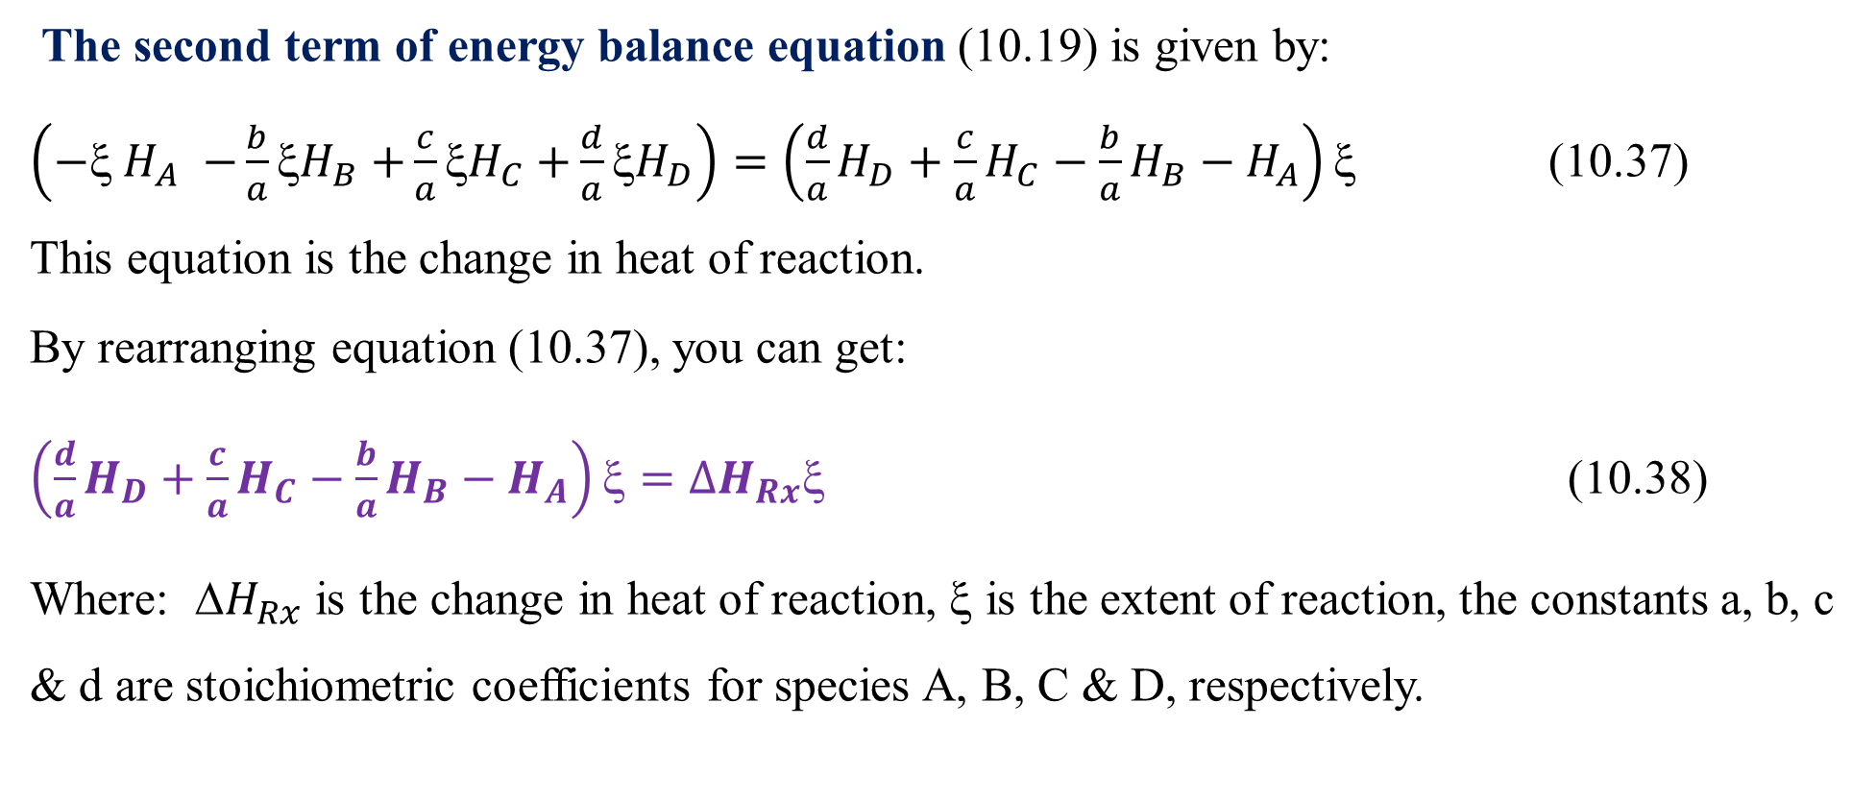
Cont’d
The second term of energy balance equation (10.19) is given by:
$\left({− H}_{A} {−\frac{b}{a}H}_{B}{+\frac{c}{a}H}_{C}{+\frac{d}{a}H}_{D}\right)=\left(\frac{d}{a}H_{D}+\frac{c}{a}H_{C}−\frac{b}{a}H_{B}−H_{A}\right)$ (10.37)
This equation is the change in heat of reaction.
By rearranging equation (10.37), you can get:
$\left(\frac{d}{a}H_{D}+\frac{c}{a}H_{C}−\frac{b}{a}H_{B}−H_{A}\right)ξ={∆H}_{Rx}ξ$ (10.38)
Where: ${H}_{Rx}$ is the change in heat of reaction, $$ is the extent of reaction, the constants a, b, c & d are stoichiometric coefficients for species A, B, C & D, respectively.
39

Slide 40
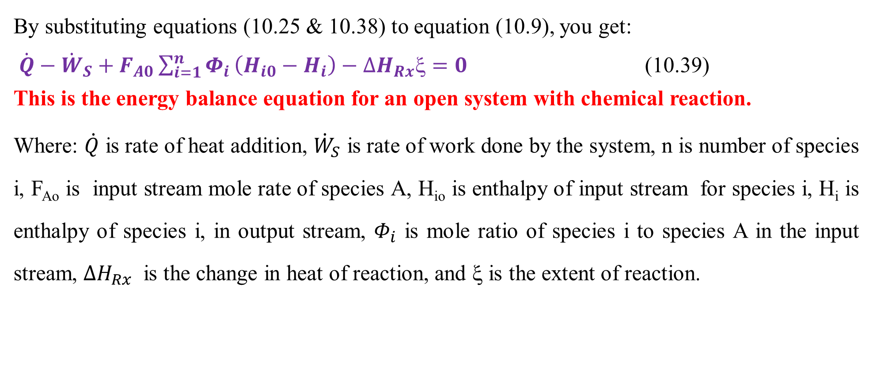
Cont’d
By substituting equations (10.25 & 10.38) to equation (10.9), you get:
$\dot{Q}−{\dot{W}}_{S}+F_{A0}\sum_{i=1}^{n}{Φ_{i}}\left(H_{i0}−H_{i}\right)−{∆H}_{Rx}ξ=0$ (10.39)
This is the energy balance equation for an open system with chemical reaction.
Where: $\dot{Q}$ is rate of heat addition, ${\dot{W}}_{S}$ is rate of work done by the system, n is number of species i, F_{Ao} is input stream mole rate of species A, H_{io} is enthalpy of input stream for species i, H_{i} is enthalpy of species i, in output stream, $Φ_{i}$ is mole ratio of species i to species A in the input stream, ${∆H}_{Rx}$ is the change in heat of reaction, and ξ is the extent of reaction.
40

Slide 41
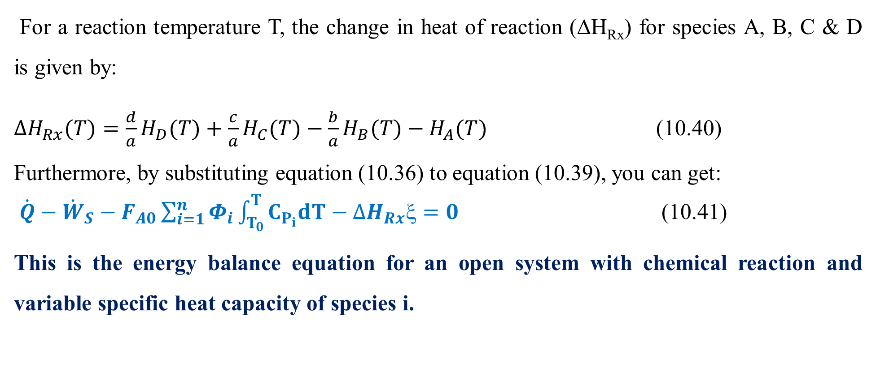
Cont’d
For a reaction temperature T, the change in heat of reaction (ΔH_{Rx}) for species A, B, C & D is given by:
${∆H}_{Rx}(T)=\frac{d}{a}H_{D}(T)+\frac{c}{a}H_{C}(T)−\frac{b}{a}H_{B}(T)−H_{A}(T)$ (10.40)
Furthermore, by substituting equation (10.36) to equation (10.39), you can get:
$\dot{Q}−{\dot{W}}_{S}−F_{A0}\sum_{i=1}^{n}{Φ_{i}}\int_{T_{0}}^{T}{C_{P_{i}}dT}−{∆H}_{Rx}ξ=0$ (10.41)
This is the energy balance equation for an open system with chemical reaction and variable specific heat capacity of species i.
41

Slide 42
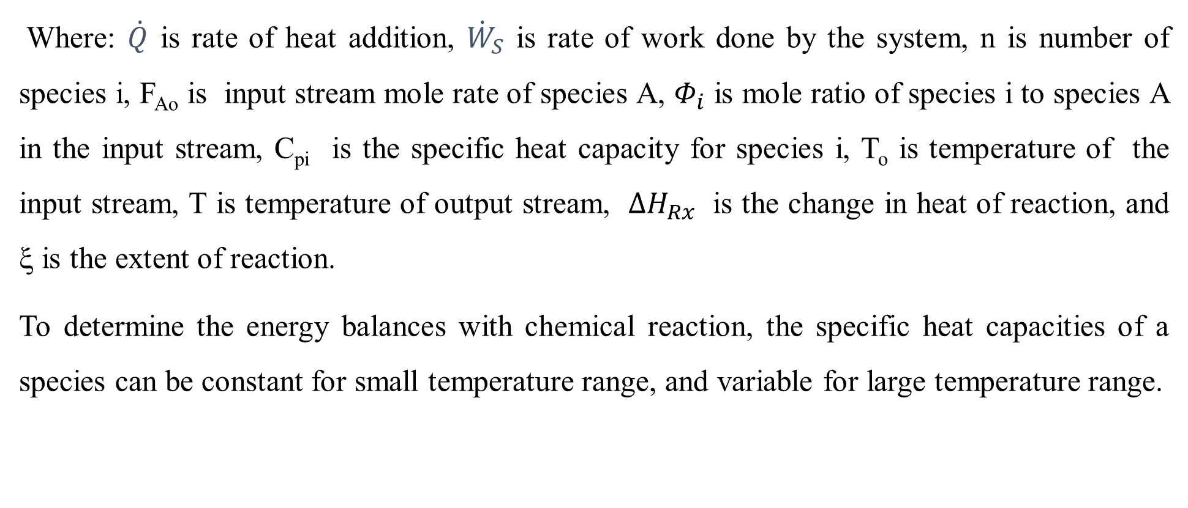
Cont’d
Where: $\dot{Q}$ is rate of heat addition, ${\dot{W}}_{S}$ is rate of work done by the system, n is number of species i, F_{Ao} is input stream mole rate of species A, $Φ_{i}$ is mole ratio of species i to species A in the input stream, C_{pi} is the specific heat capacity for species i, T_{o} is temperature of the input stream, T is temperature of output stream, ${∆H}_{Rx}$ is the change in heat of reaction, and ξ is the extent of reaction.
To determine the energy balances with chemical reaction, the specific heat capacities of a species can be constant for small temperature range, and variable for large temperature range.
42

Slide 43
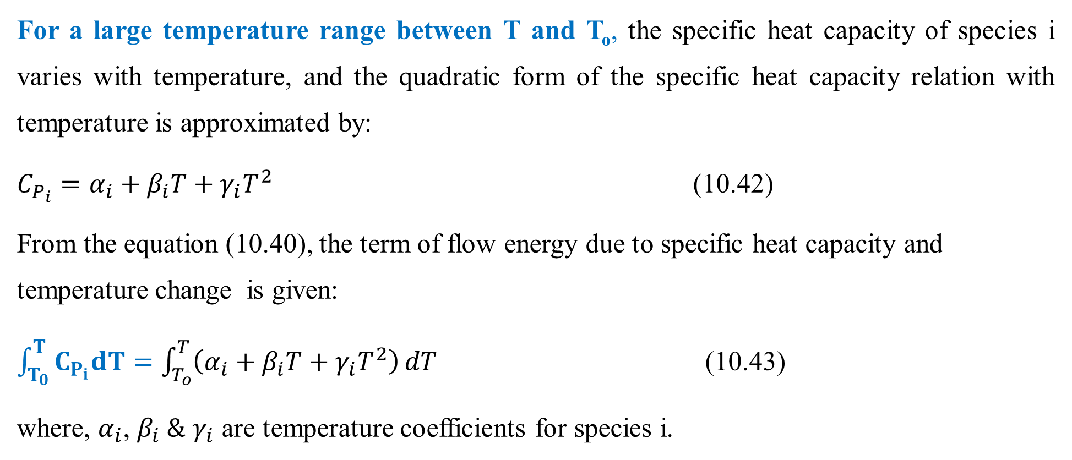
Cont’d
For a large temperature range between T and T_{o}, the specific heat capacity of species i varies with temperature, and the quadratic form of the specific heat capacity relation with temperature is approximated by:
$C_{P_{i}}=α_{i}+β_{i}T+γ_{i}T^{2}$ (10.42)
From the equation (10.40), the term of flow energy due to specific heat capacity and temperature change is given:
$\int_{T_{0}}^{T}{C_{P_{i}}dT}=\int_{T_{o}}^{T}{\left(α_{i}+β_{i}T+γ_{i}T^{2}\right)}dT$ (10.43)
where, $α_{i}$, $β_{i} \&$ $γ_{i}$ are temperature coefficients for species i.
43

Slide 44
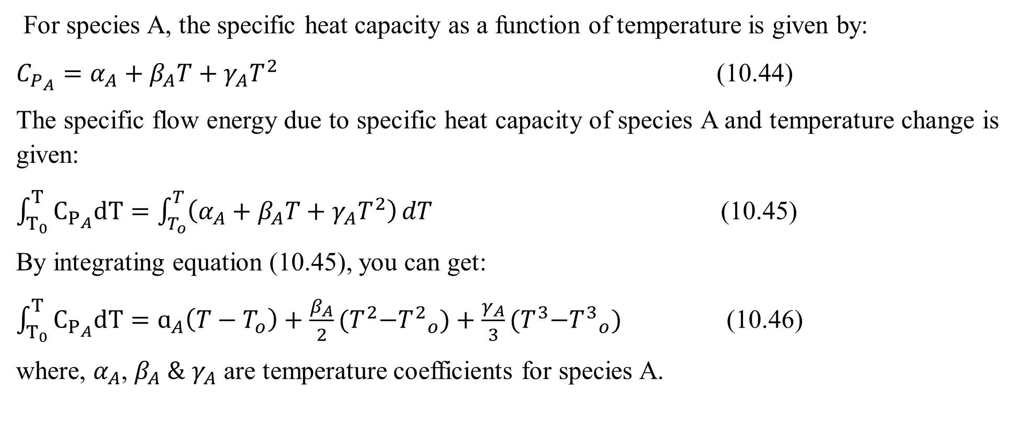
Cont’d
For species A, the specific heat capacity as a function of temperature is given by:
$C_{P_{A}}=α_{A}+β_{A}T+γ_{A}T^{2}$ (10.44)
The specific flow energy due to specific heat capacity of species A and temperature change is given:
$\int_{T_{0}}^{T}{C_{P_{A}}dT}=\int_{T_{o}}^{T}{\left(α_{A}+β_{A}T+γ_{A}T^{2}\right)}dT$ (10.45)
By integrating equation (10.45), you can get:
$\int_{T_{0}}^{T}{C_{P_{A}}dT}=ɑ_{A}\left(T−T_{o}\right)+\frac{β_{A}}{2}{(T}^{2}−{T^{2}}_{o})+\frac{γ_{A}}{3}{(T}^{3}−{T^{3}}_{o})$ (10.46)
where, $α_{A}$, $β_{A} \&$ $γ_{A}$ are temperature coefficients for species A.
44

Slide 45
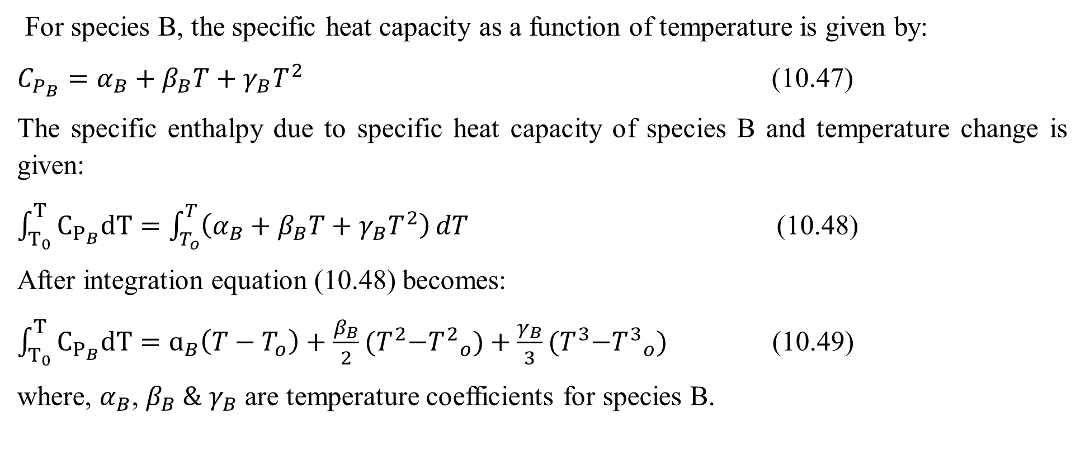
Cont’d
For species B, the specific heat capacity as a function of temperature is given by:
$C_{P_{B}}=α_{B}+β_{B}T+γ_{B}T^{2}$ (10.47)
The specific enthalpy due to specific heat capacity of species B and temperature change is given:
$\int_{T_{0}}^{T}{C_{P_{B}}dT}=\int_{T_{o}}^{T}{\left(α_{B}+β_{B}T+γ_{B}T^{2}\right)}dT$ (10.48)
After integration equation (10.48) becomes:
$\int_{T_{0}}^{T}{C_{P_{B}}dT}=ɑ_{B}\left(T−T_{o}\right)+\frac{β_{B}}{2}{(T}^{2}−{T^{2}}_{o})+\frac{γ_{B}}{3}{(T}^{3}−{T^{3}}_{o})$ (10.49)
where, $α_{B}$, $β_{B} \&$ $γ_{B}$ are temperature coefficients for species B.
45

Slide 46
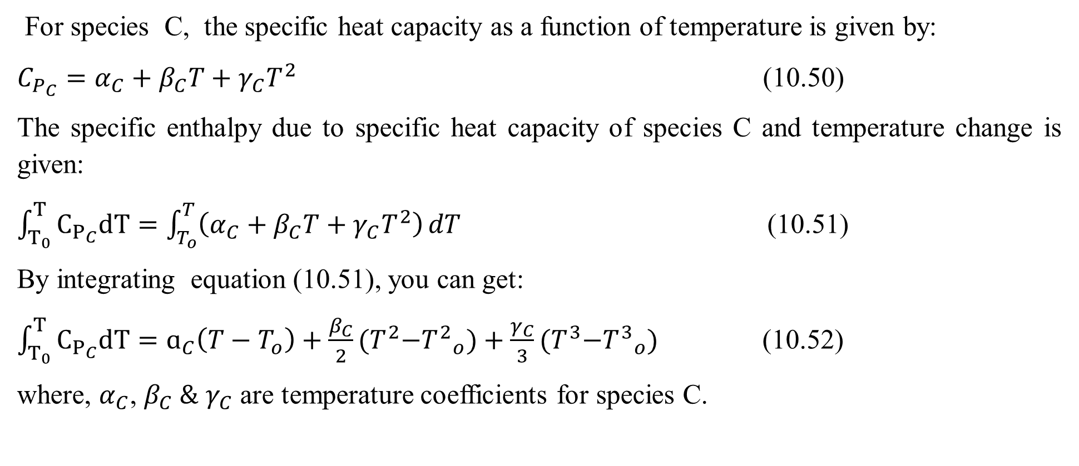
Cont’d
For species C, the specific heat capacity as a function of temperature is given by:
$C_{P_{C}}=α_{C}+β_{C}T+γ_{C}T^{2}$ (10.50)
The specific enthalpy due to specific heat capacity of species C and temperature change is given:
$\int_{T_{0}}^{T}{C_{P_{C}}dT}=\int_{T_{o}}^{T}{\left(α_{C}+β_{C}T+γ_{C}T^{2}\right)}dT$ (10.51)
By integrating equation (10.51), you can get:
$\int_{T_{0}}^{T}{C_{P_{C}}dT}=ɑ_{C}\left(T−T_{o}\right)+\frac{β_{C}}{2}{(T}^{2}−{T^{2}}_{o})+\frac{γ_{C}}{3}{(T}^{3}−{T^{3}}_{o})$ (10.52)
where, $α_{C}$, $β_{C} \&$ $γ_{C}$ are temperature coefficients for species C.
46

Slide 47
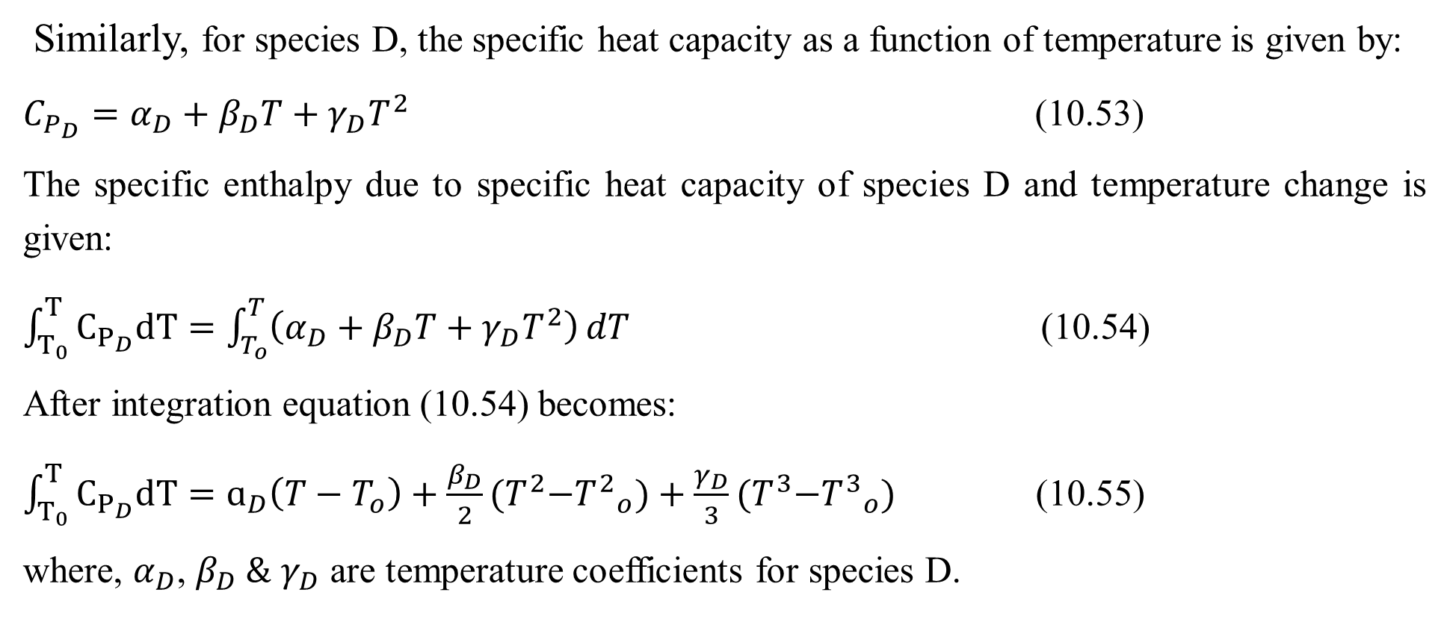
Cont’d
Similarly, for species D, the specific heat capacity as a function of temperature is given by:
$C_{P_{D}}=α_{D}+β_{D}T+γ_{D}T^{2}$ (10.53)
The specific enthalpy due to specific heat capacity of species D and temperature change is given:
$\int_{T_{0}}^{T}{C_{P_{D}}dT}=\int_{T_{o}}^{T}{\left(α_{D}+β_{D}T+γ_{D}T^{2}\right)}dT$ (10.54)
After integration equation (10.54) becomes:
$\int_{T_{0}}^{T}{C_{P_{D}}dT}=ɑ_{D}\left(T−T_{o}\right)+\frac{β_{D}}{2}{(T}^{2}−{T^{2}}_{o})+\frac{γ_{D}}{3}{(T}^{3}−{T^{3}}_{o})$ (10.55)
where, $α_{D}$, $β_{D} \&$ $γ_{D}$ are temperature coefficients for species D.
47

Slide 48
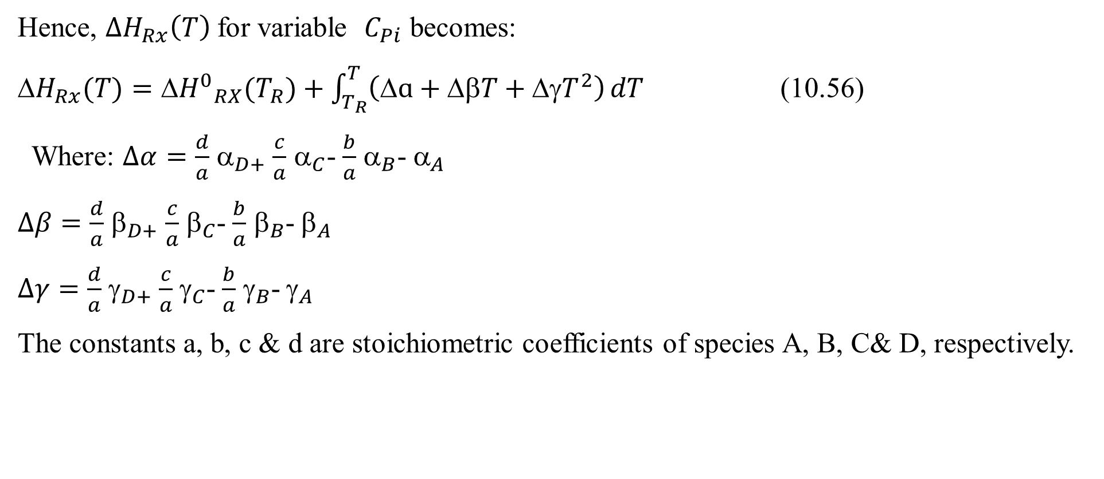
Cont’d
Hence, ${∆H}_{Rx}\left(T\right)$for variable $C_{Pi}$ becomes:
${H}_{Rx}(T)={{H}^{0}}_{RX}(T_{R})+\int_{T_{R}}^{T}{\left(ɑ+βT+{γT}^{2}\right)}dT$ (10.56)
Where: $∆α=\frac{d}{a}$ $_{D+}$ $\frac{c}{a}$ $_{C}$- $\frac{b}{a}$ $_{B}$- $_{A}$
$∆β=\frac{d}{a}$ $_{D+}$ $\frac{c}{a}$ $_{C}$- $\frac{b}{a}$ $_{B}$- $_{A}$
$∆γ=\frac{d}{a}$ $_{D+}$ $\frac{c}{a}$ $_{C}$- $\frac{b}{a}$ $_{B}$- $_{A}$
The constants a, b, c & d are stoichiometric coefficients of species A, B, C& D, respectively.
48

Slide 49
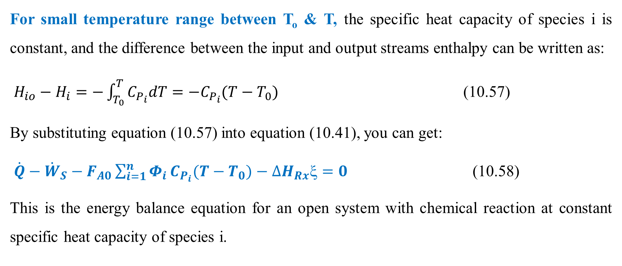
Cont’d
For small temperature range between T_{o} & T, the specific heat capacity of species i is constant, and the difference between the input and output streams enthalpy can be written as:
$H_{io}−H_{i}=−\int_{T_{0}}^{T}{C_{P_{i}}dT=−C_{P_{i}}(T−T_{0})}$ (10.57)
By substituting equation (10.57) into equation (10.41), you can get:
$\dot{Q}−{\dot{W}}_{S}−F_{A0}\sum_{i=1}^{n}{Φ_{i}}C_{P_{i}}(T−T_{0})−{∆H}_{Rx}ξ=0$ (10.58)
This is the energy balance equation for an open system with chemical reaction at constant specific heat capacity of species i.
49

Slide 50
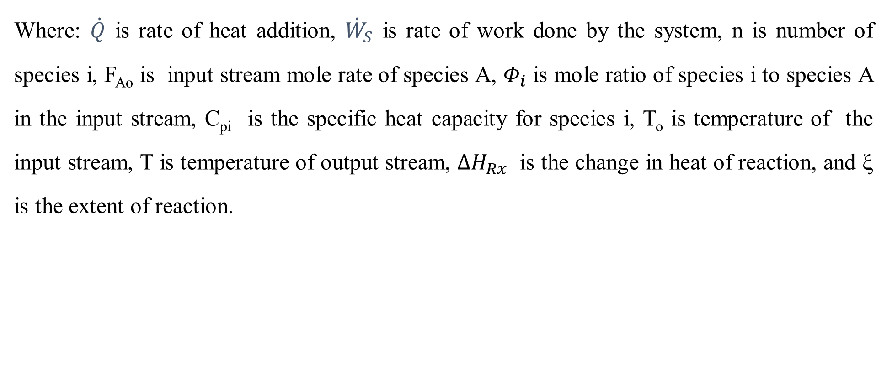
Cont’d
Where: $\dot{Q}$ is rate of heat addition, ${\dot{W}}_{S}$ is rate of work done by the system, n is number of species i, F_{Ao} is input stream mole rate of species A, $Φ_{i}$ is mole ratio of species i to species A in the input stream, C_{pi} is the specific heat capacity for species i, T_{o} is temperature of the input stream, T is temperature of output stream, ${∆H}_{Rx}$ is the change in heat of reaction, and ξ is the extent of reaction.
50

Slide 51
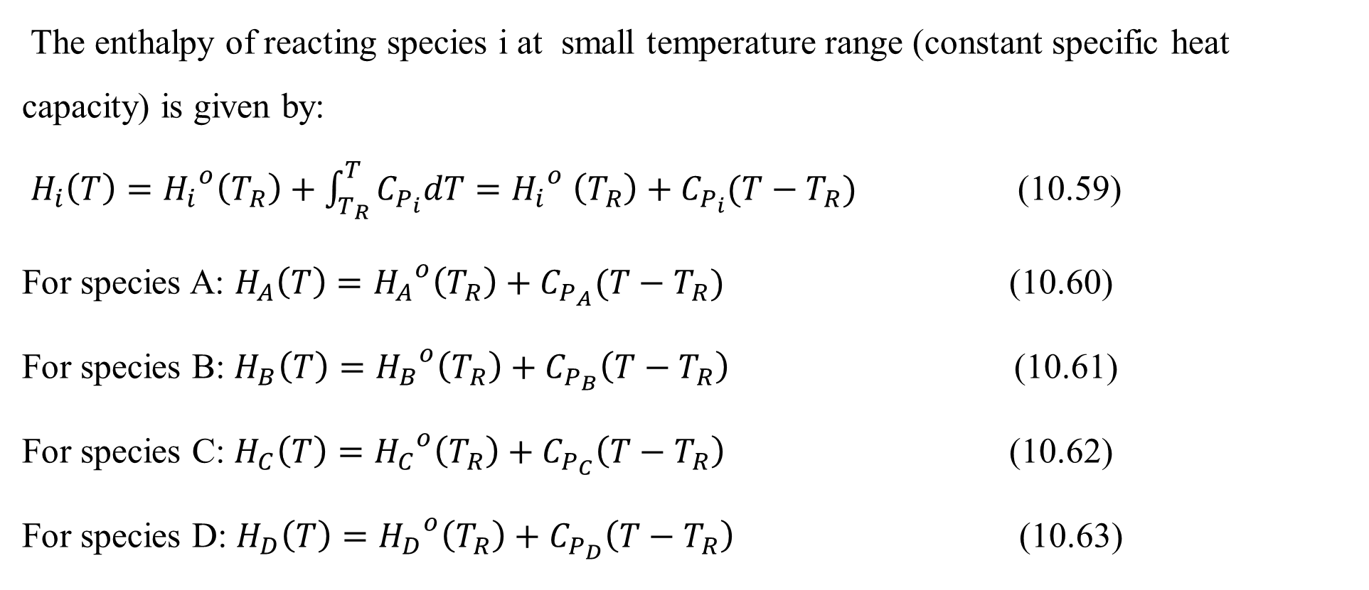
Cont’d
The enthalpy of reacting species i at small temperature range (constant specific heat capacity) is given by:
$H_{i}\left(T\right)={H_{i}}^{o}\left(T_{R}\right)+\int_{T_{R}}^{T}{C_{P_{i}}dT}={H_{i}}^{o} \left(T_{R}\right)+C_{P_{i}}(T−T_{R})$ (10.59)
For species A: $H_{A}\left(T\right)={H_{A}}^{o}\left(T_{R}\right)+C_{P_{A}}(T−T_{R})$ (10.60)
For species B: $H_{B}\left(T\right)={H_{B}}^{o}\left(T_{R}\right)+C_{P_{B}}\left(T−T_{R}\right)$ (10.61)
For species C: $H_{C}\left(T\right)={H_{C}}^{o}\left(T_{R}\right)+C_{P_{C}}\left(T−T_{R}\right)$ (10.62)
For species D: $H_{D}\left(T\right)={{H_{D}}^{o}\left(T_{R}\right)+C}_{P_{D}}\left(T−T_{R}\right)$ (10.63)
51

Slide 52
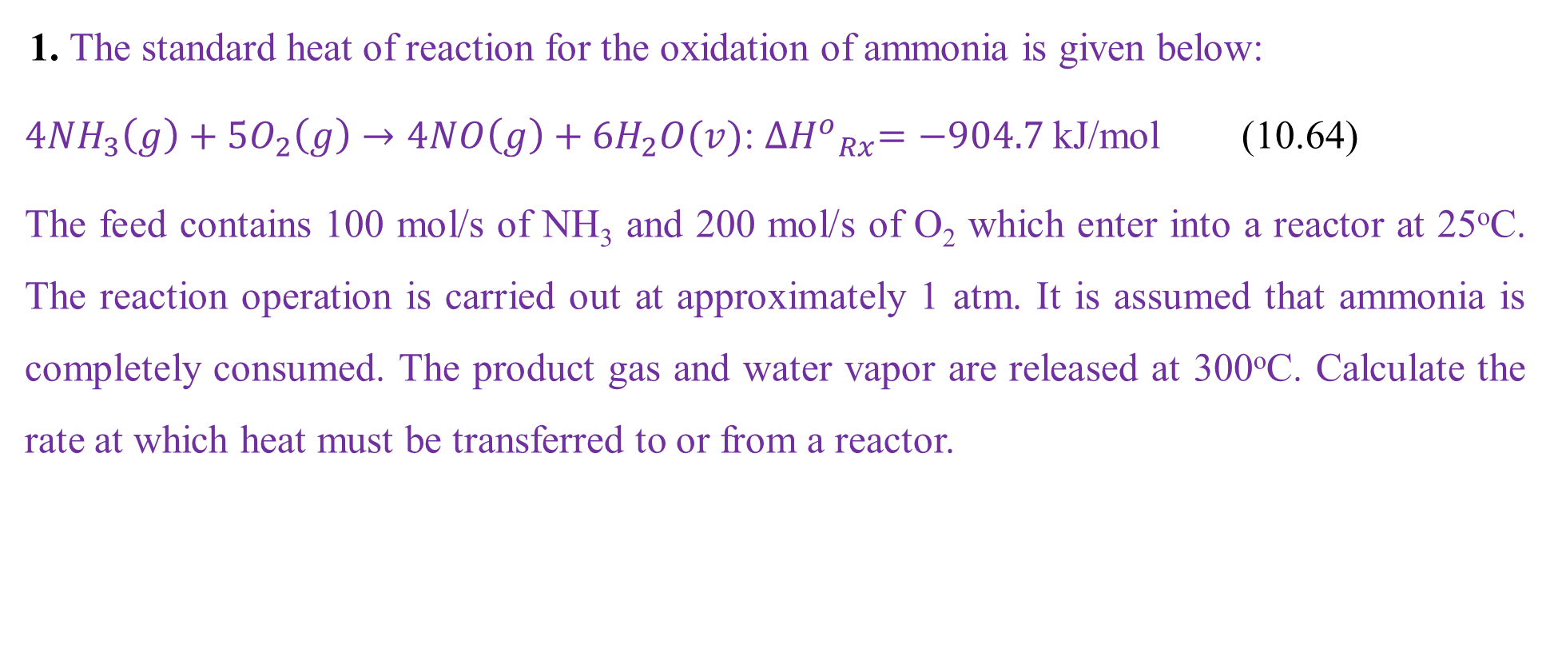
Activity 10.2
1. The standard heat of reaction for the oxidation of ammonia is given below:
${4NH}_{3}\left(g\right)+{5O}_{2}\left(g\right)→4NO\left(g\right)+{6H}_{2}O(v)$: ${{∆H}^{o}}_{Rx}=−904.7$kJ/mol (10.64)
The feed contains 100 mol/s of NH₃ and 200 mol/s of O₂ which enter into a reactor at 25ºC. The reaction operation is carried out at approximately 1 atm. It is assumed that ammonia is completely consumed. The product gas and water vapor are released at 300ºC. Calculate the rate at which heat must be transferred to or from a reactor.
52

Slide 53
Cont’d
Additional data:
Specific enthalpy of NH₃ at 300ºC= 0 since it is consumed during chemical reaction
Specific enthalpy of O₂ at 300ºC = 8.47 kJ/mol
Specific enthalpy of NO at 300ºC = 8.45 kJ/mol
Specific enthalpy of H₂O at 300ºC = 9.57 kJ/mol
(Richard M. Felder, 2005, pg. 453-454)
53

Slide 54
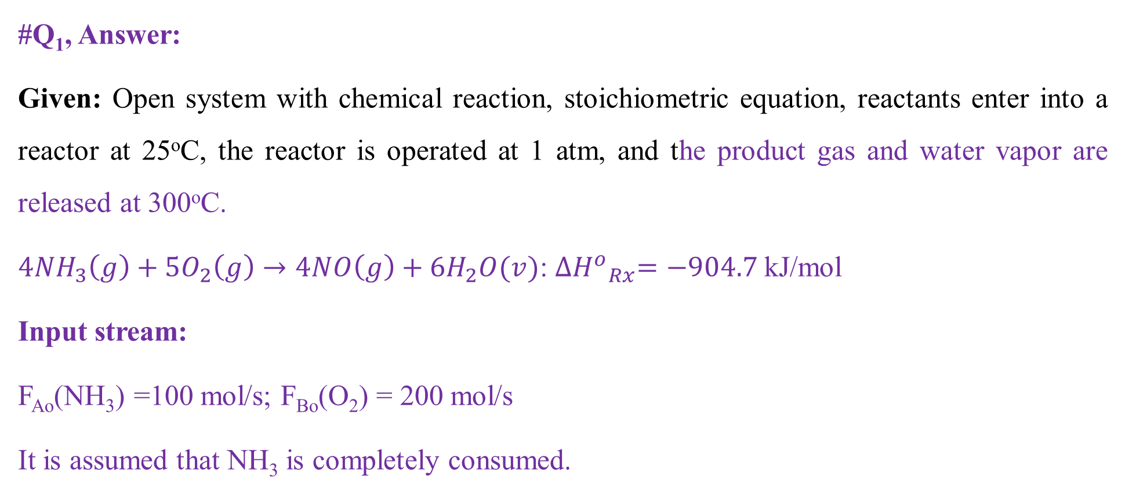
Cont’d
#Q₁, Answer:
Given: Open system with chemical reaction, stoichiometric equation, reactants enter into a reactor at 25ºC, the reactor is operated at 1 atm, and the product gas and water vapor are released at 300ºC.
${4NH}_{3}\left(g\right)+{5O}_{2}\left(g\right)→4NO\left(g\right)+{6H}_{2}O(v)$: ${{∆H}^{o}}_{Rx}=−904.7$kJ/mol
Input stream:
F_{Ao}(NH₃) =100 mol/s; F_{Bo}(O₂) = 200 mol/s
It is assumed that NH₃ is completely consumed.
54

Slide 55
Cont’d
The specific enthalpies of all species at 300ºC are given by:
H_{A} (NH₃) at 300ºC = 0 since it is consumed during chemical reaction.
H_{B} (O₂ ) at 300ºC = 8.47 kJ/mol
H_{C} (NO) at 300ºC = 8.45 kJ/mol
H_{D} (H₂O) at 300ºC = 9.57 kJ/mol
Required: Calculate the rate at which heat must be transferred to or from a reactor.
55

Slide 56

Cont’d
Assumptions: The reaction is carried out at steady state condition, the rate of work done by the system, the rate of kinetic energy and potential energy all are negligible.
To determine the energy balance with chemical reaction for an open system, the process flowsheet is shown Figure 10.3.
Reactor
H_{io}
T_{o}
F_{io}
H_{i}
T
$F$_{i}
$$\dot{Q}$$
Figure 10.3. An open system energy balances with chemical reaction
56

Slide 57
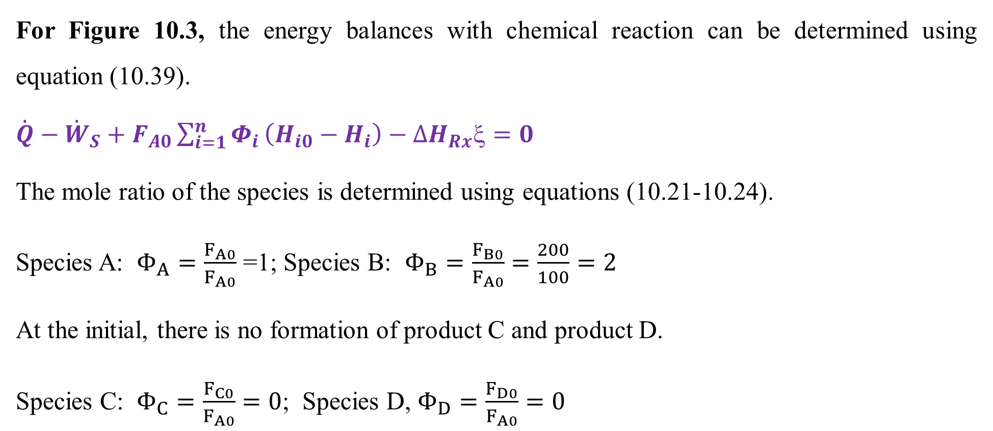
Cont’d
For Figure 10.3, the energy balances with chemical reaction can be determined using equation (10.39).
$\dot{Q}−{\dot{W}}_{S}+F_{A0}\sum_{i=1}^{n}{Φ_{i}}\left(H_{i0}−H_{i}\right)−{∆H}_{Rx}ξ=0$
The mole ratio of the species is determined using equations (10.21-10.24).
Species A: $Φ_{A}=\frac{F_{A0}}{F_{A0}}$ =1; Species B: $Φ_{B}=\frac{F_{B0}}{F_{A0}}=\frac{200}{100}=2$
At the initial, there is no formation of product C and product D.
Species C: $Φ_{C}=\frac{F_{C0}}{F_{A0}}=0$; Species D, $Φ_{D}=\frac{F_{D0}}{F_{A0}}=0$
57

Slide 58
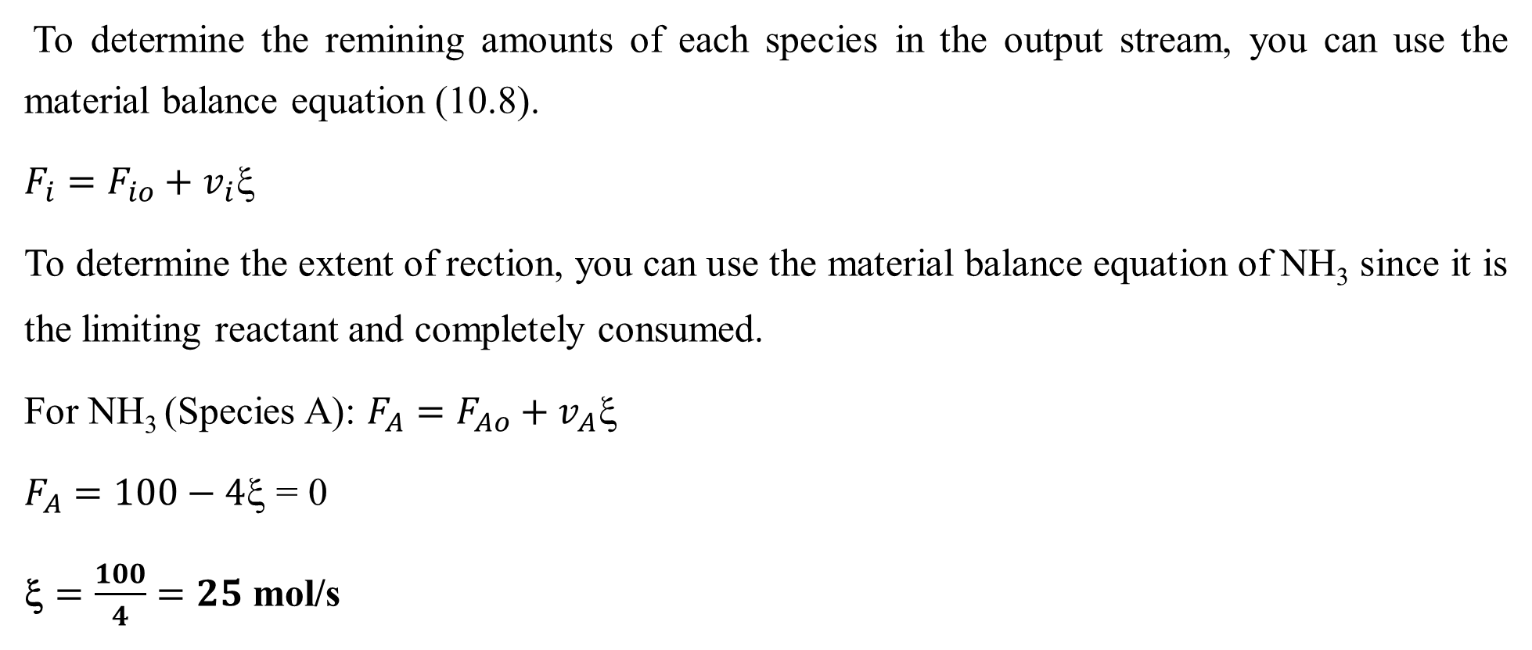
Cont’d
To determine the remining amounts of each species in the output stream, you can use the material balance equation (10.8).
$F_{i}=F_{io}+v_{i}\text{ξ }$
To determine the extent of rection, you can use the material balance equation of NH₃ since it is the limiting reactant and completely consumed.
For NH₃ (Species A): $F_{A}=F_{Ao}+v_{A}\text{ξ}$
$F_{A}=100−4\text{ξ}\text{ = 0}$
$\text{}=\frac{100}{4}=25$ mol/s
58

Slide 59
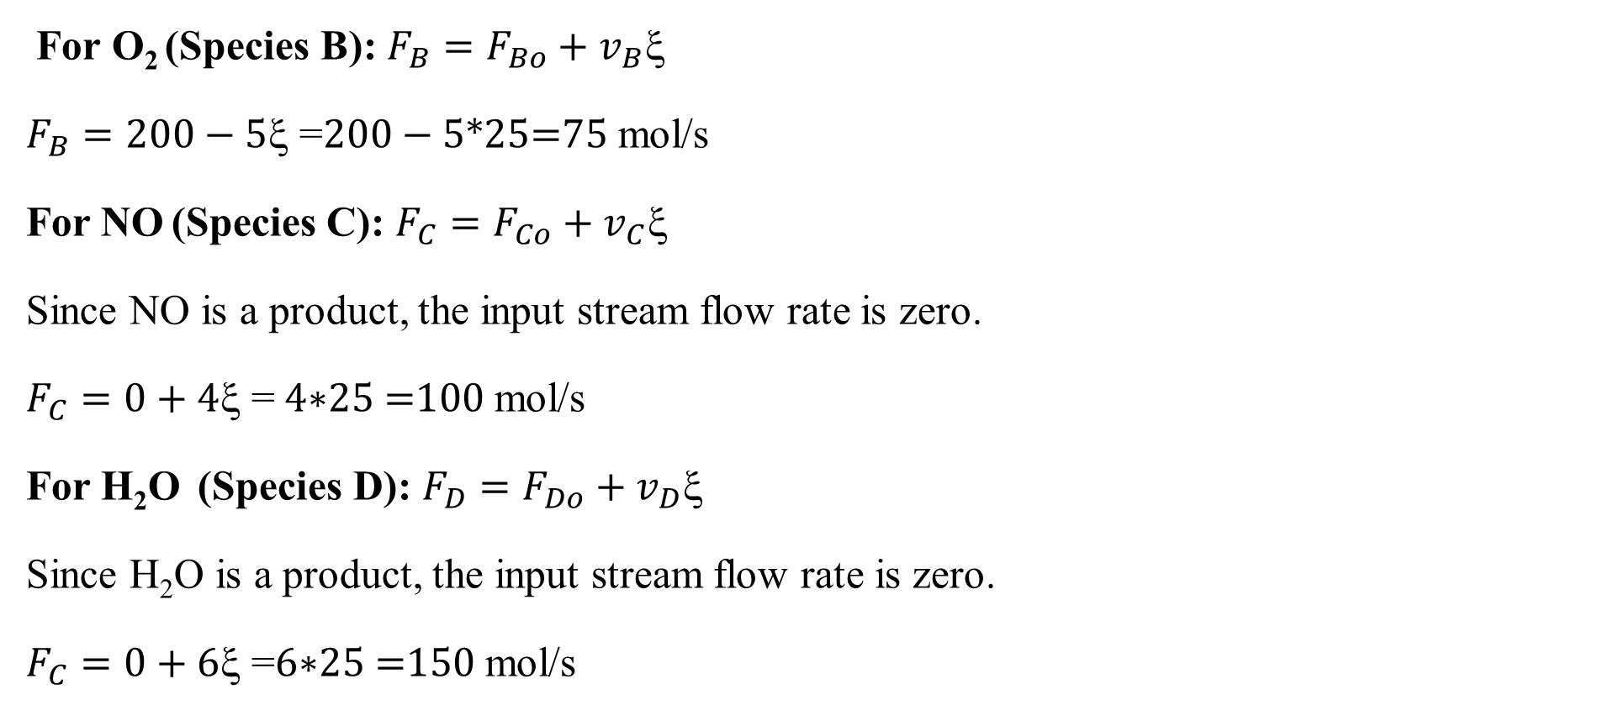
Cont’d
For O₂ (Species B): $F_{B}=F_{Bo}+v_{B}\text{ξ }$
$F_{B}=200−5\text{ξ =}200−5\text{∗25=75}$ mol/s
For NO (Species C): $F_{C}=F_{Co}+v_{C}\text{ξ }$
Since NO is a product, the input stream flow rate is zero.
$F_{C}=0+4\text{ξ =} 4\text{∗25} \text{=}\text{100}$ mol/s
For H₂O (Species D): $F_{D}=F_{Do}+v_{D}\text{ξ }$
Since H₂O is a product, the input stream flow rate is zero.
$F_{C}=0+6\text{ξ =}6\text{∗25 =1}\text{5}\text{0}$ mol/s
59

Slide 60
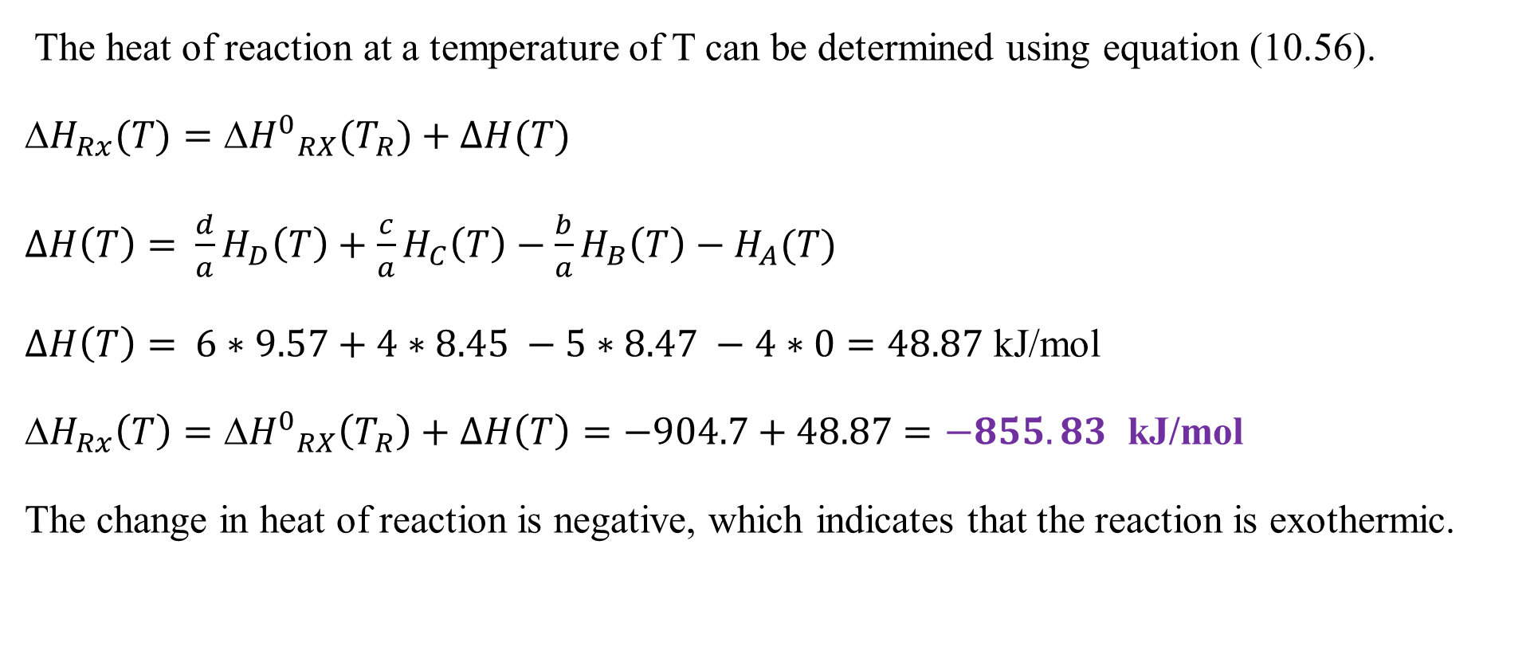
Cont’d
The heat of reaction at a temperature of T can be determined using equation (10.56).
${H}_{Rx}(T)={{H}^{0}}_{RX}(T_{R})+∆H(T)$
$∆H\left(T\right)=$ $\frac{d}{a}H_{D}\left(T\right)+\frac{c}{a}H_{C}\left(T\right)−\frac{b}{a}H_{B}\left(T\right)−H_{A}(T)$
$∆H\left(T\right)=$ $6∗9.57+4∗8.45 −5∗8.47 −4∗0=48.87$ kJ/mol
${H}_{Rx}\left(T\right)={{ΔH}^{0}}_{RX}\left(T_{R}\right)+∆H\left(T\right)=−904.7+48.87=−855.83$ kJ/mol
The change in heat of reaction is negative, which indicates that the reaction is exothermic.
60

Slide 61
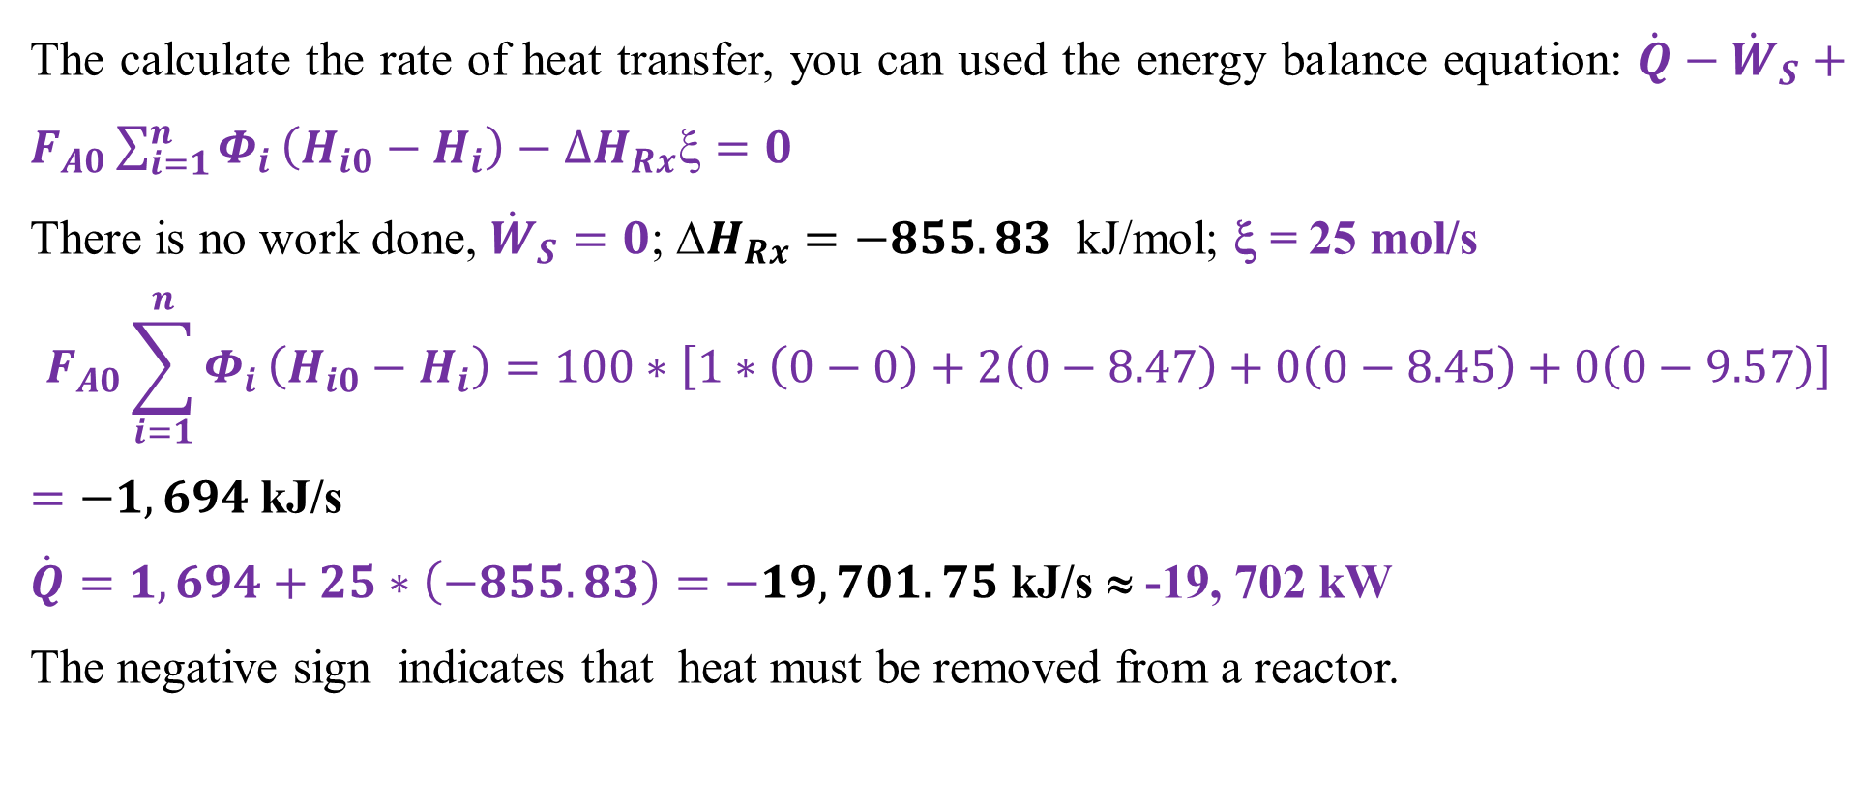
Cont’d
The calculate the rate of heat transfer, you can used the energy balance equation: $\dot{Q}−{\dot{W}}_{S}+F_{A0}\sum_{i=1}^{n}{Φ_{i}}\left(H_{i0}−H_{i}\right)−{∆H}_{Rx}ξ=0$
There is no work done, ${\dot{W}}_{S}=0$; ${H}_{Rx}=−855.83$ kJ/mol; ξ = 25 mol/s
$$F_{A0}\sum_{i=1}^{n}{Φ_{i}}\left(H_{i0}−H_{i}\right)=100∗\left[1∗\left(0−0\right)+2\left(0−8.47\right)+0\left(0−8.45\right)+0\left(0−9.57\right)\right]$$
$=−1, 694$kJ/s
$\dot{Q}=1, 694+25∗\left(−855.83\right)=−19,701.75$ kJ/s ≈ -19, 702 kW
The negative sign indicates that heat must be removed from a reactor.
61

Slide 62
Cont’d
The reaction is exothermic which requires heat removal from a reactor to enhance conversion of reactants into products.
If less heat is transferred, more of the heat of reaction will go into a reaction mixture and the outlet temperature will increase.
If a reaction temperature increases over the required level, the conversion of reactants will reduce.
Therefore, 19,702 kW of heat must be transferred from a reactor to maintain the product temperature at 300ºC.
62

Slide 63
10.4. Summary
The energy balances with chemical reaction are complex and require careful consideration to account heat transfer, work done, heat of reaction and flow enthalpy, which can transfer across system boundaries.
The stoichiometry of a chemical reaction affects energy balances, and the quantity of reactants and products affects the total change in energy.
The reaction enthalpies can be determined using standard enthalpies of formation.
The change in heat of reaction is negative for exothermic reactions whereas the change in heat of reaction is positive for endothermic reactions.
63

Slide 64
References
Basic Principles and Calculations in Chemical Engineering, Himmelblau, Pearson Education Inc, 9th edition, 2023.
Chemical Engineering Design, Volume 6, Coulson & Richardson’s, R. K. Sinnott, 3rd edition, 1999.
Elementary Principles of Chemical Processes, Richard M. Felder, John Wiley & Sons, 3rd edition, 2005.
Thank you!
64

