Slide 1
Basic Principles of Process Calculations in Chemical Engineering (ChEg2106)
Prerequisites: No prerequisite for this course
Lecture 11: Integrated Material and Energy Balances for Single Systems
Week 11
Lecturer: Adamu Esubalew (PhD, ChEg)
Addis Ababa, Ethiopia
1

Slide 2
Lecture learning outcomes
At the end of the lecture, you will be able to:
explain the characteristics of single systems,
develop integrated material and energy balances equations for single systems without and with chemical reactions, and
determine material and energy balances for single systems without and with chemical reactions.
2

Slide 3
Presentation outlines
Introduction to integrated material and energy balances
Integrated material and energy balances for single systems without chemical reactions
Integrated material and energy balances for single systems with chemical reactions
Summary
3

Slide 4
11.1. Introduction to integrated material and energy balances
Performing integrated material and energy balances provide a comprehensive framework for analyzing processes in chemical engineering.
Integrated material and energy balances for single systems involve the systematic accounting of all materials and energy inputs, outputs, and changes within a defined system.
Integrated material and energy balances are used to analyze process efficiency, determine yield, optimize resource usage, and minimize environmental impact.
Integrated material and energy balances can also help to identify potential areas for improvement or modification in process design.
4

Slide 5
Cont’d
Understanding the flow of materials and energy across system boundaries is essential for optimizing processes, minimizing waste, and ensuring sustainability of physical and chemical processes.
Chemical engineers can enhance efficiency, reduce costs, and promote sustainability in their designs and operations by accounting the flow of materials and energy across system boundaries, and transformations within a system.
5

Slide 6
Cont’d
In this lecture, integrated material and energy balances for single systems without and with chemical reactions are discussed.
System without chemical reactions (physical processes): The system only involves physical processes (e.g mixing, heating, cooling, separation).
For physical processes, integrated material and energy balances can be performed using mass units.
Material balances ensure that the total mass entering equals the total mass leaving, while energy balances account for heat, work, and enthalpy changes.
6

Slide 7
Cont’d
System with chemical reactions: The system involves chemical processes or chemical reactions that converts raw materials into products.
You shall include terms for consumption of reactants/ formation of products in the material balance equations (stoichiometry, extent of reaction, and heat of reaction become critical).
Energy balances must also consider heat of reaction (reaction enthalpy).
For chemical processes, integrated material and energy balances shall be performed using mole units to account the rate of generation of products/rate of consumption of reactants.
7

Slide 8
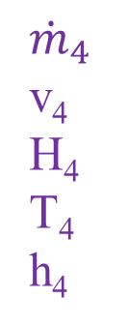
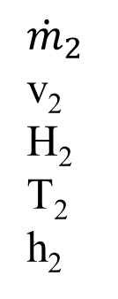
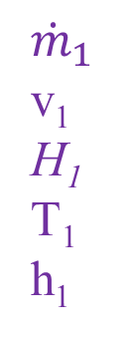


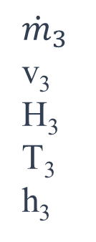
11.2. Integrated material and energy balances without reaction
To determine both material and energy balance for physical processes, you can consider the following single system as shown in Figure 11.1.
$${\dot{m}}_{2}$$
v₂
H₂
T₂
h₂
$$\dot{W}$$
$${\dot{m}}_{3}$$
v₃
H₃
T₃
h₃
System
Figure 11.1 Integrated material and energy balances for a single system without chemical reaction
$${\dot{m}}_{1}$$
v₁
H₁
T₁
h₁
$${\dot{m}}_{4}$$
v₄
H₄
T₄
h₄
$$\dot{Q}$$
8

Slide 9
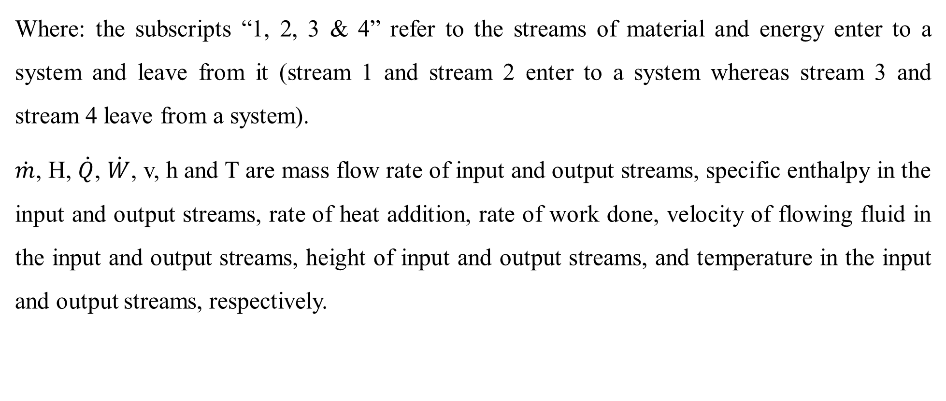
Cont’d
Where: the subscripts “1, 2, 3 & 4” refer to the streams of material and energy enter to a system and leave from it (stream 1 and stream 2 enter to a system whereas stream 3 and stream 4 leave from a system).
$\dot{m}$, H, $\dot{Q}$, $\dot{W}$, v, h and T are mass flow rate of input and output streams, specific enthalpy in the input and output streams, rate of heat addition, rate of work done, velocity of flowing fluid in the input and output streams, height of input and output streams, and temperature in the input and output streams, respectively.
9

Slide 10
Cont’d
To develop integrated material and energy balances equation for Figure 11.1, and to solve problems, you shall state your assumptions.
Assumptions:
A system is operated at a steady state condition. i.e. rate of accumulation is zero.
There is no chemical reaction.
There is no any other heat source inside a system.
There is no heat loss due to resistance of materials of a system.
10

Slide 11
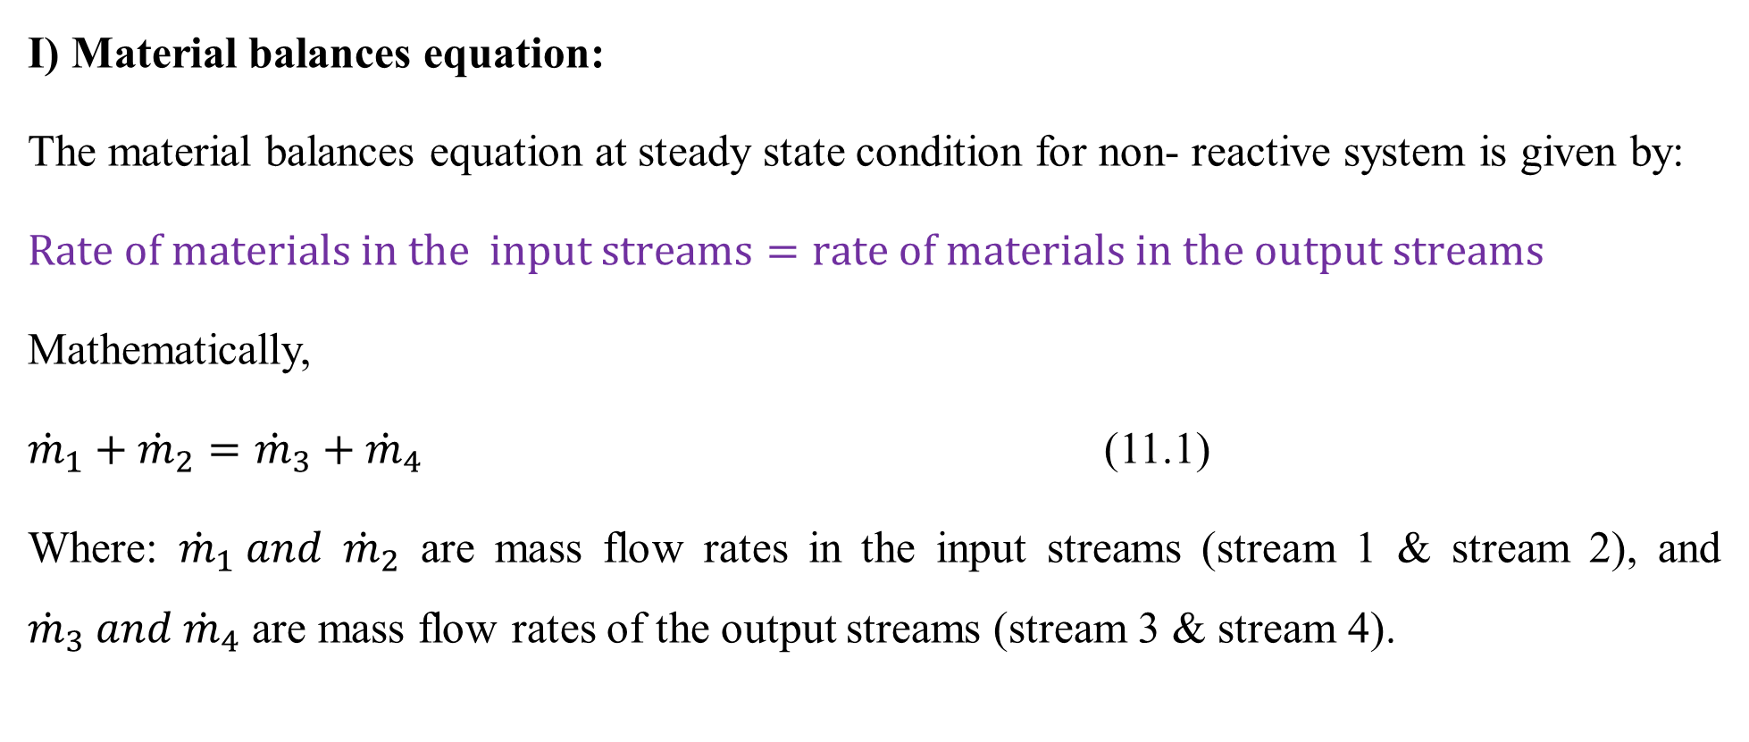
Cont’d
I) Material balances equation:
The material balances equation at steady state condition for non- reactive system is given by:
$Rate of materials in the input streams=rate of materials in the output streams$
Mathematically,
${\dot{m}}_{1}+{\dot{m}}_{2}={\dot{m}}_{3}+{\dot{m}}_{4}$ (11.1)
Where: ${\dot{m}}_{1} and {\dot{m}}_{2}$ are mass flow rates in the input streams (stream 1 & stream 2), and ${\dot{m}}_{3} and {\dot{m}}_{4}$ are mass flow rates of the output streams (stream 3 & stream 4).
11

Slide 12
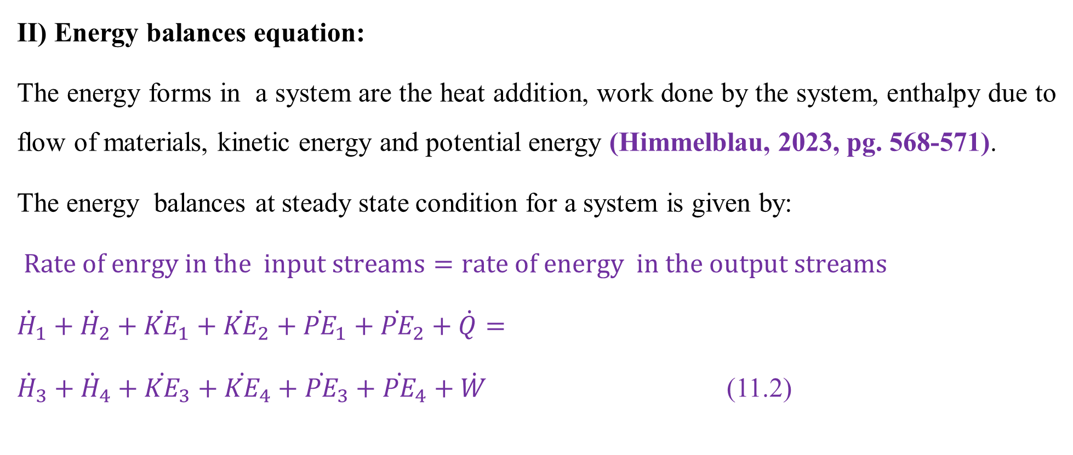
Cont’d
II) Energy balances equation:
The energy forms in a system are the heat addition, work done by the system, enthalpy due to flow of materials, kinetic energy and potential energy (Himmelblau, 2023, pg. 568-571).
The energy balances at steady state condition for a system is given by:
$Rate of enrgy in the input streams=rate of energy in the output streams$
${\dot{H}}_{1}+{\dot{H}}_{2}+{\dot{KE}}_{1}+{\dot{KE}}_{2}+{\dot{PE}}_{1}+{\dot{PE}}_{2}+\dot{Q}=$
${\dot{H}}_{3}+{\dot{H}}_{4}+{\dot{KE}}_{3}+{\dot{KE}}_{4}+{\dot{PE}}_{3}+{\dot{PE}}_{4}+\dot{W}$ (11.2)
12

Slide 13
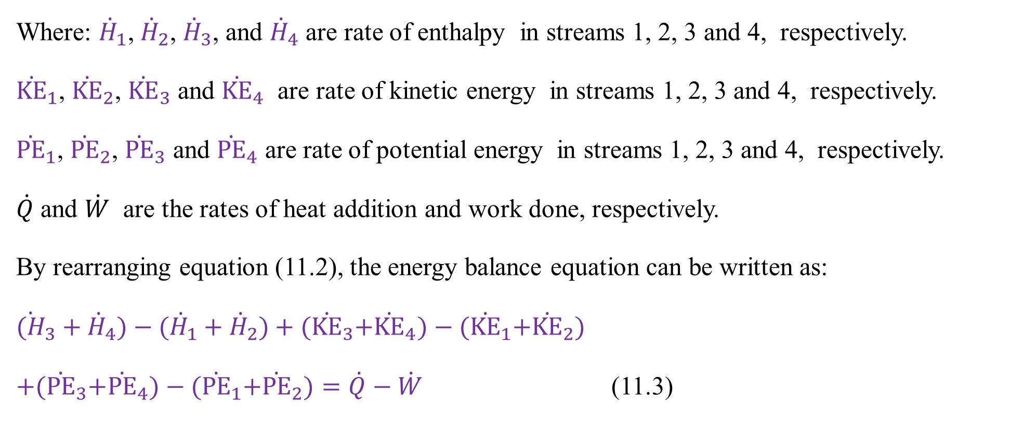
Cont’d
Where: ${\dot{H}}_{1}$, ${\dot{H}}_{2}$, ${\dot{H}}_{3}$, and ${\dot{H}}_{4}$ are rate of enthalpy in streams 1, 2, 3 and 4, respectively.
${\dot{KE}}_{1}$, ${\dot{KE}}_{2}$, ${\dot{KE}}_{3}$ and ${\dot{KE}}_{4}$ are rate of kinetic energy in streams 1, 2, 3 and 4, respectively.
${\dot{PE}}_{1}$, ${\dot{PE}}_{2}$, ${\dot{PE}}_{3}$ and ${\dot{PE}}_{4}$ are rate of potential energy in streams 1, 2, 3 and 4, respectively.
$\dot{Q}$ and $\dot{W}$ are the rates of heat addition and work done, respectively.
By rearranging equation (11.2), the energy balance equation can be written as:
${\dot{(H}}_{3}+{\dot{H}}_{4})−({\dot{H}}_{1}+{\dot{H}}_{2})+{(\dot{KE}}_{3}+{\dot{KE}}_{4})−{(\dot{KE}}_{1}+{\dot{KE}}_{2})$
$+{(\dot{PE}}_{3}+{\dot{PE}}_{4})−{(\dot{PE}}_{1}+{\dot{PE}}_{2})=\dot{Q}−\dot{W}$ (11.3)
13

Slide 14
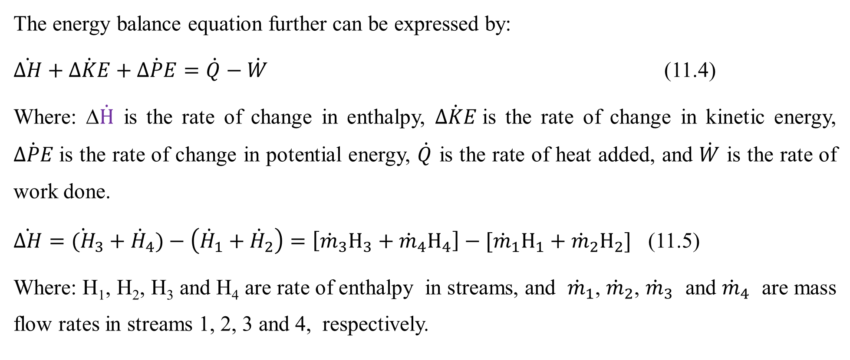
Cont’d
The energy balance equation further can be expressed by:
$\dot{∆H}+\dot{∆KE}+\dot{∆PE}=\dot{Q}−\dot{W}$ (11.4)
Where: Δ$\dot{H}$ is the rate of change in enthalpy, $\dot{∆KE}$is the rate of change in kinetic energy, $\dot{∆PE}$is the rate of change in potential energy, $\dot{Q}$ is the rate of heat added, and $\dot{W}$ is the rate of work done.
$\dot{∆H}={\dot{(H}}_{3}+{\dot{H}}_{4})−\left({\dot{H}}_{1}+{\dot{H}}_{2}\right)=\left[{\dot{m}}_{3}H_{3}+{\dot{m}}_{4}H_{4}\right]−[{\dot{m}}_{1}H_{1}+{\dot{m}}_{2}H_{2}]$ (11.5)
Where: H₁, H₂, H₃ and H₄ are rate of enthalpy in streams, and ${\dot{m}}_{1}$, ${\dot{m}}_{2}$, ${\dot{m}}_{3}$ and ${\dot{m}}_{4}$ are mass flow rates in streams 1, 2, 3 and 4, respectively.
14

Slide 15
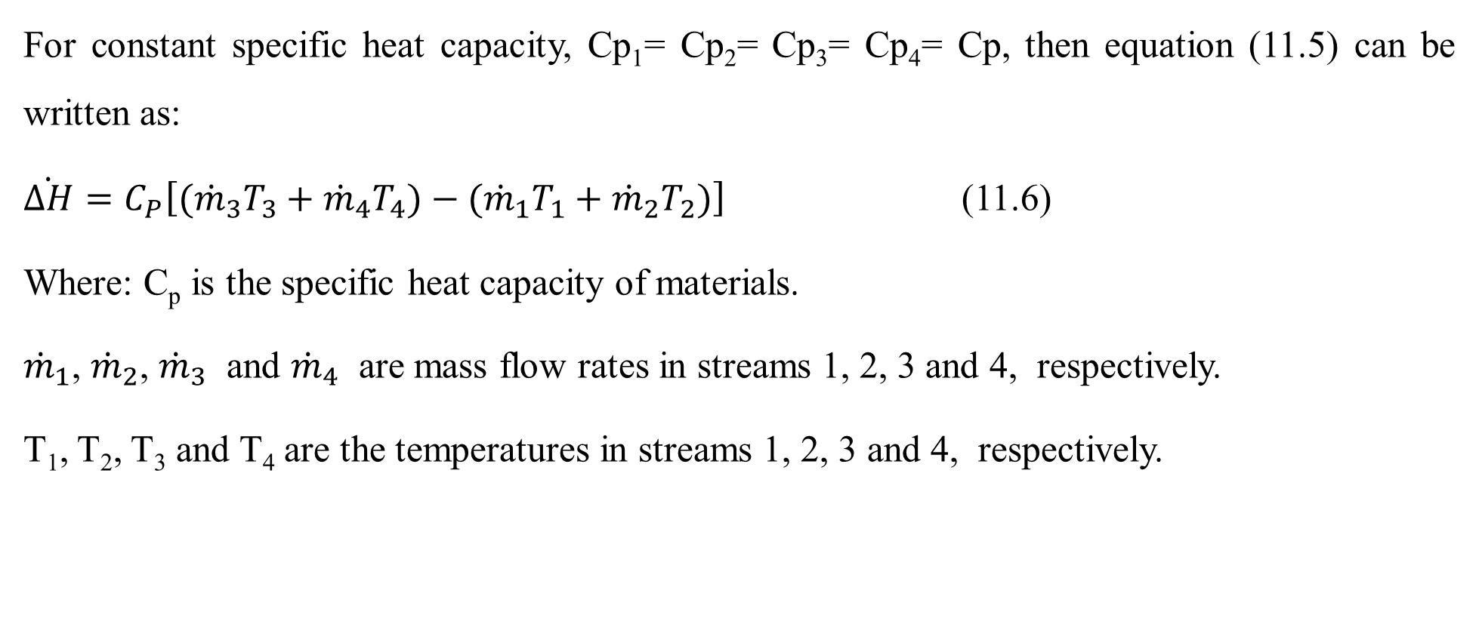
Cont’d
For constant specific heat capacity, Cp₁= Cp₂= Cp₃= Cp₄= Cp, then equation (11.5) can be written as:
$\dot{∆H}=C_{P}\left[({\dot{m}}_{3}T_{3}+{\dot{m}}_{4}T_{4})−({\dot{m}}_{1}T_{1}+{\dot{m}}_{2}T_{2})\right]$ (11.6)
Where: C_{p} is the specific heat capacity of materials.
${\dot{m}}_{1}$, ${\dot{m}}_{2}$, ${\dot{m}}_{3}$ and ${\dot{m}}_{4}$ are mass flow rates in streams 1, 2, 3 and 4, respectively.
T₁, T₂, T₃ and T₄ are the temperatures in streams 1, 2, 3 and 4, respectively.
15

Slide 16
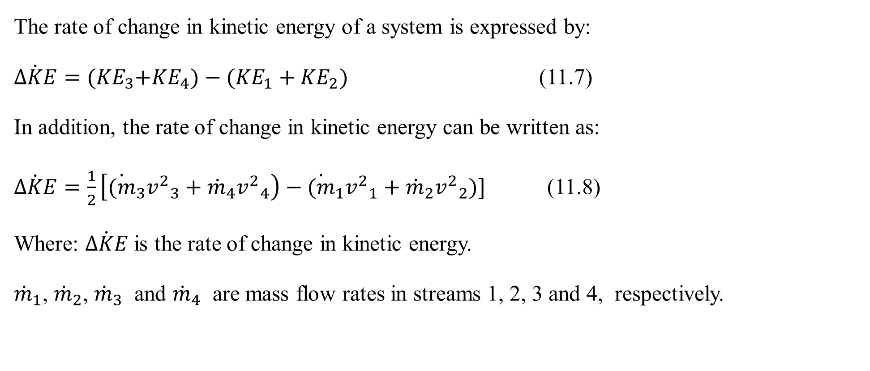
Cont’d
The rate of change in kinetic energy of a system is expressed by:
$\dot{∆KE}={(KE}_{3}+{KE}_{4})−({KE}_{1}+{KE}_{2})$ (11.7)
In addition, the rate of change in kinetic energy can be written as:
$\dot{∆KE}=\frac{1}{2}\left[{\dot{(m}}_{3}{v^{2}}_{3}+{\dot{m}}_{4}{v^{2}}_{4}\right)−{\dot{(m}}_{1}{v^{2}}_{1}+{\dot{m}}_{2}{v^{2}}_{2})]$ (11.8)
Where: $\dot{∆KE}$is the rate of change in kinetic energy.
${\dot{m}}_{1}$, ${\dot{m}}_{2}$, ${\dot{m}}_{3}$ and ${\dot{m}}_{4}$ are mass flow rates in streams 1, 2, 3 and 4, respectively.
16

Slide 17
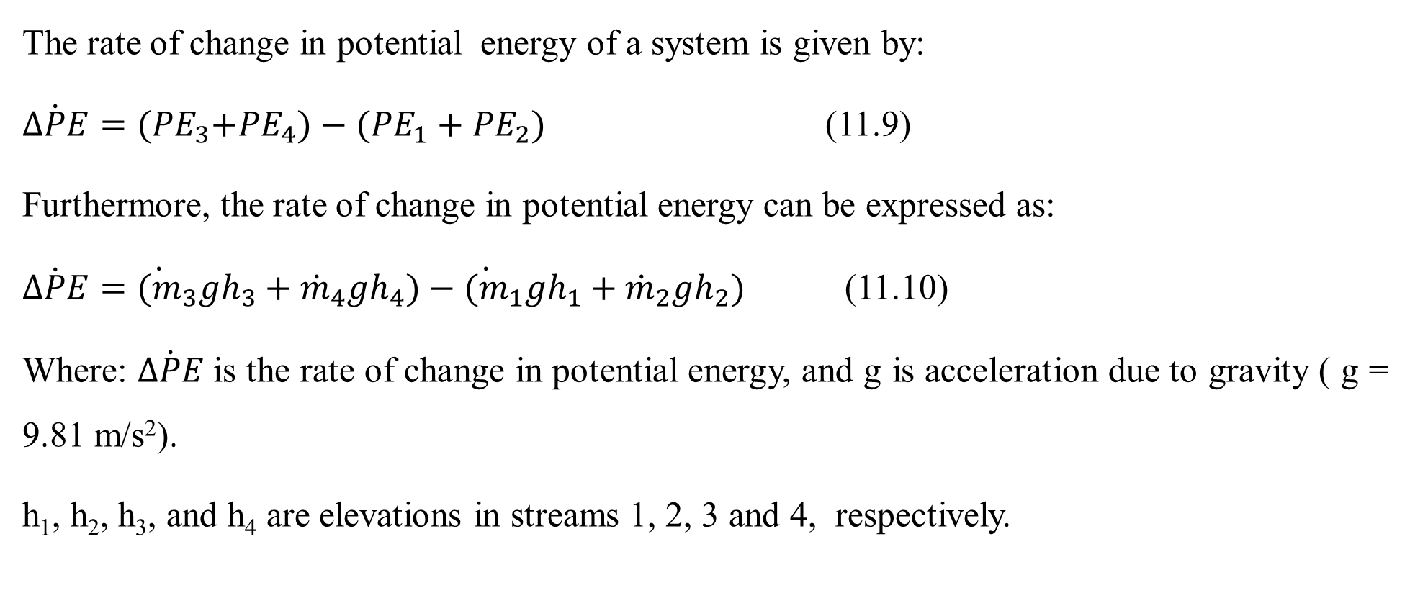
Cont’d
The rate of change in potential energy of a system is given by:
$\dot{∆PE}={(PE}_{3}+{PE}_{4})−({PE}_{1}+{PE}_{2})$ (11.9)
Furthermore, the rate of change in potential energy can be expressed as:
$\dot{∆PE}={\dot{(m}}_{3}{gh}_{3}+{\dot{m}}_{4}{gh}_{4})−{\dot{(m}}_{1}{gh}_{1}+{\dot{m}}_{2}{gh}_{2})$ (11.10)
Where: $\dot{∆PE}$is the rate of change in potential energy, and g is acceleration due to gravity ( g = 9.81 m/s²).
h₁, h₂, h₃, and h₄ are elevations in streams 1, 2, 3 and 4, respectively.
17

Slide 18
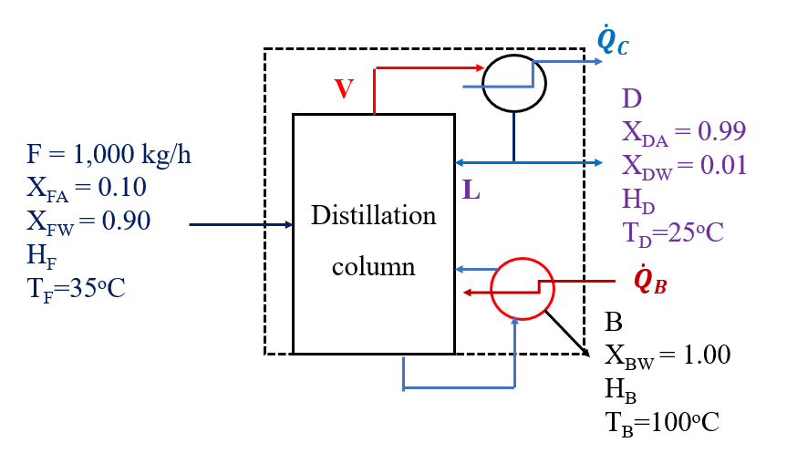
Activity 11.1
1. A distillation column is used to separate acetone and water. The feed to the distillation column enters at a rate of 1, 000 kg/h at 35ºC as shown in Figure 11.2 (Coulson & Richardson’s, 1999, pg. 64).
Figure 11.2 Integrated material and energy balances for a distillation column
18

Slide 19
Cont’d
The feed contains a mixture of 10% of acetone and 90% of water. The top product contains 99% of acetone and 1% of water, which leaves a condenser at 25ºC. The reflux ratio is 10. The bottom product has no acetone, and leaves a reboiler 100ºC. Steam is supplied via a reboiler at absolute pressure of 274 kPa (dry saturated). The distillation column is operated at 100 kPa. The rise in cooling water temperature is limited to 30°C. Based on the data, calculate the rate of heat energy enters to the distillation column and removed from it, and the mass flow rates of steam and cooling water required for the distillation column.
19

Slide 20
Cont’d
Additional data:
Specific heat capacity of acetone from 25ºC to 35ºC = 2.2 kJ/kg.ºC.
Specific heat capacity of water from 25ºC to 100ºC = 4.2 kJ/kg.ºC.
From vapor–liquid equilibrium data, the boiling point of 99% acetone with 1% water= 56.5ºC.
The specific latent heat of acetone at 56.5° is 620 kJ/kg.
The specific latent heat of water at 56.5°C is 2, 500 kJ/kg.
The specific latent heat of steam at 274 kPa is 2,174 kJ/kg.
20

Slide 21
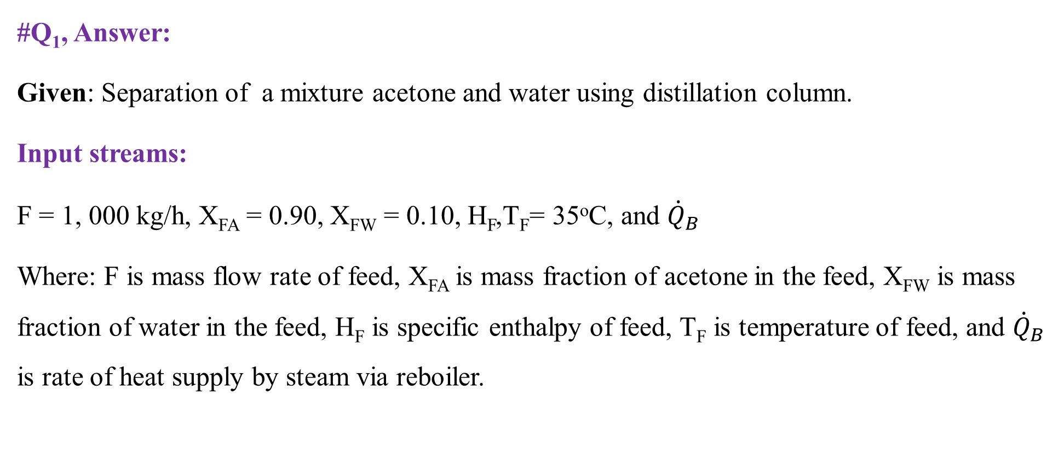
Cont’d
#Q₁, Answer:
Given: Separation of a mixture acetone and water using distillation column.
Input streams:
F = 1, 000 kg/h, X_{FA} = 0.90, X_{FW} = 0.10, H_{F},T_{F}= 35ºC, and ${\dot{Q}}_{B}$
Where: F is mass flow rate of feed, X_{FA} is mass fraction of acetone in the feed, X_{FW} is mass fraction of water in the feed, H_{F} is specific enthalpy of feed, T_{F} is temperature of feed, and ${\dot{Q}}_{B}$ is rate of heat supply by steam via reboiler.
21

Slide 22
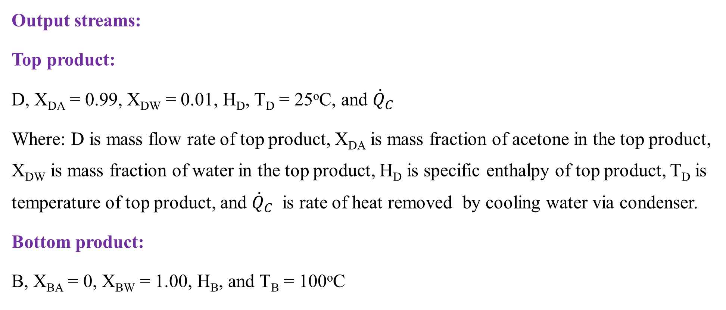
Cont’d
Output streams:
Top product:
D, X_{DA} = 0.99, X_{DW} = 0.01, H_{D}, T_{D} = 25ºC, and ${\dot{Q}}_{C}$
Where: D is mass flow rate of top product, X_{DA} is mass fraction of acetone in the top product, X_{DW} is mass fraction of water in the top product, H_{D} is specific enthalpy of top product, T_{D} is temperature of top product, and ${\dot{Q}}_{C}$ is rate of heat removed by cooling water via condenser.
Bottom product:
B, X_{BA} = 0, X_{BW} = 1.00, H_{B}, and T_{B} = 100ºC
22

Slide 23
Cont’d
Where: B is mass flow rate of bottom product, X_{BA} is mass fraction of acetone in the bottom product, X_{BW} is mass fraction of water in the bottom product, H_{B} is specific enthalpy of bottom product, and T_{B} is temperature of bottom product.
It is given that L/D = 10
Where: L and D are mass flow rates of reflux and top product, respectively.
Specific heat capacity of acetone (C_{PA}) from 25ºC to 35ºC = 2.2 kJ/kg.ºC.
Specific heat capacity of water (C_{Pw}) from 25ºC to 100ºC = 4.2 kJ/kg.ºC.
The boiling point of 99% acetone with 1% water (T_{b}) = 56.5ºC.
23

Slide 24
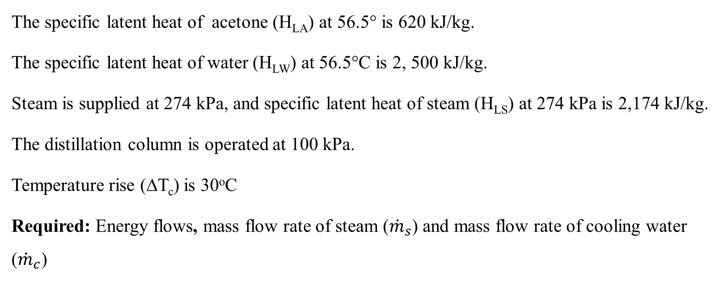
Cont’d
The specific latent heat of acetone (H_{LA}) at 56.5° is 620 kJ/kg.
The specific latent heat of water (H_{LW}) at 56.5°C is 2, 500 kJ/kg.
Steam is supplied at 274 kPa, and specific latent heat of steam (H_{LS}) at 274 kPa is 2,174 kJ/kg.
The distillation column is operated at 100 kPa.
Temperature rise (ΔT_{c}) is 30ºC
Required: Energy flows, mass flow rate of steam (${\dot{m}}_{s}$) and mass flow rate of cooling water (${\dot{m}}_{c}$)
24

Slide 25
Cont’d
Assumptions:
The process is operated at steady state condition.
There is no chemical reaction.
There is no heat loss
The rates of the change in kinetic energy, potential energy and work done by the system all are neglected as compared with rate of heat supply and rate of change in enthalpy.
25

Slide 26
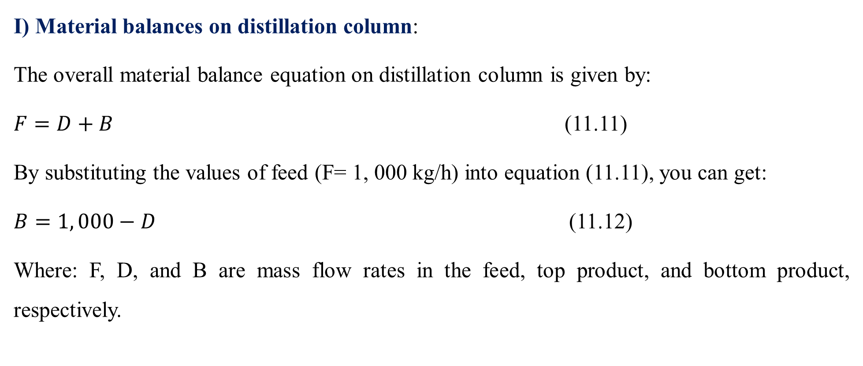
Cont’d
I) Material balances on distillation column:
The overall material balance equation on distillation column is given by:
$F=D+B$ (11.11)
By substituting the values of feed (F= 1, 000 kg/h) into equation (11.11), you can get:
$B=1, 000−D$ (11.12)
Where: F, D, and B are mass flow rates in the feed, top product, and bottom product, respectively.
26

Slide 27
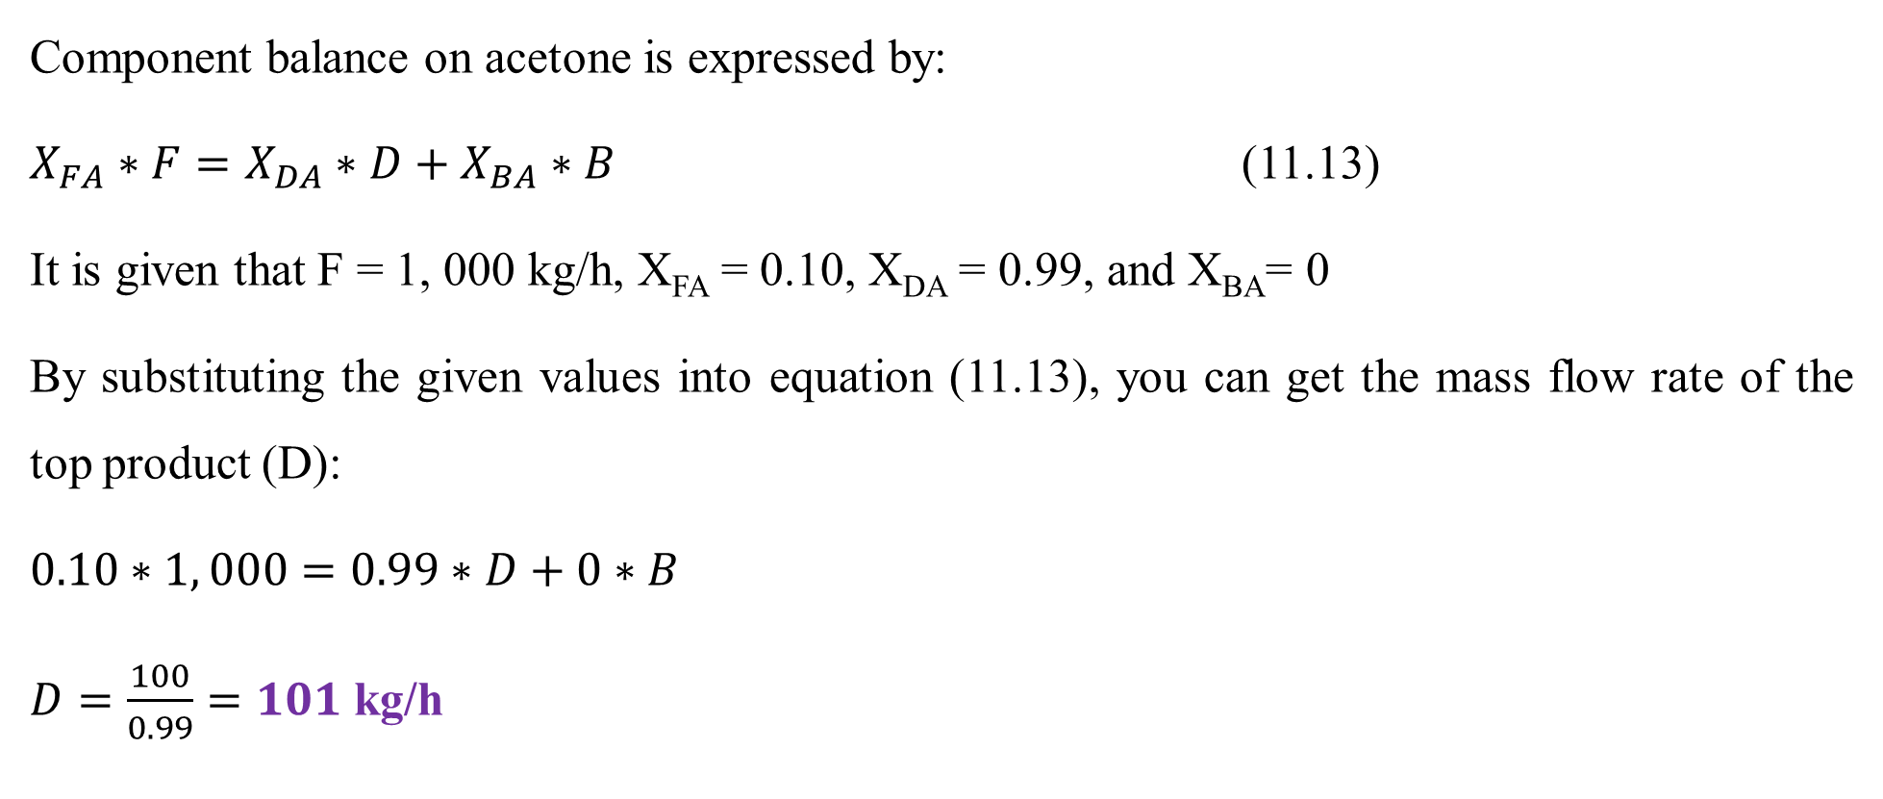
Cont’d
Component balance on acetone is expressed by:
$X_{FA}∗F=X_{DA}∗D+X_{BA}∗B$ (11.13)
It is given that F = 1, 000 kg/h, X_{FA} = 0.10, X_{DA} = 0.99, and X_{BA}= 0
By substituting the given values into equation (11.13), you can get the mass flow rate of the top product (D):
$0.10∗1, 000=0.99∗D+0∗B$
$D=\frac{100}{0.99}=101$ kg/h
27

Slide 28
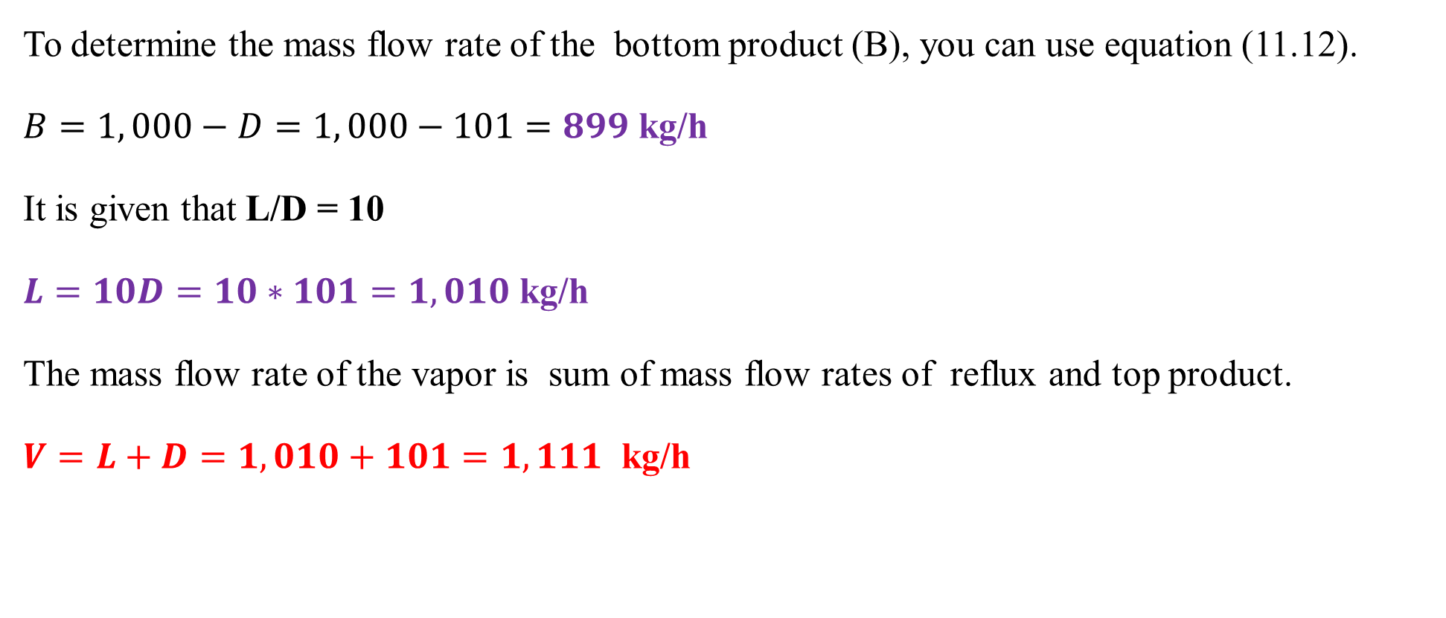
Cont’d
To determine the mass flow rate of the bottom product (B), you can use equation (11.12).
$B=1, 000−D=1, 000−101=899$ kg/h
It is given that L/D = 10
$L=10D=10∗101=1, 010$ kg/h
The mass flow rate of the vapor is sum of mass flow rates of reflux and top product.
$V=L+D=1, 010+101=1, 111$ kg/h
28

Slide 29
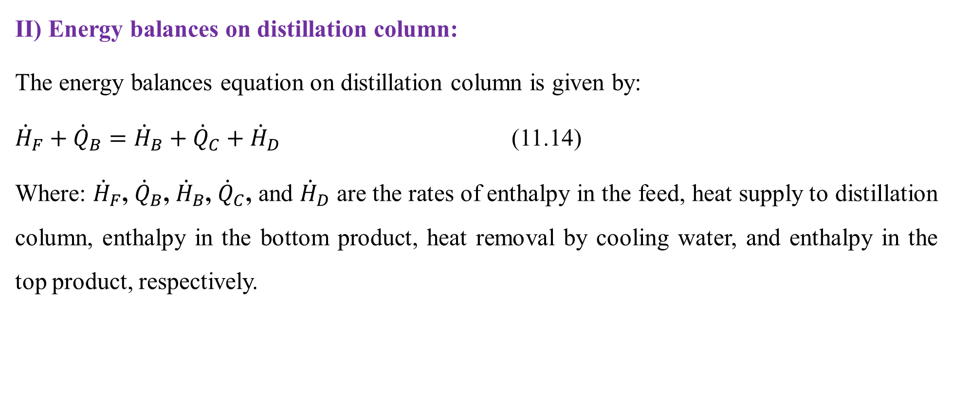
Cont’d
II) Energy balances on distillation column:
The energy balances equation on distillation column is given by:
${\dot{H}}_{F}+{\dot{Q}}_{B}={\dot{H}}_{B}+{\dot{Q}}_{C}+{\dot{H}}_{D}$ (11.14)
Where: ${\dot{H}}_{F}$, ${\dot{Q}}_{B}$, ${\dot{H}}_{B}$, ${\dot{Q}}_{C}$, and ${\dot{H}}_{D}$ are the rates of enthalpy in the feed, heat supply to distillation column, enthalpy in the bottom product, heat removal by cooling water, and enthalpy in the top product, respectively.
29

Slide 30
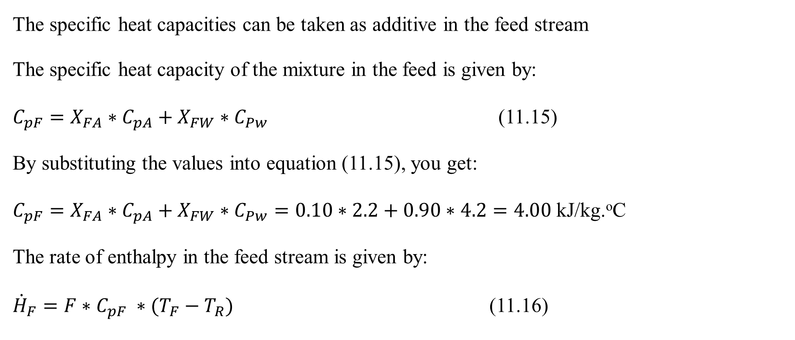
Cont’d
The specific heat capacities can be taken as additive in the feed stream
The specific heat capacity of the mixture in the feed is given by:
$C_{pF}=X_{FA}∗C_{pA}+X_{FW}∗C_{Pw}$ (11.15)
By substituting the values into equation (11.15), you get:
$C_{pF}=X_{FA}∗C_{pA}+X_{FW}∗C_{Pw}=0.10∗2.2+0.90∗4.2=4.00$ kJ/kg.ºC
The rate of enthalpy in the feed stream is given by:
${\dot{H}}_{F}=F∗C_{pF} ∗(T_{F}−T_{R})$ (11.16)
30

Slide 31
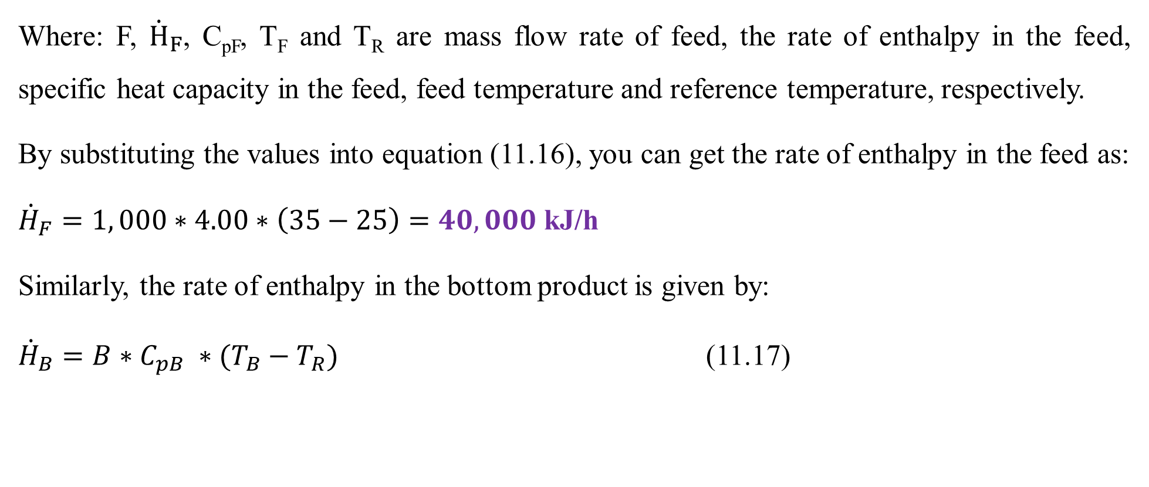
Cont’d
Where: F, ${\dot{H}}_{F}$, C_{pF}, T_{F} and T_{R} are mass flow rate of feed, the rate of enthalpy in the feed, specific heat capacity in the feed, feed temperature and reference temperature, respectively.
By substituting the values into equation (11.16), you can get the rate of enthalpy in the feed as:
${\dot{H}}_{F}=1, 000∗4.00∗\left(35−25\right)=40, 000$ kJ/h
Similarly, the rate of enthalpy in the bottom product is given by:
${\dot{H}}_{B}=B∗C_{pB} ∗(T_{B}−T_{R})$ (11.17)
31

Slide 32
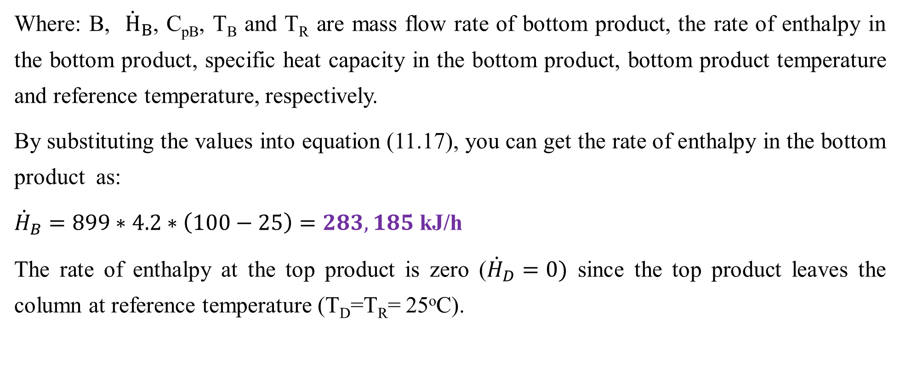
Cont’d
Where: B, ${\dot{H}}_{B}$, C_{pB}, T_{B} and T_{R} are mass flow rate of bottom product, the rate of enthalpy in the bottom product, specific heat capacity in the bottom product, bottom product temperature and reference temperature, respectively.
By substituting the values into equation (11.17), you can get the rate of enthalpy in the bottom product as:
${\dot{H}}_{B}=899∗4.2∗\left(100−25\right)=283,185$ kJ/h
The rate of enthalpy at the top product is zero (${\dot{H}}_{D}=0)$ since the top product leaves the column at reference temperature (T_{D}=T_{R}= 25ºC).
32

Slide 33
Cont’d
The specific latent heat can be taken as additive at the boiling point (56.5°C).
H_{LV}= H_{LA} + H_{LW} (11.18)
Where: H_{LV}, H_{LA}, and H_{LW} are specific latent heats at 56.5°C for vapor, acetone and water respectively.
The value of the specific latent heat at the boiling point is calculated by substituting the values into equation (11.18).
H_{LV}= 0.99*620 + 0.01*2, 500 = 638.8 kJ/ kg
33

Slide 34
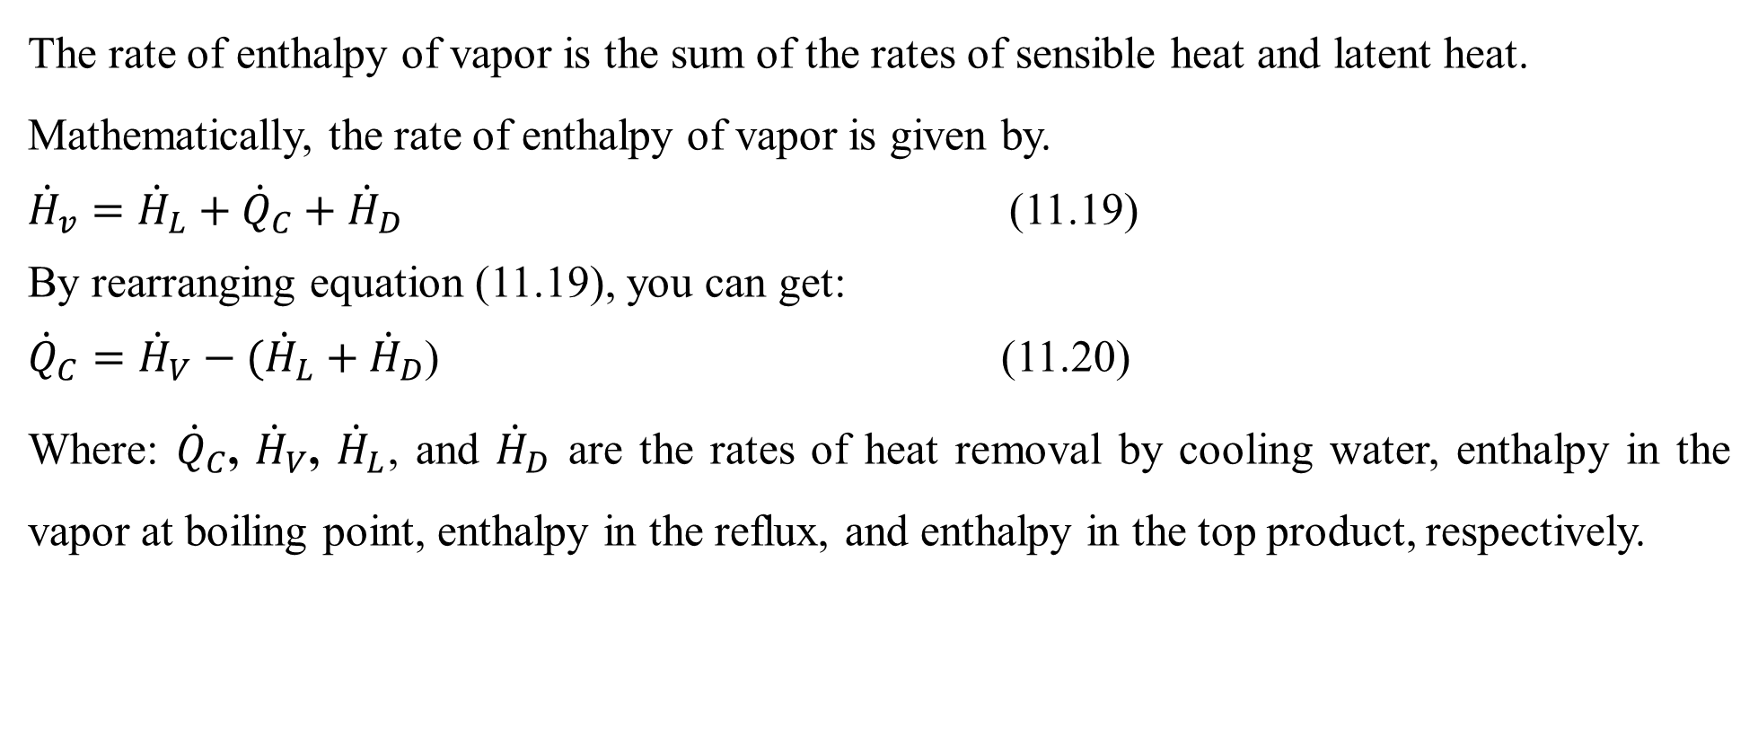
Cont’d
The rate of enthalpy of vapor is the sum of the rates of sensible heat and latent heat.
Mathematically, the rate of enthalpy of vapor is given by.
${\dot{H}}_{v}={\dot{H}}_{L}+{\dot{Q}}_{C}+{\dot{H}}_{D}$ (11.19)
By rearranging equation (11.19), you can get:
${\dot{Q}}_{C}={\dot{H}}_{V}−({\dot{H}}_{L}+{\dot{H}}_{D}$) (11.20)
Where: ${\dot{Q}}_{C}$, ${\dot{H}}_{V}$, ${\dot{H}}_{L}$, and ${\dot{H}}_{D}$ are the rates of heat removal by cooling water, enthalpy in the vapor at boiling point, enthalpy in the reflux, and enthalpy in the top product, respectively.
34

Slide 35
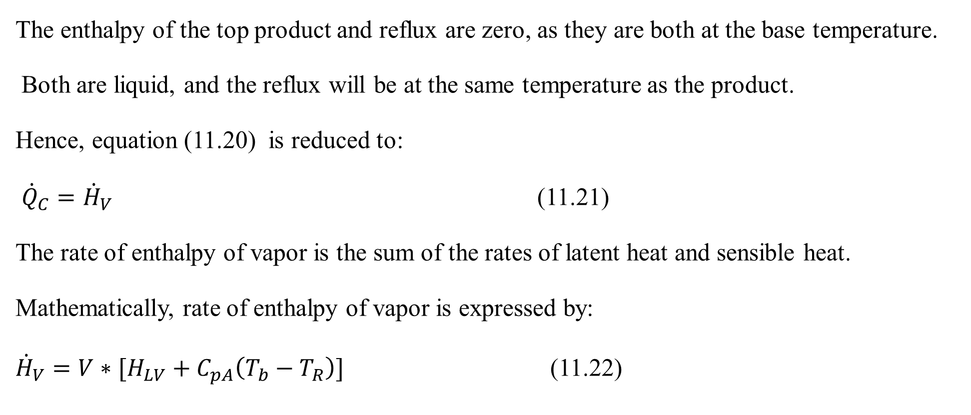
Cont’d
The enthalpy of the top product and reflux are zero, as they are both at the base temperature.
Both are liquid, and the reflux will be at the same temperature as the product.
Hence, equation (11.20) is reduced to:
${\dot{Q}}_{C}={\dot{H}}_{V}$ (11.21)
The rate of enthalpy of vapor is the sum of the rates of latent heat and sensible heat.
Mathematically, rate of enthalpy of vapor is expressed by:
${\dot{H}}_{V}=V∗[H_{LV}+C_{pA}\left(T_{b}−T_{R}\right)]$ (11.22)
35

Slide 36
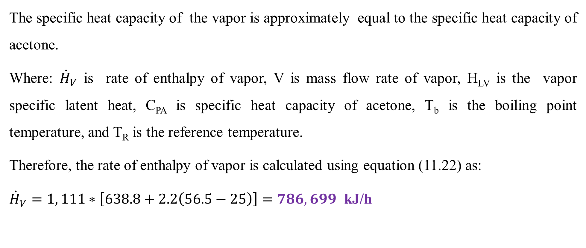
Cont’d
The specific heat capacity of the vapor is approximately equal to the specific heat capacity of acetone.
Where: ${\dot{H}}_{V}$ is rate of enthalpy of vapor, V is mass flow rate of vapor, H_{LV} is the vapor specific latent heat, C_{PA} is specific heat capacity of acetone, T_{b} is the boiling point temperature, and T_{R} is the reference temperature.
Therefore, the rate of enthalpy of vapor is calculated using equation (11.22) as:
${\dot{H}}_{V}=1, 111∗\left[638.8+2.2\left(56.5−25\right)\right]=786, 699$ kJ/h
36

Slide 37
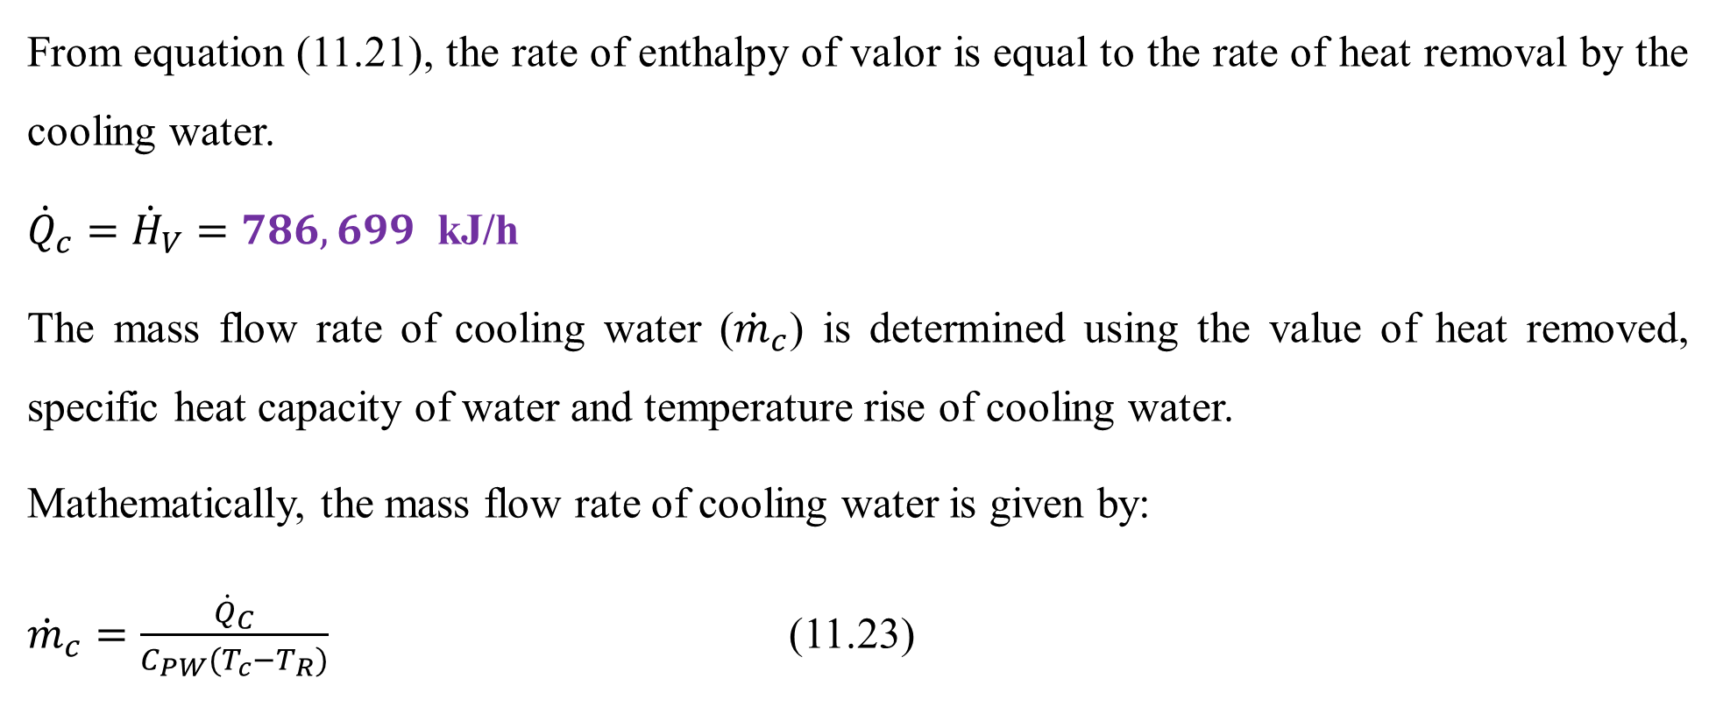
Cont’d
From equation (11.21), the rate of enthalpy of valor is equal to the rate of heat removal by the cooling water.
${\dot{Q}}_{c}={\dot{H}}_{V}=786, 699$ kJ/h
The mass flow rate of cooling water (${\dot{m}}_{c}$) is determined using the value of heat removed, specific heat capacity of water and temperature rise of cooling water.
Mathematically, the mass flow rate of cooling water is given by:
${\dot{m}}_{c}=\frac{{\dot{Q}}_{C}}{C_{PW}(T_{c}−T_{R})}$ (11.23)
37

Slide 38
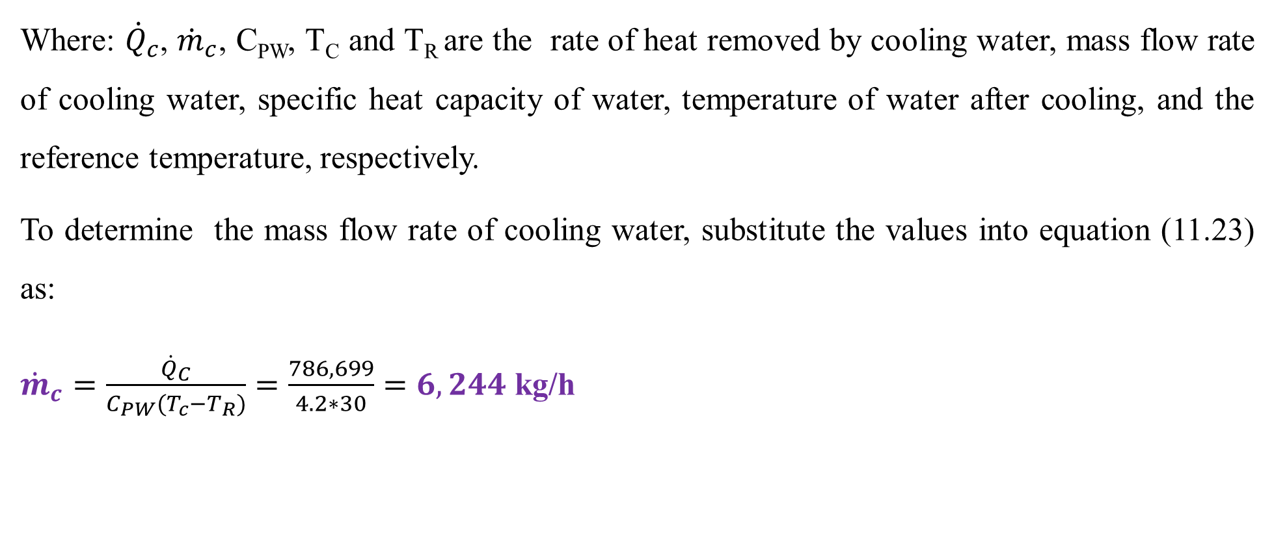
Cont’d
Where: ${\dot{Q}}_{c}$, ${\dot{m}}_{c}$, C_{PW}, T_{C} and T_{R} are the rate of heat removed by cooling water, mass flow rate of cooling water, specific heat capacity of water, temperature of water after cooling, and the reference temperature, respectively.
To determine the mass flow rate of cooling water, substitute the values into equation (11.23) as:
${\dot{m}}_{c}=\frac{{\dot{Q}}_{C}}{C_{PW}(T_{c}−T_{R})}=\frac{786, 699}{4.2∗30}=6, 244$ kg/h
38

Slide 39
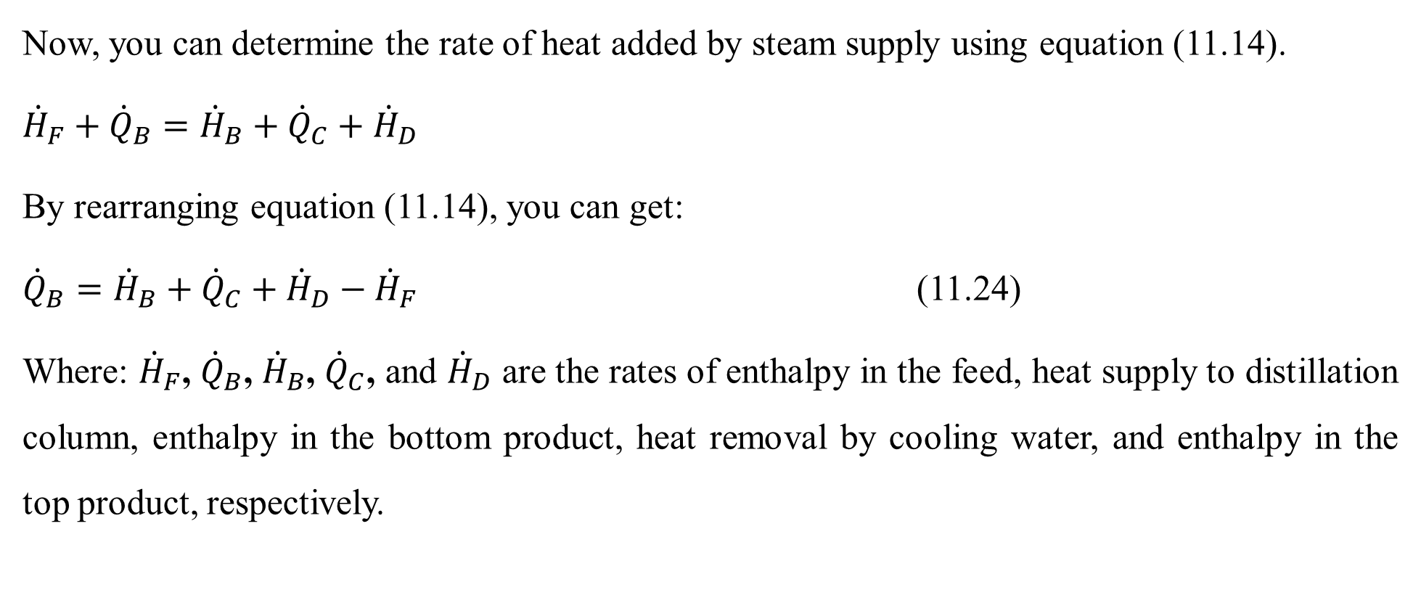
Cont’d
Now, you can determine the rate of heat added by steam supply using equation (11.14).
${\dot{H}}_{F}+{\dot{Q}}_{B}={\dot{H}}_{B}+{\dot{Q}}_{C}+{\dot{H}}_{D}$
By rearranging equation (11.14), you can get:
${\dot{Q}}_{B}={\dot{H}}_{B}+{\dot{Q}}_{C}+{\dot{H}}_{D}−{\dot{H}}_{F}$ (11.24)
Where: ${\dot{H}}_{F}$, ${\dot{Q}}_{B}$, ${\dot{H}}_{B}$, ${\dot{Q}}_{C}$, and ${\dot{H}}_{D}$ are the rates of enthalpy in the feed, heat supply to distillation column, enthalpy in the bottom product, heat removal by cooling water, and enthalpy in the top product, respectively.
39

Slide 40
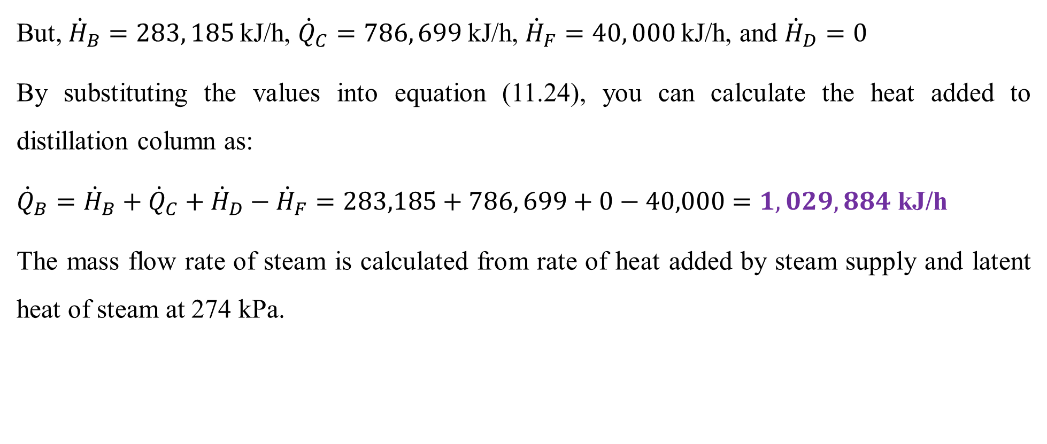
Cont’d
But, ${\dot{H}}_{B}=283, 185$kJ/h, ${\dot{Q}}_{C}=786, 699$kJ/h, ${\dot{H}}_{F}=40, 000$kJ/h, and ${\dot{H}}_{D}=0$
By substituting the values into equation (11.24), you can calculate the heat added to distillation column as:
${\dot{Q}}_{B}={\dot{H}}_{B}+{\dot{Q}}_{C}+{\dot{H}}_{D}−{\dot{H}}_{F}=283,185+786, 699+0−40,000=1,029, 884$ kJ/h
The mass flow rate of steam is calculated from rate of heat added by steam supply and latent heat of steam at 274 kPa.
40

Slide 41
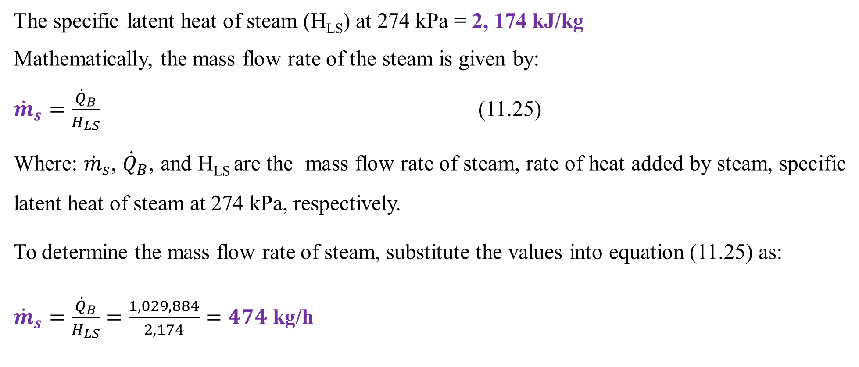
Cont’d
The specific latent heat of steam (H_{LS}) at 274 kPa = 2, 174 kJ/kg
Mathematically, the mass flow rate of the steam is given by:
${\dot{m}}_{s}=\frac{{\dot{Q}}_{B}}{H_{LS}}$ (11.25)
Where: ${\dot{m}}_{s}$, ${\dot{Q}}_{B}$, and H_{LS} are the mass flow rate of steam, rate of heat added by steam, specific latent heat of steam at 274 kPa, respectively.
To determine the mass flow rate of steam, substitute the values into equation (11.25) as:
${\dot{m}}_{s}=\frac{{\dot{Q}}_{B}}{H_{LS}}=\frac{1, 029, 884}{2, 174}=474$ kg/h
41

Slide 42
11.3. Integrated material and energy balances with reaction
In the presence of chemical reaction, the material balances are performed with moles basis to account the rates of generation/consumption of species involve in a chemical reaction (Richard M. Felder, 2005, pg. 119).
For a reactive system, the temperature of the reacting mixture can vary inside the reactor due to heat generation from exothermic reactions or absorption of heat from external source for endothermic reactions.
The integrated material and energy balances for a reactive system takes into account the rate of generation of products /consumption of reactants, heat generated by the exothermic reactions, or heat absorbed by endothermic reactions.
42

Slide 43



Cont’d
To develop integrated material and energy balance equations for a single system with chemical reaction is shown in Figure 11.3.
$${\dot{W}}_{s}$$
Reactor
H_{io}
T_{o}
F_{io}
H_{i}
T
$F$_{i}
$$\dot{Q}$$
Figure 11.3 Integrated material and energy balances for a single system with chemical reaction
43

Slide 44
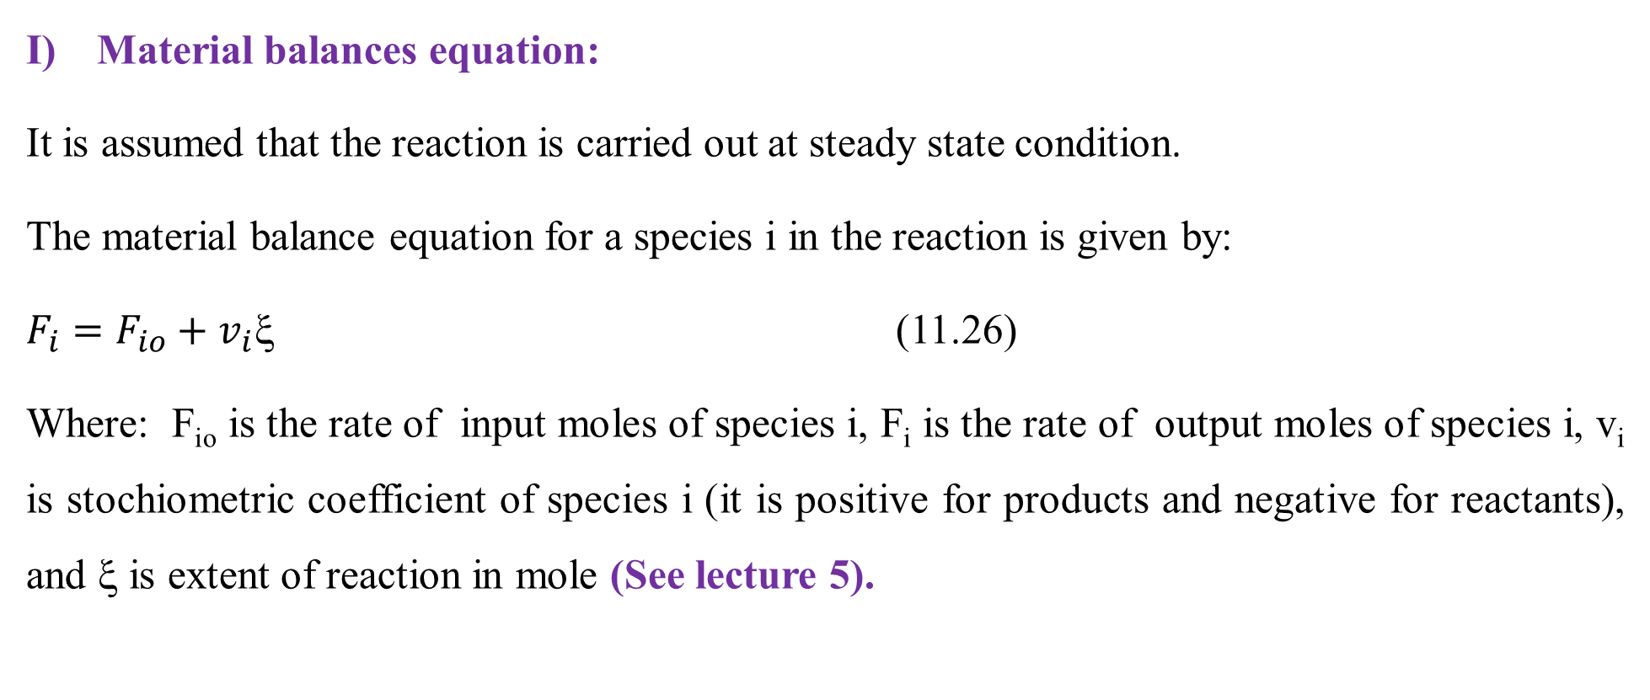
Cont’d
Material balances equation:
It is assumed that the reaction is carried out at steady state condition.
The material balance equation for a species i in the reaction is given by:
$F_{i}=F_{io}+v_{i}$ (11.26)
Where: F_{io} is the rate of input moles of species i, F_{i} is the rate of output moles of species i, v_{i} is stochiometric coefficient of species i (it is positive for products and negative for reactants), and ξ is extent of reaction in mole (See lecture 5).
44

Slide 45
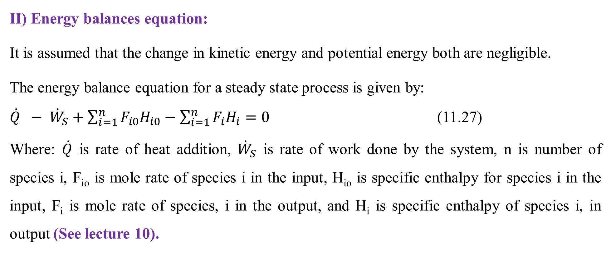
Cont’d
II) Energy balances equation:
It is assumed that the change in kinetic energy and potential energy both are negligible.
The energy balance equation for a steady state process is given by:
$\dot{Q} − {\dot{W}}_{S}+\sum_{i=1}^{n}{F_{i0}H_{i0}}−\sum_{i=1}^{n}{F_{i}H_{i}=0}$ (11.27)
Where: $\dot{Q}$ is rate of heat addition, ${\dot{W}}_{S}$ is rate of work done by the system, n is number of species i, F_{io} is mole rate of species i in the input, H_{io} is specific enthalpy for species i in the input, F_{i} is mole rate of species, i in the output, and H_{i} is specific enthalpy of species i, in output (See lecture 10).
45

Slide 46
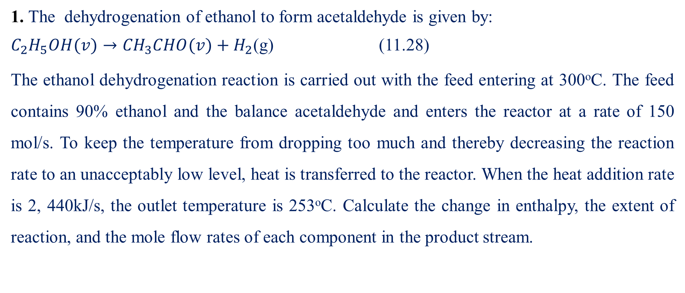
Activity 11.2
1. The dehydrogenation of ethanol to form acetaldehyde is given by:
$C_{2}H_{5}OH(v)→{CH}_{3}CHO(v)+H_{2}$(g) (11.28)
The ethanol dehydrogenation reaction is carried out with the feed entering at 300ºC. The feed contains 90% ethanol and the balance acetaldehyde and enters the reactor at a rate of 150 mol/s. To keep the temperature from dropping too much and thereby decreasing the reaction rate to an unacceptably low level, heat is transferred to the reactor. When the heat addition rate is 2, 440kJ/s, the outlet temperature is 253ºC. Calculate the change in enthalpy, the extent of reaction, and the mole flow rates of each component in the product stream.
46

Slide 47
Cont’d
Additional data:
Input stream: The specific enthalpy of ethanol (H_{1F}) at 300ºC = -212. 19 kJ/mol, and the specific enthalpy of acetaldehyde (H_{2F}) at 300ºC = -147. 07 kJ/mol.
Output stream: The specific enthalpy of ethanol (H_{1P}) at 253ºC = -216. 81 kJ/mol, the specific enthalpy of acetaldehyde (H_{2P}) at 253ºC = -150. 90 kJ/mol, and the specific enthalpy of hydrogen molecule (H_{3P}) at 253ºC = 6.595 kJ/mol.
(Richard M. Felder, 2005, pg. 458-460).
47

Slide 48
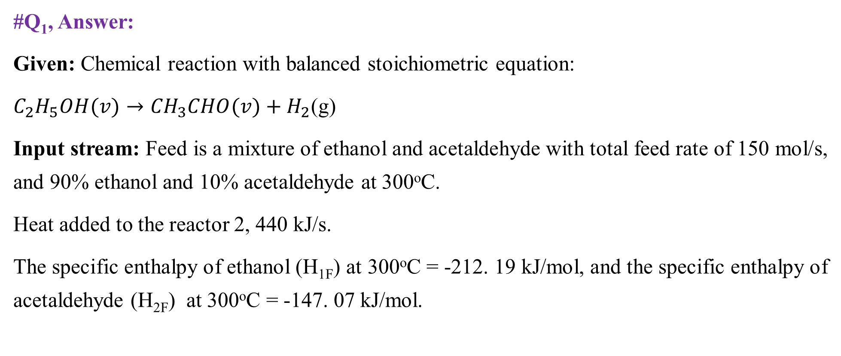
Cont’d
#Q₁, Answer:
Given: Chemical reaction with balanced stoichiometric equation:
$C_{2}H_{5}OH(v)→{CH}_{3}CHO(v)+H_{2}$(g)
Input stream: Feed is a mixture of ethanol and acetaldehyde with total feed rate of 150 mol/s, and 90% ethanol and 10% acetaldehyde at 300ºC.
Heat added to the reactor 2, 440 kJ/s.
The specific enthalpy of ethanol (H_{1F}) at 300ºC = -212. 19 kJ/mol, and the specific enthalpy of acetaldehyde (H_{2F}) at 300ºC = -147. 07 kJ/mol.
48

Slide 49
Cont’d
Output stream: The outlet temperature is 253ºC.
The specific enthalpy of ethanol (H_{1p}) at 253ºC = -216. 81 kJ/mol, the specific enthalpy of acetaldehyde (H_{2p}) at 253ºC = -150. 90 kJ/mol, and the specific enthalpy of hydrogen molecule (H_{3p}) at 253ºC = 6.595 kJ/mol.
Required: Calculate the rate of change in enthalpy, the extent of reaction, and the mole flow rates of each component in the product stream.
49

Slide 50
Cont’d
Assumptions:
The reaction process is carried out at steady state condition.
It is assumed that the rates of change in enthalpy and heat addition to the reactor have the highest effect on the reaction as compared to the rates of change in kinetic energy, change in potential energy, and work done by the system.
Hence, the rates of the change in kinetic energy, potential energy, and work done by the system are neglected.
50

Slide 51
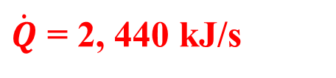
Cont’d
The process flow diagram of integrated material and energy balances on the reactor is shown in Figure 11.4.
H_{1F}= -212.19 kJ/mol
H_{2F}= -147.07 kJ/mol
T_{F} = 300ºC
F_{F} =150 mol/s
X_{1F}= 0.90
X_{2F}= 0.10
Reactor
H_{1p}= -216.81 kJ/mol
H_{2p}= -150.90 kJ/mol
H_{3p}= 6.595 kJ/mol
T_{p} = 253ºC
F_{p} = F_{1p} + F_{2p} + F_{3p}
$\dot{Q}$ = 2, 440 kJ/s
Figure 11.4 Integrated material and energy balances on the reactor
51

Slide 52
Cont’d
Where: The subscripts “1, 2 and 3” refer to ethanol, acetaldehyde, and hydrogen molecule, respectively.
The subscripts “F & p” refer to the feed stream and product stream, respectively.
F_{F} and F_{P} are the mole flow rates for feed stream and product stream, respectively.
T_{F} and T_{p} are feed stream temperature and product stream temperature, respectively.
H_{F} and H_{p} are specific enthalpy in the feed stream and product stream, respectively.
52

Slide 53
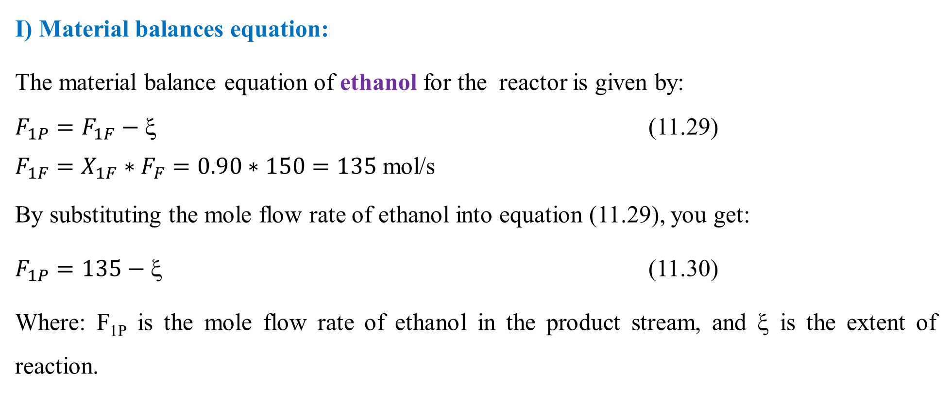
Cont’d
I) Material balances equation:
The material balance equation of ethanol for the reactor is given by:
$F_{1P}=F_{1F}−\text{ξ }$ (11.29)
$F_{1F}=X_{1F}∗F_{F}=0.90∗150=135$ mol/s
By substituting the mole flow rate of ethanol into equation (11.29), you get:
$F_{1P}=135−\text{ξ}$ (11.30)
Where: F_{1P} is the mole flow rate of ethanol in the product stream, and ξ is the extent of reaction.
53

Slide 54
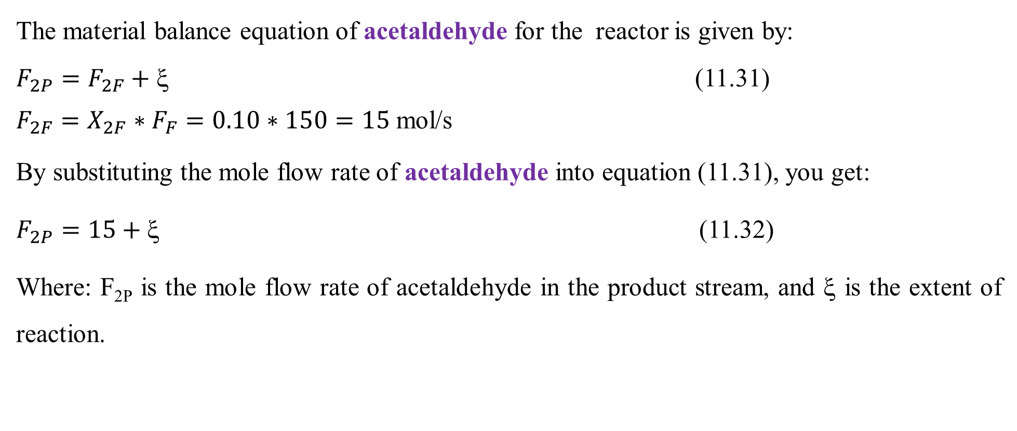
Cont’d
The material balance equation of acetaldehyde for the reactor is given by:
$F_{2P}=F_{2F}+\text{ξ }$ (11.31)
$F_{2F}=X_{2F}∗F_{F}=0.10∗150=15$ mol/s
By substituting the mole flow rate of acetaldehyde into equation (11.31), you get:
$F_{2P}=15+\text{ξ}$ (11.32)
Where: F_{2P} is the mole flow rate of acetaldehyde in the product stream, and ξ is the extent of reaction.
54

Slide 55
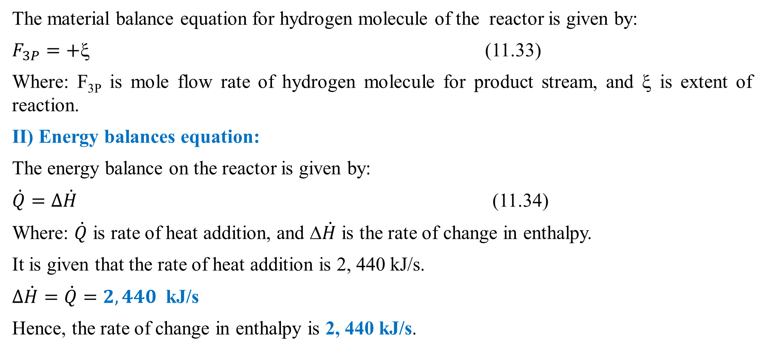
Cont’d
The material balance equation for hydrogen molecule of the reactor is given by:
$F_{3P}=+\text{ξ }$ (11.33)
Where: F_{3P} is mole flow rate of hydrogen molecule for product stream, and ξ is extent of reaction.
II) Energy balances equation:
The energy balance on the reactor is given by:
$\dot{Q}=∆\dot{H}$ (11.34)
Where: $\dot{Q}$ is rate of heat addition, and Δ$\dot{H}$ is the rate of change in enthalpy.
It is given that the rate of heat addition is 2, 440 kJ/s.
$∆\dot{H}=\dot{Q}=2, 440$ kJ/s
Hence, the rate of change in enthalpy is 2, 440 kJ/s.
55

Slide 56
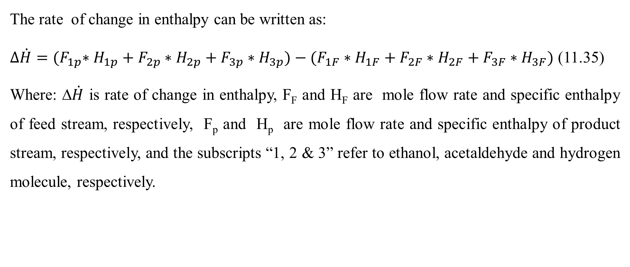
Cont’d
The rate of change in enthalpy can be written as:
$∆\dot{H}={(F}_{1p}∗H_{1p}+F_{2p}∗H_{2p}+F_{3p}∗H_{3p})−(F_{1F}∗H_{1F}+F_{2F}∗H_{2F}+F_{3F}∗H_{3F})$ (11.35)
Where: Δ$\dot{H}$ is rate of change in enthalpy, F_{F} and H_{F} are mole flow rate and specific enthalpy of feed stream, respectively, F_{p} and H_{p} are mole flow rate and specific enthalpy of product stream, respectively, and the subscripts “1, 2 & 3” refer to ethanol, acetaldehyde and hydrogen molecule, respectively.
56

Slide 57
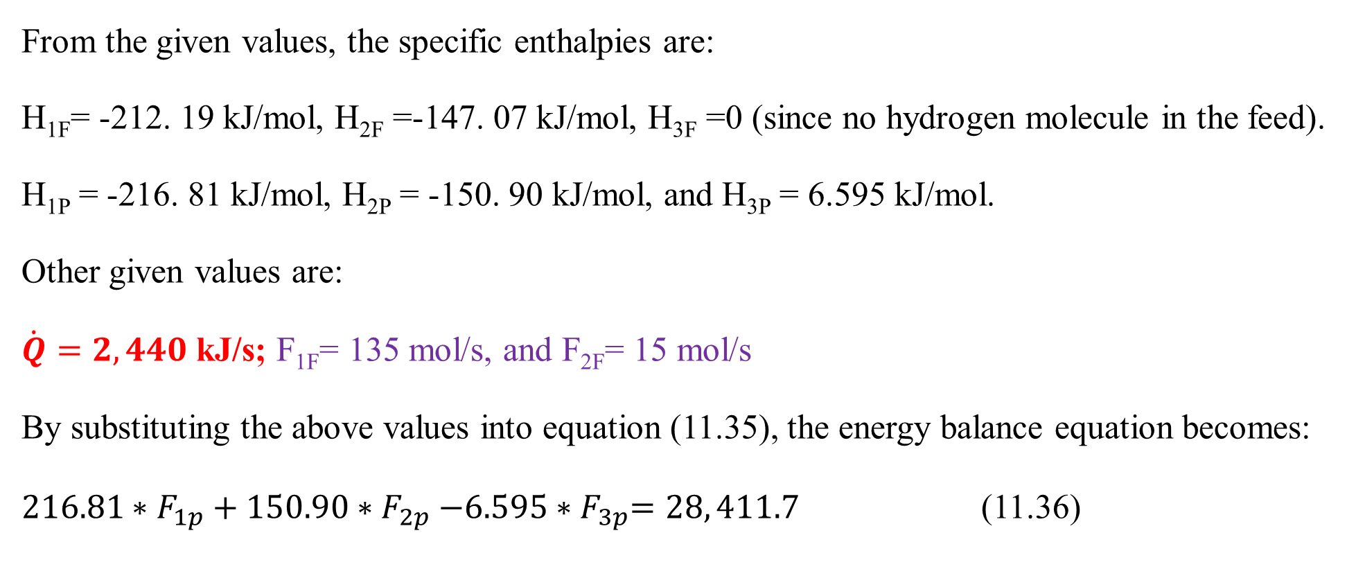
Cont’d
From the given values, the specific enthalpies are:
H_{1F}= -212. 19 kJ/mol, H_{2F} =-147. 07 kJ/mol, H_{3F} =0 (since no hydrogen molecule in the feed).
H_{1P} = -216. 81 kJ/mol, H_{2P} = -150. 90 kJ/mol, and H_{3P} = 6.595 kJ/mol.
Other given values are:
$\dot{Q}=2, 440$ kJ/s; F_{1F}= 135 mol/s, and F_{2F}= 15 mol/s
By substituting the above values into equation (11.35), the energy balance equation becomes:
${216.81∗F}_{1p}+150.90{∗F}_{2p}−6.595{∗F}_{3p}=28, 411.7$ (11.36)
57

Slide 58
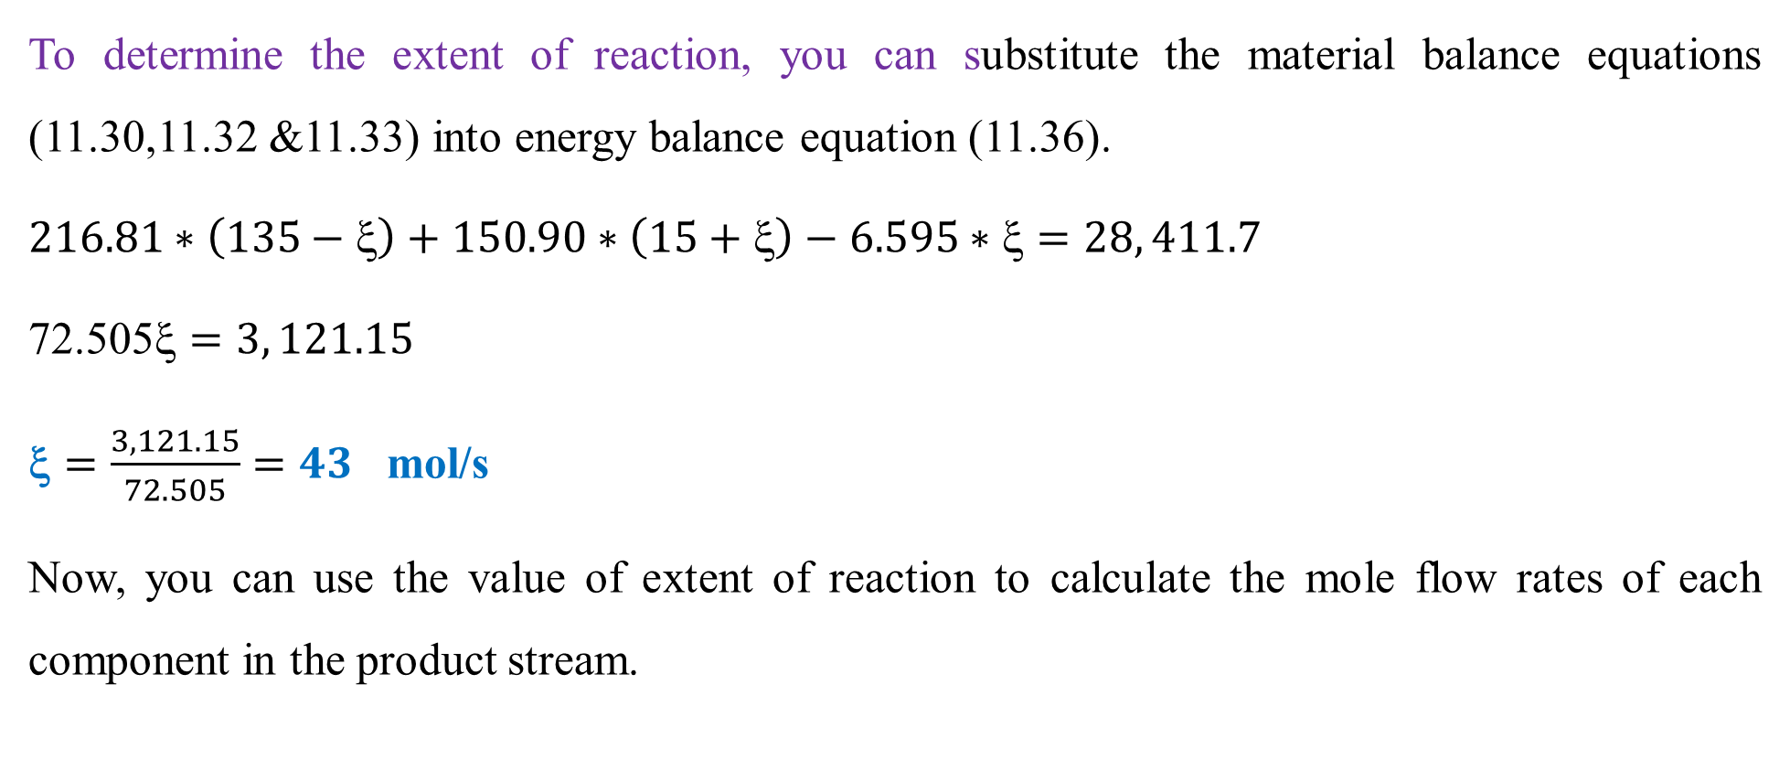
Cont’d
To determine the extent of reaction, you can substitute the material balance equations (11.30,11.32 &11.33) into energy balance equation (11.36).
$216.81∗\left(135−\text{ξ}\right)+150.90∗\left(15+\text{ξ}\right)−6.595∗\text{ξ}=28, 411.7$
$\text{72.505}\text{ξ}=3, 121.15$
$\text{}=\frac{3, 121.15}{72.505}=43$ mol/s
Now, you can use the value of extent of reaction to calculate the mole flow rates of each component in the product stream.
58

Slide 59
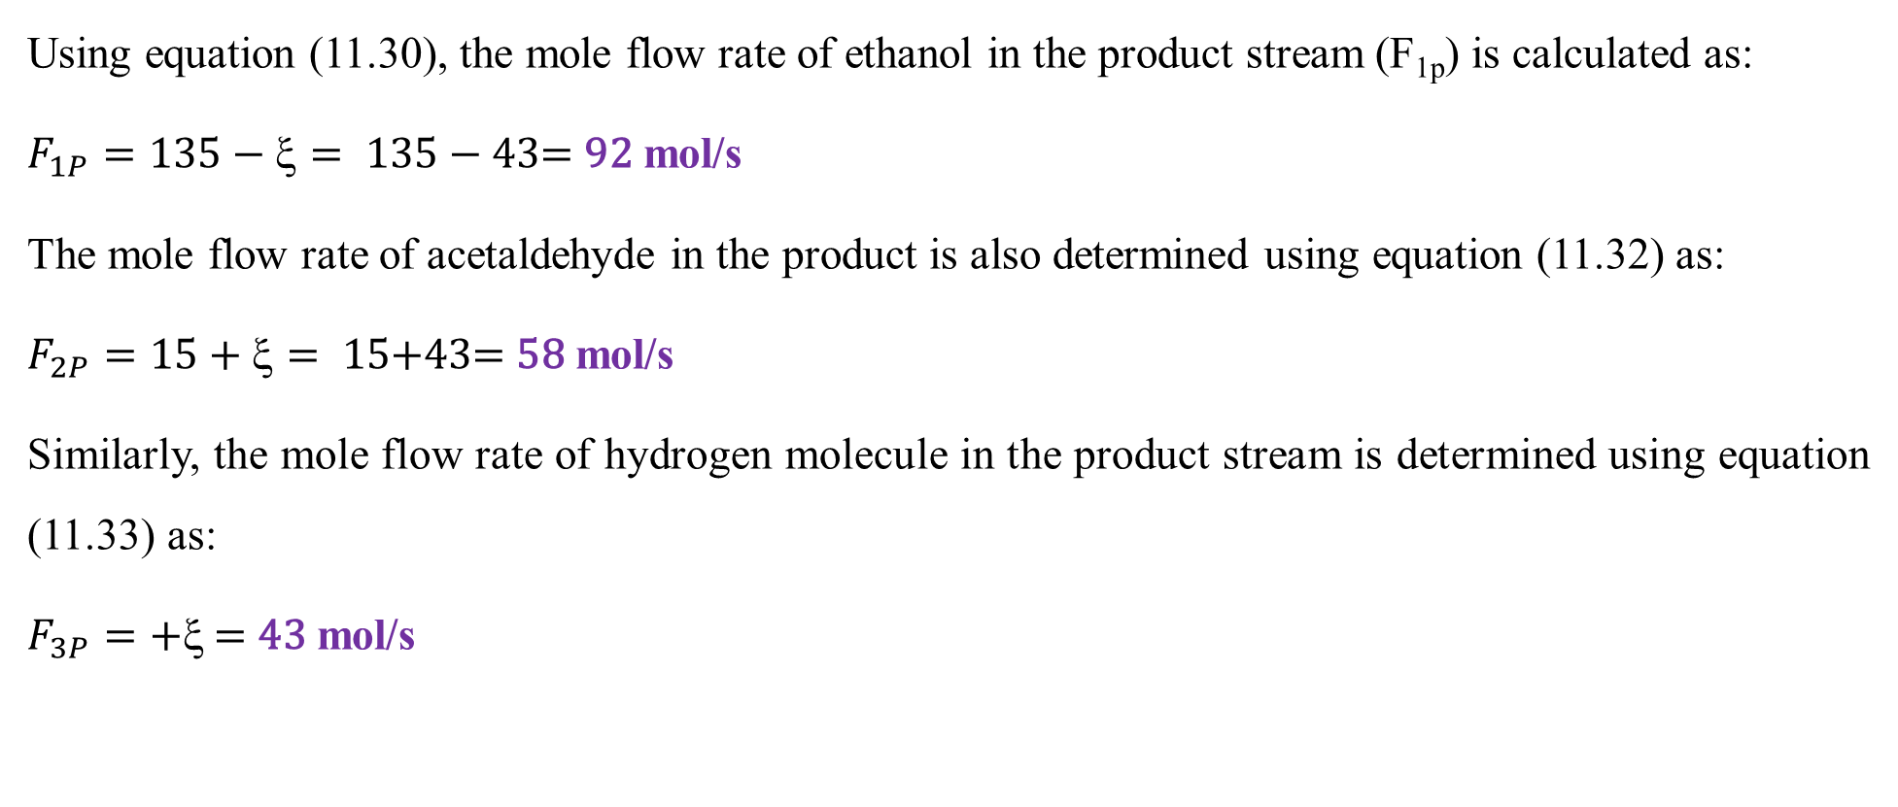
Cont’d
Using equation (11.30), the mole flow rate of ethanol in the product stream (F_{1p}) is calculated as:
$F_{1P}=135−ξ= 135−\text{43}\text{= }\text{92}$ mol/s
The mole flow rate of acetaldehyde in the product is also determined using equation (11.32) as:
$F_{2P}=15+ξ= 15\text{+}\text{43}\text{= }\text{58}$ mol/s
Similarly, the mole flow rate of hydrogen molecule in the product stream is determined using equation (11.33) as:
$F_{3P}=+ξ \text{= }\text{43}$ mol/s
59

Slide 60
11.4. Summary
Integrated material and energy balances without chemical reaction can be determined using mass unit since there is no rate of generation of products/ consumption of reactants.
Integrated material and energy balances with chemical reaction shall account account the rate of generation/consumption of species in mole unit, and heat generation by exothermic reactions/ heat absorption by endothermic reactions.
Integrated material and energy balances are used to analyze process efficiency, determine yield, optimize resource usage, identify potential areas for improvement or modification in process design, and minimize environmental impact.
60

Slide 61
References
Basic Principles and Calculations in Chemical Engineering, Himmelblau, Pearson Education Inc, 9th edition, 2023.
Chemical Engineering Design, Volume 6, Coulson & Richardson’s, R. K. Sinnott, 3rd edition, 1999.
Elementary Principles of Chemical Processes, Richard M. Felder, John Wiley & Sons, 3rd edition, 2005.
Thank you!
61

