Slide 1


Wira Wacana Christian University of Sumba
STATISTICS AND PROBABILITY
Week 1 – Introduction to Statistics and Probability:
Definition, Scope, and Applications in Information Systems
Alfrian Carmen Talakua
Department of Information Systems
2026

Slide 2
Wira Wacana Christian University of Sumba
COURSE OVERVIEW
  Introduction to statistical thinking
  Understanding data and uncertainty
  Basic concepts of probability
  Applications in information systems

Slide 3
Wira Wacana Christian University of Sumba
LEARNING OBJECTIVES
After this lecture, students should be able to:
  Explain the concept of statistics
  Understand the importance of statistics
  Describe the scope of statistics
  Explain applications in information systems

Slide 4
Wira Wacana Christian University of Sumba
LECTURE OUTLINE
Today's lecture will cover:
  Definition of statistics
  Scope of statistics
  Statistics in information systems
  Relationship between statistics and probability

Slide 5


Wira Wacana Christian University of Sumba
WHAT IS STATISTICS?
Collecting data
“Recommendations for Decision Making”
organizing data
Analyzing data
Interpreting data

Slide 6
Wira Wacana Christian University of Sumba
WHY IS STATISTICS IMPORTANT?
Statistics helps us to:
• Understand complex data
• Identify patterns and trends
• Make informed decisions
• Support research and innovation

Slide 7
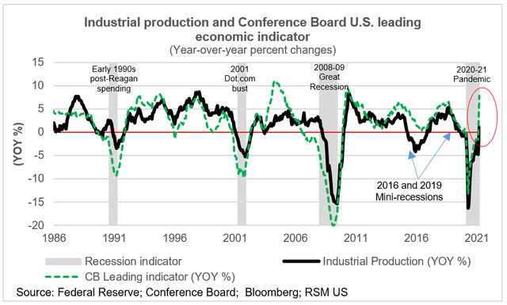
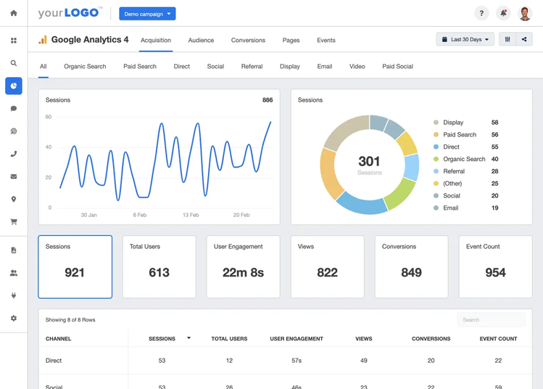
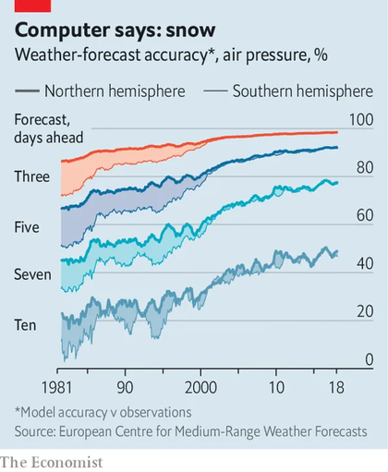
Wira Wacana Christian University of Sumba
APPLICATIONS OF STATISTICS
Statistics is used in many areas such as:
Economic indicators
Data analysis in information systems
Source : https://www.toprankindonesia.com/
Weather forecasting

Slide 8
Wira Wacana Christian University of Sumba
BRANCHES OF STATISTICS
Statistics consists of two main branches:
Descriptive Statistics:
Techniques used to organize, summarize, and present data in the form of tables, graphs, or summary measures such as the mean and median.
In Information Systems, descriptive statistics are useful for understanding system usage patterns and user behavior.
Source: Anderson, D. R., Sweeney, D. J., & Williams, T. A. (2020). Statistics for Business and Economics.
Inferential Statistics:
Techniques used to draw conclusions or make predictions about a population based on sample data through methods such as parameter estimation and hypothesis testing. In Information Systems, inferential statistics can be used to analyze technology trends or evaluate system performance.
Source: Freedman, D., Pisani, R., & Purves, R. (2017). Statistics.

Slide 9
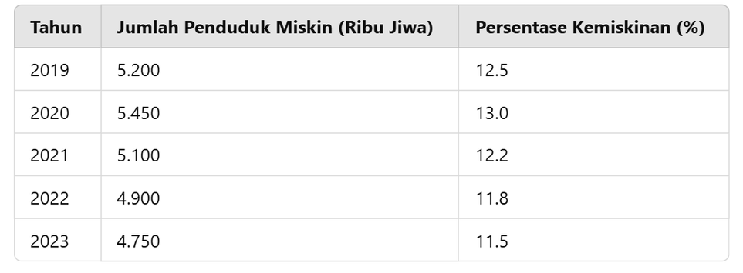


Wira Wacana Christian University of Sumba
DESCRIPTIVE STATISTICS
Descriptive statistics focuses on:
  Summarizing data
  Organizing information
  Presenting data clearly

Slide 10



Wira Wacana Christian University of Sumba
INFERENTIAL STATISTICS
Inferential Statistics
  Draw conclusions from sample data
  Estimate population characteristics
  Test hypotheses
Example
Analyzing a sample of website users to estimate the behavior of all users.
Population
Sample

Slide 11
Wira Wacana Christian University of Sumba
DATA IN STATISTICS
“Data are observations collected from real systems”
Examples:
  number of users
  number of transactions
  response time
Qualitative Data:
Data that are expressed in the form of categories or descriptions, such as the type of device used by users.
(Source: Field, A. (2018). Discovering Statistics Using IBM SPSS Statistics.)
Quantitative Data:
Data that are expressed in numerical form, such as the number of daily logins or system response time.
(Source: Weiss, N. A. (2016). Introductory Statistics.)

Slide 12




Wira Wacana Christian University of Sumba
FROM DATA TO DECISION MAKING
Data
Information
Knowledge
Decision Making

Slide 13


Wira Wacana Christian University of Sumba
UNCERTAINTY IN REAL-WORLD SYSTEMS
Real-world decisions involve uncertainty.
Examples:
Will a user click an advertisement?
Will a customer purchase a product?
Will a system experience failure?.
Statistics analyzes data, but uncertainty still exists

Slide 14

Wira Wacana Christian University of Sumba
PROBABILITY
What is Probability?
Probability is a fundamental concept in statistics used to measure the likelihood that an event will occur. In social data analysis, probability helps in making predictions and supporting data-driven decision making.
(Source: Ross, S. (2019). Introduction to Probability and Statistics for Engineers and Scientists.)
Probability measures the likelihood that an event will occur.
Probability values range from:
0 → impossible
1 → certain

Slide 15
Wira Wacana Christian University of Sumba
PROBABILITY
Probability Values
Probability values range from 0 to 1
  P(A) = 0 → impossible event
  P(A) = 1 → certain event
  0 < P(A) < 1 → possible event
Examples:
  probability of system failure
  probability of user clicking an advertisement

Slide 16
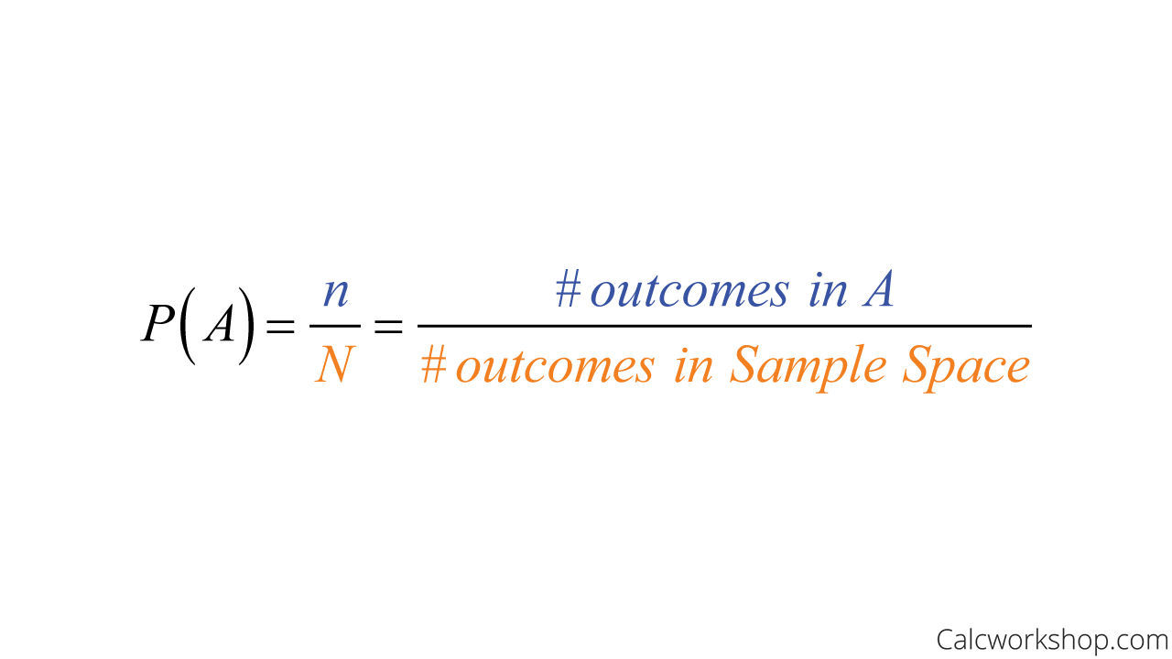
Wira Wacana Christian University of Sumba
PROBABILITY
Probability Formula

Slide 17

Wira Wacana Christian University of Sumba
PROBABILITY
Probability Example
Example: Rolling a die
Possible outcomes:
1, 2, 3, 4, 5, 6
Probability of getting 3
P(3) = 1/6
16,67 %

Slide 18

Wira Wacana Christian University of Sumba
PROBABILITY
Another Probability Example
Example: Drawing a card from a deck
Total cards = 52
Number of hearts = 13
Probability of drawing a heart:
P(heart) = 13 / 52 = 0.25
25 %

Slide 19

Wira Wacana Christian University of Sumba
PROBABILITY
Probability in Digital Systems
Applications of probability in digital systems:
  probability of user clicking an advertisement
  probability of customer purchasing a product
  probability of system failure
  probability of detecting fraudulent transactions

Slide 20
Wira Wacana Christian University of Sumba
RELATIONSHIP
Statistics vs Probability
Statistics and probability are closely related.
Probability
  studies the likelihood of events
  models uncertainty
Statistics
  analyzes data
  identifies patterns and relationships

Slide 21
Wira Wacana Christian University of Sumba
RELATIONSHIP
How Probability Supports Statistic?
Probability provides the theoretical foundation for inferential statistics.
Used in:
  Estimation
  Hypothesis testing
  Prediction

Slide 22
Wira Wacana Christian University of Sumba
RELATIONSHIP
Example: Predicting User Behavior
Example in information systems:
Predicting whether a user will click an advertisement.
  Probability helps estimate the likelihood of user actions.
  Statistics analyzes user data to identify patterns.

Slide 23
Wira Wacana Christian University of Sumba
RELATIONSHIP
Statistical Models and Probability
Many statistical models rely on probability.
Examples:
  Predictive models
  Machine learning algorithms
  Risk analysis models

Slide 24
Wira Wacana Christian University of Sumba
STATISTICS AND PROBABILITY IN MODERN DATA TECHNOLOGIES
Statistics and probability play a fundamental role in modern data technologies.
They are widely used in:
  Data science
  Machine learning
  Artificial intelligence
  Predictive analytics

Slide 25
Wira Wacana Christian University of Sumba
STATISTICS AND PROBABILITY IN MODERN DATA TECHNOLOGIES
Statistics in Data Science
Statistics is used to analyze large datasets.
Common tasks:
  Data exploration
  Identifying patterns
  Data visualization
  Statistical modeling

Slide 26
Wira Wacana Christian University of Sumba
STATISTICS AND PROBABILITY IN MODERN DATA TECHNOLOGIES
Probability in Machine Learning
Machine learning models rely on probability.
Examples:
  Classification models
  Predictive models
  Recommendation systems

Slide 27
Wira Wacana Christian University of Sumba
STATISTICS AND PROBABILITY IN MODERN DATA TECHNOLOGIES
Example: Spam Email Detection
Spam detection systems use probabilistic models.
Example:
  Naïve Bayes classifier
Used to classify emails as:
  spam
  not spam

Slide 28
Wira Wacana Christian University of Sumba
STATISTICS AND PROBABILITY IN MODERN DATA TECHNOLOGIES
Predictive Analytics and AI Systems
Modern intelligent systems combine:
  statistics
  probability
  machine learning/AI
Applications include:
  customer behavior prediction
  recommendation systems
  fraud detection
  image and speech recognition

Slide 29
Wira Wacana Christian University of Sumba
THE BIG PICTURE
Real World
Data
Prediction & Decision
Intelligent Systems
Probability
Statistics
Uncertainty

Slide 30
Wira Wacana Christian University of Sumba
KEY CONCEPTS
Why Statistics and Probability Matter
Statistics and probability are essential for:
  Understanding data
  Modeling uncertainty
  Making predictions
  Supporting intelligent decision making

Slide 31
Wira Wacana Christian University of Sumba
CONCLUSION
Statistics + Probability = Foundation of Modern Data Technologies
Applications include:
  Data science
  Machine learning
  Artificial intelligence

Slide 32
Wira Wacana Christian University of Sumba
DISCUSSION QUESTION
Discussion:
How can statistics and probability improve modern information systems?

Slide 33
Wira Wacana Christian University of Sumba
REFERENCES
James, G., Witten, D., Hastie, T., & Tibshirani, R. — An Introduction to Statistical Learning
Montgomery, D. & Runger, G. — Applied Statistics and Probability for Engineers
Walpole, R. — Probability and Statistics for Engineers and Scientists
Bruce, P., Bruce, A., & Gedeck, P. — Practical Statistics for Data Scientists
McKinney, W. — Python for Data Analysis

Slide 34
Wira Wacana Christian University of Sumba
NEXT WEEK ...
Week 2 :
Data Collection, Presentation, and Processing in the Context of Information Systems
Topics include:
  sources of data in information systems
  methods of data collection
  data processing and data cleaning
  techniques for presenting and visualizing data

Slide 35

Wira Wacana Christian University of Sumba
THANK
YOU
Alfrian Carmen Talakua
Department of Information Systems
e-Mail : Alfriantalakua@unkriswina.ac.id

