Slide 1

Wira Wacana Christian University of Sumba
STATISTICS AND PROBABILITY
Week 2 – Data Collection, Presentation, and Processing in Information Systems
Alfrian Carmen Talakua
Department of Information Systems
2026

Slide 2
Wira Wacana Christian University of Sumba
Learning Objectives
Fundamental Concepts
Data Collection Methods
Effective Presentation
Understand the essential principles of data and information, including their roles in decision-making processes and their implications for various information systems in diverse fields.
Learn about the different data collection techniques and their practical applications, allowing for improved data quality and relevance in supporting informed decision-making processes across organizations.
Master the art of data presentation and visualization, ensuring insights are communicated clearly and effectively to facilitate better understanding and informed decisions in various contexts.

Slide 3
Wira Wacana Christian University of Sumba
Why This Topic Matters ?
  Every system depends on data
  Data drives decisions
  Poor data leads to poor outcome

Slide 4
Wira Wacana Christian University of Sumba
Importance of Data
Key reasons for data significance
Decision-Making Foundation
Organizational Efficiency
Data serves as the foundation for informed decision-making within organizations, enabling leaders to make choices based on insights rather than intuition, resulting in improved outcomes.
Efficient data utilization drives organizational efficiency by streamlining processes, optimizing resource allocation, and fostering competitiveness in the marketplace, ultimately leading to enhanced overall productivity.

Slide 5
Wira Wacana Christian University of Sumba
Fundamental Concepts
Definition of Data
Understanding the Core Concept
Data refers to raw facts and figures that lack context. These unprocessed elements serve as the essential building blocks of information, including numbers, text, dates, and measurements.

Slide 6
Wira Wacana Christian University of Sumba
Definition of Information
Understanding the concept of information
Processed Data
Information is processed and organized data that provides meaning and context. It supports decision-making and holds relevance, ultimately transforming raw data into actionable insights for various applications.

Slide 7
Wira Wacana Christian University of Sumba
Data vs Information
Understanding Data and Information Concepts
Raw vs Processed
Contextual vs Actionable
Data consists of raw facts and figures that lack context, while information is processed and organized data that conveys meaning and supports decision-making in various contexts.
Data without context is not directly useful, whereas information provides actionable insights, enabling individuals and organizations to make informed decisions based on relevant and organized data.

Slide 8
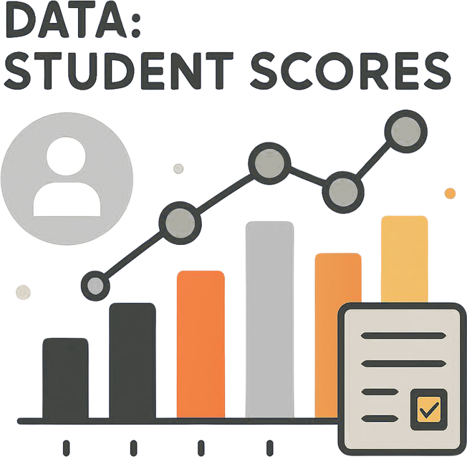
Wira Wacana Christian University of Sumba
Example
Data Student Scores
80, 90, 75, 65, 75, 90,50,65
Information:
Average score : 73,75
Source: Author (created using Canva)

Slide 9
Wira Wacana Christian University of Sumba
Information Systems
Integrated Components and Their Purpose
Key Components
Types of Systems
An information system integrates hardware, software, data, people, and processes to facilitate decision-making, coordination, and control within an organization, ultimately enhancing efficiency and effectiveness.
Information systems include Transaction Processing Systems, Management Information Systems, and Decision Support Systems, each serving unique roles to support various organizational objectives and streamline operations.

Slide 10

Wira Wacana Christian University of Sumba
Data Cycle
Transforming Data into Decisions
Data Collection
Data Processing
Information
Decision Making
The next phase involves cleaning, organizing, and transforming data into a usable format. This stage is crucial for generating meaningful insights that inform decision-making processes.
Gathering raw data is the first step in the cycle, providing the foundational elements necessary for subsequent processing and analysis. It ensures the relevance of information generated.
Finally, insights derived from processed data guide strategic choices. Effective decision-making relies on accurate information, ultimately impacting organizational outcomes and driving future data collection initiatives.
At this stage, the processed data is transformed into easily understandable information, ready to be used to support decisions.

Slide 11
Wira Wacana Christian University of Sumba
Data Collection
Definition of Data Collection
Understanding the Gathering Process
Systematic Gathering
Data collection is the systematic gathering of information from various sources. It provides the foundation for analysis and informed decision-making, ensuring quality significantly affects the entire information system.

Slide 12
Wira Wacana Christian University of Sumba
Importance of Data
Key Reasons for Effective Collection
Accuracy Assurance
Evidence-Based Decisions
Trend Analysis
Accurate data collection ensures the reliability of information, which is critical for informed decision-making. It minimizes errors and enhances the credibility of the outcomes derived from the data.
Collecting data systematically supports evidence-based decision-making within organizations. This approach enables stakeholders to make informed choices that are backed by factual insights rather than assumptions.
Effective data collection facilitates the identification of trends over time, allowing organizations to respond proactively to changes. This capability aids in forecasting future developments and improving strategic planning.

Slide 13
Wira Wacana Christian University of Sumba
Data Collection Methods
Exploring various collection techniques
Manual Input
Transaction Data
Automated Collection
Manual input involves direct user data entry through forms or interfaces, allowing flexibility and human judgment. This method is best suited for qualitative data and unique cases.
Transaction data is generated automatically from user activities within a system, such as purchases, logins, or interactions. It provides real-time, structured, and reliable data for analysis.
Automated data collection utilizes IoT devices and sensors for real-time information capture, ensuring accuracy and continuous monitoring. This method is efficient for large volumes of structured data.

Slide 14
Wira Wacana Christian University of Sumba
Data Collection Methods
Exploring various collection techniques
External Data (API)
Surveys and Interviews
External data is collected from third-party systems through APIs or web services. This method enables system integration and access to up-to-date data such as weather, financial, or government information.
Surveys and interviews are qualitative methods that provide insights into user opinions and behaviors. While time-intensive, they yield rich contextual data that supports effective decision-making.

Slide 15
Wira Wacana Christian University of Sumba
Manual Input
Understanding its advantages and disadvantages
Advantages
Disadvantages
Manual input allows for flexibility and human judgment, making it ideal for complex cases. It facilitates unique data entry like customer feedback that automated systems may overlook.
However, manual input can be time-consuming and prone to errors. Human involvement increases labor costs and may lead to inconsistencies in data collection processes.

Slide 16
Wira Wacana Christian University of Sumba
Automated Data
Leveraging IoT for Real-Time Insights
Continuous Monitoring
Diverse Applications
Automated data collection enables real-time monitoring through various sensors, providing accurate and timely information without human intervention, making it essential for modern information systems and decision-making processes.
IoT sensors are utilized in various sectors, such as health, agriculture, and smart homes, to gather critical data, enhancing operational efficiency and creating impactful insights for stakeholders and organizations.

Slide 17
Wira Wacana Christian University of Sumba
Transaction Data
Understanding Business-Generated Information
High Volume
Structured Format
Transaction data is generated from everyday business operations, including point-of-sale systems, e-commerce platforms, and banking transactions, leading to a high volume of structured information collected automatically.
This data typically includes transaction IDs, timestamps, involved parties, amounts, and item details, ensuring that it is consistently organized for easy retrieval and analysis in information systems.

Slide 18
Wira Wacana Christian University of Sumba
External Data Sources
Utilizing API and Web Resources
Third-Party Data
Open Data
External data can be sourced from third-party providers, which often includes APIs and public datasets. This vast information enhances decision-making capabilities and improves operational insights.
Open data initiatives allow organizations to access government and public datasets, providing real-time information at little or no cost, driving innovation and supporting evidence-based decisions.

Slide 19
Wira Wacana Christian University of Sumba
Qualitative Methods
Understanding Surveys, Interviews, and Observations
Surveys
Interviews
Observation
Surveys consist of structured questionnaires that gather responses from a large group. They are valuable for quantifying opinions and attitudes while providing a broad overview of topics.
Interviews allow for in-depth discussions, offering qualitative insights. This method fosters a deeper understanding of participants' perspectives, emotions, and motivations, though it is time-consuming and biased.
Observation involves monitoring behaviors and processes in real-time. This method provides contextual insights and helps identify patterns, making it effective for qualitative research in various settings.

Slide 20
Wira Wacana Christian University of Sumba
Choosing Methods
Factors for Effective Data Collection
Purpose and Objectives
Available Resources
Clearly defining the purpose and objectives of data collection is essential. This guides the choice of methods, ensuring that the data gathered aligns with the overall goals of the project.
Consideration of available resources, such as time, budget, and personnel, is vital. These factors influence method selection, ensuring that the data collection process remains efficient and effective within constraints.

Slide 21
Wira Wacana Christian University of Sumba
Data Collection Challenges
Common issues in data collection
Privacy Concerns
Data Quality
Protecting sensitive information during collection is crucial. Compliance with regulations like GDPR ensures that data is handled responsibly, safeguarding personal privacy and maintaining trust with stakeholders.
Ensuring accuracy is vital; incomplete or inaccurate data can distort findings, leading to poor decisions. Maintaining high data quality requires consistent checks and validation throughout the collection process.

Slide 22
Wira Wacana Christian University of Sumba
DATA PROCESSING
Definition of Data Processing
Understanding the processing concept
Meaningful Information
Data processing involves converting raw data into meaningful information through various operations, including validation, sorting, summarization, and calculation, serving as a critical step between data collection and presentation.

Slide 23
Wira Wacana Christian University of Sumba
Processing Stages
Steps in Data Processing Workflow
Data Input
Data Validation
Data Cleaning
The initial step involves gathering raw data from various sources, either automated or manual, ensuring it is ready for subsequent processing stages and validation.
In this stage, the gathered data undergoes checks for accuracy and completeness, identifying any discrepancies that need correction to ensure data integrity before further processing.
This crucial step focuses on removing duplicates, handling missing values, and correcting errors, thereby ensuring the data used for analysis is reliable and ready for interpretation.

Slide 24
Wira Wacana Christian University of Sumba
Data Cleaning
Essential Techniques for Accuracy
Remove Duplicates
Handle Missing Values
Identifying and eliminating duplicate records is crucial. This process improves data quality and ensures that analyses are based on unique entries, preventing skewed results and erroneous insights.
Addressing missing data through techniques such as imputation or deletion is vital. This step enhances dataset completeness, ensuring that analyses rely on a robust and representative information foundation.

Slide 25

Wira Wacana Christian University of Sumba
Data Transformation
Converting Data into Usable Formats
Normalization
Aggregation
Normalization is the process of adjusting data to a common scale. This ensures consistency and comparability across datasets, making it easier to analyze and interpret the information effectively.
Aggregation involves summarizing detailed data into a more compact format. This is useful for identifying trends and patterns, allowing for quicker insights and decision-making based on large datasets.

Slide 26
Wira Wacana Christian University of Sumba
Data Analysis
Types and Analytical Tools
Descriptive Analysis
Diagnostic Analysis
Predictive Analysis
Descriptive analysis summarizes data characteristics, such as means and trends, providing insights into historical performance. It's essential for understanding patterns and guiding further inquiries.
Diagnostic analysis explains why certain trends or patterns occur by identifying correlations and causes. This type helps organizations understand underlying factors affecting their data.
Predictive analysis utilizes statistical models and machine learning to forecast future trends based on historical data. This approach aids decision-making by anticipating potential outcomes and scenarios.

Slide 27
Wira Wacana Christian University of Sumba
Data Storage
Options for Information Management
Database Systems
Data Lakes
Database systems like SQL and NoSQL provide structured data storage, enabling efficient querying and data management. They ensure data integrity and support scalability for growing information needs.
Data lakes allow for the storage of large volumes of unstructured data. They provide flexibility for analysis and accommodate diverse data types, making them ideal for big data applications.

Slide 28
Wira Wacana Christian University of Sumba
Data Presentation
Communicating Information Effectively
Purpose of Presentation
Data presentation involves visual and textual representations that make information understandable and actionable, supporting decision-making by effectively communicating insights and bridging the gap between analysis and action.

Slide 29
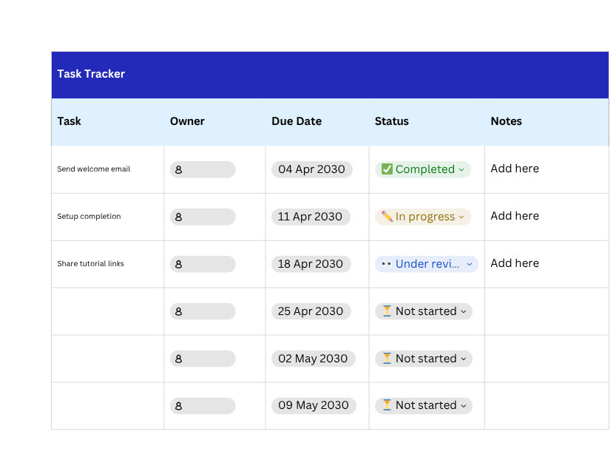
Wira Wacana Christian University of Sumba
Visualization Formats
Effective methods for data presentation
Tables
Tables provide a detailed and structured way to present data, allowing for easy comparison across multiple variables and categories, making them essential for conveying precise information.
Source: Author (created using Canva)

Slide 30
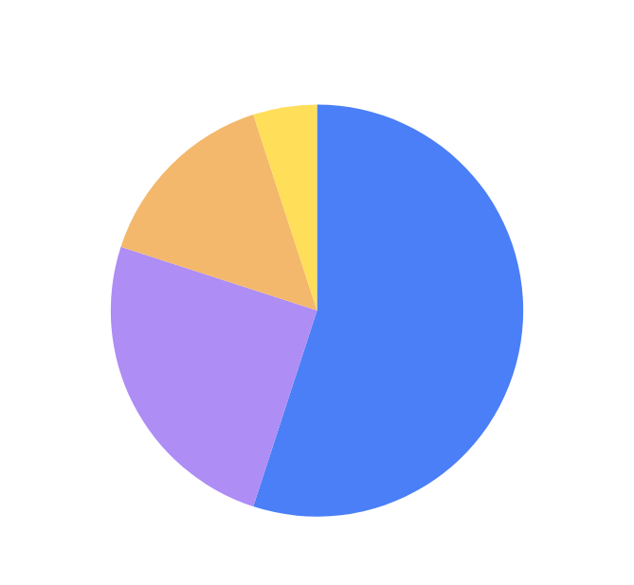
Wira Wacana Christian University of Sumba
Visualization Formats
Effective methods for data presentation
Charts
Charts offer visual summaries of data trends and relationships, enabling audiences to quickly grasp insights through graphical representations such as bar, line, and pie charts, enhancing understanding.
Source: Author (created using Canva)

Slide 31
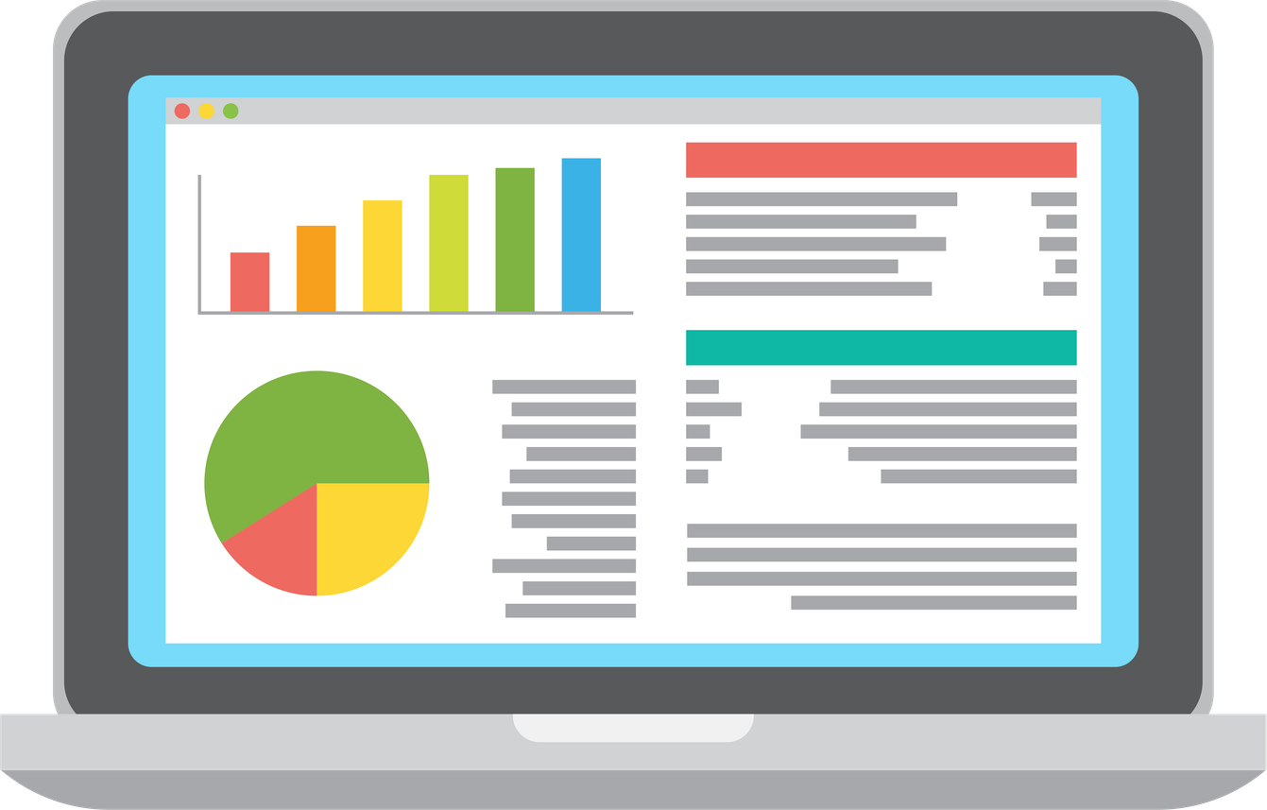
Wira Wacana Christian University of Sumba
Visualization Formats
Effective methods for data presentation
Dashboards
Dashboards consolidate various visual elements into a single interface, providing an interactive overview of key metrics, facilitating real-time monitoring and decision-making while ensuring comprehensive data analysis.
Source: Author (created using Canva)

Slide 32
Wira Wacana Christian University of Sumba
Visualization Principles
Key Guidelines for Effective Presentation
Clarity
Accuracy
Relevance
Visualizations must be simple and straightforward, allowing viewers to quickly understand the presented data, ensuring that information is accessible without unnecessary complexity or confusion.
Maintaining accuracy is critical; visualizations should represent data truthfully without distortion, allowing stakeholders to trust the insights and make informed decisions based on reliable information.
Focus on the audience's needs by providing relevant data and insights; effective visualizations highlight critical information that supports specific decision-making processes and addresses the key issues at hand.

Slide 33
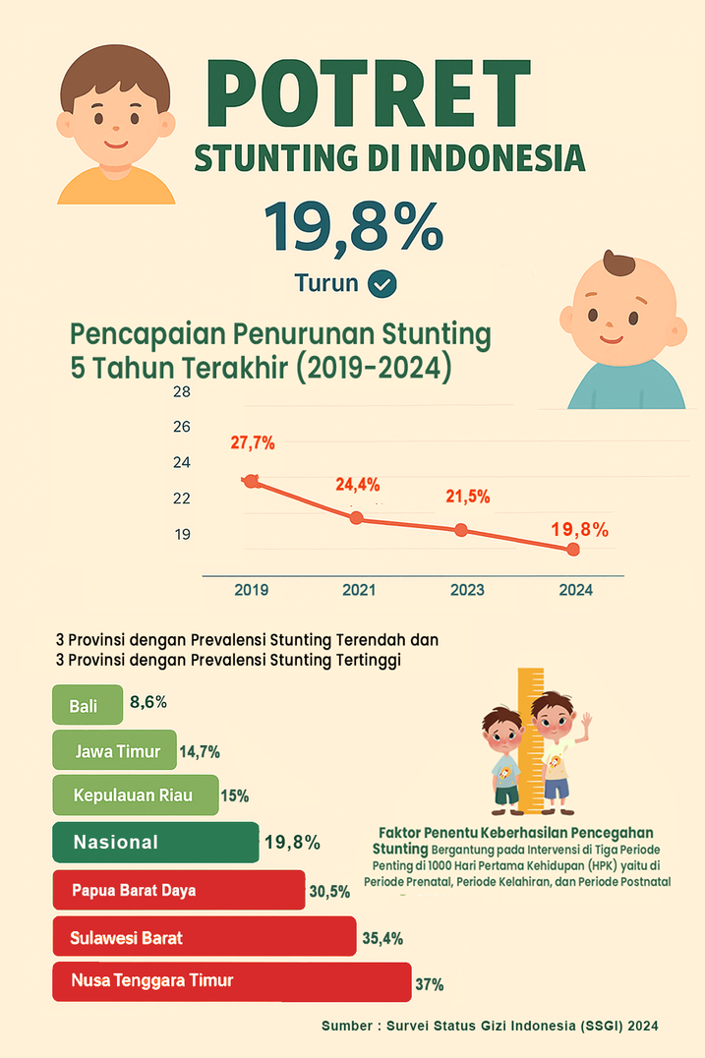
Wira Wacana Christian University of Sumba
Case Study: Stunting in Indonesia
This visualization demonstrates how data collected from child growth monitoring can be processed and presented to support early intervention and informed decision-making in health information systems.
  National stunting rate (2024): 19.8% (decreasing trend)
  Trend (2019–2024): decreasing from 27.7% → 19.8%
  Lowest prevalence:
  Bali (8.6%)
  East Java (14.7%)
  Riau Islands (15%)
4. Highest prevalence:
  West Papua (30.5%)
  West Sulawesi (35.4%)
  East Nusa Tenggara (37%)
5. Key insight:
  Data supports decision-making for targeted interventions
Source : https://www.badankebijakan.kemkes.go.id/en/potret-stunting-di-indonesia/

Slide 34
Wira Wacana Christian University of Sumba
Conclusion
Summary and next steps for learning
Data Foundation
Quality Importance
Continuous Cycle
Data serves as the foundation of information systems, enabling informed decision-making and strategic planning for organizations, fostering enhanced efficiency and competitiveness in a rapidly evolving digital landscape.
Ensuring high-quality data collection is essential for reliable information. The integrity of data directly impacts the effectiveness of processes and insights derived from information systems, guiding better outcomes.
The data-information-decision cycle is continuous; as decisions are made, new data is generated, necessitating ongoing collection, processing, and presentation efforts to adapt to changing environments and needs.

Slide 35
Wira Wacana Christian University of Sumba
References
Turban, E., Pollard, C., & Wood, G. (2018). Information Technology for Management. Wiley.
Laudon, K. C., & Laudon, J. P. (2020). Management Information Systems: Managing the Digital Firm. Pearson.
Han, J., Kamber, M., & Pei, J. (2011). Data Mining: Concepts and Techniques. Elsevier.
Kementerian Kesehatan Republik Indonesia. (2024). Profil Stunting di Indonesia.
World Health Organization. (2023). Child Malnutrition and Stunting Data.

Slide 36

Wira Wacana Christian University of Sumba
Course Assignment
Assignment Instruction
Students are required to choose a real-world case related to health, education, or social issues, collect and analyze relevant data, and create at least one clear data visualization. Students who are interested in improving or discussing their work further are welcome to submit their assignment via email to
[Alfriantalakua@unkriswina.ac.id] Subject : Assignment 1 – Week 2 - ( Your Name ) .
Source: Author (created using Canva)

Slide 37
Wira Wacana Christian University of Sumba
THANK YOU
Contact Information
Reach out for more details or inquiries regarding the course.
Alfrian Carmen Talakua
Department of Information Systems
e-Mail : Alfriantalakua@unkriswina.ac.id

