Slide 1

Wira Wacana Christian University of Sumba
STATISTICS AND PROBABILITY
Week 3 – Measures of Central Tendency and Dispersion (Mean, Median, Mode, Variance, Standard Deviation)
Alfrian Carmen Talakua
Department of Information Systems
2026

Slide 2
Wira Wacana Christian University of Sumba
Learning Objectives:
  Understand mean, median, and mode as measures of central tendency
  Understand data variability using variance and standard deviation
  Apply statistical concepts using Excel
  Interpret results for decision-making

Slide 3
Wira Wacana Christian University of Sumba
From Data Collection to Data Analysis
  Data collected previously needs to be summarized
  Summarization helps reveal patterns and insights
  Statistical measures help us understand the data
  Central tendency shows the typical value
  Dispersion shows how data varies

Slide 4

Wira Wacana Christian University of Sumba
What is Central Tendency?
Defines Data Center
Supports Decision Making
Central tendency provides a single numerical value representing the center of a dataset, simplifying the data for easier interpretation and comparison across different datasets.
Understanding central tendency aids in making informed decisions by identifying typical values, allowing analysts to recognize trends and patterns essential for effective data-driven strategies.
Central tendency helps us identify a “typical” value in a dataset.

Slide 5
Wira Wacana Christian University of Sumba
Types of Central Tendency: Mean, Median, Mode
Mean
The arithmetic average of all data values.
Each measure provides a different perspective depending on the data distribution.
Median
The middle value in an ordered dataset.
Mode
The most frequently occurring value in data.

Slide 6


Wira Wacana Christian University of Sumba
Mean Definition
Understanding Mean
The mean is a fundamental measure of central tendency, representing the average value of a dataset and providing insight into data distribution.

Slide 7


Wira Wacana Christian University of Sumba
Example of Mean
Data : 60, 65, 70, 75, 80
  The average value of the data is 70.
  This means that, in general, the data is centered around the value of 70.

Slide 8


Wira Wacana Christian University of Sumba
Understanding the Median
Importance in Data
The median is crucial as it represents the middle value of an ordered dataset, effectively splitting the data into two equal halves and minimizing the influence of outliers.
formula :
Odd Data
Even Data

Slide 9


Wira Wacana Christian University of Sumba
Example of Median
Calculating Median
This section shows how to calculate the median and understand its role in identifying the middle value of a dataset.
Odd Data
80, 70, 65, 75, 60
Median = 70
sorted data
60, 65, 70, 75, 80
Interpretation
  The median value of the data is 70
  50% of the data is below 70
  50% of the data is above 70

Slide 10

Wira Wacana Christian University of Sumba
Example of Median
Even Data
60, 65, 70, 75
Interpretation
  The median is 67.5
  The middle value is between the two data points
  The data is divided into two equal parts

Slide 11
Wira Wacana Christian University of Sumba
Mode Explained
Understanding Frequency
The mode is the most frequently occurring value in a dataset. It helps identify common trends and patterns, particularly in categorical and discrete data analysis.

Slide 12
Wira Wacana Christian University of Sumba
Example Mode
Dataset: 60, 65, 70, 70, 75, 80
Mode = 70
Interpretation
  The value 70 appears most frequently in the dataset
  This indicates that 70 is the most common value
  It represents the value that occurs most often among the data points

Slide 13
Wira Wacana Christian University of Sumba
Comparison of Mean, Median, and Mode
  Mean: the average value of the dataset
  Median: the middle value after sorting the data
  Mode: the most frequently occurring value
  Mean is affected by extreme values (outliers)
  Median is more stable when data contains outliers
  Mode shows the most common value

Slide 14
Wira Wacana Christian University of Sumba
Understanding Mean, Median, and Mode (Real Case)
Case: Employee Salaries
3, 3, 3, 3, 50 (in million rupiah)
Results:
  Mean = 12.4
  Median = 3
  Mode = 3
  The mean is affected by the extreme value (50)
  The median represents the typical employee salary
  The mode shows the most common salary

Slide 15
Wira Wacana Christian University of Sumba
Understanding Mean, Median, and Mode (Real Case)
Case: Employee Salaries
3, 3, 3, 3, 50 (in million rupiah)
Function:
Represents the overall average of the dataset
Commonly used for:
  general reporting
  global estimation
In this case:
  Mean = 12.4 million ❌ not realistic
  Influenced by the extreme value (50)

Slide 16
Wira Wacana Christian University of Sumba
Understanding Mean, Median, and Mode (Real Case)
Case: Employee Salaries
3, 3, 3, 3, 50 (in million rupiah)
Median → Realistic Representation (MOST REPRESENTATIVE)
Function:
  Shows the typical value for most individuals
  Not affected by extreme values (outliers)
In this case:
Median = 3 million
This best represents the actual condition

Slide 17
Wira Wacana Christian University of Sumba
Understanding Mean, Median, and Mode (Real Case)
Case: Employee Salaries
3, 3, 3, 3, 50 (in million rupiah)
Mode → Most Common Pattern
Function:
  Identifies the most frequently occurring value
  Useful for understanding patterns or common behavior
In this case:
  Mode = 3 million
  Most individuals fall into this value

Slide 18
Wira Wacana Christian University of Sumba
Why These Measures Matter ?
Case: Employee Salaries
3, 3, 3, 3, 50 (in million rupiah)
  Mean → shows overall average, but can be misleading
  Median → shows the real central value (most reliable here)
  Mode → shows the most frequent value
Conclusion:
  Not all measures give the same insight
  Choosing the right measure is important for accurate analysis
  There is a large gap between data values
  This affects the mean significantly
  The data is not evenly distributed
  To understand how data spreads, we use dispersion

Slide 19

Wira Wacana Christian University of Sumba
What is Dispersion?
Definition of Dispersion
Dispersion describes how spread out data points are within a dataset. It measures the variability or consistency of data, complementing central tendency to provide a complete picture of the dataset.
Dispersion shows how spread out the data is from the center.

Slide 20
Wira Wacana Christian University of Sumba
Data Variability
Stability vs. Variation
Understanding data variability is crucial. This illustration contrasts datasets with low and high variability, highlighting their impact on analysis and interpretation.
📊 Data A:
70, 70, 70, 70, 70
📊 Data B:
50, 60, 70, 80, 90
MEAN = 70

Slide 21

Wira Wacana Christian University of Sumba
Importance of Dispersion
Assessing Reliability
Impact on Comparisons
Dispersion helps assess the reliability of averages, as two datasets can have the same mean but different levels of variability, influencing decision- making and predictions significantly.
Understanding dispersion is crucial for comparing datasets; it reveals how consistent or variable the data points are, which can affect interpretations and conclusions derived from statistical analyses.
“Two datasets may have the same mean but very different variability”.

Slide 22


Wira Wacana Christian University of Sumba
Variance
Variance
Variance measures the average squared difference from the mean, indicating how far data points deviate. A larger variance suggests greater data spread and variability in the dataset. Variance measures spread (squared difference)

Slide 23
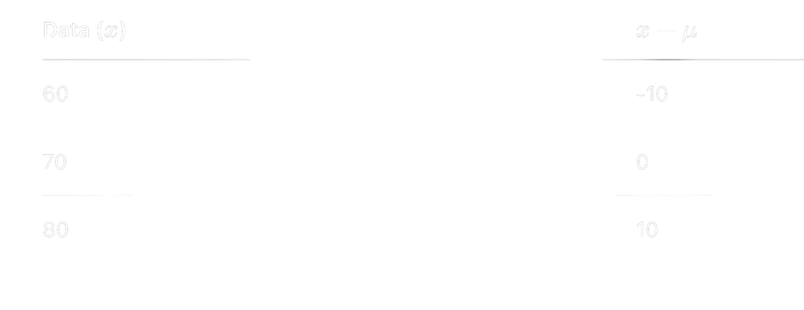
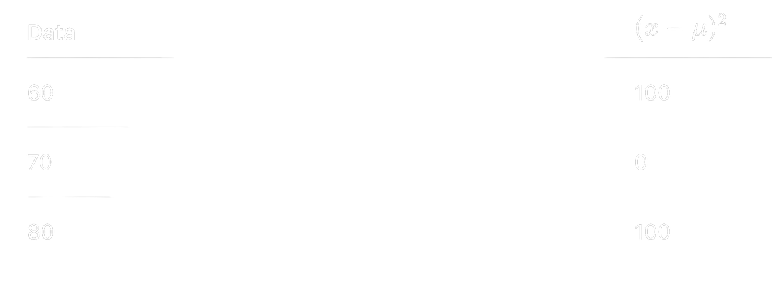


Wira Wacana Christian University of Sumba
Variance
Variance Example
📊 Dataset: 60, 70, 80
Variance = 66.67 indicates the level of data spread, but it is difficult to interpret because it does not represent the actual distance between data points. Therefore, we use standard deviation to better understand the spread.

Slide 24

Wira Wacana Christian University of Sumba
Standard Deviation
Standard Deviation
Standard deviation is the square root of variance, providing a measure of typical distance from the mean. It allows easier interpretation of data consistency in the same units as the dataset. Standard deviation shows spread in original units

Slide 25

Wira Wacana Christian University of Sumba
Standard Deviation
📊 Dataset: 60, 70, 80
A standard deviation of 8.16 indicates that the average distance of the data points from the mean is approximately 8 units.
Mean ± Standard Deviation
70 − 8 ≈ 62
70 + 8 ≈ 78
Most data values are likely to fall within the range of 62 to 78

Slide 26
Wira Wacana Christian University of Sumba
Interpretation of Variance
  Variance measures how spread out the data is from the mean
  A higher variance indicates greater variability
  A lower variance indicates more consistent data
Important Note:
  Variance is expressed in squared units
  It is difficult to interpret directly
Example Insight:
  Variance = 66.67
  Indicates that the data has a certain level of spread
  However, it does not clearly show the actual distance between values

Slide 27
Wira Wacana Christian University of Sumba
Interpretation of Standard Deviation
  Standard deviation measures the average distance from the mean
  It is easier to interpret because it uses the original unit
Example:
  Mean = 70
  Standard Deviation = 8.16
Interpretation:
  Data is spread around the mean
  Most values lie within:
70 ± 8 → 62 to 78
Insight:
  Indicates moderate variability
  Data is not too concentrated and not too dispersed

Slide 28
Wira Wacana Christian University of Sumba
Practice
Practice: Data Analysis Using Excel
  Input the dataset into Excel
  Calculate mean, median, mode
  Calculate standard deviation
  Observe the results

Slide 29

Wira Wacana Christian University of Sumba
Key Insights
  Statistics is not only about calculation, but also interpretation
  Understanding data requires critical thinking
  Data distribution helps reveal patterns and variability
  It forms the basis for probability analysis

Slide 30
Wira Wacana Christian University of Sumba
Conclusion
  Mean, median, and mode summarize the central value of data
  Variance and standard deviation explain data variability
  Understanding both helps interpret data more accurately
  Statistics is not only about calculation, but also interpretation
“Understanding measures of central tendency and dispersion helps us interpret data more effectively. These concepts form the foundation for real-world applications and support deeper statistical analysis. In the next session, we will explore probability and data distribution”.

Slide 31
Wira Wacana Christian University of Sumba
Reference
  Walpole, R. E. (2012). Probability and Statistics for Engineers and Scientists. Pearson.
  Montgomery, D. C., & Runger, G. C. (2014). Applied Statistics and Probability for Engineers. Wiley.
  Triola, M. F. (2018). Elementary Statistics. Pearson.
  OpenIntro Statistics (2019). OpenIntro Inc.
  Microsoft. (2023). Excel Functions: AVERAGE, MEDIAN, MODE, STDEV. https://support.microsoft.com
  Khan Academy. Statistics and Probability. https://www.khanacademy.org

Slide 32

Wira Wacana Christian University of Sumba
Assignment
Students are required to:
  Choose a simple real-world dataset
  Calculate mean, median, mode, and standard deviation
  Interpret the results
  Present a short explanation of their findings
  Use Excel for calculations
  Submit your work in a short report or presentation
Notes
  Submit your assignment via email (alfriantalakua@unkriswina.ac.id)
  Subject: Assignment 2 - Week 3 (Your Name)

Slide 33
Wira Wacana Christian University of Sumba
Closing
  Statistics helps us understand data patterns
  Data analysis is essential for decision-making
  These concepts will be used in the next topic: Probability
Next, we will explore how data can help us understand uncertainty and probability.

Slide 34
Wira Wacana Christian University of Sumba
THANK YOU
Contact Information
Reach out for more details or inquiries regarding the course.
Alfrian Carmen Talakua
Department of Information Systems
e-Mail : Alfriantalakua@unkriswina.ac.id

