Slide 1

STATISTICS AND PROBABILITY
Week 4 – Basic Probability Concepts and Probability Rules in Information Systems
Alfrian Carmen Talakua
Department of Information Systems
2026
Source: Author (created using Canva)

Slide 2

Learning Objectives
• Understand basic probability concepts
• Calculate probability using classical formula
• Identify sample space and events
• Apply probability rules in simple scenarios
• Interpret probability in real-world contexts
• Distinguish types of probability (classical vs empirical)
Source: Author (created using Canva)

Slide 3
From Descriptive to Predictive
Descriptive Statistics
Summarize what happened
• Mean, median, variance
• Certainty about past data
• "What occurred?"
Probability
Predict what might happen
• Foundation for inference
• Embracing uncertainty
• "What could occur?"
• Probability allows us to move from understanding data to predicting outcomes.”

Slide 4

Why Probability Matters
  Uncertainty is everywhere
  Supports decision making under uncertainty
  Risk assessment in health, finance, research
  Foundation for statistical inference
  Essential for data science and research
Source: Author (created using Canva)

Slide 5
Why Probability Matters in Data Science
  Descriptive statistics tells us what has happened
  Probability allows us to model uncertainty
  It is the foundation for:
  Prediction
  Machine learning
  Risk analysis
  Without probability, data cannot be used for decision-making
Source: Author (created using Canva)

Slide 6





What is Probability?
The number of desired outcomes (A)
Probability (P) =
Probabilitas refers to the chance or likelihood of an event occurring. This is the ratio between the number of desired outcomes and the total number of outcomes.
The total number of possible outcomes (S)
Probability ranges from 0 to 1.
0
Impossible event
1
Certain event
Source: Author (created using Canva)

Slide 7
Understanding the Probability Formula
Probability P =
The number of desired outcomes (A)
The total number of possible outcomes (S)
Source: Author (created using Canva)
  A = event of interest
  S = sample space
  Only valid when all outcomes are equally likely
  Suitable for simple experiments (dice, cards, coins)
  Not suitable for complex real-world data

Slide 8

What is an Event?
An event is a specific outcome or set of outcomes from an experiment—a subset of the sample space.
Events are denoted by capital letters (A, B, C) and represent the focus of our probability observations.
Source: Author (created using Canva)

Slide 9

Types of Events
1
2
3
Simple Event
Compound Event
Certain & Impossible
A single outcome from the sample space. Example: rolling exactly a 3 on a die.
Multiple outcomes combined. Example: rolling an even number {2, 4, 6} on a die.
Certain event: always occurs, P = 1. Impossible event: never occurs, P = 0.

Slide 10
Event Examples with Dice
Event A: Rolling an even number
A = {2, 4, 6}
Three favorable outcomes out of six possible outcomes in sample space S
Probability calculation:
P(A) = n(A) / n(S)
P(even) = 3/6 = 1/2 = 0.5
50% chance of rolling an even number

Slide 11

Sample Space Explained
Sample space (S) is the set of all possible outcomes of an experiment.
Outcomes must be mutually exclusive (cannot occur simultaneously) and exhaustive (cover all possibilities).
The sample space forms the foundation for calculating all probabilities.
Source: Author (created using Canva)

Slide 12

Dice Sample Space Example
Experiment: Roll a fair six-sided die
Sample space: S = {1, 2, 3, 4, 5, 6}
Each outcome has probability: P = 1/6 ≈ 0.167
Source: Author (created using Canva)

Slide 13






Probability can be described in 3 different ways
  Fractions
  Decimals
  Percentage
Source: Author (created using Canva)

Slide 14



Here's an example:
There are 26 red cards in a standard deck of 52 cards. Let’s express the probability of drawing a red card in fraction, decimal, and percentage form.
We can calculate the probability step by step:
  Number of desired outcomes (A): red cards = 26
  Total number of possible outcomes (S): all cards = 52
Fraction
Decimal
Percentage
Source: Author (created using Canva)
26
1
1
=
1
x 100 = 50%
52
2
= 1÷2 = 0.5
2
2
Don’t forget to simplify!
It’s as easy as moving the decimal point 2 places to the right!

Slide 15



Here's another example:
There are 15 out of 20 pins that are black. Let’s express the probability of getting a black pin in fraction, decimal, and percentage form.
Fraction
Decimal
Percentage
15
3
3
3
=
= 3÷4 = 0.75
x 100 = 75%
20
4
4
4

Slide 16



?
?
Let's try:
A number from 1 to 25 is randomly selected. What is the probability of getting a number greater than 13? Express your answer in fraction, decimal, and percentage form.
Source: Author (created using Canva)

Slide 17

Here's the answer :
A number from 1 to 25 is randomly selected. What is the probability of getting a number greater than 13? Express your answer in fraction, decimal, and percentage form.
Fraction
Decimal
Percentage
12
0.48
48%
25
Source: Author (created using Canva)

Slide 18
Types of Probability
Classical probability
Classical probability is used when all outcomes in the sample space have an equal chance of occurring. It is usually applied to simple experiments, such as rolling a die or drawing a card.

Slide 19
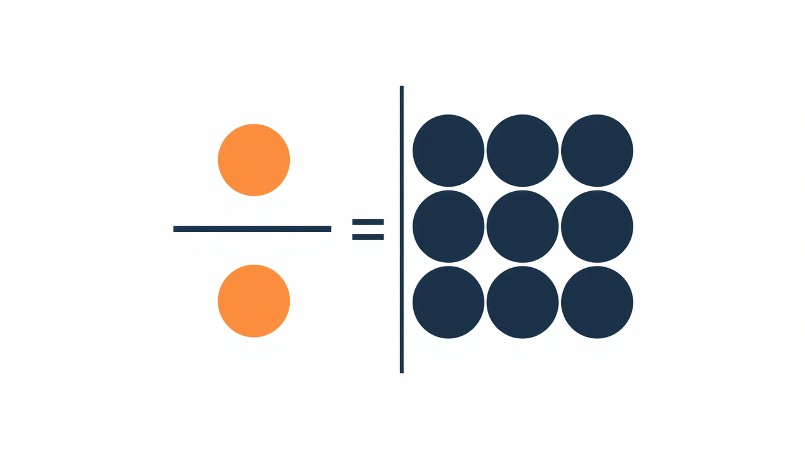
Classical Probability Formula
P(A) = n(A) / n(S)
The Foundation of Probability Calculation
P(A) = Number of favorable outcomes / Total number of possible outcomes
Where:
• A = the event of interest
• S = sample space (all possible outcomes)
• n(A) = count of favorable outcomes
• n(S) = count of total outcomes
Source: Author (created using Canva)

Slide 20

Coin Toss Example
Experiment: Toss a fair coin
Sample space: S = {Heads (H), Tails (T)}
Each outcome is equally likely with P = 0.5
Source: Author (created using Canva)

Slide 21
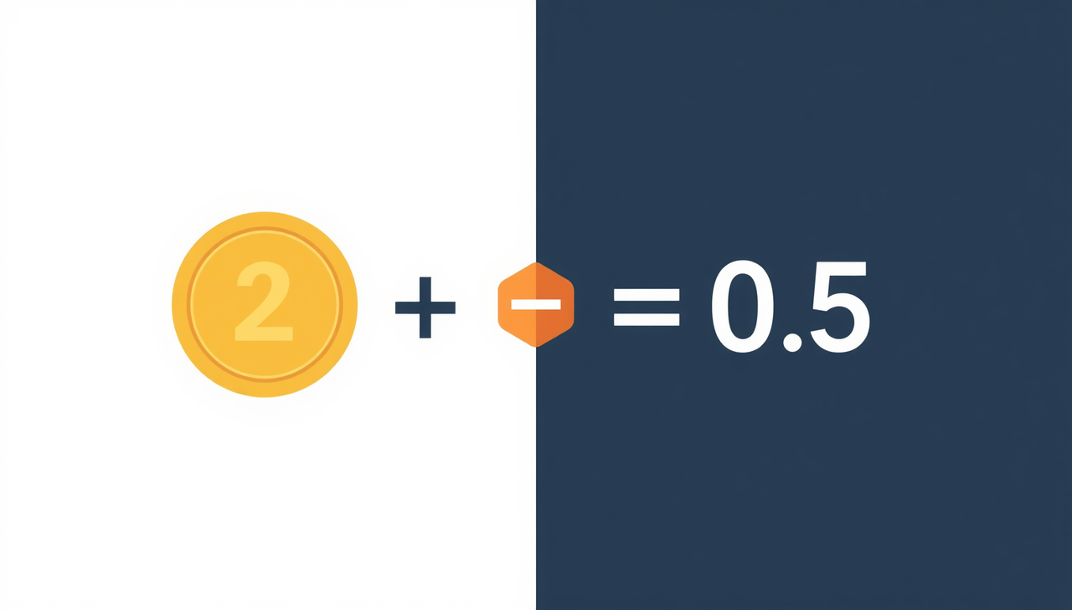
Calculating Coin Toss Probability
P(Heads) = 1/2 = 0.5 = 50%
The probability of getting heads on a fair coin toss
Favorable outcomes: 1 (Heads)
Total outcomes: 2 (Heads or Tails)
Applying the classical formula:
P(A) = n(A) / n(S) = 1/2
Source: Author (created using Canva)

Slide 22
Types of Probability
Empiris probability
P(A) = total number of observations / frequency of occurrence​
Empirical probability is based on observations or real experiments conducted in large numbers. This probability is calculated by dividing the number of events that occur by the total number of trials performed. It is often used in situations where not all outcomes can be determined theoretically.
Key Points:
  Based on actual observations or experiments
  Calculated from real data, not assumptions
  Becomes more accurate as the amount of data increases
Example:
  In the last 30 days, it rained on 18 days
  Probability of rain = 18 / 30 = 0.6

Slide 23
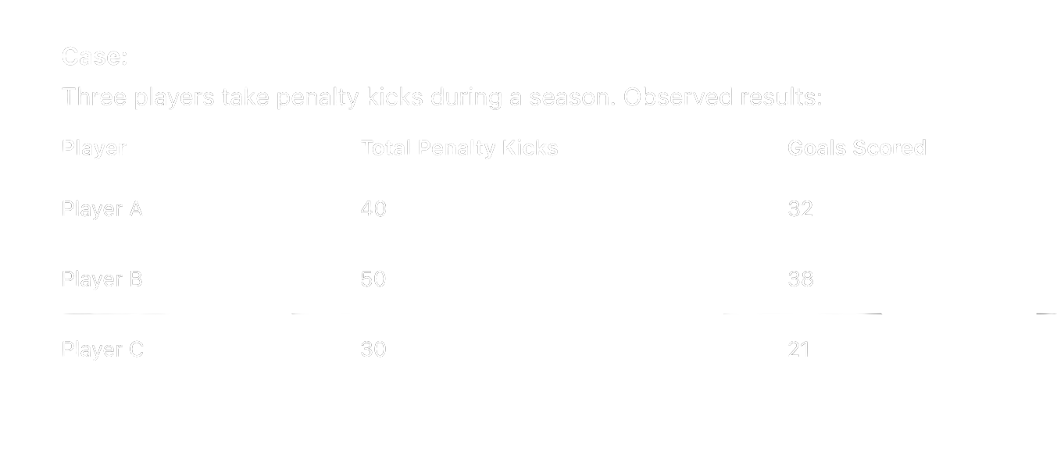
Example

Slide 24

Example

Slide 25
Example
Conclusion:
Player A: 4/5 or 0.8 or 80%
Player B: 19/25 or 0.76 or 76%
Player C: 7/10 or 0.7 or 70%

Slide 26
Types of Probability
Subjective Probability
Definition:
Subjective probability is the likelihood of an event based on personal judgment, experience, or expert opinion rather than mathematical calculations or historical data.
Key Points:
  Based on belief, experience, or available information
  Often used when data is limited or uncertain
  Can vary from person to person
Examples:
  A doctor estimating the likelihood of a disease based on symptoms
  An investor judging the chance of stock prices increasing
  A farmer predicting the likelihood of rain based on weather patterns

Slide 27
Limitations of Probability
  Not all events have equally likely outcomes
  Classical probability cannot always be applied
  Empirical probability depends on data quality
  Small sample sizes can lead to misleading results
  Probability does not guarantee outcomes

Slide 28
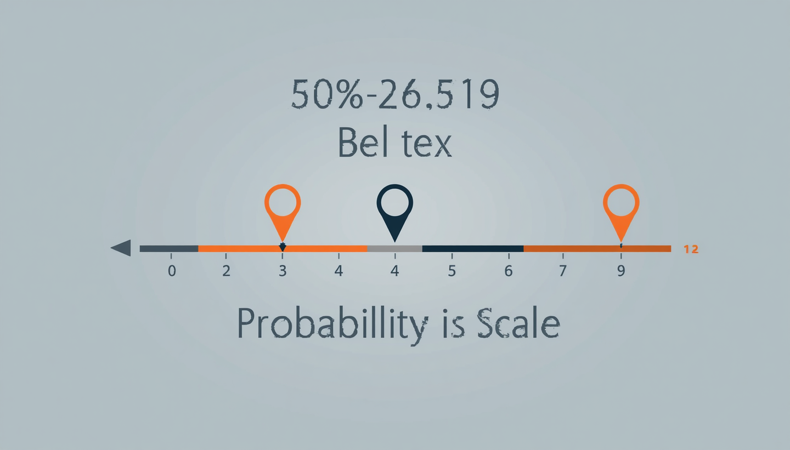
Probability Rules Summary
Source: Author (created using Canva)
01
Rule 1: P(A) ≥ 0
03
Combined Rule
Probability values can never be negative. The minimum possible probability is zero, indicating an impossible event.
Combined: 0 ≤ P(A) ≤ 1 for any event A. This is the fundamental boundary rule for all probabilities.
02
Rule 2: P(A) ≤ 1
04
Key Constraint
Probability values can never exceed one. The maximum possible probability is one, indicating a certain event.
Probabilities never negative or greater than 1. This constraint ensures mathematical consistency.

Slide 29
P(A') = 1 - P(A)
The probability that event A does NOT occur
Complement Rule
Complement of A (A' or Aᶜ): the event that A does not occur
Fundamental relationship: P(A) + P(A') = 1
Example: P(not rolling a 6) = 1 - 1/6 = 5/6 ≈ 83.3%

Slide 30
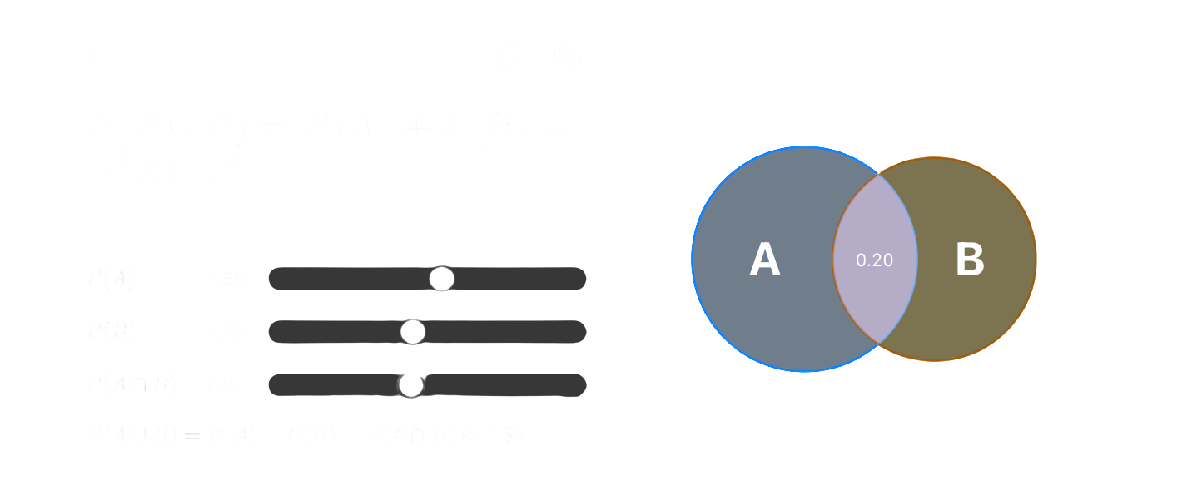
Addition Rule
Source: Author (created using Canva)

Slide 31
Addition Rule
  Probability of A or B occurring
  Avoids double counting
  Used when events may overlap

Slide 32

Dice Probability Problem
Question: What is the probability that the sum of two dice equals 7?
To solve this, we need to identify:
• Total number of possible outcomes
• Number of favorable outcomes (sum = 7)
Source: Author (created using Canva)

Slide 33
Step One
Find total possible outcomes: 6 × 6 = 36 combinations
Step-by-Step Dice Calculation
Step Two
Identify favorable outcomes for sum =
7: (1,6), (2,5), (3,4), (4,3), (5,2), (6,1)
Step Three
Calculate probability: P(sum=7) = 6/36 = 1/6 ≈ 16.7%

Slide 34

200
Children surveyed in health research study
Real Dataset Example
45
Children identified as stunted in the dataset
Real-world probability application: What is the probability that a randomly selected child from this survey is stunted?
Source: Author (created using Canva)

Slide 35
Calculating Probability from Data
Based on observed (relative frequency) data from our sample of 200 children. This empirical probability differs from theoretical probability—it comes from actual observations rather than assumed equally likely outcomes.
P(stunted) = 22.5%
45/200 = 0.225

Slide 36
Interpreting the Probability
1
2
3
Real-World Meaning
Public Health Impact
Decision Support
22.5% means approximately 1 in 4-5 children in the sample are affected by stunting
This probability quantifies the magnitude of the health problem and helps prioritize interventions
Guides resource allocation and serves as the basis for statistical inference in research

Slide 37

Probability in Research & Decision-Making
Probability in Information Systems
  Predicting user behavior
  Fraud detection
  Recommendation systems
  Health data analysis (e.g., stunting)
  Decision support systems
Source: Author (created using Canva)

Slide 38
Think Critically
  Can probability be greater than 1? Why?
  Is all probability based on formulas?
  When should we use empirical instead of classical probability?
  Can probability guarantee an outcome?

Slide 39
Conclusion
  Probability is essential for understanding uncertainty
  It provides a foundation for prediction
  Classical and empirical probability serve different purposes
  Probability rules ensure correct calculations
  Real-world data requires careful interpretation

Slide 40
Reference
  Walpole, R. E. (2012). Probability and Statistics for Engineers and Scientists
  Montgomery, D. C., & Runger, G. C. (2014). Applied Statistics and Probability
  Triola, M. F. (2018). Elementary Statistics
  OpenIntro Statistics (2019)
  Microsoft Excel Documentation
  Khan Academy – Statistics and Probability

Slide 41
THANK YOU
Contact Information
Reach out for more details or inquiries regarding the course.
Alfrian Carmen Talakua
Department of Information Systems
e-Mail : Alfriantalakua@unkriswina.ac.id

