Slide 1

STATISTICS AND PROBABILITY
Week 5 - Random Variables and Discrete Probability Distributions in Data Analytics
Alfrian Carmen Talakua
Department of Information Systems
2026
Source: Author (created using Canva)

Slide 2

Learning Objectives
  Explain random variables
  Differentiate discrete and continuous variables
  Analyze Probability distributions
  Compute expected value
  Understand variance and its interpretation
  Apply concepts to data analysis
Source: Author (created using Canva)

Slide 3

Review: Previous Meeting
1
2
3
Probability Basics
Value Range
Key Concepts
Probability measures the likelihood or chance of an event occurring in a random experiment.
Probability values always range from 0 (impossible) to 1 (certain). P(A) where 0 ≤ P(A) ≤ 1.
Event: A subset of outcomes from an experiment. Sample Space: The set of all possible outcomes.

Slide 4
Step One
Probability measures the likelihood of events occurring in a given situation.
Transition
Random variables assign numerical values to outcomes of random experiments.
Step Two
Step Three
These concepts build the foundation for moving toward systematic data analysis and interpretation.

Slide 5

Introduction to Random Variables
A random variable is a numerical result of a random experiment. It serves as a bridge between real-world outcomes and mathematical analysis.
Random variables convert qualitative outcomes into quantifiable numbers, enabling statistical computation and data-driven decision making.
This fundamental concept forms the foundation of data analysis in information systems and statistical modeling.
In simple terms, it turns outcomes into numbers.
Source: Author (created using Canva)

Slide 6

Simple Example
Source: Author (created using Canva)
Coin Toss Experiment
Why This Matters
Consider tossing a fair coin. We can assign numerical values to each outcome:
• Head = 1
• Tail = 0
This assignment creates a random variable X that takes values 0 or 1.
By converting outcomes to numbers, we can:
• Perform mathematical calculations
• Compute probabilities: P(X=1) = 0.5
• Calculate expected values
• Apply statistical analysis methods

Slide 7
Real-Life Examples
1
2
3
Class Attendance
Stunting Cases
Traffic Count
The number of students attending a lecture each day is a random variable. It can be 0, 1, 2, ... up to the total enrolled students.
The number of stunting cases recorded in a village represents a discrete random variable used in public health data analysis and intervention planning.
The number of vehicles passing through a road intersection per hour is a random variable essential for urban planning and traffic management systems.

Slide 8
Types of Random Variables
Discrete Random Variables:
Values that can be counted, typically integers. Examples include the number of students in a class, number of defective items in a batch, or number of customer arrivals per hour.
Continuous Random Variables:
Values that can take any number within an interval, including decimals. Examples include height, weight, temperature, or time duration between events.

Slide 9

Discrete Random Variables
Source: Author (created using Canva)
Definition
Examples
Discrete random variables take countable values, typically integers. These values can be listed or enumerated, with gaps between possible outcomes. The variable cannot take values in between these distinct points.
• Number of children in a family
• Number of patients in a clinic per day
• Number of defective items in a batch
• Number of students passing an exam
• Number of customer complaints received

Slide 10
Continuous Random Variables
Definition
Examples
Continuous random variables can take infinite possible values within a range. Unlike discrete variables, they can assume any decimal value, making them suitable for measuring quantities that vary smoothly.
• Height of students (e.g., 165.5 cm)
• Weight of patients (e.g., 72.3 kg)
• Time to complete a task (e.g., 4.75 minutes)
• Temperature readings
• Distance traveled

Slide 11


Discrete Random Variables
• Countable values only
• Usually whole numbers (integers)
• No values exist between consecutive points
• Example: 0, 1, 2, 3 students
Comparison
Continuous Random Variables
• Infinite possible values
• Can take any decimal value
• Values exist between any two points
• Example: 65.5 kg, 170.25 cm
Source: Author (created using Canva)
Source: Author (created using Canva)

Slide 12

Probability Distribution
A probability distribution shows the probability of each possible value a random variable can take.
Key Properties:
• Lists all possible outcomes with their probabilities
• Total probability always equals 1
• Helps identify patterns and trends in data
• Essential foundation for statistical analysis
Source: Author (created using Canva)

Slide 13

PMF (Probability Mass Function)
The Probability Mass Function (PMF) is used specifically for discrete random variables to describe the probability of each possible outcome.
Key Properties:
• Notation: P(X = x) gives the probability that random variable X equals value x
• Non-negativity: P(X = x) ≥ 0 for all values
• Normalization: The sum of all probabilities equals 1: Σ P(X = x) = 1
Source: Author (created using Canva)

Slide 14
Distribution Example
0.2
0.5
0.3
X = 0
X = 1
X = 2
Probability: P(X=0) = 0.2
This means there is a 20% chance that the random variable X takes the value 0.
Probability: P(X=1) = 0.5
This means there is a 50% chance that the random variable X takes the value 1.
Probability: P(X=2) = 0.3
This means there is a 30% chance that the random variable X takes the value 2.

Slide 15
Validation
This confirms we have a valid probability distribution. For any probability mass function, the sum of all probabilities must equal exactly 1. Our distribution satisfies this fundamental requirement, verifying that our PMF is mathematically correct and can be used for further analysis.
0.2 + 0.5 + 0.3 = 1
Sum of all probabilities equals 1

Slide 16
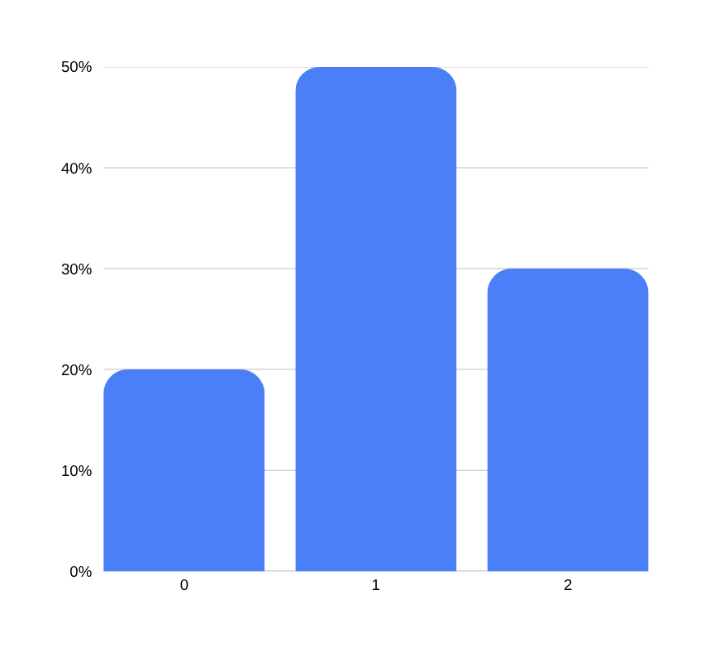
Visualization
Probability Distribution of Random Variable X
Bar charts provide a clear visual representation of probability distributions. This visualization helps identify patterns in discrete data, making it easier to understand how probabilities are distributed across possible values.
Source: Author (created using Canva)

Slide 17

Expected Value
Expected value represents the average outcome of a random variable over many repeated trials or observations.
It serves as the center of a probability distribution, indicating where values tend to cluster. This long-run average provides a single summary measure that characterizes the typical result we would expect from a random process.
Source: Author (created using Canva)

Slide 18
Expected Value Formula
The expected value of a discrete random variable X is calculated using the formula:
E(X) = Σ [x · P(x)]
This formula multiplies each possible value x by its probability P(x), then sums all the products. The result represents the theoretical long-run average of the random variable.

Slide 19
Step One
Write the formula with values:
E(X) = (0×0.2) + (1×0.5) + (2×0.3)
Example Calculation
Step Two
Calculate each term:
0 + 0.5 + 0.6 = 1.1
Step Three
Final result:
E(X) = 1.1
This is the expected value of the distribution.

Slide 20

Interpretation of Expected Value
Source: Author (created using Canva)
Key Concept
Important Note
Expected value represents a long-term average over many repetitions of an experiment. It is a theoretical measure that indicates where the center of the probability distribution lies, not necessarily a value you will observe in any single trial.
The expected value may not be an actual observed value. For example, E(X) = 1.1 children means that over many families, the average is 1.1, but no family can have exactly 1.1 children. It serves as a benchmark for comparison and decision-making.

Slide 21

Variance
Variance measures the dispersion or spread of data around the mean. It quantifies how far individual values deviate from the expected value.
A key concept in probability and statistics, variance helps us understand the consistency and reliability of data distributions in information systems analysis.
Source: Author (created using Canva)

Slide 22

Variance Formula
The variance of a discrete random variable X measures how spread out the values are from the expected value (mean).
The mathematical formula is:
Var(X) = Σ [(x − μ)² · P(x)]
Where:
• x = each possible value
• μ = expected value E(X)
• P(x) = probability of each value
Source: Author (created using Canva)

Slide 23
Standard Deviation
Standard deviation transforms variance back to the original units of measurement, making it easier to interpret. While variance is measured in squared units, standard deviation is expressed in the same units as the data itself, allowing for more intuitive comparisons and analysis.
σ = √Var(X)
The square root of variance

Slide 24
Interpretation of Variance
Small Variance: Data points cluster closely around the mean. This indicates consistency and predictability in the data. Values are similar to each other, making the distribution tight and reliable for predictions.
Large Variance: Data points are spread far from the mean. This indicates high variability and less predictability. Values differ significantly from each other, suggesting diverse outcomes and greater uncertainty in analysis.

Slide 25
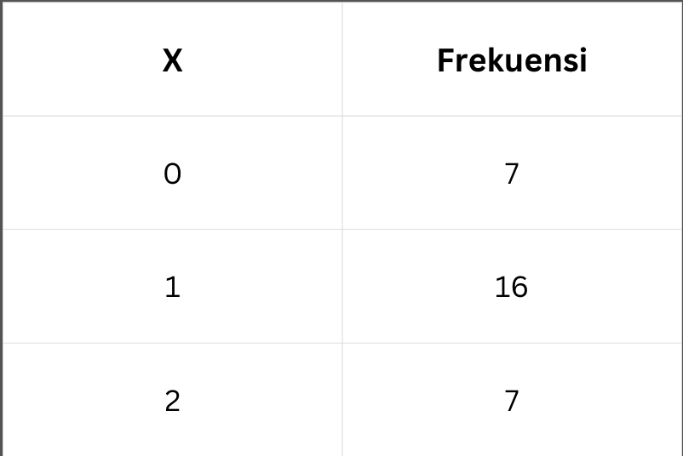
Case Study: Stunting Data
Number of stunted children per family:
0, 1, 2, 1, 0, 1, 2, 1, 1, 0,
1, 2, 1, 1, 0, 2, 1, 1, 0, 1,
2, 1, 1, 0, 1, 2, 1, 1, 0, 2

Slide 26
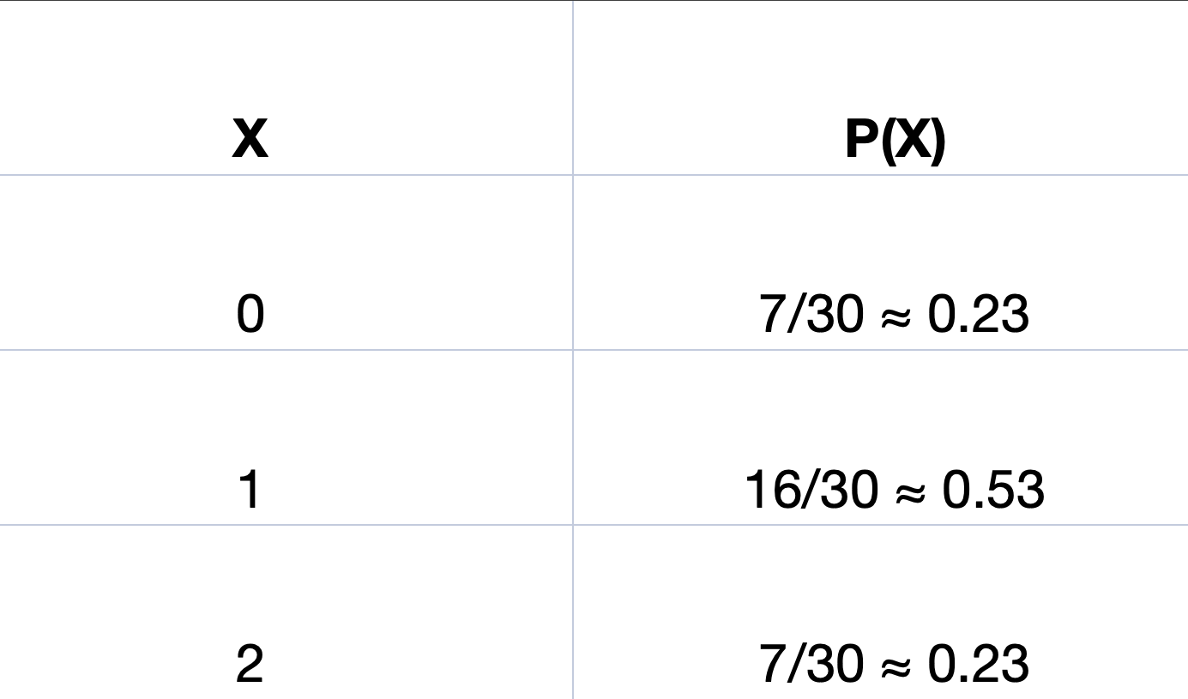
Case Study: Stunting Data
PROBABILITAS (PMF)

Slide 27

Case Study: Stunting Data
EXPECTED VALUE (MEAN)
E(X)=∑x.P(x)
Expected Value = 1

Slide 28
Case Study: Stunting Data
VARIANCE
Var(X)=∑(x−μ)2.P(x)
μ=1

Slide 29
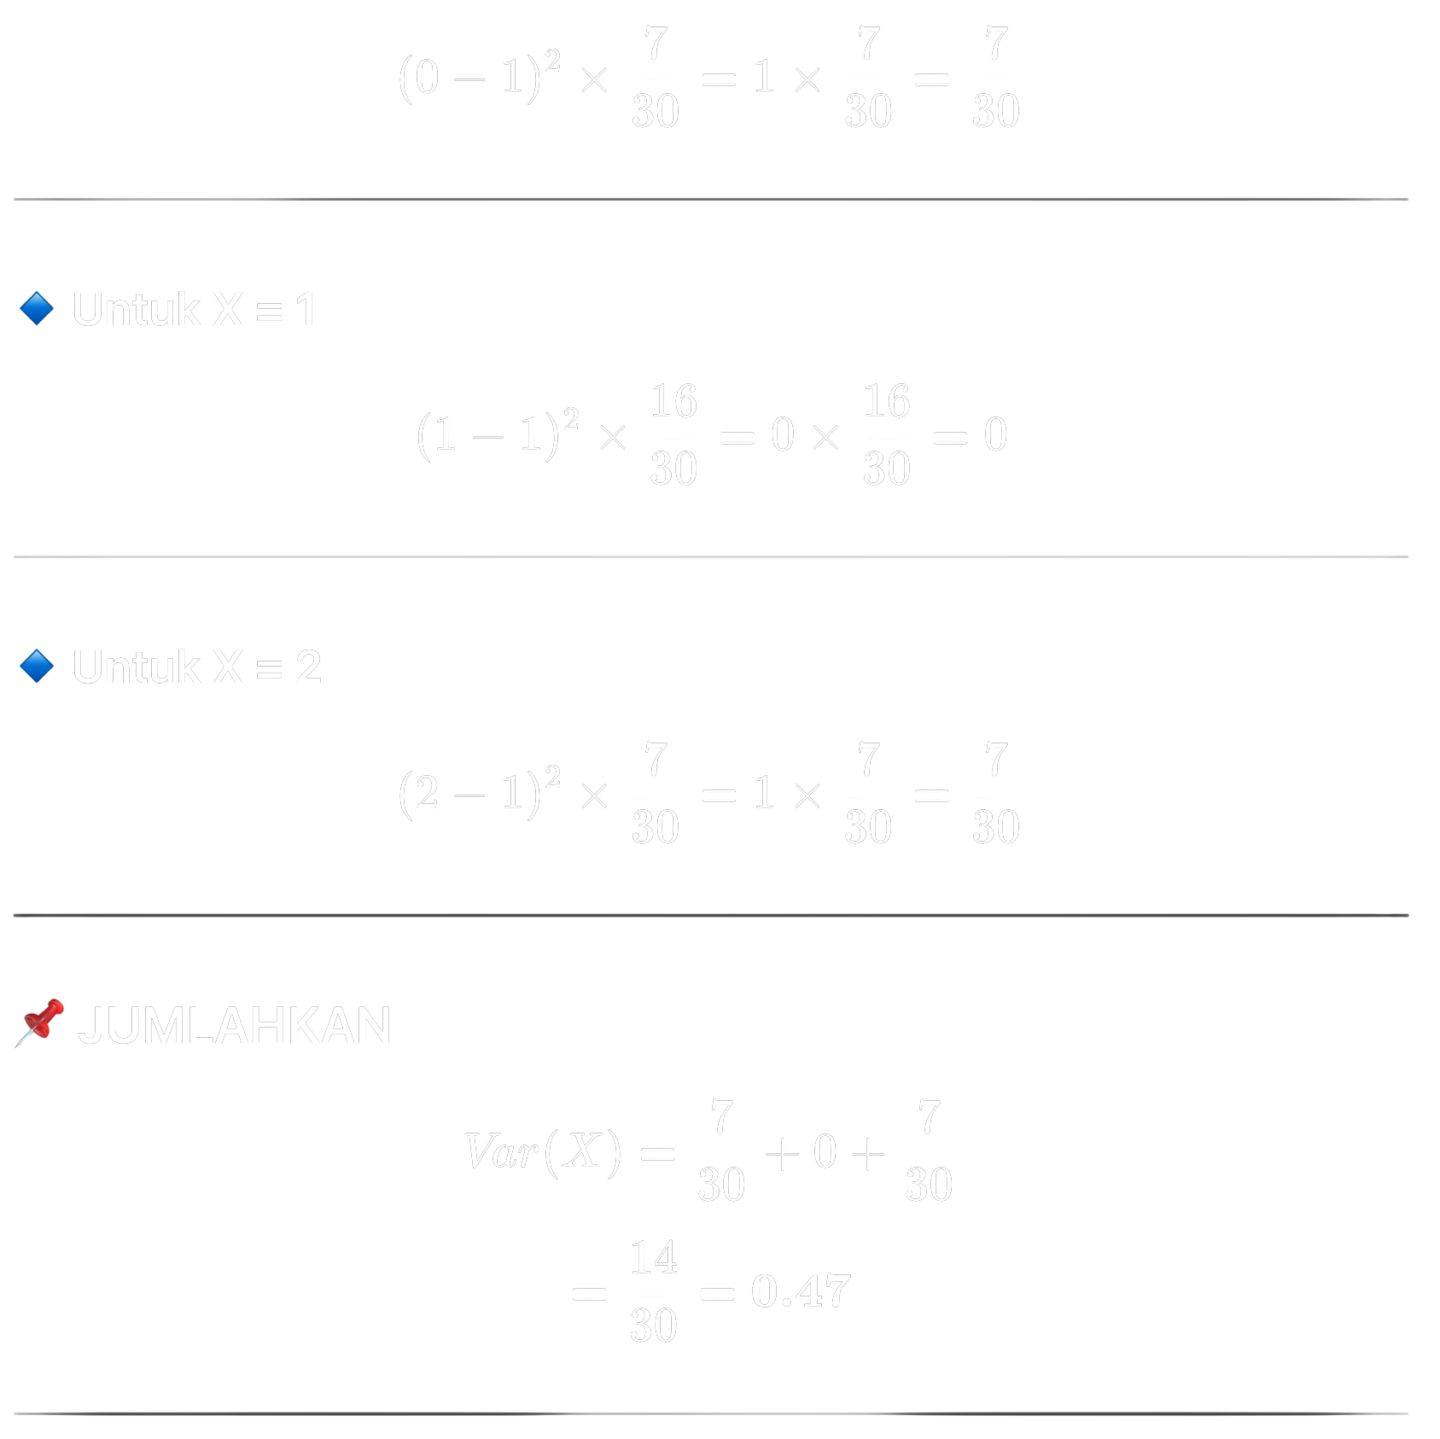
Case Study: Stunting Data
VARIANCE
X = 0
X = 1
X = 2

Slide 30
Case Study: Stunting Data
TOTAL

Slide 31

Case Study: Stunting Data
STANDARD DEVIATION

Slide 32

Simple Analysis
Based on data from 30 families, 53% have one stunted child, while 23% have none and 23% have two. The expected value of 1 indicates that, on average, each family has one stunted child. The small variance (≈0.47) and standard deviation (≈0.69) show that this condition is relatively uniform across families. This suggests that stunting is a widespread, collective issue in the village, requiring community-level intervention rather than individual treatment.
Source: Author (created using Canva)

Slide 33

Application in Information Systems
Source: Author (created using Canva)
01
Data Analytics
03
Risk Prediction
Probability distributions help analyze large datasets, identify patterns, and make data-driven predictions in business intelligence applications.
Probability distributions enable assessment of potential risks and forecasting future outcomes in business scenarios.
02
Decision Support Systems
04
Information Management
Expected values and variance calculations support managers in evaluating options and making informed strategic decisions.
Random variables help organize and structure data for storage, retrieval, and analysis in database systems.

Slide 34
Connection to Data Science
Random variables and probability distributions form the mathematical foundation of statistical modeling. Regression analysis, hypothesis testing, and parameter estimation all rely on understanding how data varies probabilistically.
Machine learning algorithms use probability distributions extensively. Classification models estimate class probabilities, while predictive analytics leverages expected values and variance to forecast outcomes and quantify uncertainty.

Slide 35
Next Topics
• Binomial Distribution (Discrete Case)
• Continuous Random Variables
• Normal Distribution (Bell Curve)
• Exponential Distribution (Time-Based Events)

Slide 36

Summary
  Random variables represent outcomes numerically
  Discrete variables: countable values (integers)
  Continuous variables: infinite possible values
  Probability distributions show likelihood of each value
  Expected value E(X): long-run average
  Variance: measures data spread
  Standard deviation: interpretable dispersion
  Total probability always equals 1
Source: Author (created using Canva)

Slide 37
Reflection Questions
Probability distributions reveal patterns in data, helping analysts predict outcomes, identify trends, and make informed decisions based on statistical evidence.
Consider healthcare risk assessment, quality control in manufacturing, customer behavior prediction, and financial forecasting in business analytics.
Why is variance important?
What are real-life applications?

Slide 38
References
Walpole, R. E., Myers, R. H., Myers, S. L., & Ye, K. (2012). Probability & Statistics for Engineers & Scientists (9th ed.). Pearson.
1
3
Triola, M. F. (2018). Elementary Statistics (13th ed.). Pearson.
OpenIntro Statistics (2019). OpenIntro, Inc. Available at openintro.org
Microsoft Excel Documentation. Microsoft Corporation. Available at support.microsoft.com
2
4

Slide 39
THANK YOU
Contact Information
Reach out for more details or inquiries regarding the course.
Alfrian Carmen Talakua
Department of Information Systems
e-Mail : Alfriantalakua@unkriswina.ac.id

