Slide 1
STATISTICS AND PROBABILITY
Week 6 - Continuous Probability Distributions Normal and Exponential Distributions in Data Processing
Alfrian Carmen Talakua
Department of Information Systems
2026

Slide 2


Learning Objectives
  Understand continuous data
  Understand normal distribution
  Understand exponential distribution
  Interpret real-world data
Source: Author (created using Canva)

Slide 3

Review of Previous Meeting
  Random Variable: A variable whose value is determined by chance outcomes
  Probability Distribution: Complete set of all possible values and their associated probabilities
  Mean & Variance: Key measures describing the center and spread of data

Slide 4
From Discrete to Continuous
Distributions
This session marks a key conceptual shift: moving from discrete data with countable values to continuous data with infinite possibilities. We transition from probability tables to smooth probability curves, fundamentally changing how we represent and analyze data.

Slide 5

Introduction to Continuous Data
  Infinite values
  Can be decimals
  Measured, not counted
Source: Author (created using Canva)

Slide 6

Examples of Continuous Data
  Height: 170.5 cm, 171.23 cm, 171.234 cm...
  Weight: 65.7 kg, 65.75 kg, 65.753 kg...
  Time: 2.5 sec, 2.53 sec, 2.531 sec...
  Continuous data can take infinite decimal values within any range.
Source: Author (created using Canva)

Slide 7


Discrete vs Continuous Data Comparison
Discrete Data: Countable, separate values that can be listed (e.g., number of students, dice rolls, defect counts). Continuous Data: Measurable values within infinite possibilities (e.g., temperature, distance, time). Understanding this distinction is fundamental to selecting appropriate probability distributions.
Source: Author (created using Canva)

Slide 8

Introduction to Normal Distribution
Source: Author (created using Canva)
  Most real-world data follows this pattern
  Also called Gaussian distribution

Slide 9

Characteristics of Normal Distribution
The normal distribution has four defining features: it is symmetrical around the mean, forms a bell-shaped curve, has mean = median = mode at the center, and its tails extend infinitely in both directions, never touching the x-axis.
Source: Author (created using Canva)

Slide 10
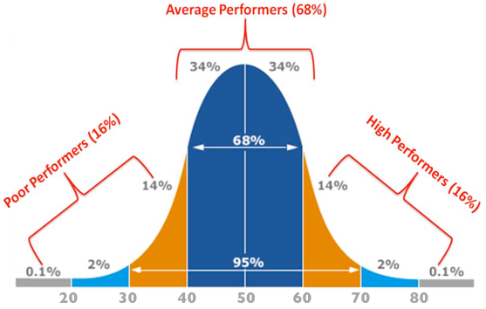
Bell Curve Visualization
The Normal Curve
The normal distribution forms a smooth, symmetrical bell-shaped curve centered on the mean. This iconic shape demonstrates how data naturally clusters around the average, with equal spread on both sides and gradually tapering tails.
Source : https://www.geeksforgeeks.org/data-science/probability-distributions-exponential-distribution/

Slide 11
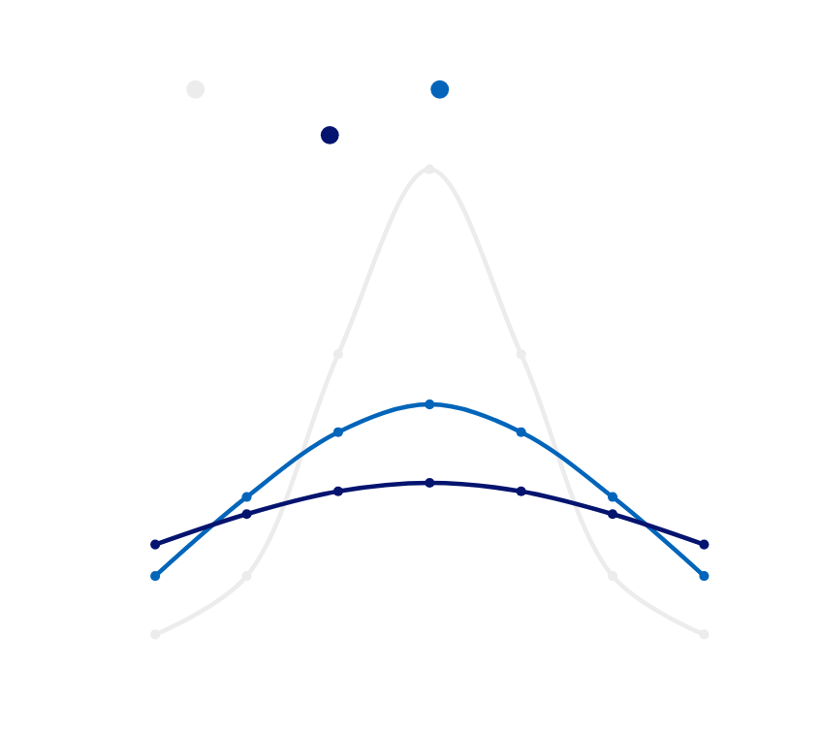
Mean and Standard Deviation
Mean (μ) defines the center point of the distribution, determining where the curve is positioned. Standard deviation (σ) controls the spread of data around the mean. A larger σ produces a wider, flatter curve, while a smaller σ creates a narrower, steeper curve.
Source: Author (created using Canva)

Slide 12
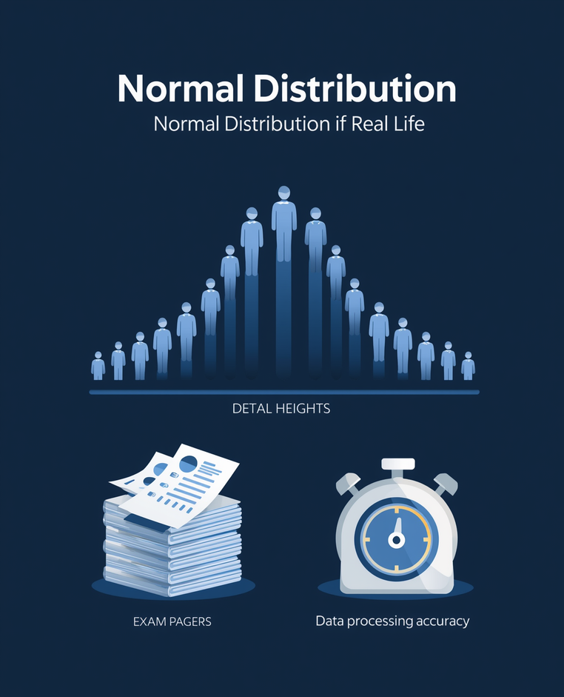
Real-Life Examples of Normal Distribution
Human Height: Most people cluster near average height, with fewer individuals being very tall or very short.
Exam Scores: Majority of students score near the middle range, with fewer achieving extremely high or low marks.
Measurement Errors: In data processing, small errors are common while large deviations are rare.
Source: Author (created using Canva)

Slide 13

Empirical Rule (68-95-99.7)
The empirical rule describes data distribution in normal curves: 68% of data falls within 1 standard deviation of the mean, 95% within 2 standard deviations, and 99.7% within 3 standard deviations. This rule helps predict data spread and identify outliers.
Source: Author (created using Canva)

Slide 14
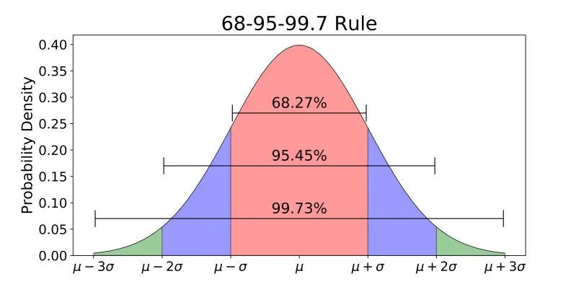
Empirical Rule
Visualization
The 68-95-99.7 rule shows data distribution within standard deviations: 68% falls within 1σ, 95% within 2σ, and 99.7% within 3σ from the mean. This color-coded visualization helps identify where data points fall.
Source : https://builtin.com/data-science/empirical-rule

Slide 15


Source: Author (created using Canva)
Interpreting Data in Normal Distribution
  Most data near mean
  Far values = rare
  Outliers = unusual

Slide 16
Z-SCORE
The Z-score standardizes data points by measuring their position relative to the mean. It indicates how many standard deviations a value is from the mean. The formula is: z = (x - μ) / σ, where x is the data point, μ is the mean, and σ is the standard deviation.

Slide 17
Simple Z-Score Example
  Example: Student score = 85, class mean = 75, SD = 10
  Calculation: z = (85 - 75) / 10 = 1.0
  Interpretation: This student scored one standard deviation above the class average.

Slide 18

Introduction to Exponential Distribution
Source: Author (created using Canva)
The exponential distribution models waiting time between events, making it essential for system and queue analysis. This distribution emphasizes time-based phenomena, helping predict when events will occur.

Slide 19

Characteristics of Exponential Distribution
The exponential distribution has distinct features: it is skewed right (asymmetrical), shows rapid decline from its peak at zero, and has a long right tail indicating that longer waiting times become progressively less likely.

Slide 20
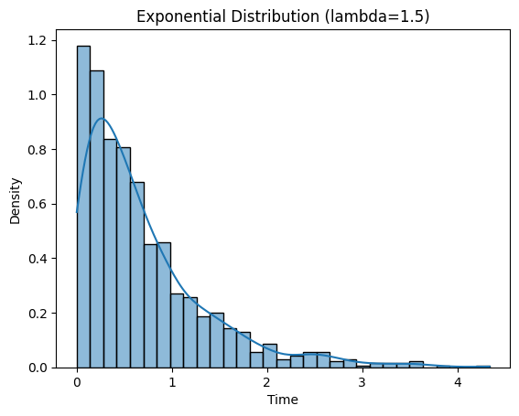
Exponential Curve
Visualization
The exponential distribution curve starts at its peak near zero and rapidly declines, creating a distinctive right-skewed shape. Unlike the symmetrical bell curve of normal distribution, this curve shows that shorter waiting times are most common, with progressively longer waits becoming increasingly rare.
Source : https://www.geeksforgeeks.org/data-science/probability-distributions-exponential-distribution/

Slide 21
Real-Life Examples of Exponential Distribution
Practical phenomena modeled by exponential distribution:
  Waiting time in queues: Customer service lines, server request processing, and support ticket response times
  System failure times: Hardware component lifespans, software crash intervals, and equipment breakdown patterns
  Time between events: Website visitor arrivals, incoming phone calls, and network packet transmissions

Slide 22


Source: Author (created using Canva)
Interpretation of Exponential Distribution
  Short time = common
  Long time = rare
  Used for prediction

Slide 23
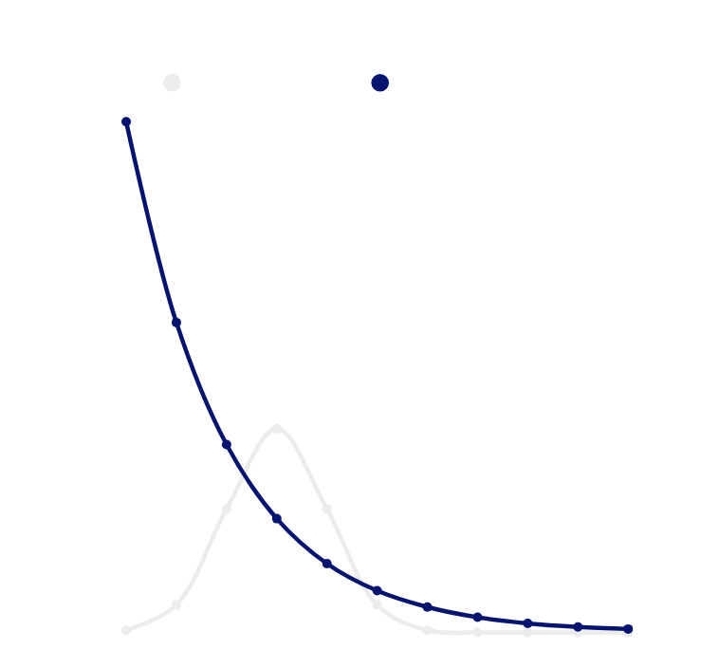
Normal vs Exponential Distribution
Normal: Symmetrical, bell-shaped curve centered around the mean, ideal for modeling natural phenomena. Exponential: Asymmetrical, right-skewed curve declining from zero, models time-based events and waiting times.
Source: Author (created using Canva)

Slide 24


Source: Author (created using Canva)
When to Use Each Distribution
Normal Distribution: Heights, weights, test scores, measurement errors, natural phenomena. Exponential Distribution: Waiting times, time between events, system lifetimes, queue analysis.

Slide 25

Simple Case Study: Queue System
Source: Author (created using Canva)
Customer arrival times modeled by exponential distribution. User session durations and response times analyzed for patterns. System performance processing times demonstrating typical queue behavior.

Slide 26

Interpretation of Case Study Results
  Understand system behavior
  Predict waiting time
  Identify bottlenecks
Source: Author (created using Canva)

Slide 27
Applications in
Information Systems
Prediction: Forecasting user behavior and system demand. System monitoring: Detecting anomalies and unusual patterns. Performance analysis: Optimizing response times and resource allocation. Capacity planning: Determining infrastructure needs.

Slide 28
Summary
  Understand system behavior
  Predict waiting time
  Identify bottlenecks

Slide 29

Reflection Questions
Source: Author (created using Canva)
When does data follow a normal distribution?
When should exponential distribution be used?
How can these distributions improve system design and analysis?

Slide 30


Source: Author (created using Canva)
Next Topic Preview
In our next session, we will explore Inferential Statistics, including Hypothesis Testing to validate assumptions, Confidence Intervals for estimation ranges, and Statistical Significance to determine meaningful results.

Slide 31
References
  Walpole, R.E. et al. "Probability & Statistics for Engineers & Scientists"
  Triola, M.F. "Elementary Statistics"
  OpenIntro Statistics (open-source textbook)
  Microsoft Learn: Data Science and Statistics modules

Slide 32
THANK YOU
Contact Information
Reach out for more details or inquiries regarding the course.
Alfrian Carmen Talakua
Department of Information Systems
e-Mail : Alfriantalakua@unkriswina.ac.id

