Slide 1


Statistics and Probability
Week 7 - Sampling and Sampling Distributions in Data Science
Alfrian Carmen Talakua
Department of Information Systems
2026
Source: Author, made with Canva

Slide 2
Review Overview
Lecture Flow: From Data to Sampling Distribution
1. Data
2. Distribution
3. Bell Curve
6. Sampling
Distribution
5. Empirical Rule
4. Z-Score

Slide 3
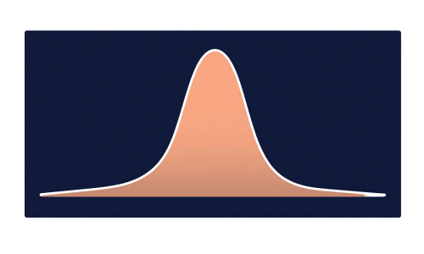
Understanding Distributions
The Foundation of Statistics
How data values are spread reveals patterns.
Student Exam Scores
Student
Score
Ana
72
Score Distribution
Budi
85
Citra
68
Dani
91
Eka
77
60-69
70-79
80-89
90-99
Fajar
83
Data Spread Visualization
Gita
79
x = 80.4
Hadi
88
60
70
80
90
100
Source: Author, made with Canva

Slide 4
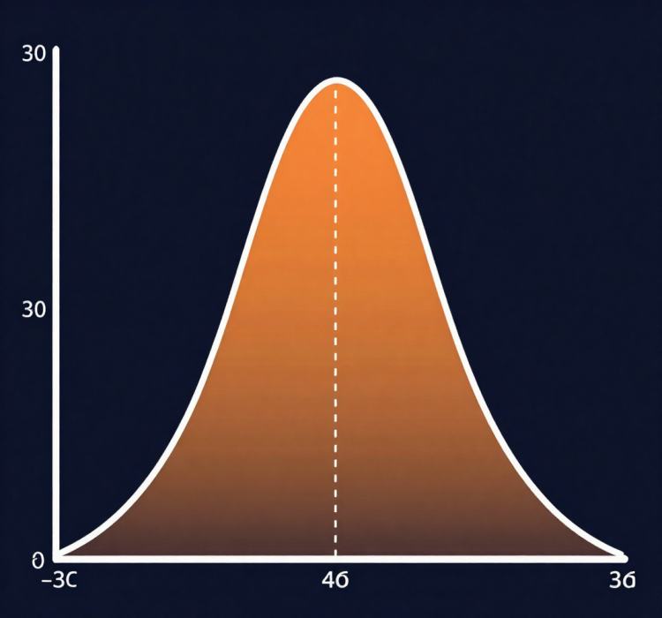
Normal Distribution Explained
Mean = Median = Mode
Mean
Median
Mode
Understanding the Properties of Normal Distribution
The normal distribution is a foundational concept in statistics, characterized by its symmetry and bell shape, where the mean, median, and mode are all equal at the center.

Slide 5
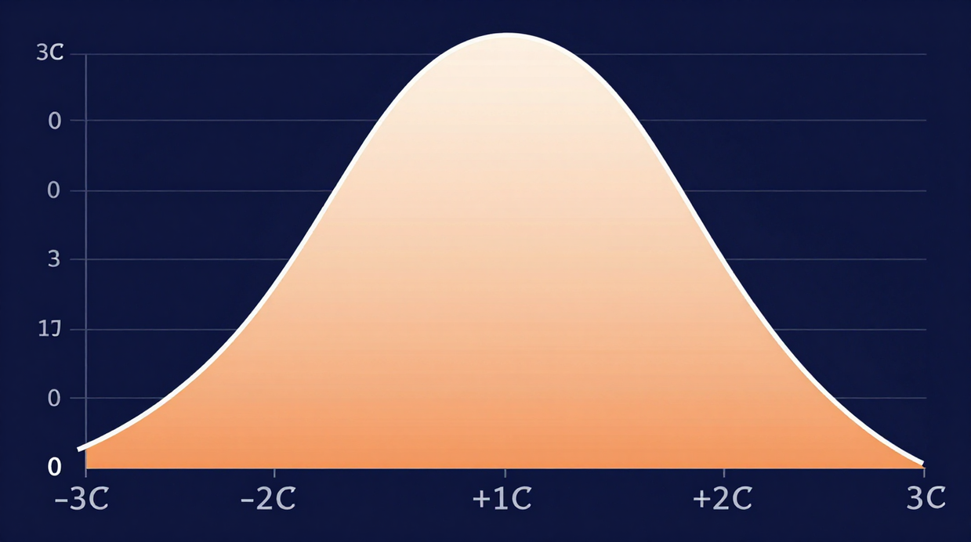
The Bell Curve
Understanding the Concept
The bell curve visually represents the normal distribution, highlighting properties like symmetry, mean, and standard deviation, essential for understanding data behavior in statistics.
Source: Author, made with Canva

Slide 6
Z-Score Calculation
Z = (X - μ) / σ
X = data value
μ = population mean
σ = standard deviation
Z = number of standard deviations from mean
Understanding Z-Scores
The Z-score measures how many standard deviations a data point is from the mean.
Example:
x = 85
μ = 75
σ = 8
z = (85 - 75) / 8 = 10 / 8
z ≈ 1.25
Φ(z) ≈ 89.4%
Score is 1.25 SD above the mean (top 10.6%)

Slide 7
Empirical Rule
The 68-95-99.7 Rule
within 1σ
68%
95%
95%
within 2σ
99.7%
99.7%
within 3σ
-3σ
-2σ
-1σ
μ
+1σ
+2σ
+3σ
Source: Author, made with Canva

Slide 8

Standard Normal Distribution
The Z-Distribution
The standard normal distribution is a special case where the mean is 0 and the standard deviation is 1, allowing for easier calculations and comparisons across different datasets.
Mean (μ) = 0
SD (σ) = 1
Source: Author, made with Canva

Slide 9
Bridging to Sampling
From Distributions to Samples
How we move from studying entire populations to making inferences through samples.
Sampling
Distribution
Population
Sample
All data (N)
Subset (n)
Distribution of x̄

Slide 10
Population vs Sample
Understanding Key Definitions
Population
Sample
Importance
The population refers to the entire group of individuals or items that are of interest in a statistical study, such as all residents of a city or all products manufactured.
A sample is a subset of the population selected for analysis, representing the larger group. It allows researchers to make inferences about the entire population without needing to study all members.
Understanding the distinction between population and sample is crucial in statistics, as it influences study design, data collection, and interpretation of results when making generalizations.

Slide 11
Population vs Sample Comparison
Population
Sample
Entire group of interest
Symbol: N
Parameters: μ, σ
Hard to measure fully
Example: All students in Indonesia
Subset of the population
Symbol: n
Statistics: x̄, s
Easier to collect & analyze
Example: 200 students from UGM
VS

Slide 12
What is Sampling?
Definition
Understanding the concept of sampling distributions in statistics
A sampling distribution is the distribution of a sample statistic, such as the sample mean, over numerous samples drawn from the population.
Importance
It is crucial for estimating population parameters and conducting statistical inference, allowing researchers to draw conclusions based on sample data.
Population
Sample
All students
in university
(N = 10,000)
30 selected
students
(n = 30)
Characteristics
We study 30 to make conclusions about 10,000
Sampling distributions have unique properties, including being centered around the population parameter and exhibiting decreased variability with larger sample sizes.

Slide 13
Formation Steps
Calculate Statistic
Draw Samples
Plot Distribution
Collect random samples from the population for analysis and calculation.
Compute the desired statistic, such as the sample mean, for each sample.
Create a visual representation of sample statistics to observe the distribution.

Slide 14
Properties of Sampling Distributions
3 Key Properties
Centered Around
Parameter
Decreased
Variability
Normal Shape
Approach
• Mean of x̄ = μ
• Unbiased estimator
• More samples = closer to μ
• SE = σ / √n
• Larger n = smaller spread
• More precise estimates
• Central Limit Theorem
• Works for any population
• Requires n ≥ 30
Source: Author, made with Canva

Slide 15
Sample Mean Explained
x̄ = Σx / n
x̄ = sample mean
Σx = sum of all values
n = number of observations
Understanding the Calculation
The sample mean (x̄) is the average of all observed values in a sample.
Example:
Data: 72, 85, 90, 68, 95
n = 5
x̄ = (72 + 85 + 90 + 68 + 95) / 5
x̄ = 410 / 5
x̄ = 82
The average score of the sample is 82

Slide 16
Distribution of Sample Means
Multiple Samples → One Distribution
Sample 1
x̄ = 78
Sample 2
x̄ = 82
Sample 3
x̄ = 80
Sample 4
x̄ = 81
Understanding the shape and properties
repeat 1000x...
Taking many samples and plotting their means creates a normal distribution — this is the Central Limit Theorem in action.
μ = 80.25
Sampling Distribution of x̄
• Shape: Normal (by CLT)
• Center: μ_x̄ = μ
• Spread: SE = σ / √n
Source: Author, made with Canva

Slide 17
Standard Error Explained
Standard Error Formula
SE = σ / √n
Understanding Standard Error
σ = population standard deviation
n = sample size
SE = standard error of the mean
The standard error (SE) measures how much sample means vary from the true population mean.
Larger n → Smaller SE → More precise estimates
Example:
σ = 10, n = 25
SE = 10 / √25 = 10 / 5
SE = 2
The sample mean is expected to be within ±2 of the population mean.

Slide 18

Understanding Standard Error
Graph showing standard error decreases with increasing sample size
The standard error (SE) reflects the variability of sample means and shows how larger sample sizes result in a smaller SE, improving the accuracy of estimates.
Source: Author, made with Canva

Slide 19
Central Limit Theorem
Understanding Sampling Distributions
As sample size increases, the sampling distribution of x̄ approaches a normal distribution — regardless of population shape.
n = 5
n = 15
n = 30+
Skewed
Less Skewed
Normal
CLT: Any population shape → Normal distribution (when n is large enough)
Source: Author, made with Canva

Slide 20

Central Limit Theorem Visualization
Visualizing convergence to normal distribution
The Central Limit Theorem illustrates how the distribution of sample means approaches normality as sample size increases, regardless of the population's shape, reinforcing its foundational role in statistics.
Source: Author, made with Canva

Slide 21
CLT Implications
Why the Central Limit Theorem matters
Statistical
Inference
Hypothesis
Testing
Confidence
Intervals
• Use normal distribution
properties on any data
• Works even when population
shape is unknown
• Enables probability
calculations on x̄
• Foundation for p-values
and significance tests
• Compare sample results
against null hypothesis
• Make data-driven
decisions
• Estimate population
parameters with precision
• Quantify uncertainty
in estimates
• Report margin of error
(e.g. ±3%)

Slide 22

Research Studies in Action
Practical Applications of Sampling Techniques
In clinical trials, researchers utilize sampling methods to gather patient data effectively, enabling them to estimate population parameters and improve treatment protocols based on statistically significant findings.
Source: Author, made with Canva

Slide 23

Quality Control in Action
Ensuring Product Excellence Through Sampling
Quality control utilizes sampling to systematically monitor production. By analyzing samples, manufacturers can detect defects early, ensuring that the final products meet quality standards and customer expectations.
Source: Author, made with Canva

Slide 24
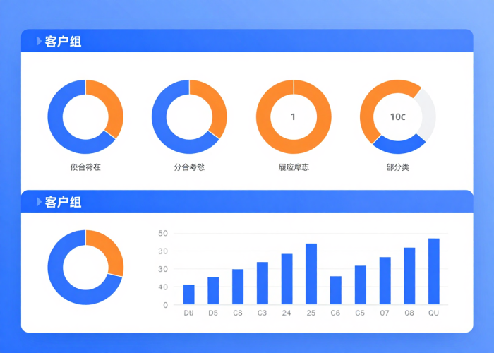
Surveys and Polling
Sampling Techniques
Pollsters utilize various sampling techniques to ensure representative results, which helps to gauge public opinion effectively and accurately.
Understanding the role of sampling in polling data
Margin of Error
The margin of error is crucial in surveys, indicating the potential range of error due to sample size and sampling methods used.
Predictive Modeling
Polling data is often used in predictive modeling, which helps to forecast election outcomes and understand voter behavior trends.
Source: Author, made with Canva

Slide 25

Applications in Research
Leveraging Sampling Techniques
Source: Author, made with Canva
Population Estimation
Hypothesis Testing
Confidence Intervals
Sampling distributions are crucial for accurately estimating population means and proportions, allowing researchers to make informed conclusions about larger groups based on smaller, manageable samples.
Researchers utilize sampling distributions to conduct hypothesis testing, providing a framework for determining the validity of assumptions or claims about population parameters through statistical significance.
Sampling distributions are essential for constructing confidence intervals, providing a range of values that likely contains the population parameter, thus enhancing the reliability of research findings.

Slide 26
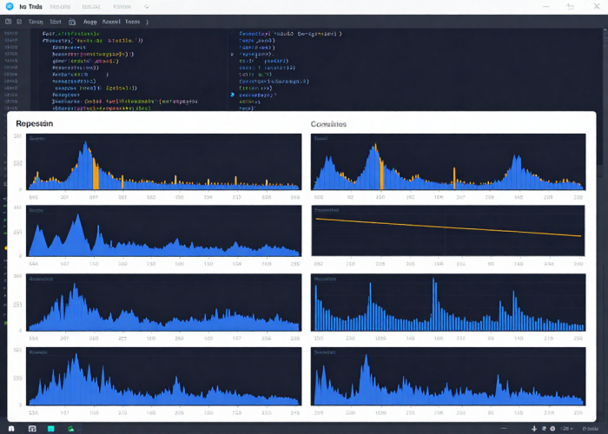
Applications in Data Science
Model Training
Sampling is essential for model training, allowing data scientists to optimize algorithms with representative datasets for improved predictions.
Utilizing sampling techniques to enhance data analysis processes
Variability Estimation
Data sampling helps estimate variability metrics, ensuring models generalize well to unseen data and maintain accuracy in real-world applications.
Bootstrapping Methods
Bootstrapping techniques leverage sampling distributions to create multiple datasets, enhancing statistical inference and providing robust insights from limited data.
Source: Author, made with Canva

Slide 27
Implementation in Data Science
How sampling distribution concepts power real-world data science workflows
1
2
3
Random Sampling
& Split Data
Train Model
& Cross-Validate
Bootstrap
& Estimate Error
• Train/test split (70/30)
• Stratified sampling
• Ensures representative data
• K-fold cross-validation
• Multiple sample means
• CLT ensures normality
• Resample with replacement
• Estimate SE of predictions
• Confidence intervals for metrics
Key Takeaways
Python Example
• Sampling distribution → foundation of ML evaluation
• SE helps quantify model uncertainty
• CLT allows normal approximation for
any metric (accuracy, loss, AUC)
• Bootstrap = resampling without
knowing population distribution
• More samples = more reliable models
import numpy as np
data = np.random.normal(mu=50, sigma=10, size=1000)
# Take 100 samples of size 30
sample_means = [np.mean(np.random.choice(data, 30))
for _ in range(100)]
se_estimated = np.std(sample_means)
print(f'SE = {se_estimated:.2f}') # ≈ 1.83

Slide 28
Case Study: Predicting Customer Churn
Applying sampling distribution & CLT in a real data science project
The Scenario
Step 1: Random Sampling
A telecom company has 50,000 customers.
They want to predict which customers
will cancel their subscription (churn).
Goal: Build a model that accurately
predicts churn using sampling concepts.
Dataset:
• Monthly charges
• Contract length
• Customer service calls
• Tenure (months)
• Churn label (yes/no)
Take n = 500 stratified random sample (preserving churn ratio 80/20).
Split into 70% train / 30% test.
Step 2: Train & Cross-Validate
Train logistic regression with 5-fold CV.
By CLT, mean accuracy across folds ≈ Normal → can compute SE.
Step 3: Bootstrap Confidence Interval
Bootstrap 1000 resamples from test predictions.
SE = 0.018, 95% CI for accuracy: [0.79, 0.86]
Step 4: Report Results
Report: "Model accuracy = 82% ± 3% (95% CI)."
Management can trust this range for decision-making.
💡 Insight: Without CLT & SE, we can't quantify how confident we are in our model's performance!

Slide 29
Summary
Key concepts from today's lecture
Normal Distribution
Sampling Distribution
Standard Error
• Bell-shaped, symmetric
• μ ± 1σ = 68%
• μ ± 2σ = 95%
• μ ± 3σ = 99.7%
• Distribution of x̄ from
repeated samples
• Mean = μ (population)
• Spread decreases with n
• SE = σ / √n
• Measures precision of x̄
• Larger n → smaller SE
• Key for confidence intervals
Central Limit Theorem
Applications
• x̄ → Normal as n increases
• Works for any population
• n ≥ 30 usually sufficient
• Foundation of inference
• Research & surveys
• Quality control
• Data science & ML
• Bootstrap estimation
These concepts form the foundation for hypothesis testing & confidence intervals in upcoming lectures.

Slide 30

Discussion & Reflection
Let’s discuss and clarify any concepts today
Reflection Question
"If you were a data scientist at an e-commerce company,
and asked to prove that the average delivery time
is less than 3 days based on a sample of 50 transactions —
Which concepts from today's lecture would you
use, and why?"
Hint: Sampling Distribution • CLT • Standard Error • Confidence Interval
Source: Author, made with Canva

Slide 31
References
[1] Moore, D. S., McCabe, G. P., & Craig, B. A. (2021). Introduction to the
Practice of Statistics (10th ed.). W.H. Freeman.
[2] Anderson, D. R., Sweeney, D. J., & Williams, T. A. (2020). Statistics for
Business and Economics (14th ed.). Cengage Learning.
[3] Wackerly, D. D., Mendenhall, W., & Scheaffer, R. L. (2014).
Mathematical Statistics with Applications (7th ed.). Cengage.
[4] James, G., Witten, D., Hastie, T., & Tibshirani, R. (2023). An Introduction
to Statistical Learning (2nd ed.). Springer.
[5] Khan Academy. (n.d.). Sampling distributions. Retrieved from
https://www.khanacademy.org/math/statistics-probability
[6] Python Software Foundation. (n.d.). NumPy & SciPy documentation.
https://numpy.org / https://scipy.org

Slide 32
THANK YOU
Contact Information
Reach out for more details or inquiries regarding the course.
Alfrian Carmen Talakua
Department of Information Systems
e-Mail : Alfriantalakua@unkriswina.ac.id

