Slide 1

STATISTICS AND PROBABILITY
Week 9 -Parameter Estimation: Estimators, Confidence Intervals in Decision Making
Alfrian Carmen Talakua
Department of Information Systems
2026

Slide 2


Learning Objectives
• Understand sampling distributions
• Define parameters vs statistics
• Explain point & interval estimation
• Interpret confidence intervals
• Understand margin of error
• Apply to real-world examples
Source: Author, made with Canva

Slide 3

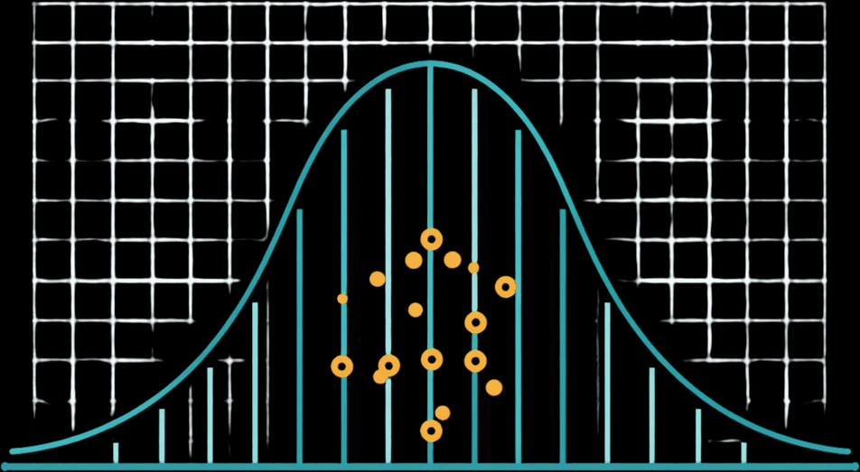
Review of Sampling Distribution
Sample means form a distribution centered around population mean μ
Distribution shape approaches normal as sample size increases
Spread (standard error) decreases with larger samples
σ
SE =
√n
Source: Author, made with Canva
SE = Standard Error σ = Population Std. Deviation n = Sample Size

Slide 4


Introduction to Inferential Statistics
Inferential statistics enables us to draw conclusions about populations using sample data, bridging the gap between observation and understanding.
Source: Author, made with Canva

Slide 5

Population vs Sample Review
Population
Sample
The entire group of interest with fixed, unknown parameters (μ, σ). Typically too large to measure completely. We seek to understand its true characteristics.
A representative subset drawn from the population. Statistics (x̄, s) are computed from sample data and used to estimate unknown population parameters.
Population Parameters: μ, σ
Sample Statistics: x̄, s

Slide 6


What is Parameter Estimation?
Parameter estimation is the process of using sample data to infer the value of unknown population parameters.
Sample Data
Estimate
Population Parameter
Source: Author, made with Canva

Slide 7





Why Estimation is Important
Predictive Modeling & ML Pipelines
A/B Testing & Experiment Design
Clinical Trials & Biostatistics
Time-Series Forecasting & Analytics

Slide 8

Parameter vs Statistic
Parameter (μ)
Statistic (x̄)
Fixed, unknown population value that describes the entire population. Denoted by Greek letters (μ, σ). Constant but typically unmeasurable directly.
Calculated from sample data, used to estimate the parameter. Denoted by Latin letters (x̄, s). Varies from sample to sample but observable.

Slide 9

Types of Estimation
Point Estimation
Interval Estimation
• Single best guess value
• Example: x̄ estimates μ
• Precise but no uncertainty
• Range of plausible values
• Includes uncertainty measure
• Example: 95% CI
x̄ = 52.3
Lower
x̄
Upper

Slide 10


What is a Point Estimate?
A point estimate is a single value calculated from sample data that serves as our best guess for an unknown population parameter.
x̄ = 52.3

Slide 11

What is Interval Estimation?
Interval estimation provides a range of plausible values with lower and upper bounds, expressing the uncertainty around our parameter estimate.
Lower
x̄
Upper

Slide 12

Introduction to Confidence Intervals
Interval estimate paired with a confidence level (e.g., 95%)
Bounds define range of plausible parameter values
Statistical confidence reflects long-run reliability of method
95% Confidence Interval
Lower
x̄
Upper

Slide 13

Confidence Level (90%, 95%, 99%)
90% Confidence Level
95% Confidence Level
99% Confidence Level
Narrowest interval width. 90% of intervals from repeated samples will contain the true parameter. Lower coverage but more precise estimate.
Most commonly used standard. 95% of intervals will capture the true parameter. Balanced trade-off between precision and coverage probability.
Widest interval width. 99% coverage probability means greater certainty but less precision. Used when high confidence is critical.

Slide 14

Understanding Margin of Error
The margin of error represents the distance from the point estimate to the interval bounds, quantifying the uncertainty magnitude in our estimation.
Margin of Error
Margin of Error
Lower
Bound
Point Estimate
Upper
Bound
ME = Z * (σ / √n)

Slide 15

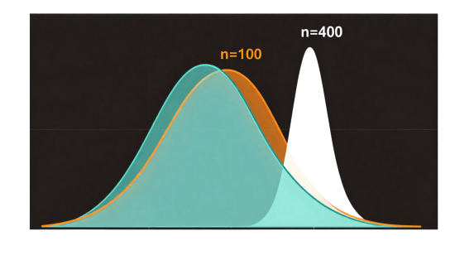
Standard Error Review
• Formula: SE = σ/√n (or s/√n for sample)
• Measures variability of the sampling distribution
• Smaller SE → more precise estimates
Effect of Sample Size (σ = 10)
n = 25
SE = 10/√25 = 2.00
Key Insight
n ↑ 4x → SE ↓ ½
Larger sample size,
smaller standard error,
more precise estimation.
n = 100
SE = 10/√100 = 1.00
n = 400
SE = 10/√400 = 0.50
n = 1600
SE = 10/√1600 = 0.25
↑ Sample size 4x → SE reduced by half (½)
Source: Author, made with Canva

Slide 16

Confidence Interval Formula
CI = point estimate ± (critical value × standard error)
Point estimate: sample statistic (e.g., x̄) as best guess
Critical value: z* or t* based on confidence level

Slide 17

Interpreting Confidence Intervals
Interval estimates plausible parameter values
Confidence level = long-run frequency of containing parameter
Not probability that parameter lies in interval for fixed data Interpret with caution: context matters
Source: Author, made with Canva

Slide 18
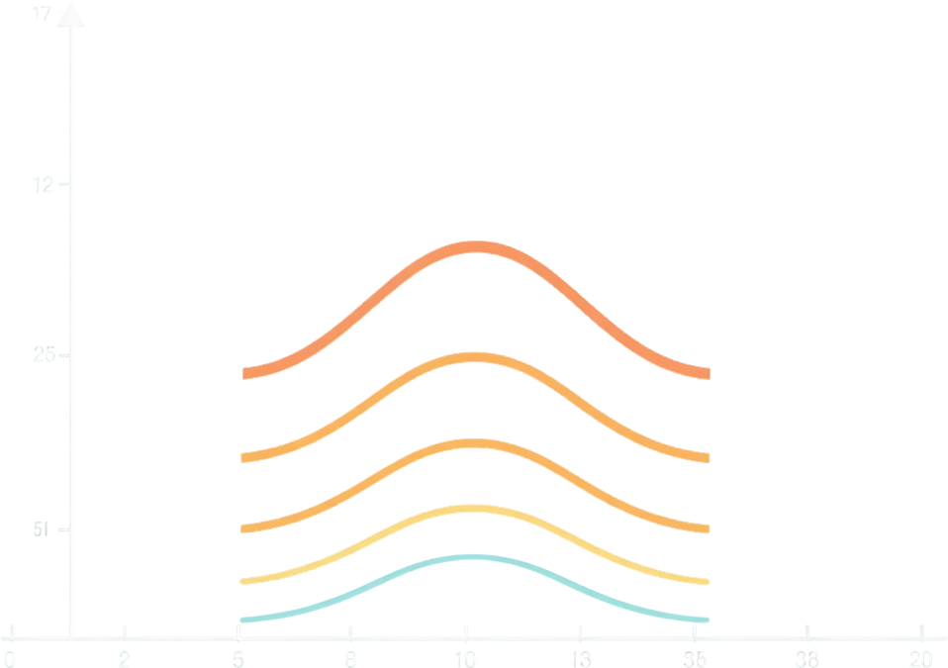
Visualizing Confidence Intervals
Multiple confidence intervals from repeated samples demonstrate how some contain the true parameter while others do not—illustrating interval reliability.
Source: Author, made with Canva

Slide 19
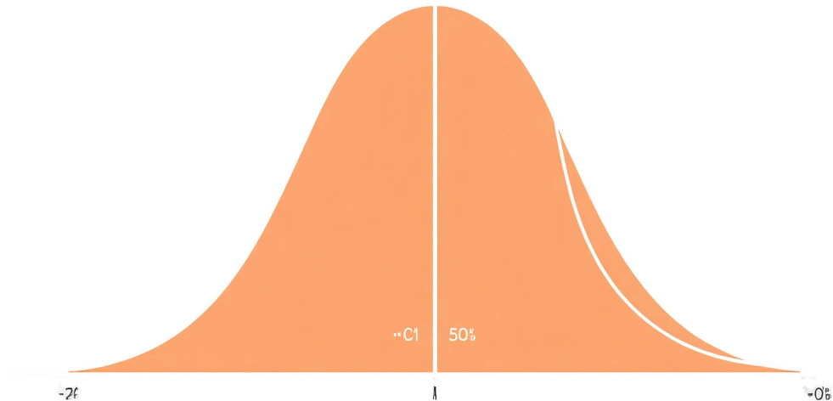
Confidence Interval on Bell Curve
95%
The shaded central area represents the confidence level (e.g., 95%), with critical values zα/2 marking the boundaries on both tails.
Source: Author, made with Canva

Slide 20
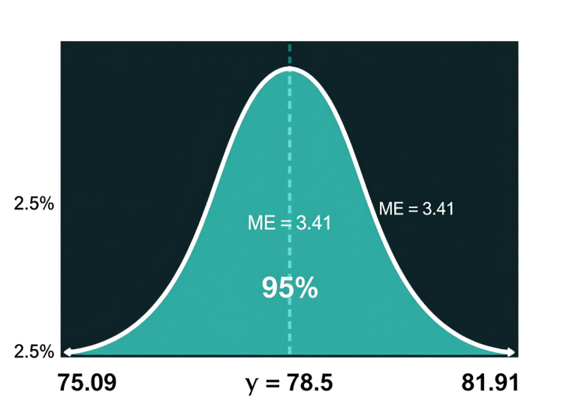
Real-world Example: Student Test Scores
Sample of 50 students: x̄ = 78.5, s = 12.3
95% CI: [75.09, 81.91] for population mean
Step-by-Step Calculation:
1. SE = s/√n = 12.3/√50 = 12.3/7.07 = 1.74
2. zα/2 = 1.96 (for 95% confidence)
3. Margin of Error = z × SE = 1.96 × 1.74 = 3.41
4. CI = x̄ ± ME = 78.5 ± 3.41 = [75.09, 81.91] ≈ [75, 82]
Source: Author, made with Canva

Slide 21
Example: Server Response Time
Case Study: IT team monitors web server performance for SLA compliance
INPUT DATA:
• Sample size (n) = 40 server requests
• Sample mean (x̄) = 245 ms
• Sample std dev (s) = 38 ms
• Confidence level = 95% (z = 1.96)
WORKFLOW
Step 1: Collect Data
n=40, x̄=245, s=38
↓
STEP-BY-STEP CALCULATION:
Step 1: SE = s/√n = 38/√40 = 38/6.32 = 6.01 ms
Step 2: Margin of Error = z × SE = 1.96 × 6.01 = 11.78 ms
Step 3: CI = x̄ ± ME = 245 ± 11.78
Step 4: CI = [233.22, 256.78] ms
Step 2: Calculate SE
SE = s/√n = 6.01
↓
Step 3: Find z-value
z = 1.96 (95%)
↓
Step 4: Compute ME
ME = z×SE = 11.78
OUTPUT & INTERPRETATION:
95% CI: [233.22, 256.78] ms
→ We are 95% confident the true mean response time is between 233 and 257 ms.
→ SLA threshold = 300 ms → Server performance is within acceptable range.
↓
Step 5: Build CI
[233.22, 256.78]
↓
Step 6: Interpret
Within SLA ✓

Slide 22
CI in Research: Drug Trial Example
Case Study: Testing a new drug's effect on blood pressure reduction
WORKFLOW
Step 1: Collect Trial Data
n=60, x̄=12.4, s=5.8
INPUT DATA:
• Treatment group (n) = 60 patients
• Mean BP reduction (x̄) = 12.4 mmHg
• Sample std dev (s) = 5.8 mmHg
• Confidence level = 95% (z = 1.96)
↓
Step 2: Calculate SE
SE = 5.8/√60 = 0.75
↓
STEP-BY-STEP CALCULATION:
Step 1: SE = s/√n = 5.8/√60 = 5.8/7.75 = 0.75 mmHg
Step 2: zα/2 = 1.96 (for 95% confidence)
Step 3: ME = z × SE = 1.96 × 0.75 = 1.47 mmHg
Step 4: CI = 12.4 ± 1.47 = [10.93, 13.87] mmHg
Step 3: Determine z-value
z = 1.96 (95%)
↓
Step 4: Compute ME
ME = 1.96×0.75 = 1.47
↓
OUTPUT & INTERPRETATION:
95% CI: [10.93, 13.87] mmHg
→ We are 95% confident the drug reduces BP by 10.93 to 13.87 mmHg.
→ CI does NOT include 0 → Drug has statistically significant effect.
→ Clinically meaningful (>5 mmHg threshold) → Recommend for Phase 3 trial.
Step 5: Build CI
[10.93, 13.87]
↓
Step 6: Clinical Decision
Significant ✓ Phase 3

Slide 23
Example: Quarterly Sales Forecasting
Case Study: E-commerce company estimates average order value for Q4 budget planning
INPUT DATA:
• Sample size (n) = 200 transactions (random sample from Q3)
• Sample mean order value (x̄) = $87.50
• Sample std dev (s) = $32.40
• Confidence level = 95% (z = 1.96)
WORKFLOW
Step 1: Sample Q3 Data
n=200, x̄=$87.50, s=$32.40
↓
Step 2: Calculate SE
SE = 32.40/√200 = $2.29
STEP-BY-STEP CALCULATION:
Step 1: SE = s/√n = 32.40/√200 = 32.40/14.14 = $2.29
Step 2: zα/2 = 1.96 (for 95% confidence)
Step 3: ME = z × SE = 1.96 × 2.29 = $4.49
Step 4: CI = 87.50 ± 4.49 = [$83.01, $91.99]
↓
Step 3: Determine z-value
z = 1.96 (95%)
↓
Step 4: Compute ME
ME = 1.96×2.29 = $4.49
OUTPUT & INTERPRETATION:
95% CI: [$83.01, $91.99] per order
→ We are 95% confident the true avg order value is between $83 and $92.
→ Q4 projected orders = 10,000 → Revenue range: $830K – $920K
→ Budget conservatively at $830K, target at $875K (point estimate).
↓
Step 5: Build CI
[$83.01, $91.99]
↓
Step 6: Business Decision
Budget: $830K–$920K

Slide 24


Excel-Based CI Calculation
Case: Data in cells A2:A201 (200 transaction values from Q3)
Step
Description
Excel Formula
Cell
Result
1
Sample Mean
=AVERAGE(A2:A201)
B2
$87.50
2
Std Deviation
=STDEV.S(A2:A201)
B3
$32.40
3
Sample Size
=COUNT(A2:A201)
B4
200
4
Std Error
=B3/SQRT(B4)
B5
$2.29
5
Margin of Error
=CONFIDENCE.T(0.05, B3, B4)
B6
$4.52
6
Lower Bound
=B2 - B6
B7
$82.98
7
Upper Bound
=B2 + B6
B8
$92.02
NOTES:
• CONFIDENCE.T(alpha, std_dev, size) → uses t-distribution (recommended for samples)
• CONFIDENCE.NORM(alpha, std_dev, size) → uses z-distribution (large n only)
• Alpha = 1 - confidence level (e.g., 0.05 for 95% CI)
• For n > 30, both give similar results. Use CONFIDENCE.T as default.
OUTPUT: 95% CI = [$82.98, $92.02] → True avg order value lies in this range.

Slide 25

Common Mistakes in Interpretation
CI is not the probability parameter lies inside
Confidence level ≠ one-sample coverage
Narrower interval is not always better
Sample must be representative
Source: Author, made with Canva

Slide 26
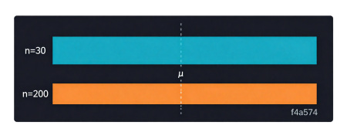
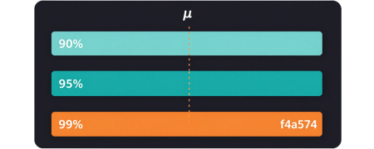
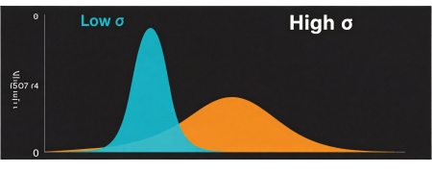
Factors Affecting Confidence Intervals
Sample Size (n)
Confidence Level
Population Variability
Larger sample sizes reduce standard error, resulting in narrower confidence intervals. Doubling n reduces interval width by factor of √2.
Higher confidence levels (90% → 95% → 99%) require wider intervals to capture the parameter more reliably. Trade-off between certainty and precision.
Greater variability (σ) in the population leads to wider confidence intervals. More spread in data means less certainty about the true parameter value.
Source: Author, made with Canva
Source: Author, made with Canva
Source: Author, made with Canva

Slide 27
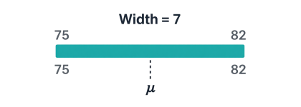

Narrow vs Wide Confidence Intervals
Narrow Interval
Wide Interval
• Higher precision in estimate
• Lower confidence level
• Larger sample size required
• Better for precise decisions
• Risk: may miss true parameter
• Lower precision in estimate
• Higher confidence level
• Smaller sample size acceptable
• Safer for critical decisions
• Trade-off: less actionable insight
Source: Author, made with Canva
Source: Author, made with Canva
Source: Author, made with Canva

Slide 28

Practical Applications in Data Science
A/B Testing
Anomaly Detection
Compare conversion rates between variants using confidence intervals to determine if differences are statistically meaningful before rolling out changes.
Establish confidence intervals around normal behavior patterns to identify outliers and flag unusual data points in real-time monitoring systems.
Model Parameters
ML Workflows
Quantify uncertainty in machine learning model coefficients and hyperparameters, enabling robust predictions with known confidence bounds.
Integrate interval estimation throughout data pipelines—from feature engineering to model validation—ensuring reliable, uncertainty-aware analytics.

Slide 29
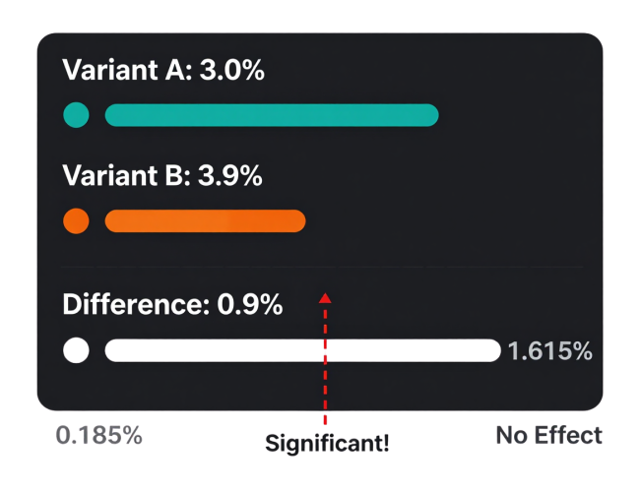
A/B Testing: Landing Page Conversion
Case: E-commerce tests new checkout button color (A=blue, B=green) to increase conversion rate
INPUT DATA:
• Variant A (control): n₁ = 5,000 visitors, conversions = 150 (p₁ = 3.0%)
• Variant B (new): n₂ = 5,000 visitors, conversions = 195 (p₂ = 3.9%)
• Observed difference: Δp = 3.9% - 3.0% = 0.9%
• Confidence level = 95%
STEP-BY-STEP:
Step 1: SE = √[p₁(1-p₁)/n₁ + p₂(1-p₂)/n₂]
= √[0.03×0.97/5000 + 0.039×0.961/5000]
= √[0.00000582 + 0.00000749] = 0.00365
Step 2: ME = 1.96 × 0.00365 = 0.00715 (0.715%)
Step 3: CI for Δp = 0.9% ± 0.715% = [0.185%, 1.615%]
OUTPUT & DECISION:
95% CI for difference: [0.185%, 1.615%]
→ CI does NOT include 0 → Difference is statistically significant
→ Variant B wins! Roll out green button → Expected +45 conversions/day
Source: Author, made with Canva

Slide 30
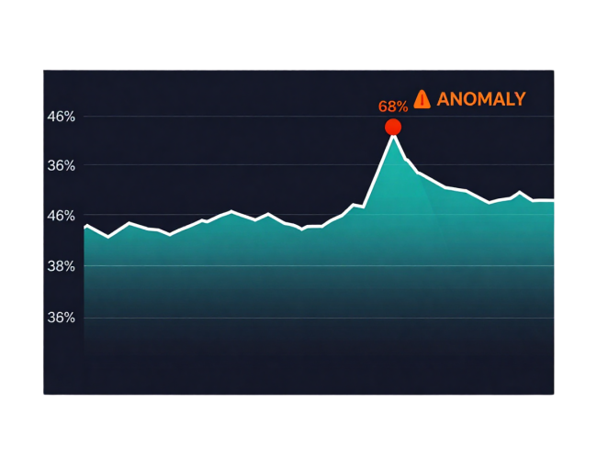
Anomaly Detection: Server Monitoring
Case: DevOps team uses CI to detect abnormal CPU usage spikes in production servers
INPUT DATA (Baseline - 30 days normal):
• Sample size (n) = 30 days of hourly avg CPU
• Mean CPU usage (x̄) = 42%
• Std deviation (s) = 8%
• Confidence level = 99% (z = 2.576)
• Current reading = 68%
STEP-BY-STEP:
Step 1: SE = s/√n = 8/√30 = 8/5.48 = 1.46%
Step 2: ME = z × SE = 2.576 × 1.46 = 3.76%
Step 3: Normal range CI = 42% ± 3.76% = [38.24%, 45.76%]
Step 4: Current = 68% > Upper bound 45.76%
Step 5: Deviation = (68 - 42)/8 = 3.25 std devs (ANOMALY!)
OUTPUT & ACTION:
99% CI normal range: [38.24%, 45.76%]
→ Current 68% is FAR outside CI → ALERT triggered
→ Auto-scale servers + notify on-call engineer
→ Root cause: unoptimized query in latest deployment
Source: Author, made with Canva

Slide 31
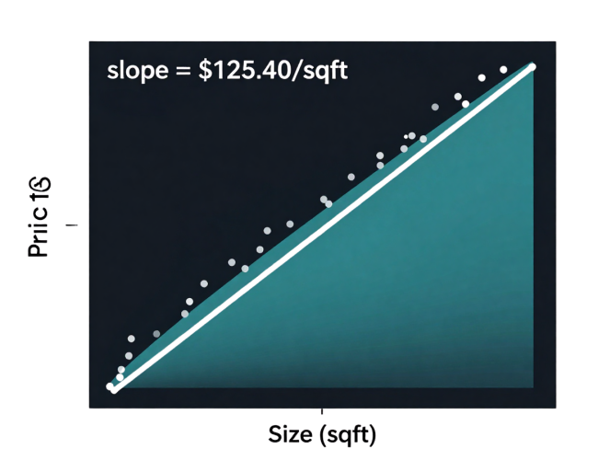
Model Parameters: Linear Regression CI
Case: Predicting house price based on size (sqft) — how reliable is the slope coefficient?
INPUT DATA:
• Model: Price = β₀ + β₁(Size) + ε
• Sample: n = 80 houses
• Estimated slope: β̂₁ = $125.40 per sqft
• Standard error of β̂₁: SE = $18.60
• Confidence level = 95%, df = 78, t = 1.991
STEP-BY-STEP:
Step 1: Point estimate: β̂₁ = $125.40/sqft
Step 2: ME = t × SE = 1.991 × 18.60 = $37.03
Step 3: CI = β̂₁ ± ME = 125.40 ± 37.03
Step 4: CI = [$88.37, $162.43] per sqft
Step 5: t-stat = 125.40/18.60 = 6.74 > 1.991 → Significant
OUTPUT & INTERPRETATION:
95% CI for slope: [$88.37, $162.43] per sqft
→ CI does NOT include 0 → Size is a significant predictor of price
→ Each extra sqft adds between $88 and $162 to house price
→ Use for pricing model with known uncertainty bounds
Source: Author, made with Canva

Slide 32
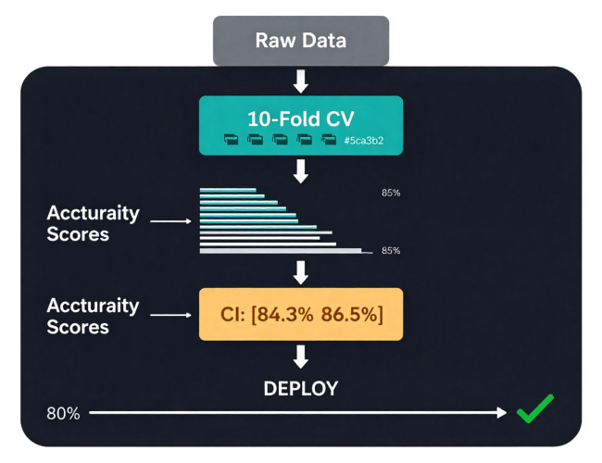
ML Workflows: Cross-Validation CI
Case: Estimating true model accuracy with CI from k-fold cross-validation before deployment
INPUT DATA:
• Model: Random Forest classifier (churn prediction)
• 10-fold cross-validation accuracies:
[0.847, 0.862, 0.831, 0.855, 0.878, 0.843, 0.869, 0.851, 0.838, 0.866]
• Mean accuracy (x̄) = 0.854
• Std dev (s) = 0.0148
• k = 10 folds, df = 9, t = 2.262 (95%)
STEP-BY-STEP:
Step 1: SE = s/√k = 0.0148/√10 = 0.0148/3.162 = 0.00468
Step 2: ME = t × SE = 2.262 × 0.00468 = 0.01058
Step 3: CI = x̄ ± ME = 0.854 ± 0.01058
Step 4: CI = [0.8434, 0.8646] or [84.3%, 86.5%]
OUTPUT & DEPLOYMENT DECISION:
95% CI for model accuracy: [84.3%, 86.5%]
→ We are 95% confident true accuracy is between 84.3% and 86.5%
→ Business threshold = 80% → Lower bound 84.3% > 80% → Safe to deploy
→ Report to stakeholders: "Model performs 84–87% in production"
Source: Author, made with Canva

Slide 33

Summary
  Sampling distributions form the foundation for inference
  Point vs interval estimation serve different purposes
  Confidence intervals quantify estimation uncertainty
  Interpret CI as long-run frequency, not probability
  Applications span research, business, and data science

Slide 34


Discussion Questions
  How does sample size affect confidence intervals in practice?
  Why can't we say there is a 95% probability the parameter lies in the computed interval?
  Discuss real-life scenarios where interval estimation is critical.
  What trade-offs exist between precision and confidence level?
Source: Author, made with Canva

Slide 35


Class Activity
  Calculate confidence intervals from sample datasets
  Interpret given intervals and explain findings
  Compare results with different confidence levels
  Discuss how sample size affects your intervals
Source: Author, made with Canva

Slide 36

Conclusion
Confidence intervals are foundational tools that bridge sample data to population insights. Continue practicing interval calculations and interpretations—these skills are essential for hypothesis testing in our next lecture.

Slide 37
References
1. Walpole, R. E., Myers, R. H., Myers, S. L., & Ye, K. (2016). Probability & Statistics for Engineers & Scientists (9th ed.). Pearson.
2. Devore, J. L. (2015). Probability and Statistics for Engineering and the Sciences (9th ed.). Cengage Learning.
3. Montgomery, D. C., & Runger, G. C. (2018). Applied Statistics and Probability for Engineers (7th ed.). Wiley.
4. Agresti, A., & Franklin, C. (2018). Statistics: The Art and Science of Learning from Data (4th ed.). Pearson.
5. Navidi, W. (2020). Statistics for Engineers and Scientists (5th ed.). McGraw-Hill.
6. Hogg, R. V., McKean, J. W., & Craig, A. T. (2019). Introduction to Mathematical Statistics (8th ed.). Pearson.
7. James, G., Witten, D., Hastie, T., & Tibshirani, R. (2021). An Introduction to Statistical Learning (2nd ed.). Springer.
8. Microsoft Support. (2024). CONFIDENCE.T function. https://support.microsoft.com/en-us/office/confidence-t-function
All illustrations and diagrams: Author, made with Canva (2026)

Slide 38

THANK YOU
Contact Information
Reach out for more details or inquiries regarding the course.
Alfrian Carmen Talakua
Department of Information Systems
e-Mail : Alfriantalakua@unkriswina.ac.id

