Slide 1


STATISTICS AND PROBABILITY
Week 10 - Hypothesis Testing
Basic Concepts, Types of Errors, and Applications
in Digital Business
Alfrian Carmen Talakua
Department of Information Systems
2026
Source: Author, Made with Canva

Slide 2





Learning Objectives
What You Will Learn Today
Understand Basics
Learn Error Types
Apply to Business
Interpret p-values
Grasp the fundamental concepts of hypothesis testing and statistical decision making.
Distinguish between Type I and Type II errors in statistical analysis.
Apply hypothesis testing concepts to real digital business scenarios and analytics.
Correctly interpret p-values to make sound statistical decisions in research and business.
Source: Author, Made with Canva

Slide 3

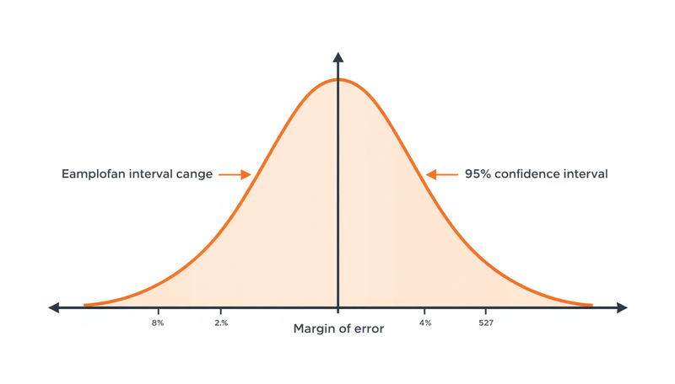
Foundation Review
Quick Review of Confidence Intervals
Before diving into hypothesis testing, let's revisit confidence intervals—the statistical foundation that bridges sample data to population inference.
  What is a Confidence Interval?
A range of values likely to contain the true population parameter with a specified level of confidence.
  Key Components
Sample mean ± margin of error, where margin depends on standard error and confidence level.
  Link to Hypothesis Testing
If a hypothesized value falls outside the CI, we reject H₀—the conceptual bridge to testing.
Source: Author, Made with Canva

Slide 4
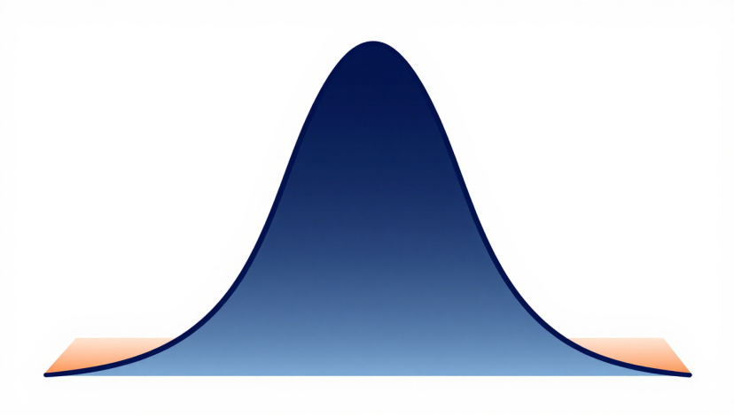
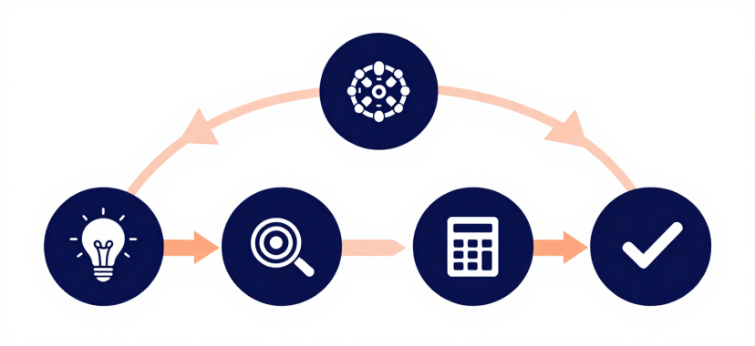
Introduction to Hypothesis Testing
What is Hypothesis Testing?
Hypothesis testing is a statistical method used to test assumptions about population parameters based on sample data. It provides a structured framework for making data-driven decisions under uncertainty.
Key Components:
• Formulate a testable claim
• Analyze sample evidence
• Make informed decisions
Source: Author, Made with Canva

Slide 5


Why Hypothesis
Testing Matters
  Data-driven decisions
  A/B testing
  User behavior analysis
  Fraud detection
  Recommendation systems
  User retention analysis
Source: Author, Made with Canva

Slide 6
Decision Framework
Statistical Decision Making Framework
Step 1
Step 2
Step 3
Step 4
Formulate hypothesis: Define H₀ and H₁ based on research question.
Collect data: Gather sample data through experiments or observations.
Compute test statistic: Calculate Z-score, t-statistic, or p-value.
Make decision: Reject or fail to reject H₀ based on results.

Slide 7
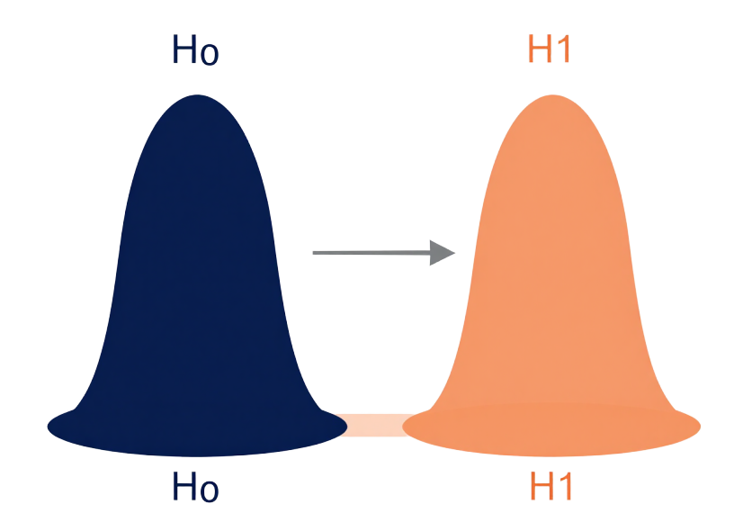
Hypothesis Testing Fundamentals
What is a Statistical Hypothesis?
Null Hypothesis (H₀)
A statement of no effect or status quo.
Example: "The new feature has no impact on user engagement."
Alternative Hypothesis (H₁)
A statement that contradicts H₀, representing an effect or difference.
Example: "The new feature increases user engagement."
Source: Author, Made with Canva

Slide 8
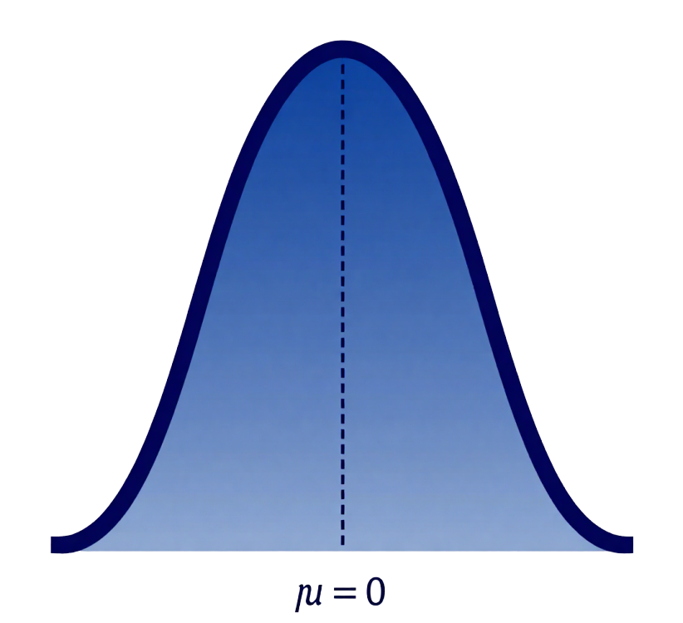
Null Hypothesis (H₀)
The Status Quo Statement
The null hypothesis (H₀) represents the default assumption that there is no effect, no difference, or no change in the population. It is the statement we test against and attempt to reject with evidence.
Key Principle: "No Effect"
Default Assumption: Status Quo
Goal: Test Against H₀
Source: Author, Made with Canva

Slide 9
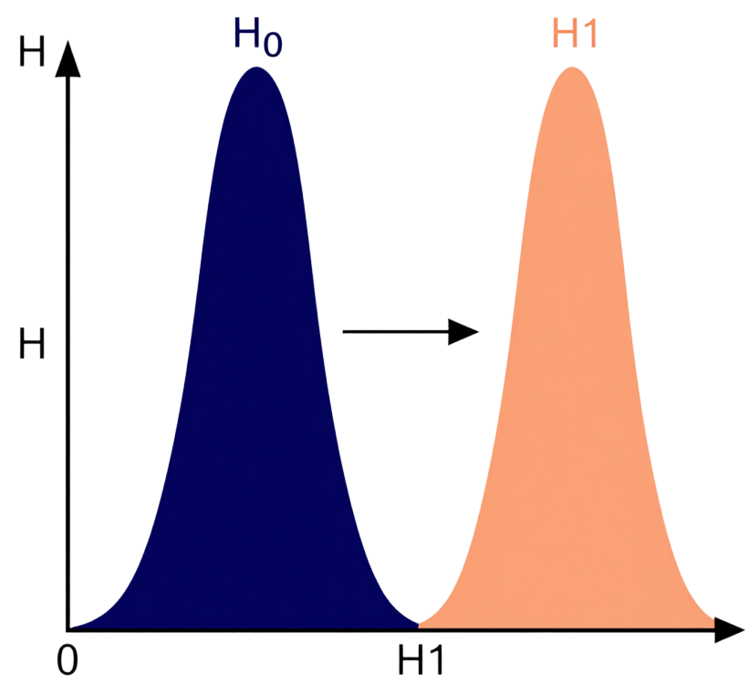
Alternative Hypothesis
Understanding H₁
The alternative hypothesis (H₁) is the statement that contradicts the null hypothesis. It represents the effect, difference, or change that the researcher is trying to detect through statistical testing.
Contradicts H₀
Represents Effect or Change
What We Aim to Prove
Source: Author, Made with Canva

Slide 10

Hypothesis Testing Fundamentals
Examples of Hypotheses
Practical hypothesis examples relevant to digital business analytics and data-driven decision making.
  Ad Campaign Click-Through Rate
H₀: μ₁ = μ₂ (no increase in CTR)
H₁: μ₁ > μ₂ (new campaign increases CTR)
  Website Conversion Rate
H₀: μ = 2% (no change)
H₁: μ ≠ 2% (conversion rate differs)
User Engagement Testing
H₀: μ = μ₀ (no effect on session duration)
H₁: μ > μ₀ (new feature increases duration)
Source: Author, Made with Canva

Slide 11
Hypothesis Testing Process
Steps in Hypothesis Testing
Step 1
Step 2
Step 3
Step 4
Step 5
Define hypotheses (H₀ and H₁) based on research question.
Choose significance level (α): typically 0.05, 0.01, or 0.10.
Collect sample data and calculate the test statistic (Z or t).
Make decision: reject or fail to reject H₀.
Interpret results: explain practical meaning of p-value and conclusion.

Slide 12
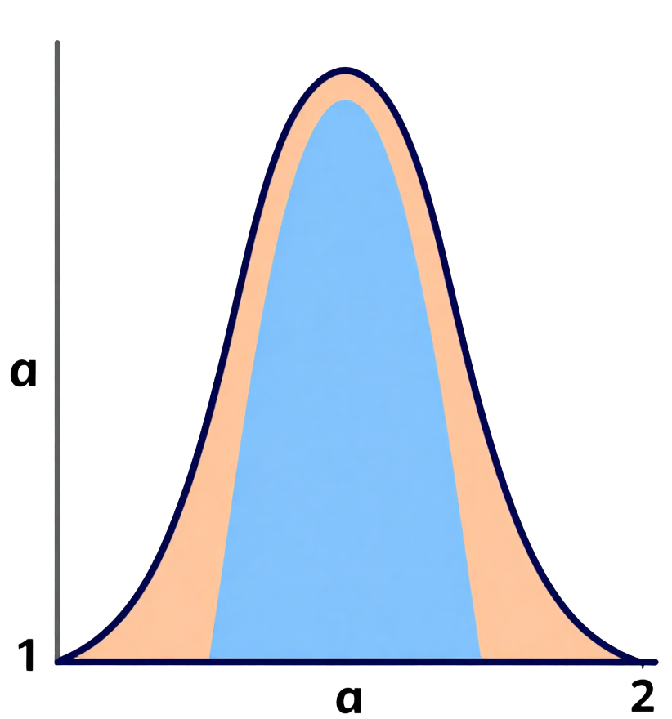
Significance Level
Understanding α
The significance level (α) is the threshold probability for rejecting H₀ when it is actually true. It represents the maximum acceptable risk of making a Type I error in your statistical decision.
Common α Values:
α = 0.05 (5% risk)
α = 0.01 (1% risk)
α = 0.10 (10% risk)
Source: Author, Made with Canva

Slide 13
Statistical Decision Making
Rejection Region vs Acceptance Region
Decision Rule
Rejection Region
Critical Value
Acceptance Region
Location
Tail(s) of distribution
Boundary point (Zα)
Center of distribution
Decision
Reject H₀
Compare statistic
Fail to reject H₀
Probability
α (e.g., 5%)
Significance level
1 - α (e.g., 95%)
Color Code
Orange shaded
Marked on curve
Blue/white area

Slide 14
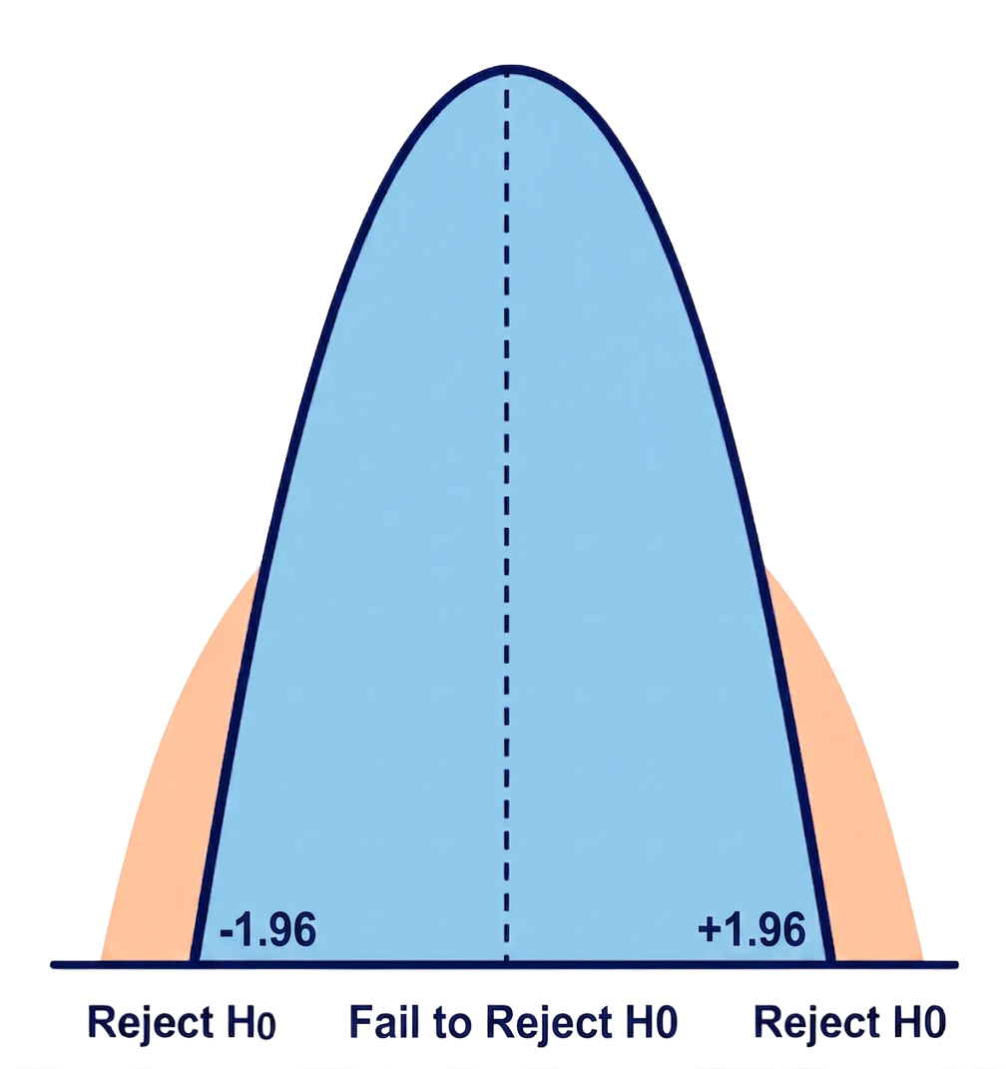
Bell Curve Visualization
Normal Distribution for Hypothesis Testing
The bell curve illustrates how we make statistical decisions. Critical values divide the distribution into rejection and acceptance regions, determining when we reject H₀.
α = 0.05 (two-tailed)
Critical values: ±1.96
Rejection regions: tails
Source: Author, Made with Canva

Slide 15
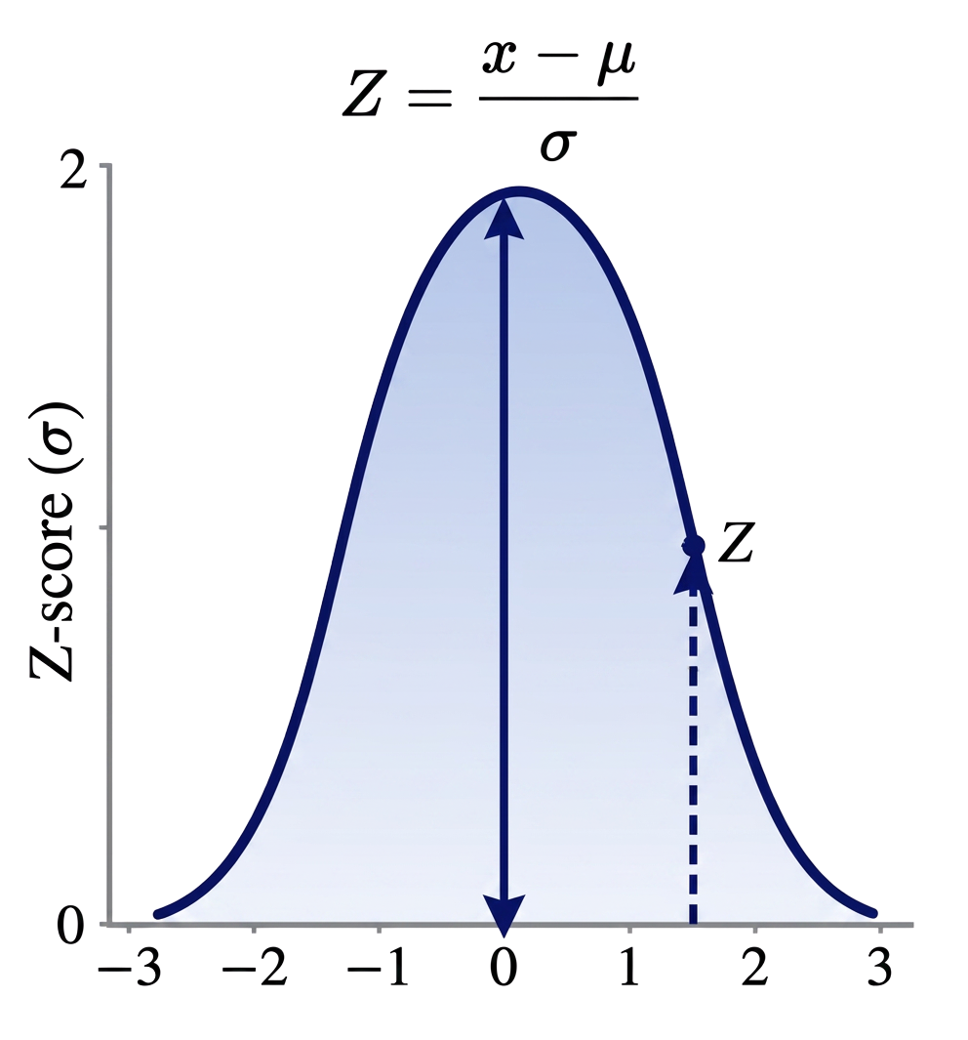
Understanding Test Statistics
Test Statistics Explained
A test statistic measures how far your sample result deviates from the null hypothesis. It converts your data into a standardized value that can be compared against known distributions.
Z-score: Used when σ is known
t-statistic: Used when σ is unknown
Both measure standard deviations from H₀
Source: Author, Made with Canva

Slide 16
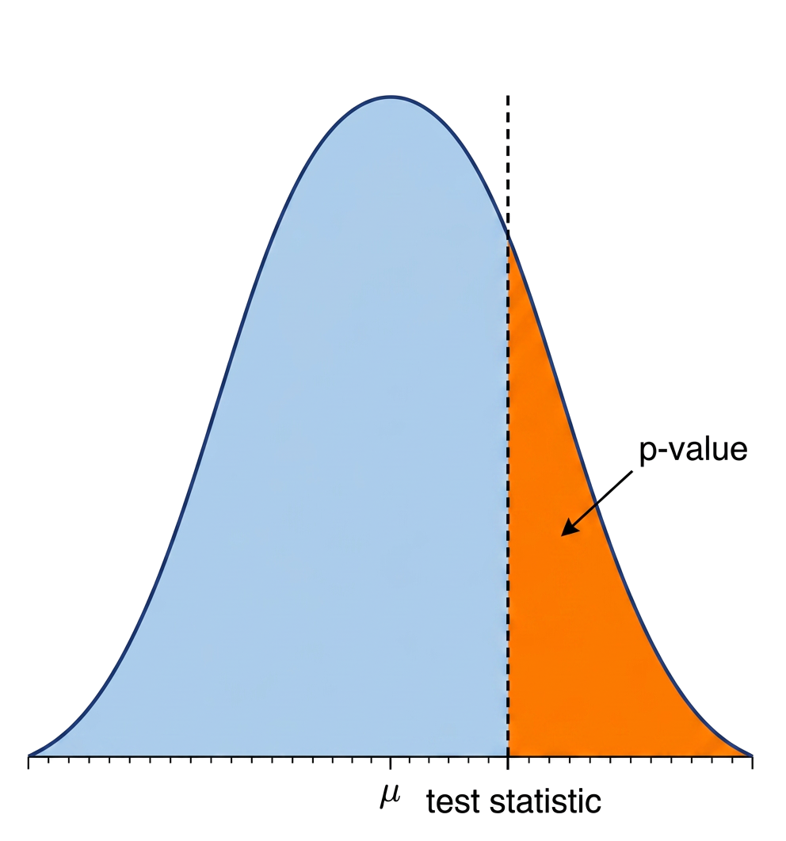
Introduction to p-value
Understanding the p-value
The p-value is the probability of obtaining a test result at least as extreme as the observed result, assuming the null hypothesis (H₀) is true. It quantifies the strength of evidence against H₀.
Key Insight:
Smaller p-value = Stronger evidence against H₀
Larger p-value = Weaker evidence against H₀
Source: Author, Made with Canva

Slide 17
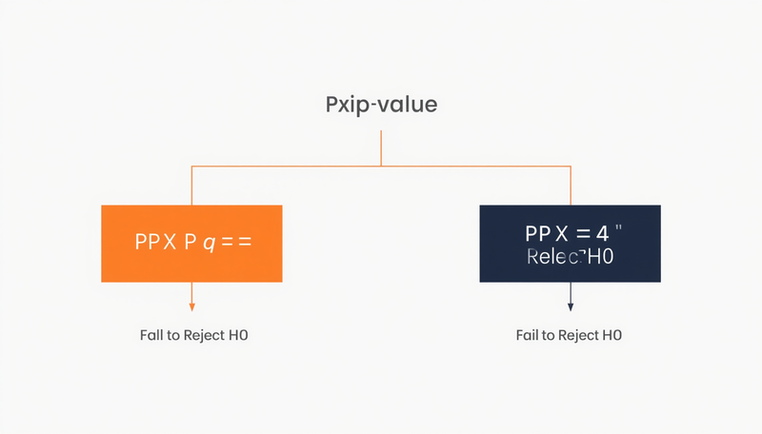
Decision Rules
How to Interpret p-value
Understanding the decision rules for p-value interpretation is essential for making correct statistical conclusions in hypothesis testing.
If p-value ≤ α → Reject H₀
Reject H₀ — Evidence is strong enough to conclude a significant effect exists.
If p-value > α → Fail to Reject H₀
Fail to reject H₀ — Insufficient evidence to conclude an effect; the null hypothesis stands.
  Key Reminder
Failing to reject H₀ does not mean H₀ is true — it means we lack sufficient evidence against it.
Source: Author, Made with Canva

Slide 18
Understanding p-values
Small p-value vs Large p-value
Characteristic
Small p-value
Large p-value
Implication
Test Statistic Position
Far in tail (rejection region)
Near center (acceptance region)
Different conclusions
Probability Value
p ≤ 0.05
p > 0.05
Threshold comparison
Decision
Reject H₀
Fail to reject H₀
Opposite outcomes
Evidence Strength
Strong against H₀
Weak against H₀
Confidence level
Example: p = 0.001 → Strong evidence, Reject H₀
Example: p = 0.48 → Weak evidence, Fail to Reject H₀

Slide 19
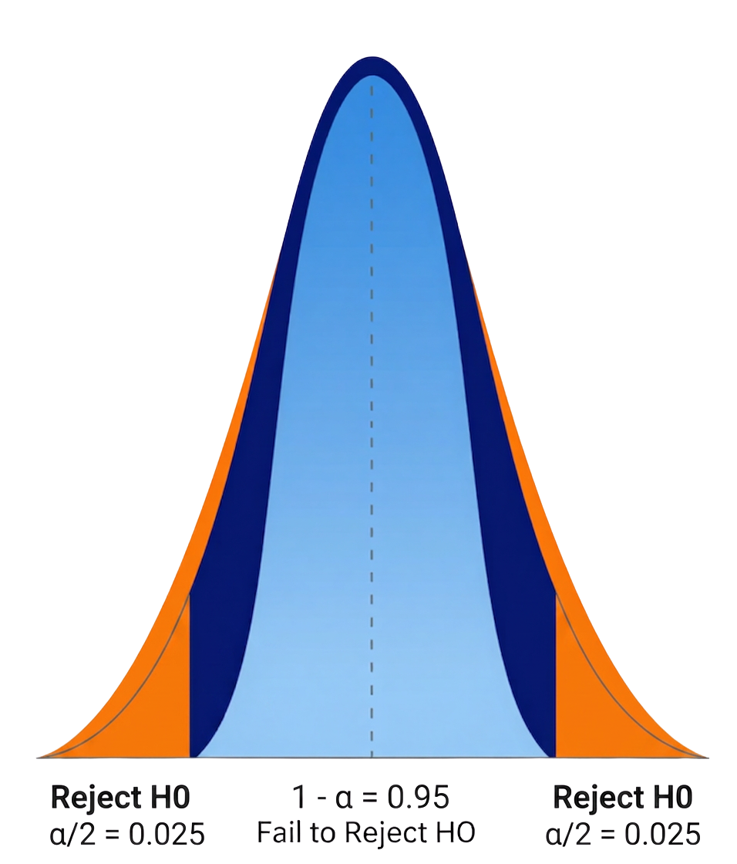
Type I Error
Type I Error (α)
A Type I error occurs when we reject a true null hypothesis—a false positive. This means concluding there is an effect when none actually exists. The probability of making this error equals α, our chosen significance level.
Significance Level: α = 0.05
False Positive Rate: 5%
Analogy: Fire alarm with no fire
Source: Author, Made with Canva

Slide 20
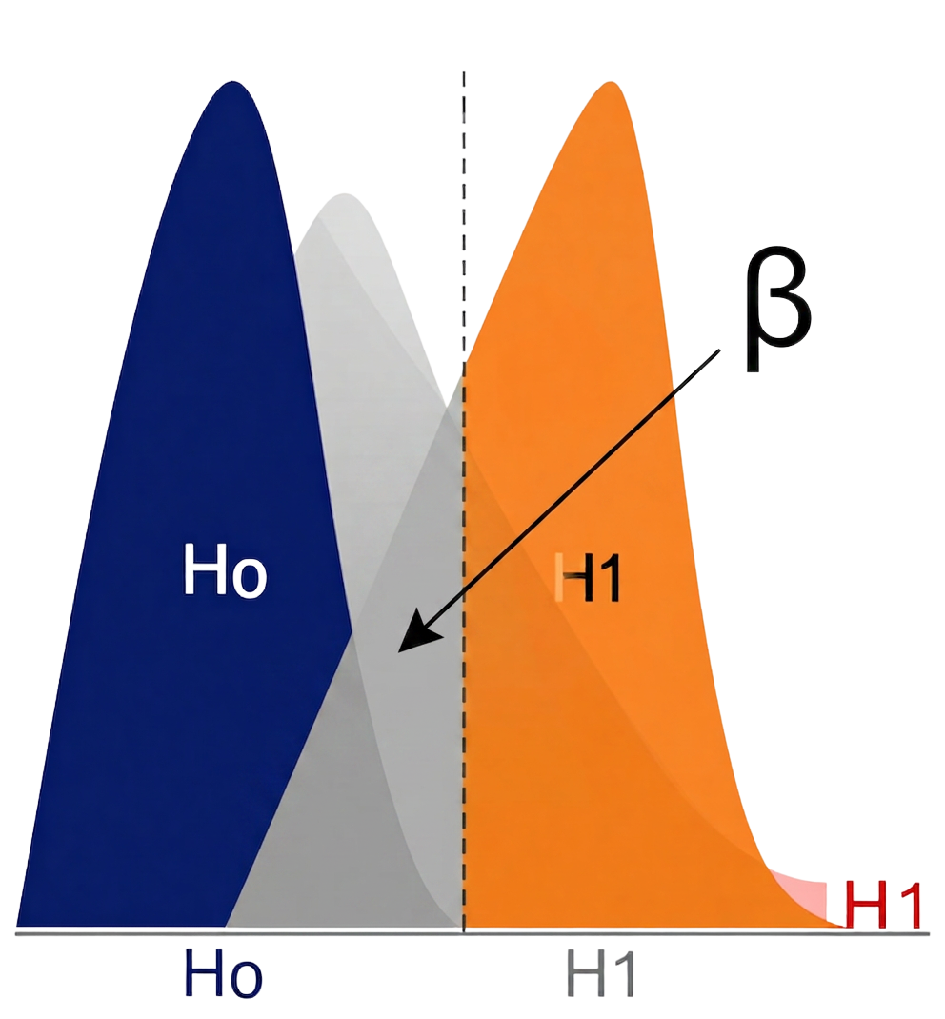
Type II Error (β)
False Negative Error
Type II error occurs when we fail to reject a false null hypothesis. This means missing a real effect that actually exists—a critical concern in digital business analytics.
β = P(Type II Error)
Power = 1 - β
Higher power = Better detection
Source: Author, Made with Canva

Slide 21
Visual Comparison of Error Types
Type I vs Type II Errors
Error Type
Type I Error (α)
Type II Error (β)
Definition
Rejecting true H₀
Failing to reject false H₀
Also Known As
False Positive
False Negative
Courtroom Analogy
Convicting innocent
Acquitting guilty
Business Example
Launching failed campaign
Missing effective strategy

Slide 22

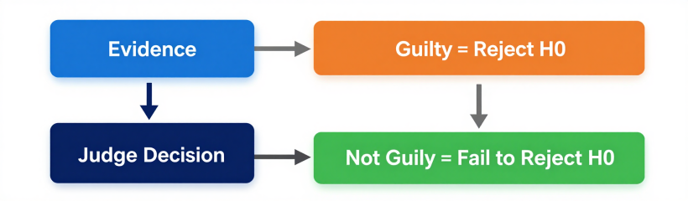
Statistical Decision Making
Courtroom
Analogy for
Hypothesis Testing
H₀ = Defendant is innocent | H₁ = Defendant is guilty
Type I Error = Convicting an innocent person | Type II Error = Acquitting a guilty person
Source: Author, Made with Canva

Slide 23
Case Study
Real-world Example: Student Scores
Testing whether a new teaching method significantly improves student performance using hypothesis testing.
Step 1: Research Question
Does the new interactive teaching method improve exam scores compared to traditional lectures?
Step 2: Hypothesis Setup
H₀: μ = 70 (no improvement) vs H₁: μ > 70 (scores improved with new method)
Step 3: Test Result
Sample mean = 74.5, p-value = 0.023 < α (0.05) → Reject H₀, evidence supports improvement.
Step 4: Conclusion
p = 0.023 < α = 0.05 → Reject H₀ → Evidence supports improvement
Interpretation: At the 5% significance level, there is sufficient evidence that the new teaching method significantly improves student exam scores (from an average of 70 to 74.5).

Slide 24
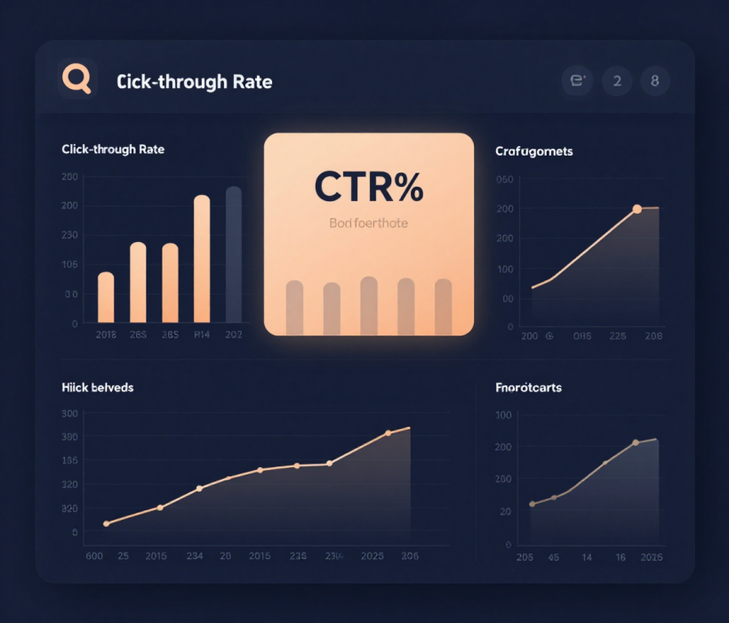
CASE STUDY — DIGITAL BUSINESS
Online Advertising
Case Study
Step 1 Business Question
Does the new online advertisement increase
click-through rate (CTR)?
Step 2 Hypothesis Setup
H₀: CTR = 2% (no improvement)
H₁: CTR > 2% (ad improves engagement)
α = 0.05 (5% significance level)
CTR
2%
CTR
>2%?
Source: Author, Made with Canva

Slide 25
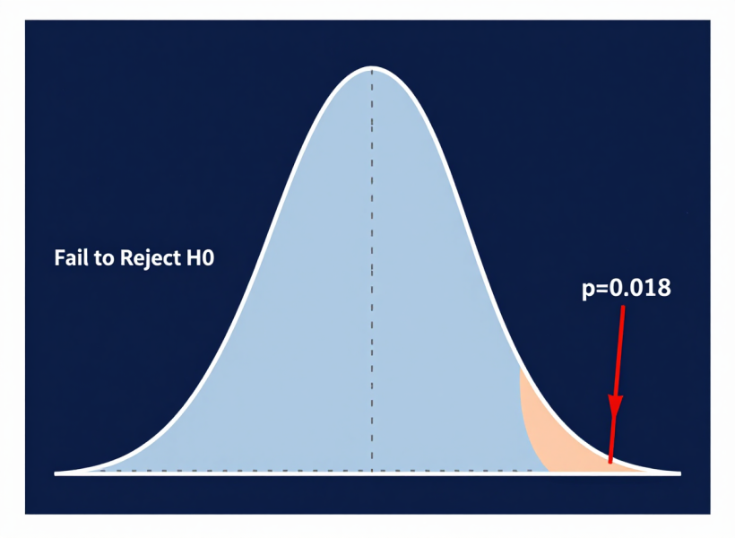
CASE STUDY — DIGITAL BUSINESS
Hypothesis Testing
Result
Observed CTR
p-value
α (significance)
3.1%
0.018
0.05
p = 0.018 < 0.05 → Reject H₀
Interpretation:
There is sufficient statistical evidence that the new advertisement improves user engagement (CTR increased from 2% to 3.1%).
Source: Author, Made with Canva
Business Decision: Implement the new ad campaign — data supports improved engagement

Slide 26
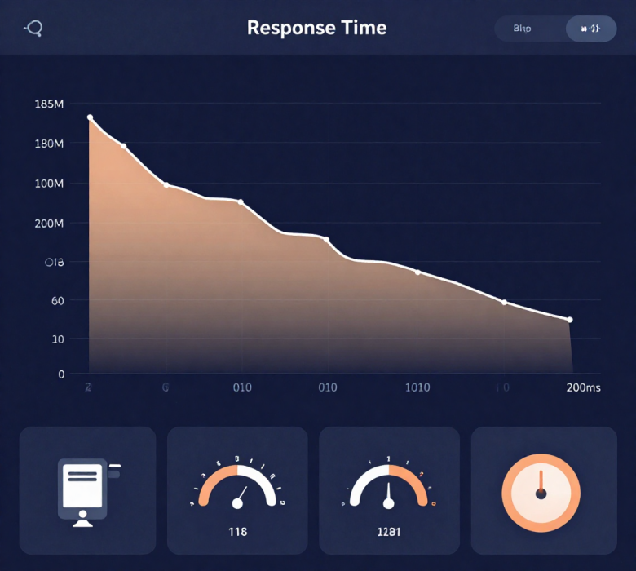
INFORMATION SYSTEMS — CASE STUDY 1
System Performance Testing
Step 1 Business Question
Does the new server configuration reduce average response time below 200ms?
Step 2 Hypothesis Setup
H₀: μ = 200ms (no improvement)
H₁: μ < 200ms (response time reduced)
Step 3 Test Result
Sample mean = 185ms | p-value = 0.012 | α = 0.05
p = 0.012 < 0.05 → Reject H₀
Interpretation: There is sufficient evidence that the new server configuration significantly reduces response time below 200ms (mean = 185ms). Recommend deployment.
Source: Author, Made with Canva
26

Slide 27

INFORMATION SYSTEMS — CASE STUDY 2
Network Security Detection
Step 1 Business Question
Does the new intrusion detection system (IDS) detect more than 90% of attacks?
Step 2 Hypothesis Setup
H₀: Detection rate = 90% (no improvement)
H₁: Detection rate > 90% (IDS performs better)
Step 3 Test Result
Observed detection rate = 94.7% | p-value = 0.003 | α = 0.05
p = 0.003 < 0.05 → Reject H₀
Interpretation: There is strong evidence that the new IDS detects significantly more than 90% of attacks (observed = 94.7%). Recommend full implementation across all network segments.
Source: Author, Made with Canva
27

Slide 28

INFORMATION SYSTEMS — CASE STUDY 3
IT Service Desk Analytics
Step 1 Business Question
Has the new ticketing system reduced average resolution time below 24 hours?
Step 2 Hypothesis Setup
H₀: μ = 24 hours (no improvement)
H₁: μ < 24 hours (resolution time reduced)
Step 3 Test Result
Sample mean = 21.3 hours | p-value = 0.008 | α = 0.05
p = 0.008 < 0.05 → Reject H₀
Interpretation: There is strong evidence that the new ticketing system reduces resolution time below 24 hours (mean = 21.3h). Recommend company-wide rollout to improve SLA compliance.
Source: Author, Made with Canva
28

Slide 29
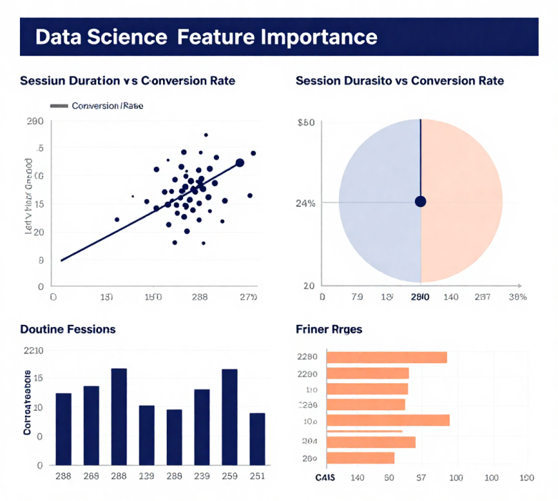
DATA SCIENCE — CASE STUDY 1
Feature Selection with
Hypothesis Testing
Step 1 Research Question
Is the feature 'session_duration' significantly correlated with purchase conversion?
Step 2 Hypothesis Setup
H₀: ρ = 0 (no correlation between session_duration and conversion)
H₁: ρ ≠ 0 (significant correlation exists)
Step 3 Test Result
Pearson r = 0.42 | p-value = 0.001 | α = 0.05
p = 0.001 < 0.05 → Reject H₀
Interpretation: Session duration is significantly correlated with purchase conversion (r = 0.42, p < 0.001). Include this feature in the predictive model — it adds meaningful signal.
Source: Author, Made with Canva
29

Slide 30
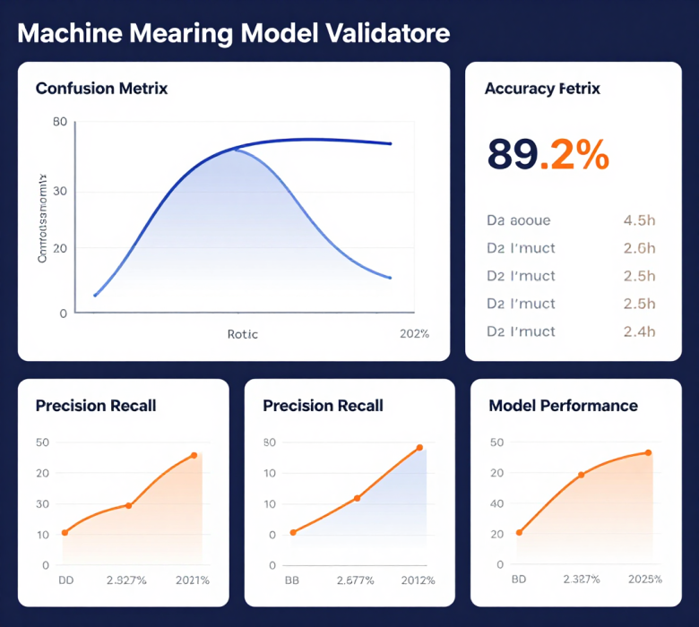
DATA SCIENCE — CASE STUDY 2
Model Validation:
Accuracy Testing
Step 1 Research Question
Does the new classification model achieve accuracy significantly greater than 85%?
Step 2 Hypothesis Setup
H₀: Accuracy = 85% (model does not exceed baseline)
H₁: Accuracy > 85% (model outperforms baseline)
Step 3 Test Result
Observed accuracy = 89.2% | p-value = 0.004 | α = 0.05
p = 0.004 < 0.05 → Reject H₀
Interpretation: The new model achieves accuracy significantly above 85% (observed = 89.2%). Deploy to production — it outperforms the baseline with strong statistical confidence.
Source: Author, Made with Canva
30

Slide 31
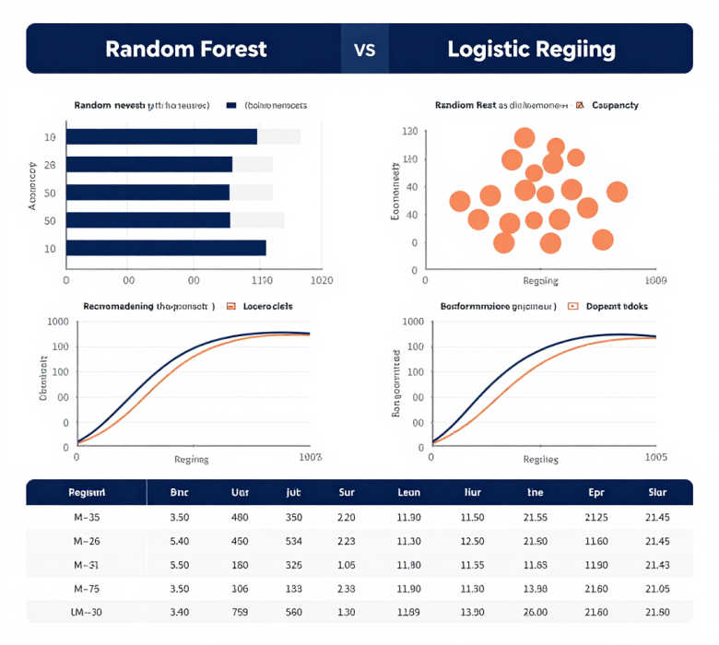
DATA SCIENCE — CASE STUDY 3
Algorithm Comparison:
A/B Testing Models
Step 1 Research Question
Does Random Forest perform significantly better than Logistic Regression on customer churn prediction?
Step 2 Hypothesis Setup
H₀: Accuracy(RF) = Accuracy(LR) (no difference)
H₁: Accuracy(RF) > Accuracy(LR) (RF is superior)
Step 3 Test Result
RF accuracy = 91.4% | LR accuracy = 86.1% | p-value = 0.007 | α = 0.05
p = 0.007 < 0.05 → Reject H₀
Interpretation: Random Forest significantly outperforms Logistic Regression for churn prediction (91.4% vs 86.1%). Deploy RF as the production model for better customer retention targeting.
Source: Author, Made with Canva
31

Slide 32

Lecture 10 – Hypothesis Testing
Common Mistakes in Interpretation
Avoid these critical errors when conducting and interpreting hypothesis tests in your digital business analytics.
Misunderstanding p-value
P-value is NOT the probability H₀ is true—it's the probability of observing data this extreme if H₀ were true.
"Accept H₀" Fallacy
We "fail to reject" H₀, not "accept" it. Absence of evidence is not evidence of absence.
Ignoring Error Trade-offs
Reducing Type I error increases Type II error risk. Balance based on business context and consequences.
Correlation ≠ Causation
A significant correlation does not prove one variable causes the other. Always consider confounders and experimental design.
Source: Author, Made with Canva

Slide 33
Summary of Key Concepts
The complete hypothesis testing workflow:
Hypothesis
Test Statistic
p-value
Decision
H₀: no effect
H₁: effect exists
Calculate z, t,
or chi-square
Compare p-value
with α = 0.05
Reject or Fail
to Reject H₀
If p < α → Reject H₀ (evidence supports H₁) | If p ≥ α → Fail to Reject H₀ (insufficient evidence)

Slide 34

Engagement
Discussion Questions
Reflect on these prompts to deepen your understanding of hypothesis testing in digital business contexts.
  Type I Error in Business
Why is controlling Type I error critical when making data-driven business decisions?
  Improving UX with Testing
How can digital businesses use hypothesis testing to optimize user experience?
  P-value Interpretation
What challenges arise when interpreting p-values in real-world analytics scenarios?
Source: Author, Made with Canva

Slide 35

Assignment
Hypothesis Testing Assignment
Scenario: E-commerce A/B Test
An online retailer tests a new checkout design. Original conversion rate: 3.2%. After testing with 500 users, the new design shows 4.1% conversion.
Your Assignment
1. Formulate H₀ and H₁ for this test
2. If p-value = 0.03 and α = 0.05, what is your decision?
3. What type of error could you be making? Explain.
4. Write your interpretation in a business context.
Source: Author, Made with Canva

Slide 36

Conclusion
Mastering Data-Driven Decisions
Hypothesis testing is a foundational tool for making informed, evidence-based decisions in statistics and business analytics. By understanding how to formulate hypotheses, interpret p-values, and manage Type I and II errors, you are equipped to drive meaningful insights in digital business contexts.
"Without data, you're just another person with an opinion."
— W. Edwards Deming
Apply these concepts in your coursework and projects
Practice with real A/B testing scenarios
Next: Lecture 11 – One-Sample Tests
Source: Author, Made with Canva

Slide 37
References
1. Moore, D. S., McCabe, G. P., & Craig, B. A. (2021). Introduction to the Practice of Statistics (10th ed.). W.H. Freeman.
2. Walpole, R. E., Myers, R. H., Myers, S. L., & Ye, K. (2016). Probability & Statistics for Engineers and Scientists (9th ed.). Pearson.
3. Field, A. (2018). Discovering Statistics Using IBM SPSS Statistics (5th ed.). SAGE Publications.
4. Wasserstein, R. L., & Lazar, N. A. (2016). The ASA Statement on p-Values: Context, Process, and Purpose. The American Statistician, 70(2), 129-133.
5. Bruce, P., Bruce, A., & Gedeck, P. (2020). Practical Statistics for Data Scientists (2nd ed.). O'Reilly Media.
6. Provost, F., & Fawcett, T. (2013). Data Science for Business. O'Reilly Media.
7. All illustrations and visuals: Author, Made with Canva (2025).

Slide 38
THANK YOU
Contact Information
Reach out for more details or inquiries regarding the course.
Alfrian Carmen Talakua
Department of Information Systems
e-Mail : Alfriantalakua@unkriswina.ac.id

