Slide 1

Statistics and Probability
Week 11 – Hypothesis Testing for Means & Proportions
E-commerce and Business Data Analytics: Statistical methods for data-driven decision making.
Alfrian Carmen Talakua
Department of Information Systems
2026
Source: Author, made by Canva

Slide 2


02
Learning Objectives
Week 11
WHAT YOU WILL LEARN IN THIS WEEK'S SESSION
By the end of this session, you will master the fundamental concepts and practical applications of hypothesis testing for business analytics and e-commerce data analysis.
HYPOTHESIS TESTING SKILLS
  Understand hypothesis testing concepts and terminology
  Understand sampling distribution and standard error
  Learn Z-test and T-test methodologies for means
  Interpret significance levels and Type I/II errors
  Apply hypothesis testing to e-commerce data
  Use Excel NORM.S.DIST and T.DIST functions
  Analyze real business case studies
Source: Author, made by Canva

Slide 3
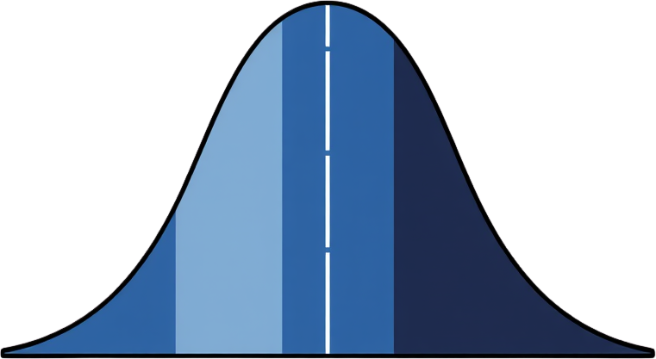
03
DEFINITION, PURPOSE, AND IMPORTANCE IN BUSINESS ANALYTICS
Introduction to Hypothesis Testing
Hypothesis testing is a statistical method used to make decisions about population parameters based on sample data. It provides a systematic framework for determining whether observed differences are statistically significant or due to random chance.
This methodology is crucial for data-driven business and e-commerce decisions, enabling organizations to move beyond intuition to evidence-based strategies.
Why do we need samples?
Because observing the entire population is often impossible, we use samples to make statistical inference about population parameters.
Key Applications in Business:
• A/B testing for website optimization
• Quality control in supply chain management
• Customer behavior and conversion rate analysis
• Sales performance evaluation before/after campaigns
Source: Author, made by Canva

Slide 4

04
WHY WE USE SAMPLES INSTEAD OF POPULATIONS
Population vs Sample
Population
Sample
All students
30 students
Complete data
Partial data
Expensive & time-consuming
Easier & practical
In practice, collecting data from an entire population is often impossible due to cost, time, and accessibility constraints. Instead, we draw a representative sample and use it to make inferences about the population.
Does one sample truly represent the population?
Source: Author, made by Canva

Slide 5
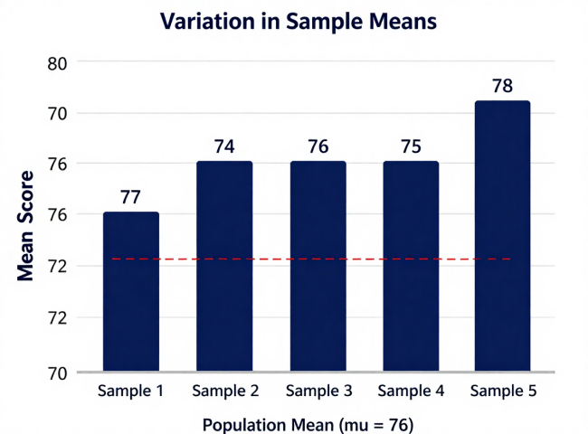
05
SAMPLING VARIABILITY AND INFERENCE
Why One Sample Is Not Enough
Sample
Mean
Sample 1
77
Sample 2
74
Sample 3
76
Sample 4
75
Sample 5
78
Key Insight:
Different samples may produce different results.
One sample alone may not perfectly represent the population.
Source: Author, made by Canva

Slide 6
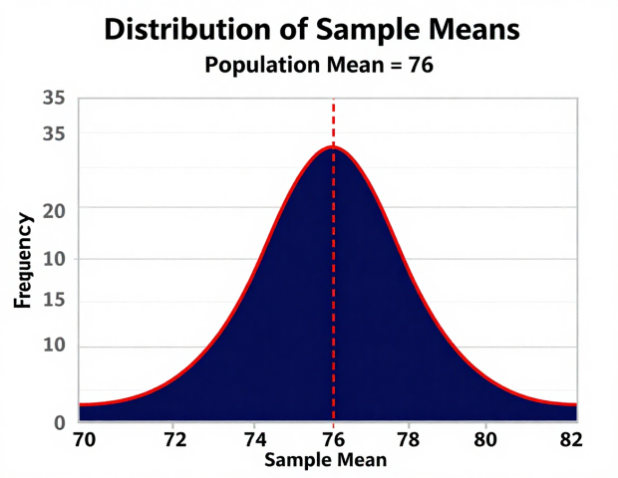
06
CENTRAL LIMIT THEOREM IN ACTION
Sampling Distribution
When we repeatedly draw samples from a population and calculate the mean of each sample, the distribution of those sample means forms a sampling distribution. According to the Central Limit Theorem, this distribution approximates a normal (bell-shaped) curve regardless of the population's original shape.
Key Concept:
Sample means tend to cluster around the population mean.
The more samples we take, the clearer this pattern becomes.
Properties of Sampling Distribution:
• Mean of sampling distribution = Population mean (mu)
• Shape approaches normal distribution (bell curve)
• Standard error decreases as sample size increases
• Larger samples produce tighter clustering around mu
Source: Author, made by Canva

Slide 7
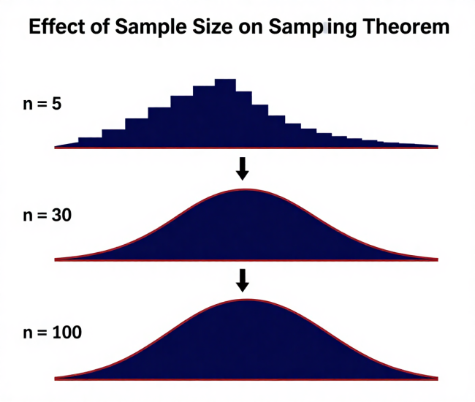
07
THE FOUNDATION OF STATISTICAL INFERENCE
Central Limit Theorem
As sample size increases,
the sampling distribution approaches a normal distribution.
Key Insight:
Sample means tend to cluster around the population mean.
This clustering becomes tighter as sample size (n) increases.
Conditions for CLT:
• Sample size n >= 30 (rule of thumb)
• Samples are independent and randomly selected
• Population has a finite variance
• Works regardless of the population's original shape
Standard Error (SE) = sigma / sqrt(n) | As n increases, SE decreases, distribution narrows
Source: Author, made by Canva

Slide 8
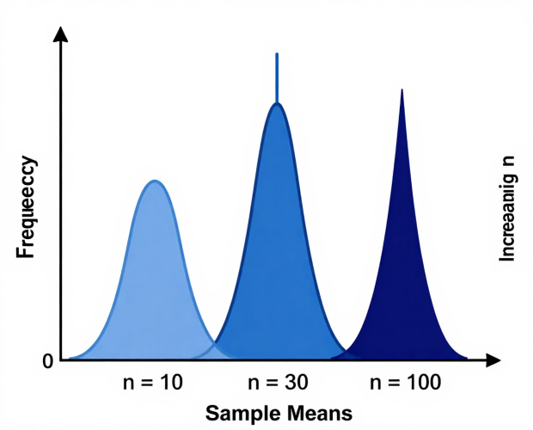
08
MEASURING PRECISION OF SAMPLE ESTIMATES
Standard Error
SE = s / sqrt(n)
s = sample standard deviation | n = sample size
Standard Deviation
Standard Error
Variability of data
Variability of sample means
Spread within one sample
Precision of sample mean
Does not depend on n
Decreases as n increases
Key Takeaway:
Smaller standard error means more stable estimates.
Increase sample size (n) to reduce SE and improve precision.
Source: Author, made by Canva

Slide 9




01
02
03
04
NULL HYPOTHESIS (H₀)
ALTERNATIVE HYPOTHESIS (H₁)
EXAMPLE: NULL HYPOTHESIS
EXAMPLE: ALTERNATIVE HYPOTHESIS
Represents the status quo or no effect assumption. States there is no significant difference or change in the population parameter being tested.
Represents the claim we want to test. States that an effect, difference, or relationship exists in the population parameter.
H₀: μ = $85
The mean order value equals $85. This is our baseline assumption that we test against.
H₁: μ ≠ $85
The mean order value is different from $85. This two-tailed test detects any significant change.
Null & Alternative Hypothesis
Understanding the distinction between null and alternative hypotheses is fundamental to hypothesis testing. The null hypothesis assumes no effect, while the alternative represents the change or effect we aim to detect through statistical analysis.
Source: Author, made by Canva

Slide 10
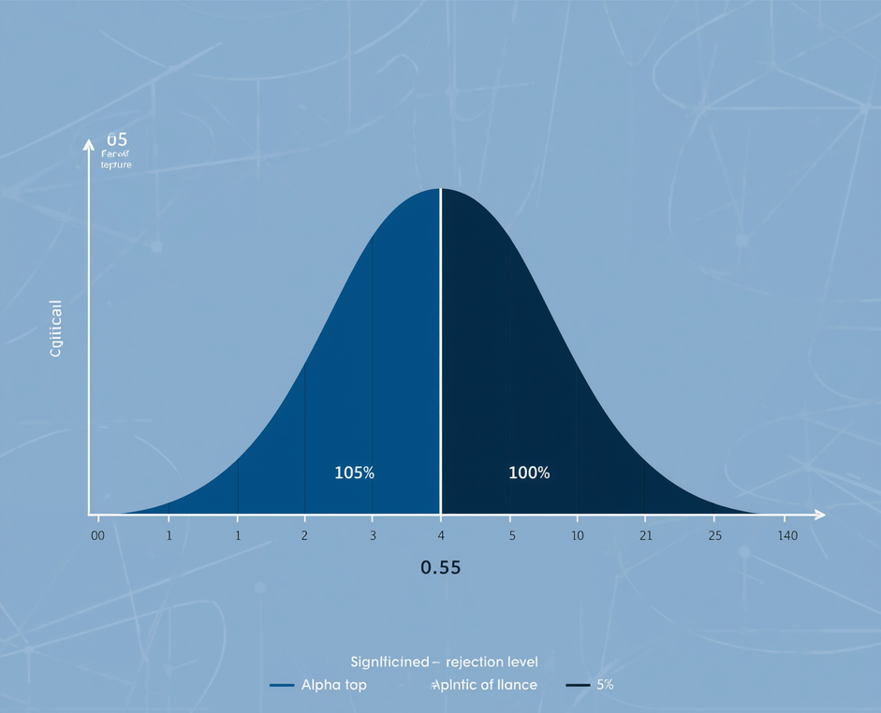
10
Significance
Level (α)
UNDERSTANDING THE THRESHOLD FOR STATISTICAL DECISION-MAKING
The significance level (α) is the probability threshold used to determine when to reject the null hypothesis. It represents the maximum acceptable risk of making a Type I error. Common α values in business analytics are 0.05 (5%) and 0.01 (1%). When α = 0.05, we accept a 5% chance of incorrectly rejecting a true null hypothesis. The critical regions, located in the tails of the distribution, define where test statistics lead to rejection of H₀. If your calculated p-value falls below α, the result is considered statistically significant. α represents the maximum acceptable probability of Type I error.
α=0.05
Most common threshold in business research
Source: Author, made by Canva

Slide 11
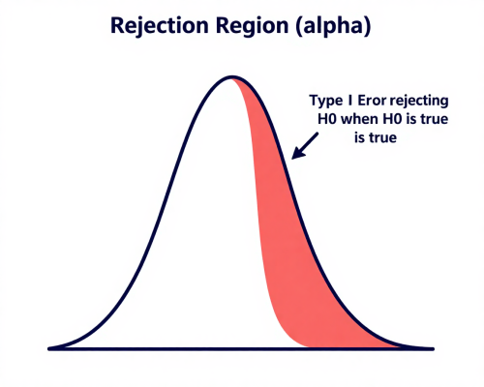
11
Type I Error
FALSE POSITIVE — REJECTING A TRUE NULL HYPOTHESIS
Definition:
Type I Error occurs when we reject the null hypothesis (H0) even though it is actually true. We conclude there is an effect or difference when in reality there is none.
Key Points:
• Probability of Type I Error = alpha (significance level)
• If alpha = 0.05, there is a 5% chance of Type I Error
• Also called a "false positive" or "false alarm"
• Controlled by choosing a smaller alpha (e.g., 0.01)
Example:
A pharmaceutical company concludes a new drug is effective (rejects H0: drug has no effect), but in reality the drug does NOT work. Patients receive an ineffective treatment based on a false conclusion.
P(Type I Error) = P(Reject H0 | H0 is true) = alpha
Source: Author, made by Canva

Slide 12
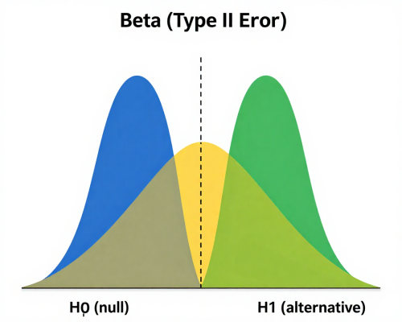
12
Type II Error
FALSE NEGATIVE — FAILING TO REJECT A FALSE NULL HYPOTHESIS
Definition:
Type II Error occurs when we fail to reject the null hypothesis (H0) even though it is actually false. We miss a real effect or difference that truly exists.
Key Points:
• Probability of Type II Error = beta
• Power of a test = 1 - beta (ability to detect a real effect)
• Also called a "false negative" or "missed detection"
• Reduced by increasing sample size or effect size
Example:
A pharmaceutical company concludes a new drug is NOT effective (fails to reject H0), but in reality the drug DOES work. Patients miss out on a beneficial treatment because the study failed to detect the real effect.
P(Type II Error) = P(Fail to Reject H0 | H0 is false) = beta
Source: Author, made by Canva

Slide 13
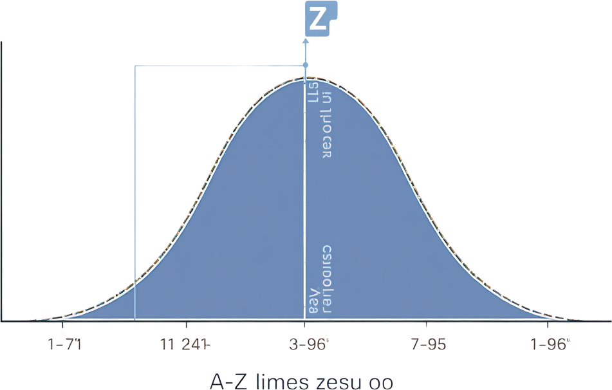
13
Z-test Explanation
WHEN TO USE, ASSUMPTIONS, FORMULA, AND DISTRIBUTION
The Z-test is used when the population variance is known and sample sizes are large (n > 30). Under these conditions, the sampling distribution of the mean follows a normal distribution.
Formula: Z = (x̄ - μ₀) / (σ / √n)
Where:
• x̄ = sample mean
• μ₀ = hypothesized population mean
• σ = population standard deviation
• n = sample size
The test statistic follows the standard normal distribution (mean = 0, SD = 1), allowing us to determine the probability of observing our sample result if H₀ is true.
Large samples produce more stable sampling distributions.
Source: Author, made by Canva

Slide 14
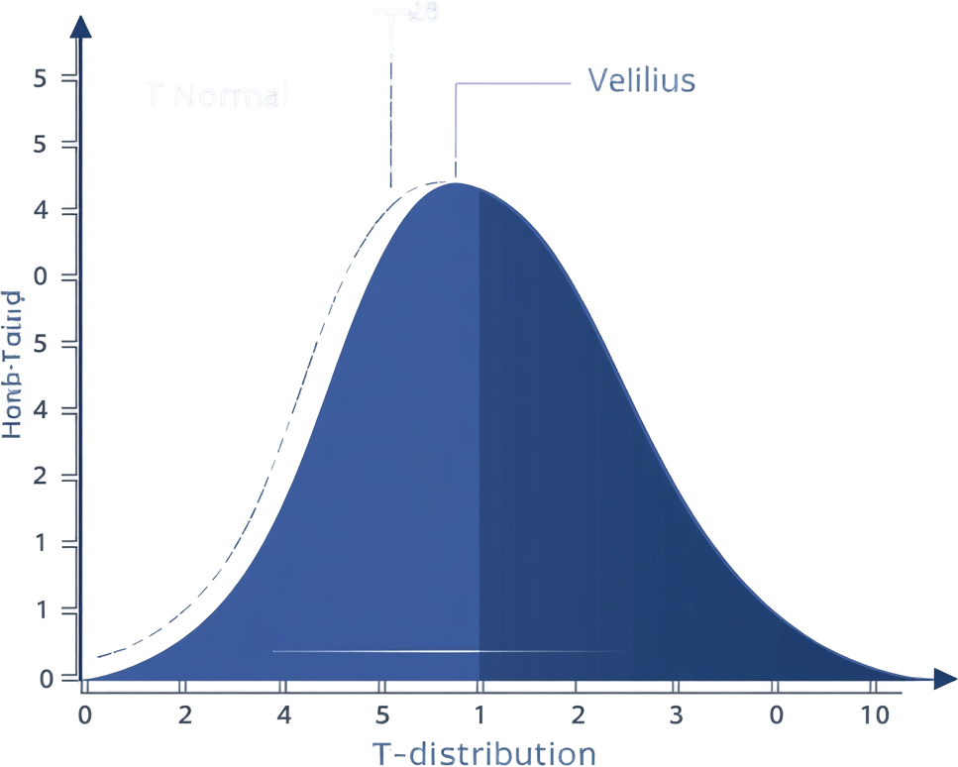
14
T-test Explanation
WHEN TO USE, ASSUMPTIONS, FORMULA & DISTRIBUTION
The T-test is used when population variance is unknown and sample sizes are small (n≤30). It provides robust inference for real-world business scenarios where population parameters are rarely known.
Formula: t = (x̄ - μ₀) / (s / √n)
Where x̄ is sample mean, μ₀ is hypothesized population mean, s is sample standard deviation, and n is sample size.
The test statistic follows a t-distribution with degrees of freedom df = n - 1. Unlike the normal distribution, the t-distribution has heavier tails, accounting for additional uncertainty when estimating variance from small samples.
T-distribution accounts for uncertainty in small samples.
Source: Author, made by Canva

Slide 15
15
Z-test vs T-test
CHOOSING THE RIGHT TEST FOR YOUR DATA
Condition
Z-test
T-test
Sample Size
Large (n > 30)
Small (n <= 30)
Population SD
Known (sigma)
Unknown (use s)
Distribution
Normal
t-distribution
When n > 30, t-distribution approximates normal distribution — both tests yield similar results.

Slide 16
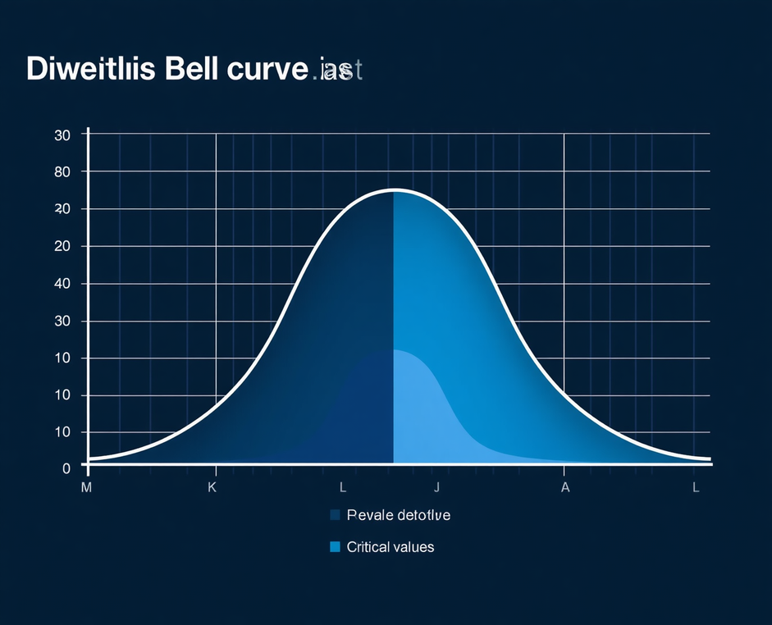
16
Decision Making
Using P-value
UNDERSTANDING P-VALUE INTERPRETATION AND DECISION RULES
The p-value represents the probability of observing your sample data (or more extreme results) assuming the null hypothesis is true. It quantifies the strength of evidence against H₀. The decision rule is straightforward: if p ≤ α (significance level), reject H₀; if p > α, fail to reject H₀. In business terms, a small p-value indicates strong evidence that an observed effect (such as increased conversion rates or higher order values) is unlikely due to random chance alone, supporting data-driven strategic decisions.
p ≤ α
p-value measures evidence against the null hypothesis.
Source: Author, made by Canva

Slide 17
17
Hypothesis Testing Workflow
A SYSTEMATIC APPROACH TO STATISTICAL DECISION-MAKING
STATE
HYPOTHESES
02
04
FIND P-VALUE & DECIDE
Define H₀ (null) and H₁ (alternative) based on business question.
Compare p-value to α level; reject or fail to reject H₀.
CHOOSE TEST & CALCULATE
INTERPRET
RESULTS
Select Z-test or T-test based on sample size and variance; compute statistic.
Translate statistical findings into actionable business insights.
01
03

Slide 18


18
Business and E-commerce Applications
REAL-WORLD EXAMPLES OVERVIEW
Conversion rate testing in online marketing campaigns and digital advertising optimization.
Customer satisfaction score analysis to measure service quality improvements.
Sales performance evaluation before and after promotional campaigns.
A/B testing of website changes to optimize user experience and conversions.
Source: Author, made by Canva

Slide 19

19
Z-test Example – Scenario & Hypotheses
WEBSITE REDESIGN EFFECT ON AVERAGE ORDER VALUE
Business Scenario: An e-commerce company redesigned their website and wants to test if average order value changed.
Given Data:
• Population mean μ₀ = $85 (before redesign)
• Sample mean x̄ = $89 (after redesign)
• Population std. deviation σ = $15
• Sample size n = 100
Step 1 – State Hypotheses:
• H₀: μ = 85 (no change in order value)
• H₁: μ ≠ 85 (order value has changed)
This is a two-tailed test at α = 0.05
Source: Author, made by Canva

Slide 20
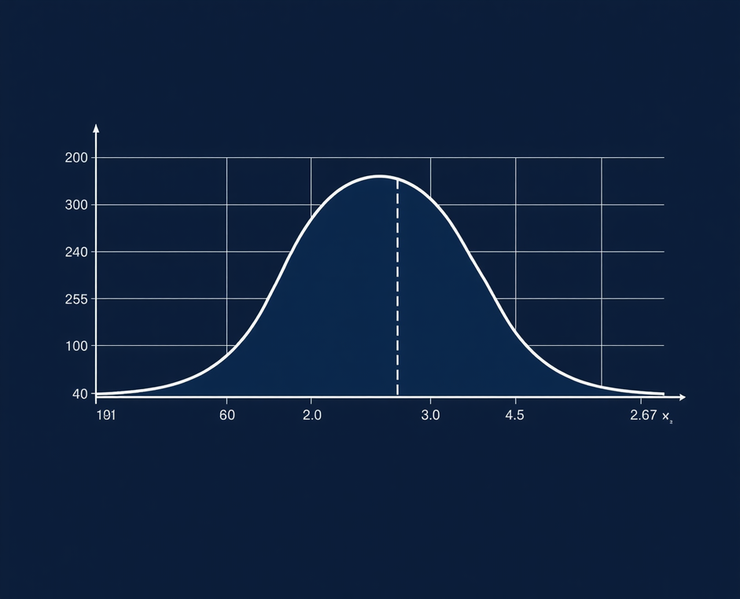
20
Z-test Example
Calculate Z Statistic
CALCULATING THE Z STATISTIC WITH FORMULA SUBSTITUTION
Using our website redesign scenario, we calculate the Z statistic step by step. Given: sample mean x̄ = $89, population mean μ₀ = $85, population standard deviation σ = $15, and sample size n = 100.
Formula: Z = (x̄ - μ₀) / (σ / √n)
Substitution: Z = (89 - 85) / (15 / √100)
Z = 4 / (15 / 10)
Z = 4 / 1.5
Z = 2.67
The Z-value of 2.67 indicates the sample mean is 2.67 standard errors above the hypothesized population mean. This will be used to determine the p-value and make our statistical decision.
2.67
Standard Error
Substitution Steps
Z = 2.67 standard errors from mean
Source: Author, made by Canva

Slide 21

Z-test Example
TWO-TAILED P-VALUE CALCULATION
For Z = 2.67, we calculate the two-tailed p-value using Excel's NORM.S.DIST function. The formula =2*(1-NORM.S.DIST(2.67,TRUE)) returns approximately 0.0075, representing the probability of observing such extreme results if H₀ were true.
0.0075
01
P-VALUE RESULT
STATISTICAL DECISION
Since p-value (0.0075) < α (0.05), we reject the null hypothesis H₀: μ = $85. The evidence is statistically significant at the 5% level. This means there is less than a 1% chance of observing this difference by random chance alone.
02
TWO-TAILED P-VALUE
Using Excel NORM.S.DIST(2.67, TRUE) × 2 for two-tailed test.
BUSINESS INTERPRETATION
DECISION RULE
The website redesign has produced a statistically significant increase in average order value from $85 to $89. This $4 increase represents meaningful business impact, supporting the investment in the redesign. The company can confidently attribute the improvement to the changes made.
Compare p-value to significance level α = 0.05.
03
BUSINESS CONCLUSION
Reject H₀ and conclude significant effect on order value.
Source: Author, made by Canva

Slide 22

22
T-test Example – Scenario & Hypotheses
MARKETING CAMPAIGN IMPACT ANALYSIS
Business Scenario: A retail company wants to test if their new marketing campaign increased average customer spending.
Given Data:
• Sample mean (x̄) = $120
• Hypothesized population mean (μ₀) = $110
• Sample standard deviation (s) = $25
• Sample size (n) = 25
Step 1 – State Hypotheses:
• H₀: μ = 110 (no increase in spending)
• H₁: μ > 110 (spending increased)
This is a one-tailed test since we're testing for an increase only.
Population variance is unknown, therefore we use a T-test.
Source: Author, made by Canva

Slide 23
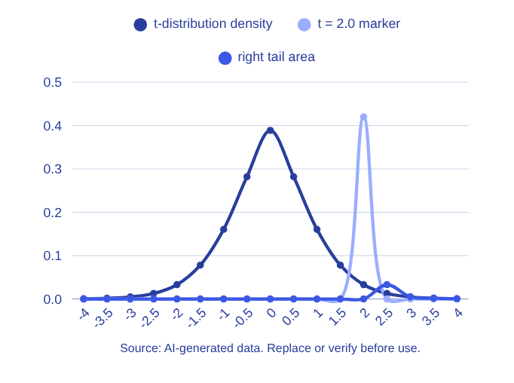
23
T-test Example
Calculate t Statistic & df
CALCULATION WITH FORMULA AND SUBSTITUTION
Using the t-test formula for unknown population variance:
t = (x̄ - μ₀) / (s / √n)
Substituting the values from our marketing campaign scenario:
t = (120 - 110) / (25 / √25)
t = 10 / (25 / 5)
t = 10 / 5
t = 2.0
Degrees of freedom: df = n - 1 = 25 - 1 = 24
The calculated t-statistic of 2.0 with 24 degrees of freedom will be used to determine the p-value and make our statistical decision.
t=2.0
Degrees of freedom for hypothesis testing

Slide 24

T-test Example
ONE-TAILED P-VALUE USING T.DIST
p ≈ 0.028
01
For our one-tailed test (H₁: μ > 110), we calculate the upper-tail probability. The T.DIST function in Excel returns the cumulative probability up to t=2.0. Subtracting from 1 gives the p-value for the right tail, yielding approximately 0.028.
REJECT H₀ AT Α = 0.05
DECISION RULE APPLICATION
02
Compare p-value to significance level α = 0.05. Since 0.028 < 0.05, we have sufficient evidence to reject H₀. The observed difference is statistically significant at the 5% level, meaning there's only a 2.8% chance of seeing this result if H₀ were true.
DATA PREPARATION
Using T.DIST function with t=2.0 and df=24 for one-tailed test.
BUSINESS INTERPRETATION
P-VALUE CALCULATION
Excel formula: =1-T.DIST(2.0, 24, TRUE) returns p ≈ 0.028.
03
The marketing campaign significantly increased customer spending. With sample mean $120 vs. hypothesized $110, and p = 0.028, we conclude the campaign had a real positive impact. This evidence supports continued investment in similar marketing strategies.
STATISTICAL DECISION
Since p = 0.028 < α = 0.05, we reject the null hypothesis H₀.
Source: Author, made by Canva

Slide 25
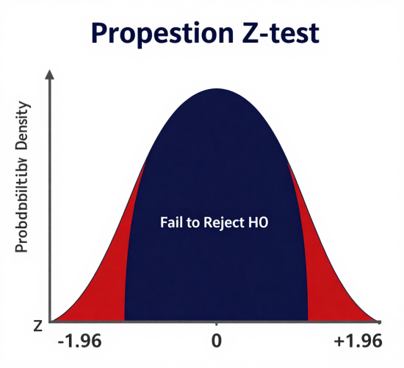
25
Hypothesis Testing
for Proportions
SECTION 7 — PROPORTION TESTING
Z = (p̂ - p) / sqrt( p(1-p) / n )
Z-test statistic for population proportion
Symbol
Meaning
p̂
Sample proportion
p
Population proportion (hypothesized)
n
Sample size
Source: Author, made by Canva

Slide 26
26
Proportion Test
Example
TESTING CONVERSION RATE IMPROVEMENT
Scenario: A marketing team launched a new campaign to improve website conversion rates. They want to know if the campaign made a statistically significant difference.
Hypotheses:
H0: p = 0.032
(No improvement, conversion rate
remains at 3.2%)
H1: p > 0.032
(Campaign improved conversion rate)
BEFORE
AFTER
→
3.2%
4.1%
Conversion Rate
Conversion Rate
Given:
p̂ = 0.041 (sample proportion after campaign)
p = 0.032 (hypothesized proportion)
n = sample size (from campaign data)
Research Question:
Did the campaign significantly improve conversion rates?

Slide 27
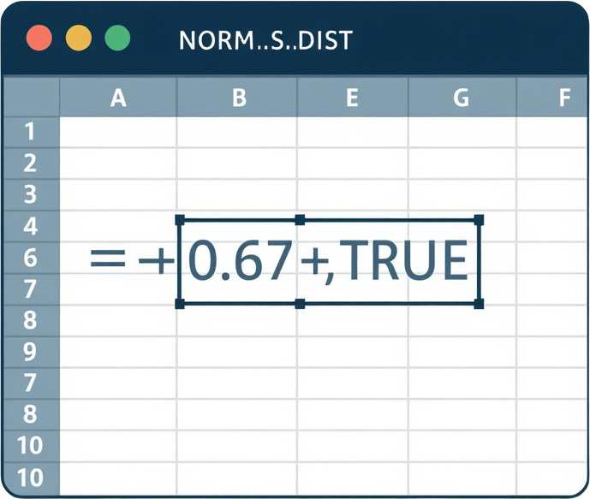
STEP-BY-STEP WORKFLOW FOR P-VALUE CALCULATION
27
Excel Practice
NORM.S.DIST Function
1
Input Data
Enter sample data into Excel spreadsheet
2
Calculate Mean
Use =AVERAGE(range) to find sample mean
3
Calculate SE
Use =STDEV.S(range)/SQRT(n) for standard error
4
Calculate Z
Z = (x̄ - μ₀) / SE
5
Calculate p-value
=2*(1-NORM.S.DIST(z, TRUE)) for two-tailed test
Source: Author, made by Canva

Slide 28
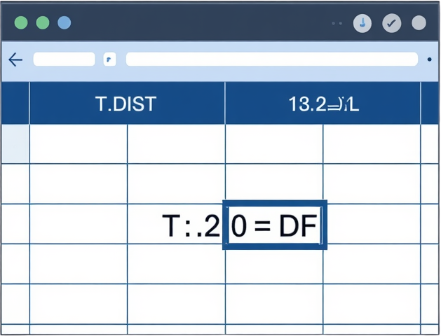
28
Excel Practice
T.DIST Function
SYNTAX, PARAMETERS, AND CUMULATIVE VS. NON-CUMULATIVE EXPLAINED
Degrees of Freedom (df)
df = n - 1 (sample size minus one)
Represents the number of independent values that can vary in the calculation.
As df increases, the t-distribution approaches the normal distribution.
One-Tail vs Two-Tail Test
One-tailed: Tests direction (greater or less than). p-value = 1 - T.DIST(t, df, TRUE)
Two-tailed: Tests any difference (not equal). p-value = 2 * (1 - T.DIST(|t|, df, TRUE))
Use one-tail when you predict a specific direction; use two-tail when testing for any change.
Source: Author, made by Canva

Slide 29

29
Business Case Study 1 – Conversion Rate Testing
TESTING CONVERSION RATE CHANGES AFTER MARKETING CAMPAIGN IMPLEMENTATION
Scenario: An e-commerce company launched a new landing page design to improve conversion rates.
Data: Pre-campaign conversion rate: 3.2% (n=5,000 visitors). Post-campaign conversion rate: 4.1% (n=5,000 visitors).
Hypotheses:
• H₀: No change in conversion rate (p₁ = p₂)
• H₁: Conversion rate increased (p₂ > p₁)
Test Results: Z-statistic = 2.45, p-value = 0.007
Decision: Since p < 0.05, reject H₀
Business Implication: The new landing page design significantly increased conversion rates, justifying the redesign investment and supporting broader rollout.
28%
CONVERSION RATE IMPROVEMENT

Slide 30
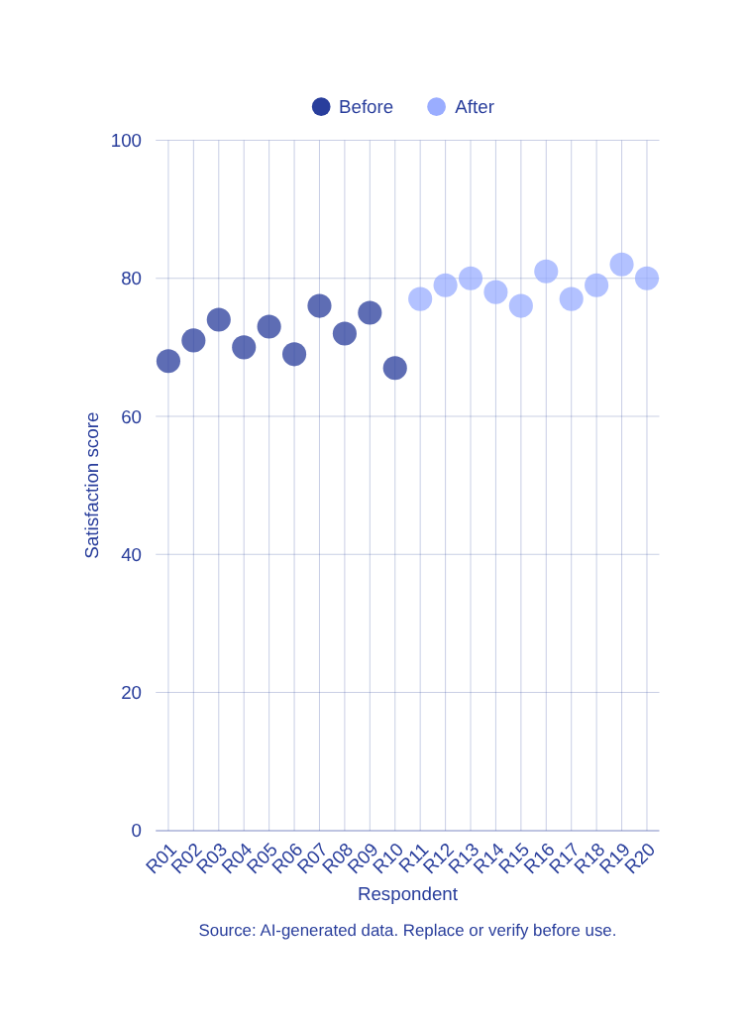
30
Business Case Study 2 – Customer Satisfaction Score
ANALYZING SATISFACTION SCORES BEFORE AND AFTER SERVICE IMPROVEMENT USING HYPOTHESIS TESTING
A retail company implemented a new customer service training program and wants to evaluate its effectiveness.
Data Summary:
• Before: n₁ = 45, x̄₁ = 72.3, s₁ = 8.5
• After: n₂ = 45, x̄₂ = 78.6, s₂ = 7.2
Hypothesis Testing Approach:
• H₀: μ_after = μ_before (no improvement)
• H₁: μ_after > μ_before (improvement occurred)
• α = 0.05, one-tailed t-test
Result: t = 3.82, p < 0.001 → Reject H₀
Conclusion: Training significantly improved satisfaction scores.
+6.3
POINT INCREASE IN SATISFACTION

Slide 31
31
Product Return Rate Analysis
BUSINESS CASE STUDY 3 – TESTING POLICY IMPACT ON RETURNS
01
02
03
04
BEFORE POLICY
AFTER POLICY
HYPOTHESIS TEST
KEY FINDING
p-value = 0.021 < 0.05 → Significant reduction in returns
Return rate: 12.5% with n=400 orders over 3-month period
Return rate: 9.8% with n=450 orders post-policy update
H₀: p₁ = p₂; H₁: p₁ > p₂ (one-tailed test for reduction)

Slide 32

32
Discussion Questions
W11
ENGAGING PROMPTS FOR COLLABORATIVE LEARNING AND CRITICAL THINKING
GROUP DISCUSSION ACTIVITY
Work in groups to discuss these critical thinking questions about hypothesis testing in business contexts. Consider real-world implications and share your insights with the class.
  How should analysts interpret conflicting test results?
  What are the business risks of Type I and Type II errors?
  How do managers make decisions under statistical uncertainty?
  Discuss e-commerce scenarios where hypothesis testing guides strategy
Source: Author, made by Canva

Slide 33

33
Summary
Key Takeaways
REVIEW OF MAIN CONCEPTS FROM WEEK 11
Hypothesis testing provides a systematic framework for data-driven business decisions in e-commerce.
Z-test applies to large samples with known variance; T-test suits small samples with unknown variance.
Significance level (α) and Type I/II errors have critical business consequences requiring careful consideration.
Excel functions NORM.S.DIST and T.DIST enable practical p-value calculations for real business data analysis.
Source: Author, made by Canva

Slide 34

34
Assignment – Homework Problems
DUE
COMPLETE HYPOTHESIS TESTING ANALYSIS ON REAL BUSINESS DATA
SUBMIT VIA LMS PORTAL
Apply hypothesis testing techniques learned this week to analyze provided business datasets. Your submission should demonstrate mastery of Z-test and T-test methodologies with clear statistical reasoning.
Analyze given business datasets using hypothesis testing
Write clear interpretations of statistical results
Provide actionable business recommendations
Submit by deadline posted on course portal
Source: Author, made by Canva

Slide 35
35
References
Primary Textbooks
  Walpole, R. E., Myers, R. H., Myers, S. L., & Ye, K. (2012). Probability and Statistics for Engineers and Scientists. Pearson.
  Montgomery, D. C., & Runger, G. C. (2018). Applied Statistics and Probability for Engineers. Wiley.
  Triola, M. F. (2019). Elementary Statistics. Pearson.
Supporting References
  Freedman, D., Pisani, R., & Purves, R. (2007). Statistics. W. W. Norton & Company.
  OpenIntro Statistics. (2019). OpenIntro Statistics. OpenIntro Inc.
  Microsoft. (2023). Excel Statistical Functions Documentation. Microsoft Learn.

Slide 36
THANK YOU
Contact Information
Reach out for more details or inquiries regarding the course.
Alfrian Carmen Talakua
Department of Information Systems
e-Mail : Alfriantalakua@unkriswina.ac.id
“In God we trust. All others must bring data.”
— W. Edwards Deming
Let data guide your decisions through evidence, analysis, and statistical reasoning.

