Slide 1

Statistics and Probability
Week 12 - Simple Regression and Correlation for Prediction and Data Analytics
Alfrian Carmen Talakua
Department of Information Systems
2026

Slide 2

Learning Objectives
After completing this lesson, students will be able to:
1. Explain relationships between variables.
2. Interpret correlation coefficients.
3. Build simple linear regression models.
4. Use regression equations for prediction.
5. Apply regression and correlation in data analytics.

Slide 3
From Hypothesis Testing to Prediction
Previous Meeting
Today
Hypothesis Testing
Correlation & Regression
→
Significant difference
Relationship strength
→
Decision making
Prediction
→
Means & proportions
Variable relationships
→
"Previously, we tested whether differences existed. Today, we explore how variables relate and how predictions can be made."

Slide 4
From One Variable to Two Variables
Previous Topics
Today
Focused on ONE variable:
We analyze TWO variables together.
• Mean
→
• Variance
• Standard Deviation
• Hypothesis Testing
1 Variable
→
2 Variables
Source: Author, Made by Canva

Slide 5

Introduction to Variables
"Variables are measurable characteristics that can change."
Independent Variable (X)
Dependent Variable (Y)
Example
The predictor or explanatory variable that influences outcomes. This is the input we control or measure to understand its effect on another variable.
The response or outcome variable being predicted. This is what we want to explain or forecast based on changes in the independent variable.
Study Hours (X) → Exam Scores (Y)
More study time predicts higher exam performance.

Slide 6



Types of Relationships
Positive Relationship
Negative Relationship
No Relationship
X↑ → Y↑
As one variable increases, the other increases proportionally.
Example: Study time and test scores
X↑ → Y↓
As one variable increases, the other decreases proportionally.
Example: Price and demand
X changes → Y unchanged
No systematic effect between variables.
Example: Shoe size and intelligence
Source: Author, Made by Canva

Slide 7

Statistical Analysis Flow
Data Collection
↓
Identify Variables
↓
Observe Relationships
↓
Measure Correlation
↓
Build Regression Model
↓
Make Predictions
"Why do we learn regression?"
This process shows that regression is the final step in analyzing relationships between variables — from collecting data to making predictions.
Source: Author, Made by Canva

Slide 8



Correlation Concept
Strength & Direction
Range of Values
Key Principle
Correlation measures the strength and direction of the linear relationship between two quantitative variables, providing the foundation for predictive modeling.
Correlation coefficients range from -1 to +1, where -1 indicates perfect negative correlation, +1 indicates perfect positive correlation, and 0 indicates no linear relationship.
Correlation indicates association, not causation. Two variables may correlate without one causing the other.
Source: Author, Made by Canva

Slide 9
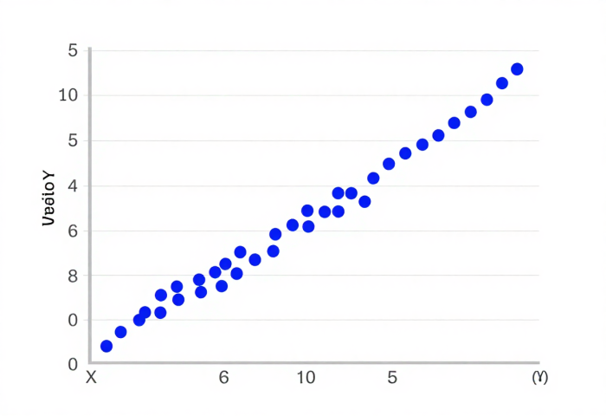
Scatter Plot Introduction
Understanding the foundation of correlation and regression analysis
How to Read a Scatter Plot
Each point represents one observation. The X-axis displays the independent variable, while the Y-axis shows the dependent variable.
The pattern of points reveals relationship strength and direction. Upward trends indicate positive correlation, downward trends indicate negative correlation.
"Scatter plots are the first step in exploring relationships between variables."
Source: Author, Made by Canva

Slide 10
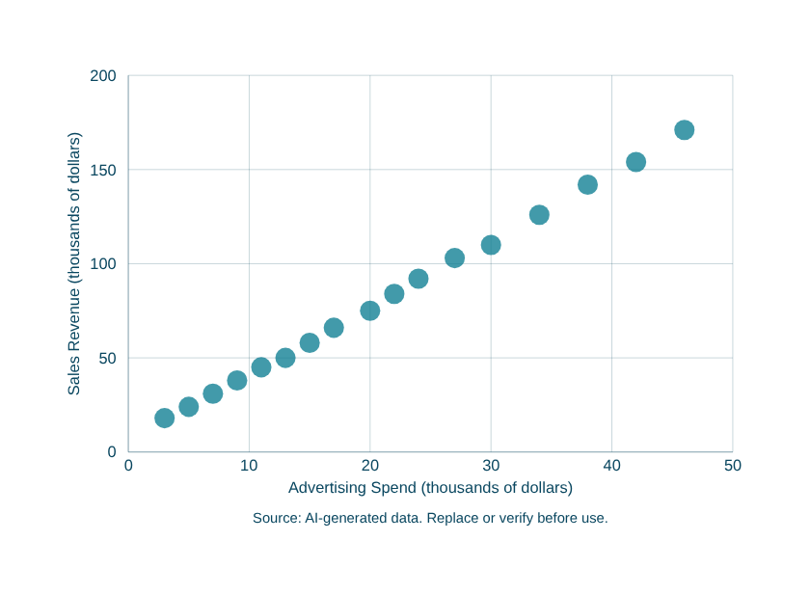
Positive Correlation
Visualizing the relationship between advertising spend and sales revenue
Positive Correlation Visualization
This scatter plot demonstrates a strong positive correlation between advertising expenditure and sales revenue. As advertising spend increases, sales revenue rises proportionally, with r approaching +1.
This pattern validates the effectiveness of marketing investment in driving business growth.
"As one variable increases, the other increases proportionally — the hallmark of positive correlation."
Source: Author, Made by Canva

Slide 11
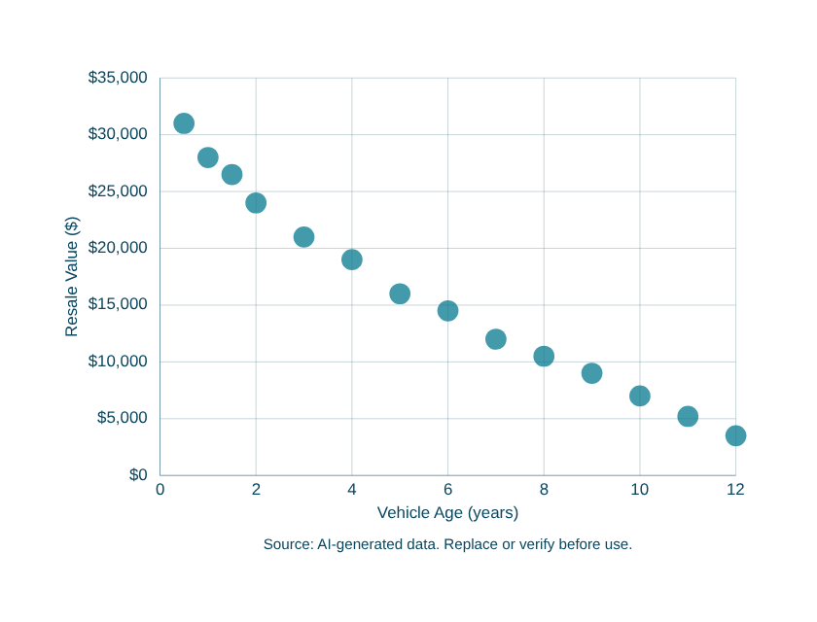
Negative Correlation
Visualizing inverse relationships between variables
Negative Correlation Visualization
Points cluster around a downward slope, with correlation coefficient ranging from -1 to 0.
Example: As vehicle age increases, resale value decreases. This inverse relationship is common in depreciation analysis.
"As one variable increases, the other decreases — the defining pattern of negative correlation."
Source: Author, Made by Canva

Slide 12
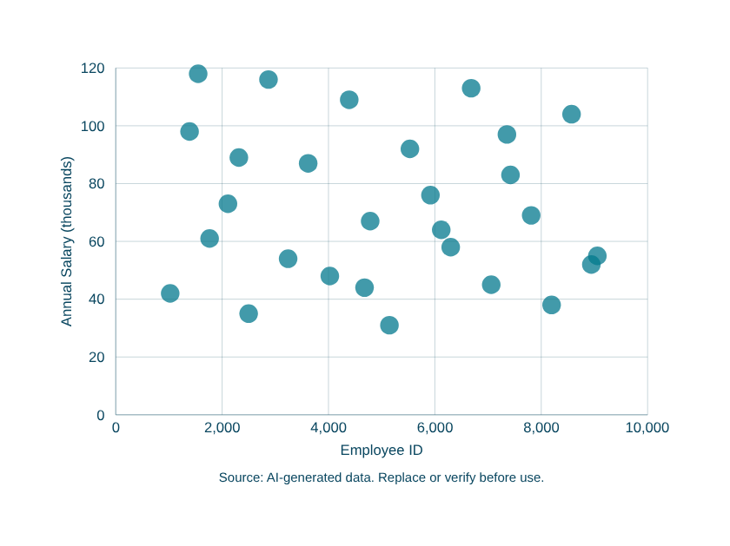
No Correlation
When variables show no systematic relationship
No Correlation Visualization
Points are scattered randomly with no discernible pattern. The correlation coefficient is near zero, indicating no linear relationship exists between the variables.
Example: Employee ID number has no predictive relationship with salary level.
"No correlation means no predictable linear pattern — the variables are independent of each other."
Source: Author, Made by Canva

Slide 13
Pearson Correlation Coefficient
Measuring the strength and direction of linear relationships
What Does r Mean?
The Formula
r = +1.0 Perfect positive relationship
r = +0.7 Strong positive relationship
r = +0.3 Weak positive relationship
r = 0.0 No linear relationship
r = -0.3 Weak negative relationship
r = -0.7 Strong negative relationship
r = -1.0 Perfect negative relationship
r = Σ[(xᵢ - x̄)(yᵢ - ȳ)] / √[Σ(xᵢ - x̄)² × Σ(yᵢ - ȳ)²]
r = correlation coefficient
xᵢ, yᵢ = individual data points
x̄, ȳ = sample means
Σ = sum of all values
n = number of data pairs
"Don't memorize the formula — focus on what r tells you about the relationship between variables."
Source: Author, Made by Canva

Slide 14
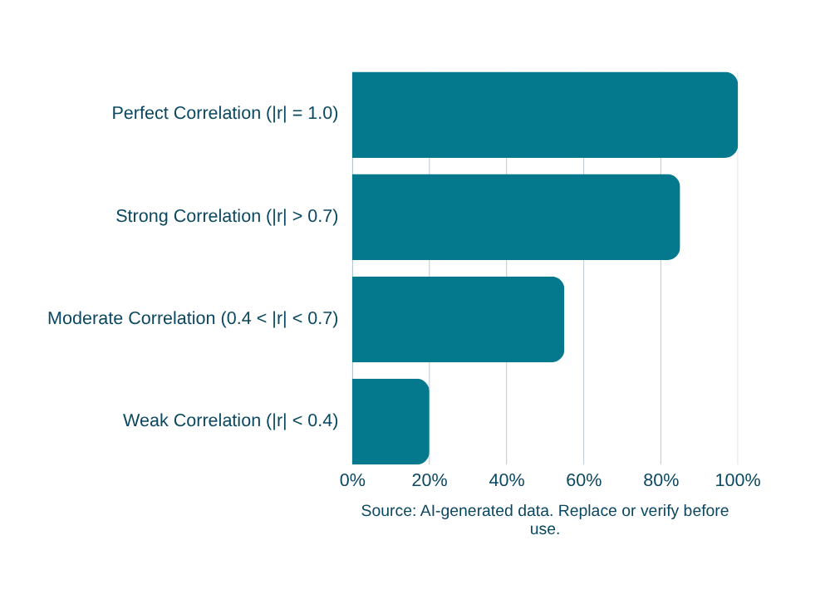
Correlation Scale Interpretation
Interpreting the Pearson correlation coefficient (r) ranges from -1 to +1
r Value Interpretation
0.80 – 1.00 Very Strong
0.60 – 0.79 Strong
0.40 – 0.59 Moderate
0.20 – 0.39 Weak
0.00 – 0.19 Very Weak
Understanding correlation strength helps interpret statistical relationships. The closer |r| is to 1, the stronger the linear association between variables.
Source: Author, Made by Canva

Slide 15
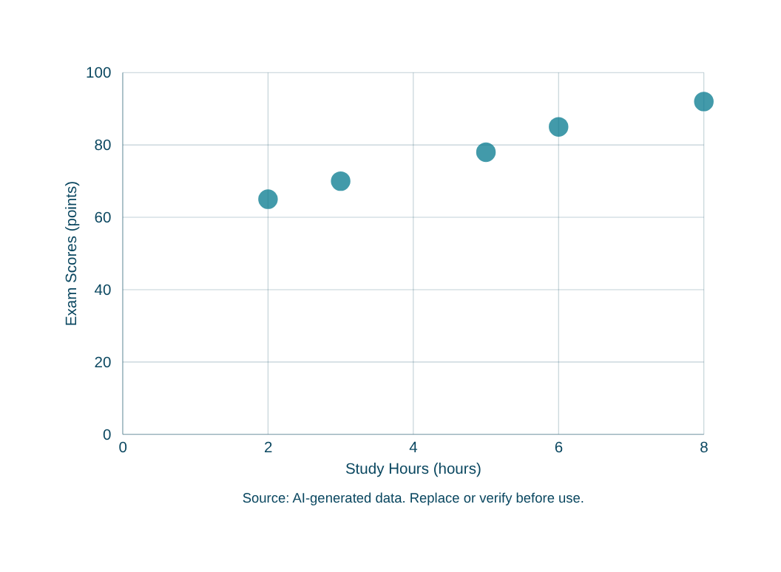
Correlation Example
Case study demonstrating strong positive correlation
Data Sample:
• Student A: 2 hours → 65 points
• Student B: 5 hours → 78 points
• Student C: 8 hours → 92 points
• Student D: 3 hours → 70 points
• Student E: 6 hours → 85 points
Calculated r = 0.95 (Strong Positive Correlation)
"A correlation of r = 0.95 indicates a very strong positive linear relationship between study hours and exam scores."
Source: Author, Made by Canva

Slide 16



Important Note
Correlation ≠ Causation
Confounding Variables
Spurious Example
Two variables may show strong correlation without any causal relationship. Always question whether X actually causes Y or if they merely move together.
Hidden third variables can create misleading correlations. A confounding variable influences both X and Y, creating an apparent relationship that doesn't exist.
Ice cream sales and drowning deaths both rise in summer. The confounder? Temperature. Heat drives both variables independently.
Source: Author, Made by Canva

Slide 17
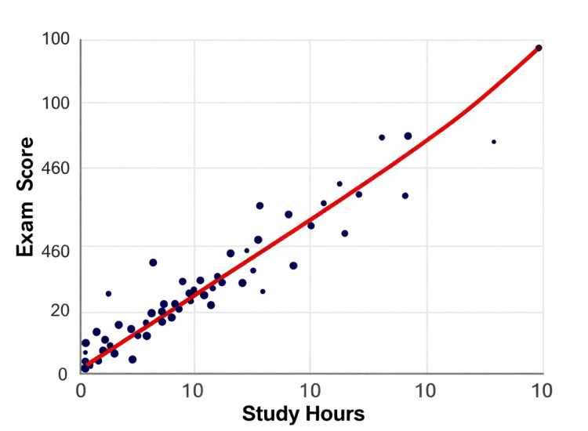
Introduction to Regression
From correlation to prediction — modeling relationships between variables
📐 What is Regression?
A statistical method to model the relationship between a dependent variable (Y) and one or more independent variables (X).
📈 Purpose
To predict outcomes, understand relationships, and quantify how changes in X affect Y.
🎯 Key Idea
Find the best-fitting line (Y = a + bX) that minimizes the distance between observed and predicted values.
"Regression goes beyond correlation — it allows us to predict and explain."
Source: Author, Made by Canva

Slide 18
Real-World Applications of Regression
How regression analysis is used across industries to solve real problems
📊
Sales Forecasting
🔮
Prediction Models
Predict future revenue based on historical sales data, seasonal trends, and market conditions. Helps businesses plan inventory and budgets.
Build models that estimate outcomes like housing prices, stock trends, or customer lifetime value using multiple input variables.
🎯
Recommendation Systems
🎓
Student Performance Prediction
Analyze user behavior patterns to predict preferences and suggest relevant products, content, or services to users.
Forecast academic outcomes based on study hours, attendance, and engagement metrics to enable early intervention.
"Regression turns data into actionable predictions across every industry."
Source: Author, Made by Canva

Slide 19
Simple Linear Regression Formula
The equation that defines the best-fit line through your data
Y = a + bX
92
90
86
80
80
74
Nilai Ujian (Y)
68
Keterangan Variabel:
70
62
Y = Dependent variable (predicted value / response)
60
55
X = Independent variable (predictor / explanatory)
50
a = Intercept (value of Y when X = 0)
50
b = Slope (change in Y for each unit change in X)
1
2
3
4
5
6
7
8
Jam Belajar (X)
"The regression line minimizes the sum of squared residuals between observed and predicted values."
Source: Author, Made by Canva

Slide 20
Understanding Intercept and Slope
Intercept (a)
Slope (b)
Together
The y-intercept represents the baseline value of Y when X equals zero. It indicates the starting point of your prediction line on the Y-axis.
The slope measures the rate of change in Y for each one-unit increase in X. A positive slope means Y increases as X increases.
Intercept and slope together define the complete prediction line equation: y = a + bx, enabling accurate forecasting.
Source: Author, Made by Canva

Slide 21
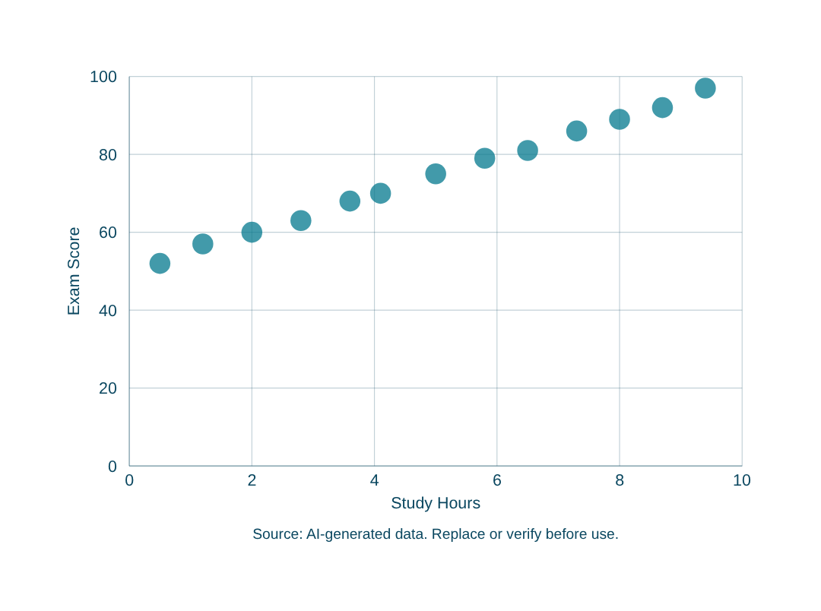
Positive Slope Example
Visualizing positive relationship between study hours and exam scores
When the slope (b) is positive, Y increases as X increases.
Interpretation:
- Each additional study hour raises score by ~5 points
- Intercept (a) = 50 (baseline score without studying)
- Slope (b) = +5 (rate of change)
Regression Equation
Y = 50 + 5X
Source: Author, Made by Canva

Slide 22
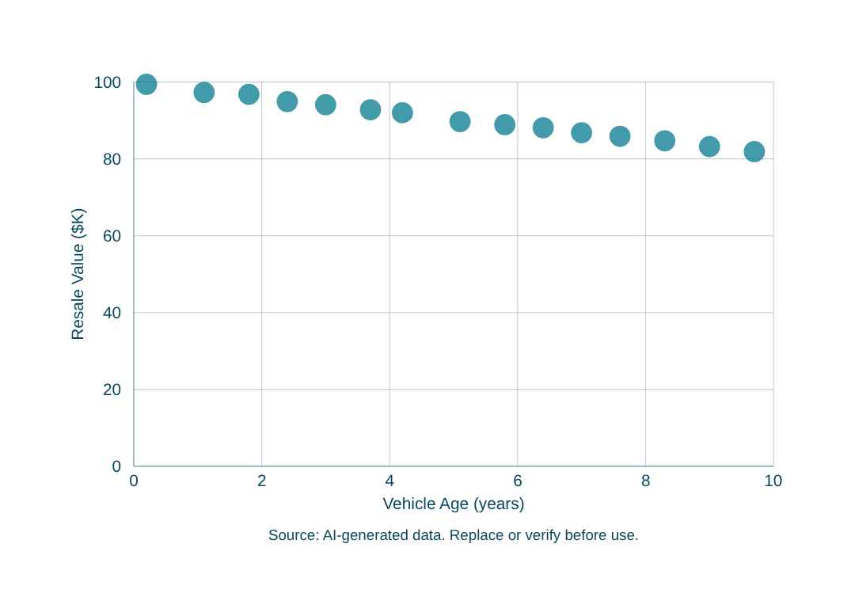
Negative Slope Example
Visualizing inverse relationships between variables
When the slope (b) is negative, Y decreases as X increases.
Interpretation:
- Each additional year of vehicle age reduces value by $2,000
- Intercept (a) = 100 (initial value)
- Slope (b) = -2 (rate of decline)
Regression Equation
Y = 100 - 2X
Source: Author, Made by Canva

Slide 23
Dataset Example
Study Hours (X) vs Exam Score (Y) - Sample data for regression analysis
Study Hours (X)
Exam Score (Y)
1
55
2
60
3
66
4
72
5
78
6
84
7
90
8
95
n = 8 data points | Positive linear trend observed
Source: Author, Made by Canva

Slide 24
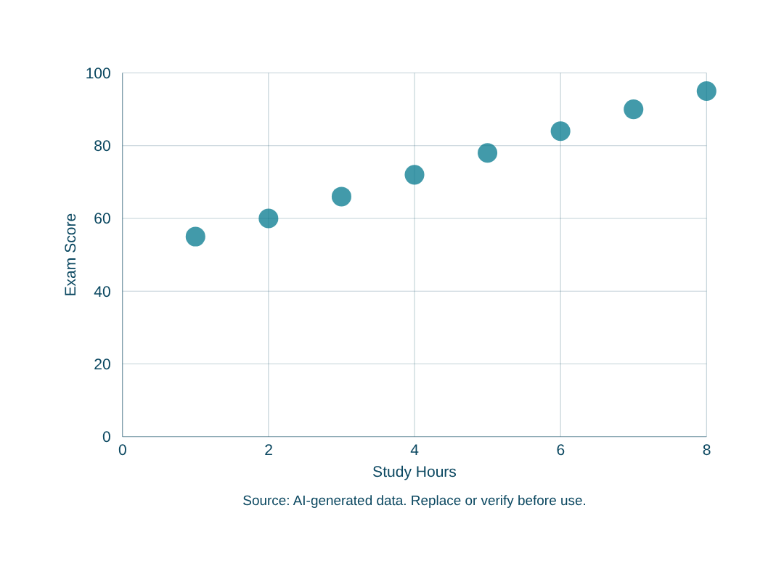
Scatter Plot from Dataset
Visualizing the relationship between study hours and exam performance
Observation:
Data points show a clear upward trend: as study hours increase from 1 to 8, exam scores rise from 55 to 95 points.
This visual pattern suggests a strong positive linear relationship suitable for regression analysis.
Key Insight
Strong positive correlation (r > 0.95)
Source: Author, Made by Canva

Slide 25
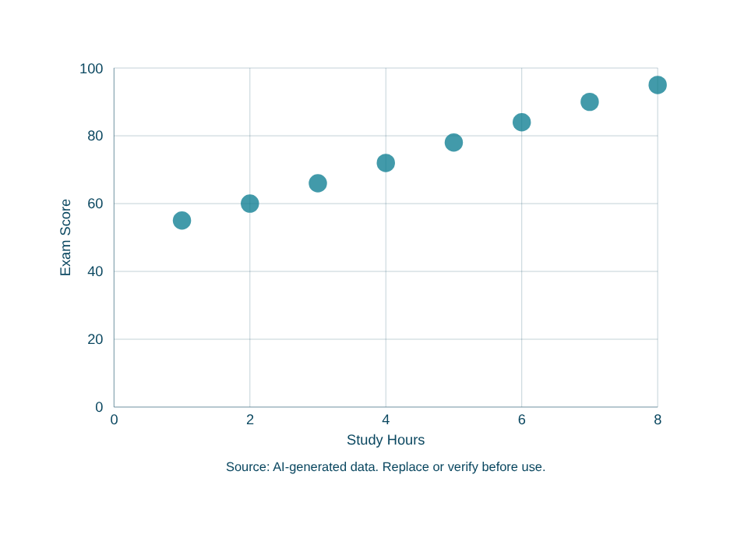
Regression Line Visualization
Best-fit line minimizes sum of squared residuals
How It Works:
The regression line Y = 48 + 6X represents the best fit through the data points, minimizing the total squared distance from each point to the line.
This line captures the average relationship between study hours and exam scores, enabling accurate predictions.
Regression Equation
Y = 48 + 6X
Source: Alfrian Carmen Talakua, Made by Canva

Slide 26
Prediction Example
Using the regression equation to predict exam scores from study hours
Step 1: Identify Equation
Step 2: Substitute Value
Step 3: Calculate Result
Using our regression equation:
y = 48 + 6x
Where x represents study hours
and y represents predicted
exam score.
For a student studying 7 hours:
y = 48 + 6(7)
y = 48 + 42
Substitute x = 7 into the
regression equation.
Final prediction:
y = 90 points
A student studying 7 hours is
predicted to score 90 on
the exam.
Source: Author, Made by Canva

Slide 27
Correlation vs Regression
Understanding the key differences between two related statistical methods
Correlation
Regression
Key Differences
- Measures relationship strength
- Output: Coefficient (r)
- Range: -1 to +1
- Direction: Symmetric
- Use: Describe association
- Answers: How strongly are
variables related?
- Predicts outcomes
- Output: Equation (y = a + bx)
- Range: Unlimited
- Direction: Asymmetric (X→Y)
- Use: Make predictions
- Answers: What value of Y
do we expect for a given X?
Correlation tells us how strongly variables relate.
Regression enables forecasting and quantifies the predictive relationship.
Correlation is symmetric;
regression is directional.
Source: Author, Made by Canva

Slide 28
Assumptions of Linear Regression
Conditions that must be met for valid regression analysis
1
Linear Relationship
2
No Extreme Outliers
The relationship between X and Y must follow a straight-line pattern. A scatter plot should show data points forming a linear trend.
Data should not contain extreme values that distort the regression line. Outliers can heavily influence the slope and intercept.
3
Independent Observations
4
Data Approximately Linear
Each data point must be collected independently. One observation should not influence or depend on another.
The overall pattern in the data should be approximately linear. Non-linear patterns require different models.
Source: Author, Made by Canva

Slide 29
Understanding R²
Coefficient of Determination - Essential for Data Analytics
What is R²?
Example
R² explains how much variation in Y
is explained by X.
It ranges from 0 to 1:
• R² = 0 → Model explains nothing
• R² = 0.5 → 50% of variation explained
• R² = 1.0 → Perfect prediction
Higher R² = better model fit.
R² = 0.81
→ 81% of variation in Y
is explained by the model
Why It Matters for Data Analytics
R² helps evaluate model quality
before making business decisions.
A critical metric in predictive analytics.
Source: Author, Made by Canva

Slide 30
Applications in Information Systems
How regression and correlation are used in real-world IS applications
1
User Behavior Prediction
2
Website Traffic Analysis
Predict how users interact with apps and websites based on past activity. Helps improve UX design and increase engagement.
Forecast visitor counts based on time, campaigns, or seasonal trends. Enables better server planning and marketing strategy.
3
Recommendation Systems
4
Database Performance
Use correlation between user preferences to suggest relevant content, products, or services automatically.
Predict query response times based on data volume and system load. Helps optimize indexing and resource allocation.
Source: Author, Made by Canva

Slide 31
Applications in Business Analytics
How regression and correlation drive strategic business decisions
1
Sales Forecasting
2
Customer Analytics
Predict future revenue based on historical trends, seasonal patterns, and market indicators. Enables accurate budgeting and resource planning.
Analyze customer behavior patterns to predict churn, lifetime value, and purchasing trends. Supports targeted retention strategies.
3
Inventory Prediction
4
Marketing Analysis
Forecast demand to optimize stock levels and reduce waste. Balances holding costs against stockout risks using historical data.
Measure campaign effectiveness by correlating ad spend with conversions. Optimize budget allocation across channels for maximum ROI.
Source: Author, Made by Canva

Slide 32
Practical Session Using Excel
Essential Excel formulas for correlation and regression analysis
Correlation Coefficient
Slope (b)
=CORREL(X_range, Y_range)
=SLOPE(Y_range, X_range)
Measures strength and direction of linear relationship between two variables.
Calculates the slope of the regression line. Shows how much Y changes per unit of X.
Intercept (a)
R-Squared
=INTERCEPT(Y_range, X_range)
=RSQ(Y_range, X_range)
Calculates the Y-intercept. The predicted value of Y when X = 0.
Returns the coefficient of determination. Shows % of variance explained by the model.
Predicted Value
Standard Error
=INTERCEPT(...) + SLOPE(...) * X
=STEYX(Y_range, X_range)
Combines intercept and slope to predict Y for any given X value.
Measures the standard error of the predicted Y values. Indicates prediction accuracy.
Source: Author, Made by Canva

Slide 33
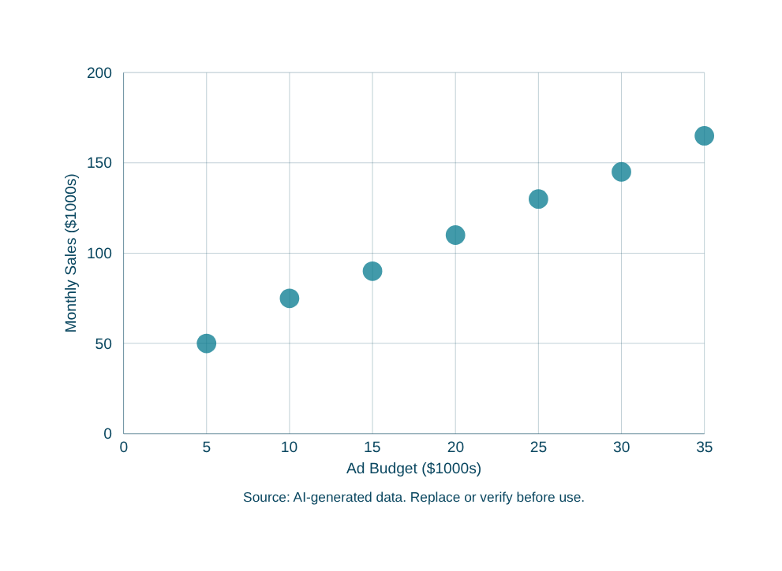
Mini Case Study
Advertising Budget vs Sales Revenue - Applying Correlation and Regression
Scenario
A company tracks monthly ad budget ($1000s) and corresponding sales revenue ($1000s) over 8 months to determine if advertising drives sales growth.
Analysis Results
Correlation: r = 0.98 (very strong positive)
Regression Equation:
y = 32 + 3.8x
Interpretation:
Every $1,000 increase in ad budget generates approximately $3,800 in additional sales revenue.
Prediction:
For $35K budget → Sales = 32 + 3.8(35) = $165K
Key Insight: R² = 0.96 means 96% of sales variation is explained by ad budget. This model is highly reliable for forecasting.
Source: Author, Made by Canva

Slide 34
Common Mistakes
Avoid these critical pitfalls in regression and correlation analysis
1
Assuming Correlation Means Causation
Just because two variables move together does not mean one causes the other. Always consider confounding variables and alternative explanations.
2
Ignoring Outliers
Extreme data points can heavily distort correlation coefficients and regression lines. Always check for outliers using scatter plots before analysis.
3
Using Poor Quality Data
Inaccurate, incomplete, or biased data leads to unreliable results. Ensure data is clean, validated, and representative of the population.
4
Predicting Outside Observed Range
Extrapolation beyond your data range assumes the linear trend continues indefinitely, which is often incorrect and leads to invalid predictions.
5
Using Regression for Non-Linear Data
Applying linear regression to curved relationships produces misleading results. Always verify linearity with a scatter plot first.
Source: Author, Made by Canva

Slide 35
Summary
Key concepts covered in this module
Correlation
Measures strength & direction of linear relationship (r = -1 to +1)
Scatter Plots
Visualize data patterns before computing any statistical measure
Regression Equation
y = a + bx enables prediction of Y from any given X value
R² (Coefficient of Determination)
Shows % of variation in Y explained by the model
Assumptions & Validation
Check linearity, outliers, independence, and data quality
Source: Author, Made by Canva

Slide 36
Discussion Questions
Reflect on these questions to deepen your understanding
1
Why is correlation important in data science?
Think about how identifying relationships between variables helps in making predictions, detecting patterns, and informing data-driven decisions.
2
Can strong correlation guarantee causation?
Consider examples where two variables are highly correlated but one does not cause the other. What role do confounding variables play?
3
Why do businesses use regression models?
Reflect on how forecasting sales, predicting customer behavior, and optimizing resources all rely on understanding variable relationships.
Source: Author, Made by Canva

Slide 37
Assignment
Complete the following tasks and submit your work
1
Collect at least 10 paired observations (X and Y variables)
2
Create a scatter plot to visualize the relationship
3
Calculate the correlation coefficient (r)
4
Build the regression equation (y = a + bx)
5
Interpret the relationship strength using R²
6
Make one prediction using your regression model
7
Submit Excel file and a short written report
Source: Author, Made by Canva

Slide 38
References
Sources and recommended readings
Walpole, R.E., Myers, R.H., Myers, S.L., & Ye, K.
Probability & Statistics for Engineers & Scientists. Pearson, 2016.
Montgomery, D.C., & Runger, G.C.
Applied Statistics and Probability for Engineers. Wiley, 2018.
Triola, M.F.
Elementary Statistics. Pearson Education, 2017.
Microsoft Excel Documentation
Statistical Functions Guide - CORREL, SLOPE, INTERCEPT, RSQ, STEYX.
Khan Academy
Statistics and Probability Course - Regression & Correlation Module.
Source: Author, Made by Canva

Slide 39
THANK YOU
Contact Information
Reach out for more details or inquiries regarding the course.
Alfrian Carmen Talakua
Department of Information Systems
e-Mail : Alfriantalakua@unkriswina.ac.id

