Slide 1

01
Statistics and Probability
Week 13 - Analysis of Variance (ANOVA) in System Development and UX Research
Alfrian Carmen Talakua
Department of Information Systems
2026
Source: Author, Made With Canva

Slide 2
Learning Objectives
02
After completing this lesson, students will be able to:
01
Explain the concept of ANOVA
02
Compare means across multiple groups
03
Understand variance in datasets
04
Interpret ANOVA results
05
Use ANOVA to support data-driven decisions
Key Insight: ANOVA is not just about comparing means — it is a tool for data-driven decision making.

Slide 3
From Regression to Group Comparison
03
Previously, we studied relationships between variables. Today, we analyze differences between groups.
Previous Topic
Today's Focus
• Correlation
• ANOVA
• Regression
→
• Group comparison
• Prediction
• Variance analysis
• Relationship between variables
• Comparing multiple means
Choosing the Right Method
Statistical Question
Method
Is there a relationship?
Correlation
Can we predict values?
Regression
Are groups different?
ANOVA
Key Insight: Statistics is about choosing the right method based on the question you are asking.

Slide 4
Why Compare Groups?
04
Many real-world decisions require comparing alternatives.
ANOVA is a decision-evaluation tool — not just a method for comparing means.
UX Design
Business
Which app interface gives better user satisfaction?
Which marketing strategy produces higher sales?
Education
Systems
Which teaching method gives higher exam scores?
Which system design performs faster?
These questions all require comparing multiple groups to find meaningful differences and support decisions.

Slide 5
Introduction to Variability
05
Variability is the foundation of ANOVA. Without understanding variance, we cannot judge significance.
Data naturally varies — not all users behave the same way
Variance measures how spread out data points are from the mean
A difference in means alone does NOT guarantee significance
Scenario A
Scenario B
Group A
Group B
Group A
Group B
Mean = 7.2
Mean = 7.5
Mean = 6.0
Mean = 8.5
Variance = HIGH
Variance = HIGH
Variance = LOW
Variance = LOW
Small mean difference + Large variance
Large mean difference + Small variance
Likely NOT significant
Likely SIGNIFICANT
Which scenario is more likely to show a significant difference? Why?
Key Takeaway: Significance depends on BOTH the difference between means AND the variability within groups.
Source: Author, Made With Canva

Slide 6
Why Variance Matters
06
Mean differences alone are not enough
01
Two groups can have different averages, but if the data is highly spread out, that difference may just be noise — not a real effect.
Variability affects significance
02
A small difference with low variance can be more meaningful than a large difference with high variance. Context matters.
ANOVA analyzes variability to detect meaningful differences
03
By comparing between-group variance to within-group variance, ANOVA determines whether observed differences are statistically real.
Key Insight: Significance = Signal (between-group difference) vs. Noise (within-group variance).

Slide 7
What is ANOVA?
07
ANOVA compares means indirectly by analyzing variation in the data.
Definition
ANOVA (Analysis of Variance) is a statistical method used to compare the means of three or more groups simultaneously.
Instead of testing pairs individually, ANOVA examines all groups at once
It determines if observed differences are due to actual group effects or random variation
This makes it more efficient and statistically reliable than multiple t-tests
Why does ANOVA use variance to compare means?
Because a difference in means is only meaningful when we consider how much the data varies.
If data points within each group are widely spread, even a large mean difference might be due to chance.
ANOVA solves this by comparing the variation BETWEEN groups to the variation WITHIN groups.
Multiple Groups
→
Analyze Variance
→
Compare Means
Focus on conceptual understanding over formulas
Source: Author, Made With Canva

Slide 8
Why Not Use Multiple t-Tests?
08
The Problem
How Tests Multiply
When comparing multiple groups, running separate t-tests dramatically increases the probability of Type I error (false positive).
Groups
Number of t-Tests
Each t-test carries a 5% chance of false positive
3 groups
3 tests
Multiple tests compound this error exponentially
4 groups
6 tests
ANOVA maintains overall error rate at 0.05
5 groups
10 tests
More tests = Higher error risk
The ANOVA Solution
ANOVA tests all groups simultaneously in a single analysis, controlling the overall Type I error rate at 0.05.
This provides a more efficient, reliable, and statistically sound approach than running multiple t-tests.
Multiple t-Tests
→
ANOVA ✓
ANOVA controls error rate and provides a single, comprehensive result
Source: Author, Made With Canva

Slide 9
Basic Concept of ANOVA
09
ANOVA works by comparing two types of variance in your data.
Between-Group Variance
Within-Group Variance
How much the group means differ from each other.
Large between-group variance suggests the groups are truly different.
How much individual data points vary within each group.
This represents natural variation or random noise in the data.
Group A mean ≠ Group B mean ≠ Group C mean
Individual scores spread around their group mean
The ANOVA Logic
If Between-Group Variance >> Within-Group Variance → Groups are likely truly different
If groups are truly different:
Between-Group Variance ↑ increases
Within-Group Variance ↓ decreases
↓
F-ratio is LARGE → Significant difference
This is the logic of the F-ratio: it measures how much group means differ relative to how much data varies within groups.
Source: Author, Made With Canva

Slide 10
Understanding Variance
10
Variance measures how spread out data points are from the mean.
Variance is calculated as the average of squared deviations from the mean. Understanding variance is essential for ANOVA because it helps us determine whether differences between groups are meaningful or simply due to natural variation.
Low Variance
High Variance
Data points are close together
Data points are spread far apart
Mean
Mean
Predictable, consistent data
Unpredictable, noisy data
Why this matters for ANOVA: High within-group variance makes it harder to detect real differences between groups.
Variance = average of squared deviations from the mean
Source: Author, Made With Canva

Slide 11
Between-Group Variance
11
Between-group variance measures how much the group means differ from the overall (grand) mean.
When group averages are spread far apart from the grand mean, between-group variance is high. This indicates that the grouping variable has a meaningful effect on the outcome.
Visual: Group Means Far Apart = High Between-Group Variance
Group A
Group B
Group C
Mean = 4.2
Mean = 7.1
Mean = 9.8
Grand Mean
Groups appear meaningfully different.
Key Insight: High between-group variance suggests real differences exist among the groups being compared.
ANOVA uses this variance component to determine whether observed differences are statistically significant or due to random chance.
Source: Author, Made With Canva

Slide 12
Within-Group Variance
12
Within-group variance represents natural randomness in the data.
It is the noise that ANOVA must account for when detecting real group differences.
Within-group variance measures how much individual data points scatter around their own group mean. Even if groups are treated identically, individual responses will differ due to natural variation. This is why we cannot simply compare means — we must also consider the noise.
Visual: Data Points Scatter Around Their Group Mean
Group Mean
This spread = Within-Group Variance = NOISE
Why this matters for the F-ratio:
F = Between-Group Variance / Within-Group Variance = Signal / Noise
If noise (within-group variance) is high, even large mean differences may not be significant.
Key Insight: Within-group variance is the denominator of the F-ratio. Lower noise makes it easier to detect real differences.
Source: Author, Made With Canva

Slide 13
ANOVA Logic
13
ANOVA works like detecting a signal hidden inside noisy data.
Just like filtering Wi-Fi signal from interference — ANOVA separates real group differences from random noise.
The core principle of ANOVA relies on comparing two types of variance. If the variance between groups is substantially larger than the variance within groups, this suggests the group means are truly different — not just due to random chance.
SIGNAL
NOISE
Between-Group Variance
Within-Group Variance
The real differences we want to detect.
Are the groups truly different?
Natural randomness in the data.
Individual variation within each group.
F-ratio = Signal / Noise = Between-Group Variance / Within-Group Variance
F is LARGE → Signal > Noise → Significant
F is SMALL → Signal ≤ Noise → Not Significant
Key Insight: When between-group variance >> within-group variance,
we conclude significant differences exist between groups.
Think of it like this: can you hear the music (signal) over the crowd noise?
Source: Author, Made With Canva

Slide 14
Example Scenario
14
Comparing User Satisfaction Across Three Mobile Apps
A UX research team is evaluating three mobile applications. They want to determine which app delivers the best user satisfaction. By collecting satisfaction scores from users of App A, App B, and App C, researchers can use ANOVA to compare whether the differences in mean satisfaction scores are statistically significant.
App A
App B
App C
Social Media
Platform
E-Commerce
Marketplace
Productivity
Tool
Research Setup
5 users per app
→
Rate satisfaction (1-10)
→
Compare means with ANOVA
Statistical Question:
Do these apps truly differ in user satisfaction?
Remember: Every statistical method answers a specific question. ANOVA answers: "Are there significant differences among group means?"
Source: Author, Made With Canva

Slide 15
Sample Dataset
15
User Satisfaction Scores (1-10 scale) | n=5 per group
User
App A
App B
App C
Mean Satisfaction by Group
1
8
4
6
10
7.8
2
7
5
7
8
6.0
3
9
5
5
6
4.2
4
8
3
6
4
5
7
4
6
2
Mean
7.8
4.2
6.0
0
App A
App B
App C
Observation: App A has the highest mean (7.8), App B the lowest (4.2). But are these differences statistically significant?
ANOVA will help us determine whether these observed differences are real or simply due to random variation.
Source: Author, Made With Canva

Slide 16
Visualizing Group Means
16
Mean User Satisfaction Scores by App (Scale 1-10)
10
7.8
8
6.0
6
Grand Mean = 6.0
Satisfaction Score
4.2
4
2
0
App A
App B
App C
Mobile Application
Visual Insight: App A scores well above the grand mean, App B well below. ANOVA tests whether these gaps are statistically significant.
Bar height represents mean satisfaction score per group. Red line indicates the overall (grand) mean across all groups.
Source: Author, Made With Canva

Slide 17
Null and Alternative Hypotheses
17
In ANOVA, we test whether the means of three or more groups are statistically equal. Every hypothesis test starts with a clear question and two competing statements.
Step 1: In Plain Language
Mean App A = Mean App B = Mean App C
↓
Step 2: Formal Notation
μ₁ = μ₂ = μ₃
Null Hypothesis (H₀)
Alternative Hypothesis (H₁)
μ₁ = μ₂ = μ₃
At least one μ differs
All group means are equal.
Any observed differences are due to random chance.
At least one group mean is significantly
different from the others.
If F is large enough (p < 0.05) → Reject H₀ → Conclude: groups are significantly different
Remember: Every statistical method answers a specific question. ANOVA asks: are the group means truly different, or is it just noise?
Source: Author, Made With Canva

Slide 18
ANOVA Test Statistic
18
The F-statistic is the key measure in ANOVA. It quantifies how much group means differ relative to the variation within groups.
F-Statistic Formula
F = Between-Group Variance (MSB) / Within-Group Variance (MSW)
F = Signal / Noise = Real Differences / Random Variation
Why does a large F mean groups are different?
Large F means:
Differences between groups are MUCH LARGER than random variation.
The signal is strong enough to be heard above the noise.
F is LARGE
F is SMALL
Groups are likely different
p < 0.05 → Reject H₀
Differences likely due to chance
p > 0.05 → Fail to reject H₀
Example: If F = 12.0, it means the between-group differences are 12 times larger than the random noise within groups.
Key Insight: A large F-value is evidence that the group means are not all equal.
Source: Author, Made With Canva

Slide 19
Understanding the F-Ratio
19
This is the core of ANOVA. The F-ratio tells you whether group differences are real or just noise.
Between-Group Variance (MSB)
← SIGNAL
F =
Within-Group Variance (MSW)
← NOISE
Signal vs Noise Analogy
Imagine trying to hear someone talking (signal) in a noisy crowd (noise).
If their voice is MUCH LOUDER than the crowd → you can clearly hear them → F is large → groups are different.
F ≈ 1
F >> 1
F < 1
Signal = Noise
No real difference
between groups
Signal >> Noise
Real differences exist
p < 0.05 → Reject H₀
Signal < Noise
Groups are very similar
p > 0.05 → Fail to reject H₀
Our Example: F = MSB / MSW = 16.2 / 1.45 = 11.17 → Between-group differences are 11× larger than noise!
The bigger the F-ratio, the stronger the evidence that group means are truly different.
Source: Author, Made With Canva

Slide 20
Interpreting F Values
20
What do different F values tell us? Here are concrete examples to build intuition.
F Value
Interpretation
What it means
Decision
0.8
Groups similar
Differences ≈ random noise
Fail to reject H₀
1.2
Borderline
Slight differences, inconclusive
Fail to reject H₀
5.2
Groups likely different
Differences > random variation
Reject H₀
11.17
Groups clearly different
Differences >> random variation
Reject H₀
Visual Comparison: How F relates to group separation
F = 0.8
Groups overlap heavily — no real difference
F = 5.2
Groups clearly separated — likely significant
F = 11.17
Strong evidence — groups are very different
Small F → Groups are Similar
Large F → Groups are Different
Between-group variance ≈ Within-group variance
Differences are just random noise
Fail to reject H₀
Between-group variance >> Within-group variance
Signal is much stronger than noise
Reject H₀
The larger the F, the more confident we are that group differences are real — not random.
Source: Author, Made With Canva

Slide 21
Significance Level (p-value)
21
The Golden Rule of p-values
The p-value tells us whether observed differences are likely real or simply random chance.
What exactly is a p-value?
The probability of seeing results this extreme IF there is actually no difference between groups (H₀ is true).
In plain language:
"If p is small, the difference is real. If p is large, it might just be luck."
p < 0.05
p > 0.05
Reject H₀
Differences are statistically significant
Less than 5% chance this is random
Fail to reject H₀
Differences are NOT significant
Could easily be random chance
Common Misconception
p-value is NOT the probability that H₀ is true.
✔ p-value IS the probability of getting these results IF H₀ were true.
Our Example: p = 0.001 → Only 0.1% chance the differences are random → Reject H₀ → Groups ARE different!
Remember: Don't just memorize p < 0.05. Understand that a small p means the evidence against H₀ is strong.
Source: Author, Made With Canva

Slide 22
ANOVA Decision Flow
22
Follow these steps to make a decision using ANOVA results.
01
Calculate F-Statistic
F = Between-Group Variance / Within-Group Variance
↓
02
Check p-value
Compare the p-value from the F-distribution to your significance level (α = 0.05)
↓
03
Accept or Reject H₀
Use the decision rules below to determine your conclusion
↓
04
Draw Conclusion
State whether the group means are significantly different
Decision Rules (Step 03)
If p < 0.05 → Reject H₀
Groups are significantly different
If p > 0.05 → Fail to reject H₀
No significant difference found
Our Example: F = 11.17, p = 0.001 < 0.05 → Reject H₀ → At least one group mean is different!
Key: ANOVA tells you IF groups differ. Post-hoc tests tell you WHICH groups differ.
Source: Author, Made With Canva

Slide 23
Example ANOVA Result
23
Don't be intimidated by ANOVA tables. Focus on the two values that matter most.
Source
SS
df
MS
F
p-value
Between Groups
32.4
2
16.2
11.17
0.001
Within Groups
17.4
12
1.45
Total
49.8
14
↑
↑
These are the most important values for interpretation.
Reading the Table
Source — Where the variance comes from
MS — Mean Square (SS ÷ df)
SS — Sum of Squares (total variation)
F — Test statistic (MS Between ÷ MS Within)
df — Degrees of Freedom
p-value — Probability result is due to chance
Interpretation
F = 11.17 tells us the between-group differences are 11× larger than random noise.
p = 0.001 means there's only a 0.1% chance this happened by random chance → Reject H₀
Don't fear the table. Just find F and p-value — they tell you everything you need.
Source: Author, Made With Canva

Slide 24
Interpretation Example
24
How to write a proper ANOVA interpretation for your research report.
Our Example
Comparing satisfaction scores of 3 mobile apps (A, B, C) with 5 users each. | F = 11.17 | p = 0.001 | α = 0.05
Standard Interpretation Format (for Research Reports)
Because p < 0.05,
we reject the null hypothesis.
At least one group mean differs significantly.
Full Written Example (copy-paste ready)
"A one-way ANOVA revealed a statistically significant difference in user satisfaction scores among the three mobile apps, F(2, 12) = 11.17, p = 0.001. Since p < 0.05, we reject H₀ and conclude that at least one app's mean satisfaction score differs significantly from the others."
Tips for Your Report
• Always report: F(df₁, df₂) = value, p = value
• State the decision: reject or fail to reject H₀
• Provide a plain-language conclusion about what the result means
Use this format in every ANOVA report. It shows your lecturer you understand the logic, not just the numbers.
Source: Author, Made With Canva

Slide 25
Post-Hoc Analysis
25
ANOVA tells us differences exist, but post-hoc tests identify which groups differ.
ANOVA
"Differences exist"
Post-Hoc Test
"Which groups differ"
Common Post-Hoc Tests
Tukey HSD
Bonferroni
Compares all possible pairs of group means.
Best when groups have equal sample sizes.
Adjusts significance level for multiple comparisons.
More conservative, reduces Type I error.
Key Insight: ANOVA finds the signal. Post-hoc tests pinpoint the source.
Source: Author, Made With Canva

Slide 26
ANOVA Assumptions
26
These must be met BEFORE running ANOVA. Violations can invalidate your results.
1. Independence
2. Normality
Data points are unrelated to each other
Data is approximately normally distributed
Check: Each observation from a different subject
Check: Shapiro-Wilk test or Q-Q plot
3. Homogeneity of Variance
4. Random Sampling
Groups have similar variances (spread)
Samples drawn randomly from population
Check: Levene's test (p > 0.05 = OK)
Check: Proper experimental design
What Happens If Violated?
Independence
Normality
Homogeneity
Inflated Type I error
(false positives increase)
F-statistic becomes unreliable
for small sample sizes
F-test loses power
results become misleading
Tip: Independence and Random Sampling are checked at design stage. Normality and Homogeneity are checked with statistical tests after collecting data.
Always check assumptions FIRST. Running ANOVA on violated assumptions = unreliable conclusions.
Source: Author, Made With Canva

Slide 27
Homogeneity of Variance
27
All groups must have approximately equal variances (spread) for ANOVA to work correctly.
What is Homogeneity of Variance?
It means the spread (variance) of data in each group is roughly the same. If Group A has tightly clustered scores and Group C has widely scattered scores, the assumption is violated.
Why Does This Matter?
Unequal variances can distort the F-statistic.
The F-ratio assumes equal spread. If one group is much more variable, ANOVA may detect false differences or miss real ones.
Visual Comparison
✔ Equal Variances (Assumption Met)
Unequal Variances (Violated)
Group A: spread = 2.1
Group B: spread = 2.3
Group C: spread = 1.9
Group A: spread = 1.2
Group B: spread = 2.5
Group C: spread = 8.7
How to Test: Levene's Test
Levene's Test: If p > 0.05 → variances are equal (assumption met) ✔
Levene's Test: If p < 0.05 → variances are NOT equal (assumption violated)
If violated: Use Welch's ANOVA (does not assume equal variances) or transform your data.
Unequal variances distort F. Always run Levene's test before interpreting ANOVA results.
Source: Author, Made With Canva

Slide 28
One-Way ANOVA
28
The simplest form of ANOVA: comparing means across multiple groups using one independent variable.
Key Concept
One factor = one grouping variable
Example: App Type (A, B, C) is the single factor used to group participants.
What is One-Way ANOVA?
One-Way ANOVA compares the means of 3 or more groups that differ on ONE independent variable (factor). It tests whether at least one group mean is significantly different from the others.
Structure
One Factor
→
Multiple Groups (Levels)
→
Compare Means
= One grouping variable
e.g., App Type
= 3+ categories within that factor
e.g., App A, App B, App C
Are the group means
significantly different?
Our Example
Factor: App Type (1 variable) | Levels: App A, App B, App C (3 groups) | DV: Satisfaction Score
Question: Does satisfaction differ significantly across the three app types?
One-Way = 1 factor (e.g., app type) vs Two-Way = 2 factors (e.g., app type + gender)
One factor, multiple groups, one question: Are the means different?
Source: Author, Made With Canva

Slide 29
Real Example of One-Way ANOVA
29
A practical SI-oriented scenario showing how ANOVA supports real business decisions.
Scenario
A university IT department tested three server configurations to determine which provides the fastest response times.
• Server A: Traditional architecture
• Server B: Load balancing
• Server C: Cloud-based infrastructure
Each server was tested 30 times under identical conditions.
Results
Server A (Traditional)
Server B (Load Balancing)
Server C (Cloud-based)
Mean: 245 ms
Mean: 198 ms
Mean: 212 ms
ANOVA Question: Are these response time differences statistically significant, or just due to random variation?
ANOVA Setup
Factor: Server Configuration (1 variable) | Levels: A, B, C (3 groups) | DV: Response Time (ms) | n: 30 per group
Business Question: Which server configuration should be implemented?
Statistics = Decision Making. ANOVA tells you which option to choose with confidence.
Source: Author, Made With Canva

Slide 30
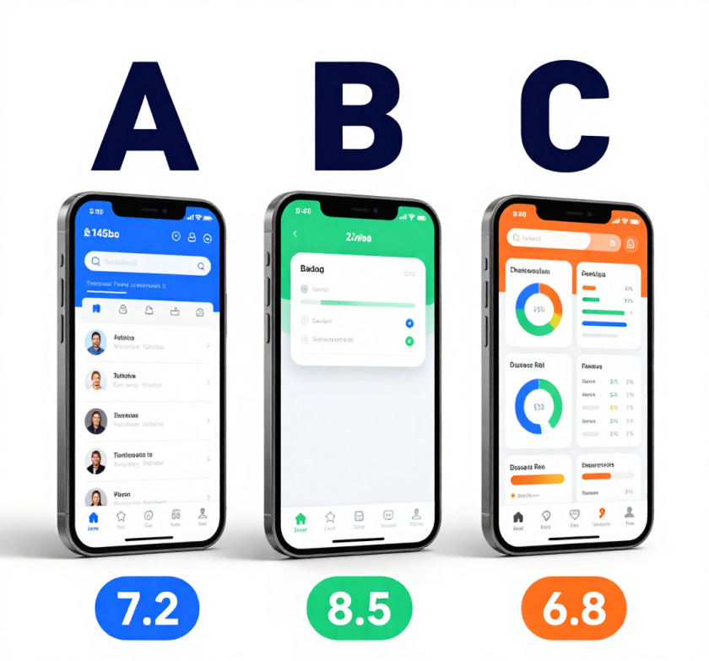
ANOVA in UX Research
30
Why ANOVA in UX?
When testing 3+ interface designs, ANOVA tells you if user satisfaction differences are real or just random noise.
ANOVA Question: Is there a significant difference in satisfaction across the three interface designs?
Setup
Factor: Interface Design (1 variable)
Levels: Interface A, B, C (3 groups)
DV: User Satisfaction Score (1-10)
n: 50 users per group
Mean Satisfaction Scores
• Interface A (Classic): 7.2 / 10
• Interface B (Modern): 8.5 / 10
• Interface C (Dashboard): 6.8 / 10
UX Research Applications
• Interface layout comparison (A/B/C testing)
• Navigation efficiency across design patterns
• Task completion time across user groups
• Satisfaction scores across product versions
ANOVA replaces guesswork with evidence. Test multiple designs and know which one wins.
Source: Author, Made With Canva

Slide 31
ANOVA in Information Systems
31
Using ANOVA to compare system performance, infrastructure options, and technology decisions with statistical rigor.
Why ANOVA in Information Systems?
IS professionals constantly compare multiple system options. ANOVA provides statistical evidence for choosing the best configuration instead of relying on gut feeling or single benchmarks.
Real IS Examples
Database Engines
Cloud Performance
API Response Time
Comparing query performance across
3 database systems
Evaluating compute speed across
3 cloud providers
Testing API latency across
3 server architectures
Factor: Database Engine
Levels: MySQL, PostgreSQL, MongoDB
DV: Query execution time (ms)
Factor: Cloud Provider
Levels: AWS, Azure, GCP
DV: Processing time (seconds)
Factor: Architecture Type
Levels: Monolith, Microservices, Serverless
DV: Response time (ms)
Core Question: Are the performance differences between systems statistically significant, or just due to random variation?
Why This Matters for IS Professionals
• Infrastructure investments cost thousands — ANOVA ensures you pick the right option
• Single benchmarks can be misleading — ANOVA accounts for variability across multiple tests
• Stakeholders need evidence, not opinions — ANOVA provides p-values and confidence levels
• Scalability decisions require comparing 3+ configurations simultaneously
Business Decision: Which technology stack should we invest in for the next 5 years?
ANOVA turns system benchmarks into actionable, evidence-based technology decisions.
Source: Author, Made With Canva

Slide 32
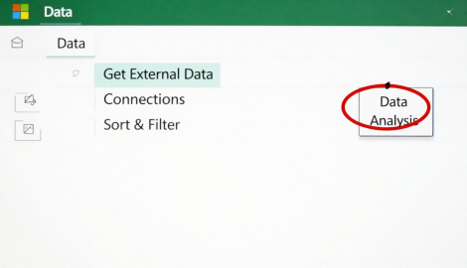
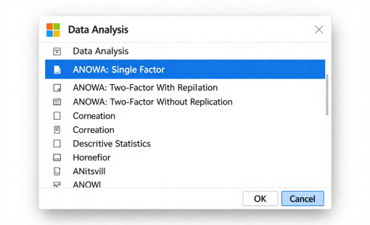
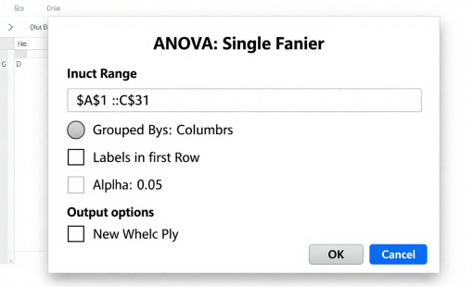
Practical Session: ANOVA in Excel
32
Step-by-step guide to running One-Way ANOVA using Excel's Data Analysis ToolPak.
How to Run ANOVA in Excel (3 Steps)
1
2
3
Click the Data tab
Click Data Analysis
Select ANOVA: Single Factor
What Excel Outputs
Summary Table: Count, Sum, Average, Variance per group
ANOVA Table: SS (Sum of Squares), df (degrees of freedom), MS (Mean Square), F-statistic, P-value, F-critical
Tips
• Enable ToolPak first: File → Options → Add-ins → Analysis ToolPak
• Data must be in columns (one column per group)
• If P-value < 0.05, the group means are significantly different
3 clicks to run ANOVA: Data tab → Data Analysis → ANOVA: Single Factor. That's it!
Source: Author, Made With Canva

Slide 33
ANOVA Table Components
33
Understanding each component of the ANOVA output table — what it means in plain language.
SS
Sum of Squares
Quick Reference Table
Total variation in the data — how spread out the values are from the overall mean.
Component
Simple Meaning
df
SS (Sum of Squares)
Total variation in the data
Degrees of Freedom
df (Degrees of Freedom)
Available information for calculation
How many independent data points contribute to the calculation.
MS (Mean Square)
Average variation (SS ÷ df)
MS
F-Statistic
Signal-to-noise ratio (MS Between ÷ MS Within)
Mean Square
P-value
Probability result is due to chance
Average variation — SS divided by df. Gives a fair per-unit measure of variability.
F-critical
Threshold value for decision making
F
F-Statistic
MS Between ÷ MS Within. Larger F = stronger group differences.
How They Connect
MS = SS ÷ df → F = MS Between ÷ MS Within → Compare F with F-critical
Decision Rule
If P-value < 0.05 (or F > F-critical)
→ Reject H₀ → Groups are significantly different
If P-value ≥ 0.05 (or F ≤ F-critical)
→ Fail to reject H₀ → No significant difference
SS measures total spread, df adjusts for sample size, MS gives fair comparison, F makes the decision.
Source: Author, Made With Canva

Slide 34
Common Mistakes in ANOVA
34
Avoid these critical errors that compromise your ANOVA analysis and lead to wrong conclusions.
1
Using ANOVA for Only Two Groups
Why #4 Matters in Modern Analytics
A simple t-test is more efficient and appropriate when comparing just two groups. ANOVA is designed for 3+ groups.
With big data, even tiny differences become statistically significant due to large sample sizes.
Example:
API response times: A = 201ms, B = 203ms, C = 199ms
p-value = 0.001 (significant!)
But the 4ms difference has ZERO practical impact on users.
2
Ignoring Assumptions
Normality, independence, and homogeneity of variance must be verified before running ANOVA. Violations invalidate results.
How to Avoid These Mistakes
3
Misinterpreting P-values
✓ Use t-test for 2 groups, ANOVA for 3+
A non-significant result (p > 0.05) does NOT prove groups are equal — it only means we lack sufficient evidence of difference.
✓ Run Levene's test for homogeneity of variance
✓ Check normality with Shapiro-Wilk test
✓ Report effect size alongside p-values
Assuming Statistical = Practical Significance
✓ Consider practical significance before concluding
4
A statistically significant result may have trivial real-world impact. Always check effect size (e.g., eta-squared) alongside p-values.
⚠ Remember: Statistical significance ≠ Practical importance. Always ask: "Does this difference actually matter in the real world?"
Before Running ANOVA, Always Check:
✓ 3+ groups?
✓ Independent samples?
✓ Normal distribution?
✓ Equal variances?
✓ Effect size planned?
Good statistics = right test + verified assumptions + practical interpretation.
Source: Author, Made With Canva

Slide 35
Summary
35
Key Takeaways
What You Can Now Do
ANOVA compares means across 3+ groups in a single, controlled analysis
✓ Identify when to use ANOVA vs t-test
✓ Set up hypotheses (H₀ and H₁)
✓ Run ANOVA in Excel (Data Analysis ToolPak)
Variance is split into Between-Group (signal) and Within-Group (noise)
✓ Interpret F-statistic and P-value
✓ Make evidence-based decisions from results
✓ Apply ANOVA to real IS/UX problems
The F-statistic measures signal-to-noise ratio for decision making
ANOVA Workflow
Applied in analytics, system evaluation, UX research, and IS decisions
Define Groups → Check Assumptions → Run ANOVA → Interpret F & P → Decide
Always verify assumptions: normality, independence, equal variances
CLOSING STATEMENT
Statistical significance ≠ practical importance — check effect size
ANOVA helps researchers compare multiple groups efficiently and make evidence-based decisions.
Fields Where ANOVA Makes an Impact:
UX Research
Information Systems
Data Analytics
Cloud Computing
Software Engineering
Don't guess. Test. ANOVA gives you the statistical power to compare and decide with confidence.
Source: Author, Made With Canva

Slide 36
Discussion Questions
36
Reflect on how ANOVA connects to real-world scenarios in Information Systems and digital product development.
Reflective Questions
Discussion Format
Q1
When would you choose ANOVA over a t-test in your research?
1
Identify a digital product/service you use daily
Q2
2
Define 3+ groups you could compare (designs, features, configs)
What are the consequences of violating ANOVA assumptions?
3
Choose a measurable outcome (time, satisfaction, conversion)
Q3
How would you explain the F-statistic to a non-technical stakeholder?
4
Explain how ANOVA would help make a better decision
Q4
Give an example of statistical significance without practical importance.
KEY DISCUSSION QUESTION
How could ANOVA improve digital products or services?
Think About These Scenarios:
• Comparing 3 checkout flows to find which has the lowest cart abandonment rate
• Testing 4 push notification strategies to maximize user engagement
• Evaluating 3 recommendation algorithms on user satisfaction scores
• Comparing server response times across 3 CDN providers for your SaaS product
• Testing 3 onboarding flows to reduce time-to-first-value for new users
ANOVA transforms product decisions from opinion-based to evidence-based. Every digital product can benefit.
Source: Author, Made With Canva

Slide 37
Assignment
37
Complete the following steps to demonstrate your understanding of One-Way ANOVA.
01
Collect Simple Grouped Data
04
Run ANOVA Using Excel
Gather numeric data for at least 3 groups (e.g., satisfaction scores for 3 app designs, response times for 3 servers).
Use Data tab → Data Analysis → ANOVA: Single Factor. Set alpha = 0.05. Record the output table.
02
Compare at Least 3 Groups
05
Interpret the P-value
Ensure your dataset has 3+ independent groups with the same measured variable. Label each group clearly.
Compare your p-value to α = 0.05. If p < 0.05, the group differences are statistically significant. Report F-statistic and df.
03
Create Charts Visualizing Means
06
Write a Statistical Conclusion
Use bar charts or box plots to show group means and spread. Visual comparison helps identify patterns before testing.
State whether you reject or fail to reject H₀. Explain what this means in context of your data. Discuss practical significance.
⚠ NEW: Steps 05 & 06 are mandatory
Your assignment is NOT complete without interpretation and conclusion. Running ANOVA alone is not enough — you must explain what the results mean and make a decision based on evidence.
Submission Requirements
Grading Focus
• Excel file (.xlsx) with raw data, ANOVA output, and charts
• Data Collection & Setup — 20%
• Written report (1-2 pages): hypothesis, method, results, interpretation, conclusion
• Visualization — 15%
• Clearly state H₀ and H₁ before running the test
• ANOVA Execution — 20%
• Include effect size discussion (practical vs statistical significance)
• P-value Interpretation — 25%
• Statistical Conclusion — 20%
Running the test is step 4. Interpreting and concluding (steps 5-6) is where real learning happens.
Source: Author, Made With Canva

Slide 38
References
38
These references provide foundational knowledge for ANOVA concepts covered in this lecture.
[1] Walpole, R. E., Myers, R. H., Myers, S. L., & Ye, K. (2016). Probability and Statistics for Engineers and Scientists (9th ed.). Pearson.
[2] Montgomery, D. C., & Runger, G. C. (2018). Applied Statistics and Probability for Engineers (7th ed.). Wiley.
[3] Triola, M. F. (2021). Elementary Statistics (14th ed.). Pearson.
[4] Microsoft Corporation. (2023). Data Analysis ToolPak for Excel. Microsoft Support Documentation.
[5] Khan Academy. (n.d.). Statistics and Probability. Retrieved from khanacademy.org

Slide 39
39
THANK YOU
Contact Information
Reach out for more details or inquiries regarding the course.
Alfrian Carmen Talakua
Department of Information Systems
e-Mail : Alfriantalakua@unkriswina.ac.id

