Slide 1
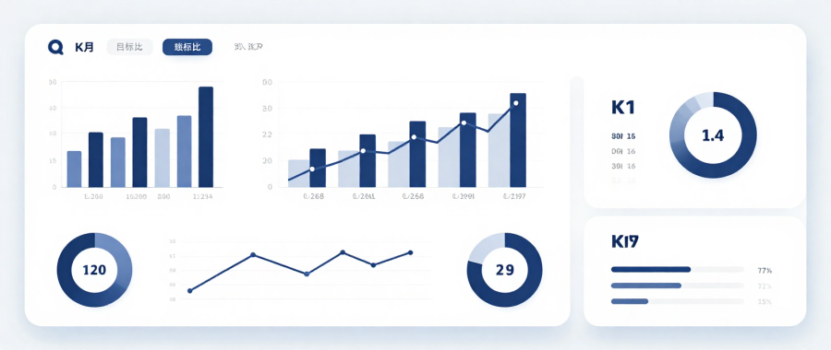
Statistics and Probability
Week 15 - Case Studies and Applications in
Data-Driven Information System Development
Alfrian Carmen Talakua
Department of Information Systems
2026
Integrating Statistical Thinking into Information Systems Development
Source: Author, Made with Canva

Slide 2

Learning Objectives
2 / 47
1
Integrate statistical concepts into real-world Information Systems cases
2
Apply statistical reasoning in data-driven decision making
3
Interpret analytical results critically
4
Evaluate Information Systems using statistical evidence
5
Build evidence-based recommendations from data
Source: Author, Made with Canva

Slide 3
From Statistical Theory to Real-World Applications
3 / 47
Descriptive Statistics
Probability
Sampling
Hypothesis Testing
Reviewed
Reviewed
Reviewed
Reviewed
Regression
ANOVA
Chi-Square
Non-Parametric Tests
Reviewed
Reviewed
Reviewed
Reviewed
Today: Applying ALL concepts in practical Information Systems scenarios

Slide 4
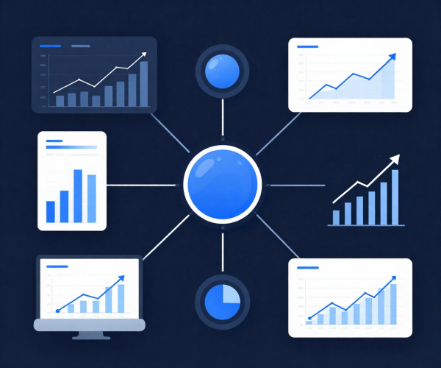
Why Data-Driven Systems Matter
4 / 47
Improve Performance
Optimize processes through continuous data monitoring
Predict Outcomes
Use historical data to forecast trends and behaviors
Reduce Risks
Identify threats and anomalies before they escalate
Support Decision Making
Replace guesswork with evidence-based strategies
Optimize Services
Source: Author, Made with Canva
Enhance user experience through analytics feedback

Slide 5
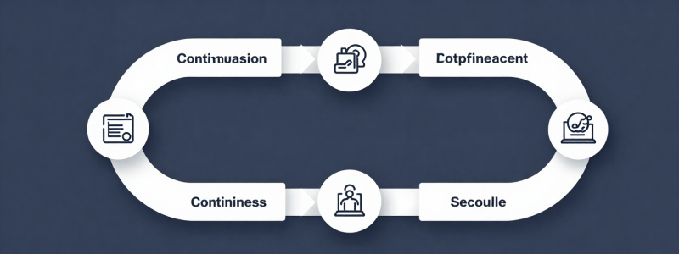
Statistical Thinking in Information Systems
5 / 47
Collect Data
Analyze Data
Interpret Results
Make Decisions
Improve Systems
Statistics supports continuous system improvement through a structured analytical cycle.
Source: Author, Made with Canva

Slide 6

Information Systems and Analytics
6 / 47
Information Systems today depend heavily on analytics
and statistical reasoning for intelligent operations.
Recommendation Systems
User Analytics
Personalized content delivery
Behavior tracking and insights
Security Monitoring
Smart Applications
Threat detection and response
Adaptive and intelligent systems
Source: Author, Made with Canva

Slide 7
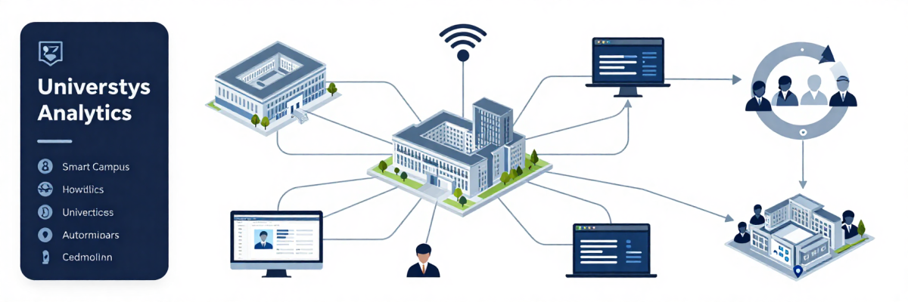
Case Study: Smart Campus Analytics System
7 / 47
Smart Campus Analytics System
A university collects digital activity data to improve
learning systems and student engagement.
Source: Author, Made with Canva

Slide 8
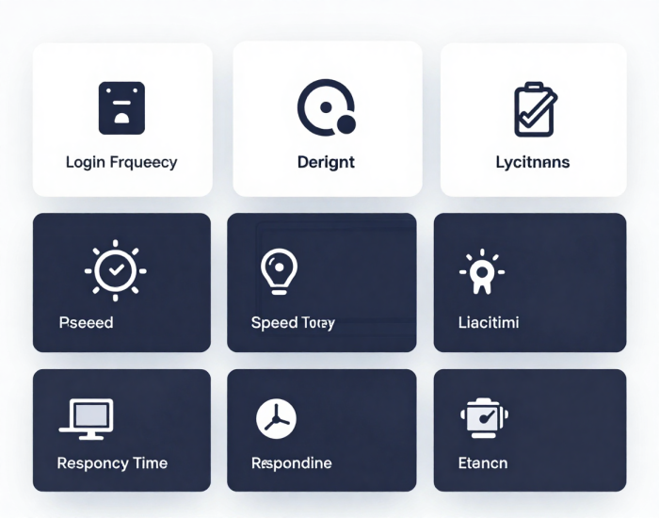
Dataset Overview
8 / 47
LMS Login Frequency
Assignment Completion
Numerical
Numerical
Internet Speed
User Satisfaction
Numerical
Ordinal
Device Type
Response Time
Categorical
Numerical
Attendance
Numerical
Source: Author, Made with Canva

Slide 9
Identifying Data Types
9 / 47
Numerical Data
Categorical Data
Ordinal Data
Continuous or discrete values
that can be measured
Labels or groups with
no inherent order
Ranked categories with
a meaningful order
Login frequency, GPA,
response time, speed
Device type, browser,
user role, department
Satisfaction rating,
performance level
Identifying data types is the first step in choosing the right statistical method.

Slide 10
Choosing the Right Statistical Method
10 / 47
Statistical Goal
Method
Summarize data
Descriptive Statistics
Estimate population parameters
Confidence Interval
Test differences between groups
Hypothesis Testing
Predict values from variables
Regression Analysis
Compare multiple groups
ANOVA
Analyze categorical relationships
Chi-Square Test
This table connects all semester concepts — choose the right tool for the right question.

Slide 11
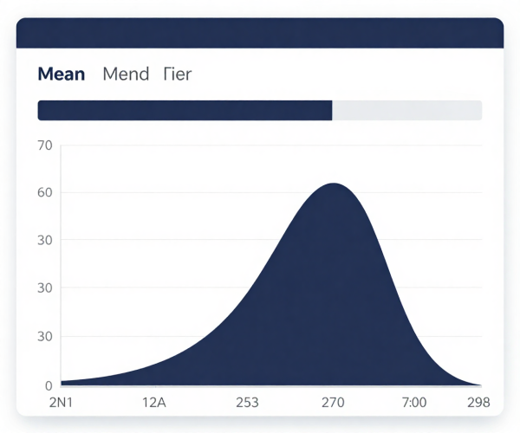
Descriptive Statistics Review
11 / 47
Mean
Average LMS login = 4.2 times/day
Typical usage level across all students
Median
Median assignment completion = 85%
Middle value, robust against outliers
Standard Deviation
SD of response time = 1.3s
How spread out data is from the mean
Source: Author, Made with Canva

Slide 12
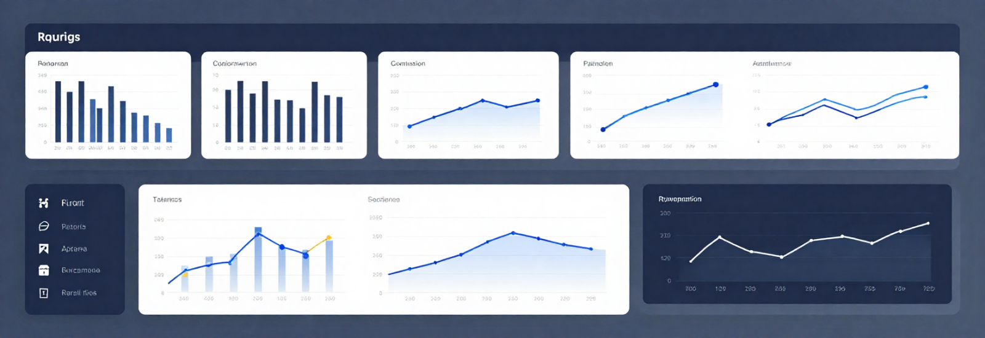
Data Visualization in Action
12 / 47
Effective visualizations transform raw data into actionable insights.
Dashboards
Bar & Line Charts
Heatmaps
Activity Graphs
Source: Author, Made with Canva

Slide 13
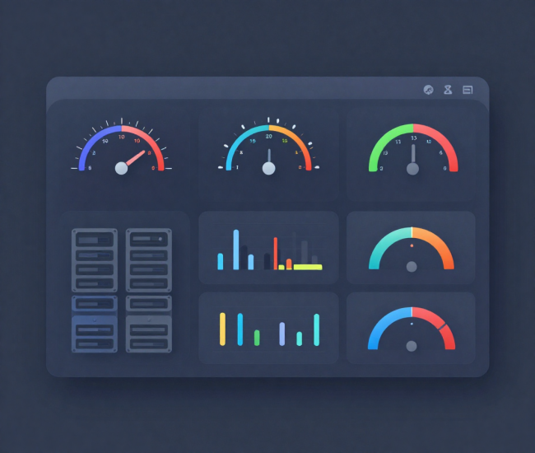
Probability in System Monitoring
13 / 47
Server Failure
P(failure) = 0.02
2% chance of downtime per day
Login Success
P(success) = 0.96
96% authentication attempts succeed
Network Interruption
P(interruption) = 0.05
5% probability during peak hours
Source: Author, Made with Canva

Slide 14
Sampling in Information Systems
14 / 47
Why analyze samples instead of entire populations?
Sampling saves time, reduces costs, and still produces accurate decisions.
User Surveys
Traffic Monitoring
Customer Feedback
Sample 500 of 50,000 users
to estimate satisfaction
Analyze peak-hour samples
to predict server load
Random sample of reviews
for sentiment analysis
A well-chosen sample represents the population accurately.

Slide 15
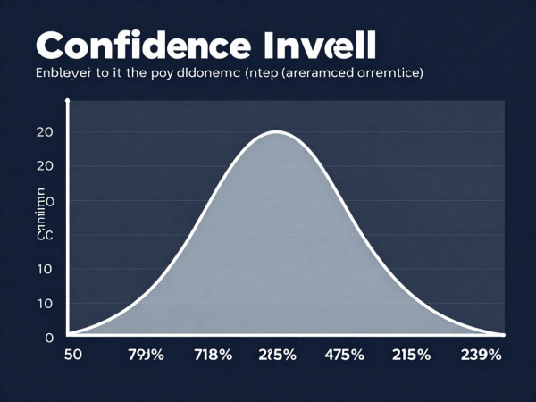
Confidence Interval Application
15 / 47
Estimating Average Student Satisfaction with LMS
95% Confidence Interval: 3.8 to 4.2 (out of 5.0)
We are 95% confident the true mean falls between 3.8 and 4.2
This does NOT mean 95% probability the mean is in this range
Wider intervals = more confidence but less precision
Larger samples = narrower intervals = better estimates
Source: Author, Made with Canva

Slide 16
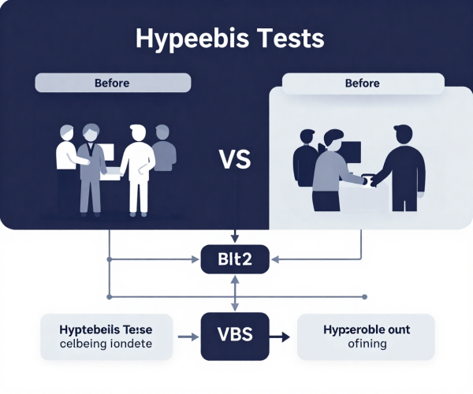
Hypothesis Testing Review
16 / 47
Case: Did the new LMS improve student engagement?
Null Hypothesis (H0)
The new LMS has NO effect on engagement
Alternative Hypothesis (H1)
The new LMS IMPROVES engagement
Decision Rule
If p-value < 0.05, reject H0
Source: Author, Made with Canva

Slide 17
Type I and Type II Errors
17 / 47
Understanding errors in statistical decision making
Type I Error (False Positive)
Type II Error (False Negative)
Rejecting H0 when it is actually true
Failing to reject H0 when it is actually false
IS Example:
A security system triggers a false alert
for a legitimate user login
IS Example:
An intrusion detection system misses
a real cyberattack
In Information Systems, both errors have real consequences.

Slide 18
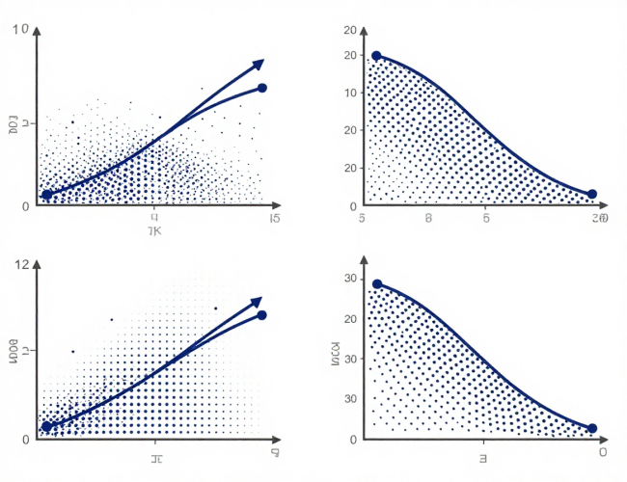
Correlation Example
18 / 47
Study Time vs GPA
Positive correlation: more study hours tend to lead to higher GPA
Traffic vs Server Load
Strong positive: as web traffic increases, server load rises proportionally
Internet Speed vs Satisfaction
Moderate positive: faster internet generally improves user satisfaction
Source: Author, Made with Canva
Correlation measures the strength and direction of a linear relationship between two variables.

Slide 19
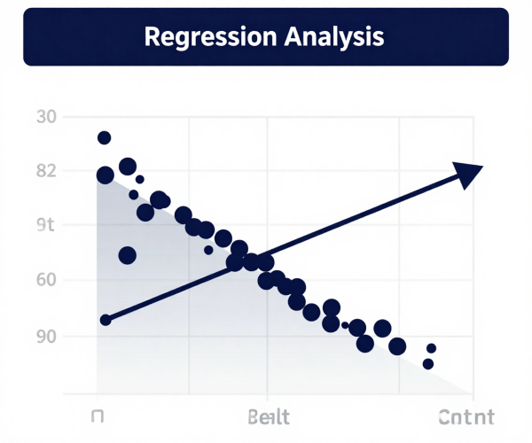
Regression Application
19 / 47
Predictive Analytics Using Regression
User Engagement
Predict daily active users based on feature updates and marketing spend
Website Traffic
Forecast monthly visitors using historical trends and seasonal patterns
System Response Time
Estimate server response based on concurrent users and load
Source: Author, Made with Canva

Slide 20
Regression Interpretation
20 / 47
Slope (b)
For every 1-unit increase in X, Y changes by b units.
Example: Each additional study hour increases GPA by 0.3 points.
Prediction
Use the regression equation to estimate future values.
Example: If a student studies 5 hours, predicted GPA = 2.0 + 0.3(5) = 3.5
R-Squared
Proportion of variance in Y explained by X.
Example: R² = 0.72 means 72% of GPA variation is explained by study time.
Trend Interpretation
Identify whether the relationship is increasing, decreasing, or flat.
Helps decision makers understand the direction of impact.

Slide 21
ANOVA Application
21 / 47
Comparing Multiple Groups in Information Systems
Three App Interfaces
Three Server Configs
Three Teaching Methods
Compare user satisfaction scores
across Interface A, B, and C
to find the best design.
Compare response times across
Configuration 1, 2, and 3
to find the optimal setup.
Compare student performance
across traditional, blended,
and online learning.
ANOVA tests whether the means of three or more groups are significantly different.

Slide 22
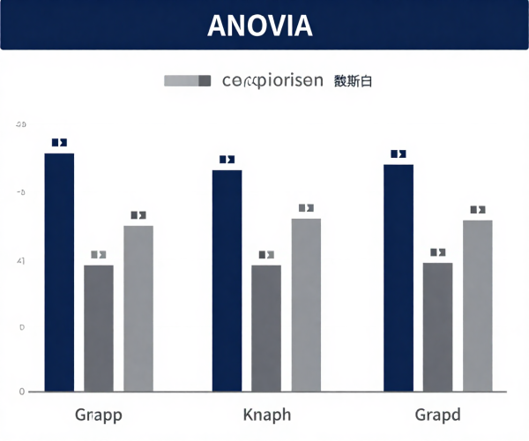
ANOVA Interpretation
22 / 47
Understanding ANOVA Results
F-Value
Ratio of between-group variance to within-group variance.
A larger F-value suggests greater differences between groups.
p-Value
Probability of observing the result if H0 is true.
If p < 0.05, at least one group is significantly different.
Significant Differences
When ANOVA is significant, use post-hoc tests (e.g., Tukey)
to identify which specific groups differ from each other.
Source: Author, Made with Canva

Slide 23
Chi-Square Application
23 / 47
Analyzing Categorical Relationships
Device Type vs Login Success
Is there a relationship between the device
used (mobile, desktop, tablet) and whether
login attempts succeed or fail?
Browser Type vs Satisfaction
Does user satisfaction differ significantly
across Chrome, Firefox, Safari, and Edge
browser users?
User Role vs Access Problems
Are system access problems associated
with specific user roles (admin, student,
lecturer, staff)?
Chi-Square tests whether two categorical variables are independent or associated.

Slide 24
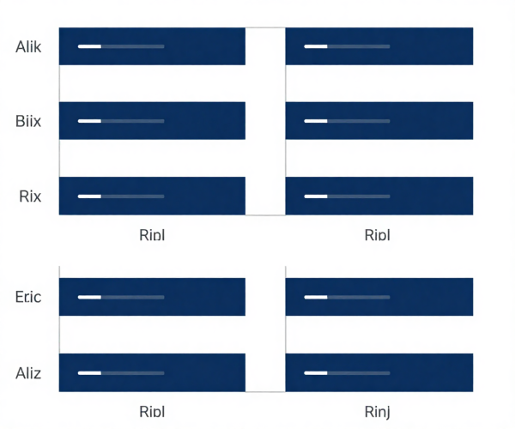
Non-Parametric Test Application
24 / 47
When Data Doesn't Follow Normal Distribution
Example: Ranked Satisfaction Data
Students rate LMS satisfaction on a 1-5 Likert scale.
This ordinal data requires non-parametric methods
like Mann-Whitney U or Kruskal-Wallis test.
Why Use Non-Parametric Tests?
Data is ordinal (ranked) rather than continuous
Sample size is too small for parametric assumptions
Data distribution is skewed or has outliers
Comparing medians instead of means
Source: Author, Made with Canva

Slide 25
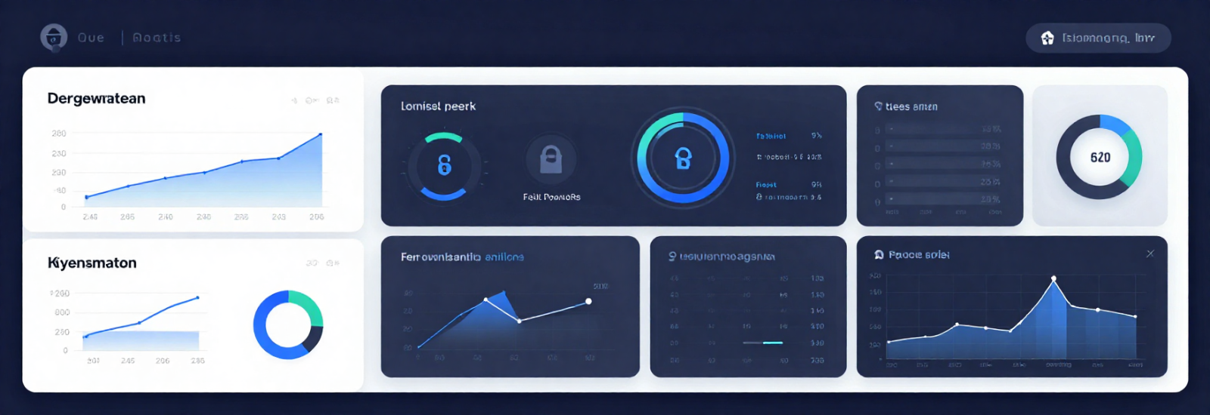
Dashboard Analytics Example
25 / 47
A modern dashboard integrates multiple analytics streams into a single view.
User Analytics
Security Alerts
System Performance
Traffic Monitoring
Source: Author, Made with Canva

Slide 26
UX Research Case Study
26 / 47
Case: Comparing User Satisfaction Across App Versions
1
2
3
4
Data Collection
Analysis
Interpretation
Decision Making
Survey 300 users across
App v1.0, v2.0, and v3.0
Use ANOVA to compare
mean satisfaction scores
v3.0 scored significantly
higher (p < 0.01)
Roll out v3.0 as the
default for all users
UX research uses statistical evidence to drive design decisions and improve user experience.

Slide 27
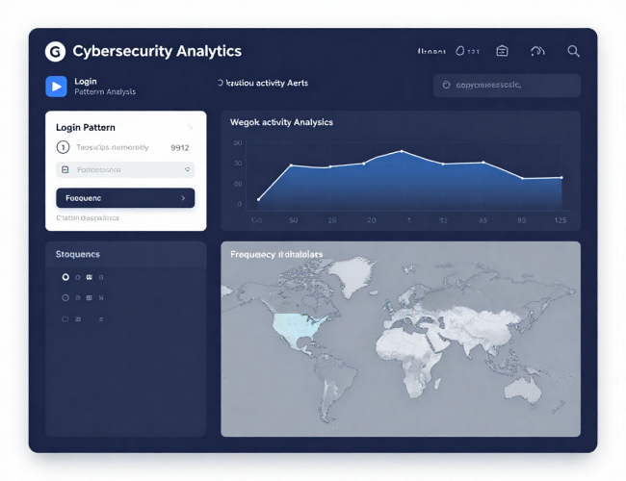
Cybersecurity Analytics Case
27 / 47
Case: Detecting Suspicious Login Behavior
A university monitors login patterns to detect potential security threats
using frequency analysis and statistical anomaly detection.
Unusual login times (e.g., 3 AM on weekdays)
Multiple failed login attempts from same IP
Geographic anomalies (login from two countries in 1 hour)
Frequency spikes compared to baseline patterns
Source: Author, Made with Canva

Slide 28
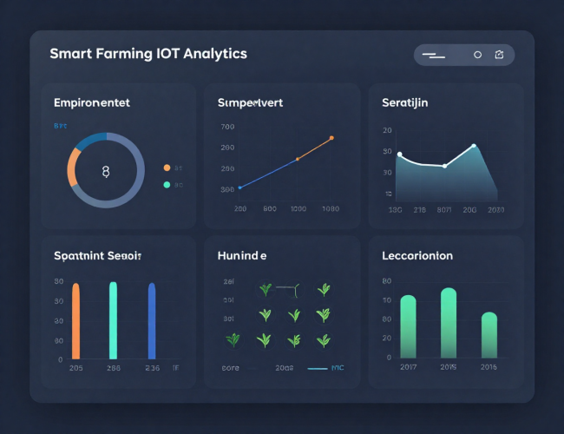
Smart Farming Analytics Case
28 / 47
Case: Analyzing Environmental Sensor Data
Temperature
Humidity
Monitor daily temperature
patterns for optimal growth
Track humidity levels to
prevent crop disease
Water Usage
Crop Monitoring
Analyze irrigation data
for efficient water management
Use regression to predict
yield based on conditions
Source: Author, Made with Canva

Slide 29
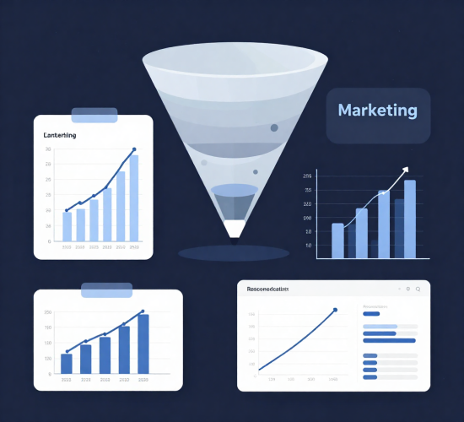
Business Analytics Case
29 / 47
How Statistics Powers Business Intelligence
Sales Forecasting
Use regression and time series to predict future revenue and plan inventory
Marketing Effectiveness
A/B testing and hypothesis testing to measure campaign impact
Customer Retention
Chi-Square and logistic regression to identify churn risk factors
Product Recommendation
Correlation analysis to find purchase patterns and suggest products

Slide 30
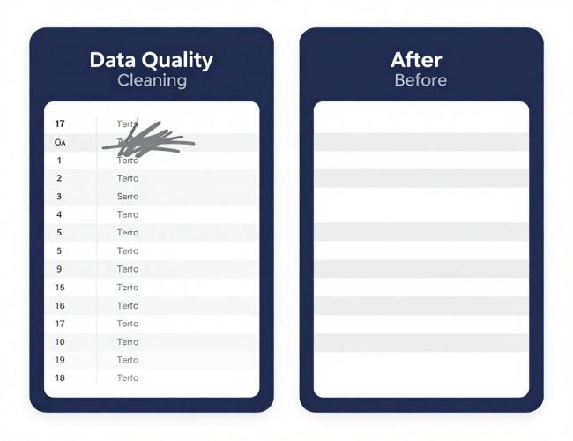
Data Quality and Cleaning
30 / 47
Clean Data is the Foundation of Good Analytics
Missing Data
Outliers
Empty cells or null values that
skew results and reduce accuracy
Extreme values that distort
mean and standard deviation
Duplicate Records
Inconsistent Values
Repeated entries that inflate
counts and bias analysis
Different formats or labels for
the same category (e.g., M vs Male)
Source: Author, Made with Canva

Slide 31
Why Data Quality Matters
31 / 47
"Poor data leads to poor decisions."
The quality of your data directly determines the quality of your insights.
Inaccurate data leads to wrong conclusions and costly mistakes
Biased samples produce misleading statistical results
Missing values reduce statistical power and reliability
Inconsistent data makes comparison across groups impossible
Data cleaning typically takes 60-80% of an analyst's time

Slide 32
Ethical Issues in Data Analytics
32 / 47
Responsible Data Use in Information Systems
Privacy
Security
Bias
Protect personal data and ensure
compliance with regulations (GDPR)
Safeguard data from unauthorized
access and breaches
Avoid discriminatory outcomes
in algorithms and sampling
Responsible AI
Ethical Collection
Ensure transparency and fairness
in automated decision systems
Obtain informed consent and
use data only for stated purposes
Ethics is not optional — it is a core responsibility of every data professional.

Slide 33

Statistical Decision Making
33 / 47
Statistics Supports Evidence-Based Decision Making
Business Decisions
Use A/B testing results to choose the best marketing strategy
System Optimization
Use performance data to decide which server configuration to deploy
Risk Management
Use probability analysis to prioritize security investments
Product Development
Use user feedback analysis to guide feature prioritization
Source: Author, Made with Canva

Slide 34
Data-Driven Organizations
34 / 47
How Leading Companies Use Data Analytics
Google
Netflix
Amazon
Tokopedia
Shopee
Search ranking, ad targeting,
user behavior prediction
Content recommendation,
viewing pattern analysis
Product recommendation,
demand forecasting, pricing
Seller analytics, fraud
detection, personalization
Customer segmentation,
promotion optimization
Every successful digital company is fundamentally a data-driven organization.

Slide 35
Information Systems Development Lifecycle
35 / 47
Statistics Supports Every Phase of IS Development
Planning
Development
Testing
Evaluation
Improvement
Use descriptive statistics
to analyze requirements
and user needs
Apply sampling to test
prototypes with
representative users
Use hypothesis testing
to validate system
performance
Apply ANOVA to compare
system versions and
user satisfaction
Use regression to predict
future performance
and plan upgrades
Statistical thinking is embedded in every stage of the systems development lifecycle.

Slide 36
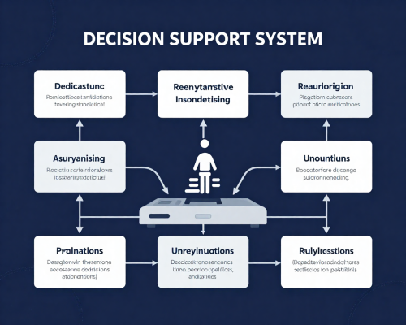
Decision Support Systems (DSS)
36 / 47
How Statistics Powers DSS and Business Intelligence
A Decision Support System uses data, models, and analytics
to help managers make better decisions under uncertainty.
Data Collection
Statistical Analysis
Model Building
Decision Output
Inventory management systems using demand forecasting
Credit scoring models using logistic regression
Healthcare diagnostics using probability analysis
Marketing mix optimization using regression models
Source: Author, Made with Canva

Slide 37

Predictive Analytics Overview
37 / 47
Using Data to Predict the Future
Recommendation Systems
Forecasting
Predict what users want to see,
buy, or interact with next
Predict future trends in sales,
traffic, or system demand
Risk Prediction
User Behavior
Estimate probability of security
breaches or system failures
Predict churn, engagement,
and conversion patterns
Source: Author, Made with Canva

Slide 38

Big Data and Analytics
38 / 47
The Role of Statistics in the Big Data Era
Big Data
Machine Learning
Statistics helps extract meaningful
patterns from massive datasets
Statistical foundations power
classification and prediction models
AI Systems
Analytics Platforms
Probability and inference enable
intelligent automated decisions
Statistical methods are embedded
in tools like Tableau, Power BI, SPSS
Source: Author, Made with Canva

Slide 39
Practical Session Using Excel
39 / 47
Hands-On Data Analysis Workflow
Charts & Graphs
Pivot Tables
Correlation Analysis
Create bar charts, line graphs,
and pie charts from raw data
Summarize and cross-tabulate
large datasets efficiently
Use CORREL function to measure
relationships between variables
ANOVA Testing
Frequency Analysis
Dashboard Creation
Use Data Analysis ToolPak
to compare group means
Build frequency tables using
COUNTIF and histograms
Combine charts and KPIs into
a single interactive view
Excel is a powerful starting point for statistical analysis in Information Systems.

Slide 40
Integrated Mini Case Study
40 / 47
Apply Everything You Have Learned
Analyze a complete dataset using multiple statistical methods in an integrated workflow.
1
2
3
4
5
User Engagement
Satisfaction
Performance
Security
Prediction
Descriptive statistics
to summarize usage
Confidence intervals
to estimate population
ANOVA to compare
three configurations
Chi-Square to test
device vs breach
Regression to forecast
future demand
This integrated workflow mirrors how real IS professionals analyze complex systems.

Slide 41
Common Mistakes in Data Analysis
41 / 47
Avoid These Pitfalls in Your Analysis
1
Misinterpreting p-values
A p-value < 0.05 does NOT mean the result is practically important.
It only means the result is statistically unlikely under H0.
2
Ignoring Data Quality
Analyzing dirty data produces unreliable results.
Always clean and validate data before running tests.
3
Correlation is NOT Causation
Two variables moving together does not mean one causes the other.
Consider confounding variables and alternative explanations.
4
Overgeneralization
Results from one sample may not apply universally.
Be cautious about extending findings beyond the study scope.
5
Poor Sampling
Biased or too-small samples lead to misleading conclusions.
Use random sampling and ensure adequate sample size.

Slide 42
Key Skills for Future IS Professionals
42 / 47
Essential Competencies for the Data-Driven Era
1
2
3
4
5
Data Literacy
Statistical Reasoning
Critical Thinking
Analytical Skills
Evidence-Based
Decision Making
Read, understand, and
communicate with data
Apply the right methods
and interpret results
Question assumptions and
evaluate evidence objectively
Break complex problems
into data-driven components
Use data to support
strategic recommendations
These skills will set you apart in the modern Information Systems industry.

Slide 43
Final Summary
43 / 47
Key Takeaways from This Semester
1
Statistics supports modern Information Systems
Every phase of IS development benefits from statistical reasoning and data analysis.
2
Data-driven decisions improve systems
Organizations that use evidence-based approaches outperform those relying on intuition.
3
Analytics helps reduce uncertainty
Statistical methods quantify risk, measure confidence, and guide strategic choices.
4
Statistical thinking is essential in digital transformation
As systems become smarter, the need for statistical literacy grows exponentially.

Slide 44

Reflection
44 / 47
"How can statistical thinking
improve the systems we use every day?"
Take a moment to reflect on how the concepts from this semester
connect to the technology and systems around you.

Slide 45
Final Assignment / Project Guidance
45 / 47
Your Final Project Requirements
Apply your statistical knowledge to a real Information Systems problem.
1
2
3
Choose an IS Problem
Collect or Simulate Data
Apply 2+ Statistical Methods
Select a real-world Information
Systems challenge to investigate
Gather real data or create a
realistic simulated dataset
Use at least two methods
(e.g., regression + ANOVA)
4
5
6
Interpret Results
Create Visual Dashboard
Provide Recommendations
Explain what the results mean
in practical IS context
Build charts, graphs, and
visual presentations of findings
Give evidence-based suggestions
for system improvement
Deadline and submission details will be shared separately. Good luck!

Slide 46
References
46 / 47
Recommended Reading and Resources
Walpole, R. E., Myers, R. H., Myers, S. L., & Ye, K. (2016).
Probability & Statistics for Engineers & Scientists. Pearson.
Montgomery, D. C. & Runger, G. C. (2018).
Applied Statistics and Probability for Engineers. Wiley.
Triola, M. F. (2022).
Elementary Statistics. Pearson.
Provost, F. & Fawcett, T. (2013).
Data Science for Business. O'Reilly Media.
Microsoft Excel Documentation.
https://support.microsoft.com/en-us/excel
Khan Academy Statistics and Probability.
https://www.khanacademy.org/math/statistics-probability

Slide 47
THANK YOU
Contact Information
Reach out for more details or inquiries regarding the course.
Alfrian Carmen Talakua
Department of Information Systems
e-Mail : Alfriantalakua@unkriswina.ac.id

