Slide 1
International Trade and Policy
WEEK 1 - Introduction: The Foundations of International Trade
University: Tajik State University of Commerce
Lecturer: Abduvaliev Mubinzhon, PhD

Slide 2
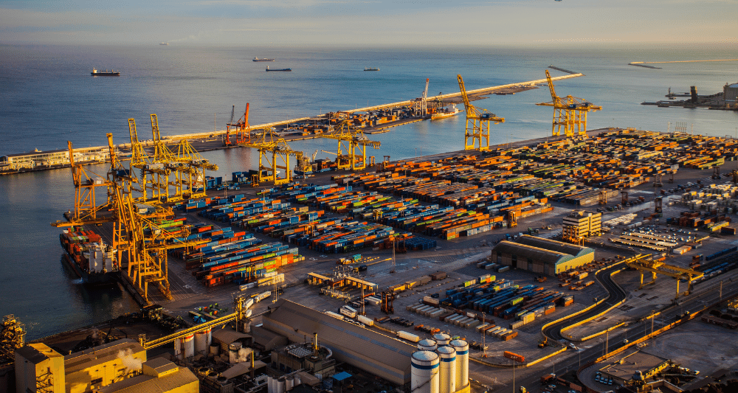
Source: SEASPACE International Forwarders. (2022, January 23) Importance of seaports for international trade. Retrieved from: https://www.seaspace-int.com/importance-of-seaports-for-international-trade/

Slide 3
Our Roadmap for Today
1. Mercantilism: The flawed idea that started it all.
2. Absolute Advantage: Adam Smith's simple case for trade.
3. Comparative Advantage: David Ricardo's powerful insight (even if you're the best at everything).
4. The Ricardian Model: A formal look at production, prices, and the pattern of trade.
5. Production Possibilities in an Open Economy: How trade expands what a country can consume.

Slide 4
Why Do Nations Trade?
To acquire goods and services that they cannot produce themselves (e.g., tropical fruits in cold climates).
To obtain goods more cheaply than they can produce them at home.
To benefit from economies of scale and larger markets.
To increase the variety of goods available for their citizens.

Slide 5
The Global Economy in One Picture
Text Box 1: "World Merchandise Trade: Over $20 Trillion Annually"
Text Box 2: "Commercial Services Trade: Over $5 Trillion Annually"
Text Box 3: "Trade accounts for ~60% of global GDP"

Slide 6
The Concept of "Autarky"
To measure the benefits of trade, economists use a concept called 'autarky' . This is a hypothetical situation where a country does not trade at all. It's like a single family on a remote island trying to grow all its own food, build its own shelter, and make its own clothes. It's possible, but it's incredibly limiting. By comparing this self-sufficient state to an open economy, we can clearly identify the advantages that trade provides

Slide 7
What Are the "Gains from Trade"?
Definition: The improvement in a country's welfare (the well-being of its citizens) that becomes possible when it moves from autarky to free trade.
Two Main Sources of Gains:
  Differences (Inter-industry trade): Countries have different resources, climates, and worker skills. Trade lets them focus on what they're naturally good at.
  Economies of Scale (Intra-industry trade): Trade creates larger markets, allowing firms to produce more, which lowers the average cost per unit.

Slide 8
Foundational Concepts
Core Belief: A nation's wealth was measured by its stock of gold and silver (specie).
Goal: Maximize exports and minimize imports to generate a trade surplus, paid for in gold.
Policy: High tariffs, quotas, and government regulation to restrict imports

Slide 9
The Problem with Mercantilism
Zero-Sum Game: It viewed trade as a winner and a loser. If one country has a surplus, its trading partner must have a deficit.
Hume's Price-Specie Flow Doctrine: A sustained trade surplus would bring in so much gold that it would increase the money supply, causing inflation. This would make the country's goods more expensive and its trading partners' goods cheaper, automatically reversing the surplus .
Limited Consumption: By restricting imports, it limited the choices and purchasing power of its own people.

Slide 10
Adam Smith and Absolute Advantage
The Wealth of Nations (1776): Advocated for free trade and specialization.
Concept: A country has an absolute advantage in producing a good if it can produce it using fewer resources (e.g., labor hours) than another country .
Implication: Countries should specialize in what they do more efficiently and trade for the rest. This makes both countries better off.

Slide 11
A Numerical Example of Absolute Advantage
Good | Country A (Hours/unit) | Country B (Hours/unit)
Cars | 10 | 20
Bikes | 15 | 10
Analysis:
  Country A is more efficient at making Cars (10 < 20) → Absolute Advantage in Cars.
  Country B is more efficient at making Bikes (10 < 15) → Absolute Advantage in Bikes.
  Conclusion: Specialization and trade are clearly beneficial.

Slide 12
Introducing David Ricardo and Comparative Advantage
The Problem: What if one country is better at producing everything? Does trade still make sense?
David Ricardo (1817): Yes! Trade can still be beneficial based on comparative advantage.
Key Concept: A country has a comparative advantage in producing a good if it can produce it at a lower opportunity cost than another country

Slide 13
The Magic of Opportunity Cost
Every path you choose transforms the roads not taken into phantom possibilities the career you didn't pursue becomes a silent mentor, the love you didn't chase becomes a standard for present joy, and the sleep you sacrificed for ambition becomes a wistful reminder of rest's true value revealing how opportunity cost magically defines our lives not by what we gather, but by the beautiful possibilities we willingly surrender to inhabit the reality we choose.

Slide 14
The Magic of Opportunity Cost
Country A's Opportunity Cost of 1 Car: It could have used those 10 hours to make 0.66 bikes (10 hours / 15 hours per bike). To make 1 car, A gives up 0.66 bikes.
Country B's Opportunity Cost of 1 Car: It could have used those 20 hours to make 2 bikes (20 hours / 10 hours per bike). To make 1 car, B gives up 2 bikes.

Slide 15
Determining the Pattern of Trade
Compare Opportunity Costs:
  Cars: Country A's opportunity cost (0.66 bikes) is lower than Country B's (2 bikes).
  Bikes: Country B's opportunity cost of making a bike is 0.5 cars (10 hours / 20 hours per car). Country A's opportunity cost of making a bike is 1.5 cars (15 hours / 10 hours per car). Country B's cost (0.5 cars) is lower.
The Pattern of Trade:
  Country A has a comparative advantage in CARS (lower opportunity cost).
  Country B has a comparative advantage in BIKES (lower opportunity cost).

Slide 16
The Ricardian Model: Assumptions
To explore this idea, we need a simple model with clear assumptions :
  Two countries: Home and Foreign.
  Two goods: (e.g., Wine and Cheese).
  One factor of production: Labor.
  Labor is perfectly mobile between industries within a country, but immobile between countries.
  Constant returns to scale: The labor needed to produce one unit is fixed (e.g., always 1 hour for cheese, 2 for wine).
  Perfect competition.
  No transportation costs.

Slide 17
Production Possibilities in a Closed Economy (Autarky)
Definition: The PPF shows the maximum amount of two goods an economy can produce given its resources and technology .
In the Ricardian Model: Because labor is the only input and productivity is constant, the PPF is a straight line .
Visual: A simple graph with "Wine" on the Y-axis and "Cheese" on the X-axis. A straight, downward-sloping line labeled "PPF."
Slope of PPF = Opportunity Cost of Cheese (in terms of wine).

Slide 18
Life Without Trade: The Autarky Equilibrium
In autarky, a country's consumption is limited by its production. It can only consume what it makes.
The production/consumption point is somewhere on the PPF.
In a competitive market, the economy will produce where the relative price of the two goods equals the opportunity cost (the slope of the PPF)

Slide 19
Opening the Borders: The Basis for Trade
Assume Home's autarky relative price of cheese (Pc/Pw) is lower than Foreign's.
Interpretation: Cheese is relatively cheaper in Home than in Foreign. Wine is relatively cheaper in Foreign.
This difference in relative prices (driven by differences in labor productivity/opportunity cost) is the basis for trade
Conclusion: Home has a comparative advantage in Cheese. Foreign has a comparative advantage in Wine.

Slide 20
The Response to Trade: Specialization
Home producers see they can get a higher price for cheese by exporting. They shift resources from wine to cheese.
Foreign producers shift resources from cheese to wine.
This continues until each country is completely specialized in the good where it has a comparative advantage .
A new, single world relative price emerges, somewhere between the two autarky prices

Slide 21
The Gains from Trade: Expanding Consumption
The Trading Possibilities Line: Unlike in autarky, a country's consumption is no longer limited by its own PPF. It can trade its specialized production for the other good at the world price.
The "budget constraint" for consumers is now different from the PPF.
This allows a country to consume outside its own PPF.

Slide 22
Visualizing the Gains from Trade
Consumption Possibilities Expand" means that an individual, household, or economy can afford to purchase a greater quantity and variety of goods and services than before, typically due to an increase in income, a decrease in prices, or access to new products.

Slide 23
The Real World: Many Goods
The two-good model can be extended to many goods.
Countries rank goods by their relative labor productivities (or comparative advantage) .
Example: Calculate the ratio of Home's labor required to Foreign's labor required for each good.
The Cutoff: The world relative wage determines which goods are produced where. Home will produce goods where its productivity advantage is greater than its wage disadvantage.

Slide 24
Key Takeaways: The Ricardian Model
Basis for Trade: Differences in labor productivity (technology) between countries .
Pattern of Trade: A country exports the good in which it has a comparative advantage (lowest opportunity cost).
Gains from Trade: Both countries gain because trade allows them to consume beyond their production possibilities.
Policy Implication: Provides a powerful argument for free trade over protectionism

Slide 25
Production Possibilities in an Open Economy
The production possibilities of an open economy are the same as for a closed one. The PPF is still defined by its resources and technology.
However, its consumption possibilities are vastly different.
International trade acts as an "indirect method of production." A country can "produce" a good by making something else and trading for it

Slide 26
The Trading Possibilities Line: Your New Budget Constraint
The terms of trade (the world relative price of your export in terms of your import) determine the slope of the trading possibilities line.
Favorable terms of trade (a higher price for your exports) allow you to consume even more.
Example: If a country specializes in cheese and the world price of cheese rises, it can buy more wine with the same amount of cheese.

Slide 27
From Autarky to Open Economy: A Summary Example
Step 1: Autarky: Country produces and consumes at point A on its PPF.
Step 2: Specialization: In response to world prices, it moves production to point S (complete specialization in its comparative advantage good).
Step 3: Trade: It exports some of good X and imports good Y.
Step 4: New Consumption: It consumes at point C on the trading possibilities line, which is outside the PPF.

Slide 28
A Note on Realism: Increasing Opportunity Costs
The Ricardian model assumes constant costs (straight-line PPF), leading to complete specialization.
In reality, resources are not all equally good at producing everything (e.g., some land is better for wheat, some for corn). This leads to increasing opportunity costs (bowed-out PPF) .
Under increasing costs:
  Countries tend to partially specialize, not completely.
  The PPF is bowed, and the trading line touches it at the production point.
  The gains from trade still exist but are slightly more complex.

Slide 29
Key Concepts Review
Autarky: A state of no trade.
Gains from Trade: The increased welfare from trading versus not trading.
Absolute Advantage: Producing a good with fewer resources.
Comparative Advantage: Producing a good at a lower opportunity cost.
Opportunity Cost: The value of the next best alternative given up.
Pattern of Trade: Who exports what (determined by comparative advantage).
Production Possibilities Frontier (PPF): Shows maximum possible production.
Trading Possibilities Line: Shows maximum possible consumption with trade.

Slide 30
Questions for Discussion / Debate
If trade is so beneficial, why do we see so much political opposition to it (e.g., tariffs, trade wars)?
The Ricardian model shows gains for the country as a whole. Does that mean everyone in the country gains? Who might lose?
How does the concept of "opportunity cost" apply to your own decisions about studying, working, or pursuing a hobby?

Slide 31
The "So What?" Why This Matters
Why Should We Care?
  For Policymakers: These theories provide the rationale for free trade agreements (like NAFTA/USMCA, EU) and for opposing protectionism (tariffs, quotas).
  For Business: Understanding comparative advantage helps firms make decisions about where to locate production and which markets to enter (global supply chains) .
  For Citizens: It explains the variety and lower prices of goods in stores, and also helps us understand the impact of trade on jobs and industries

Slide 32
Thank You
Abduvaliev M.H. PhD
https://orcid.org/0000-0003-3576-5014

