Slide 1
International Trade and Policy
WEEK 2 - Supply and Demand in Global Markets
University: Tajik State University of Commerce
Lecturer: Abduvaliev Mubinzhon, PhD

Slide 2

The Foundation of Global Trade
Source: Gemini created
foto" (Google, April, 2026)
The foundation of global trade rests on the intricate interplay of shared human need, the pursuit of comparative advantage, and the enduring structures of cooperation that transform geographic distance into economic interdependence.

Slide 3
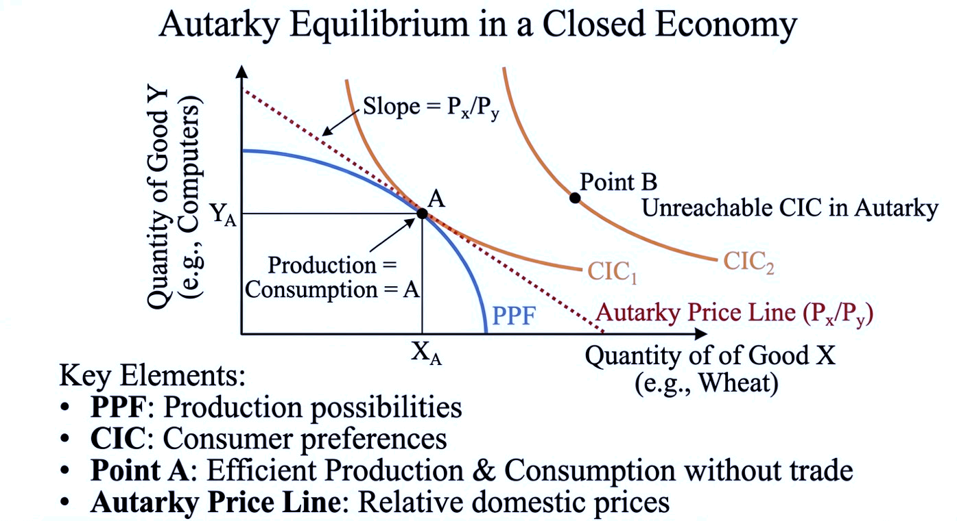
The Framework - From Autarky to Global Trade
The Closed Economy Equilibrium
Figure 1. Autarky Equilibrium in a Closed Economy
Source: Created by the author

Slide 4
Defining the World Market
The world market is the global arena where the aggregate supply and demand from all countries interact to determine a single equilibrium world price for a traded good.
Global demand is the sum of the demand from all countries at each possible price, while global supply is the sum of the supply from all producing nations.
The world market functions as the arbitrage mechanism that eliminates price differentials across countries, subject to trade costs and policy barriers.

Slide 5
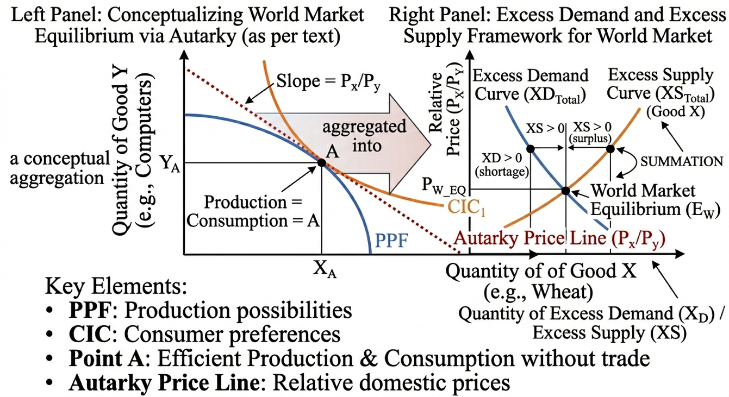
Figure 2. General Equilibrium of World Trade
Source: Created by the author

Slide 6
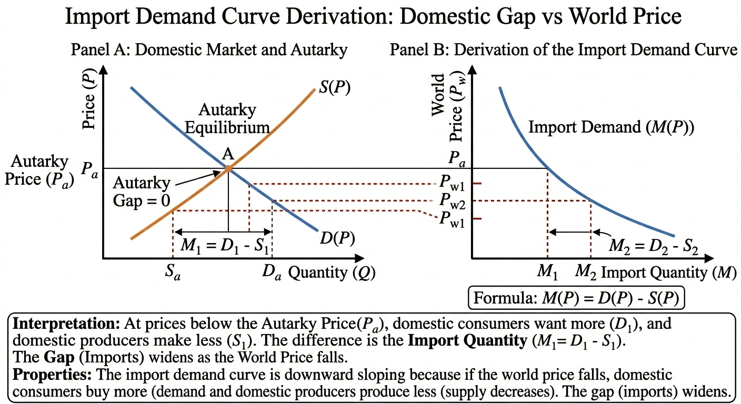
Deriving Import Demand and Export Supply
Figure 3. Import Demand Curve Derivation: Domestic Gap vs World Price
Source: Created by the author

Slide 7
The Import Demand (MD)
MD curve illustrates how a country's internal shortage creates a demand for foreign goods. When the world price falls below a nation's autarky price, local consumers buy more while local producers cut back, creating a gap.
This gap is plotted as the MD curve, which slopes downward because a lower price makes imports more attractive and necessary to satisfy domestic demand.

Slide 8
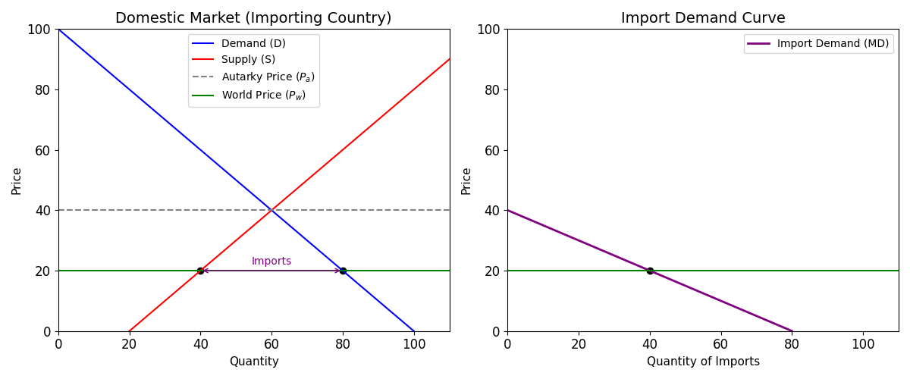
Figure 4. The Derivation of the Import Demand Curve
Source: Created by the author

Slide 9
Export Supply Curve
The Export Supply curve represents the quantity a country is willing to export at each world price, derived from the gap between domestic supply. and domestic demand, expressed as X(P)=S(P)−D(P).
The Export Supply curve shows how a country's internal surplus is offered to the global market.
When the world price rises above the autarky price, domestic production exceeds domestic consumption, leaving a surplus.

Slide 10
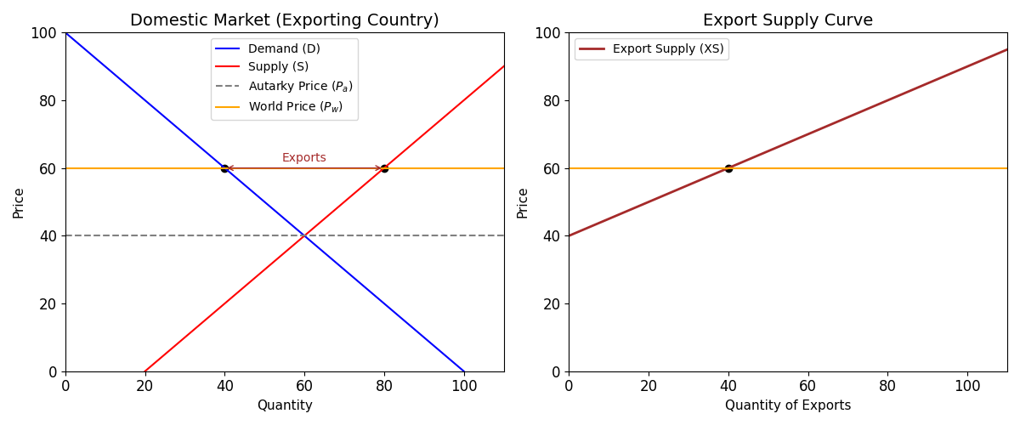
Figure 5. The Derivation of the Export Supply Curve
Source: Created by the author

Slide 11
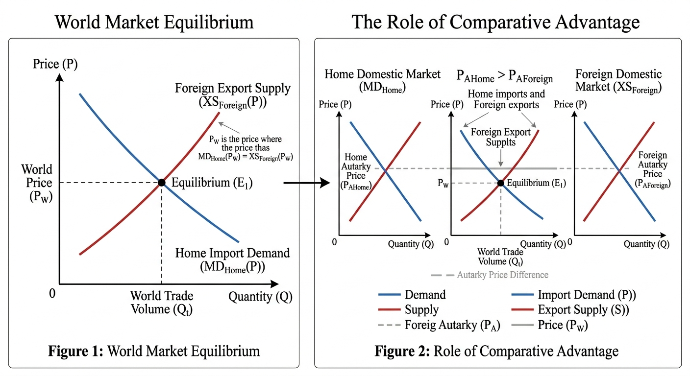
World Market Equilibrium
Figure 6. Partial Equilibrium Model of International Trade. The Intersection
Source: Created by the author

Slide 12
Determinants of Import Demand and Export Supply
Determinants of Import Demand
A shift in the import demand curve is driven by three key factors: changes in domestic demand (such as rising income or shifting tastes), which increase imports and shift the curve outward; changes in domestic supply (like technological improvements), which reduce the need for imports and shift the curve inward; and changes in the price of domestic substitutes, where a cheaper substitute reduces import demand and also shifts the curve inward.

Slide 13
Determinants of Export Supply
A rightward shift in the export supply curve meaning greater exports at every price can stem from three key factors: an increase in domestic supply (like a technological breakthrough), a decrease in domestic demand (such as during a recession), or a depreciation of the domestic currency that makes goods cheaper for foreign buyers.

Slide 14
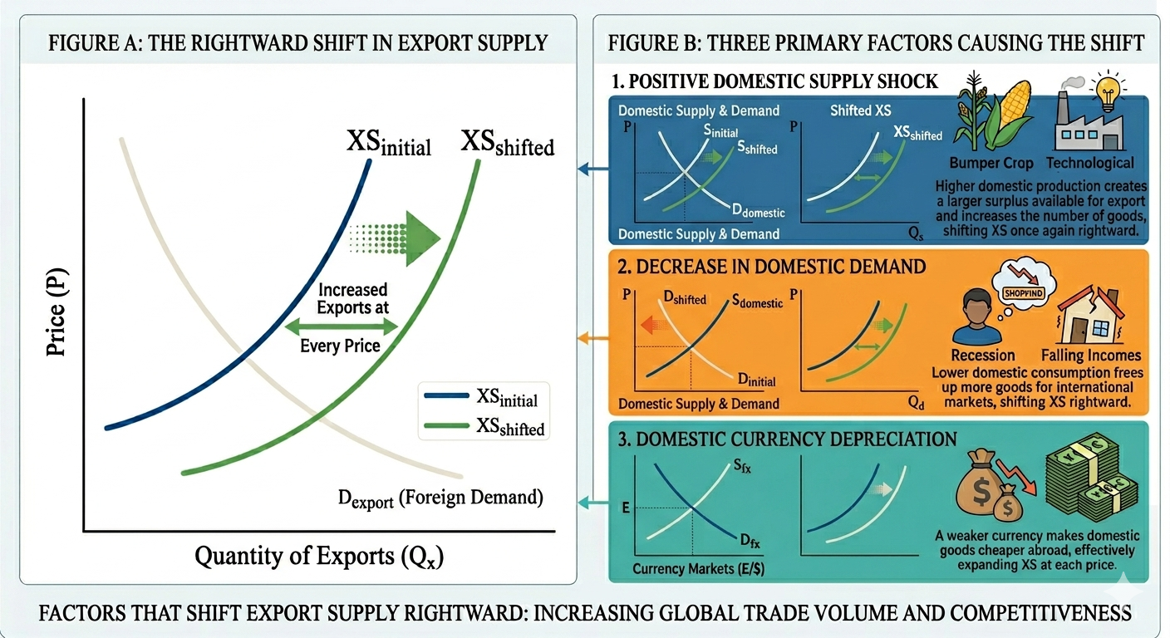
Figure 7. A rightward shift in export supply is driven by a positive supply shock, a drop in domestic demand, or a depreciation of the domestic currency.
Source: Gemini created
foto" (Google, April, 2026)

Slide 15
Trade Policy – Tariffs
Governments intervene in trade for three main reasons: generating revenue (especially for developing economies), protecting domestic industries from foreign competition, and gaining strategic leverage in diplomatic negotiations with tariffs being the most common tool used to achieve these goals.
Regardless of the motivation, the most common policy instrument used to achieve these goals is the tariff a tax imposed on imported goods.

Slide 16
The Small Country Case (Tariff)
A small country faces a perfectly elastic export supply curve. It is a "price taker." Its imports are an infinitesimal fraction of the world market, so its purchasing decisions do not affect the world price
In the small country case, a tariff raises the domestic price to the world price plus the tariff, reducing imports and creating a deadweight loss from consumption and production inefficiencies without improving the country's terms of trade.

Slide 17
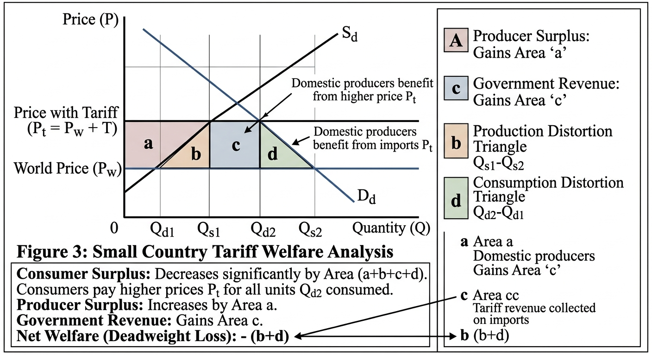
Welfare Analysis (Small Country)
Figure 8. Welfare Analysis of a Tariff in a Small Country
Source: Created by the author

Slide 18
The Large Country Case (Tariff)
A large country has monopsony power in the import market. Its import demand is a significant share of world demand. When it imposes a tariff, its reduced import demand lowers the world price
In the large country case, a tariff reduces import demand enough to lower the world price, allowing the importing nation to capture terms of trade gains that can potentially offset its own deadweight losses.

Slide 19
The Terms of Trade Effect as the Crucial Distinction
The key difference is that a large country's tariff lowers world prices due to its market power, causing domestic prices to rise by less than the full tariff amount unlike a small country, which simply accepts world prices without influencing them.
A large country possesses market power, so when it imposes a tariff, its reduced import demand drives down the world price. Consequently, the domestic price rises by less than the full tariff amount because the decline in the world price partially offsets the increase.

Slide 20
Price Dynamics Under a Large Country Tariff
Let PW represent the new, lower world price faced by foreign exporters after the tariff is imposed. The domestic price is then determined by the sum of this new world price and the tariff, expressed as PDomestic​=PW+t. Because PW​ is lower than the original world price, the increase in the domestic price is smaller than the tariff amount t. This partial pass-through distinguishes the large country case from the small country case, where the domestic price rises by the full tariff.

Slide 21
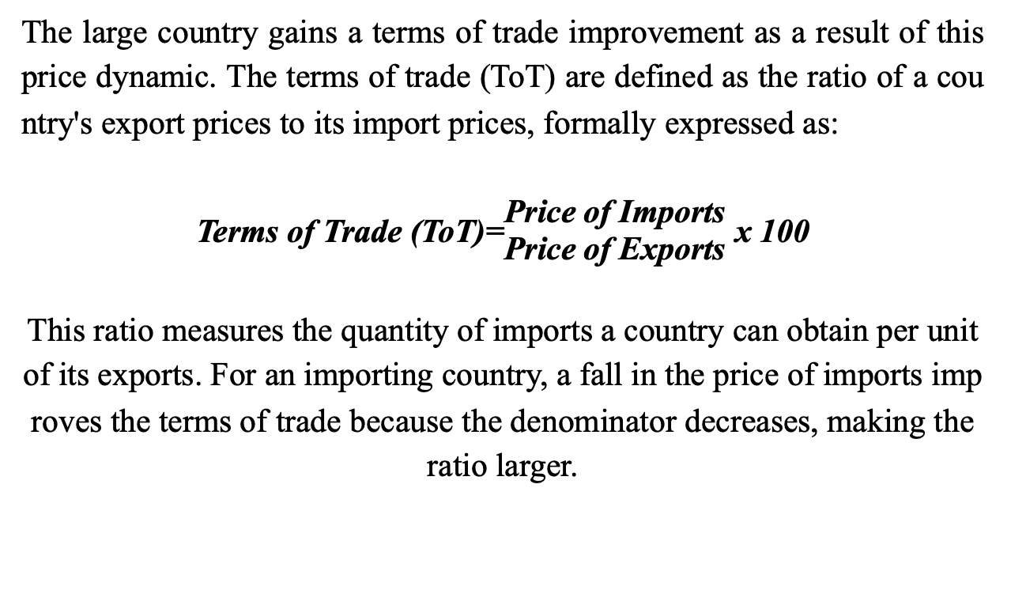
Definition and Improvement of the Terms of Trade

Slide 22
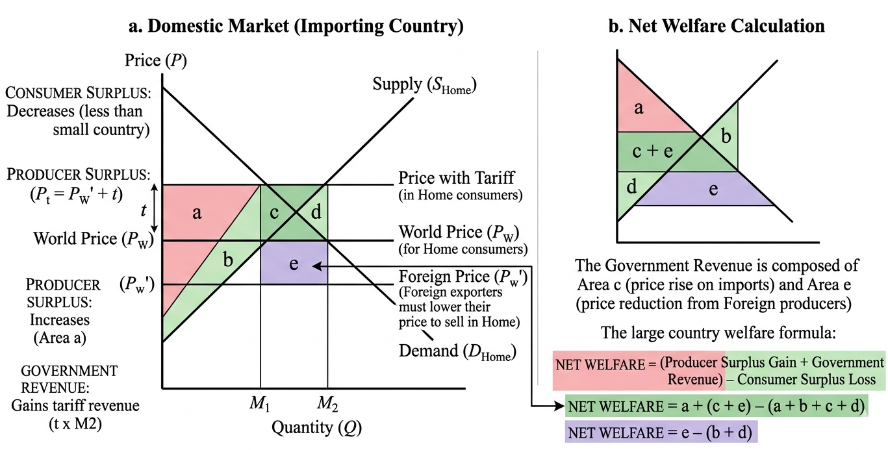
Welfare Analysis (Large Country)
Figure 9. Large Country Tariff Welfare Analysis
Source: Created by the author

Slide 23
The Optimal Tariff
If the terms of trade gain exceeds the deadweight loss, the large country can increase its national welfare through a tariff. This leads to the concept of the optimal tariff the tariff rate that maximizes the difference between the terms of trade gain and the deadweight loss.
However, this comes with a caveat: the gain for the home country comes at the expense of the foreign country (who receives a lower price for their exports). This is a "beggar-thy-neighbor" policy, likely to provoke retaliation.

Slide 24
Trade Policy – Quotas
A quota is a physical limit on the quantity of a good that can be imported. While tariffs generate revenue, quotas restrict volume.
In theory, a tariff and a quota can have the same effect on price and quantity if the quota is set at the post-tariff import level. However, in practice, they differ significantly.

Slide 25
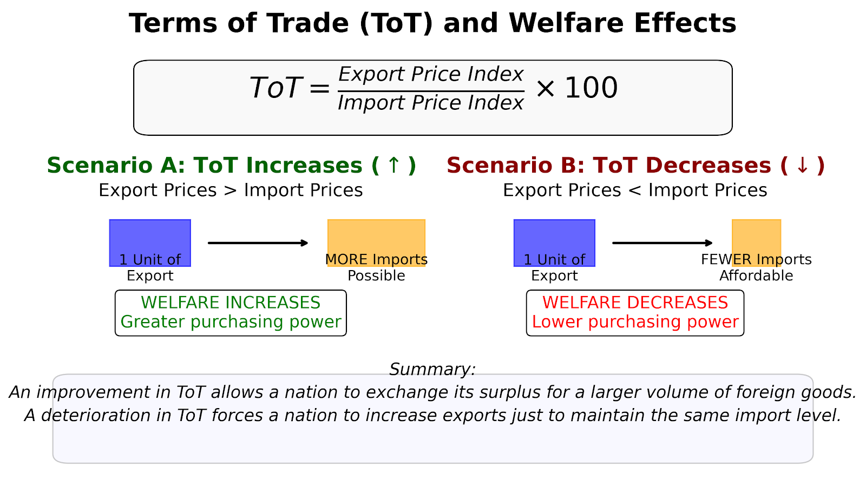
Trade Volume
Figure 10. Terms of Trade (ToT) and Welfare Effects.
Source: Created by the author

Slide 26
Determinants of Terms of Trade
Growth: Export-biased growth (growth that expands the export sector) worsens the terms of trade (supply increases, price falls). Import-biased growth (growth that reduces demand for imports) improves the terms of trade.
Trade Policies: As we saw with the large country tariff, restricting imports improves the terms of trade (by lowering import prices). Export subsidies worsen the terms of trade (by increasing export supply, lowering export prices).
Exchange Rates: A depreciation of the domestic currency tends to lower the terms of trade in the short run (export prices fall in foreign currency, import prices rise in domestic currency) before the J-curve effect takes hold.

Slide 27
The Metzler Paradox
While we have covered standard theory, a nuance exists for large countries: the Metzler Paradox. It is theoretically possible that for a large country, a tariff can actually cause the domestic price of the importable good to fall. This happens if the foreign export supply curve is very steep (inelastic) and the tariff causes such a dramatic fall in the world price that the domestic price (PW​+t) ends up lower than the original free trade price. While rare in practice, it highlights the complexity of large-country dynamics.

Slide 28
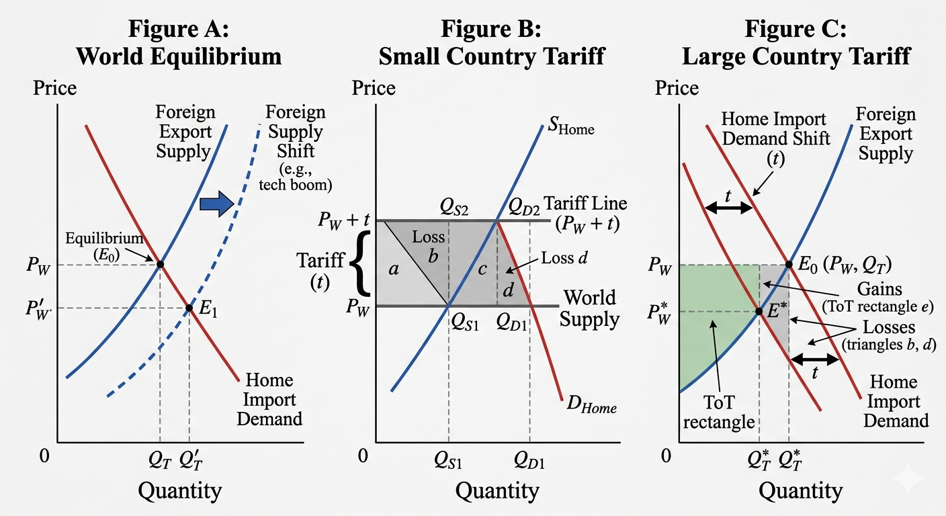
Figure 11. Comparative Analysis of Trade Equilibria and Tariff Welfare Effects.
Source: Gemini created
foto" (Google, April, 2026)

Slide 29
Is Free Trade Always Optimal?
For a small country, the theoretical answer is "yes." Free trade maximizes national welfare by allowing consumers to purchase at the world price, maximizing consumer surplus.
For a large country, theory suggests an "optimal tariff" exists. However, in practice, policymakers rarely know the precise elasticities to calculate this tariff. Furthermore, the threat of retaliation makes the pursuit of optimal tariffs highly risky. The post-World War II trend (GATT/WTO) has been toward multilateral reductions in tariffs precisely to avoid this destructive cycle.

Slide 30
Non-Economic Objectives
National Security
Political Economy
Infant Industry Argument

Slide 31
Modern Challenges: Supply Chains
The traditional supply/demand analysis assumes goods are finished products. However, modern global supply chains mean that components cross borders multiple times. A tariff on "imported steel" might hurt domestic auto manufacturers.
This complexity has led to the rise of tariff engineering and debates about reshoring.

Slide 32
Conclusion and Review Questions
Import Demand and Export Supply curves are derived from domestic fundamentals and determine the world price and trade volume.
Tariffs create a wedge between domestic and world prices.
The size of the country matters: small countries lose from tariffs; large countries might gain via improved terms of trade, but risk retaliation.
Quotas are similar to tariffs but raise the issue of rent allocation.
Trade volume is influenced by economic size, distance, and policy.
Terms of trade are a critical measure of a nation’s economic welfare from trade.

Slide 33
Review Questions
Using a diagram, illustrate why a small country loses welfare when it imposes a tariff. Identify the producer surplus gain, consumer surplus loss, and the deadweight loss triangles.
Explain the difference between a small country and a large country in the context of an import tariff. How does the large country’s ability to affect world prices change the welfare outcome?
A large country imposes a quota on imports. Compare the welfare outcomes if the government auctions the import licenses versus if it gives them away to domestic importers.
How does export-biased growth in a large country affect its terms of trade? How does this differ from import-biased growth?

