Slide 1
International Trade and Policy
WEEK 3 – Comparative Advantage and Factor Endowment
University: Tajik State University of Commerce
Lecturer: Abduvaliev Mubinzhon, PhD

Slide 2
Our Roadmap for Today
1. The Ricardian Model
Driver of Trade: Technology (labor productivity)
Key Insight: Comparative advantage = lower opportunity cost
Outcome: Gains from specialization; no domestic income conflict
2. The Heckscher-Ohlin (H-O) Model
Driver of Trade
Four Core Theorems: H-O:, FPE; and Stolper-Samuelson
3. Reality Check
Leontief Paradox (1953)
Modern View

Slide 3
Why Do Countries Trade?
Why do countries trade? What is the underlying cause of international exchange?
What determines the pattern of trade? Which goods does a country export, and which does it import?
Who gains from trade? Does trade benefit everyone in a country, or are there winners and losers?
How does trade affect a country's economic structure, wages, and income distribution?

Slide 4
Definition ….
Over the centuries, economists have developed theoretical frameworks to answer these questions. The two most foundational theories are the Ricardian model and the Heckscher-Ohlin (H-O) model. These models form the bedrock of trade theory, and understanding them is essential for analyzing more complex modern trade phenomena.

Slide 5
The Ricardian Model of Comparative Advantage
The Ricardian model posits that international trade is driven by cross-country differences in technology, reflected in labor productivity. It operates under a simplified framework with two countries, two goods, and a single factor of production labor which is perfectly mobile within each country but immobile internationally. The model assumes constant returns to scale, perfect competition, and that technology differences are captured by unit labor requirements.

Slide 6
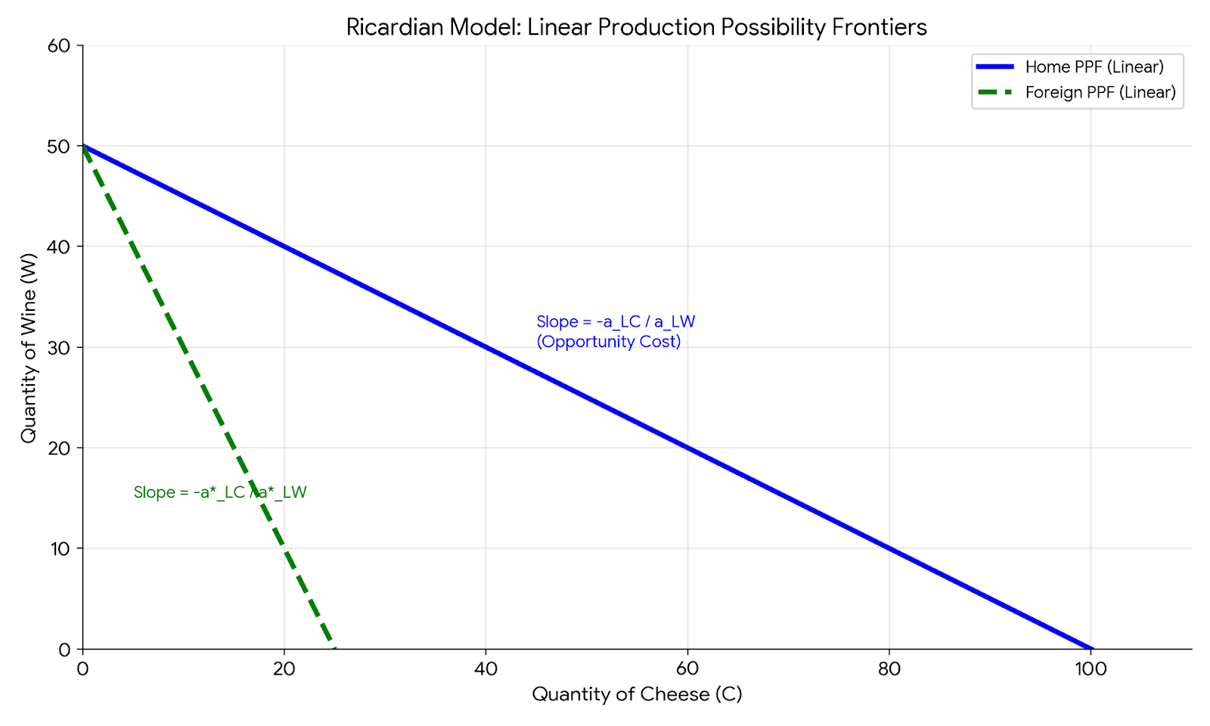
Figure 1. Ricardian Model: Linear Production Possibility Frontier
Source: Created by the author

Slide 7
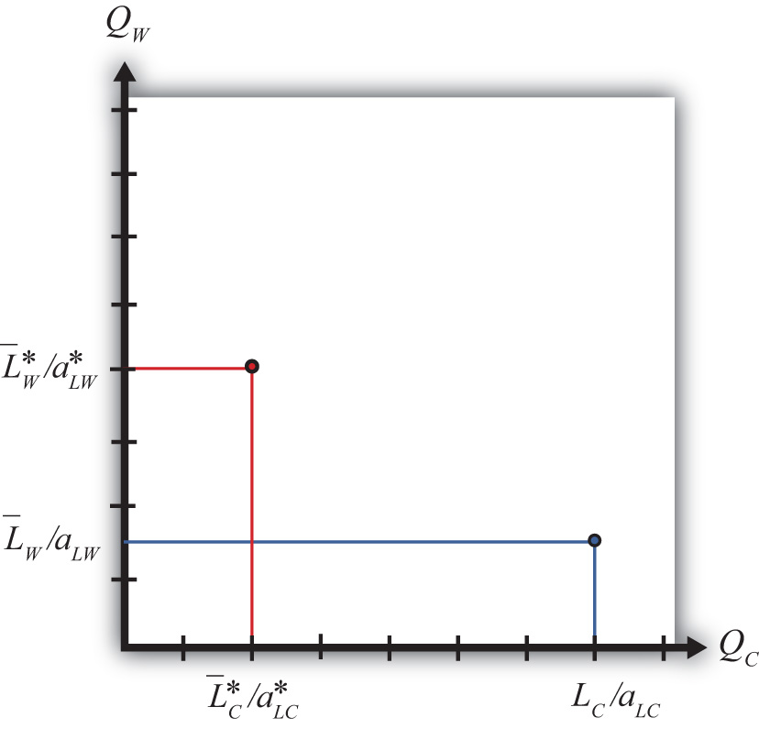
Autarky Equilibrium: Production and Consumption
In autarky, in the immobile-factor model, consumption will occur at the only production point possible. The autarky terms of trade for a good will be lower in the country with the productivity advantage (or the greater factor endowment in that product).
Source: Saylor Foundation. (n.d.). Autarky equilibrium in the immobile factor model. In International trade: Theory and policy. Retrieved March 1, 2026, from https://saylordotorg.github.io/text_international-trade-theory-and-policy/s07-06-autarky-equilibrium-in-the-imm.html

Slide 8
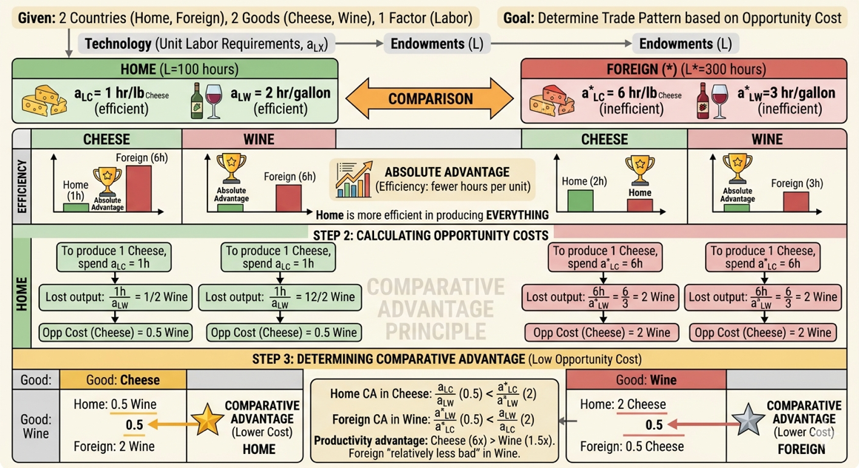
Figure 2. The Determination of Comparative Advantage via Opportunity Costs.
Source: Created by the author

Slide 9
Free Trade Equilibrium: Specialization and Gains from Trade
Krugman (1981) argues that with economies of scale and imperfect competition, trade generates gains through intraindustry specialization. Countries exchange similar goods by expanding market size, increasing product variety, and reducing average costs, even when countries are identical in resources and technology.

Slide 10
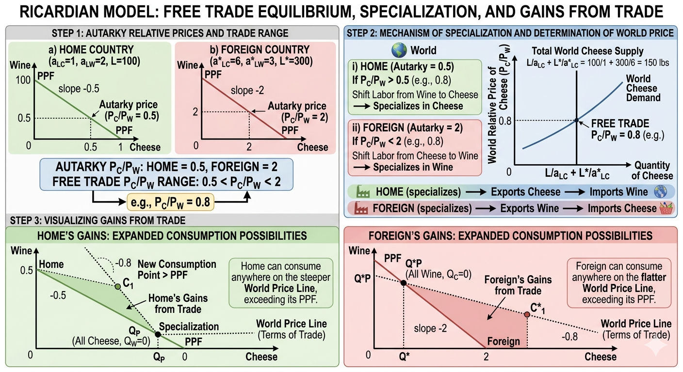
Figure 3. Ricardian Model: Free Trade Equilibrium, Specialization, and Gains from Trade.
Source: Created by the author

Slide 11
Figure 3….
Source: Created by the author
Source: Created by the author

Slide 12
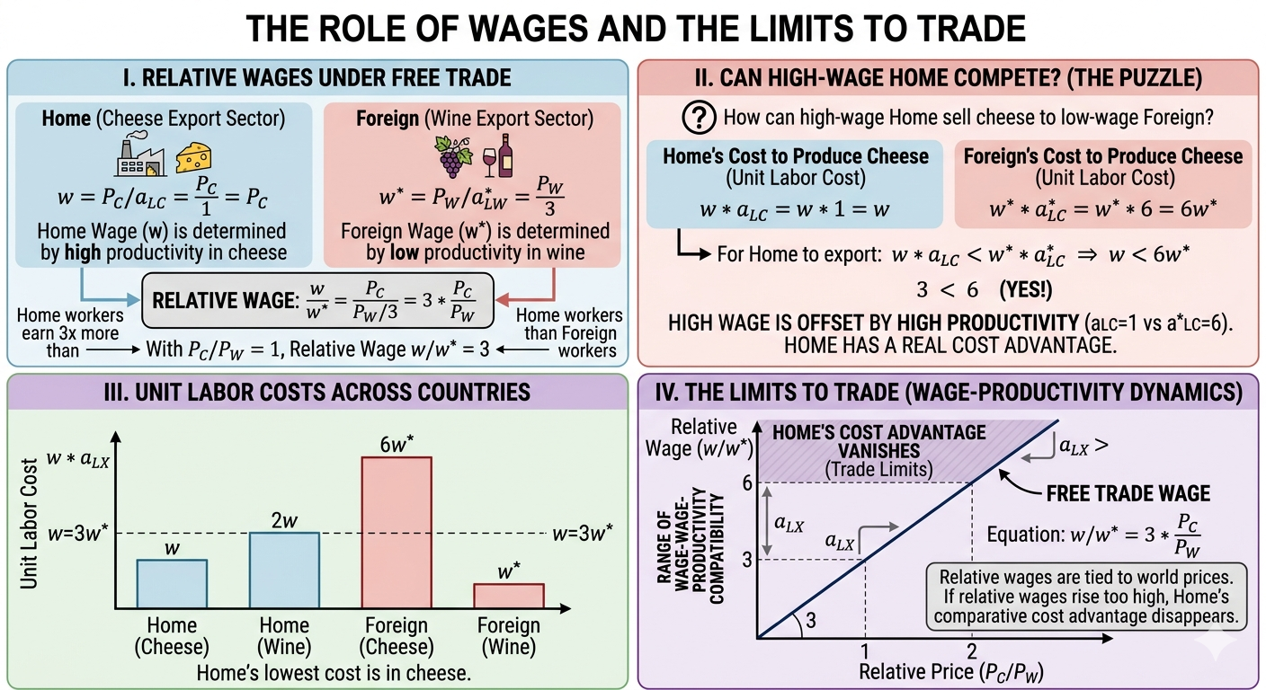
Figure 4. The Role of Wages and the Limits to Trade
Source: Created by the author

Slide 13
Extensions and Limitations of the Ricardian Model
The Ricardian model has been extended (e.g., Dornbusch-Fischer-Samuelson continuum of goods, non-traded goods, transport costs) but suffers key limitations: it assumes only labor as a factor, ignores income distribution effects (despite evidence trade creates winners and losers), rules out economies of scale and imperfect competition, and treats technology as exogenousleading to the Heckscher-Ohlin model, which incorporates multiple factors of production.

Slide 14
The Heckscher-Ohlin (H-O) Model: A General
Equilibrium Approach
The Heckscher-Ohlin model, developed by Eli Heckscher (1919) & Bertil Ohlin (1933), represents a significant advance over the Ricardian model. While Ricardo emphasized technology differences, the H-O model proposes that the fundamental cause of comparative advantage is differences in countries' factor endowments their relative supplies of labor, capital, land, etc.

Slide 15
From Labor Productivity to Factor Endowments: Motivation
While the Ricardian model assumes only labor as a factor of production, the Heckscher-Ohlin (H-O) model introduces factor intensity goods differ in their use of labor, capital, and land and factor endowments countries differ in their relative abundance of these inputs. Building on this, the Heckscher-Ohlin theorem states that a country will export goods that use its abundant factors intensively and import goods that use its scarce factors intensively, shifting the explanation for trade patterns from technological differences to differences in countries' relative factor endowments.

Slide 16
Core Assumptions of the 2x2x2 H-O Model
The 2x2x2 Heckscher-Ohlin model assumes two countries, two goods, and two factors of production (labor and capital), with identical technologies across countries, constant returns to scale, perfect competition, identical homothetic preferences, free trade, and factors that are mobile domestically but immobile internationally, so that differences in factor endowments alone determine the pattern of trade.

Slide 17
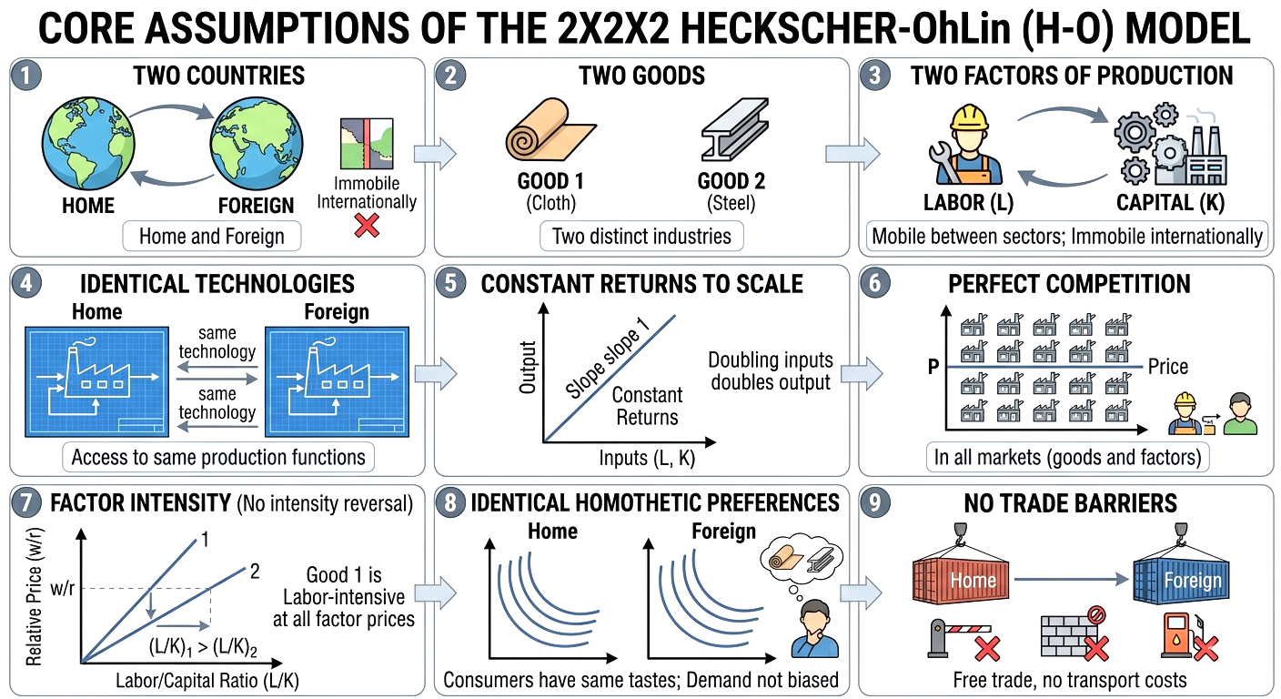
Figure 5. Core Assumption of the 2x2x2 H-O Model
Source: Created by the author

Slide 18
Key Concepts: Factor Abundance and Factor Intensity
Summary Table: Factor Abundance vs. Factor Intensity
Feature | Factor Abundance | Factor Intensity
Entity Described | The Country (Home vs. Foreign) | The Good (Cloth vs. Steel)
Physical Definition | The relative ratio of total endowments: K/L>K∗/L∗ | The relative ratio of inputs used: (K/L)_{Steel}​>(K/L)_{Cloth}​
Price Definition | The relative cost of factors in autarky: (r/w)<(r∗/w∗) | The relative share of total production costs attributed to a factor.
Nature of Concept | Relative: A country is abundant only in comparison to another country. | Relative: A good is intensive only in comparison to another good.
Key Question | Which resource does this nation have the most of? | Which resource does this product require the most of?
Role in H-O Theory | Determines the comparative advantage of the nation. | Determines which factor will see increased demandduring trade.
Example | Home has 100 machines and 50 workers (K/L=2); it is Capital-Abundant. | Steel requires 5 machines per worker; Cloth requires 1. Steel is Capital-Intensive.

Slide 19
The Heckscher-Ohlin Theorem: The Basis for Trade
The Heckscher-Ohlin Theorem states that a country will export the good that intensively uses its relatively abundant factor of production and import the good that intensively uses its relatively scarce factor, because differences in factor endowments across countries lead to differences in autarky relative prices specifically, the capital-abundant country has a lower autarky price for the capital-intensive good and the labor-abundant country has a lower autarky price for the labor-intensive good and when trade opens, each country specializes in and exports the good in which it has this comparative advantage derived from its factor endowment.

Slide 20
The Factor Price Equalization (FPE) Theorem
The Factor Price Equalization (FPE) Theorem, proven by Paul Samuelson, states that under the H-O model's assumptions identical technologies, free trade, no transport costs, perfect competition, incomplete specialization, and no factor intensity reversals free trade in goods equalizes factor prices (wages and rental rates) across countries by allowing trade to act as a substitute for factor mobility, though this strong prediction fails in reality due to violations like technology differences and trade barriers, while the weaker version that trade narrows factor price differences remains generally supported.

Slide 21
The Stolper-Samuelson Theorem: Income Distribution Effects
Perhaps the most important political economy implication of the H-O model is the Stolper-Samuelson Theorem (1941). It directly addresses the winners and losers from trade within a country.
An increase in the relative price of a good will increase the real return to the factor used intensively in its production, and decrease the real return to the other factor.

Slide 22
The Rybczynski Theorem: Growth and Output Mix
The Rybczynski Theorem (1955) explores how changes in factor endowments affect production. It is a key result for understanding how economic growth (an increase in a country's factor supply) impacts its industrial structure and trade patterns.
At constant relative goods prices, an increase in the endowment of a factor will increase the output of the good that uses that factor intensively, and decrease the output of the other good.

Slide 23
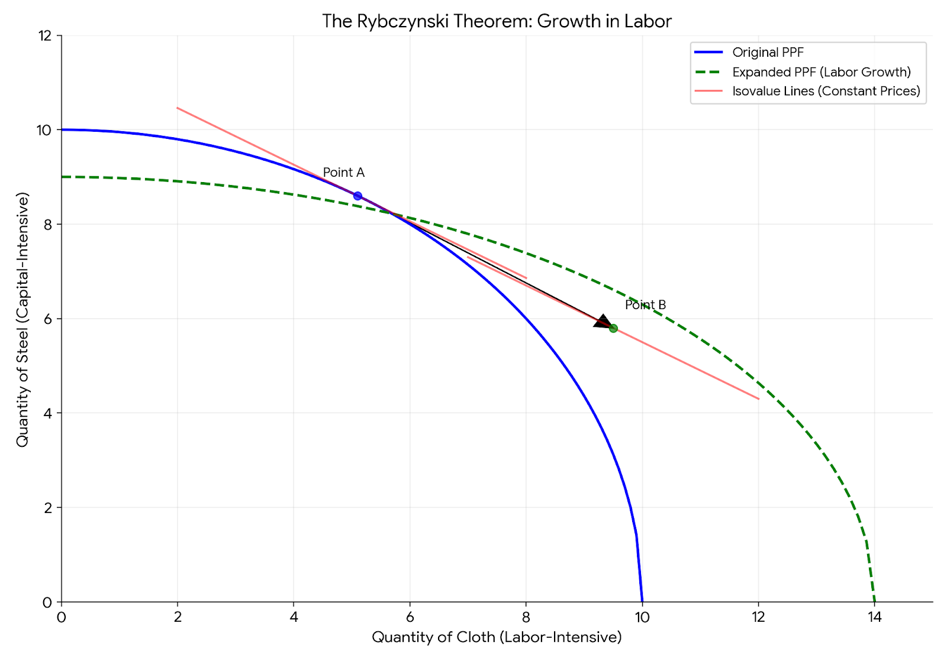
Figure 10. The Rybczynski Theory: Growth of Labour
Source: Created by the author

Slide 24
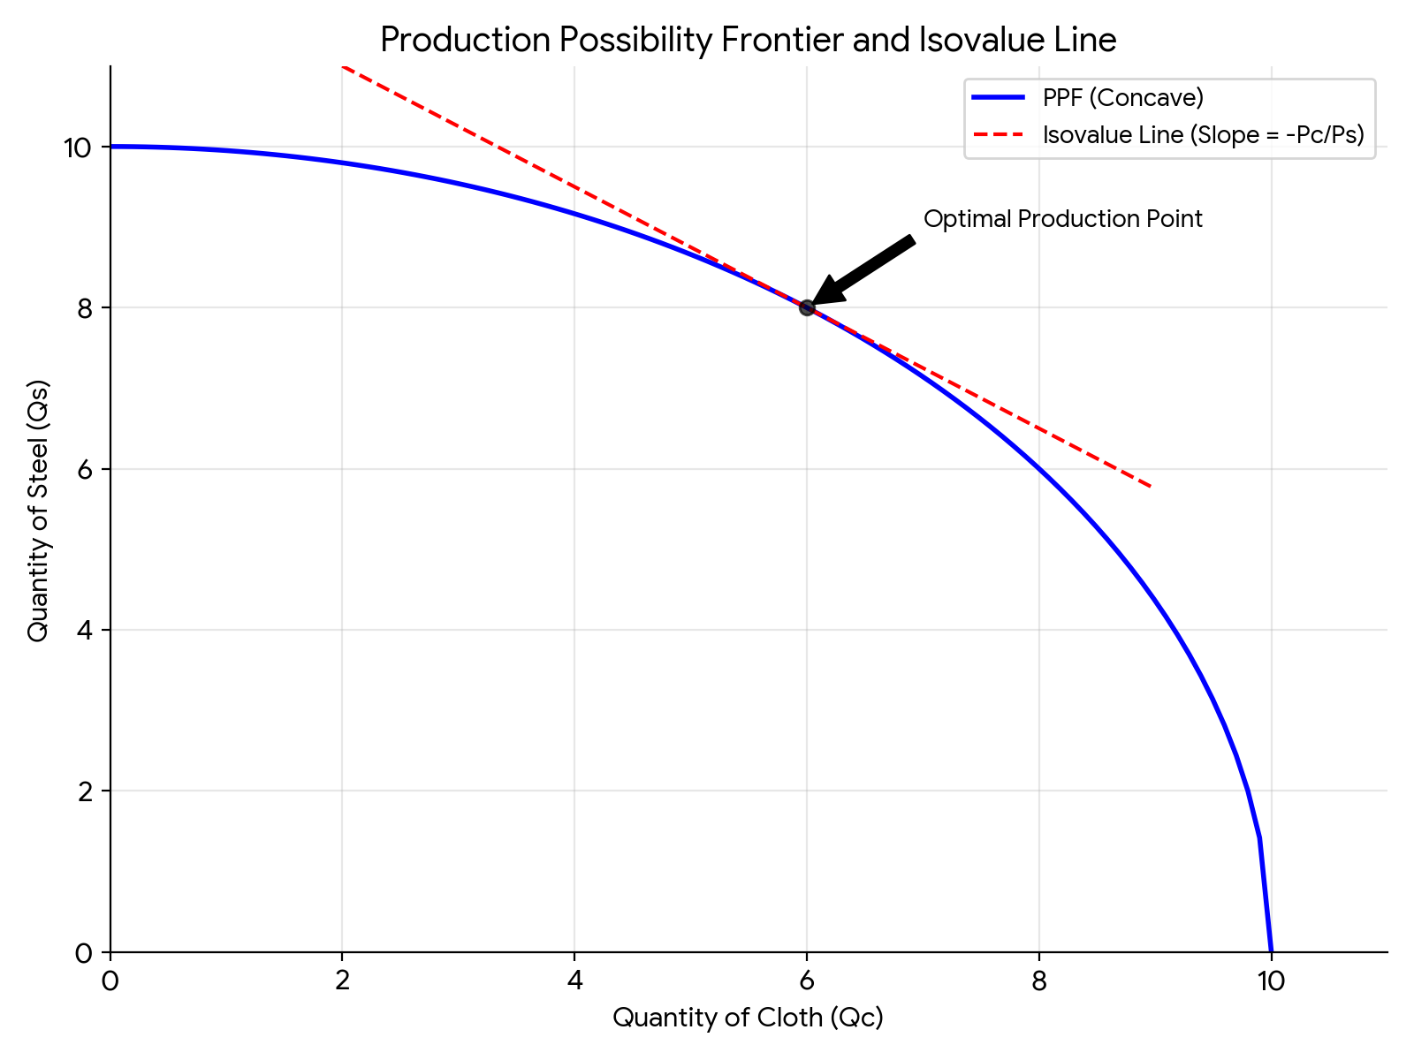
Unified Diagrammatic Analysis of the H-O Model
Figure 11. Production Possibility Frontier with Isovalue Lines
Source: Created by the author

Slide 25
The Heckscher-Ohlin Theorem: The Basis for Trade
The Heckscher-Ohlin Theorem states that a country will export the good that intensively uses its relatively abundant factor of production and import the good that intensively uses its relatively scarce factor, because differences in factor endowments across countries lead to differences in autarky relative prices specifically, the capital-abundant country has a lower autarky price for the capital-intensive good and the labor-abundant country has a lower autarky price for the labor-intensive good and when trade opens, each country specializes in and exports the good in which it has this comparative advantage derived from its factor endowment.

Slide 26
Autarky Equilibrium in H-O Model
In autarky, Home produces and consumes the same bundle of goods with no international trade. Its production possibility frontier is curved and tilted toward steel, the capital-intensive good, reflecting Home’s abundance of capital.

Slide 27
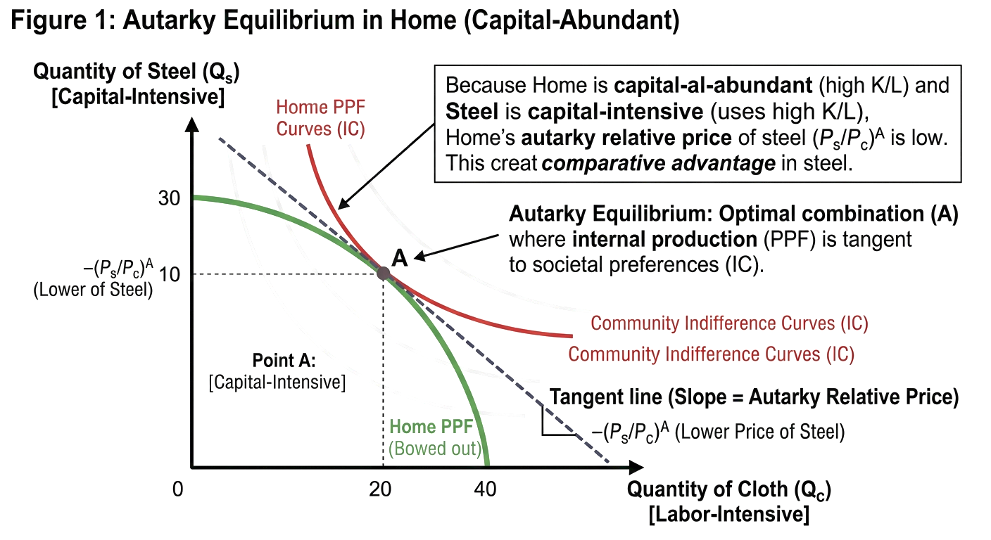
Figure 12: Autarky Equilibrium in Home (Capital-Abundant)
Source: Created by the author

Slide 28
Figure 13. From Autarky to Free Trade: Global Equilibrium
The Heckscher-Ohlin Theorem states that a country will export the good that intensively uses its relatively abundant factor of production and import the good that intensively uses its relatively scarce factor, because differences in factor endowments across countries lead to differences in autarky relative prices specifically, the capital-abundant country has a lower autarky price for the capital-intensive good and the labor-abundant country has a lower autarky price for the labor-intensive good and when trade opens, each country specializes in and exports the good in which it has this comparative advantage derived from its factor endowment.

Slide 29
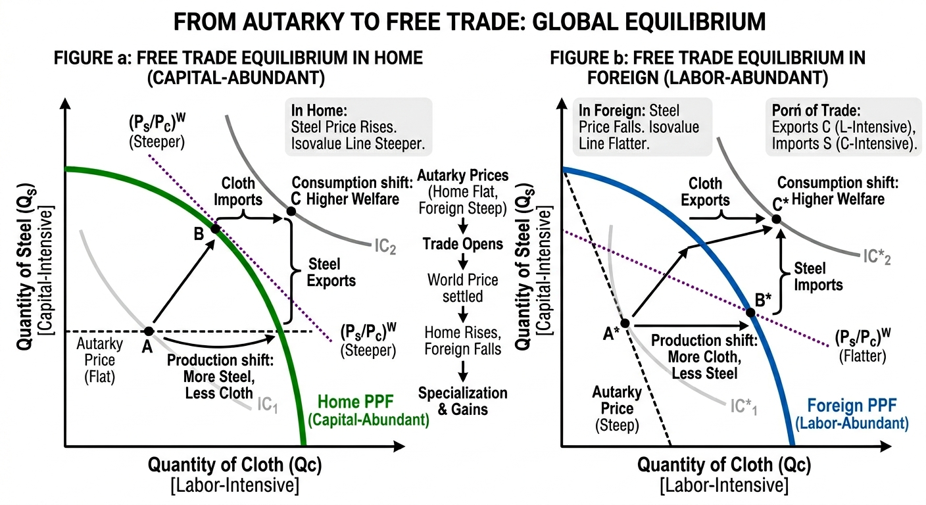
Figure 13. From Autarky to Free Trade: Global Equilibrium
Source: Created by the author

Slide 30
Empirical Evidence: The Leontief Paradox
The Leontief Paradox (1953) challenged the Heckscher-Ohlin model by finding that the capital-abundant United States exported labor-intensive goods and imported capital-intensive goods the opposite of H-O predictions leading economists to recognize that trade is also driven by human capital, technology, and demand differences.

Slide 31
Conclusion: Comparing the Two Paradigms and Empirical Evidence
Feature | Ricardian Model | Heckscher-Ohlin Model
Basis of Trade | Differences in technology (labor productivity) | Differences in factor endowments
Number of Factors | One (labor) | Two or more (e.g., capital, labor, land)
Production Technology | Constant returns, linear PPF | Constant returns, concave PPF (diminishing returns)
Pattern of Trade | Based on comparative advantage in labor productivity | Based on comparative advantage in factor intensity
Gains from Trade | Yes, for both countries (overall) | Yes, for both countries (overall)
Income Distribution | No effect (all workers identical) | Stolper-Samuelson: Winners and losers within a country
Factor Prices | No prediction on international equality | Factor Price Equalization: Tendency towards equality

Slide 32
References
Dornbusch, R., Fischer, S., & Samuelson, P. A. (1977). Comparative advantage, trade, and payments in a Ricardian model with a continuum of goods. The American Economic Review, 67(5), 823–839.
Krugman, P. (1981). Intraindustry specialization and the gains from trade. Journal of Political Economy, 89(5), 959–973.
Feenstra, R. C. (2016). Advanced International Trade: Theory and Evidence (2nd ed.). Princeton, NJ: Princeton University Press.
Leontief, W. (1953). Domestic production and foreign trade: The American capital position re-examined. Proceedings of the American Philosophical Society, 97(4), 332–349.
Samuelson, P. A. (1948). International trade and the equalisation of factor prices. The Economic Journal, 58(230), 163–184.
Saylor Foundation. (n.d.). International trade: Theory and policy. Retrieved from https://saylordotorg.github.io/text_international-trade-theory-and-policy/

Slide 33
Thank You
Abduvaliev M.H. PhD
https://orcid.org/0000-0003-3576-5014

