Slide 1
International Trade and Policy
WEEK 4 – Trade Theory II – Beyond Comparative Advantage
University: Tajik State University of Commerce
Lecturer: Abduvaliev Mubinzhon, PhD

Slide 2

Beyond Comparative
Advantage
Souce: Freepik. (n.d.). International trade vectors. Retrieved April 8, 2026, from https://www.freepik.com/vectors/international-trade

Slide 3
Table of Contents
Introduction: The Limits of Comparative Advantage
Module 1: The Specific-Factors Model (Short-Run Trade Effects)
Module 2: Increasing Returns to Scale (IRS) and Trade
Module 3: Monopolistic Competition and Intra-Industry Trade
Module 4: The Gravity Model of Trade
Synthesis: Putting It All Together
Key Terms and Review Questions
References

Slide 4
SECTION 1: Introduction – The Limits of Comparative Advantage
1.1. The Standard Model’s Successes and Failures
The standard model of comparative advantage successfully explains broad trade patterns, such as why labour-abundant countries export labour-intensive goods. However, it fails to account for persistent wage disparities, increasing returns to scale, intra-industry trade between similar economies, and the uneven distribution of trade gains. These shortcomings reveal that comparative advantage, while useful, provides an incomplete picture of how trade actually functions.

Slide 5
SECTION 2: The Specific-Factors Model
2.1 Assumptions and Motivation
The specific-factors model (also known as the Ricardo-Viner model) relaxes the H-O assumption that factors are perfectly mobile between sectors. In the short run, some factors are specific to an industry.
In this two-good economy (Manufacturing and Agriculture), labor is a mobile factor that can freely move between sectors, leading to a single equilibrium wage (w∗) across the entire economy. In contrast, capital is specific to Manufacturing and land to Agriculture, meaning these "trapped" resources cannot be used in the other sector.

Slide 6
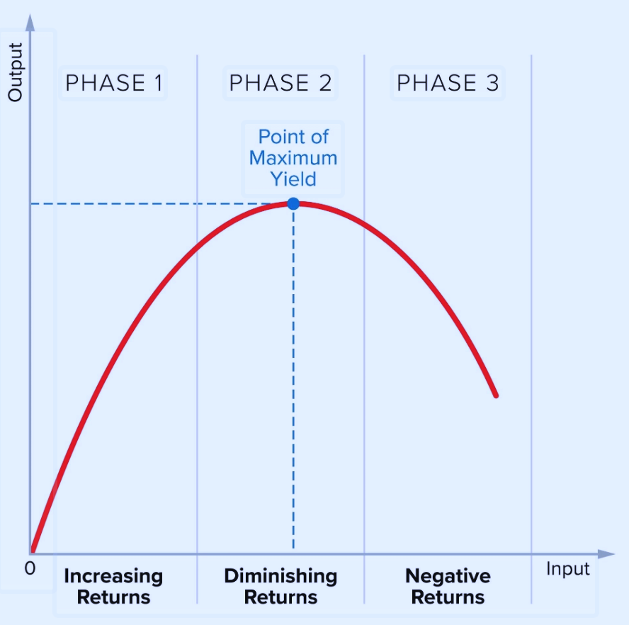
Figure 1. The Production Function and Diminishing Returns
Source: Created by the author.

Slide 7
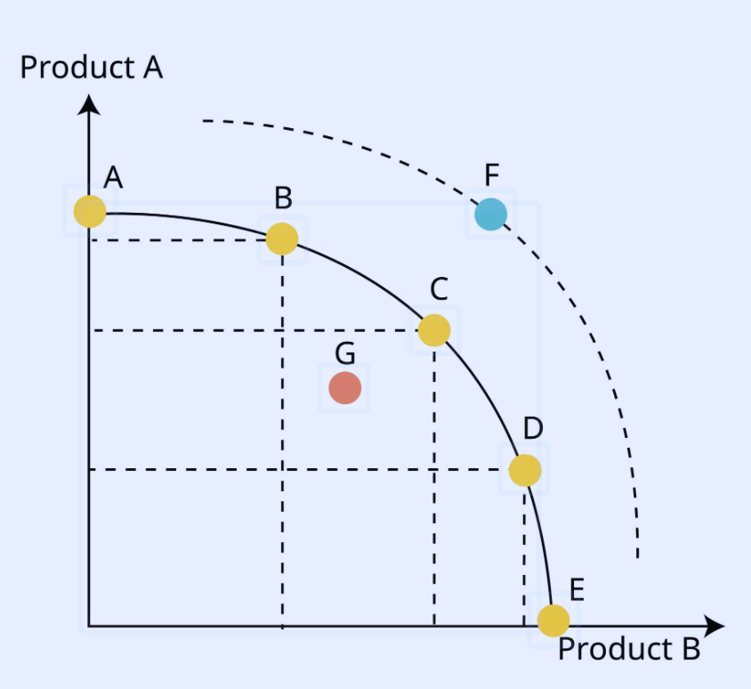
Figure 2. The Concave PPF
Source: Created by the author.

Slide 8
Why This Matters for Trade
The Export Sector: If the price of Manufacturing rises (due to exports), the specific factor in that sector (Capital owners) wins significantly.
The Import Sector: The specific factor in the competing sector (Land owners) loses significantly because their resource is stuck in a shrinking industry.
Labor: The effect on workers is ambiguous, as it depends on whether they spend more of their income on the good that became cheaper or the one that became more expensive.

Slide 9
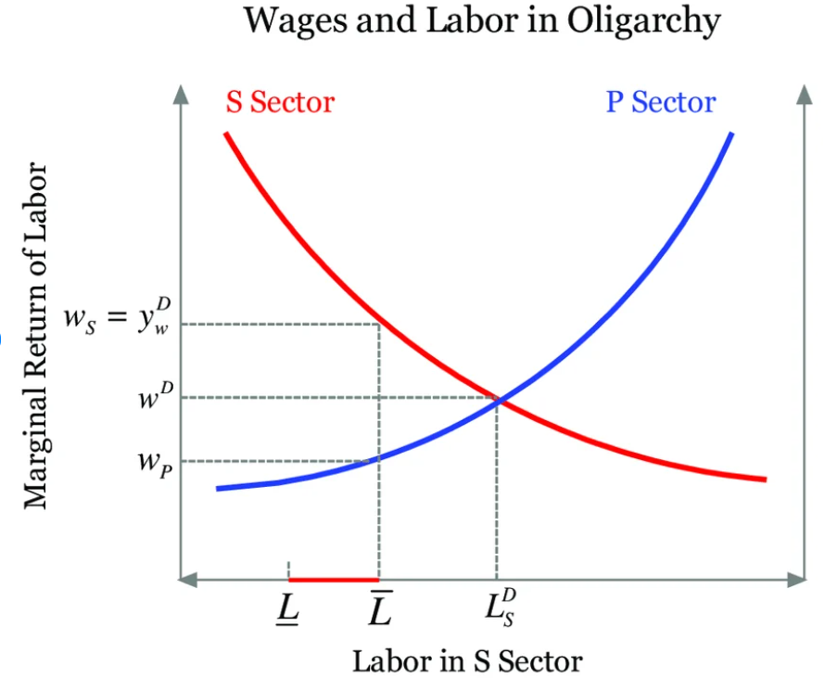
Labor Allocation and Wages
Labor is mobile between sectors, so workers move to whichever pays a higher wage until wages equalize across Manufacturing and Agriculture at a single equilibrium . Each sector hires labor until the value of the marginal product of labor equals.
Source: Wang, Y. (2014). Essays in political economy and development [Doctoral dissertation, University of Zurich]. https://doi.org/10.5167/uzh-109327

Slide 10
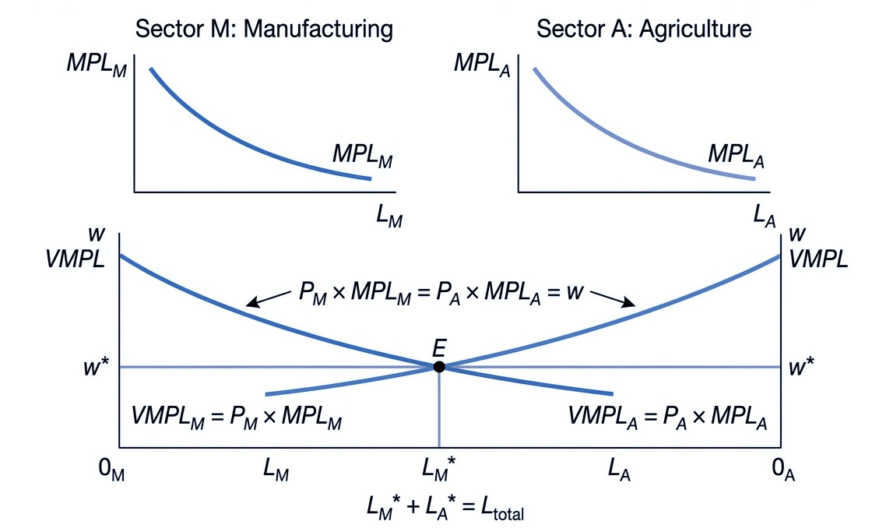
Figure 3. Labor Allocation and Wage Determination in Equilibrium
Source: Created by the author.

Slide 11
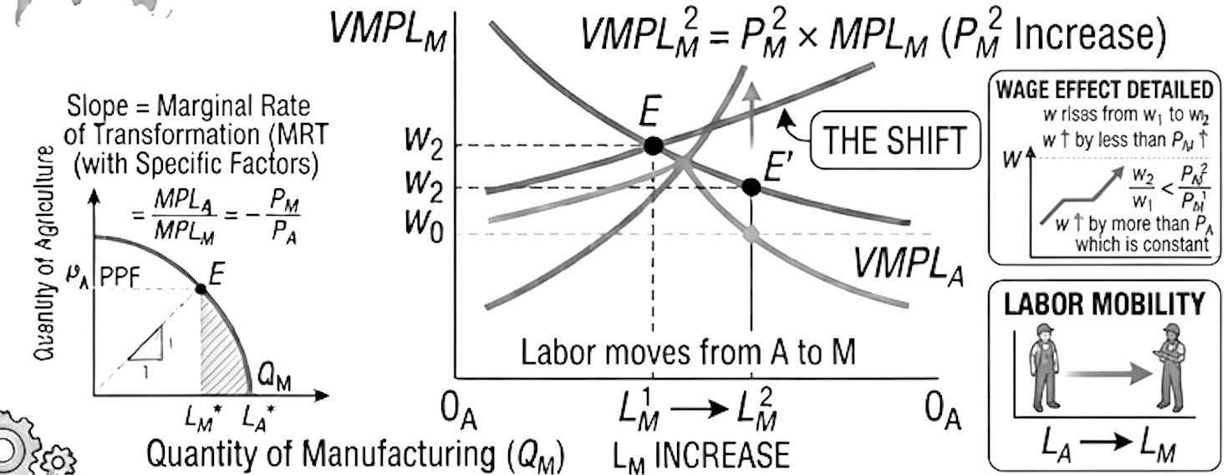
Figure 4. Effect of Trade (price change): Labor relocation and wage determination
Source: Created by the author.

Slide 12
Comparison with H-O
Table 1: Comparison of the Heckscher-Ohlin and Specific-Factors Models of International Trade
Feature | H-O Model | Specific-Factors Model
Time horizon | Long run (full adjustment) | Short/medium run (partial adjustment)
Factor mobility | Perfect across sectors | Some factors immobile (specific), others mobile
Trade effects on factor prices | Factor prices equalize across countries | Factor prices diverge across countries
Winners/losers | By factor ownership (abundant vs. scarce) | By industry affiliation (export vs. import-competing)

Slide 13
SECTION 3: Increasing Returns to Scale (IRS)
Why IRS Matters for Trade
In the context of international trade, Increasing Returns to Scale (IRS) explains why countries trade even when they have similar resources or technology. Unlike traditional theories that focus on natural advantages, IRS suggests that a country can create an advantage simply by specializing in a specific industry and producing at a massive volume.

Slide 14
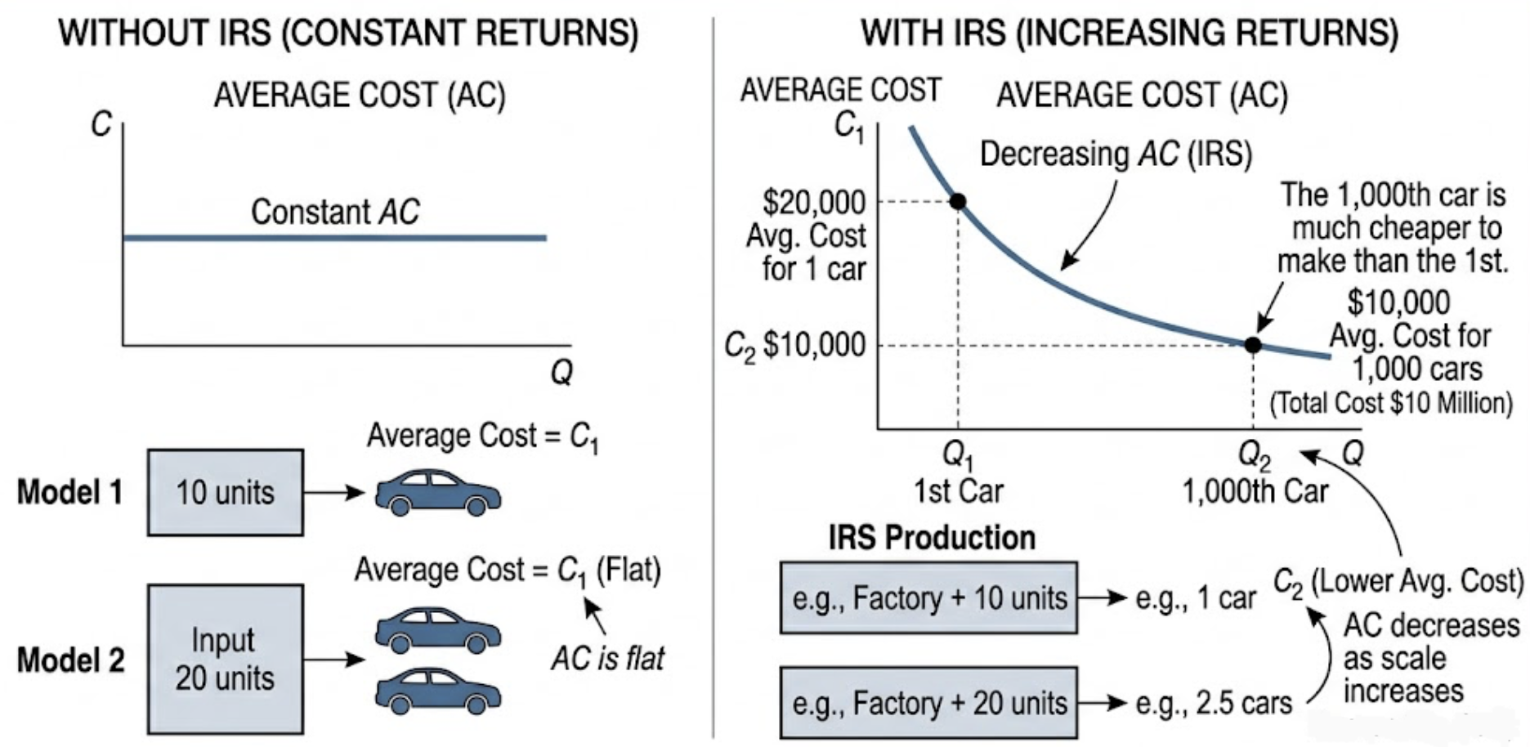
Figure 5. Economic of Scale and Average Cost (AC)
Source: Created by the author.

Slide 15
Types of Economies of Scale a. Internal Economies of Scale
Internal economies of scale occur when a single firm’s own increase in output leads to a decrease in its average cost (cost per unit). Unlike external factors, this cost advantage is firm-specific and not automatically shared with competitors.

Slide 16
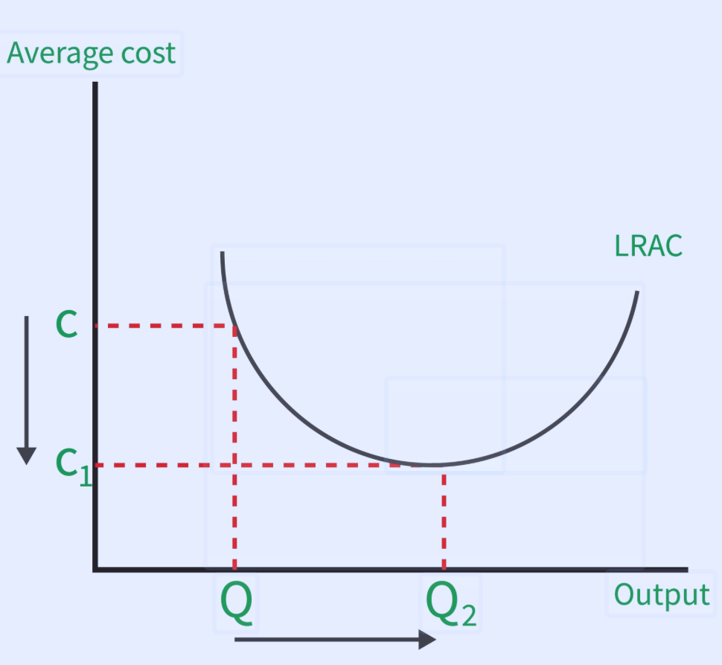
Figure 7. IRS and AC
Source: Created by the author.

Slide 17
Market Structure Consequences
Internal economies of scale naturally lead to imperfect competition because they create significant barriers to entry. A new, small firm cannot compete on price because it lacks the volume to achieve the incumbent’s low average costs.
Market Type | Condition | Examples
Monopoly | Scale economies are so vast that one firm can serve the entire market more efficiently than two or more. | Water utilities, electricity grids.
Oligopoly | A few large firms achieve scale and dominate the industry. | Aircraft (Boeing vs. Airbus), CPUs (Intel vs. AMD).

Slide 18
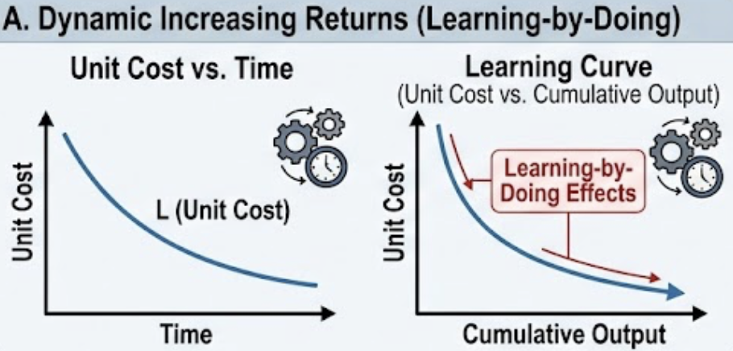
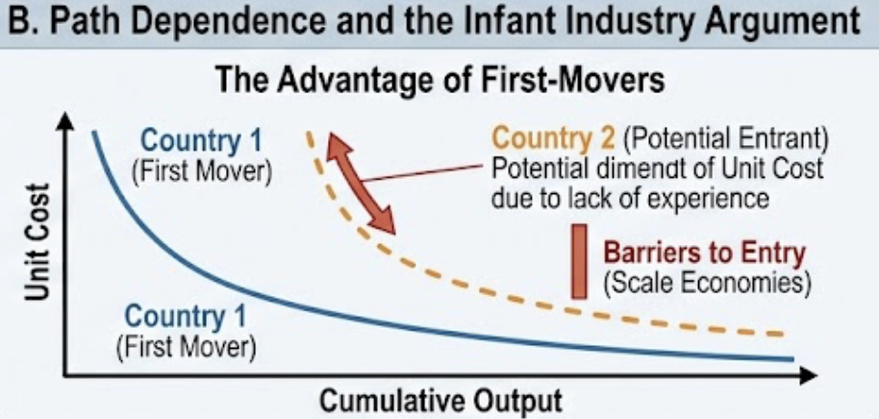
Figure 8. External Economies of Scale and Trade Path Dependence
Source: Created by the author.

Slide 19
External vs. Internal Economies of Scale: A Side-by-Side
Feature | Internal Economies of Scale | External Economies of Scale
Source of cost reduction | Firm’s own output level | Industry’s total output level
Control | Within the firm’s direct control | Outside the firm (a public good / cluster effect)
Barriers to entry | High – new small firms have higher costs | Low – new small firms share the benefits
Typical market structure | Imperfect competition (monopoly, oligopoly) | Perfect competition (many small firms)
Examples | Auto plant, aircraft manufacturer, R&D-heavy pharma | Silicon Valley, Hollywood, financial district in NYC
Does a small firm benefit? | No – it cannot spread fixed costs enough | Yes – it benefits from the industry’s scale

Slide 20
Limitations & When External Economies Can Fail
Congestion Diseconomies (The "Too Much Success" Problem
As an industry cluster grows beyond a certain point, the very factors that created low costs begin to reverse. The influx of firms and workers drives up prices for fixed local resources (especially land and housing) and degrades the local quality of life.

Slide 21
2. Knowledge Spillovers Can Be Hard to Appropriate (The Innovation Market Failure)
When knowledge flows too freely between firms, the firm that paid for research and development (R&D) may not capture enough of the financial benefit. This discourages investment in innovation, leading to less overall progress than is socially optimal.

Slide 22
Summary Table of Limitations
Limitation | Core Problem | Example | Consequence
Congestion diseconomies | Growth beyond optimal density raises costs (housing, traffic, pollution) | San Francisco Bay Area high housing costs | Offsets external economy benefits; firms may leave
Hard to appropriate knowledge | R&D investors cannot capture full returns; free-riding reduces innovation | Semiconductor firms copying each other's chips | Underinvestment in R&D (market failure)
Not all industries benefit | External economies only matter for knowledge-intensive or complex-input industries | Wheat farming vs. Hollywood films | Policy misdirection if applied universally

Slide 23
Why It Matters: Key Implications
This explains why Germany and France trade cars, but Germany and Nigeria trade cars for oil.
Feature | Inter-Industry Trade (Old) | Intra-Industry Trade (New)
Basis | Comparative advantage (differences) | Economies of scale, product differentiation (similarities)
Between | Different countries (North-South) | Similar countries (North-North)
Adjustment costs | High (workers must switch industries) | Low (workers switch within same industry)
Gains from trade | Cheaper imports, efficiency | More variety, lower prices due to scale
Trade pattern | Predictable by factor endowments | Less predictable (historical accident matters)

Slide 24
The Dixit-Stiglitz-Krugman Model (1977, 1979)
The Dixit-Stiglitz-Krugman Model is a groundbreaking theory that explains why countries trade even when they have similar resources (like Germany and France trading cars). Before this model, economists couldn't explain why similar countries traded similar goods; Krugman won the Nobel Prize for showing that Variety and Efficiency are the drivers.

Slide 25
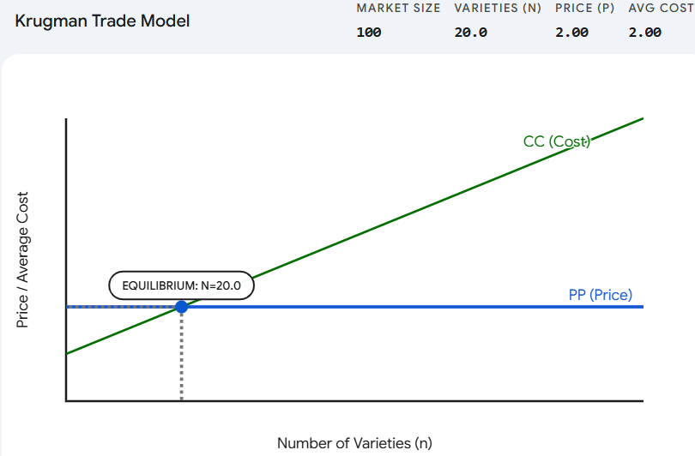
Figure 7. Krugman Trade Model
Source: Created by the author.

Slide 26
Helpman-Krugman Extensions
Helpman & Krugman (1985) showed that with differences in factor endowments, both inter- and intra-industry trade coexist:
Inter-industry trade: Capital-abundant country exports capital-intensive goods.
Intra-industry trade: Within each sector, countries exchange differentiated varieties.

Slide 27
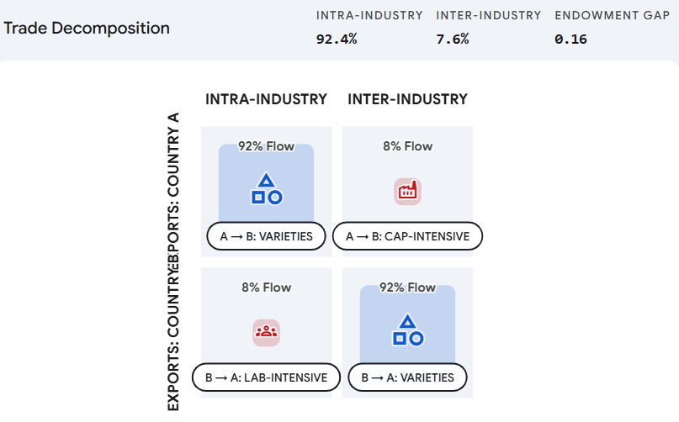
Figure 8. Trade Decomposition
Source: Created by the author.

Slide 28

SECTION 5: The Gravity Model of Trade
While the "traditional" gravity model simply looked at GDP and distance, this derivation by Anderson and van Wincoop solved the "Gold Medal Error" in trade economics by accounting for Multilateral Resistance.

Slide 29
SECTION 6: Synthesis – Putting It All Together
When to Use Which Model?
Research Question | Best Model
Who gains/loses from a tariff in the short run? | Specific-factors
Why do similar countries trade so much? | Monopolistic competition / IIT
Why do large economies trade more with each other? | Gravity + IRS
How does a new free trade agreement affect volumes? | Gravity model
Why do industries cluster in one location? | External economies of scale

Slide 30
Review Questions
Short answer: In the specific-factors model, why do landowners lose from a rise in manufactured goods prices? Be specific about real returns.
Numerical: Two countries (Home, Foreign) have identical demand and cost conditions: F=100,c=10,σ=3F=100,c=10,σ=3. Market size in autarky = 1000. Calculate autarky price and number of firms. Then with trade (market size 2000), recalculate. Show gains from trade.
Graphical: Draw a diagram showing how labor allocation changes when the price of the import-competing good falls in the specific-factors model. Identify winners and losers.
Data interpretation: The Grubel-Lloyd index for US-Japan auto trade is 0.7. Explain what this means and why it is higher than US-Mexico auto trade (0.2).

Slide 31
References
Ricardo, D. (1817). On the Principles of Political Economy and Taxation. (Ch. 7)
Heckscher, E., & Ohlin, B. (1933). Interregional and International Trade.
Leontief, W. (1953). Domestic Production and Foreign Trade. Proceedings of the American Philosophical Society.
Samuelson, P. (1948). International Trade and the Equalisation of Factor Prices. Economic Journal.
Beyond Comparative Advantage
Jones, R. (1971). A Three-Factor Model in Theory, Trade, and History. Trade, Balance of Payments, and Growth.
Krugman, P. (1979). Increasing Returns, Monopolistic Competition, and
Helpman, E., & Krugman, P. (1985). Market Structure and Foreign Trade. MIT Press.
Tinbergen, J. (1962). Shaping the World Economy. Twentieth Century Fund.
Anderson, J., & van Wincoop, E. (2003). Gravity with Gravitas. American Economic Review, 93(1), 170-192.
Gravity
Model

Slide 32
Thank you!

