Slide 1
International Trade and Policy
WEEK 5 – Trade Policy Instruments – Tariffs and Non-Tariff Barriers
University: Tajik State University of Commerce
Lecturer: Abduvaliev Mubinzhon, PhD

Slide 2
Learning Objectives
Define tariffs and distinguish between specific, ad valorem, and compound tariffs.
Analyze the welfare, revenue, and redistribution effects of a tariff in a small and large country setting.
Explain the economic impact of quotas, VERs, and TRQs.
Compare and contrast tariffs and non-tariff barriers (NTBs).
Evaluate real-world cases of trade policy instruments.

Slide 3
Glossary of Key Terms
Ad valorem tariff – Percentage of import value.
Compound tariff – Mix of specific and ad valorem.
Deadweight loss – Net welfare loss due to trade restriction.
Quota rent – Extra profit from selling at higher domestic price.
Specific tariff – Fixed $ per unit.
Tariff-rate quota (TRQ) – Low tariff up to limit, higher tariff beyond.
Terms of trade – Ratio of export prices to import prices.
Voluntary export restraint (VER) – Export limit imposed by exporter at importer’s request.
WTO – World Trade Organization, regulates trade policies.

Slide 4
Introduction to Trade Policy Instruments
Governments intervene in international trade for multiple reasons: protecting domestic industries, generating revenue, correcting the balance of payments, or responding to foreign trade practices. The two broad categories of trade policy instruments are the following:
Tariffs – taxes on imported goods.
NTBs – regulations, quotas, or other restrictions not in the form of taxes.

Slide 5
Why study them?
They affect consumer prices, producer profits, and government revenue.
They influence domestic employment, income distribution, and global welfare.
They are central to WTO negotiations and trade disputes.

Slide 6
Tariffs: Definition and Types
2.1 Specific Tariff
A fixed monetary amount per unit of import (e.g., $10 per ton of steel, €5 per pair of shoes).
Advantages: Easy to administer, stable revenue regardless of price fluctuations.
Disadvantages: Protection declines if import prices rise (tariff becomes smaller as % of the price).
Example: U.S. tariff on imported tuna – $0.02 per kilogram.

Slide 7
Ad Valorem Tariff
A percentage of the import’s value (e.g., 15% of the customs value).
Advantages: Protection rises automatically with price inflation.
Disadvantages: Requires accurate valuation, prone to fraud (under-invoicing).
Example: EU tariff on cars – 10% of value.

Slide 8
Compound Tariff
Combination of specific and ad valorem (e.g., $5 per kg + 10% ad valorem).
Used for products with wide quality/price variation (e.g., electronics, agricultural goods).

Slide 9
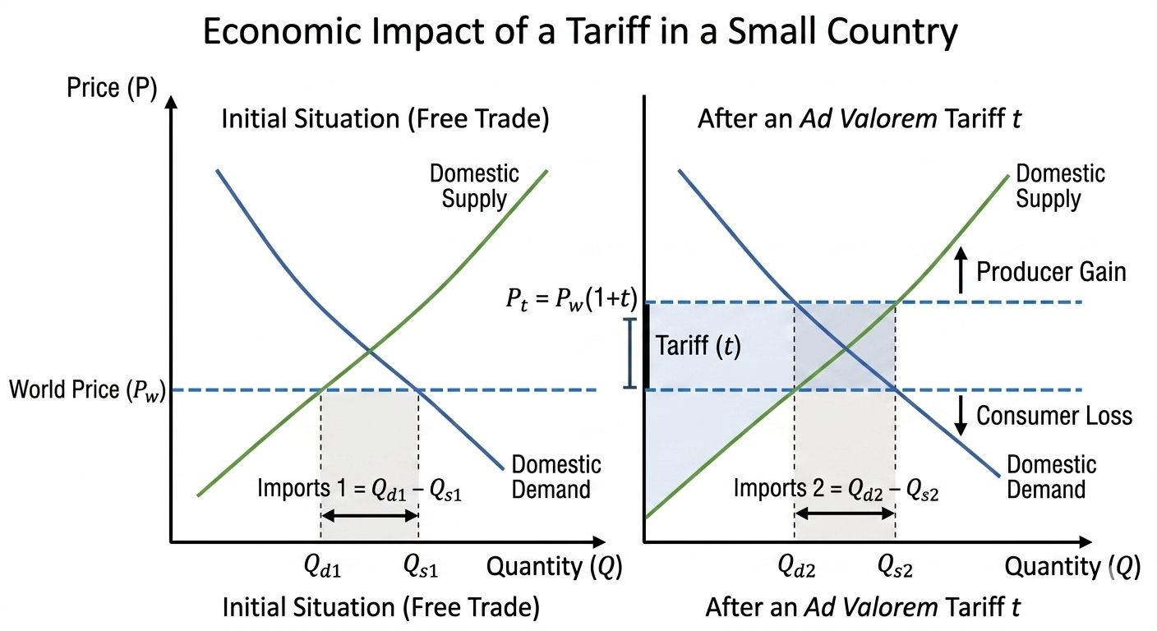
Economic Effects of a Tariff (Partial Equilibrium) (Fig. 1)
Source: Created by the author

Slide 10
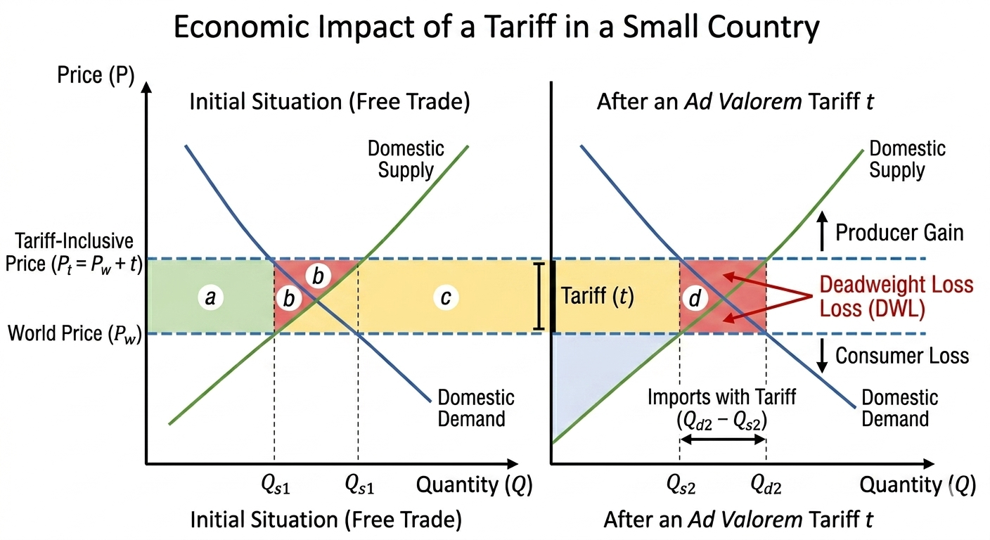
Welfare Effects (Small Country) (Figure. 2)
Source: Created by the author

Slide 11
Welfare Effects of a Tariff in a Small Country
This figure shows that tariffs create producer gain (a) and government revenue (c), but consumer loss (a+b+c+d) exceeds these. Since deadweight losses (b and d) are not offset by trade gains, tariffs always reduce national welfare in a small country.

Slide 12
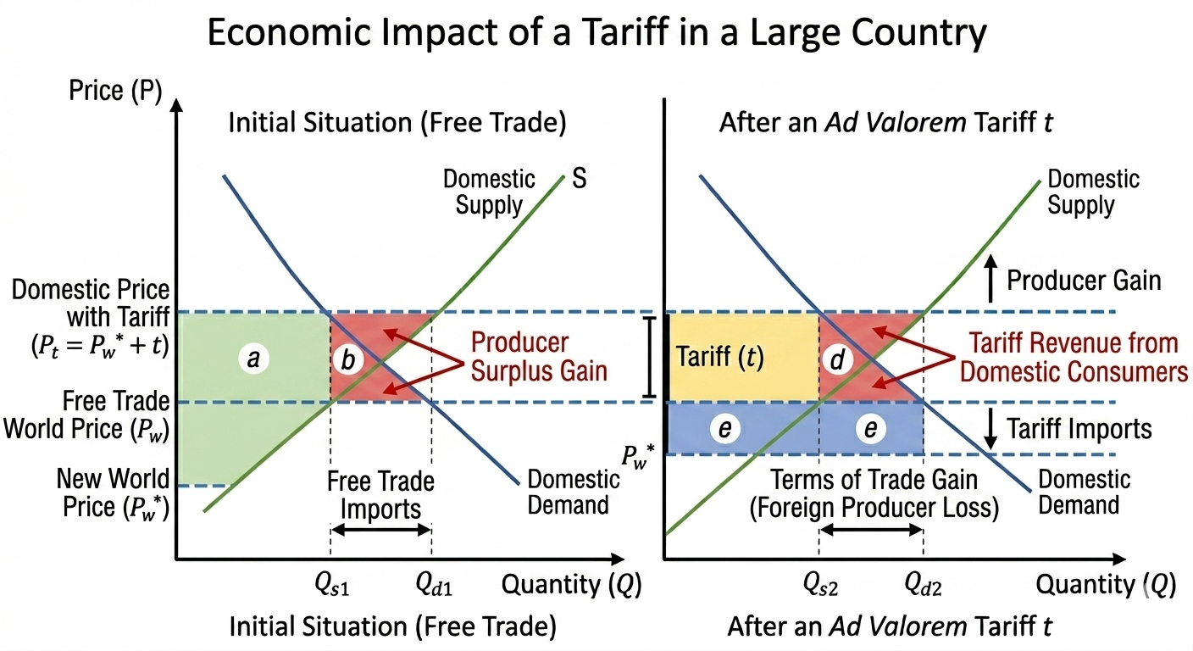
Large Country Case (Optimal Tariff Argument) (Figure. 3)
Source: Created by the author

Slide 13
When Tariffs Can Improve Welfare (Large Country)
This figure shows that for a large country, a tariff lowers world prices, creating a terms-of-trade gain. The optimal tariff balances this gain against deadweight loss; beyond that point, welfare falls.

Slide 14
Tariff Redistribution Effects
Tariffs act as a regressive tax because lower-income households spend a larger share of their income on tradable goods. The redistribution flows:
From consumers (higher prices)
To domestic producers (higher profits, possibly higher wages in protected sectors)
To the government (tariff revenue)
To inefficient firms (rent-seeking opportunities)

Slide 15
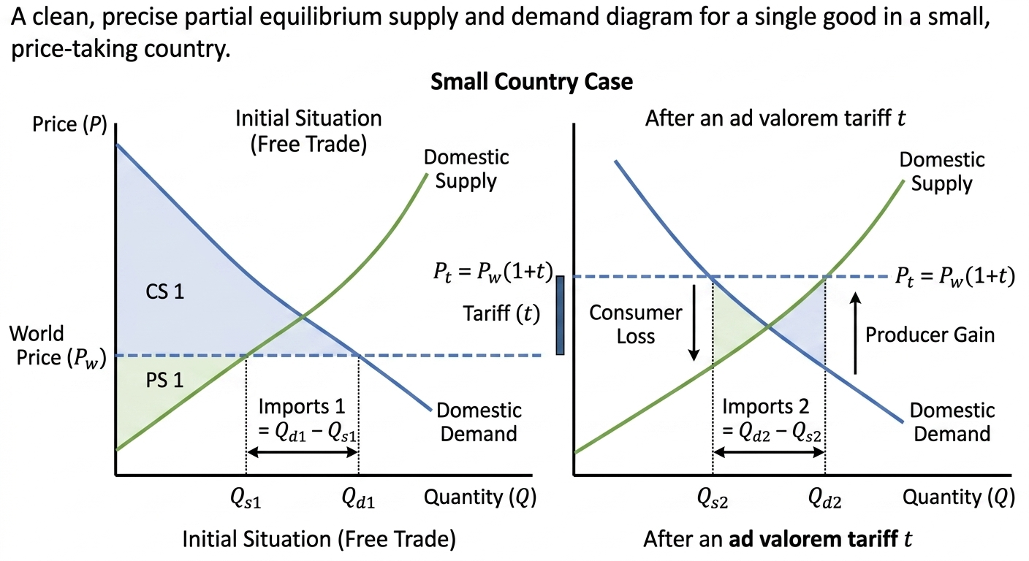
Economic Effects of a Tariff (Partial Equilibrium) (Figure. 4)
Source: Created by the author

Slide 16
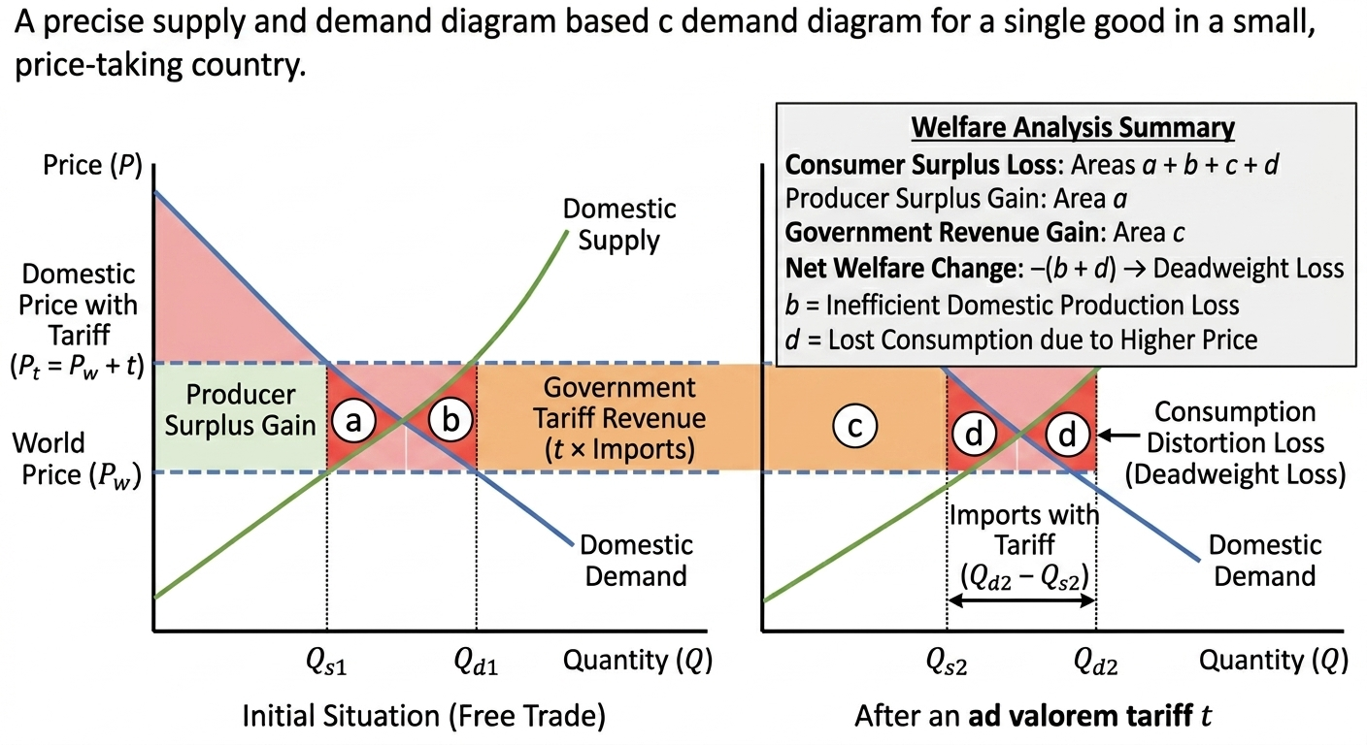
Welfare Effects (Small Country) (Figure. 5)
Source: Created by the author

Slide 17
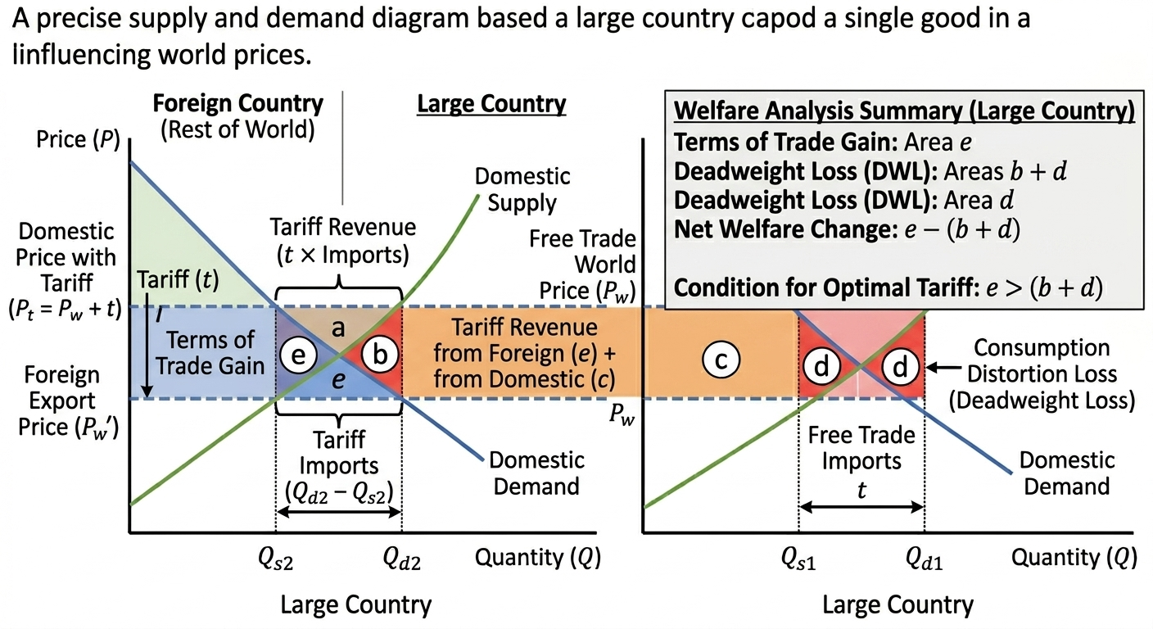
Large Country Case (Optimal Tariff Argument) (Figure. 6)
Source: Created by the author

Slide 18
Tariff Redistribution Effects
Tariffs act as a regressive tax because lower-income households spend a larger share of their income on tradable goods. The redistribution flows:
From consumers (higher prices)
To domestic producers (higher profits, possibly higher wages in protected sectors)
To the government (tariff revenue)
To inefficient firms (rent-seeking opportunities)

Slide 19
Non-Tariff Barriers (NTBs): Overview
NTBs are trade restrictions that do not involve explicit taxes. Since the WTO tariff reductions, NTBs have proliferated. They include:
Quotas
Voluntary Export Restraints (VERs)
Tariff-Rate Quotas (TRQs)
Technical barriers to trade (TBT)
Sanitary and phytosanitary (SPS) measures
Subsidies and countervailing duties
Local content requirements
Customs delays and red tape
We focus on quantitative restrictions: quotas, VERs, and TRQs.

Slide 20
NTBs at a Glance
NTBs are trade restrictions without explicit taxes that have grown in use since WTO tariff reductions, and they include measures such as quotas, VERs, TRQs, technical standards, subsidies, and customs red tape. This presentation focuses specifically on quantitative restrictions, namely quotas, VERs, and TRQs.

Slide 21
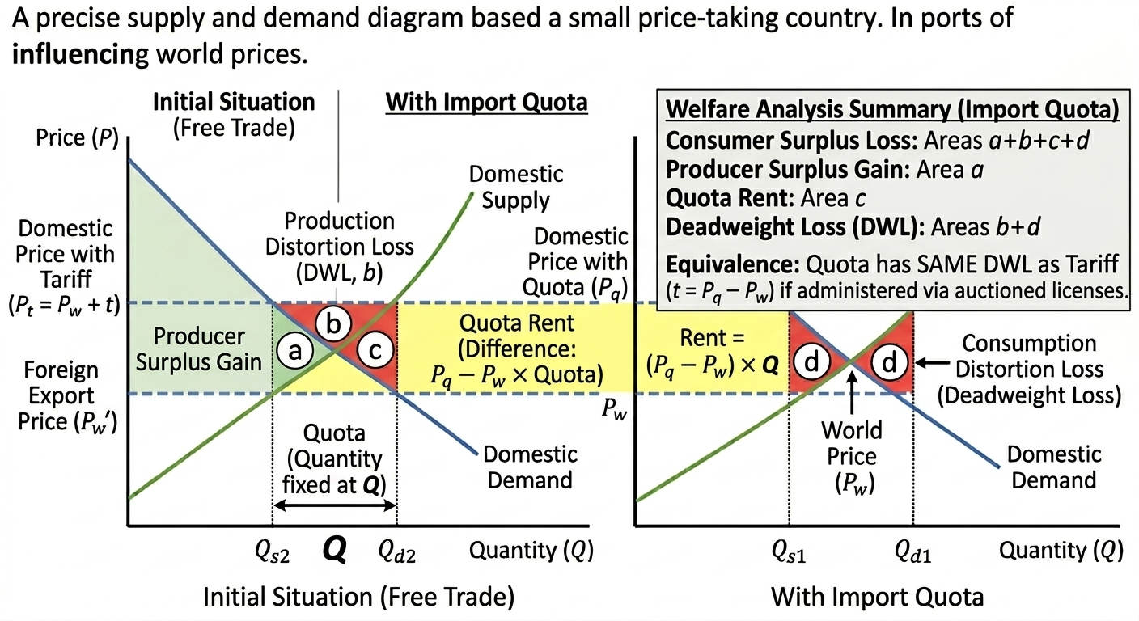
Import Quotas (Figure 7)
Source: Created by the author

Slide 22
Quota vs. Tariff: Key Differences (Table 1)
Feature | Tariff | Quota
Price effect | Determined by tariff rate | Determined by supply/demand
Government revenue | Yes (tariff receipts) | Only if licenses auctioned
Certainty of import limit | No (imports vary with demand) | Yes (absolute limit)
Corruption potential | Lower | Higher (license allocation)
WTO legality | Generally allowed | Bound quotas illegal except for agriculture

Slide 23
Voluntary Export Restraints (VERs)
Definition: A two-tier tariff system – imports within a specified quantity face a low tariff (in-quota rate), while imports above that quantity face a higher tariff (over-quota rate).
Purpose: Allow a minimum market access while protecting domestic producers beyond that level. Common in agriculture (WTO Uruguay Round Agreement on Agriculture).

Slide 24
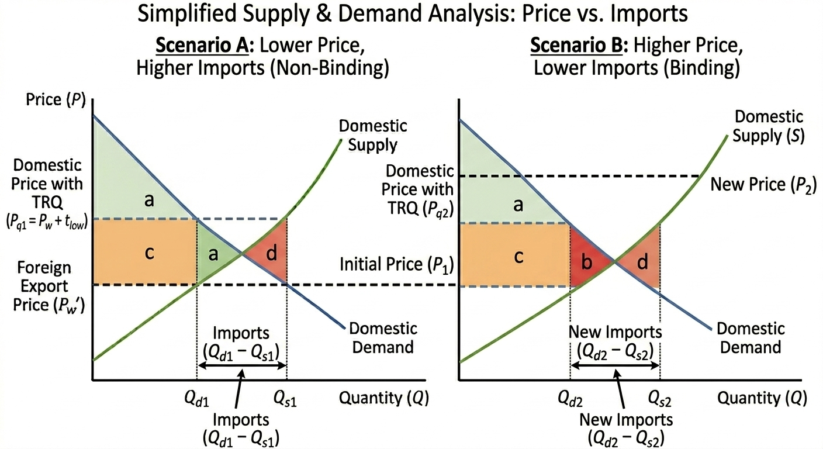
Economic Effects of TRQs (Figure 8)
Source: Created by the author

Slide 25
Comparison of Tariffs and NTBs (Table 2)
Instrument | Price effect | Rent recipient | Welfare (importer) | WTO status
Tariff | Increases | Government | Loss (small country) | Bound tariffs allowed
Quota (auctioned) | Increases | Government | Loss | Restricted
Quota (assigned) | Increases | License holders | Loss (larger) | Restricted
VER | Increases | Foreign exporters | Severe loss | Illegal (WTO)
TRQ | Increases stepwise | Mixed | Moderate loss | Allowed (agriculture)

Slide 26
Impact of Trade Restrictions on Importers
The table shows how trade policies raise prices and affect rent recipients and importer welfare. Tariffs and auctioned quotas benefit the government but harm importers, with tariffs WTO-legal and auctioned quotas restricted. Assigned quotas and VERs shift rents elsewhere, causing even larger losses, and VERs are WTO-illegal.

Slide 27
Real-World Cases and Data
U.S. Steel Tariffs (2002, 2018)
2002: Bush imposed 30% tariff on steel. Result: Job losses in steel-using industries exceeded gains in steel production. WTO ruled illegal.
2018: Trump 25% tariff on steel (Section 232). EU and China retaliated. Net welfare loss for U.S.

Slide 28
Policy Implications and WTO Rules
WTO principles relevant to tariffs & NTBs:
Binding commitments: Tariffs cannot exceed bound rates.
Most-Favored Nation (MFN): Tariff applied equally to all WTO members (except FTAs).
National treatment: Internal taxes/regulations cannot discriminate against imports.
Prohibition of VERs – illegal under WTO (Agreement on Safeguards).
Tariffication – quotas converted to tariffs (agriculture).
TRQs – permitted for agriculture under market access commitments.

Slide 29
Conclusion
Tariffs – simple but harmful for small economies; can improve terms of trade for large economies but risk retaliation.
Specific vs. ad valorem – each has administrative and protective differences.
Welfare effects – always deadweight loss for small country; redistribution from consumers to producers and government.
Quotas – limit quantity; create rents; more distortionary than equivalent tariff if rents go abroad.
VERs – worst for importing country; rents to foreigners; now illegal under WTO.
TRQs – compromise between protection and market access; common in agriculture.

Slide 30
Discussion Questions & Problem Set
Why would a government use a VER instead of a tariff, even though VERs are worse for national welfare?
Compare the distributional effects of an ad valorem tariff vs. a specific tariff during inflation.
If a large country imposes an optimal tariff, why might its trading partners retaliate? What is the final equilibrium likely to be?
How does a TRQ differ from a simple quota? Give an example where a TRQ might be preferred politically.

Slide 31
Problem Set:
Small country tariff:
Demand: Q_d = 100 – P, Supply: Q_s = 20 + P, World price = $20.
(a) Find free trade imports.
(b) Impose $10 specific tariff. Find new price, imports, consumer surplus loss, producer surplus gain, revenue, deadweight loss.
Quota vs. tariff:
Same demand/supply as above. Instead of tariff, impose quota of 20 units.
(a) Find domestic price.
(b) Calculate quota rent if licenses given to domestic firms.
(c) Compare welfare with tariff case.
VER analysis:
Using the same data, assume that the exporting country imposes a VER of 20 units. Calculate the welfare loss for the importing country compared to an equivalent tariff. Who gets the quota rents?

Slide 32
References
Krugman, P. R., Obstfeld, M., & Melitz, M. J. (2023). International Trade: Theory and Policy (12th ed.). Pearson. (Chapter 9: "The Instruments of Trade Policy")
Feenstra, R. C., & Taylor, A. M. (2021). International Trade (5th ed.). Macmillan International Higher Education. (Chapter 8: "Import Tariffs and Quotas Under Perfect Competition")
Davies, W., & Chen, C. G. (2023). International Trade and FDI: An Advanced Introduction to Regulation and Facilitation. Business Expert Press. (Chapters 2: "Tariff Barriers" and 3: "Non-Tariff Barriers")
Appleyard, D. R., Field, A. J., & Cobb, S. L. (2016). International Economics (9th ed.). McGraw-Hill Education.
World Trade Organisation (WTO). Integrated Trade Intelligence Portal (I-TIP) (Online database for WTO members' trade policies, non-tariff measures, and trade concerns)
Laird, S., & Francois, J. F. (2012). "Quantifying Commercial Policies." In J. F. Francois & K. A. Reinert (Eds.), Applied Methods for Trade Policy Analysis. Cambridge University Press.

Slide 33
Thank you!

