Slide 1
International Trade and Policy
WEEK 6 – Analysis of Trade Policy & Midterm Exam I Review
University: Tajik State University of Commerce
Lecturer: Abduvaliev Mubinzhon, PhD

Slide 2
Part 1. COSTS AND BENEFITS OF PROTECTION

Slide 3
Why Protection? The Core Tension
We learned (from the previous lecture, Week 2) that a small country always loses from a tariff (DWL). A large country might gain from an optimal tariff via terms of trade improvement, but risks retaliation.
If free trade maximizes global welfare, why do all countries restrict trade?
Because trade creates winners and losers within a country. Losers from trade (e.g., workers in import-competing sectors) are often better organized politically than winners (consumers or exporters).

Slide 4
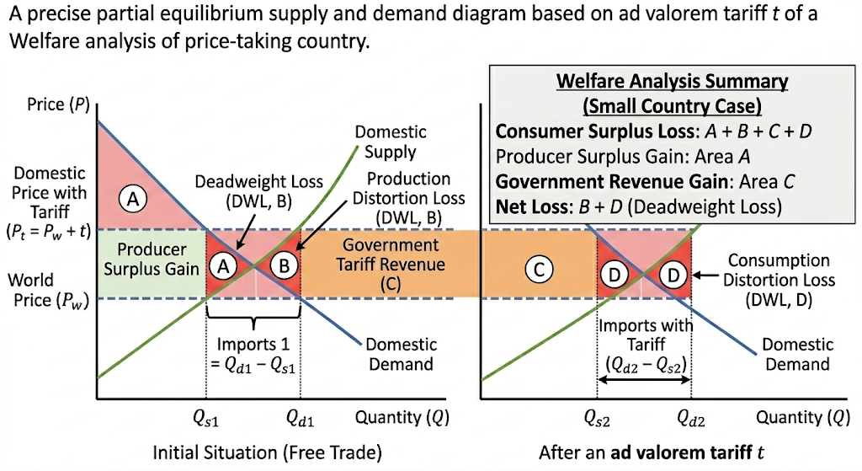
Review of Consumer and Producer Surplus
Key insight: The DWL triangles represent pure economic waste – no one gets that surplus.
Recall from Week 2
Figure 1. Partial Equilibrium Analysis of a Small Country Tariff
Source: Created by the author

Slide 5
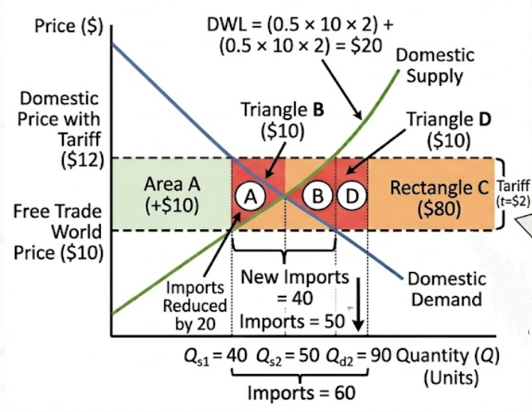
Static Costs of Protection
Figure 2. Optimal Tariff and Terms of Trade in a Large Country
Source: Created by the author

Slide 6
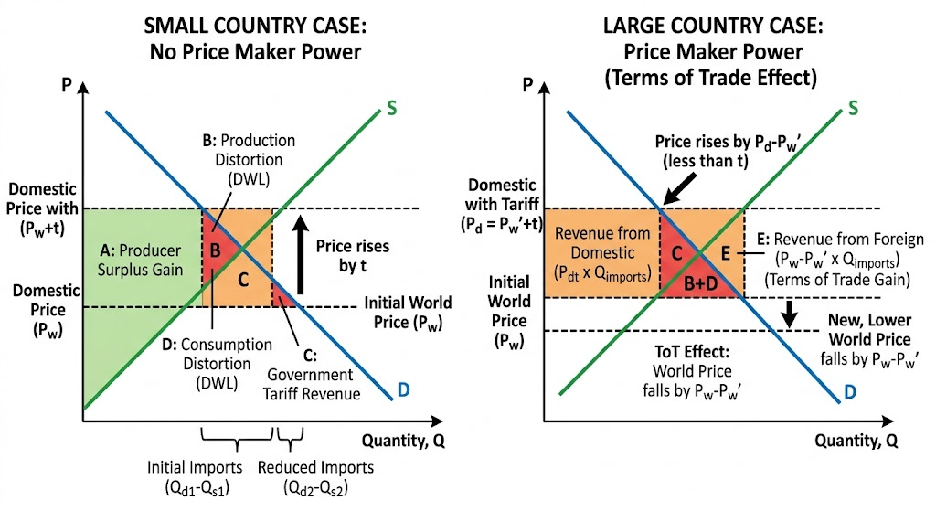
Large and Small Country Tariff – Terms of Trade Gain (Fig. 3)
Recall from Week 2
Source: Created by the author

Slide 7
Quotas vs. Tariffs (from Week 2)
A quota is a physical limit on import quantity, which generates quota rents (extra profit for license holders) rather than government revenue unlike a tariff. If import licenses are given to foreign exporters, quota rents flow abroad, resulting in greater welfare loss than a tariff.
A Voluntary Export Restraint (VER) is an even worse instrument, as the exporter “voluntarily” limits exports, rents go entirely to foreign firms, and it produces the same deadweight loss as a quota plus lost rents, as illustrated by the 1980s US VER on Japanese autos, where Japanese firms raised prices, kept the rents, and US consumers bore the loss.

Slide 8
Dynamic Costs of Protection (Beyond Static DWL)
Static DWL (triangles B and D) often underestimates true costs of protection.
Static Cost | Dynamic Cost | Explanation
Production DWL | X-inefficiency | Protected firms have no incentive to minimize costs → waste
Consumption DWL | Reduced product variety | Consumers get fewer choices
(not in static) | Rent-seeking | Resources spent lobbying for protection, not producing
(not in static) | Reduced innovation | Lack of competition slows technological progress
(not in static) | Retaliation risk | Trade wars reduce export opportunities for domestic firms

Slide 9
Example: Rent-seeking costs
Estimated at up to 3–5% of GDP in highly protected sectors (Krueger, 1974).
Firms spend money on lawyers, lobbyists, and campaign contributions instead of R&D or expansion.
Example: US steel tariffs (2002, 2018)
Saved ~10,000 steel jobs.
Cost downstream industries (auto parts, machinery, construction) ~200,000 jobs.
Net job loss, not gain.

Slide 10
Benefits of Protection – The Standard Arguments
While mainstream economics favors free trade, protectionist arguments exist but are mostly flawed. The infant industry argument is weak because protection is hard to remove and subsidies are superior (though South Korea succeeded). National security is often overused for non-strategic goods. A terms of trade argument works only for large countries but invites retaliation. Second-best protection is always inferior to direct subsidies. And anti-dumping frequently disguises protectionism.

Slide 11
Empirical Evidence on Costs of Protection
US Sugar Quotas
Policy: Restrictive import quotas since 1982.
US sugar price = 2–3× world price.
Consumer cost: ~$3 billion per year.
Jobs saved: ~4,000 sugar farms.
Cost per job saved: ~$750,000/year (far above the farmer's average wage).
Downstream jobs lost: Candy makers and food processors relocate overseas.

Slide 12
Summary Table – Costs vs. Benefits of Protection
Costs | Benefits
Deadweight loss (production & consumption triangles) | Potential terms of trade gain (large country only)
Rent-seeking & lobbying waste | Infant industry maturation (rare, requires good governance)
Higher prices for consumers & downstream firms | National security (narrowly defined – e.g., defense only)
Retaliation & trade wars | Political expediency (saving visible jobs)
Reduced innovation & X-inefficiency | Income transfer to specific groups (e.g., steel workers)
Net job loss in downstream sectors | Anti-dumping against genuine predation (rare)
Most protectionist arguments fail cost-benefit analysis except in narrow, temporary, or large-country cases. Even then, a direct subsidy or adjustment assistance is usually superior.

Slide 13
Part 2. EFFECTIVE RATE OF PROTECTION (ERP)

Slide 14
Why Nominal Tariffs Are Misleading
Nominal tariffs on final goods underestimate true protection when imported intermediates face low or zero tariffs. In global supply chains, a high final-good tariff combined with low input tariffs magnifies protection for domestic value added, a key insight from Week 2.

Slide 15
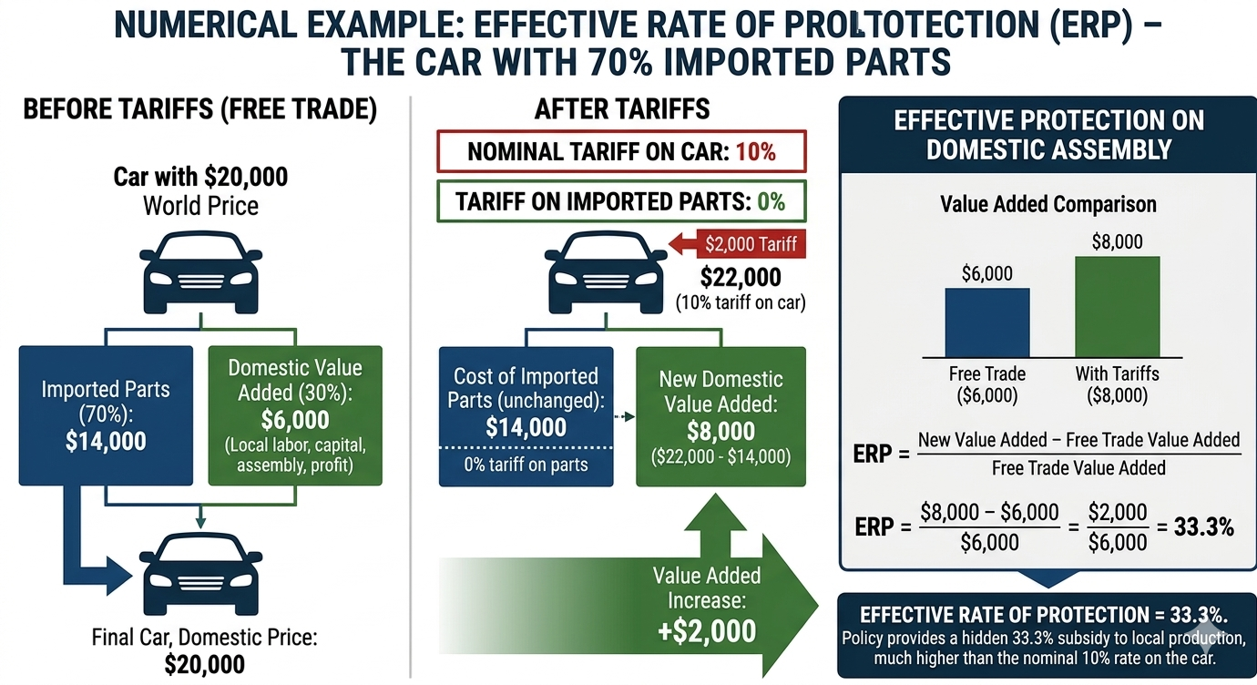
Figure 4. The Effective Rate of Protection on Domestic Value Added
Source: Created by the author

Slide 16
Example: A car has 70% imported parts.
Nominal tariff on cars = 10%.
Tariff on parts = 0%.
A 10% nominal tariff sounds low, but domestic value added gets much higher protection because the cost of imported inputs is unchanged while final price rises.
Effective rate of protection measures protection on value added, not final price.

Slide 17

ERP Formula
ERP measures net tariff protection on domestic value added, rising when final-good tariffs exceed input tariffs and falling when input tariffs are higher.

Slide 18
Numerical Example 1 – ERP > Nominal
Product: Shirt
World price = $100
Inputs: Fabric (50% of cost, af=0.5af​=0.5), Buttons (10% of cost, ab=0.1ab​=0.1)
Tariffs: Shirt = 20%, Fabric = 0%, Buttons = 0%
Free trade VA = 100−(50+10)=40100−(50+10)=40
Protected VA = 120−(50+10)=60120−(50+10)=60
ERP = (60−40)/40=0.50=50%(60−40)/40=0.50=50% (vs. nominal 20%)
Low tariffs on inputs magnify protection on domestic value added. Domestic shirt producers benefit enormously.

Slide 19
Numerical Example 2 – Negative ERP (Disprotection)
Product: Computer
World price = $1000
Inputs: Chips (60% of cost, ac=0.6ac​=0.6)
Tariffs: Computer = 5%, Chips = 20%
Free trade VA = 1000−600=4001000−600=400
Protected VA = 1050−720=3301050−720=330
ERP = (330−400)/400=−17.5%(330−400)/400=−17.5%
High tariff on inputs destroys domestic value added. This is called tariff escalation in reverse – discourages domestic assembly. Common in developing countries that tax imported machinery.

Slide 20
Tariff Escalation and Policy Implications
Tariff escalation higher tariffs on final goods than on inputs boosts domestic final production in developed countries but harms developing nations, whose processed exports face high tariffs on their value added.

Slide 21
Example
Tariffs rise from 0% on raw cocoa to 20% on chocolate bars, trapping developing countries as raw material exporters. The Doha Round tried but failed to reduce this escalation.
For policymakers: High ERP (>50%) signals heavy, likely inefficient protection.

Slide 22
ERP – Summary Table for Exam
Condition | ERP relative to nominal | Interpretation
No imported inputs (∑ai=0∑ai​=0) | ERP = tf​ | Simple case – nominal = effective
Low input tariffs, high final tariff | ERP > tf​ | High effective protection (common in developed countries)
High input tariffs, low final tariff | ERP < tf​ (even negative) | Disprotection (common in developing countries)
tf=∑ait∑ai​ti​ | ERP = 0 | No protection of value added
ERP > 100% | Extremely high | Severe inefficiency; likely rent-seeking

Slide 23
PART III: POLITICAL ECONOMY OF TRADE AND LOBBYING

Slide 24

The Puzzle of Persistent Protection
The puzzle: If protection reduces national welfare (for a small country) and often even for a large country (after retaliation), why does protectionism persist?
Source: The Global Trade Puzzle,” Georgia Trend Magazine (March 1, 2019)

Slide 25
Answer from political economy: Concentrated benefits vs. diffuse costs (Mancur Olson, 1965).
Group | Benefit per person from protection | Incentive to organize
Steel workers (winners from tariff) | High (jobs, wages – thousands of dollars per worker) | Strong – they lobby actively
Consumers (losers from tariff) | Very low (pennies per year per person) | Weak – rational ignorance
Consumers don't bother to learn about or fight trade barriers because the cost to each individual is tiny. Producers have large stakes and organize.

Slide 26
Collective Action and Trade Policy
Collective action problem: Large groups with small individual stakes do not organize. Small groups with large stakes do.
Implications for trade:
Import-competing sectors (steel, sugar, textiles, autos) lobby hard for protection.
Export sectors also lobby (for open markets abroad), but less intensely because their gains are more diffuse.
Consumer groups are almost absent from trade debates.

Slide 27
Example
US sugar program. Sugar farmers are ~4,000. Each gains hundreds of thousands of dollars per year. They organize tightly. Consumers are 330 million. Each loses only ~$9 per year. No consumer lobby fights sugar quotas.
Recalling Week 3 (Stolper-Samuelson): Trade hurts the scarce factor. In developed countries, labor (especially low-skilled) is the scarce factor. Workers in import-competing industries have strong incentives to lobby for protection.

Slide 28
Models of Trade Policy Determination
Stigler's Capture Theory (1971) argues that regulation, including trade policy, is effectively "sold" to the highest-bidding interest group. Government officials prioritize political support over social welfare, so protection consistently goes to well-organized industries that lobby effectively.
The Grossman-Helpman "Protection for Sale" model (1994) formalizes this: government maximizes a weighted sum of social welfare and campaign contributions. Organized sectors receive higher protection, especially those with high import penetration, low elasticity of import demand (consumers can't easily switch away), and few downstream users to oppose protection.

Slide 29
Who Lobbies for Protection?
Pro-protection lobbies (the "demand side"):
Domestic firms in import-competing industries (e.g., US Steel, Nucor)
Labour unions (United Steelworkers, UAW, textile unions)
Specific industries: sugar, dairy, peanuts, steel, semiconductors, solar panels
Pro-free trade lobbies:
Export-oriented firms (need access to foreign markets – Boeing, Caterpillar)
Multinational corporations (global supply chains – Apple, GM)
Retailers (Walmart, Target – want low prices for consumers)
Consumer groups (rarely effective due to diffuse interests)

Slide 30
How Lobbying Works (Instruments)
Method | Example
Campaign contributions | PACs, Super PACs to congressional candidates (US)
Grassroots mobilization | "Save our jobs" advertisements, rallies
Administrative filings | Anti-dumping and countervailing duty petitions
Revolving door | Former government officials become lobbyists
Testimony at ITC | Presenting injury claims from imports (US International Trade Commission)
Direct meetings | Lobbying visits to trade ministry or parliament

Slide 31
Anti-Dumping as Disguised Protection
Dumping (selling below cost or home market price) triggers anti-dumping (AD) duties equal to the dumping margin, but AD is widely abused as a legal protectionist tool: domestic firms file petitions to harass foreign competitors, duties often last for decades, and "zeroing" artificially inflates margins. The WTO allows AD with an injury test, yet abuse persists e.g., US AD on Chinese steel since the 1990s, with each new Chinese firm facing separate investigations. Politically, AD petitions are a form of lobbying, allowing firms to secure protection without new legislation.

Slide 32
Institutions and Trade Policy (US Context – for reference)
Institution | Role
Congress | Writes trade laws (e.g., Trade Act of 1974)
USTR (Office of US Trade Representative) | Negotiates trade agreements
ITC (International Trade Commission) | Investigates injury from imports (safeguards, AD injury)
Commerce Department | Conducts anti-dumping and countervailing duty investigations
WTO | Dispute settlement, but slow and under threat

Slide 33
PART 4: MIDTERM EXAM I REVIEW

Slide 34
Exam Structure
Multiple choice (20%) – definitions, small calculations
Short answer (30%) – explain concepts, draw diagrams
Problems (30%) – tariff welfare, ERP, comparative advantage, H-O
Essay (20%) – political economy or protection argument evaluation
Exam time allocation (90 minutes): 20 min for multiple choice, 25 min for short answer, 30 min for problems, and 15 min for the essay.

Slide 35
Key Concepts Checklist (Weeks 1–5)
Week 1 (Foundations):
Week 2
(Supply and Demand in Global Markets)
Week 3
(Comparative Advantage and Factor Endowments)
Week 4
(Beyond Comparative Advantage)
Week 5
(Trade Policy Instruments)

Slide 36
Practice Problems for Midterm I
Problem 1 (Small Country Tariff):
Demand: Qd=100−PQd​=100−P,
Supply: Qs=20+PQs​=20+P, World price = $20. Impose a $10 specific tariff.
Find imports before/after, DWL !!!
Solution:
Freetrade: P=20P=20,Qd=80Qd​=80, Qs=40Qs​=40, imports = 40.
Tariff: P=30P=30, Qd=70Qd​=70, Qs=50Qs​=50, imports = 20.
DWL= 0.5×10×10+0.5×10×10=1000.5×10×10+0.5×10×10=100

Slide 37
Practice Problems for Midterm I
Problem 2 (ERP Calculation):
Final good price = $200. Inputs: A (40% of cost, tariff 5%), B (30% of cost, tariff 15%). Final good tariff = 25%.
Find ERP.
Solution:
aA=0.4,aB=0.3,∑ai=0.7aA​=0.4,aB​=0.3,∑ai​=0.7
Numerator = 0.25−(0.4×0.05+0.3×0.15)=0.25−0.065=0.1850.25−(0.4×0.05+0.3×0.15)=0.25−0.065=0.185
Denominator = 1−0.7=0.31−0.7=0.3
ERP = 0.185/0.3=0.6167=61.7%0.185/0.3=0.6167=61.7%

Slide 38
Practice Problems for Midterm I
Problem 3 (Stolper-Samuelson):
Country X is capital-abundant, labour-scarce. It opens to trade. Which factor gains? Which loses? Why?
Solution:
Country X exports capital-intensive goods (H-O theorem).
Capital is abundant → gains (↑ real return).
Labor is scarce → loses (↓ real wage).
This explains why workers in developed countries often oppose trade liberalization.

Slide 39
MIDTERM EXAM I Question are attached in Google Drive

Slide 40
Thank you!

