Slide 1
International Trade and Policy
WEEK 8 – Trade Agreements and Regional Integration
University: Tajik State University of Commerce
Lecturer: Abduvaliev Mubinzhon, PhD

Slide 2
Agenda
What is Regional Integration?
Types of Economic Integration (FTA to Political Union)
Key Concepts: Trade Creation vs. Trade Diversion
Rules of Origin
Deep vs. Shallow Agreements
Case Study 1: European Union (EU)
Case Study 2: Eurasian Economic Union (EAEU)
Conclusions & Q&A

Slide 3
Why Do Countries Integrate?
Section 1: Introduction
Economic Benefits: Larger markets, economies of scale, increased FDI
Political Benefits: Peace, stability, collective bargaining power
Strategic Benefits: Reduce dependency on non-member states
Challenge: Loss of some policy sovereignty

Slide 4
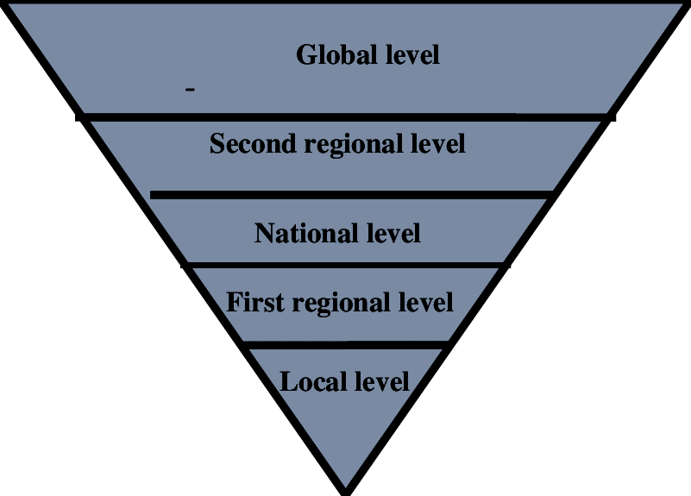
The Spectrum of Integration
Low integration: Preferential Access
→ Free Trade Area
→ Customs Union
→ Common Market
→ Economic Union
Source: Ionescu, V. R. (2020). Globalisation, Global Challenges and Global Chaos. The Need of a New Approach. Public Administration & Regional Studies, 13(1), 4-17.
High integration: Political Union

Slide 5
Key Terminology
Trade Agreement: A pact between countries on trade terms
Regional Integration: Process where neighboring states cooperate via common institutions/rules
WTO+: Provisions going beyond WTO commitments
WTO-X: Issues not covered by WTO (e.g., investment, competition policy)

Slide 6
Type 1 – Preferential Trade Agreement (PTA)
Section 2: Types of Economic Integration
Definition: Lower tariffs on certain products from certain countries
Not full free trade – selective reductions
Example: Global System of Trade Preferences (GSTP) among developing countries
Limitation: Complex and often limited impact

Slide 7
Type 2 – Free Trade Area (FTA)
Definition: Eliminate internal tariffs/quota; each country keeps its own external tariff
Key feature: Rules of Origin (RoO) to prevent trade deflection
Examples: USMCA (NAFTA successor), AFTA (ASEAN)
Challenge: “Trade deflection” – goods enter via lowest external tariff country

Slide 8
Type 3 – Customs Union
Definition: FTA + Common External Tariff (CET) on non-members
Eliminates need for Rules of Origin internally
Examples: Mercosur (partial), EU’s original form (1968-1992)
Benefit: Simpler customs administration

Slide 9
Type 4 – Common Market
Definition: Customs Union + Free movement of factors of production (labor, capital)
Additional elements: Mutual recognition of qualifications, capital market integration
Examples: European Economic Area (EEA), early EU (1993 – Maastricht)
Challenge: Requires harmonized labor and business laws

Slide 10
Type 5 – Economic Union
Definition: Common Market + Harmonized economic policies (fiscal, monetary)
Shared currency possible (monetary union)
Examples: EU (Eurozone countries)
Requires: Central bank, budget coordination, transfer payments

Slide 11
Type 6 – Political Union
Definition: Complete integration – common government, parliament, military, foreign policy
Not yet fully achieved anywhere (EU is closest but still intergovernmental on key issues)
Example in progress: EU federalist aspirations
Historical example: United States after 1789

Slide 12
Visual Summary – Depth of Integration
Type | Internal Tariffs | Common External Tariff | Factor Mobility | Unified Policies
PTA | Partial | No | No | No
FTA | Yes | No | No | No
Customs Union | Yes | Yes | No | No
Common Market | Yes | Yes | Yes | No
Economic Union | Yes | Yes | Yes | Partial
Political Union | Yes | Yes | Yes | Full

Slide 13
Why Not Just Jump to Political Union?
Loss of national sovereignty is politically difficult
Requires similar income levels and business cycles
Need for fiscal transfers (rich to poor regions)
Cultural and language barriers
Democratic accountability concerns

Slide 14
Regional Integration in the World
European Union (EU),
EurAsian Economic Union (EAEU),
United States-Mexico-Canada Agreement (USMCA)
Association of Southeast Asian Nations (ASEAN),
Southern Common Market (MERCOSUR),
African Continental Free Trade Area (AfCFTA),
Gulf Cooperation Council (GCC),
South Asian Association for Regional Cooperation (SAARC)

Slide 15
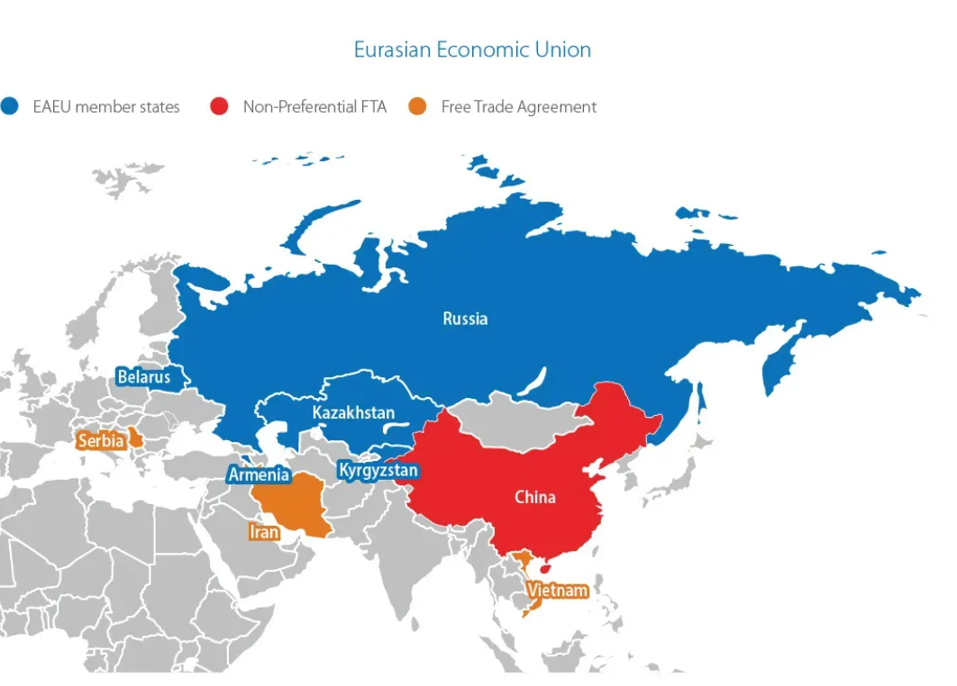
Checkpoint – Activity
Question: Which type of integration is the Eurasian Economic Union (EAEU) officially?
Answer: Customs Union + some common market elements – officially an Economic Union, but incomplete)
Source: India Briefing from Dezan Shira Associates
https://www.india-briefing.com/news/india-expands-industrial-cooperation-with-the-eurasian-economic-union-29472.html/

Slide 16
Section 3: Trade Creation vs. Trade Diversion
The Core Welfare Question
Integration is not automatically good – depends on whether it creates or diverts trade
Introduced by Jacob Viner (1950)

Slide 17
Trade Creation (Good)
Definition: High-cost domestic production replaced by lower-cost partner production
Result: More efficient resource allocation → world welfare ↑
Example: Germany buys wine from France (low cost) instead of making poor wine in greenhouses

Slide 18
Trade Diversion (Potentially Bad)
Definition: Low-cost world producer replaced by higher-cost partner producer due to tariff preferences
Result: Less efficient allocation → world welfare ↓ (though member gains)
Example: UK joins EU – stops buying cheap bananas from Central America, buys more expensive Greek bananas (tariff-free inside EU)

Slide 19
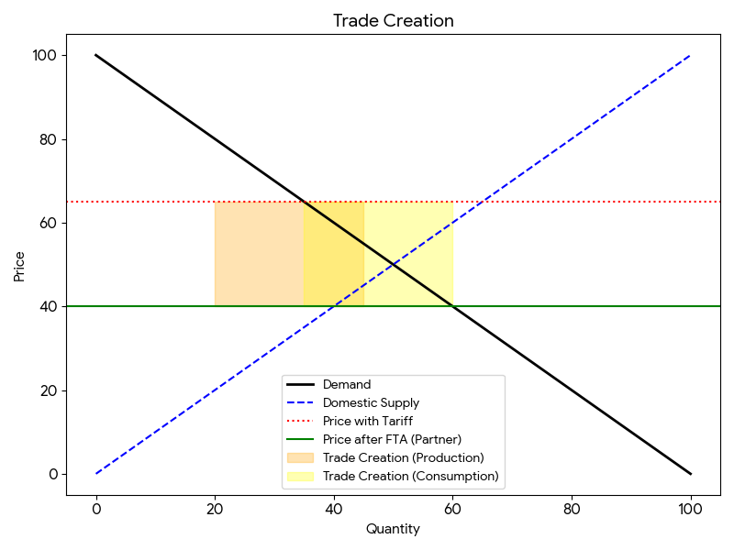
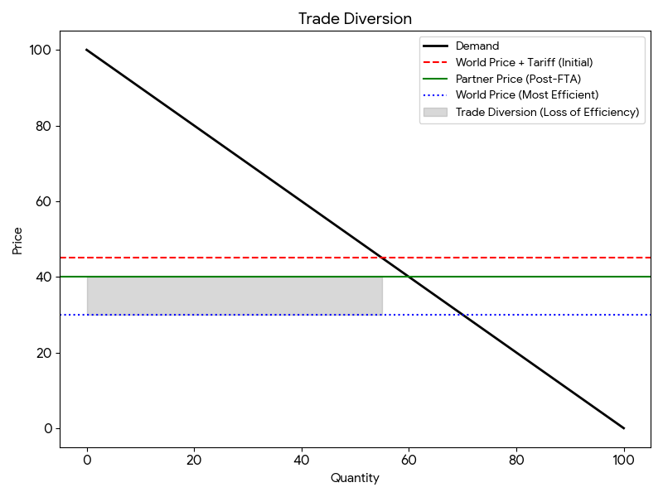
Visual Comparison
Figure 1: Trade Creation
Figure 2: Trade Diversion
Source: Created by the author
Source: Created by the author

Slide 20
Net Effect on a Country
Determinants of net gain:
  High pre-integration external tariffs (more to gain)
  Similar cost structures among partners (less diversion risk)
  Geographic proximity (lower transport costs)
Empirical finding: Most FTAs are net trade-creating, but some sectors lose

Slide 21
Section 4: Rules of Origin (RoO)
What Are Rules of Origin?
Definition: Criteria to determine the “nationality” of a product in an FTA
Why needed? Without RoO, non-members could ship goods via the lowest-tariff member country (trade deflection)

Slide 22
Types of Rules of Origin
Wholly obtained: Agricultural products, minerals (100% from within FTA)
Substantial transformation: Change in tariff classification (CTH – Change in Tariff Heading)
Value-added rule: Minimum % of regional value content (e.g., 40% from FTA)
Specific processes: “Yarn forward” rule in textiles

Slide 23
The “Spaghetti Bowl” Effect
Problem: Multiple overlapping FTAs with different RoO → high compliance cost
Example: A car part may need different RoO for USMCA vs. EU-Japan FTA
Solution: Cumulation (diagonal or full cumulation across agreements)

Slide 24
Costs and Benefits of RoO
Benefits | Costs
Prevents trade deflection | Administrative burden
Protects sensitive domestic industries | Discourages use of FTA preferences
Encourages local supply chains | Creates compliance costs for SMEs

Slide 25
Real-World Example – USMCA Auto RoO
USMCA (2020) increased Regional Value Content (RVC) for autos:
  75% (up from 62.5% in NAFTA)
  70% steel/aluminum must be North American
  40-45% of auto content from high-wage ($16/hr) labor
Purpose: Force auto production back to North America

Slide 26
Deep vs. Shallow Agreements
Definition
Shallow agreements: Only tariffs and quotas
Deep agreements: Tariffs + behind-the-border policies
  Investment, competition policy, labor standards, environmental rules, IPR, digital trade, regulatory coherence

Slide 27
The Deepening Trend
1950s-80s: Shallow FTAs (goods only)
1990s-2000s: Added services, investment, IP (WTO+)
2010s+: Deep integration (regulatory alignment, e-commerce, state-owned enterprises)

Slide 28
Examples of Deep Provisions
Regulatory coherence: Mutual recognition of standards
Labor & environment: Enforceable chapters (e.g., USMCA)
E-commerce & data flows: No data localization
Competition policy: Anti-trust cooperation
State-owned enterprises (SOEs): Disciplines on subsidies

Slide 29
Why Deep Integration Matters
Modern trade is in tasks, not just goods (global value chains)
Non-tariff measures (NTMs) are now bigger barriers than tariffs
Deep agreements raise FDI by 20-40% (World Bank study)
Downside: Greater sovereignty loss → political backlash

Slide 30
Shallow vs. Deep – Comparison
Aspect | Shallow | Deep
Focus | Border measures | Behind-the-border
Sovereignty loss | Low | High
Enforcement | Tariff reduction only | Strong dispute settlement
Impact on trade | Moderate | Large (especially services)
Example | GATT-era, early FTAs | CPTPP, EU Single Market

Slide 31
Section 6: Case Study 1 – European Union
EU – The Most Integrated Bloc
Started 1951: ECSC (coal & steel)
1957: Treaty of Rome (Common Market)
1993: Single Market (4 freedoms)
1999: Euro (monetary union)
Current: Economic union + political integration elements

Slide 32
EU’s Deep Integration Features
Customs Union + Common Market + Monetary Union (Eurozone)
Supranational institutions: Commission, Parliament, Court of Justice
Harmonized regulations (CE marking, food safety)
Schengen area (no internal border controls)
Common agricultural and trade policy

Slide 33
Trade Creation vs. Diversion in EU
Trade creation: Massive intra-EU trade ↑ from 40% to 60%+ of total
Trade diversion: Common External Tariff hurt some non-members (e.g., Turkey, Morocco)
Net effect: Strongly positive for members, mixed for outsiders

Slide 34
Rules of Origin in EU
Preferential RoO for FTAs with non-EU countries
Pan-Euro-Med cumulation zone – diagonal cumulation with Morocco, Tunisia, etc.
New 2021 RoO: More flexible, allows value-added from cumulation
Internal EU: No RoO within Single Market

Slide 35
Challenges to EU Model
Brexit (2016-2020) – sovereignty concerns
Asymmetric shocks (Eurozone debt crisis)
Migration disputes (common market vs. national control)
Regional disparities (North vs. South)

Slide 36
Section 7: Case Study 2 – Eurasian Economic Union
EAEU – Overview
Founded: 2015 (Belarus, Kazakhstan, Russia, Armenia, Kyrgyzstan)
Predecessor: Customs Union (2010)
Population: ~183 million
GDP: ~$2.5 trillion (PPP)
Goal: Deep integration but less supranational than EU

Slide 37
Level of Integration
Officially: Economic Union (beyond Customs Union but short of Common Market)
Achieved: FTA + CET + common competition rules + labor mobility (common market for workers)
Not fully achieved: Single energy market (target 2025), common financial market
Institutions: Eurasian Economic Commission (supranational, but weak)

Slide 38
Trade Creation and RoO in EAEU
Trade creation: Intra-EAEU trade grew post-2015, but heavily oil-dependent
Trade diversion: Western sanctions on Russia → diverted trade to China, but EAEU preferences limited effect
RoO: Common rules (non-preferential for third countries); preferential RoO for FTAs (Vietnam, Iran, etc.)

Slide 39
EAEU vs. EU – Key Differences
Feature | EU | EAEU
Supranational power | High | Low
Common currency | Yes (Eurozone) | No
Labor mobility | Full | Yes (workers)
Political integration | Aspirational | Minimal
External influence | Democratic institutions | Russia-led

Slide 40
Conclusion and Key Takeaways
Spectrum matters: FTA to Political Union – each has trade-offs
Not all integration is welfare-improving: Watch for trade diversion
RoO are necessary but costly – they shape supply chains
Deep agreements drive modern trade but require regulatory sacrifice
EU remains the gold standard for deep integration
EAEU is a newer, less integrated model with political constraints
Future trend: More mega-regionals (AfCFTA, RCEP), digital trade, climate provisions

Slide 41
References
Ionescu, V. R. (2020). Globalisation, Global Challenges and Global Chaos. The Need of a New Approach. Public Administration & Regional Studies, 13(1),
Viner, J. (1950). The Customs Union Issue. Carnegie Endowment for International Peace.
World Bank. (2021). Deep Trade Agreements and Foreign Direct Investment. World Bank Publications.
Baldwin, R. (2016). The Great Convergence: Information Technology and the New Globalization. Harvard University Press.
Dezan Shira & Associates. (2023). India Expands Industrial Cooperation with the Eurasian Economic Union. India Briefing. Retrieved from https://www.india-briefing.com
European Commission. (2021). Rules of Origin for Preferential Trade Agreements: Pan-Euro-Mediterranean Cumulation Zone. Directorate-General for Trade.

Slide 42
Thank you!

