Slide 1
International Trade and Policy
WEEK 9 – Strategic Trade Policy and Global Oligopolies
University: Tajik State University of Commerce
Lecturer: Abduvaliev Mubinzhon, PhD

Slide 2
Agenda
Part 1: Foundations of Strategic Trade Policy
Part 2: Global Oligopolies & Game Theory
Part 3: The Boeing-Airbus Case Study
Part 4: Subsidies, R&D, and Open Economy Implications
Part 5: WTO Rules and Subsidy Disputes
Part 6: Conclusions & Policy Debates

Slide 3
What is Strategic Trade Policy?
Definition: Government policies designed to shift economic rents from foreign to domestic firms in imperfectly competitive global markets.
Key departure from traditional trade theory (comparative advantage).
Focus on oligopolistic industries (high barriers, few firms, supernormal profits).

Slide 4
The Traditional View vs. Strategic View
Feature | Traditional (Smith/Ricardo) | Strategic (Brander & Spencer)
Market Structure | Perfect Competition: Many small firms, no one controls the price. | Oligopoly: A few giant firms dominate (e.g., Boeing vs. Airbus).
Core Assumption | Markets are self-correcting and inherently efficient. | Markets are imperfect; firms have "market power" and earn excess profits (rents).
Government Role | Laissez-faire: Hands-off approach; intervention causes "deadweight loss." | Active Partner: Intervention (subsidies) can shift profits from foreign firms to domestic ones.
Policy Goal | Maximize global efficiency and consumer surplus. | Profit Shifting: Capturing a larger slice of the global "profit pie."

Slide 5
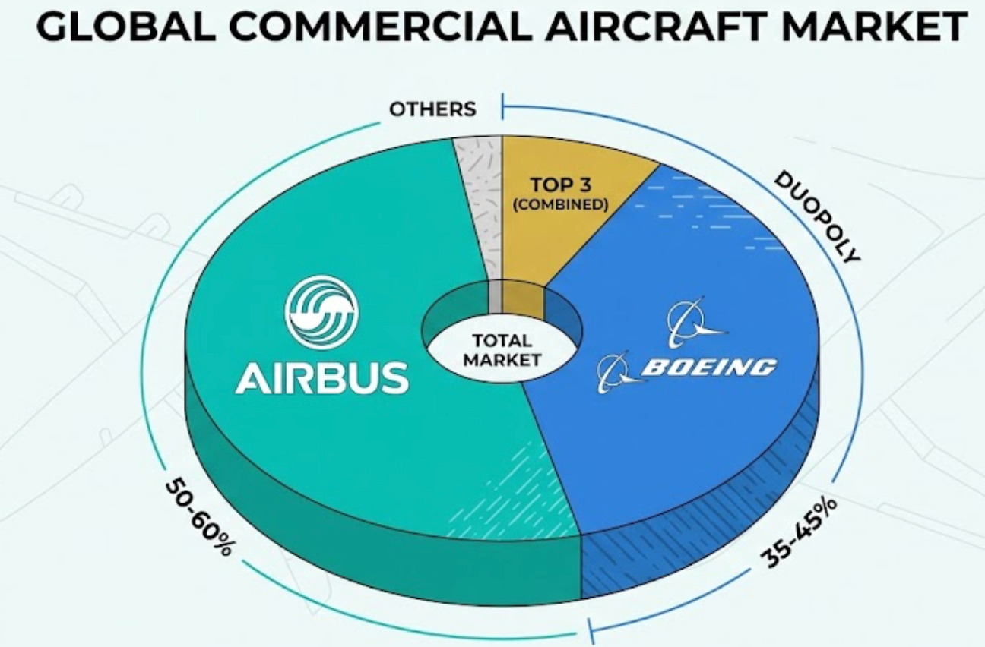
Why Global Oligopolies Matter
Figure 1. Global commercial aircraft market
Industries: Aerospace, semiconductors, automobiles, pharmaceuticals.
Characteristics:
  High fixed costs & economies of scale.
  Significant R&D intensity.
  Strategic interdependence (firms react to rivals).
Source: Created by the author

Slide 6
Key Economic Rents
Definition: Profits exceeding normal returns (above competitive level).
In oligopolies, rents exist due to barriers to entry.
Strategic trade policy aims to shift rents from foreign firms to domestic firms (and domestic taxpayers/workers).

Slide 7
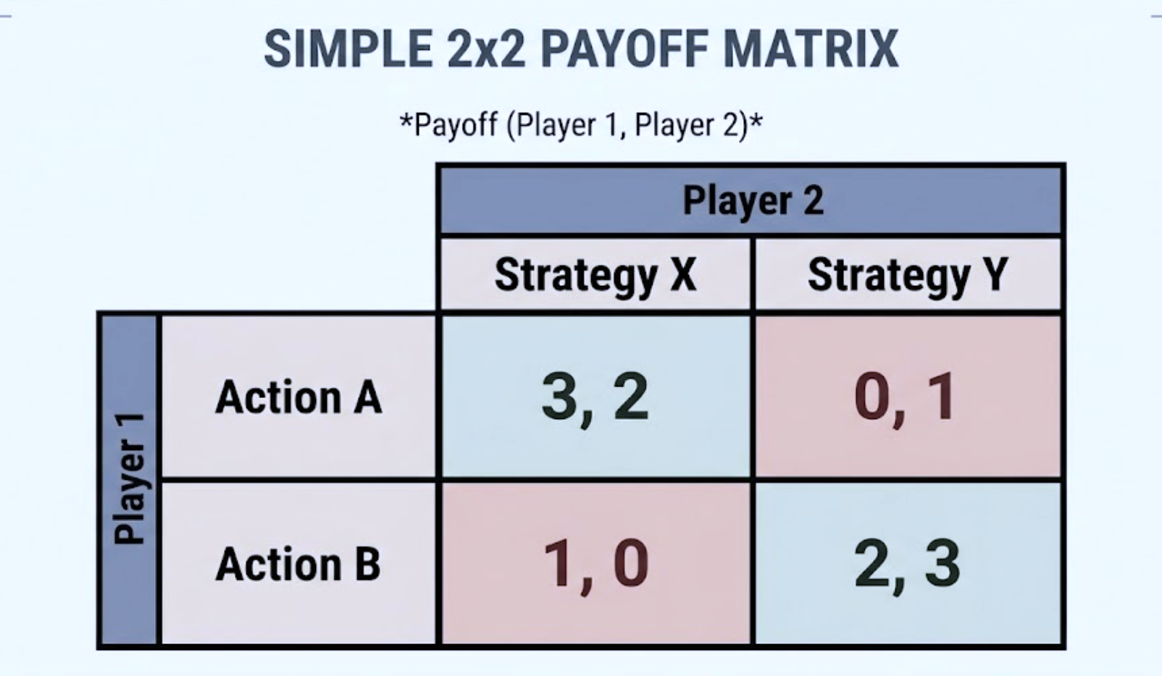
Section 2: Game Theory Foundations
Strategic Interactions as a Game
Players: Two firms (e.g., Boeing & Airbus) or two governments.
Strategies: Produce high output, invest in R&D, set prices.
Payoffs: Profits (rents).
Source: Created by the author

Slide 8
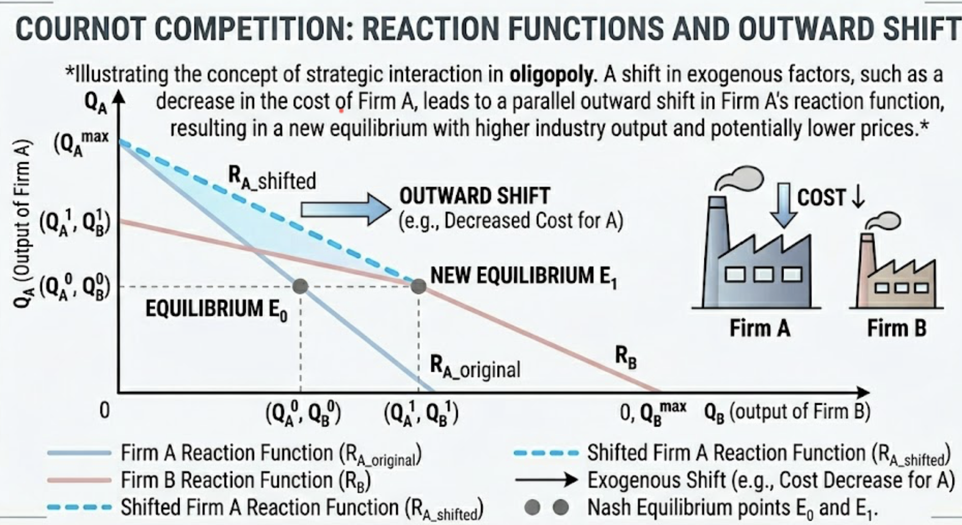
The Brander-Spencer Model (1985) – Third-Country Market
Figure 2: Strategic Trade Subsidy and the Outward Shift of the Domestic Reaction Function in Cournot Duopoly
Source: Created by the author

Slide 9
First-Mover Advantage & Credible Commitments
Government acts as a strategic leader.
Subsidy makes domestic firm’s aggressive output strategy credible.
Analogous to “puppy dog” (strategic retreat) vs. “top dog” (strategic aggression) – Fudenberg & Tirole.

Slide 10
Limitations of the Simple Model
Requires government to commit before firms choose output.
Assumes perfect information about demand and costs.
Risk of retaliation (trade wars).
Rent-seeking: Firms may lobby for subsidies without delivering rents.

Slide 11
Summary of Theoretical Insights
Subsidies can raise national welfare if:
  Rents are large.
  Rival does not retaliate effectively.
  Domestic firm’s gains exceed subsidy cost.
But: Globally, subsidies are beggar-thy-neighbour.

Slide 12
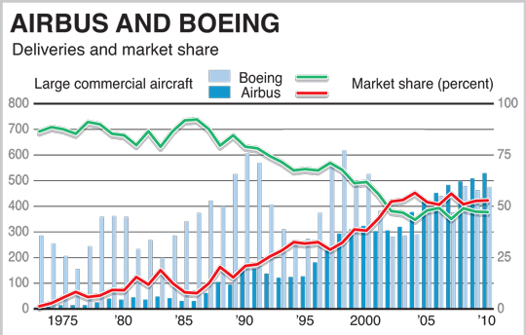
Section 3: The Boeing-Airbus Case Study
Introduction to the Duopoly
Figure 3. Airbus and Boeing: Deliverables and market share
Commercial aircraft: High fixed costs (~$15B for new airframe).
High barriers to entry.
Since 1990s: A near-perfect duopoly (Boeing vs. Airbus).
Source: Hobert Haupt, 2012

Slide 13
Early Years – Boeing Dominance
1950s-1970s: Boeing (US) dominant, with McDonnell Douglas.
European governments wanted a challenger.
1970: Airbus Industrie founded as a consortium (France, Germany, Spain, UK).

Slide 14
Launch Aid – The First Major Subsidies
European governments provided “launch aid” (repayable loans with low interest, long maturity).
Total to Airbus (1970-2000): ~$15 billion (estimated subsidy element ~30-40%).
Effect: Allowed Airbus to develop A300, A320, A330/340 families.

Slide 15
US Response – Indirect Subsidies
Boeing benefits from:
  NASA and Pentagon R&D spillovers (e.g., composite materials, aerodynamics).
  Federal tax breaks (Foreign Sales Corporation, later various manufacturing deductions).
  State-level incentives (Washington, South Carolina).
US estimated value: ~$23 billion (1992-2000).

Slide 16
The 1992 Bilateral Agreement
US-EU agreement to limit subsidies:
  Launch aid capped at 33% of development cost.
  Repayable with interest; maximum production-linked subsidies.
  Limited indirect support (e.g., NASA).

Slide 17
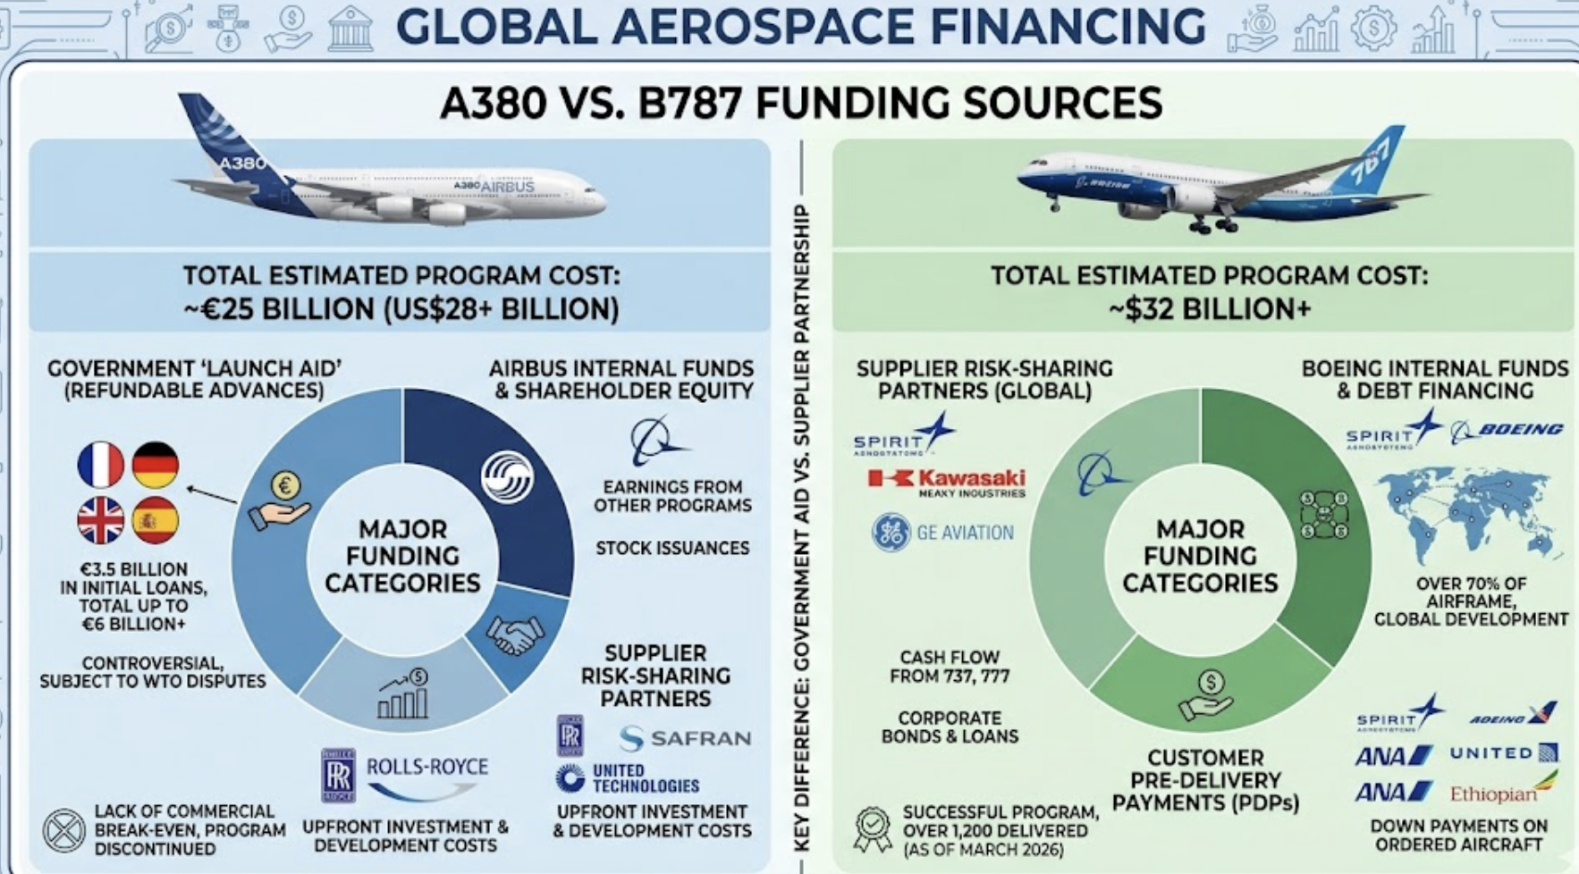
Escalation – The Superjumbos (2000s)
Figure 4. Global Aerospace Financing
Airbus launches A380 (2000): $12B development, heavy launch aid.
Boeing launches B787 Dreamliner (2004): tax breaks, state subsidies, R&D support.
Each accuses the other of violating 1992 agreement.
Source: Created by the author

Slide 18
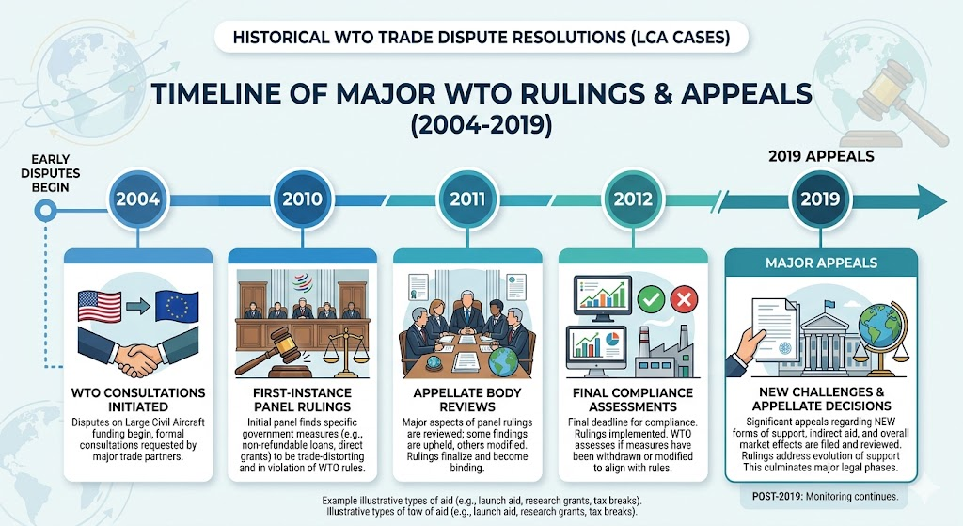
WTO Litigation (2004-2019)
Figure 5. Timeline of WTO ruling
US files WTO complaint (2004): EU launches aid illegal.
EU files counter-complaint: US tax breaks and NASA subsidies illegal.
Source: Created by the author

Slide 19
Key WTO Findings
Against EU: Launch aid for A350 and A380 were prohibited subsidies ($18B+).
Against US: Washington State tax incentives ($5.7B), R&D spillovers, and defense contracts were illegal subsidies.
Both authorized retaliatory tariffs (but settled in 2021).

Slide 20
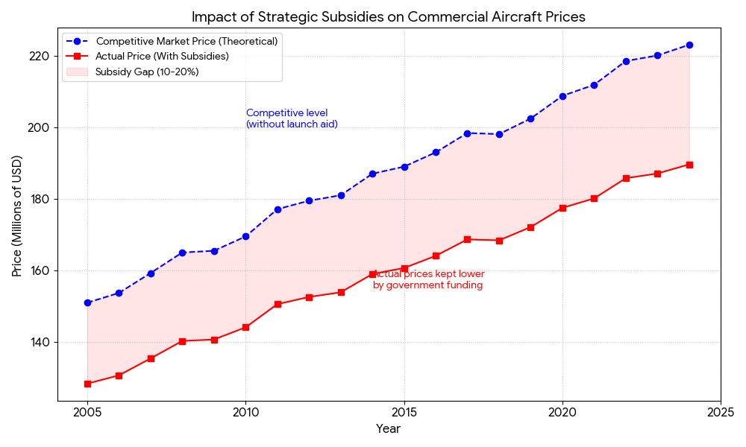
Figure 6. Comparative Analysis of Subsidised vs Competitive Aircraft Pricing (2005–2025)
Data Basis: Simulated trends based on WTO Dispute Settlement findings (Cases DS316 and DS353) regarding the Boeing-Airbus subsidy conflict.

Slide 21
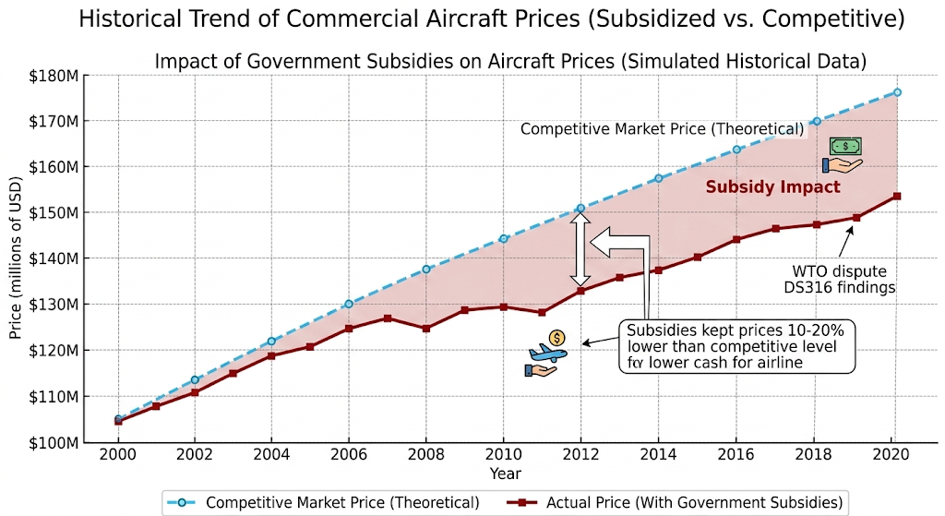
Figure 7. Economic Impact of the Subsidy War
Source: Compiled by the author based on price suppression data from Irwin and Pavcnik (2021) and findings of "serious prejudice" in WTO Disputes DS316 (Airbus) and DS353 (Boeing). Simulated trends assume a 10–20% deviation from competitive equilibrium consistent with WTO estimates of launch aid impact.

Slide 22
Lessons from Boeing-Airbus
Strategic trade policy works in shifting rents but triggers retaliation.
WTO system can manage but not eliminate subsidy competition.
Multiple instruments: R&D subsidies, production subsidies, tax breaks, procurement policies.

Slide 23
Subsidies and R&D Policy in Open Economies Beyond Production Subsidies – R&D Subsidies
R&D has positive spillovers (knowledge externalities).
- In closed economy: Underinvestment in R&D → case for subsidy.
- In open economy: R&D subsidy can also shift profits from foreign rivals (strategic effect).

Slide 24
Strategic R&D Policy (Spencer & Brander, 1983)
Two-stage game:
1. Governments choose R&D subsidies.
2. Firms choose R&D investment (cost reduction).
3. Firms compete in output market.
R&D subsidy commitment makes domestic firm more efficient, commits to aggressive output.

Slide 25
R&D Spillovers and Policy
If R&D spills over to foreign rival (knowledge leakage), domestic subsidy benefits foreign firm too.
- Policy implication: Need intellectual property protection (IPR) or targeted subsidies to prevent leakage.

Slide 26
Examples of Strategic R&D Policy
Semiconductors: EU Chips Act ($45B), US CHIPS Act ($52B) to compete with TSMC (Taiwan), Samsung (Korea).
Electric vehicles: US Inflation Reduction Act (domestic content requirements), China’s EV subsidies.
Pharmaceuticals: Orphan drug credits, R&D tax credits

Slide 27
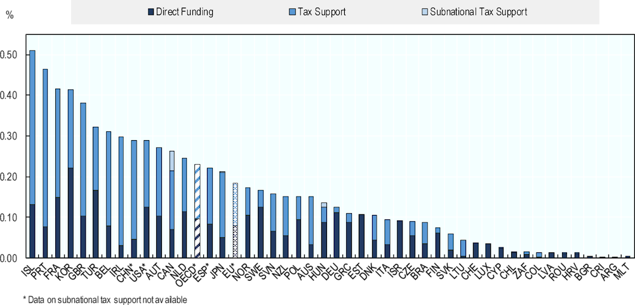
Open Economy Complications – Capital Mobility
Figure 8. Direct government funding and expenditure-based tax support for business R&D (BERD), 2023
Multinational firms can shift production to the location with the lowest subsidies/taxes.
Governments may engage in “subsidy competition” for FDI
Source: OECD (2025), R&D Tax Incentive Database, http://oe.cd/rdtax October 2025, (accessed in October 2025).

Slide 28
The Race to the Bottom vs. Strategic Targeting
General subsidies to all industries → wasteful competition.
- Strategic targeting: Only high-rent, oligopolistic industries (aircraft, chips, AI).
- But: Political economy leads to “strategic” subsidies for agriculture, steel (low rents) → inefficiency

Slide 29
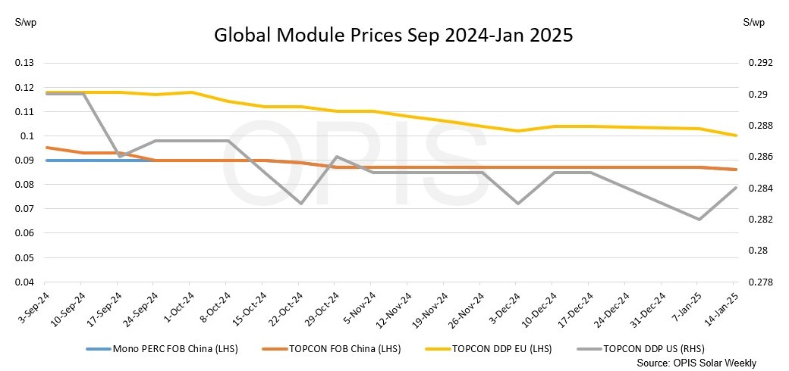
Case – Solar Panels (China vs. EU/US)
Figure 9. Global Modules Priced, 2024-2025
China’s massive production subsidies (loans, land, electricity) → global oversupply → price collapse.
EU/US countervailing duties.
Result: Rent-shifting succeeded (China >80% global market), but global welfare loss due to overcapacity.
Source: pv-magazine. (2025, January 17). Global solar module prices mixed on varying demand expectations. https://www.pv-magazine.com/2025/01/17/global-solar-module-prices-mixed-on-varying-demand-expectations/

Slide 30
Optimal Policy in Open Oligopolies
No single best policy. Depends on:
- Degree of competition.
- Cross-country spillovers.
- Ability to tax foreign profits.
- General principle: Production subsidies > R&D subsidies > Investment subsidies (depending on spillovers).

Slide 31
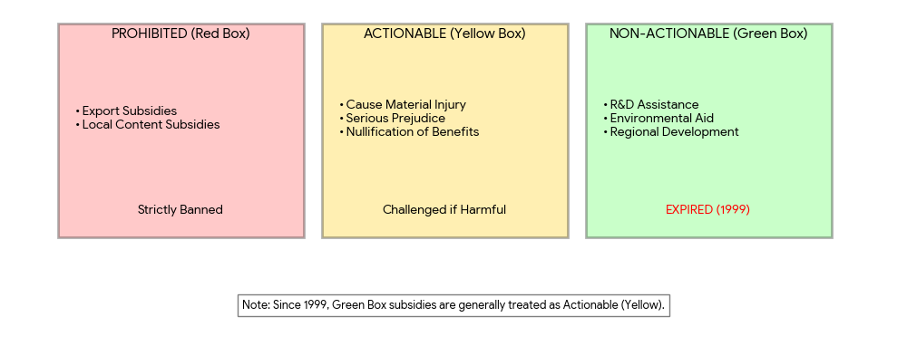
Section 5: WTO and Subsidy Disputes
WTO Subsidies and Countervailing Measures Agreement
Source: Created by the author

Slide 32
How to Challenge a Subsidy at WTO
Routes:
1. Multilateral dispute settlement (state-to-state).
2. Unilateral countervailing duty (CVD) investigation (must show injury).

Slide 33
Major Subsidy Disputes (post-2000)
Boeing-Airbus (DS316, DS353)
- Civil aircraft (Bombardier vs. Boeing – CSeries)
- Large civil aircraft (A380)
- Renewable energy (China – wind/solar equipment)
- Digital services taxes (not subsidies but related)

Slide 34
The Problem of “Informal” Subsidies
Not all subsidies are direct cash grants.
- Examples found illegal:
- Below-market loans (Airbus).
- Tax exemptions contingent on exports (FSC).
- State-owned bank lending at non-commercial rates (China).
- Difficult to prove “specificity” (i.e., subsidy targeted to a firm/industry).

Slide 35
WTO Reform and Subsidies
Current challenges:
- Industrial policy resurgence (US CHIPS, EU Green Deal, China Made 2025).
- Appellate Body non-functional (since 2019).
- Proposals: Expand prohibited list (subsidies to overcapacity), new rules for state-owned enterprises.

Slide 36
Effectiveness of WTO in Managing Subsidy Wars
Pros:
Provides a legal framework, transparency, and limits on retaliation.
Cons:
Slow (5-10 years), weak remedies (retaliation harms both sides), cannot stop domestic political pressures for subsidies.
Verdict:
WTO reduces but does not eliminate strategic trade policy.

Slide 37
Section 6: Conclusions & Policy Debates
Conditions:
- High concentration (duopoly/oligopoly).
- Significant scale economies.
- Large initial rents.
- Low risk of retaliation or retaliation is ineffective.
- Credible government commitment (no rent capture).

Slide 38
The Case Against Strategic Trade Policy
Information requirements (governments seldom know true rent/payoff matrix).
- Retaliation leads to trade wars (negative sum).
- Domestic political capture (lobbying for subsidies in non-strategic industries).
- Global welfare loss due to resource misallocation.

Slide 39
The Future – Strategic Competition vs. Rules-Based System
Rise of “geoeconomics”: Subsidies as tools of great power competition (US-China, US-EU).
- Will WTO rules survive?
- Possible equilibrium: Subsidies for green tech, AI, semiconductors – but constrained by fear of retaliation.

Slide 40
Key Takeaways
Strategic trade policy can shift rents in global oligopolies.
- Boeing-Airbus: Classic case of subsidy war that yielded mixed results.
- R&D subsidies are powerful but spillovers complicate policy.
- WTO provides a weak but useful disciplining mechanism.
- Policy debate remains unresolved: efficiency vs. strategic advantage.

Slide 41
Discussion Questions
1. Should the US subsidize Intel to compete with TSMC (Taiwan Semiconductor Manufacturing Company Limited)? Why or why not?
2. Was the EU’s launch aid for Airbus a success despite WTO losses?
3. Can the WTO survive the new era of industrial policy?

Slide 42
References
1. Brander, J. A., and Spencer, B. J. (1985). Export subsidies and international market share rivalry. Journal of International Economics, 18(1–2), 83–100.
2. Spencer, B. J., and Brander, J. A. (1983). International R&D rivalry and industrial strategy. Review of Economic Studies, 50(4), 707–722.
3. Krugman, P. R. (1987). Is free trade passé? Journal of Economic Perspectives, 1(2), 131–144.
4. Eaton, J., and Grossman, G. M. (1986). Optimal trade and industrial policy under oligopoly. Quarterly Journal of Economics, 101(2), 383–406.
5. Helpman, E., and Krugman, P. R. (1989). Trade policy and market structure. MIT Press.
6. World Trade Organization. (2022). World Trade Report 2022: Climate change and international trade. WTO Publications.

Slide 43
Thank you!

