Slide 1
International Trade and Policy
WEEK 10 – Factor Mobility and Global Value Chains / Midterm Exam II
University: Tajik State University of Commerce
Lecturer: Abduvaliev Mubinzhon, PhD

Slide 2
Midterm Exam II – What to Expect
Topics Covered:
  International labor mobility & migration
  Foreign Direct Investment (FDI)
  Outsourcing vs. Offshoring
  Fragmentation of production
  Trade in tasks

Slide 3
Key Concept – Global Value Chains (GVCs)
Definition: Movement of factors of production (labor, capital) across international borders
Two types:
  Labor mobility – people moving (migration)
  Capital mobility – FDI (physical capital & technology)
Why does it matter? → Affects wages, returns to capital, income distribution, and global production efficiency

Slide 4
Key Concept – Global Value Chains (GVCs)
Definition: Full range of activities (design, production, marketing, distribution) across multiple countries
GVCs rely on fragmentation and trade in tasks
Examples: iPhone (designed in US, components from Korea/Japan, assembled in China)

Slide 5
Exam Tip – Connecting Factor Mobility to GVCs
Simple logic: Factor mobility enables GVCs.
  Labor moves → fills skill gaps abroad
  Capital (FDI) moves → builds factories near low-cost labor
  Fragmentation → splits production across borders
  Trade in tasks → you don’t trade goods, you trade value-added activities

Slide 6
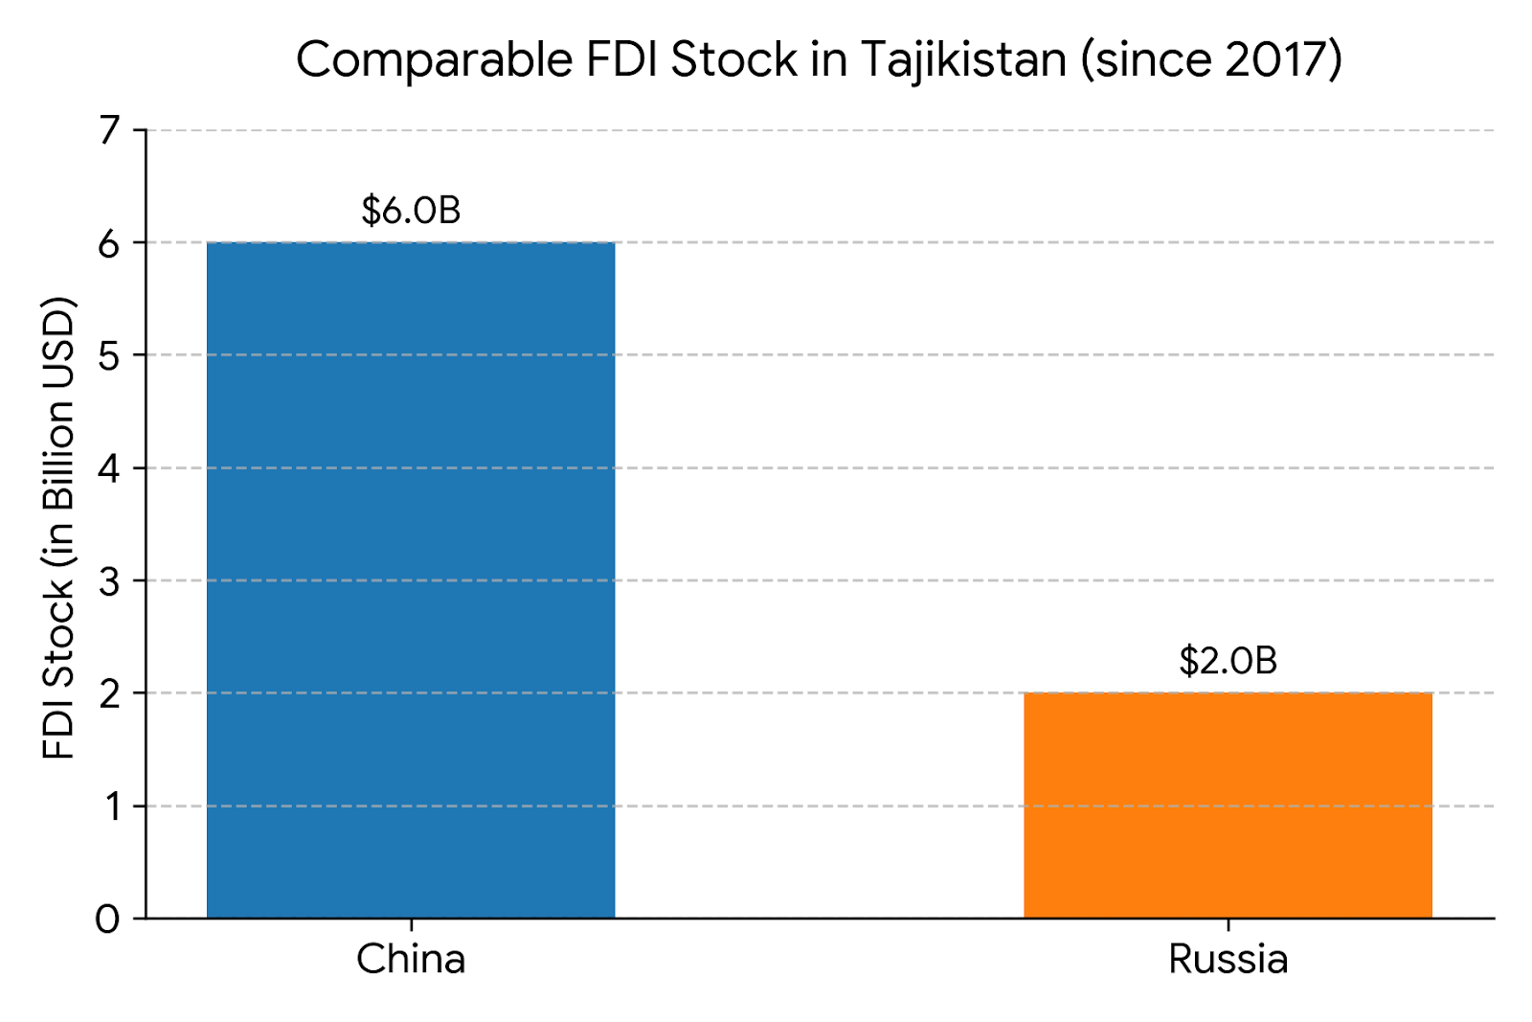
PART II: INTERNATIONAL LABOR MOBILITY & MIGRATION
International Labor Mobility – Basics
Case Study 1 – FDI in Tajikistan: The Rise of China
Driven by a cumulative foreign direct investment stock of nearly $6 billion since 2017 that heavily eclipses Russia's $2 billion footprint, China surpassed Russia as Tajikistan's primary trading partner in 2025 for the first time in over two decades, with bilateral trade reaching $4.3 billion and expanding by 50% year-on-year in the first quarter of 2026.
Source: China and Central Asia Studies Centre, 2025

Slide 7
Case Study 1 – FDI in Tajikistan: Sectors & Mechanisms
Top FDI Sectors (2024 data):
Sector | Key Features
Critical Minerals | Antimony, gold, lithium, tungsten – clean energy supply chains
Infrastructure | Dushanbe-China highway, border posts, energy projects
Digital/AI | Tajik-China Digital Business Connect – $647 million in deals
Agriculture & Processing | Import substitution, new jobs

Slide 8
Case Study 2 – Migration from Tajikistan: Scale & Dependency
Central Asian Countries personal remittances, received (% of GDP), 2005-2022
Source: Author calculation based on the World Development Indicator, 2023 data

Slide 9
PART IV: INTERNATIONAL LABOR MOBILITY & MIGRATION
International Labor Mobility – Basics
Movement of workers from home country (source) to host country (destination)
Push factors: low wages, unemployment, political instability
Pull factors: higher wages, better opportunities, family networks

Slide 10
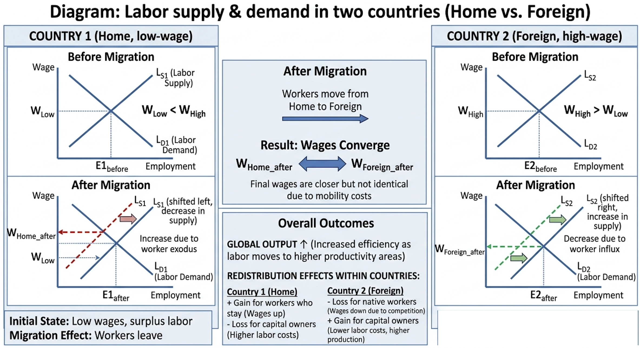
Figure. 1: Economic Effects – A Simple Model
Source: Created by the author

Slide 11
Winners and Losers from Migration
Host country:
  Winners: Firms (lower labor costs), complementary workers
  Losers: Competing domestic workers (wage ↓)
Source country:
  Winners: Remittances, returning migrants with skills
  Losers: Labor shortage, brain drain

Slide 12
Brain-drain vs. Brain-gain
Brain drain: Loss of skilled workers (doctors, engineers) from poor countries
Brain gain: Diaspora networks send back knowledge, investment, and trade links
Exam focus: The “new economics of migration” – remittances reduce poverty more than aid

Slide 13
Policy & Restrictions
Immigration quotas, skill-based points systems (Canada, Australia)
Guest worker programs (Gulf States, EU Blue Card)
Economic impact of restrictions: Creates inefficiency, underground labor markets, misallocation of talent

Slide 14
Exam Questions – Labor Mobility
Show wage convergence using supply-demand graphs.
Explain why migration benefits global GDP but creates winners/losers.
Define brain drain and give one real-world example.

Slide 15
PART III: FOREIGN DIRECT INVESTMENT (FDI)
FDI vs. Portfolio Investment
FDI: Investment to acquire lasting interest (≥10% ownership) and control in a foreign firm
  Greenfield – build new factory
  Brownfield – acquire or merge with existing firm
Portfolio investment: Purchase of stocks/bonds without control

Slide 16
Motivations for FDI
Market-seeking – access large consumer markets (avoid tariffs)
Resource-seeking – natural resources, cheap labor
Efficiency-seeking – reduce costs by locating production optimally
Strategic asset-seeking – technology, brands, R&D

Slide 17
Horizontal vs. Vertical FDI
Horizontal FDI: Same production activities in multiple countries (e.g., Toyota makes cars in US & Japan) – market seeking
Vertical FDI: Different stages of production across countries (e.g., US designs chips, Taiwan fabricates) – efficiency seeking

Slide 18
OLI Eclectic Paradigm (Dunning) – Exam Favorite
Ownership advantage (firm-specific asset: tech, brand)
Location advantage (host country: labor, infrastructure, policy)
Internalisation advantage (keep within the firm rather than license)
FDI occurs only when O + L + I are present.

Slide 19
Effects of FDI on Host & Home Countries
Country Type | Core Benefits (Pros) | Core Costs (Cons)
Host Country (Recipient) | • Technology & Capital Inflow • Job Creation • Spillover Efficiency | • Crowding out local firms • Profit repatriation outflow • Potential loss of sovereignty
Home Country (Investor) | • Profit & Dividend Repatriation • Lower-cost inputs • Reverse technology learning | • Short-term capital outflow • Domestic job displacement • Forgone domestic investment

Slide 20
Exam Questions – FDI
Distinguish horizontal vs. vertical FDI with an example.
Apply OLI framework to explain why Tesla builds a factory in Germany.
Discuss one positive and one negative effect of FDI for a developing country.

Slide 21
PART IV: OUTSOURCING, OFFSHORING & FRAGMENTATION
Key Definitions – Don’t Confuse!
Outsourcing: Contracting tasks to an external firm (domestic or foreign)
Offshoring: Moving activities abroad (can be in-house subsidiary or outsourced)
Key point: Outsourcing = make-or-buy decision; Offshoring = location decision

Slide 22
The Offshoring Decision – Cost vs. Risk
Benefits: Lower wages, taxes, regulations
Costs: Coordination, transport, intellectual property risk, political risk
Trade-off: Cheaper labor vs. longer supply chains

Slide 23
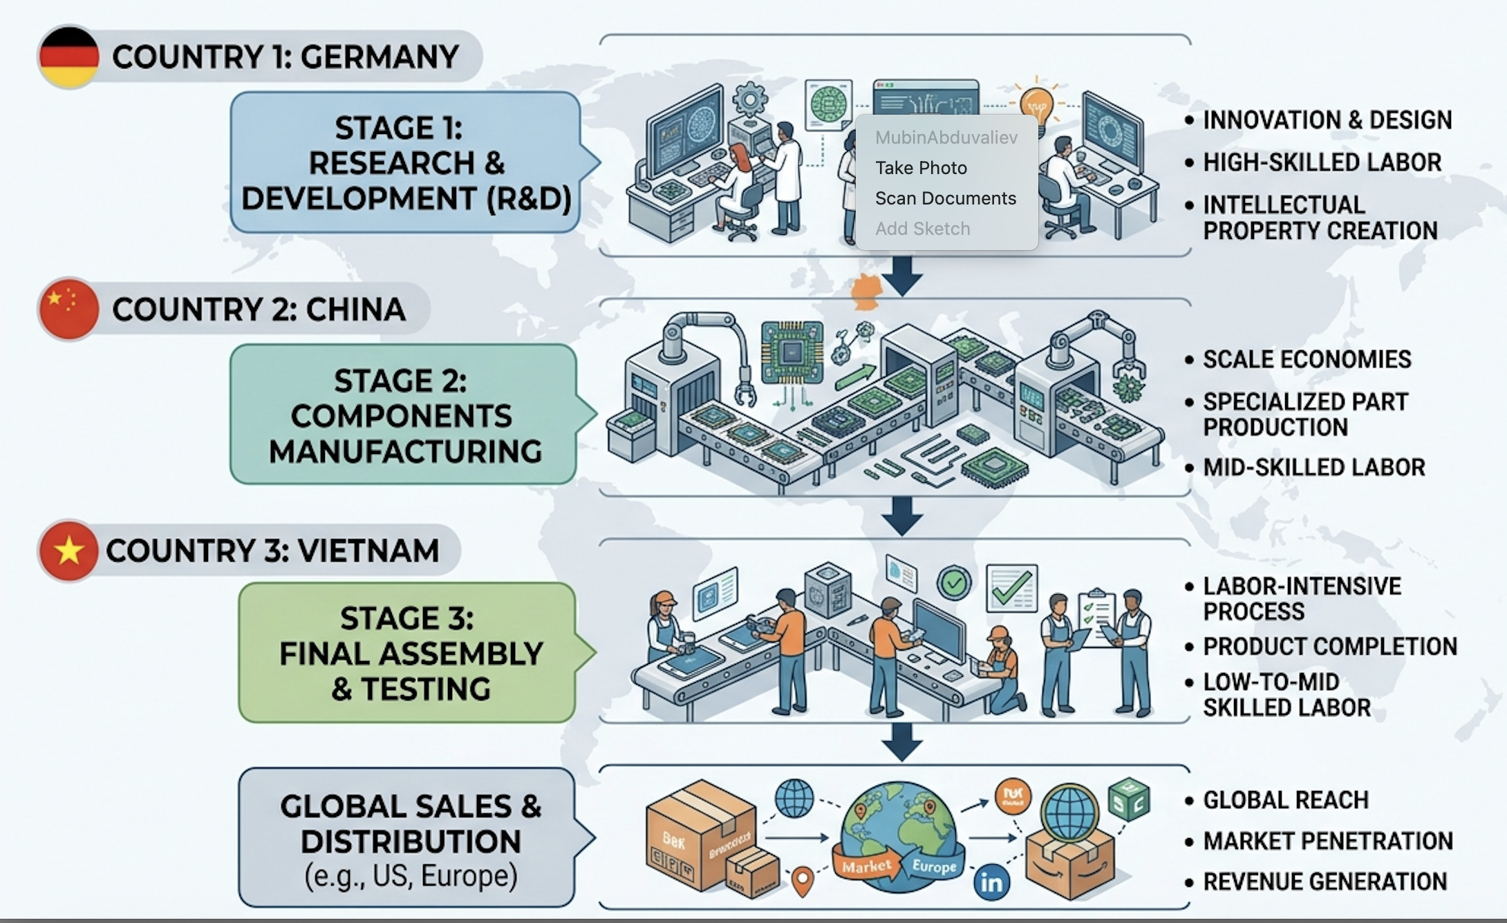
Figure 2. Global value chains: Deconstructed production process
Fragmentation of Production
Source: Created by the author

Slide 24
Why Fragmentation Happens
Technological progress (ICT, container shipping)
Liberal trade & investment policies
Wage differentials across countries
Modular design (products easily split into tasks)

Slide 25
Trade in Tasks (Richard Baldwin, Grossman & Rossi-Hansberg)
Old view: Countries trade goods.
New view: Countries trade tasks (value chain stages).
Example: Call centers, software coding, design, assembly – each "task" is traded globally
Implication: Tasks, not industries, define competitiveness

Slide 26



Real-World Examples of Fragmentation
Electronics: Apple – design CA, chips Taiwan, assembly China, final sales global
Automotive: BMW – engines Germany, wiring Poland, assembly US & China
Clothing: Design Italy, fabric China, sewing Bangladesh, labels Portugal

Slide 27
Risks of Fragmented GVCs
Supply chain disruptions (COVID-19, Suez Canal blockage)
Geopolitical tensions (US-China decoupling)
Loss of domestic industrial base
Response: Reshoring, nearshoring, friend-shoring

Slide 28
Exam Questions – Outsourcing & Fragmentation
Differentiate offshoring from outsourcing using real firms.
Explain how fragmentation changes the pattern of trade.
Draw a fragmented production chain and label each country’s task.

Slide 29
PART V: SYNTHESIS & EXAM PREPARATION
Connecting All Concepts – The Big Picture
Labor mobility supplies workers to GVC nodes
FDI provides capital & control to build offshore facilities
Outsourcing/offshoring operationalize fragmentation
Trade in tasks is the unit of analysis for GVCs

Slide 30
Review Table – Key Terms
Term | Definition | Example
Labor mobility | Workers cross borders | Mexican farmworkers in US
FDI | Control investment abroad | Toyota plant in Kentucky
Offshoring | Move activity abroad | Call center to India
Fragmentation | Split production stages | iPhone supply chain
Trade in tasks | Buy/sell value chain steps | US design, China assembly

Slide 31
Possible Diagrams for Exam (Draw These!)
Labor migration: Two-country wage convergence graph
FDI: OLI triangle (Ownership, Location, Internalization)
Fragmentation: Smiley curve (value added per stage)
Trade in tasks: Task trade vs. goods trade comparison table

Slide 32
Sample Short Answer Question 1
Question: “Using the OLI paradigm, explain why a pharmaceutical company from Switzerland opens an R&D center in the US and a manufacturing plant in Vietnam.”
Model answer structure:
O: proprietary drug patents
L (US): skilled scientists, IP protection
L (Vietnam): low-cost labor, less regulation
I: internalize to protect formula

Slide 33
Sample Short Answer Question 2
Question: “How does fragmentation of production affect the demand for high-skilled vs. low-skilled labor in developed countries?”
Model answer:
High-skilled: gains (design, marketing, logistics stay home)
Low-skilled: losses (assembly tasks move abroad)
Implication: Wage inequality rises unless retraining occurs

Slide 34
Sample Essay Outline (Exam)
Topic: “Global value chains have made factor mobility more important than ever.” Agree or disagree?
Intro – define GVCs & factor mobility
Body para 1 – Labor mobility supplies workers to GVC hubs
Body para 2 – FDI funds fragmentation
Body para 3 – Offshoring depends on capital/labor movement
Counterargument – Digital tasks need less physical mobility
Conclusion – Agree, but digital GVCs reduce labor mobility need

Slide 35
Common Mistakes to Avoid (Exam)
Confusing outsourcing (external) with offshoring (abroad)
Forgetting that FDI implies control (≠ portfolio investment)
Thinking migration only harms host countries (ignores complementarity)
Treating trade in tasks as same as trade in goods – different value drivers

Slide 36
Study Tips for Midterm II
Draw diagrams for labor mobility & FDI at least 3 times each
Memorize OLI + one example per letter
Learn one real GVC (Apple, Toyota, Zara) inside out
Practice defining key terms in one sentence each

Slide 37
Practice Multiple-Choice Questions
Which is an example of horizontal FDI?
a) US firm mines copper in Chile
b) German carmaker builds same model in China
c) UK bank hires Indian call center
d) France buys bonds in Japan
Answer: B
Fragmentation of production is most directly enabled by:
a) High trade tariffs
b) Falling communication costs
c) Labor unions
d) Currency controls
Answer: B

Slide 38
References
Bhagwati, J. N. (1984). Splintering and disembodiment of services and developing nations. The World Economy, 7(2), 133–144.
Blomström, M., & Kokko, A. (1998). Multinational corporations and spillovers. Journal of Economic Surveys, 12(3), 247–277.
Borjas, G. J. (2014). Immigration Economics. Harvard University Press.
Dunning, J. H. (2000). The eclectic paradigm as an envelope for economic and business theories of MNE activity. International Business Review, 9(2), 163–190.
Feenstra, R. C. (1998). Integration of trade and disintegration of production in the global economy. Journal of Economic Perspectives, 12(4), 31–50.
Grossman, G. M., & Rossi-Hansberg, E. (2008). Trading tasks: A simple theory of offshoring. American Economic Review, 98(5), 1978–1997.
World Bank. (2020). World Development Report 2020: Trading for Development in the Age of Global Value Chains. World Bank Group.

Slide 39
Good luck on Midterm Exam II!

