Slide 1
International Trade and Policy
WEEK 11 – International Institutions and Trade Governance
University: Tajik State University of Commerce
Lecturer: Abduvaliev Mubinzhon, PhD

Slide 2
Agenda
Overview of Global Trade Governance
The WTO: Principles & Functions
Dispute Settlement Mechanism
Rounds of Negotiation (GATT to WTO)
IMF & World Bank: Roles in Trade
Critiques and Contemporary Challenges
Conclusion & Q&A

Slide 3
Why International Institutions for Trade?
Prevent trade wars and protectionism
Create predictable rules for global commerce
Resolve cross-border disputes peacefully
Assist developing countries’ integration
Coordinate monetary, fiscal, and trade policies

Slide 4
The Institutional Architecture
Three Pillars:
  WTO (trade rules)
  IMF (exchange rate stability & balance of payments)
  World Bank (development finance & infrastructure)
Shared goal: Stable, open global economy

Slide 5
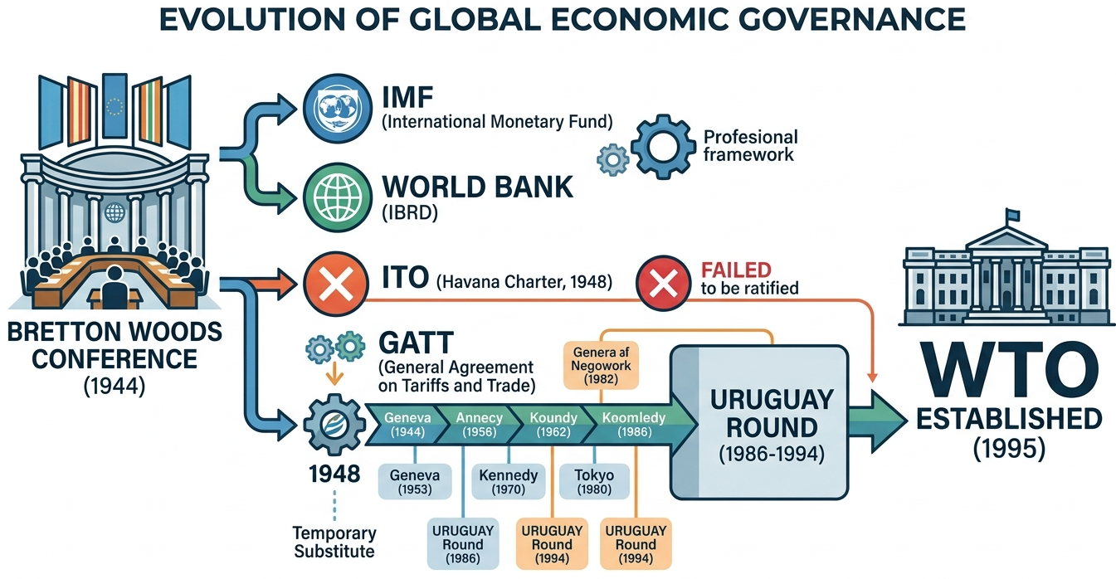
Historical Context – Post-WWII
Source: Created by the author

Slide 6
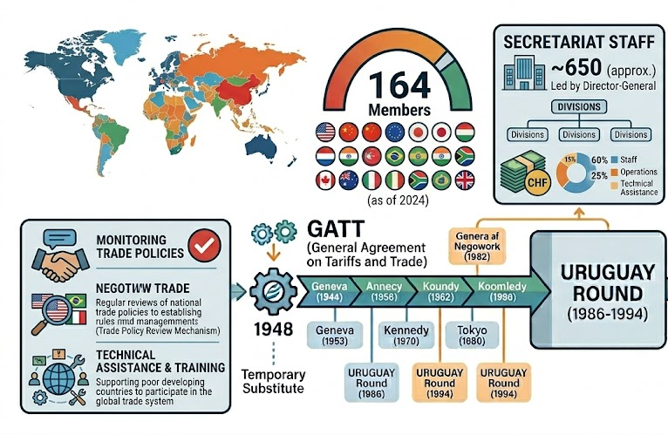
Overview of WTO
Source: Created by the author

Slide 7
Section 2: WTO Principles
Core Principles of the WTO
Non-discrimination
Reciprocity
Transparency
Binding commitments
Special and Differential Treatment (SDT)

Slide 8
Most-Favoured-Nation (MFN)
Any trade advantage given to one member must be given to all
Exceptions: FTAs, preferences for developing countries
Article I of GATT

Slide 9
National Treatment
Foreign goods, services, IP, once inside the market, treated no less favorably than domestic products
Applies to internal taxes, regulations, standards
Article III of GATT

Slide 10
Reciprocity & Binding Commitments
Reciprocity: Mutual opening of markets (especially tariff reductions)
Binding: Tariff ceilings (“bound tariffs”) cannot be raised without compensation
Creates predictability for exporters

Slide 11
Transparency
Members must publish trade regulations
Notify WTO of changes
Trade Policy Review Mechanism (TPRM) – regular reviews of members’ policies

Slide 12
Special and Differential Treatment (SDT)
Longer transition periods
Technical assistance
Preferential market access (e.g., Everything But Arms for LDCs)
Less stringent dispute compliance rules

Slide 13
Section 3: Dispute Settlement
WTO Dispute Settlement – Why Important?
“Crown jewel” of the WTO
Binding, rules-based system (unlike GATT’s consensus-based model)
Prevents unilateral retaliation

Slide 14
Key Bodies
Dispute Settlement Body (DSB) – all members
Panels (ad hoc)
Appellate Body (currently non-functional – crisis)
Arbitrators

Slide 15
Stages of Dispute Settlement
Consultation (60 days)
Panel establishment & proceedings
Panel report (6–9 months)
Appellate review (if not blocked)
Adoption by DSB
Implementation & retaliation if non-compliance

Slide 16
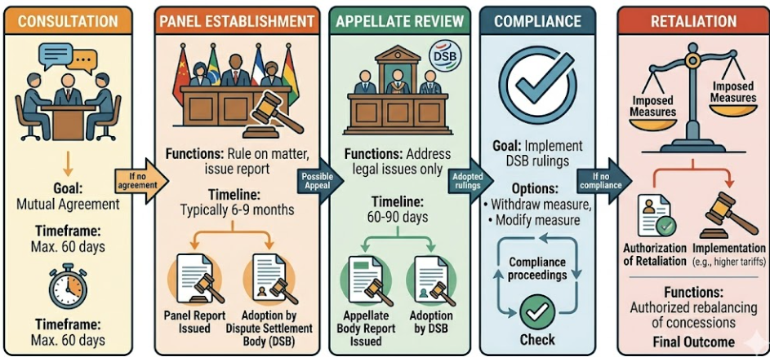

Timeline Graphic
Source: Created by the author

Slide 17
Notable Cases
US – Steel Safeguards (2003)
EU – Hormones (beef dispute)
China – Rare earths (2014)
Airbus / Boeing subsidy disputes

Slide 18
The Appellate Body Crisis
The US has blocked appointments since 2019
Remaining judges → no quorum
Alternative mechanisms: Multi-Party Interim Appeal Arbitration Arrangement (MPIA)
Calls for reform

Slide 19
Section 4: Rounds of Negotiation
GATT Rounds (1947–1994)
Geneva (1947) – 45,000 tariff lines
Annecy (1949), Torquay (1950), Geneva (1956) – incremental cuts
Dillon (1960–61) – EEC negotiations
Kennedy (1964–67) – Anti-dumping code
Tokyo (1973–79) – Non-tariff barriers, codes

Slide 20
The Uruguay Round (1986–1994)
Most ambitious round
Established WTO
Expanded scope: Services (GATS), IP (TRIPS), agriculture (AoA), textiles (ATC)

Slide 21
Key Outcomes of Uruguay Round
Tariff reductions by 40%
Creation of Dispute Settlement Understanding (DSU)
Trade Policy Review Mechanism
TRIPS minimum standards

Slide 22
The Doha Development Round (2001–present, stalled)
Mandate: Development focus
Issues: Agriculture (domestic subsidies), NAMA, services, TRIPS & public health
Deadlocked over differences between developed & developing countries

Slide 23
Why Doha Failed
US-EU agricultural subsidies vs. G20 (Brazil, India, China)
Special Safeguard Mechanism for developing countries
Lack of political will
Rise of mega-regionals (TPP, TTIP) – now mostly superseded

Slide 24
MC13 (Abu Dhabi, 2024) & Future
Partial agreement on e-commerce moratorium, fisheries subsidies (Phase 2)
No agreement on agriculture, dispute reform
Shift toward plurilateral agreements (Joint Statement Initiatives – e-commerce, investment facilitation)

Slide 25
Section 5: IMF & World Bank Roles in Trade
IMF – Mandate & Trade Linkages
Surveillance of the global economy & exchange rates
Balance of payments financing
Conditionality influences trade policies (tariffs, quotas, subsidies)

Slide 26
IMF’s Specific Trade Roles
Assessing exchange rate misalignment (affects competitiveness)
Trade policy reviews as part of Article IV consultations
Technical assistance on customs, tariff systems
Financing to prevent import compression during crises

Slide 27
Example – IMF & Trade During COVID-19
Emergency financing ($100+ billion)
Advice against export restrictions on medical goods
Support for vaccine supply chains

Slide 28
World Bank – Group Structure
IBRD (middle-income countries)
IDA (low-income countries)
IFC (private sector)
MIGA (political risk insurance)

Slide 29
World Bank’s Trade-Related Activities
Trade facilitation projects (ports, borders, logistics)
Aid for Trade (co-financed with WTO)
Support for regional integration (e.g., AfCFTA, ASEAN)
Analysis of non-tariff measures

Slide 30
IMF vs. World Bank – Division of Labor
IMF | World Bank
Short-term balance of payments | Long-term development
Macroeconomic stability | Structural & infrastructure projects
Exchange rates | Trade corridors

Slide 31
Cooperation with WTO
Joint publications (e.g., “Global Trade & Trade Policy” reports)
Technical assistance for developing countries
Aid for Trade initiative (WTO, WB, regional banks)

Slide 32
Case Study – Vietnam’s Integration
WTO accession (2007)
IMF-supported reforms (liberalization, FX policy)
World Bank infrastructure & trade facilitation loans
Result: Export-led growth, poverty reduction

Slide 33
Section 6: Critiques & Challenges
Critiques of the WTO
Power imbalances (developed countries dominate)
Slow decision-making (consensus, single undertaking)
Appellate Body paralysis
Neglect of labor & environmental standards (though some progress)

Slide 34
Section 6: Critiques & Challenges
Critiques of the WTO
“Washington Consensus” – one-size-fits-all policies
Conditionality can worsen inequality, cut social spending
Voting shares favor rich countries (US has veto at IMF)
Environmental & social harms of large infrastructure loans

Slide 35
Contemporary Challenges
Rise of industrial policy & subsidies (US CHIPS Act, EU Green Deal)
Climate change & trade (carbon border adjustments)
Digital trade & data governance (no WTO rules)
Geopolitical tensions (US-China trade war, sanctions)

Slide 36
Reform Proposals
WTO: Revive Appellate Body, update rulebook for digital trade, SDT graduation
IMF: Increase SDR allocation for climate, reform quota formula
World Bank: Evolve mission for global public goods (climate, pandemic preparedness)

Slide 37
The Future of Trade Governance
Plurilateral agreements within WTO framework
Role of regional trade agreements (RCEP, CPTPP, USMCA)
Greater inclusion of civil society & labor voices
Adaptation to a multipolar world

Slide 38
Section 7: Conclusion & Q&A
WTO remains central but must reform dispute & negotiation functions.
IMF & World Bank shape the monetary & development context for trade.
All face legitimacy, relevance, and geopolitical pressures.
Key takeaway: No single institution can govern global trade alone – coordination is essential.

Slide 39
References
John H. Jackson (1997). The World Trading System: Law and Policy of International Economic Relations. MIT Press.
Anne O. Krueger (Ed.) (1998). The WTO as an International Organisation University of Chicago Press.
Douglas A. Irwin (2022). "The World Bank, the IMF, and the GATT/WTO: Which Institution Most Supported Trade Reform in Developing Economies?" *Peterson Institute for International Economics Working Paper 22-19*.
Marina Foltea (2012). International Organizations in WTO Dispute Settlement: How Much Institutional Sensitivity? Cambridge University Press.
Dukgeun Ahn (2016). "Linkages between International Financial and Trade Institutions: IMF, World Bank and WTO." Journal of World Trade, Volume 50, Issue 5.
Anna Pitaraki (2014). "Institutional Linkages: WTO – IMF, World Bank, WIPO, WHO... A Global Administrative Law Approach." EUI PhD Thesis, European University

Slide 40
References
Randall W. Stone (2011). Controlling Institutions: International Organizations and the Global Economy. Cambridge University Press.
Sol Picciotto (2011). Regulating Global Corporate Capitalism. Cambridge University Press.
Janet Dine (2005). Companies, International Trade and Human Rights. Cambridge University Press.
Kent Jones, Thomas Cottier & Manfred Elsig (Eds.) (2011). Governing the World Trade Organization: Past, Present and Beyond Doha. Cambridge University Press.
Jens L. Mortensen (2012). "Seeing Like the WTO: Numbers, Frames and Trade Law." New Political Economy, 17(5), 571-597

Slide 41
Thank you!

