Slide 1
International Trade and Policy
WEEK 12 – Global Issues I: Trade and the Environment
University: Tajik State University of Commerce
Lecturer: Abduvaliev Mubinzhon, PhD

Slide 2
Learning Objectives
Understand the pollution havens hypothesis and empirical evidence
Define carbon leakage and its mechanisms
Analyze environmental standards as non-tariff barriers (NTBs)
Evaluate interactions between MEAs (e.g., Paris Agreement) and trade rules (WTO)

Slide 3
Structure of the Presentation
Carbon Leakage
Environmental Standards as non-tariff barriers (NTBs)
Multilateral Environmental Agreements & Trade Rules
Case Studies & Data
Conclusions & Policy Implications

Slide 4
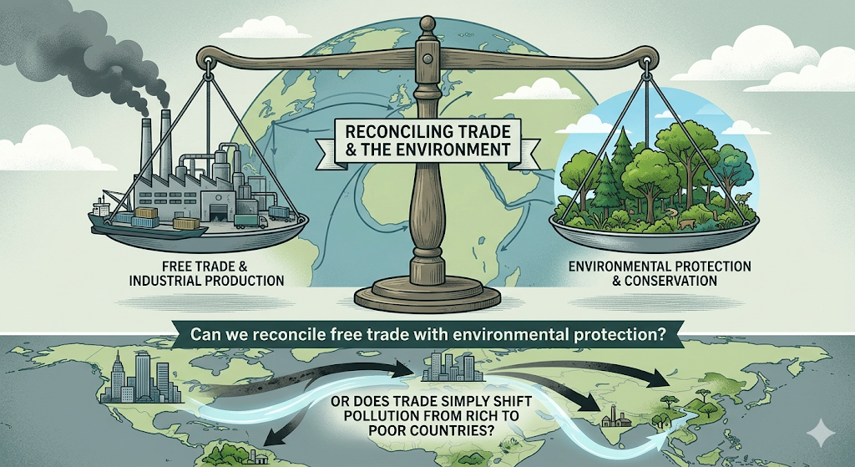
Key Question
Can we reconcile free trade with environmental protection?
Or does trade simply shift pollution from rich to poor countries?
Source: Created by the author

Slide 5
The Trade-Environment Debate
Optimists: Trade raises incomes → demand for cleaner environment → stricter regulations
Pessimists: Race to the bottom → pollution havens → carbon leakage
Institutional gap: WTO vs. MEAs – no clear hierarchy

Slide 6
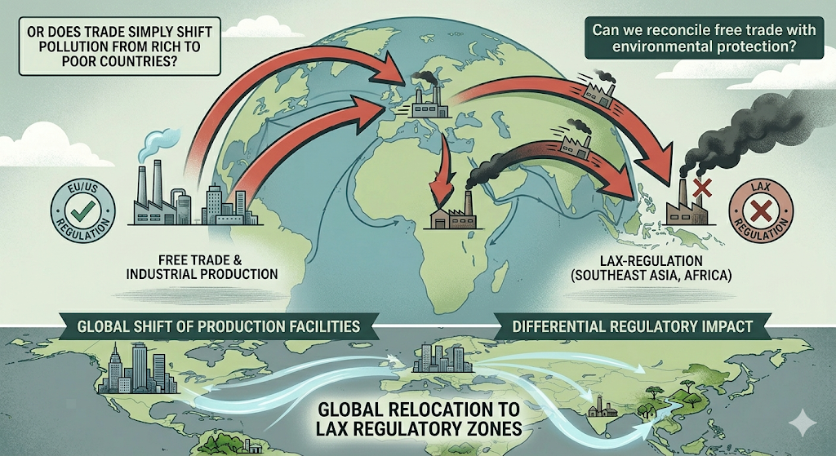
Section 2: Pollution Havens Hypothesis
Definition – Pollution Havens
Firms relocate production to countries with weaker environmental regulations
Result: “Dirty” industries concentrate where compliance costs are lowest
Source: Created by the author

Slide 7
Theoretical Mechanism
Trade liberalization + environmental regulation differences
Abatement costs vary (e.g., 5-15% of total costs in chemicals/metals)
Comparative advantage shifts toward pollution-intensive goods in lax-reg countries

Slide 8
Empirical Evidence – Mixed Results
Early studies (1990s): Weak evidence – trade costs, scale effects dominate
Recent meta-analyses (2010-2025): Stronger evidence for "footloose" sectors (metals, paper, chemicals)
Key study: Levinson & Taylor (2008) – US environmental stringency reduces net imports from Mexico by 8-12%

Slide 9
Pollution Haven vs. Factor Endowment
Does dirty production go to poor countries because of lax rules OR cheap labor?
Ederington et al. (2005): Labor-intensive dirty sectors move for labor costs, not regulation
Takeaway: Regulation matters only at the margin – but that margin can be decisive

Slide 10
Real-World Example – US-Mexico Border (NAFTA era)
Post-NAFTA: Maquiladora plants increase along border
Air pollution along Texas-Mexico border: SO2 and particulates ↑ 30% in Mexican cities
Environmental compliance costs in Mexico ~30% lower than US for cement & glass

Slide 11
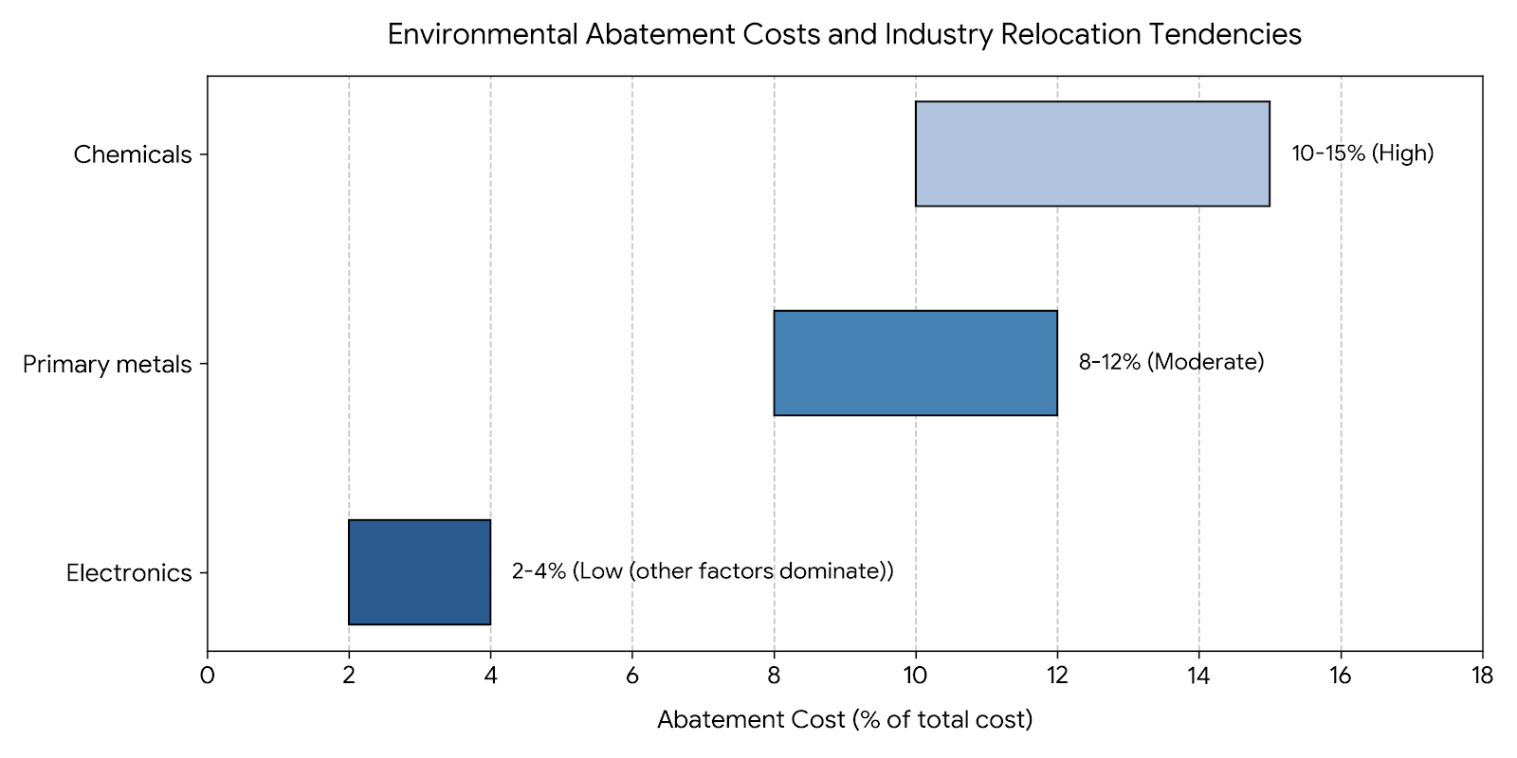
Pollution Haven Hypothesis – Critical Data
Source: Created by the author

Slide 12
Summary – Pollution Havens
Exists but not universal; strongest in footloose, high-abatement-cost sectors
Trade liberalization can amplify pollution havens if environmental governance is weak
Policy implication: Harmonize minimum standards or use border adjustments

Slide 13
Section 3: Carbon Leakage
Definition – Carbon Leakage
Stringent climate policy in one country → production (and emissions) shift to countries with weaker policies
Leakage rate = (increase in foreign emissions) / (domestic emissions reduction)
Typical estimates: 5-25% for OECD carbon taxes

Slide 14
Channels of Carbon Leakage
Competitiveness channel: Energy-intensive firms lose market share to foreign rivals
Energy market channel: Lower domestic fossil fuel demand → lower world prices → higher foreign consumption
Investment channel: New capital locates in lax-reg countries

Slide 15
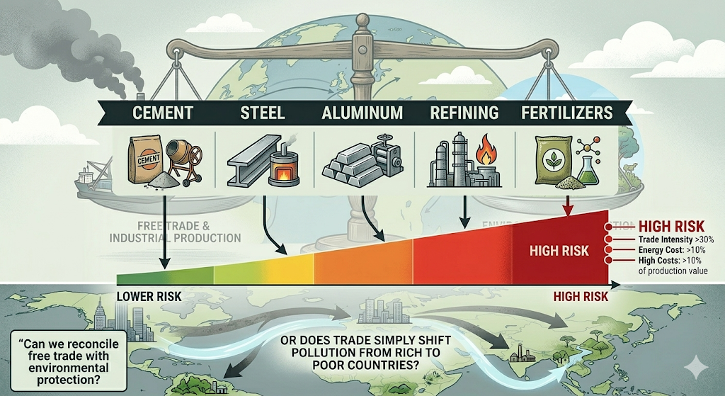

Which Sectors Are Most Vulnerable?
Cement, steel, aluminium, refining, fertilisers
Trade intensity > 30% + energy costs > 10% of production value
Source: Created by the author

Slide 16
EU Example – Carbon Border Adjustment Mechanism (CBAM)
Implemented transition phase 2023, full effect 2026
CBAM covers: cement, iron/steel, aluminum, fertilizers, electricity, hydrogen
Importers buy certificates = EU carbon price – carbon price already paid in origin country
Goal: Prevent leakage + incentivize foreign carbon pricing

Slide 17
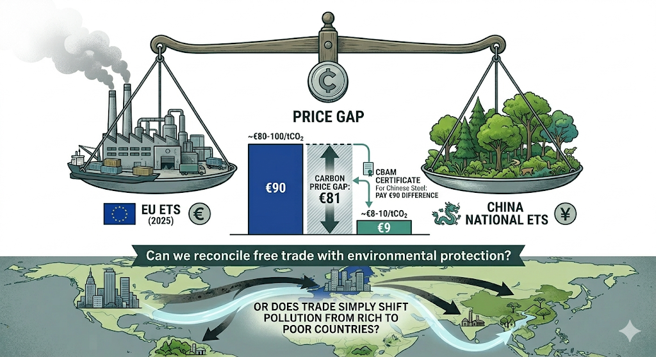
CBAM Data (Illustrative)
EU carbon price (ETS): ~€80-100/tCO2 (2025)
China national ETS: ~€8-10/tCO2
CBAM certificate for Chinese steel: pay €90 difference
Source: Created by the author

Slide 18
Critiques of CBAM
WTO compatibility? Possible violation of most-favored-nation (MFN)
Developing country objection: Unfair burden, "green protectionism"
Complexity: Monitoring embedded emissions along supply chains
Retaliation risk: China, India, Brazil may impose counter-tariffs

Slide 19
Carbon Leakage – Summary
Real and measurable, especially for energy-intensive trade-exposed (EITE) sectors
Unilateral climate policy without border measures → leakage rates 15-25%
CBAM is first major policy experiment – outcomes will shape future trade-climate governance

Slide 20
Section 4: Environmental Standards as Non-Tariff Barriers : Definition – Environmental NTBs
Domestic environmental regulations that affect imported goods
Legitimate goal: Protect human health, ecosystems, climate
Problem: Can be intentionally or unintentionally discriminatory

Slide 21
Examples of Environmental NTBs
Product standards: Maximum pesticide residues, fuel efficiency, chemical bans (e.g., REACH)
Process & Production Methods (PPMs): Dolphin-safe tuna, timber from legal harvest (FLEGT)
Packaging & labeling: Recyclability, plastic-free, carbon footprint labels

Slide 22
WTO Rules on Environmental NTBs
GATT Article XX(b): Necessary to protect human, animal, plant life/health
GATT Article XX(g): Relating to conservation of exhaustible natural resources
Chapeau (intro clause): Must not be arbitrary or disguised protectionism

Slide 23
Landmark WTO Case – Shrimp-Turtle (1998)
US banned shrimp imports from countries without turtle-excluder devices (TEDs)
Initial ruling: Violated GATT (discrimination)
Appellate Body (modified): Allowed if US negotiates multilateral agreements first
Key principle: Unilateral PPMs can be WTO-legal but must be non-arbitrary

Slide 24
Environmental NTBs – Legitimate vs. Protectionist
Legitimate use | Protectionist abuse
Phasing out ozone-depleting substances (Montreal Protocol) | Complex testing requirements only foreign firms fail
Ban on toxic lead in paint | Different standards for imported vs. domestic organic produce
Energy efficiency labels | Frequent changes in standards without notice

Slide 25
Developing Country Concerns
Compliance costs high (testing, certification, redesign)
Small producers excluded from supply chains
Example: EU Deforestation Regulation (2024) – requires geolocation of farms; smallholders in Indonesia/DRC struggle to comply
Call for: Technical assistance + longer transition periods

Slide 26
Summary – Environmental Standards as NTBs
Necessary for legitimate environmental goals
But can become hidden protectionism
WTO allows them if: necessary, non-arbitrary, least trade-restrictive
Need for transparency, harmonization, and capacity-building

Slide 27
Section 5: MEAs & Trade Rules
What Are Multilateral Environmental Agreements?
Legally binding treaties among multiple countries on environmental issues
Examples: Montreal Protocol (ozone), CITES (endangered species), Basel Convention (hazardous waste), Paris Agreement (climate)

Slide 28
Trade Measures in MEAs
Many MEAs include trade restrictions to achieve environmental goals:
Montreal Protocol (1987): Ban trade in ozone-depleting substances with non-parties
CITES (1975): Trade permits for endangered species; ban on commercial trade
Basel Convention (1989): Prior informed consent for hazardous waste trade
Rotterdam Convention (1998): Prior informed consent for hazardous chemicals

Slide 29
The Conflict – MEAs vs. WTO Rules
WTO complaint: Trade measures in MEAs may violate MFN, national treatment, or prohibition on quantitative restrictions
MEA argument: Environmental necessity should override trade rules
Legal gap: No WTO agreement explicitly exempts MEA trade measures

Slide 30
Vienna Convention & Montreal Protocol – A Success Story
Trade bans on CFCs with non-parties → universal participation (197 parties)
No WTO challenge ever filed – pragmatic cooperation
Lesson: When environmental threat is clear and alternatives exist, trade measures work

Slide 31
Paris Agreement (2015) – Trade Measures?
Paris Agreement itself has no explicit trade measures
But Nationally Determined Contributions (NDCs) often imply trade policies:
  Carbon border adjustments (CBAM)
  Fossil fuel subsidy phase-outs
  Green procurement rules
Unresolved: Can a country impose trade restrictions to enforce another’s NDC?

Slide 32
WTO Committee on Trade & Environment (CTE)
Established 1995 – forum for dialogue, not dispute resolution
Key debates:
  Should MEAs get a "waiver" from WTO rules?
  Criteria for judging MEA trade measures?
  Observer status for MEAs in WTO disputes?
Outcome: No consensus after 30 years

Slide 33
Proposed Solutions to MEA-WTO Tension
Mutual supportiveness clause in future trade agreements (e.g., CETA, CPTPP)
Advisory opinion mechanism from WTO dispute panel on environmental cases
Limited waiver for MEA trade measures under specific conditions (transparent, proportional, time-bound)
Interpretative note that GATT Article XX includes compliance with MEAs

Slide 34
Real-World Clash – EU Seal Ban (2015)
EU banned seal products for animal welfare reasons
Canada, Norway challenged at WTO (DS400, DS401)
WTO ruling (2015): Upheld ban as covered by Article XX(a) (public morals)
Importance: First time WTO allowed trade restriction based on animal welfare – shows flexibility

Slide 35
Summary – MEAs & Trade Rules
Many MEAs use trade measures effectively (Montreal Protocol)
WTO has not struck down an MEA measure yet – de facto coexistence
Paris Agreement’s interaction with trade rules remains the next frontier
Likely future: More climate-related trade measures, more disputes, need for reformed WTO rules

Slide 36
Section 6: Case Studies & Data Slides
Case Study 1 – China’s Waste Import Ban (2018)
Under Basel Convention, China banned imports of plastic waste (National Sword policy)
Trade effect: Global recycling markets collapse; waste diverted to SE Asia (Vietnam, Malaysia, Thailand)
Environmental effect: Illegal dumping and open burning in receiving countries ↑
MEA/trade lesson: Unilateral environmental ban shifts problem, not solves it – need global Basel amendments (adopted 2019)

Slide 37
Case Study 2 – EU’s Deforestation Regulation (EUDR)
Requires proof that imported commodities (soy, beef, palm, coffee, cocoa, timber) not from deforested land after 2020
Trade partners’ complaint: Brazil, Indonesia say it violates WTO, burdens smallholders
De facto NTB or legitimate environmental policy? Ongoing WTO consultation request (2024)
Outcome (as of 2025): Delayed implementation, but still moving forward with adjustments

Slide 38
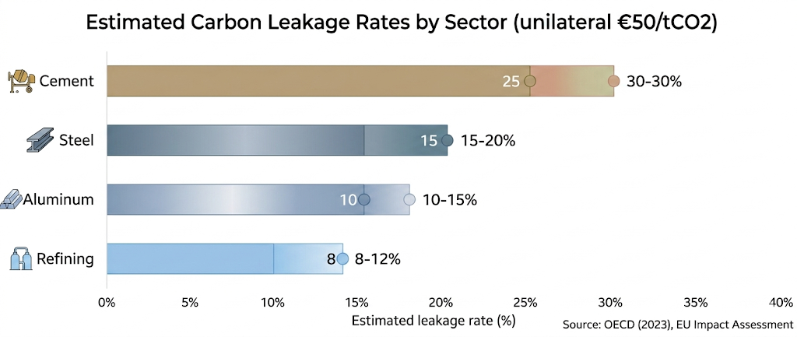
Key Data – Carbon Leakage Rates by Sector

Slide 39
Data – Environmental NTB Notifications to WTO (1995-2024)
Total TBT (technical barriers) notifications: ~30,000
Labeled "environmental": ~4,500 (15%)
Fastest growth: climate-related (carbon labels, recycled content)
Top notifiers: EU, US, China, Brazil
Disputes filed: 14 involving environmental NTBs; 3 decided against regulator (mostly discrimination)

Slide 40
Conclusions & Policy Implications
Key Takeaways
Pollution havens are real but sector-specific; trade policy must account for abatement cost differences
Carbon leakage requires border measures (CBAM) or international carbon price floor
Environmental NTBs are legitimate but must avoid disguised protectionism; transparency and technical assistance key
MEA-WTO interaction is cooperative in practice but legally unresolved; Paris Agreement will test this
Reform needed: WTO dispute resolution reform (including environment expertise); climate club agreements

Slide 41
Final Discussion Question & References
Discussion Question:
Should the WTO allow countries to impose trade sanctions against Paris Agreement non-compliant countries?
Why or why not?

Slide 42
References
WTO (2023). World Trade Report – Climate Change and Trade
IPCC AR6 (2022). Chapter on Trade and Leakage
Copeland, B. & Taylor, S. (2004). Trade and the Environment. Princeton Press.
European Commission (2024). CBAM Impact Assessment
UNEP (2025). Trade and Environment Review

Slide 43
Thank you!

