Slide 1
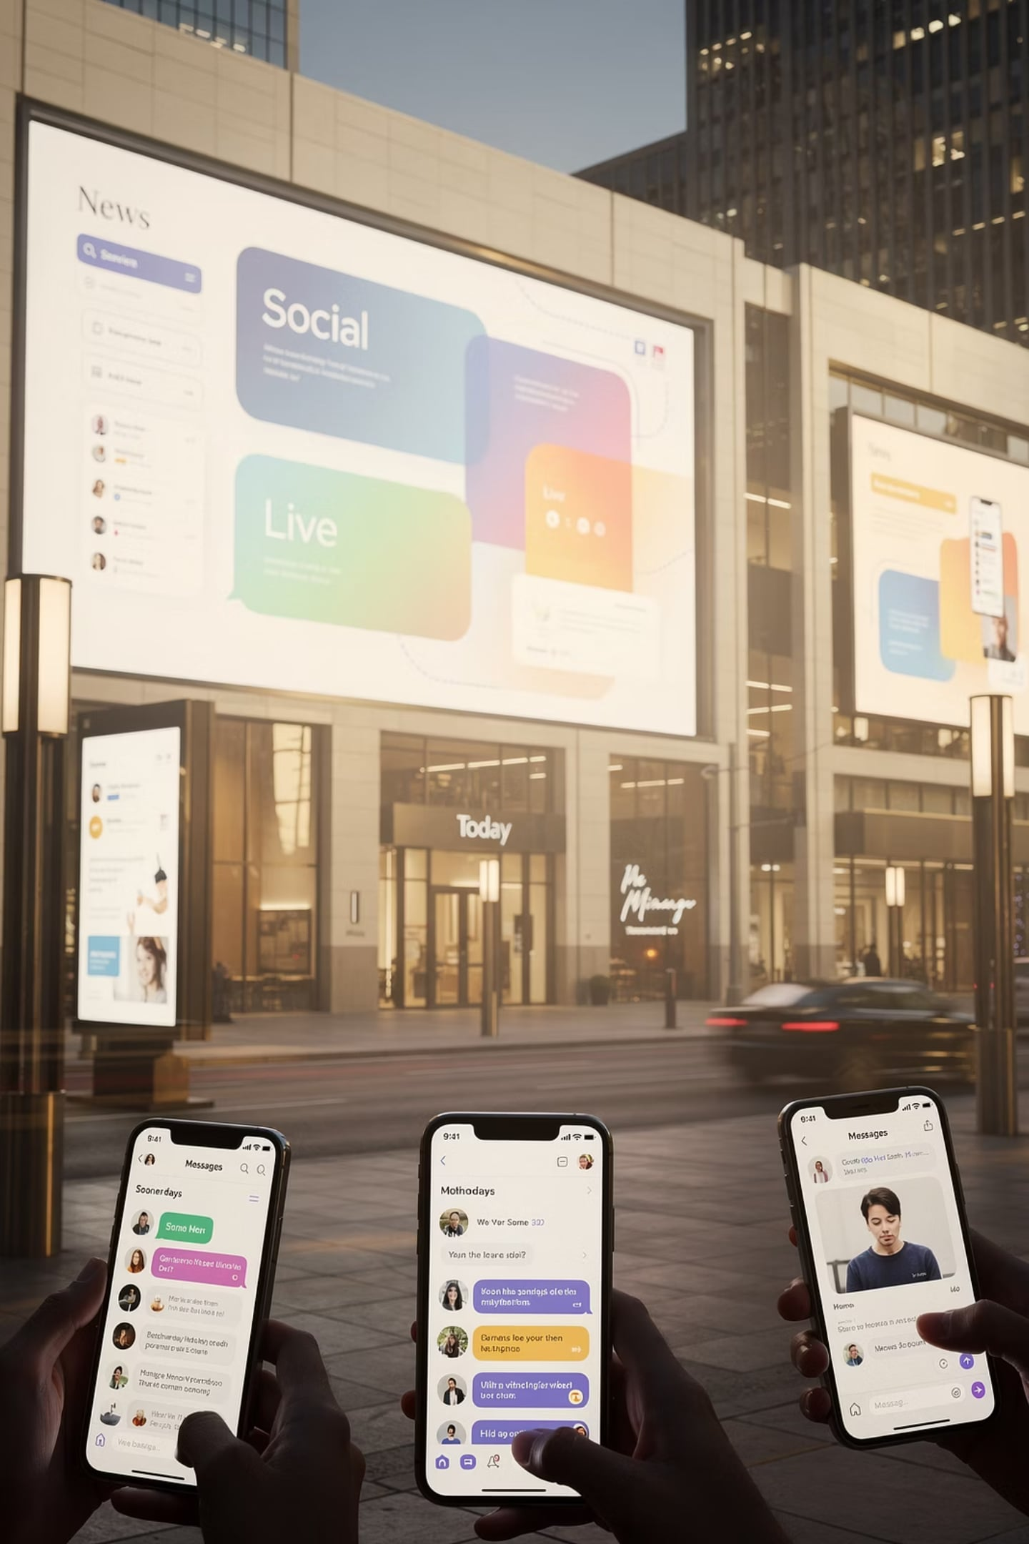
Advertising and Integrated Marketing Communications
Week 1 — Integrated Marketing Communications
By: Prof. Fidela R. Balajadia

Slide 2
Lecture Learning Objectives
01
02
Communication
IMC
How communication takes place
What an integrated marketing communications program is
03
04
Trends
Components
Trends affecting marketing communications
Components of an IMC program

Slide 3

A Rapidly Shifting Landscape
Decline
Rise
Traditional media viewership falling
Internet & social media usage surging
Challenge
Firms must cut through clutter with a clear voice

Slide 4
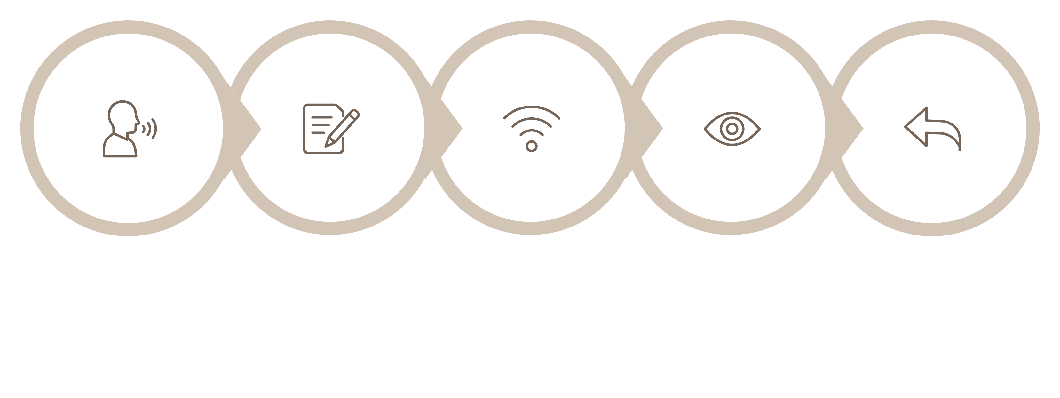
The Communication Process
Sender
Encode
Channel
Decode
Feedback
Effective marketing communication occurs when the receiver decodes the message exactly as the sender intended.

Slide 5




Key Elements of Communication
Sender
Encoding
Brand or company transmitting the message (e.g., KFC, Chick-fil-A)
Verbal & nonverbal cues shaped into an attention-getting message
Channel
Decoding
TV, print, website, social media — the transmission device
Consumer sees, hears, or feels the message and interprets it

Slide 6

Noise & Feedback
Feedback
Talking during a TV commercial
Scrolling past internet ads
Purchases, inquiries, complaints, store visits, website hits
Noise
Anything that distorts or disrupts a message — clutter is the most common form
Ignoring irrelevant tweets
Being offended by a flyer

Slide 7

What Is IMC?
The coordination and integration of all marketing communications tools, avenues, and sources into a seamless program designed to maximize impact on customers and stakeholders.

Slide 8






Components of Promotion
Advertising
Sales Promotions
Personal Selling
Digital & Social Media
Database & Direct Response
Sponsorships & PR

Slide 9
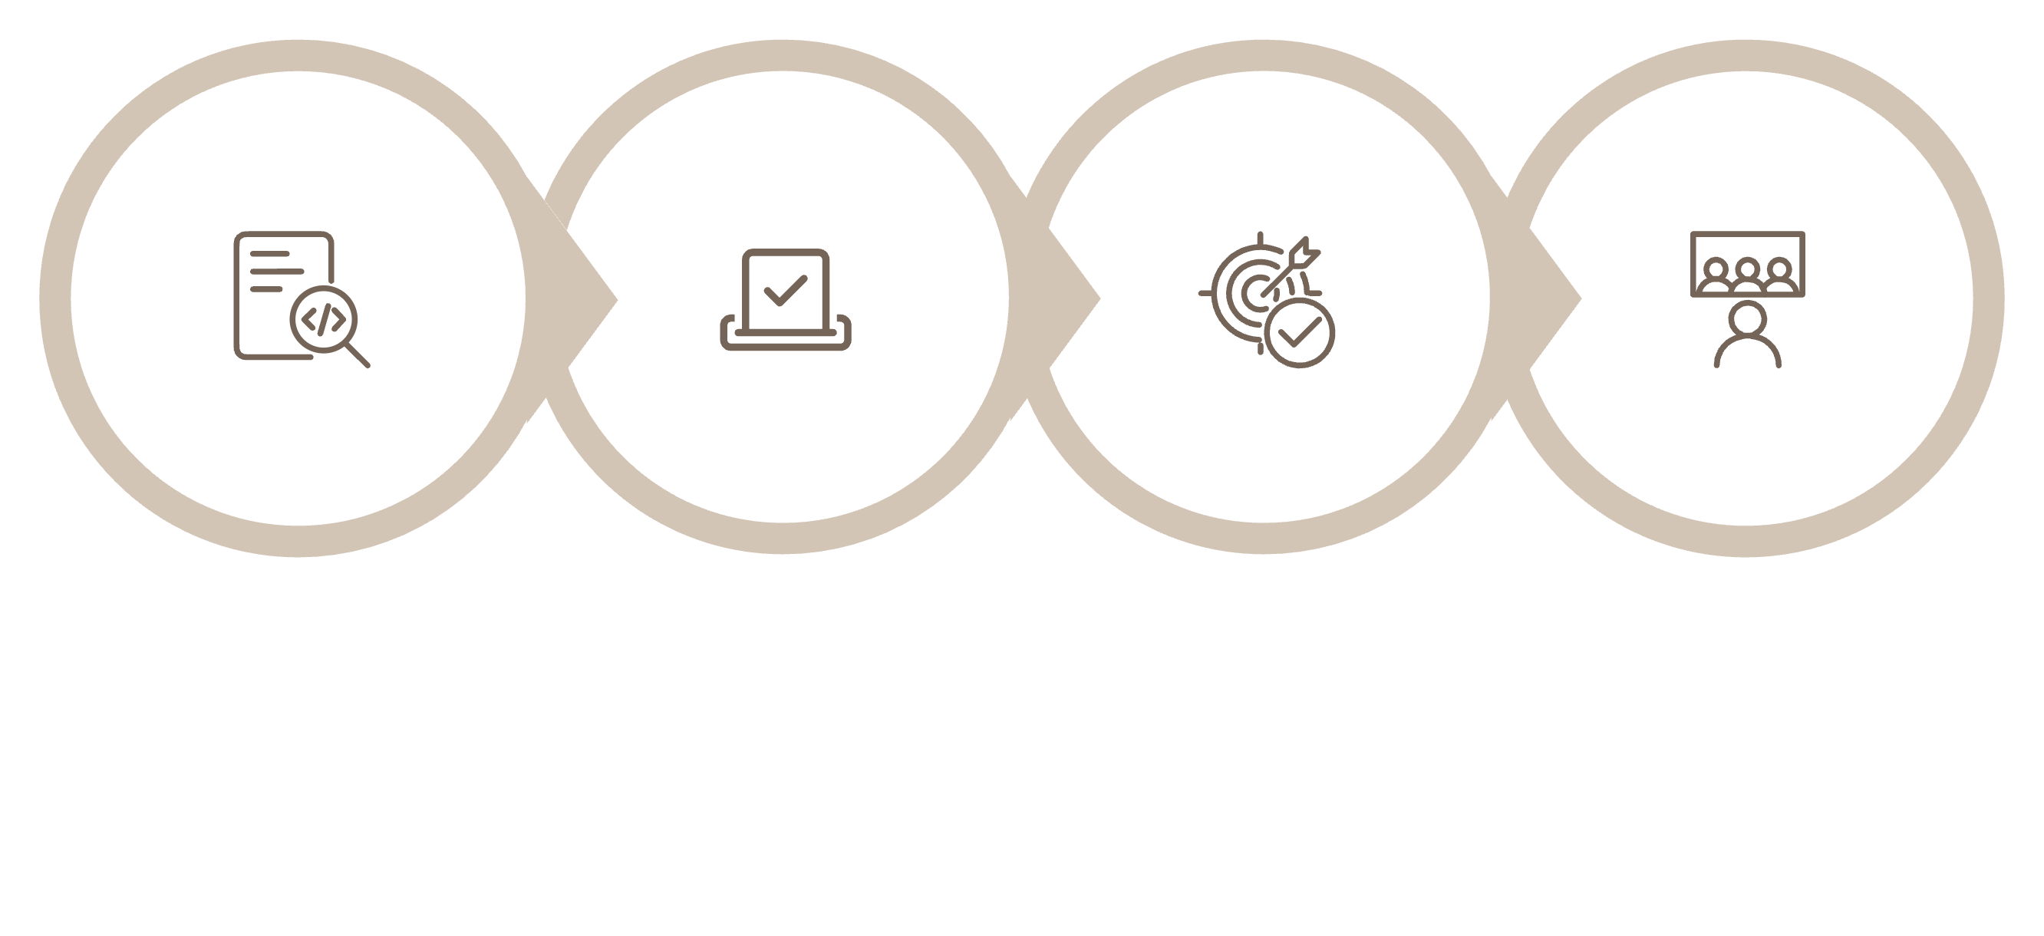
The IMC Marketing Plan
Target Market
Situational
SWOT
Objectives
A strategic marketing plan coordinates all mix elements to deliver a consistent, unified message.

Slide 10
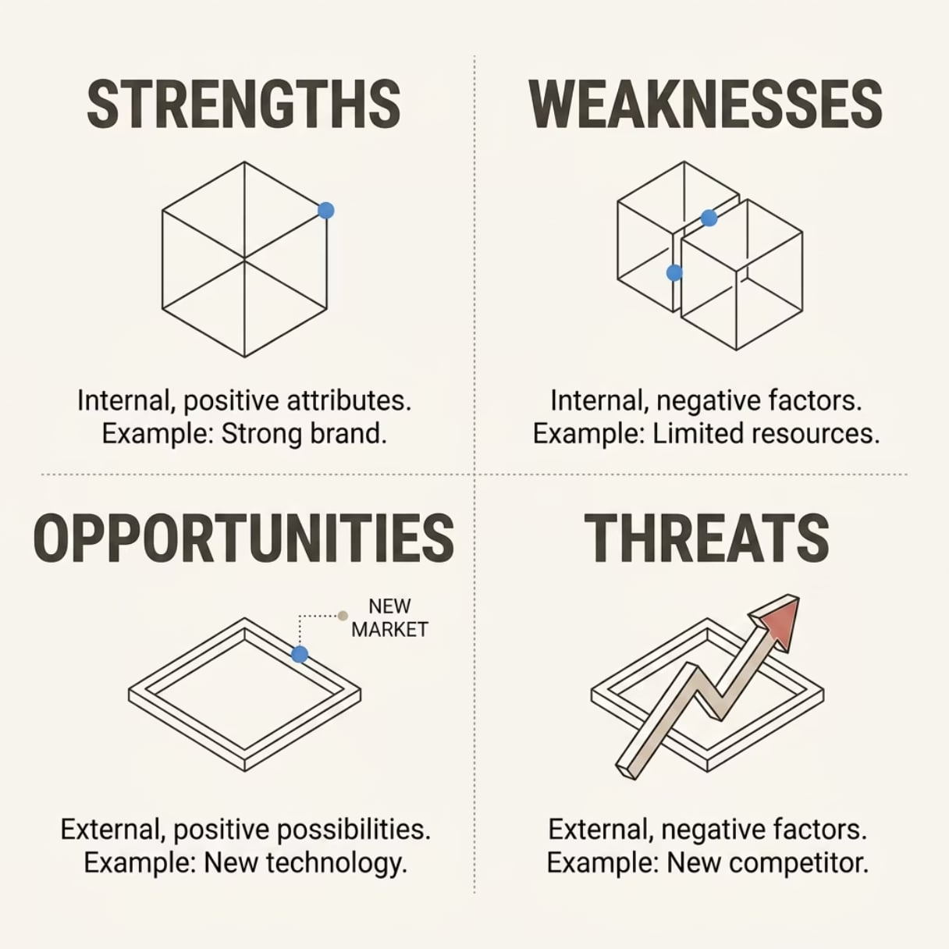

SWOT Analysis
Marketers examine internal and external environments to guide IMC strategy.
SWOT identifies where to compete and how to communicate effectively.

Slide 11

Trends Affecting Marketing Communications
Accountability & Measurable Results
Explosion of the Digital Arena
Integration of Media Platforms
Shift in Channel Power
Increase in Global Competition
Increase in Brand Parity
Emphasis on Customer Engagement

Slide 12
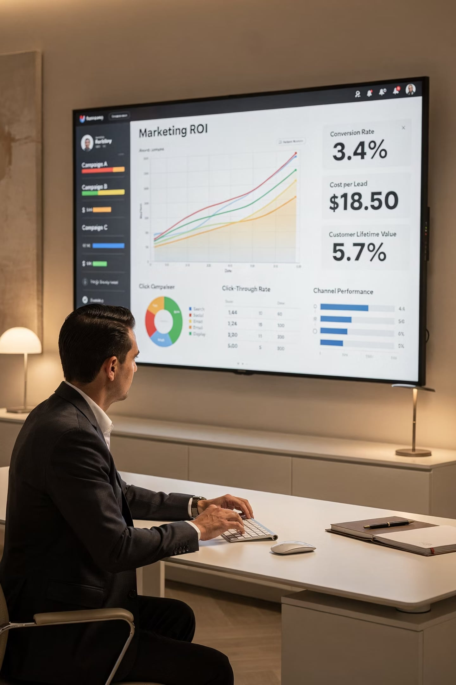

Accountability & Measurable Results
CEOs, CFOs, and CMOs demand tangible outcomes. Marketing is an investment, not an expense — every campaign must yield measurable gains in sales, market share, or brand awareness.
Companies are replacing costly 30-second TV spots with digital and alternative media. — Martyn Straw, BBDO Worldwide

Slide 13
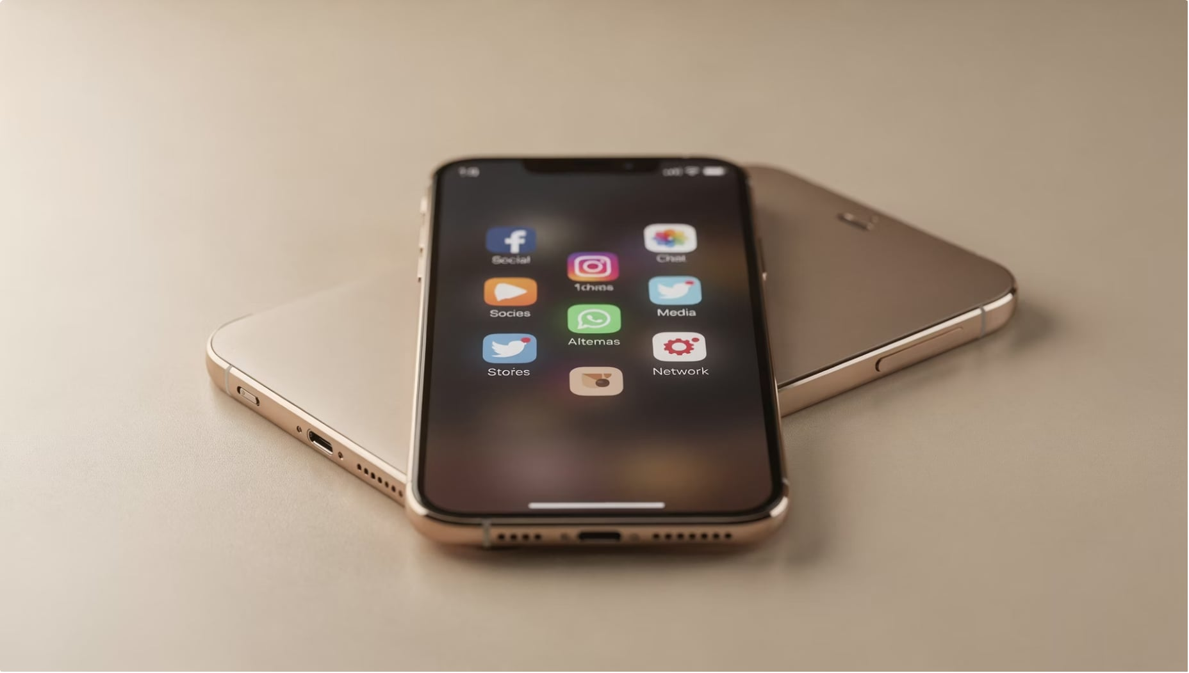
Integration of Digital Media
Digital is now mandatory
Websites, blogs, social networks
Smartphones, tablets, text messaging
Creates brand experiences, not just purchases
Consumers share ratings instantly

Slide 14
How Consumers Use Multiple Screens
Content Grazing
Investigative Spider-Webbing
Two screens simultaneously — unrelated content (e.g., TV + texting)
Pursuing specific content across platforms (e.g., game stats on phone while watching)
Quantum Journey
Social Spider-Webbing
Completing a task across devices (e.g., PC → smartphone → map app)
Sharing content across multiple devices and platforms

Slide 15
Channel Power, Competition & Brand Parity
Shift in Channel Power
Global Competition
Brand Parity
Mega-retailers control shelf space & purchase data — suppliers must comply
A competitor can be 10,000 miles away — best value wins regardless of location
Consumers perceive brands as nearly identical — price & promotions drive decisions, loyalty declines

Slide 16
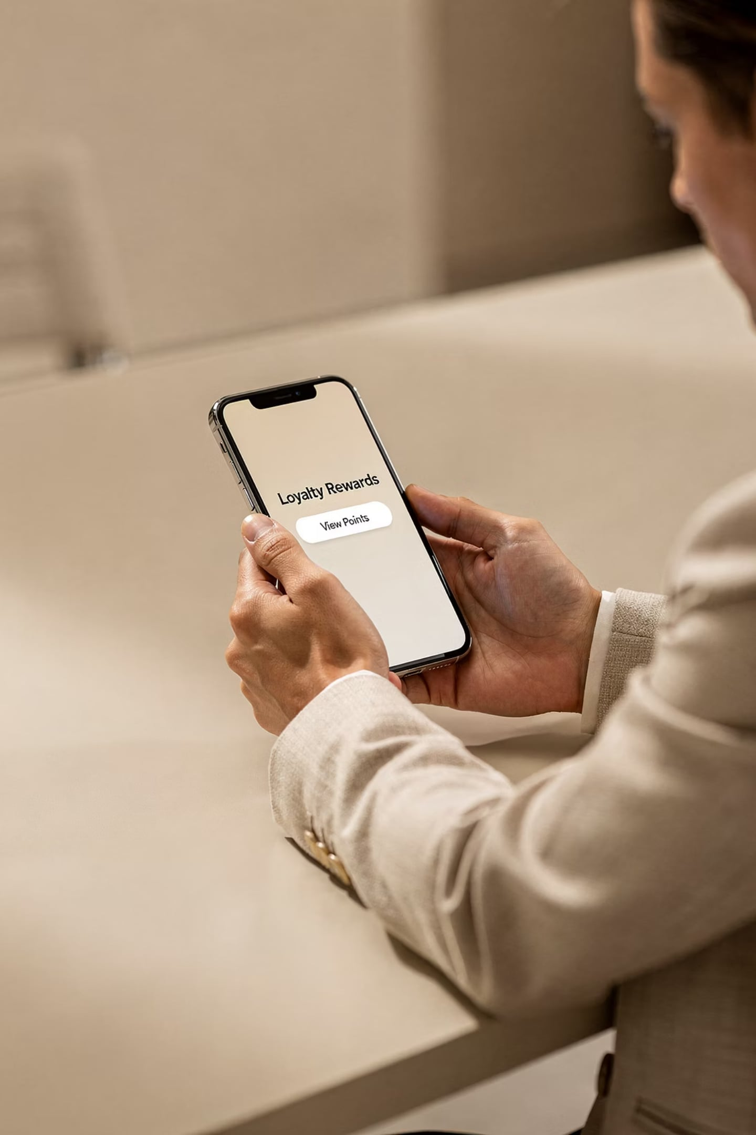

Customer Engagement
Marketers engage customers at every contact point — any place where customers interact with or learn about a firm.
Digital and social media are central to building loyalty in a world of brand parity.

Slide 17
Why Integrated Marketing Works
Unifies Strategy
Streamlines Timing
Connects Audiences
Consistent message across all channels
Coordinated campaign delivery
Reaches multiple stakeholders
Creates Insights
Maximizes Impact
Meaningful, measurable data
Greater ROI across all efforts

Slide 18
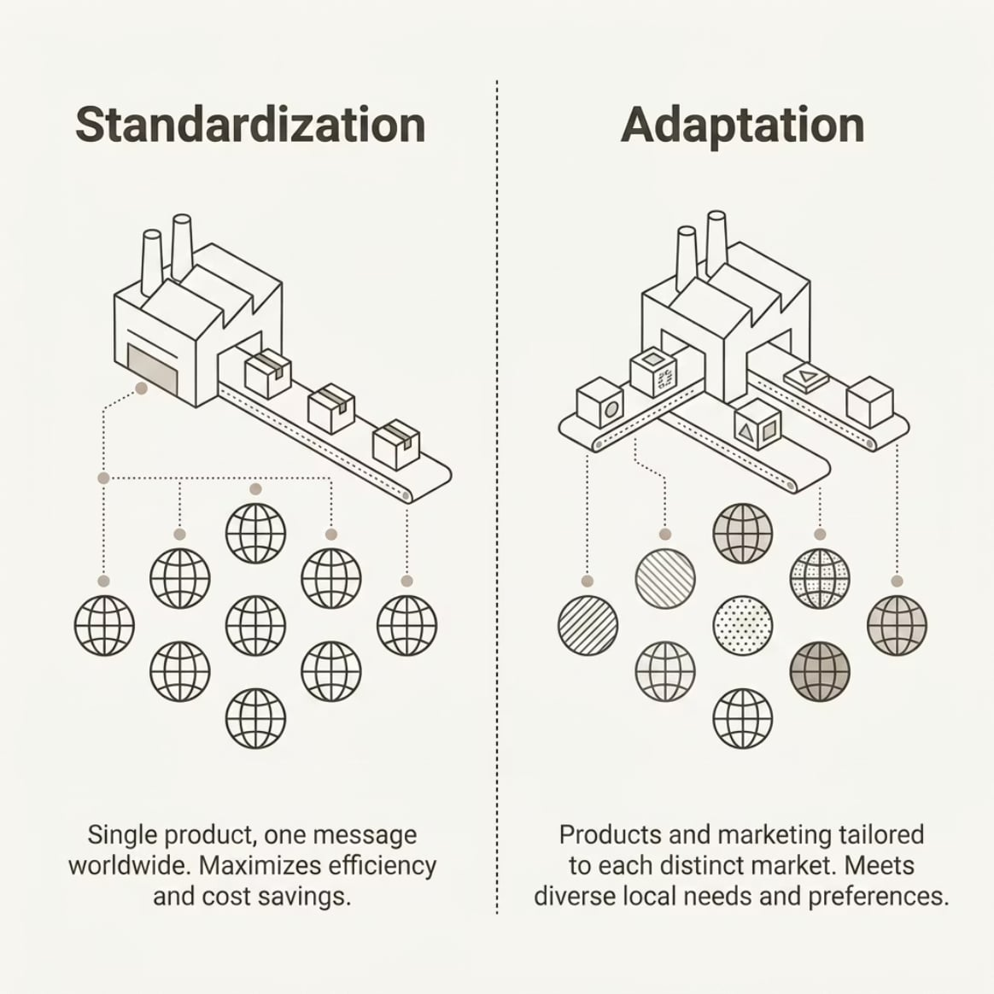
International IMC — GIMC
Globally Integrated Marketing Communications
Same goal as IMC — coordinate across all platforms — but greater cultural & national complexity.

Slide 19

Key Terms at a Glance
IMC
Encoding / Decoding
Coordination of all marketing tools into a seamless program
Transforming ideas into messages; receivers interpreting them
Noise & Clutter
Brand Parity
Anything distorting a message; hundreds of daily ads tuned out
Perception that most brands are essentially the same
Contact Point
Standardization vs. Adaptation
Any place customers interact with or learn about a firm
Uniform global message vs. country-specific tailoring

Slide 20
Advertising vs. Other Promotional Tools
Each communication tool offers distinct advantages and serves specific strategic goals within an integrated marketing plan.
Promotional Tool
Key Characteristics
Advertising
Paid, non-personal, mass media, controlled message, ideal for brand building and awareness.
Public Relations
Unpaid, earned media, builds credibility and trust, manages public image and reputation.
Sales Promotions
Short-term incentives, immediate response, encourages quick purchases and trial.
Personal Selling
Personal, direct interaction, customized messages, fosters long-term customer relationships.
Direct Marketing
Measurable, targets specific individuals, drives direct action and engagement.

Slide 21

The Role of Advertising Agencies
Advertising agencies are crucial partners in crafting and executing integrated marketing communications (IMC) campaigns, bringing specialized expertise and resources to coordinate efforts.
Full-Service Agencies
Boutique Agencies
In-House Agencies
These agencies provide a complete suite of services: creative development, media planning and buying, market research, and account management. They streamline IMC by offering holistic campaign integration from strategy to execution.
Specializing in niche areas such as digital marketing, branding, public relations, or specific creative services, boutique agencies offer deep, focused expertise to enhance particular components of an IMC campaign.
Owned and operated by the client company, in-house agencies handle advertising and marketing needs internally. They ensure brand consistency, offer cost-efficiency for ongoing needs, and provide closer alignment with company goals.

Slide 22



Setting Communication Objectives
Effective marketing communication hinges on clearly defined objectives, often structured using the Hierarchy of Effects Model. This model outlines the progression a consumer typically follows from initial exposure to a brand to making a purchase, moving through "Think, Feel, Do" stages.
Cognitive (Think)
Affective (Feel)
Conative (Do)
Focuses on awareness and knowledge. Objectives here aim to make consumers aware of the product/brand and understand its features or benefits.
Deals with attitudes and emotions. Objectives aim to build positive feelings, liking, preference, and conviction towards the brand.
Relates to actions or purchase intent. Objectives aim to induce trial, purchase, repurchase, or other desired behaviors.
Liking
Preference
Conviction
Purchase
Action
Engagement
Awareness
Knowledge

Slide 23

Budgeting for IMC: Setting the Promotional Budget
Determining the optimal budget for Integrated Marketing Communications (IMC) is crucial. Various methods exist, each with its own advantages and limitations, influencing how resources are allocated across promotional activities.
1
2
Percentage of Sales Method
Competitive Parity Method
Budget is set as a fixed percentage of current or anticipated sales revenue. Simple to calculate, but assumes sales cause promotion, rather than promotion causing sales.
Matches competitors' spending on promotional activities. This approach helps avoid promotional wars but assumes competitors have optimal budgets and objectives.
3
4
Objective-and-Task Method
Affordable Method
Define specific communication objectives, determine the tasks required to achieve them, and then estimate the costs of performing these tasks. This is the most logical but often the most difficult to implement.
Companies allocate funds based on what they believe they can afford for promotion. While simple, it often leads to under-spending and an arbitrary budget with little strategic justification.

Slide 24






Media Planning & Selection
Effective media planning is crucial for maximizing the impact of IMC campaigns, ensuring messages reach the right audience through optimal channels with appropriate exposure.
Reach
Frequency
The total number of different individuals or households exposed to an advertisement at least once over a specific period, focusing on audience breadth.
The average number of times an individual or household is exposed to an advertisement within a specified time frame, aiming for message repetition and retention.
Gross Rating Points (GRP)
Media Mix
A metric quantifying the total audience exposure to a campaign, calculated by multiplying Reach by Frequency. It measures total advertising weight.
The strategic blend of communication channels—both traditional (TV, radio, print) and digital (social media, search, email)—used to connect with the target audience.
Choosing Channels
Selecting media involves analyzing target audience habits, budget constraints, campaign objectives, and the unique strengths and weaknesses of each available medium.

Slide 25




Social Media & Influencer Marketing
Social media and influencer marketing have revolutionized how brands connect with consumers, fostering dynamic interactions and authentic relationships through diverse digital channels.
Social Platforms
User-Generated Content (UGC)
Digital hubs for connection, discovery, and engagement. They enable targeted outreach and direct dialogue between brands and consumers, driving awareness and consideration.
Authentic, consumer-created content that builds trust and fosters community. UGC is highly effective for social proof and enhancing brand credibility.
Influencer Tiers
Brand Authenticity
Categorizing influencers by audience size (nano, micro, macro, mega) helps brands tailor strategies for optimal reach, engagement, and niche targeting.
The cornerstone of trust in digital marketing. Genuine messaging and transparent partnerships are vital for building lasting consumer loyalty and engagement.

Slide 26


Ethical & Regulatory Issues in Marketing Communications
Navigating the complex landscape of marketing requires adherence to strict ethical standards and regulatory frameworks to maintain trust and protect consumers.
Truth in Advertising
FTC Guidelines
Privacy Concerns
All marketing claims must be substantiated and truthful, avoiding deception, exaggeration, or misleading implications to ensure consumer confidence.
The Federal Trade Commission enforces laws preventing deceptive and unfair marketing practices, including endorsements, data privacy, and environmental claims.
Responsible handling of customer data, clear privacy policies, and compliance with regulations like GDPR and CCPA are crucial for protecting consumer information.
Targeting Vulnerable Audiences
Corporate Social Responsibility (CSR)
Marketers must avoid exploiting children, the elderly, or other vulnerable groups with manipulative or inappropriate content, upholding social responsibility.
Integrating ethical practices and societal welfare into marketing strategies, aligning brand values with community impact and sustainable initiatives.

Slide 27
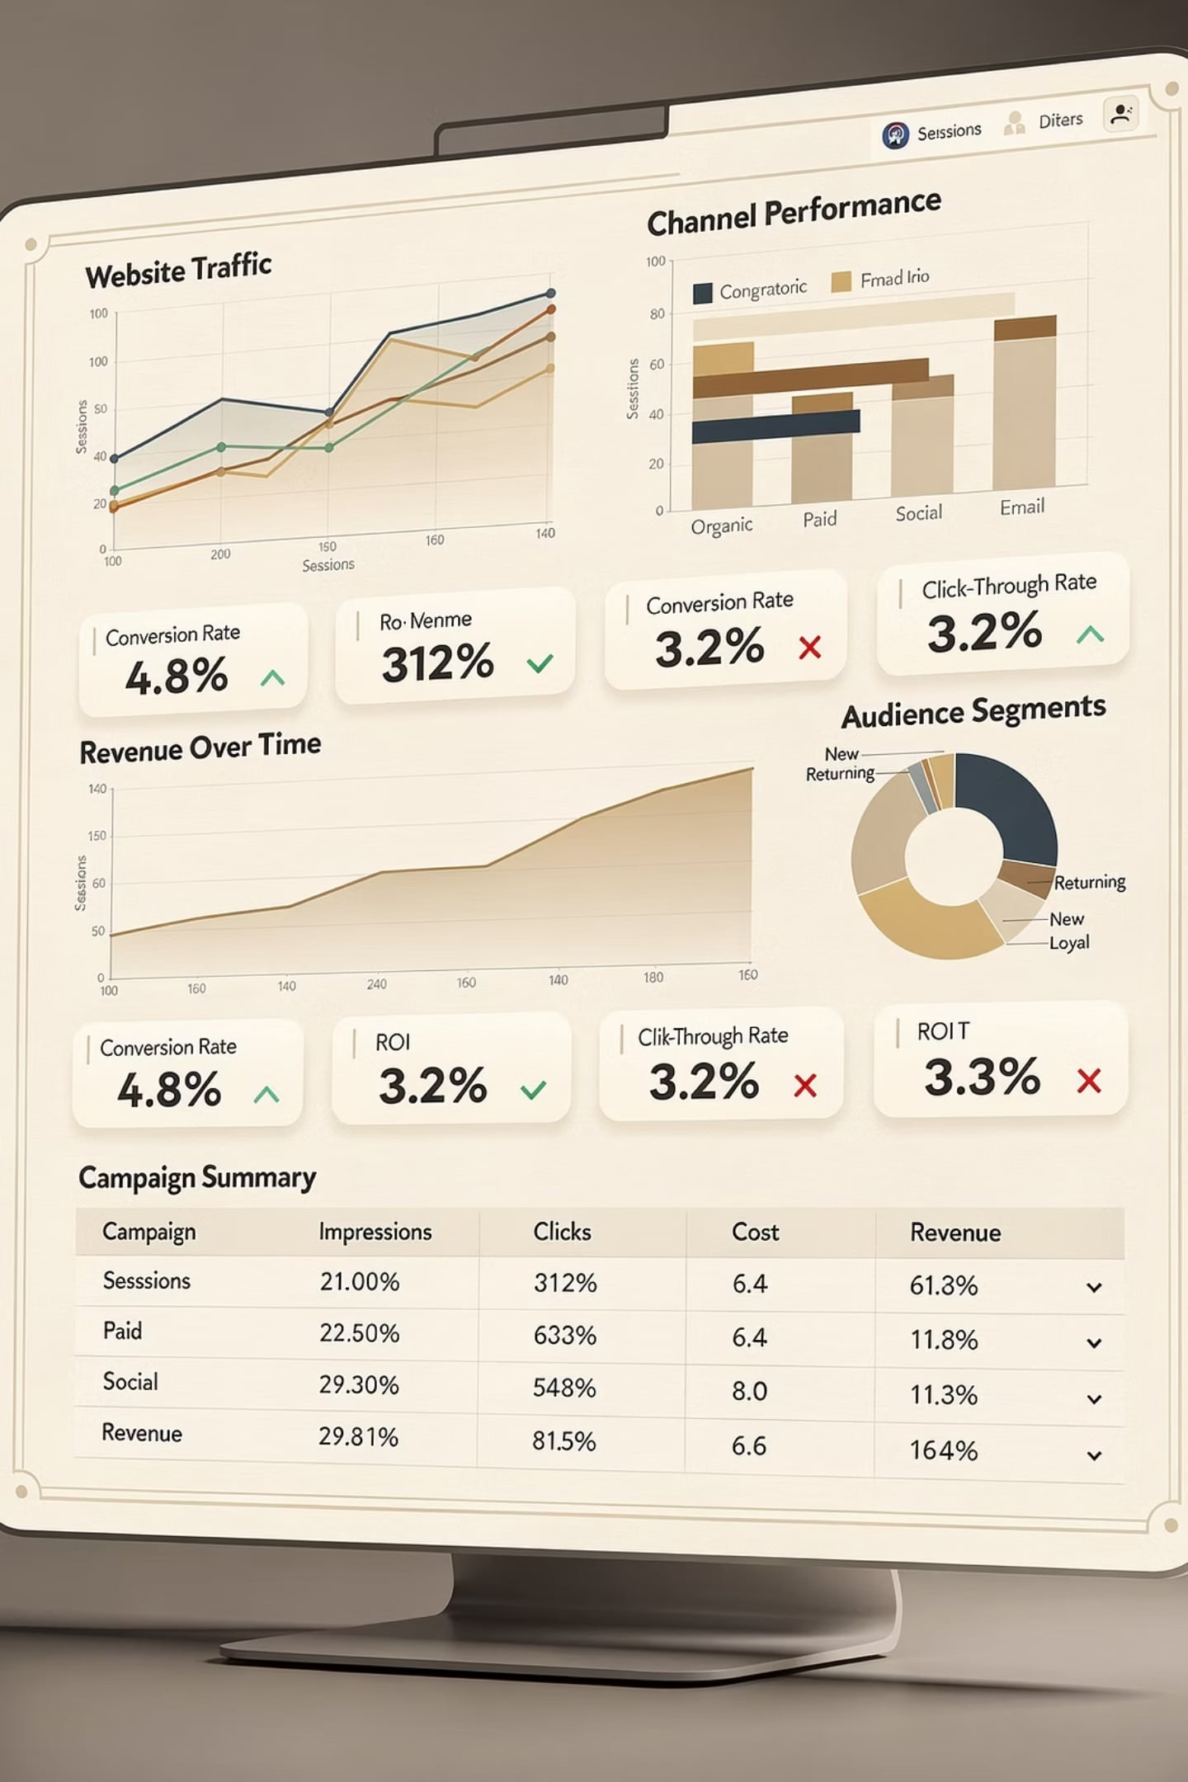







Measuring IMC Effectiveness
Evaluating the success of Integrated Marketing Communications (IMC) campaigns requires a robust framework of key performance indicators (KPIs) that span brand perception to financial returns.
Brand Awareness
Measures the extent to which consumers recognize or recall a brand, indicating its visibility and familiarity within the target market.
Recall
The ability of consumers to remember specific aspects of a marketing message or brand without external cues, crucial for top-of-mind presence.
Engagement Rate
Quantifies audience interaction with content (e.g., likes, shares, comments, clicks), reflecting the resonance and relevance of the communication.
Conversion Rate
The percentage of recipients who complete a desired action, such as making a purchase, signing up for a newsletter, or downloading content.
Return on Investment (ROI)
A financial metric that assesses the profitability of marketing investments by comparing the net profit generated to the cost of the campaign.
Customer Lifetime Value (CLV)
Predicts the total revenue a business can expect to generate from a single customer account throughout their relationship with the company.

Slide 28






The Future of IMC
The Integrated Marketing Communications landscape is rapidly evolving, driven by technological advancements and shifting consumer expectations. Key trends are reshaping how brands connect with their audiences.
AI-driven Personalization
Programmatic Advertising
Leveraging artificial intelligence to deliver highly tailored content and product recommendations, anticipating customer needs and behaviors for hyper-relevant engagement.
Automated, data-driven buying and selling of ad space in real-time. This optimizes campaign performance and efficiency by reaching precise audiences at optimal moments.
Omnichannel Experiences
Data Privacy Evolution
Creating a cohesive and integrated customer journey across all touchpoints—online, offline, mobile, and in-store—ensuring a consistent brand message and experience.
Increasing focus on ethical data collection, transparent usage policies, and robust security measures, with evolving regulations shaping how brands interact with consumer information.
Purpose-Driven Marketing
Brands increasingly align with social and environmental causes, communicating authentic values and contributing to societal well-being to build deeper connections with conscious consumers.

Slide 29
Key Takeaways
IMC coordinates all marketing tools to deliver one unified message across channels.
Communication is a two-way process shaped by noise, feedback, and audience response.
Digital media and multi-screen behavior have transformed how brands reach consumers.
Customer engagement and accountability are central to effective IMC strategy.
The future of IMC is being shaped by AI, data privacy, and omnichannel experiences.

Slide 30

Review Questions
Test your understanding of Integrated Marketing Communications concepts.
1
Describe the communication process and identify each of its components. Why is encoding and decoding important?
2
What is Integrated Marketing Communications (IMC)? How does it differ from traditional advertising?
3
List and briefly describe the five components of the promotional mix.
4
What are the key steps in developing an IMC marketing plan?
5
Explain the concept of brand parity. How does it affect marketing strategy?
6
What is GIMC? How do standardization and adaptation strategies differ?
7
Identify three major trends affecting marketing communications today and explain their impact.
8
Why is accountability and measuring results increasingly important in modern marketing communications?

