Slide 1
Brand Management
ADVERTISING AND INTEGRATED MARKETING COMMUNICATIONS
Week 2 — How brands are built, sustained, and protected
By: Prof. Fidela R. Balajadia

Slide 2
Lecture Learning Objectives
What We'll Cover
01
02
03
Brand Image
Brand Types & Logos
Building Equity
How it affects consumers, businesses, and the company
Categories, characteristics, and design principles
Developing, sustaining, and measuring brand equity
04
05
Private Brands & Packaging
Global Branding
Trends, labels, and IMC support
International strategies and ethical issues

Slide 3
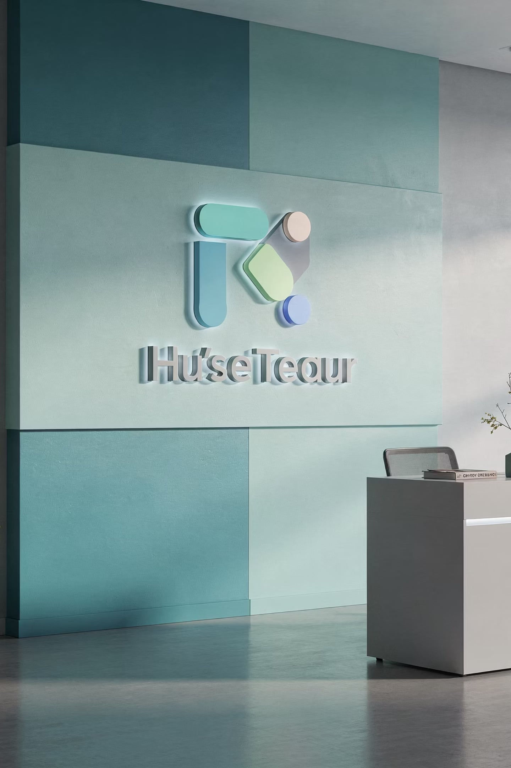
What Is a Brand?
Definition
Brand Image
A word, term, or phrase that names a product, product line, or company
Feelings consumers and businesses have about the organization and its products
IMC Foundation
Brand image is a critical element of every integrated marketing communications plan

Slide 4
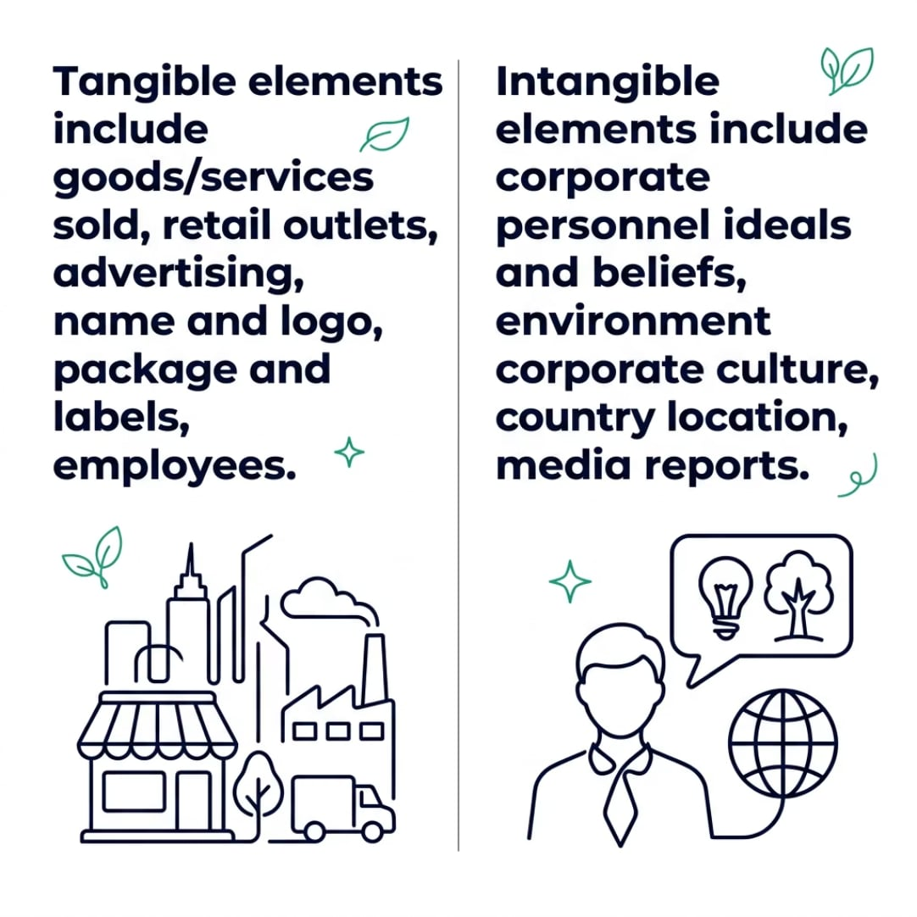

Components of Brand Image
What Shapes Perception?
A recent study ranked these as most important:
Quality of goods and services
Standing behind products when things go wrong
How the firm treats customers
Consumer beliefs about a firm are more important than how company officials perceive the image.

Slide 5




Brand Image: Consumer Benefits
Confidence
Saves Time
Social Acceptance
Assurance about purchase decisions, especially with little prior experience
Reduces search time — loyal Ford buyers spend fewer hours shopping for a new car
Psychological reinforcement and social approval from peers who made the same choice
A can of Coke purchased in California tastes the same in Liverpool or Kuala Lumpur — that's positive assurance.

Slide 6
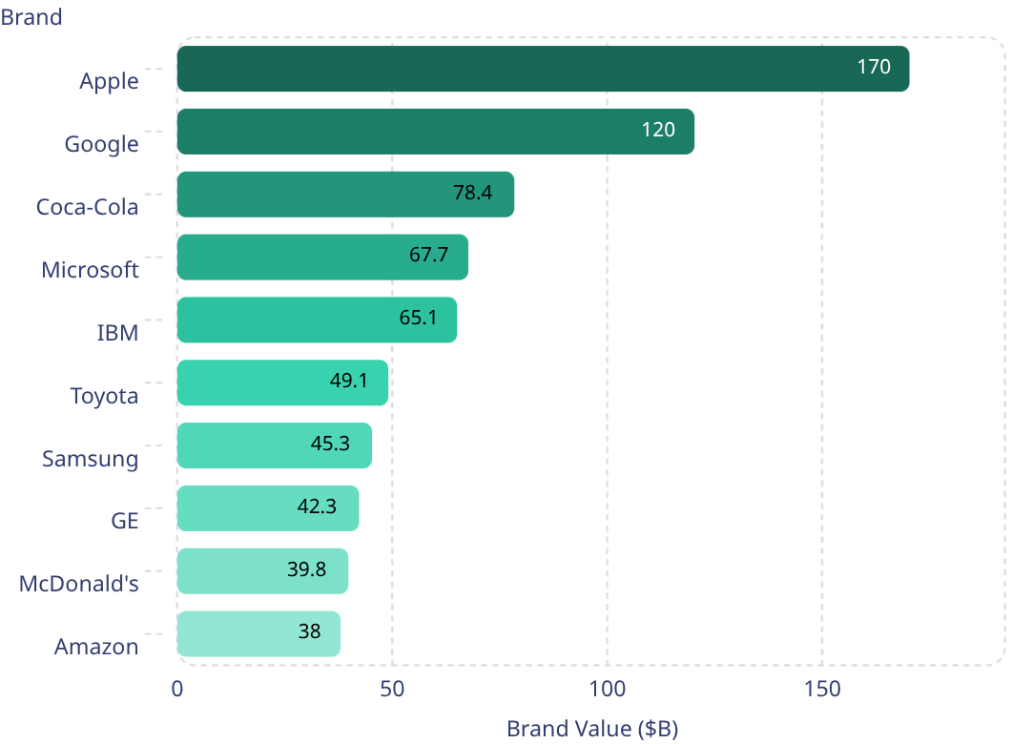

Top 10 Global Brands
Brand Value by the Numbers
Source: Interbrand
Rankings exclude companies with product portfolios under multiple names (e.g., P&G) and privately-held firms.
Apple leads at $170.3B — more than the GDP of many nations.

Slide 7
Brand Image: Company Benefits
New Products
Premium Pricing
Loyalty
Easier launches — customers transfer trust to new offerings
Strong image allows higher prices and improved margins
Loyal customers resist competitor discounts and promotions
Word of Mouth
Talent
Positive endorsements attract new customers organically
Strong reputation attracts quality employees, reducing recruiting costs

Slide 8




Types of Brand Names
Overt
Implied
Reveal what a company does
American Airlines, BMW Motorcycles
Convey what a company does through word parts
FedEx, Home Depot
Conceptual
Iconoclastic
Capture the essence of the offering
Google, Twitter, Krispy Kreme
Unique, different, and memorable
Samsung, Nabisco, Reebok
"The brand name is the cornerstone of a company's relationship with its customers." — David Placek, Lexicon Inc.

Slide 9


Types of Brands
Family Brand
Group of related products under one name — e.g., Campbell's
Brand Extension
Established name on unrelated products — e.g., Nike clothing
Flanker Brand
New brand in same category — e.g., P&G's Gain alongside Tide
Co-Branding
Two or more brands in one offer — ingredient, cooperative, or complementary
Private Brand
Proprietary brand sold exclusively within the retailer's outlets

Slide 10



Brand Logos
Four Tests of a Quality Logo
Logo Design Tips
1
2
Reflects the brand — a cheap logo suggests an inferior brand
Keep it simple — Nike Swoosh, McDonald's arches
Make it media transferrable — print, digital, social
Use professional designers
Best logos transcend cultures globally
Recognizable
Familiar
3
4
Changing logos carries risk — American Airlines learned this through social media backlash.
Consensual Meaning
Evokes Positive Feelings

Slide 11




Brand Equity: Building Intangible Value
Brand equity represents the additional value that a brand adds to a product or service beyond its functional benefits. It's the premium customers are willing to pay, the preference they show, and the trust they place in a name, even when the physical offerings might be similar. Essentially, it's the sum of a consumer's experiences and perceptions of a brand.
This intangible asset is crucial because it drives customer choice, fosters loyalty, allows for premium pricing, and provides a competitive advantage. Strong brand equity can cushion a company during market downturns and amplify success during growth periods.
The Four Dimensions of Brand Equity
Brand Awareness
Brand Loyalty
The extent to which consumers can recognize and recall a brand, whether unaided or aided.
The likelihood of consumers repeatedly purchasing a brand and resisting competitor offerings.
Perceived Quality
Brand Associations
The consumer's subjective judgment about a product or service's overall superiority or excellence.
All attributes, benefits, attitudes, and connections that consumers link to a brand in their memory.

Slide 12





Building Brand Equity: A Strategic Blueprint
Building strong brand equity is not an overnight task; it's a deliberate and sustained effort that involves a holistic approach to every touchpoint consumers have with a brand. It requires commitment, consistency, and a deep understanding of what truly resonates with your audience.
Deliver Superior Quality
Maintain Consistent Messaging
Cultivate Exceptional Customer Experiences
Foundational to any strong brand, consistently offering high-quality products or services builds trust and credibility with customers.
Every communication, from advertising to packaging, should convey a clear, unified brand story, tone, and visual identity.
Positive interactions at every stage of the customer journey foster loyalty and create strong, favorable associations with the brand.
Forge Emotional Connections
Build a Thriving Community
Beyond functional benefits, successful brands tap into consumer emotions, creating deeper, more meaningful relationships.
Encourage interaction among customers and foster a sense of belonging, transforming users into passionate advocates.

Slide 13
Measuring Brand Equity: Quantifying Your Intangible Asset
Understanding the theoretical dimensions of brand equity is crucial, but equally important is the ability to measure it. Quantifying brand equity allows businesses to track performance, justify investments, and make informed strategic decisions. There are generally three main approaches to measuring this valuable intangible asset, each offering unique insights.

Slide 14
Sustaining Brand Equity: The Long Game
Building strong brand equity is only half the battle; the real challenge lies in protecting and sustaining it over time. This requires continuous vigilance, strategic adaptation, and an unwavering commitment to core brand values. Brands are dynamic assets that can appreciate or depreciate based on internal actions and external market forces.
Brand Consistency
Regular Audits
Crisis Management
Maintain a unified message, visual identity, and customer experience across all touchpoints to reinforce brand values.
Periodically assess brand health, identify strengths and weaknesses, and ensure alignment with strategic objectives.
Develop swift and transparent response plans to protect brand reputation during unforeseen challenges.
Adapt to Market Changes
Avoid Brand Dilution
Evolve the brand to stay relevant with changing consumer preferences and competitive landscapes, without losing core identity.
Guard against overextension or association with too many unrelated products/services that can weaken brand meaning and value.

Slide 15

Private Brands: A Strategic Shift in Retail
Private brands, also known as store brands or own brands, are products exclusively manufactured for and sold by a specific retailer. Once perceived as budget alternatives, these brands have undergone a significant transformation, now representing a strategic pillar for retailers and a compelling value proposition for consumers.
Their surge in popularity is driven by a confluence of factors, including economic pressures encouraging value-seeking, improved product quality, and retailers' increasing investment in developing distinctive and compelling private label offerings.
National Brands: Established & Recognized
Private Brands: Value & Retailer Power
Owned by the retailer themselves, private brands are developed to offer consumers competitive alternatives, often directly challenging national brand dominance by focusing on value and quality.
Traditionally dominating market share, national brands are products from manufacturers that are sold across various retailers. They heavily invest in marketing and innovation to build strong brand recognition and consumer loyalty.
Retailer Benefits: Higher profit margins, exclusive product differentiation, enhanced customer loyalty to the store, and greater control over supply chain and pricing.
Consumer Benefits: More affordable price points, often comparable or even superior quality to national brands, and increased choice leading to better value for money.
Market Impact: Forces national brands to innovate, optimize pricing, or risk losing market share.
High advertising and marketing expenditures.
Broad distribution across numerous retail channels.
Often positioned as premium or innovative options.
Established consumer trust, sometimes commanding higher prices.

Slide 16




Packaging: Your Brand's Silent Salesperson
Far more than a mere container, product packaging is a pivotal element in brand strategy, serving multifaceted roles that extend from protecting contents to influencing purchase decisions and reinforcing brand identity.
Functional Imperative
Communication Catalyst
Marketing Powerhouse
Ensuring product safety, integrity, and ease of use. This includes protection during transit, maintaining freshness, and providing convenient storage solutions for the consumer.
The primary visual ambassador for your brand, communicating essential information, brand values, and product benefits at a glance. It's where brand identity meets product utility.
Designed to capture attention on the crowded shelf, trigger impulse buys, and create a memorable unboxing experience. It acts as a silent salesperson, persuading without a word.

Slide 17
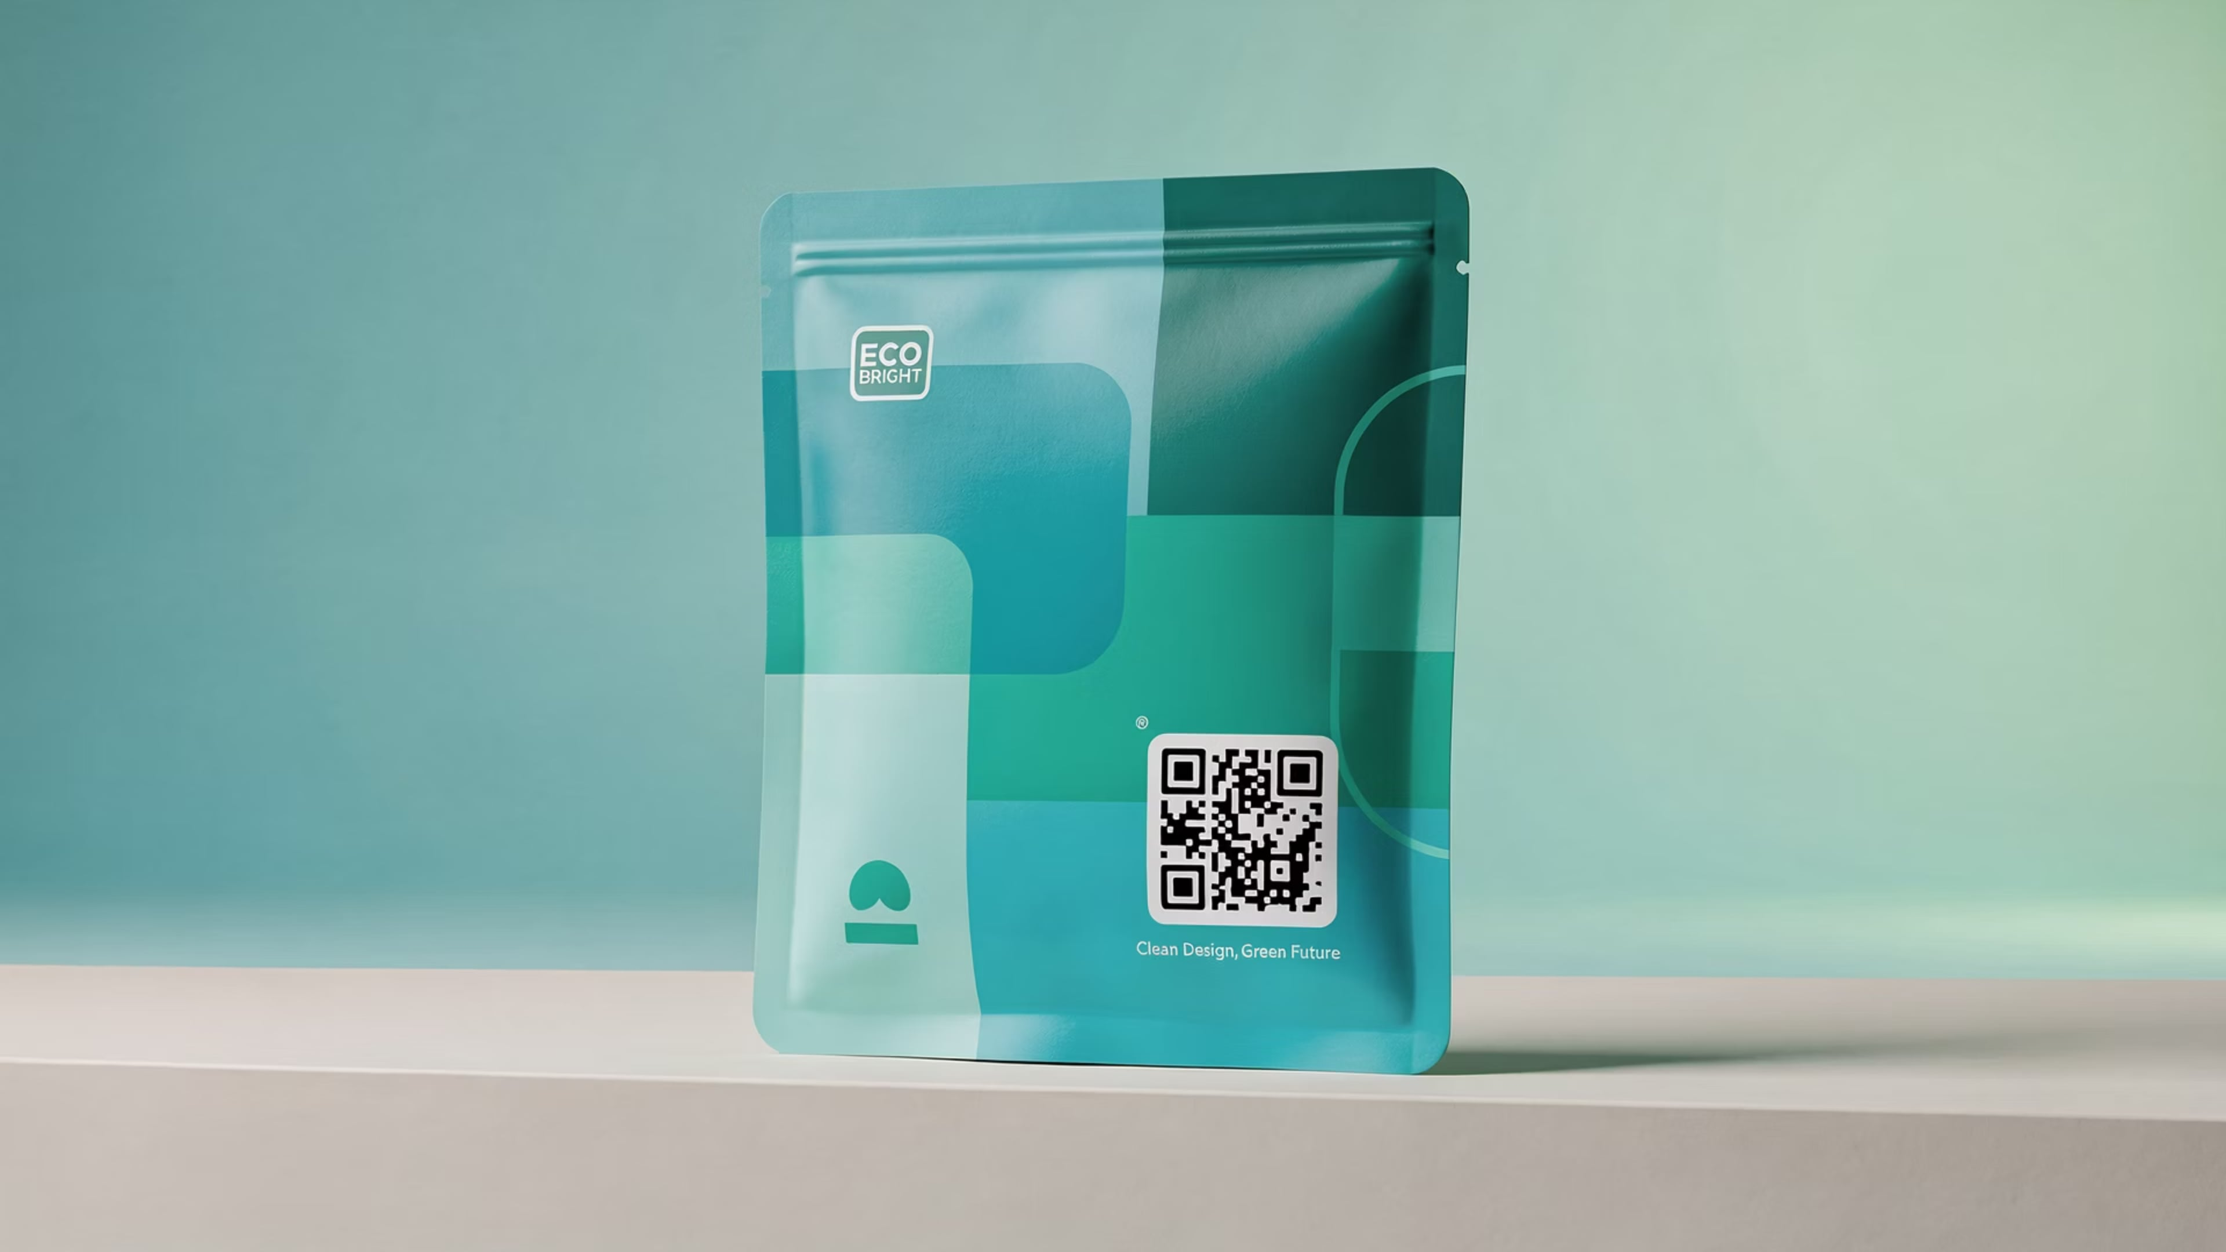





Packaging Design Trends: Shaping Tomorrow's Shelf
The world of packaging is constantly evolving, driven by consumer demands, technological advancements, and a growing consciousness. Staying ahead of these key trends is crucial for brands looking to connect with modern consumers and stand out in a competitive market.
Sustainable & Eco-Friendly
Minimalist Aesthetics
Smart & Connected
A non-negotiable for many, embracing recyclable, biodegradable, or renewable materials, along with reduced packaging waste.
Less is more. Clean lines, simple typography, and ample white space convey sophistication and focus on product essence.
Integrating QR codes, NFC tags, and AR experiences to offer digital content, product transparency, or interactive engagement.
Personalization
Premium Unboxing
Tailored designs or variable data printing that makes each package feel unique, fostering a deeper connection with the consumer.
Elevating the moment of opening into a memorable experience, often seen in e-commerce, enhancing perceived value and brand loyalty.

Slide 18




Product Labeling: Beyond the Barcode
Product labels are miniature billboards and vital information hubs, communicating critical details and reinforcing brand identity with every glance.
Types of Labels
Key Legal Requirements
Brand Label: Identifies the product and its maker.
Grade Label: Indicates quality level (e.g., USDA Grade A).
Descriptive Label: Provides product use, care, or features.
Informational Label: Details ingredients, nutrition facts, warnings.
FDA: Food, drug, cosmetic, and medical device labeling regulations.
FTC: Ensures advertising and marketing claims are truthful.
Country of Origin: Mandates disclosure of product origin.
Specific Industry Laws: Alcohol, tobacco, chemicals, etc.

Slide 19
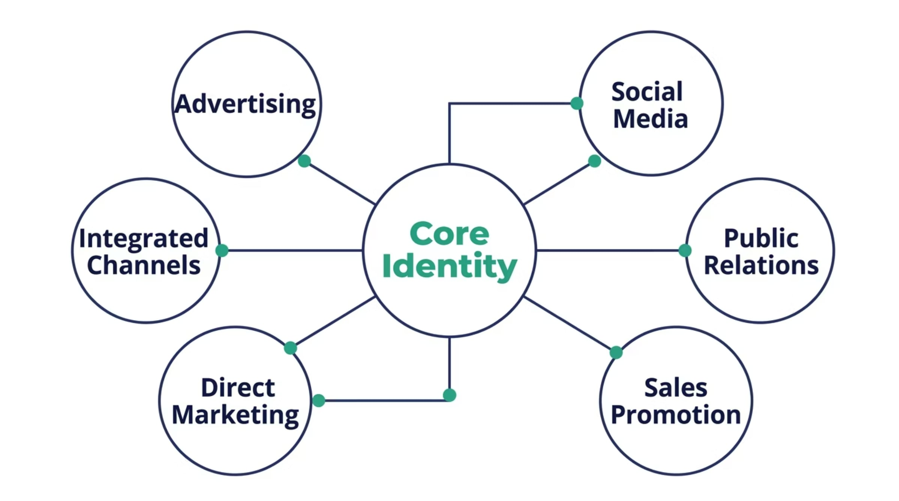
Integrated Marketing Communications: A Unified Voice
In today's fragmented media landscape, ensuring your brand speaks with one voice across all channels is paramount. Integrated Marketing Communications (IMC) is the strategic approach that harmonizes every touchpoint to build a cohesive and powerful brand image.

Slide 20

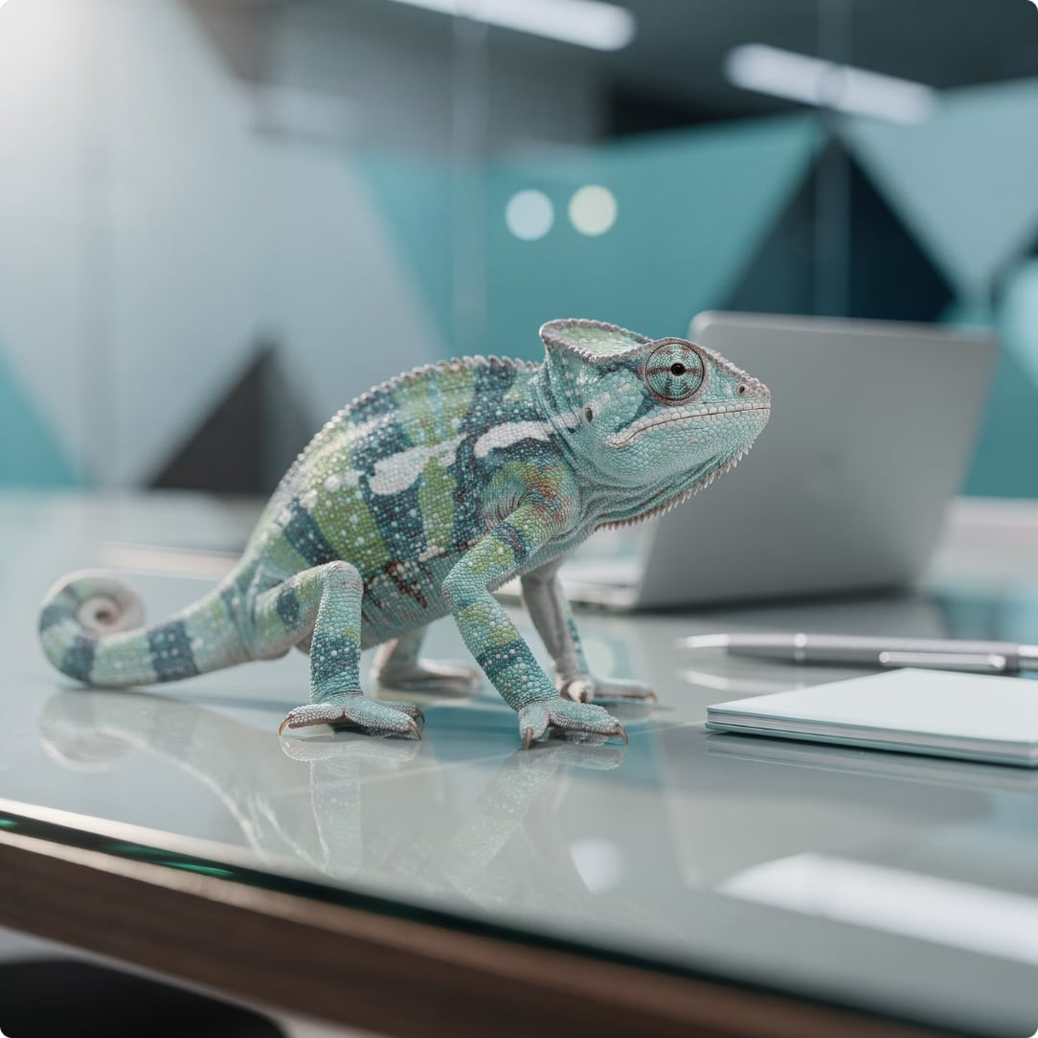
Global Branding: Expanding Horizons
As businesses look beyond domestic markets, global branding emerges as a critical strategy. It's about building a consistent brand identity that resonates across diverse cultures and geographies, driving recognition and trust worldwide.
STRATEGY
STRATEGY
Standardization
Adaptation
Maintain a uniform brand message, product, and marketing mix across all international markets.
Tailor brand elements, products, and marketing to fit local cultures, preferences, and regulations.
Cost-effective production
Consistent global image
Simpler management
Increased local relevance
Better market penetration
Higher customer acceptance

Slide 21
Global Branding Strategies
Navigating international markets requires a clear approach to brand management. Different strategies allow brands to maximize impact while respecting local nuances.
Global Brand
Glocal Brand
Local Brand
A unified brand identity and message maintained consistently across all markets worldwide, leveraging universal appeal and economies of scale. Think Apple.
Combines global brand recognition with significant local adaptation in products, marketing, and communication to resonate with cultural preferences. Like KFC in Asia.
A brand developed exclusively for a specific country or region, tailored entirely to local tastes, regulations, and competitive landscapes. For instance, Jollibee in the Philippines.
Licensed Brand
Brand rights are sold to local partners who produce and market the product in their territory, allowing broader reach without direct investment. E.g., Many fashion labels in different countries.

Slide 22




Cultural Considerations in Global Branding
Successful global branding goes beyond language; it requires a deep understanding of diverse cultural nuances. Ignoring these can lead to missteps and damage brand perception.
Language & Translation
Color Symbolism
Literal translations can lead to unintended meanings or even offense. Chevy Nova's "no va" (doesn't go) in Spanish markets is a classic example.
Colors evoke different emotions and meanings. White, a symbol of purity in the West, signifies mourning in many Asian cultures. Black can represent evil or sophistication.
Symbols & Taboos
Cultural Research
Images, gestures, and numbers carry cultural weight. An "OK" sign in the US is offensive in some Latin American countries. Religious symbols require utmost sensitivity.
Thorough local research is paramount. Understanding consumer behavior, values, and traditions ensures branding resonates positively and avoids costly errors.

Slide 23


Ethical Issues in Global Branding
Navigating international markets brings unique ethical challenges. Brands must uphold universal values while respecting local contexts to maintain trust and avoid negative impacts.
Cultural Appropriation
Misleading Claims
Environmental Responsibility
Using traditional motifs or practices without understanding, respect, or attribution, often leading to commodification.
Exaggerating product benefits or safety in developing markets with less consumer protection or regulatory oversight.
Failing to adopt sustainable practices globally, contributing to pollution or resource depletion in host countries.
Labor Practices
Brand Accountability
Overlooking exploitative labor conditions, child labor, or unsafe working environments in global supply chains.
Lack of transparency and responsibility for negative social or economic impacts of brand operations worldwide.

Slide 24
Brand Positioning Strategies
Brand positioning defines the unique place a brand occupies in the consumer's mind, distinguishing it from competitors and highlighting its value proposition. It's about shaping perception to create a strong, favorable, and distinctive image.
1
By Attribute
Focuses on a specific product feature or characteristic. E.g., Volvo for safety, or a smartphone highlighting its camera quality.
2
By Benefit
Emphasizes the value or outcome the consumer receives. E.g., Crest for cavity prevention, or a mattress brand for better sleep.
3
By Use/Application
Positions the brand for a particular usage occasion or specific purpose. E.g., Gatorade for rehydration during sports, or baking soda for cleaning.
4
By User
Targets a specific consumer group or lifestyle. E.g., Harley-Davidson for rugged individualists, or baby food brands for new parents.
5
By Competitor
Positions the brand directly against a rival, highlighting superior aspects. E.g., Avis's "We Try Harder" against Hertz, or smartphone OS wars.
6
By Price/Quality
Emphasizes either premium quality at a higher price or value at a lower price. E.g., Rolex for luxury, Walmart for everyday low prices.

Slide 25
Brand Repositioning
Brand repositioning involves strategically altering a brand's identity, messaging, or target market to adapt to changing consumer perceptions, market trends, or competitive landscapes. It's about giving an established brand a fresh narrative and purpose.
What & Why (Market)
Changing market dynamics, new competitive threats, or evolving consumer needs often necessitate a strategic shift in how a brand is perceived.
Why (Image) & How
An outdated brand image or the pursuit of a new target audience are key drivers. Success requires deep market research, a clear new value proposition, and consistent communication.
Old Spice
Transformed from an "old man's aftershave" to a playful, vibrant brand for younger men through humorous and memorable campaigns.
Burberry
Elevated its image from mass-market to exclusive luxury by consolidating product lines, controlling distribution, and embracing digital innovation.
Mountain Dew
Shifted from a rural Appalachian drink to a high-energy beverage associated with extreme sports and youth culture.

Slide 26









Fostering Brand Loyalty
Brand loyalty is the ultimate goal for any business: customers repeatedly choose your products or services, often overlooking competitors. It's built on trust, consistent positive experiences, and emotional connection.
Advocacy
1
Customers actively promote the brand.
2
Loyalty
Regular, exclusive purchasing behavior.
3
Preference
Customers choose brand over others, but not exclusively.
4
Trial
Initial purchase or engagement with the brand.
5
Awareness
Customers recognize the brand's existence.
Loyal customers are invaluable. They not only provide higher lifetime value but also reduce customer acquisition costs through positive word-of-mouth.
Building Lasting Connections
Rewards Programs
Personalization
Incentivize repeat purchases and engagement.
Tailored experiences and communication.
Community
Consistent Quality
Foster a sense of belonging among customers.
Reliably meet or exceed customer expectations.

Slide 27




Brand Communities: Cultivating a Collective Passion
Brand communities are groups of passionate customers united by a shared connection to a brand, transcending simple transactional relationships to form a powerful collective identity and voice.
Defining the Collective
Amplifying Brand Equity
Formation & Engagement
More than just customers, members share values and interact around a central brand, fostering a sense of belonging.
Communities act as powerful advocates, generating organic buzz, providing feedback, and deepening emotional ties to the brand.
They thrive through online forums, fan clubs, exclusive events, and social media groups, creating rich interaction spaces.
Iconic Examples of Brand Communities
1
2
3
Harley Owners Group (HOG)
LEGO Ideas
Nike Run Club
A global community fostering camaraderie and shared experiences among Harley-Davidson motorcycle enthusiasts.
An online platform empowering fans to submit, vote on, and co-create new LEGO product concepts, directly influencing the brand's offerings.
An app and community connecting runners worldwide, offering tracking, coaching, and a shared sense of accomplishment.

Slide 28






Brand Crisis & Recovery
Even the strongest brands can face unforeseen challenges. Effective crisis management is crucial for protecting reputation and ensuring long-term trust.
Common Brand Crises
Product Failure
Defects, safety issues, or poor performance.
PR Scandal
Negative public perception from actions or statements.
Social Media Backlash
Rapid viral outrage and negative sentiment.
CEO Misconduct
Leadership actions damaging brand integrity.
The Crisis Response Framework
Acknowledge
Act quickly and take responsibility.
Act
Implement solutions to resolve the issue.
Communicate
Maintain transparent dialogue with stakeholders.
Rebuild
Restore trust and brand equity.
Lessons From Real Cases
Tylenol Crisis (J&J)
United Airlines (Passenger Removal)
Swift, transparent recall and public safety focus set the gold standard.
Poor initial response exacerbated public outrage, highlighting transparency needs.
Pepsi (Kendall Jenner Ad)
Demonstrated the risk of tone-deaf messaging in sensitive social contexts.

Slide 29






Digital Branding: Navigating the Online Ecosystem
In today's interconnected world, effective branding extends far beyond traditional advertising. It's about cultivating a dynamic online presence, engaging communities, and managing reputation across diverse digital touchpoints.
Social Media Branding
Influencer Marketing
User-Generated Content (UGC)
Crafting a consistent voice and visual identity across platforms to foster direct engagement and build community.
Partnering with credible online personalities to reach targeted audiences authentically and expand brand reach.
Harnessing authentic content created by customers to build trust, demonstrate product value, and drive advocacy.
SEO & Brand Visibility
Online Reputation Management
Optimizing online content to rank higher in search results, ensuring discoverability and relevance to potential customers.
Proactively monitoring and addressing online feedback and mentions to maintain a positive and trusted brand image.

Slide 30





The Future of Branding: Emerging Horizons
As technology accelerates and consumer values evolve, branding faces new frontiers. Staying ahead means embracing innovation, authenticity, and immersive experiences.
AI-Powered Personalization
Hyper-targeted experiences and content delivery, anticipating individual needs.
Purpose-Driven Branding
Authenticity and commitment to social and environmental responsibility.
Metaverse & Virtual Branding
Building immersive brand presence and interactive experiences in digital worlds.
Voice Branding
Crafting distinct audio identities for intelligent assistants and voice interfaces.
Radical Transparency
Openness in operations, supply chains, and social impact to build deep trust.

Slide 31
Module Summary & Key Takeaways
We've embarked on a comprehensive journey through the multifaceted world of branding. Here’s a recap of the core concepts that define a powerful brand:
Brand Definition & Essence
Brand Image & Perception
Brand Equity & Value
Understanding what a brand truly represents beyond a product or service.
How consumers perceive and connect with a brand, shaped by every interaction.
The added value a brand name gives to a product beyond the functional benefits.
Diverse Brand Types
Visual Identity (Logos, Packaging, Labeling)
Integrated Marketing Communications (IMC)
Exploring different classifications, from corporate to personal brands.
Crafting distinctive visual elements that communicate brand personality.
Coordinating all marketing channels for a consistent, unified brand message.
Global Branding Strategies
Strategic Positioning
Cultivating Brand Loyalty
Navigating cultural nuances and market differences for international reach.
Defining a unique space in the consumer's mind relative to competitors.
Building strong, lasting relationships that foster repeat business and advocacy.
Digital Branding Evolution
The Future of Branding
Adapting to the online ecosystem through social media, SEO, and reputation management.
Embracing AI, metaverse, and radical transparency for tomorrow's challenges.

Slide 32
Review Questions
1
What is the difference between a brand name and brand image? Give an example of a brand with a strong image and explain what contributes to it.
2
Identify and explain the three key benefits of brand image for consumers. Which do you think is most important, and why?
3
What are the four dimensions of brand equity? How does a company build and sustain each one over time?
4
Compare and contrast family brands, brand extensions, and flanker brands. When would a company choose each strategy?
5
What makes a logo effective? Apply the four tests of a quality logo to a brand of your choice.
6
What is the difference between standardization and adaptation in global branding? Give a real-world example of each.
7
Why is brand positioning important in a crowded market? Choose one positioning strategy and explain how a brand uses it effectively.
8
How should a brand respond to a crisis? Use one of the case studies from this module to support your answer.

