Slide 1
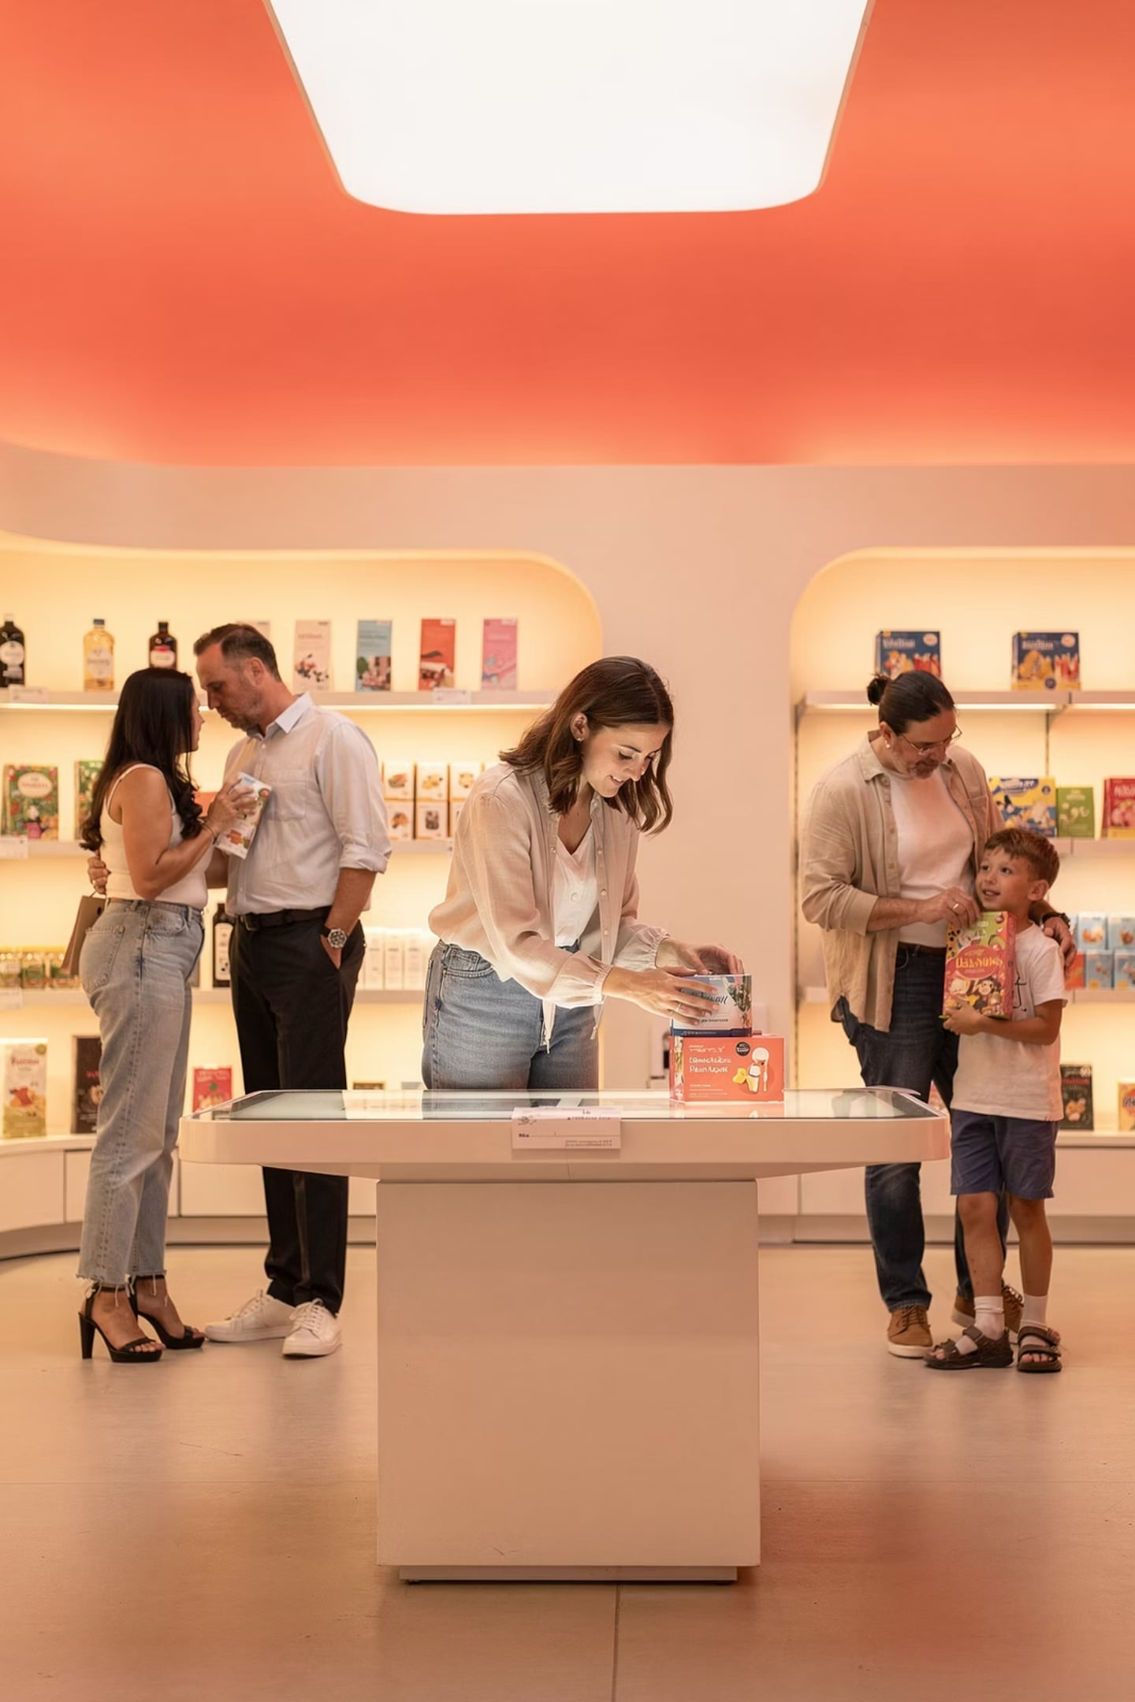
Buyer Behaviors
Advertising and Integrated Marketing Communications
Week 3 - How consumers and businesses make purchase decisions — and what it means for IMC
By: Prof. Fidela R. Balajadia

Slide 2
Lecture Learning Objectives:
01
02
Information Search
Evaluation Models
Internal & external search elements
Three models for evaluating alternatives
03
04
Consumer Trends
B2B Behaviors
Trends shaping the buying environment
Buying center roles, purchase types, dual channel marketing

Slide 3
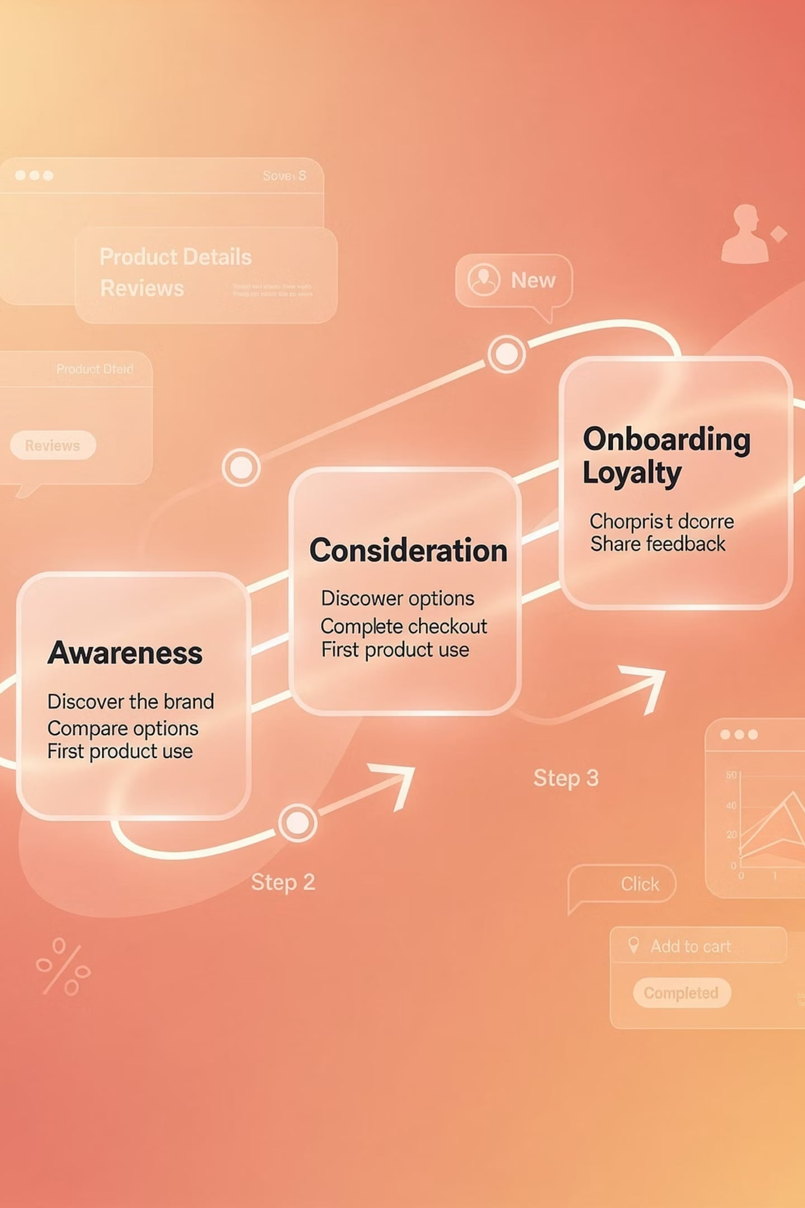

The Consumer Buying Process
Five steps: Need Recognition → Information Search → Evaluation of Alternatives → Purchase → Post-Purchase
IMC focuses most on the information search and evaluation of alternatives stages.

Slide 4
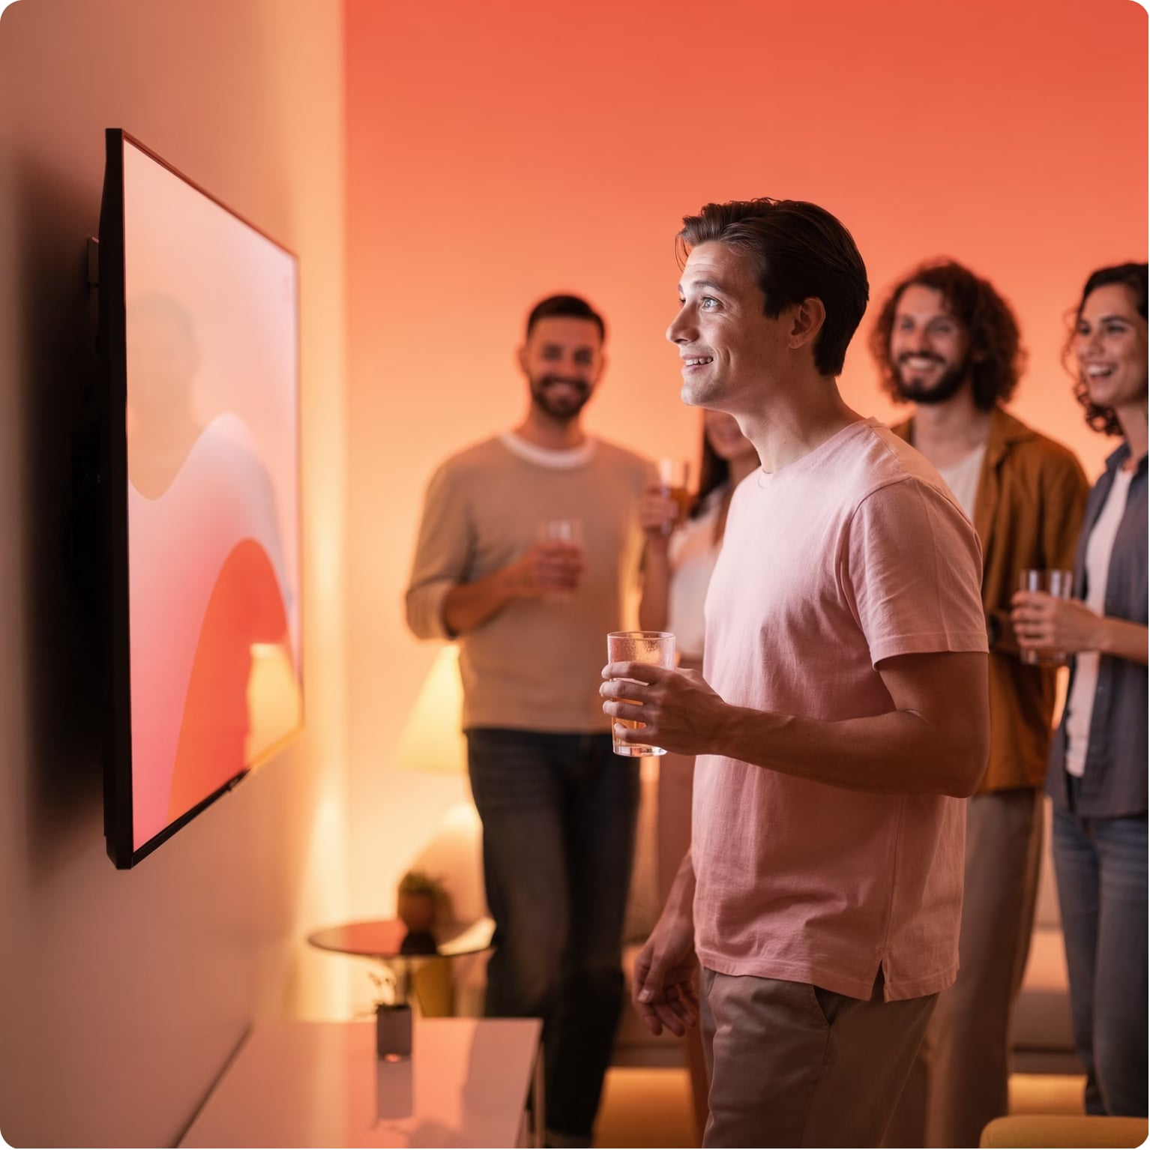
Need Recognition
Types of Needs
Physical
Hunger, thirst
Social
Seeing a friend's new HDTV
Psychological
Desire for love or protection
Marketing communications can also trigger consumer needs.

Slide 5
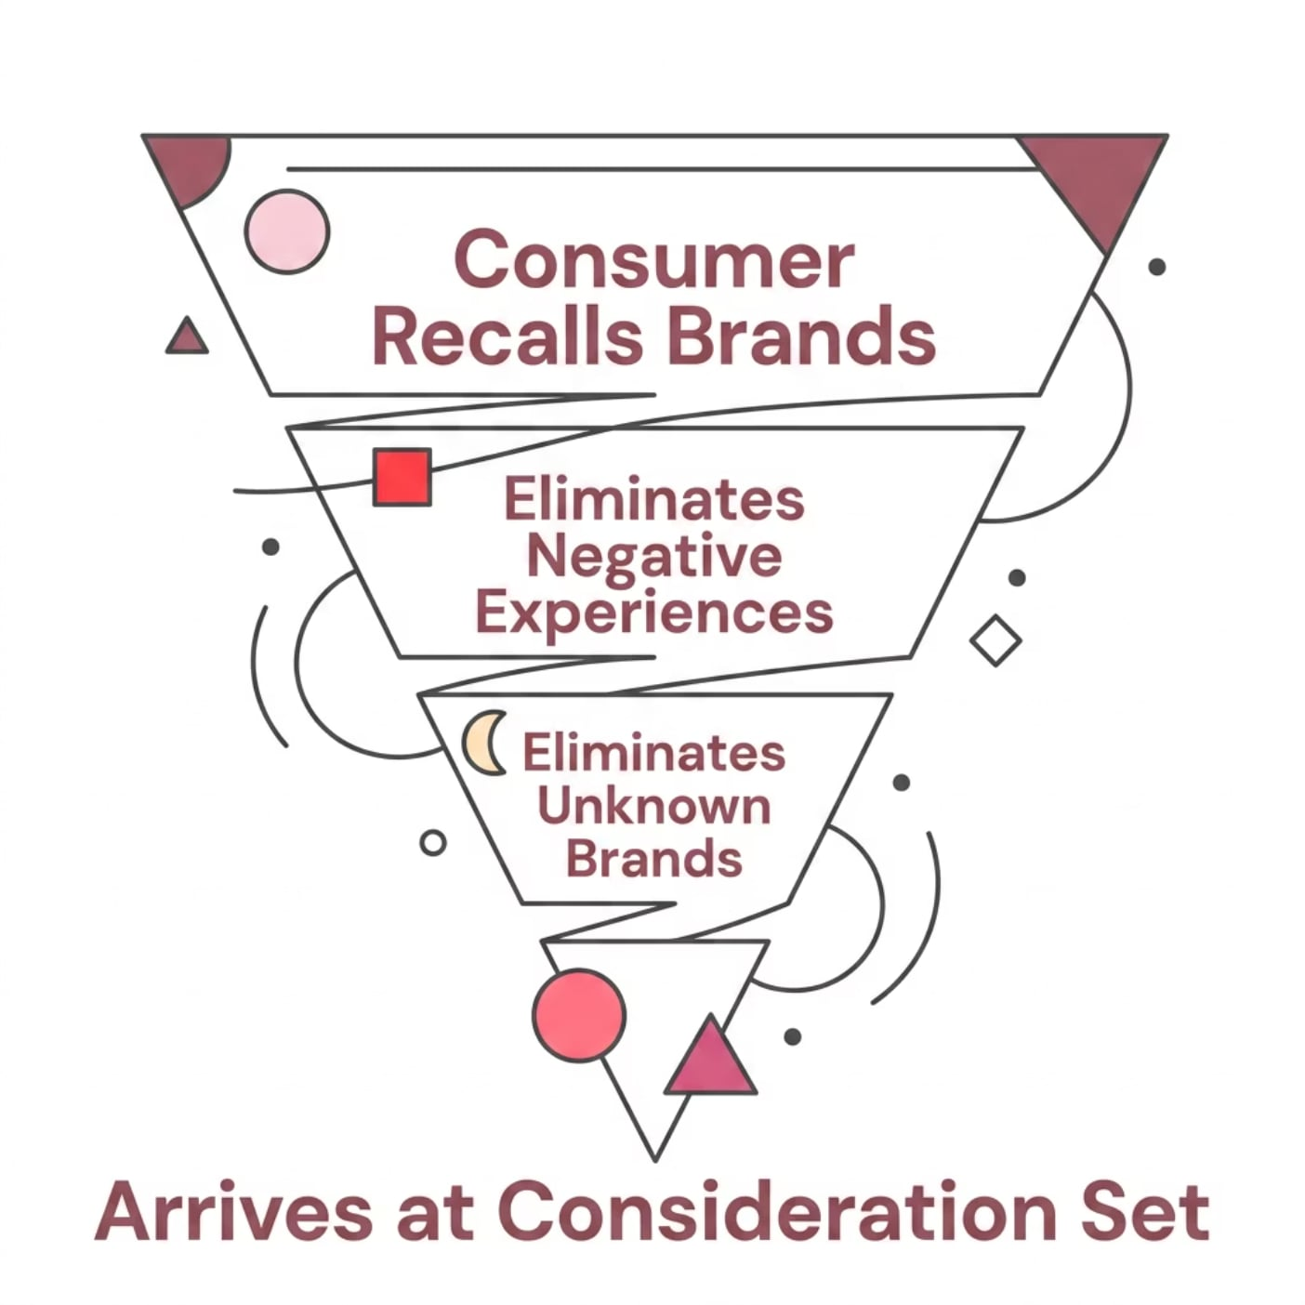

Internal Search
What Happens
Consumer mentally recalls brands that might satisfy the need — eliminating those with negative experiences or little knowledge.
Key IMC goal: ensure your brand is in the consumer's set of potential alternatives.

Slide 6




External Search
When internal information is insufficient, consumers seek outside sources: friends, experts, ads, social media, in-store displays.
Ability
Motivation
Education & product knowledge
Involvement, cognition, shopping enthusiasm
Costs vs. Benefits
Perceived value of searching

Slide 7
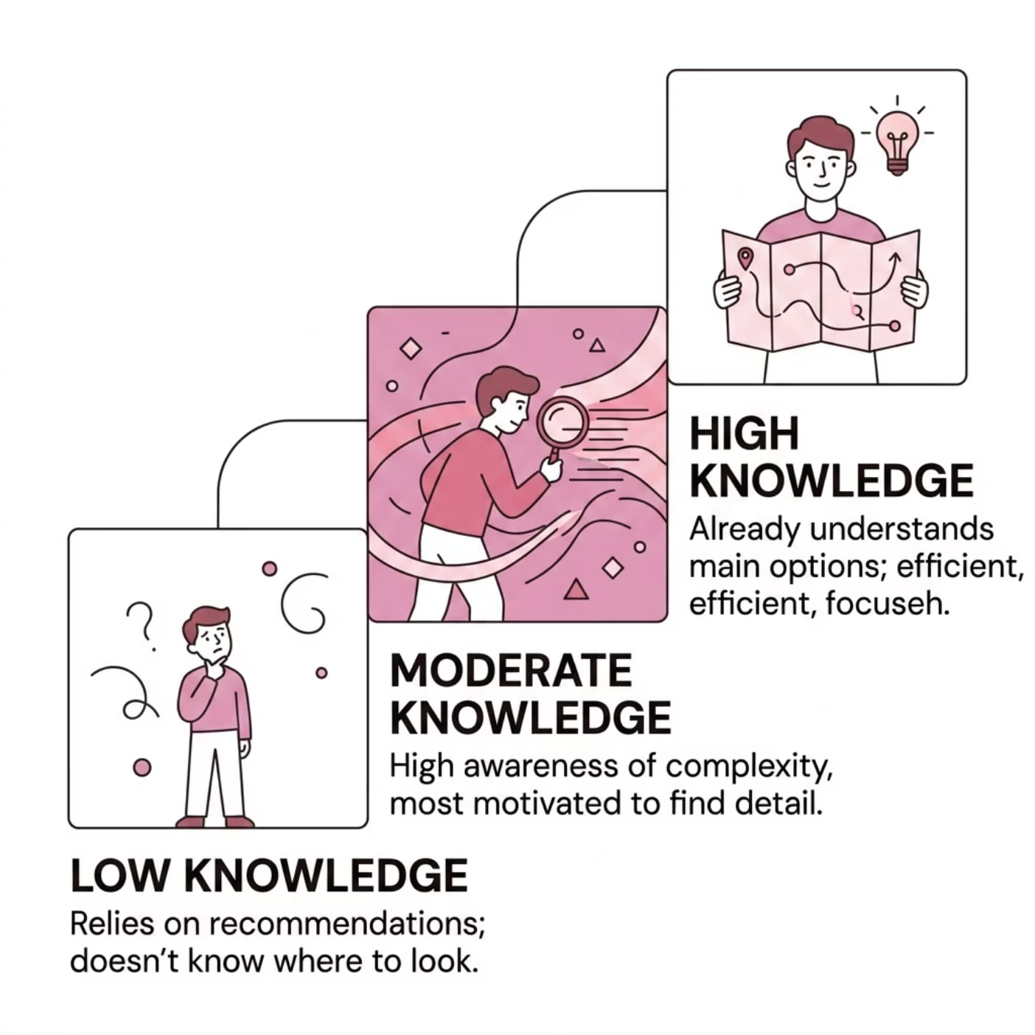
Ability to Search
The Knowledge Paradox
Low knowledge: can't identify useful info — searches less
Moderate knowledge: needs more info — searches most
High knowledge: already informed — searches less

Slide 8

Motivation & Costs vs. Benefits
Involvement
Need for Cognition
Higher stakes = more search. Prom tuxedo vs. everyday jeans.
People who enjoy mental activity gather more information.
Shopping Enthusiasm
Perceived Cost
Consumers who enjoy shopping search more deeply.
Time, anxiety, opportunity cost — all reduce search likelihood.

Slide 9


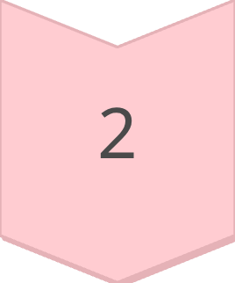
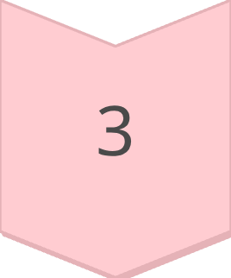
Consumer Attitudes
An attitude is a mental position toward a topic that influences feelings, perceptions, and behaviors.
Affective
Feelings & emotions
Cognitive
Mental images & understanding
Conative
Intentions & actions
These components combine in different sequences: Cognitive→Affective→Conative, Affective→Conative→Cognitive, or Conative→Cognitive→Affective.

Slide 10
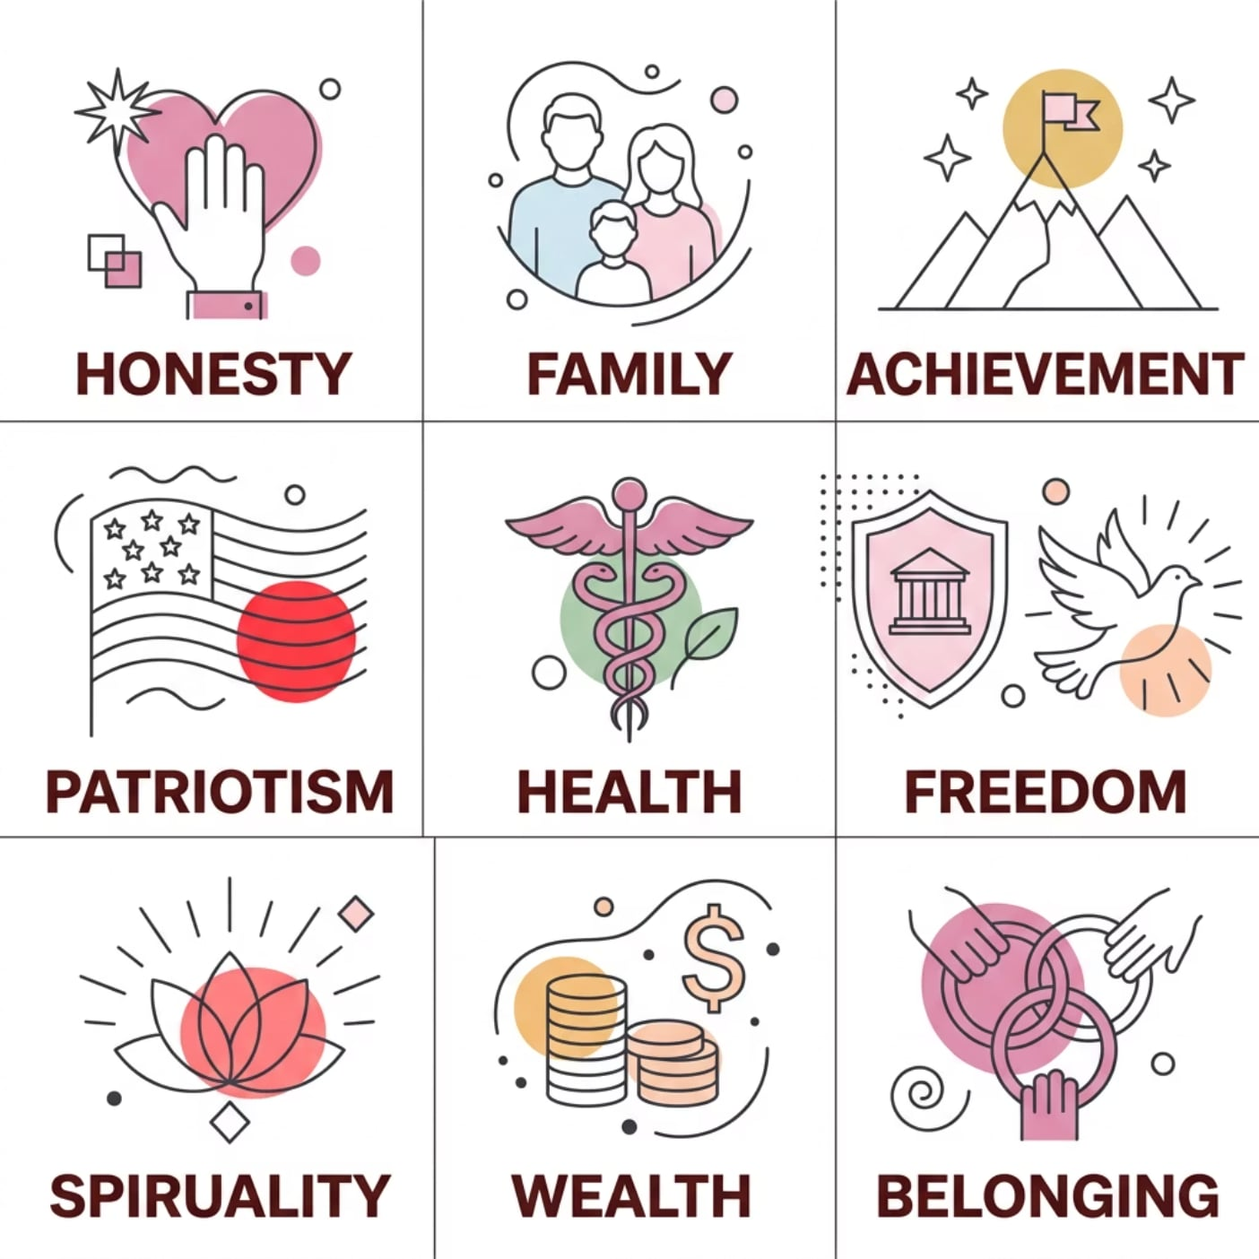

Consumer Values
What Are Values?
Strongly held beliefs that frame attitudes and guide personal actions. Shaped by personality, environment, and culture.
Brand Keys survey: Jeep ranked #1 most patriotic brand, followed by Hershey's, Coca-Cola, Levi Strauss, and Disney.
Marketers align products with universal values like patriotism to build brand equity.

Slide 11

Cognitive Mapping
Cognitive maps simulate the knowledge structures and memories in an individual's mind — beliefs, feelings, and interpretations that shape responses to new information.
Strengthen Linkages
Create New Linkages
Consistent messages reinforce existing brand connections.
New messages build fresh associations (e.g., Ruby Tuesday = good food).
Repetition is Key
Short-term memory holds only 5–9 items; repetition moves info to long-term memory.

Slide 12

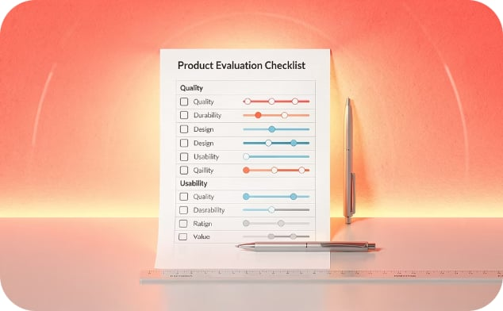

Evaluation of Alternatives
THREE MODELS
Evoked Set
Multiattribute
Affect Referral
Brands the consumer actively considers. Goal: get your brand in the evoked set.
Rates brands on key attributes weighted by importance. Used for high-involvement purchases.
Choose the brand you like best. Saves mental energy; used for low-involvement, repeat purchases.

Slide 13
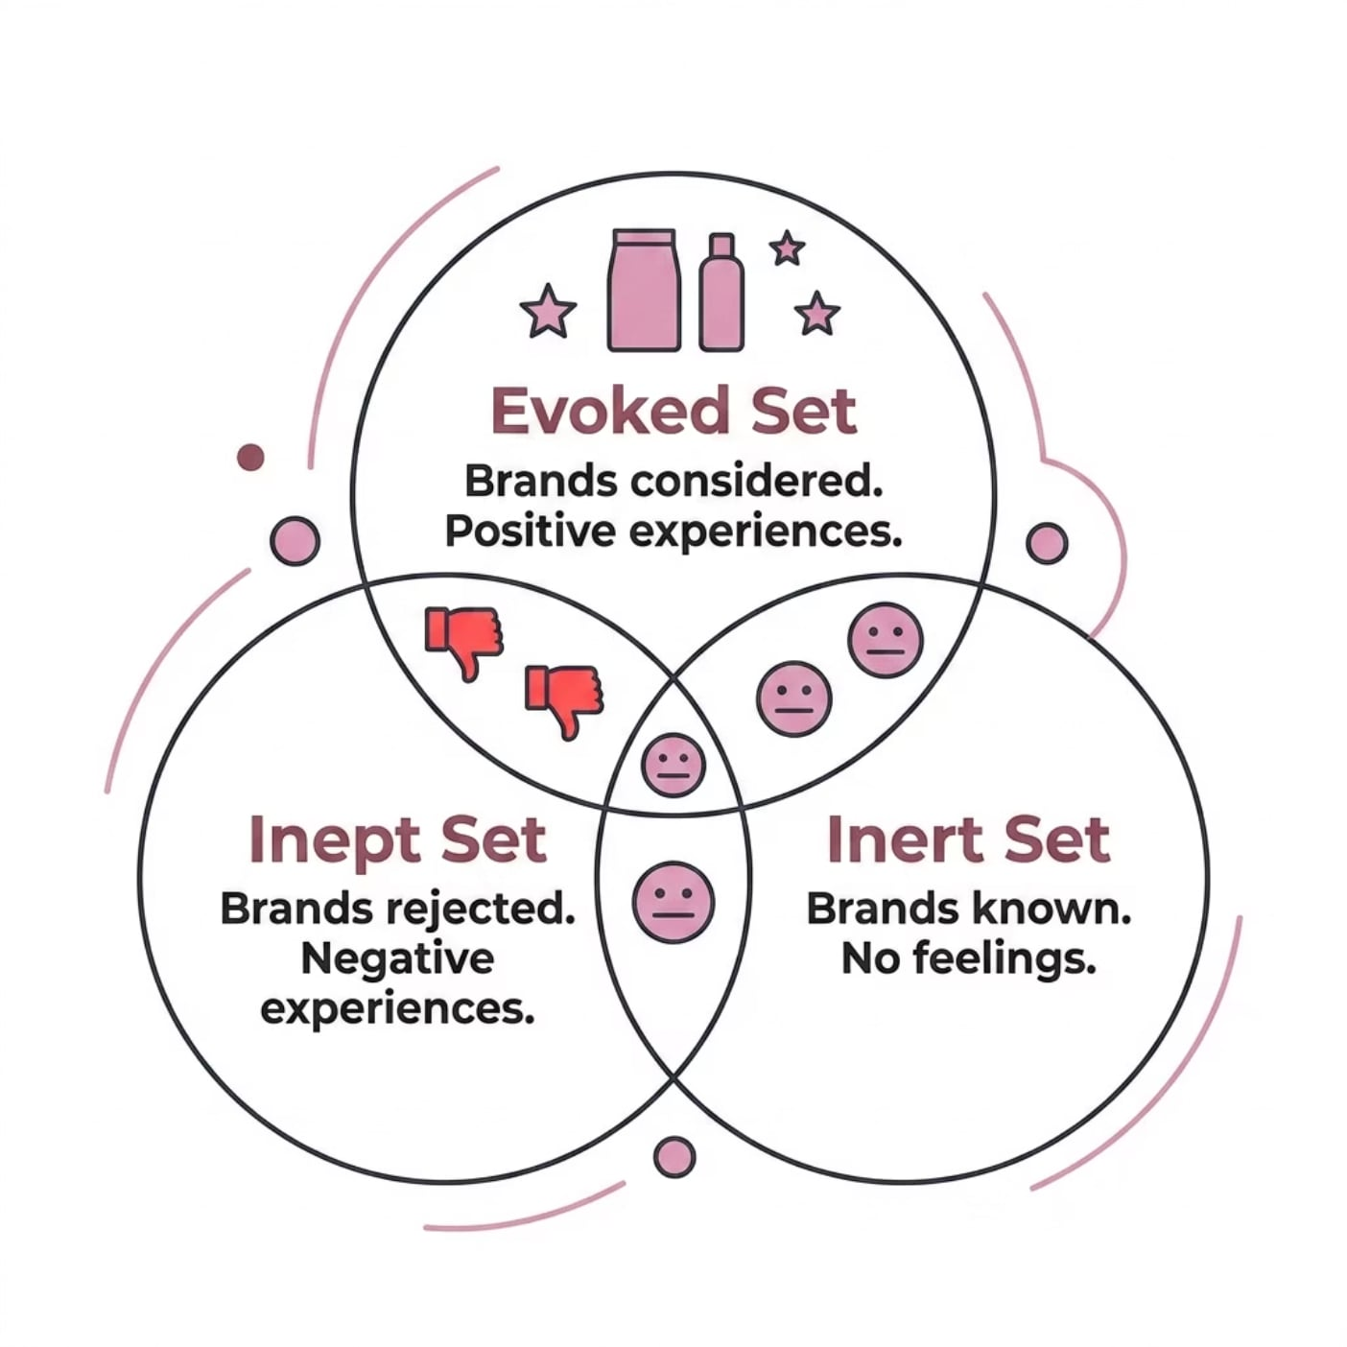
Evoked, Inept & Inert Sets
What This Means for IMC
Evoked: Target — get your brand here
Inept: Avoid — negative associations block consideration
Inert: Neutral — no linkages, usually eliminated
Placing a brand in the evoked set may be the primary goal of a marketing message.

Slide 14







Trends in the Consumer Buying Environment
Age Complexity
Gender Complexity
Active Lifestyles
Diverse Lifestyles
Communication Revolution
Experience Pursuits
Health Emphasis

Slide 15

Key Consumer Trends — Closer Look
Age & Gender
Busy & Diverse
Experiences & Health
Kids mature earlier; adults resist aging. Men now 1/3 of primary household shoppers, spending 38% of grocery dollars.
47% prefer free time over money. Convenience products surge. Diverse living arrangements reshape target markets.
Consumers buy experiences over things. Health + convenience = winning combo. Reebok's "Live with Fire" campaign exemplifies this.
Social media enables instant negative word-of-mouth — and powerful positive engagement.

Slide 16

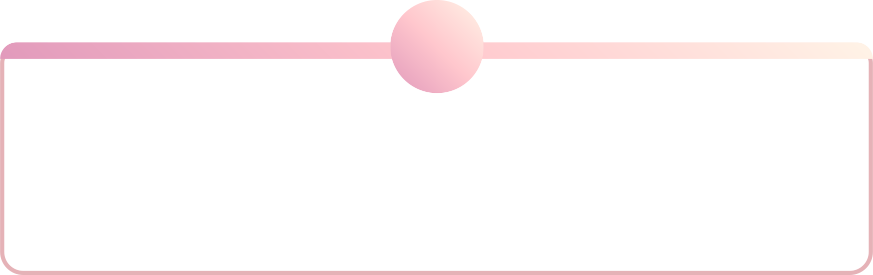
B2B Buyer Behaviors
In business purchases, multiple people make decisions. Corporate policies, costs, quality, and profit all influence outcomes.
1
2
3
Users
Buyers
Influencers
Actually use the product
Formal purchase responsibility
Shape decisions via criteria
4
5
Deciders
Gatekeepers
Authorize the purchase
Control information flow

Slide 17
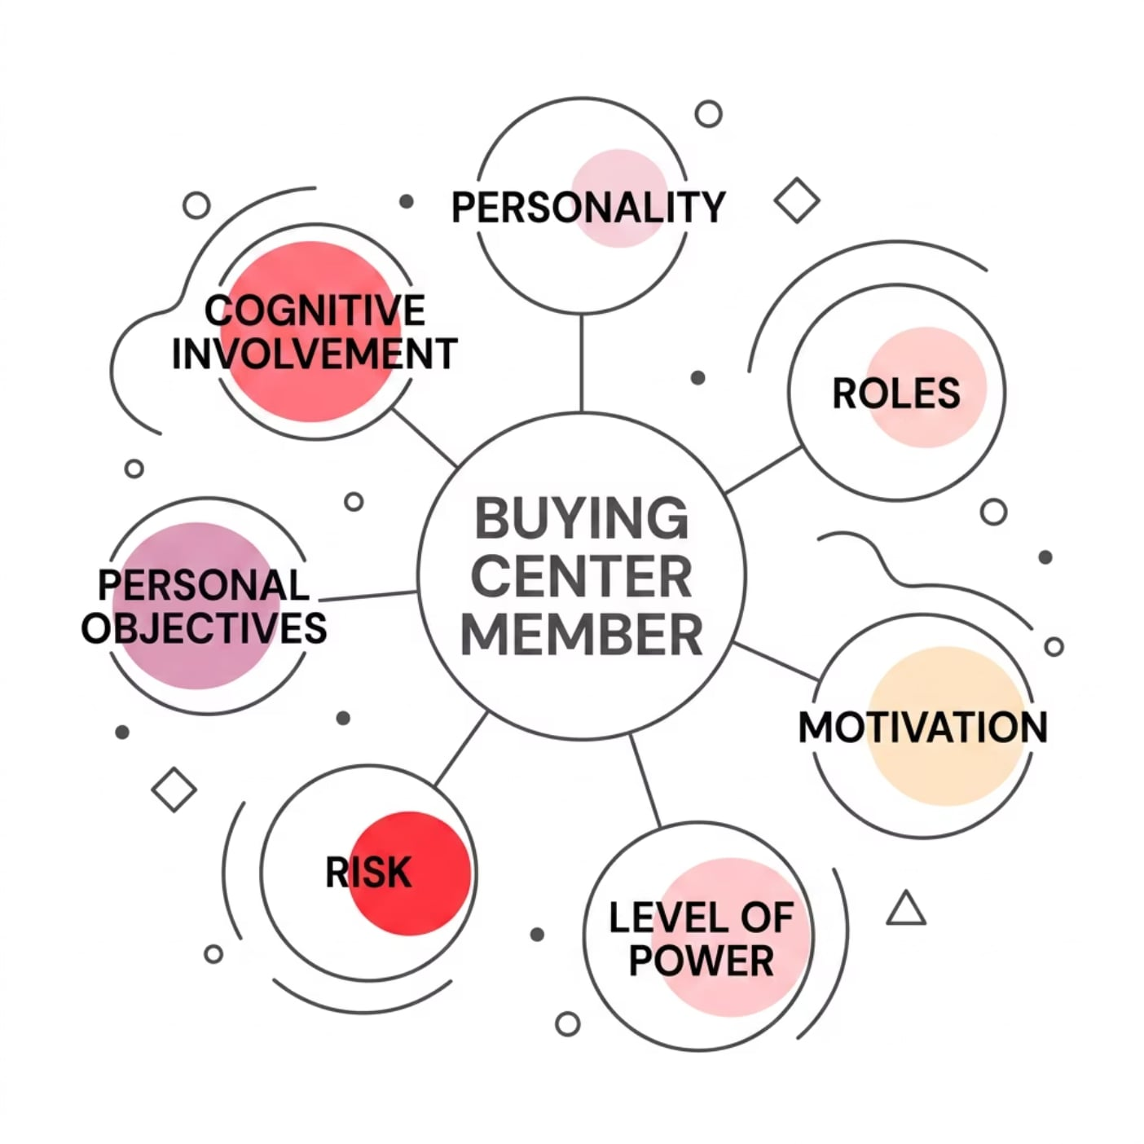
Influences on the Buying Center
Organizational Factors
Company goals & environment
Finances & market position
Heuristics & satisficing rules
Individual Factors
Personality & roles
Motivation & power level
Risk tolerance
Cognitive involvement
Personal objectives

Slide 18


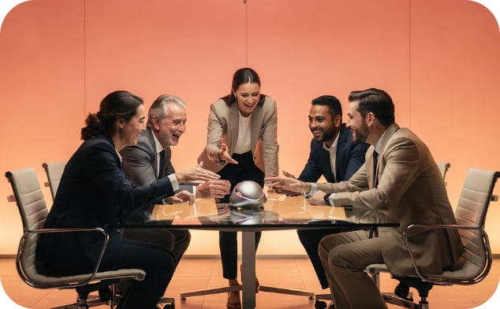
Types of B2B Sales
Straight Rebuy
Modified Rebuy
New Task
Reorder from existing vendor. Minimal evaluation. Often electronic.
Evaluates new alternatives. Triggered by dissatisfaction, better offers, contract renewal, or infrequent purchases.
First-time purchase. Extensive research, multiple buying center members, vendor input on specs.

Slide 19
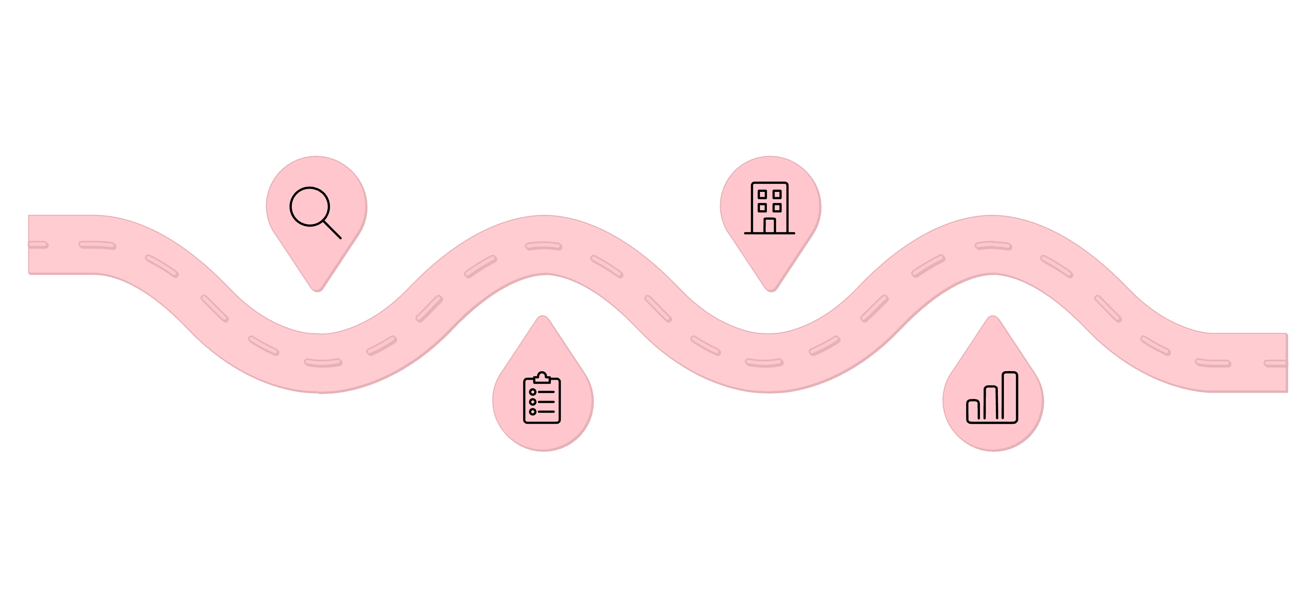
The B2B Buying Process
Identify Needs
Identify Vendors
Recognize business demand and requirements
Find potential suppliers and partners
Establish Specs
Evaluate Vendors
Define technical and purchase specifications
Assess proposals, capabilities, and fit
New task purchases follow all seven steps. Straight and modified rebuys may skip steps. Derived demand drives many business needs — linked to production and sale of other goods

Slide 20
Dual Channel Marketing
Same Product, Two Markets
Sell to businesses first (less price-sensitive), then adapt for consumers as economies of scale emerge.
Spin-Off Sales
Dual Branding
Business users buy personally (e.g., Holiday Inn: 30% of business customers also vacation there)
Separate brand names avoid confusion (e.g., Black & Decker → DeWalt for professionals)

Slide 21




Purchase Decision: How Consumers Finally Choose
The final stage of the consumer buying process moves from evaluating options to the actual transaction. This critical moment is often influenced by factors that are far removed from the initial rational assessment of alternatives.
Situational Influences
In-Store Factors
Impulse Buying
External factors like physical environment, social context, perceived time pressure, and even a consumer's mood can significantly sway a purchase decision, often overriding initial preferences.
Merchandising, promotional offers, the helpfulness of sales personnel, and the overall store atmosphere (music, scent, lighting) directly impact whether a customer converts browsing into buying.
Unplanned purchases driven by immediate gratification or strong emotional urges, often triggered by attractive displays, limited-time offers, or a perceived sense of scarcity without prior consideration.

Slide 22





Post-Purchase Evaluation & Cognitive Dissonance
The buying process doesn't end with the transaction. After a purchase, consumers enter a crucial stage of evaluation where their satisfaction, dissatisfaction, or even regret takes shape. This post-purchase experience profoundly influences future buying decisions and brand loyalty.
Satisfaction
Dissatisfaction
Occurs when the product's perceived performance meets or exceeds the buyer's expectations, leading to positive feelings, repeat purchases, and positive word-of-mouth.
Arises when the product fails to meet expectations, potentially leading to complaints, negative reviews, brand switching, or even legal action.
Buyer's Remorse
Cognitive Dissonance
A feeling of regret or anxiety after making a major purchase, especially when choices were difficult and involved high cost or high emotional investment.
The mental discomfort experienced by a person who holds two or more contradictory beliefs, ideas, or values. Post-purchase, this manifests as doubts about the decision or anxiety over foregone alternatives.
Marketers play a vital role in reducing post-purchase anxiety and ensuring customer satisfaction through proactive communication, strong customer support, and easy access to returns or warranties.

Slide 23


Types of Consumer Decision Making
Consumer decision-making isn't a one-size-fits-all process. The level of effort and thought a consumer puts into a purchase varies greatly depending on the product, its price, perceived risk, and their familiarity with it. Marketers must understand these different types to tailor their strategies effectively.
Routine/Habitual
Limited
Extended
Consumers engage in minimal thought or effort for low-cost, frequently purchased, and familiar products. Decisions are often made out of habit or brand loyalty without much evaluation.
Moderate involvement for products purchased occasionally. Consumers may seek some information or compare a few options, especially if unfamiliar with a brand in a known product category.
High involvement for expensive, infrequent, or high-risk purchases. Consumers undertake extensive information search, careful evaluation, and consider many alternatives before deciding.
When: Low involvement, frequent, low cost.
Examples: Buying milk, bread, preferred brand of toothpaste or coffee.
When: Moderate involvement, occasional, some comparison.
Examples: Choosing a new brand of shampoo, a restaurant for dinner, or a basic kitchen appliance.
When: High involvement, infrequent, high cost/risk.
Examples: Purchasing a car, a house, a major electronic device like a laptop, or choosing a university.

Slide 24
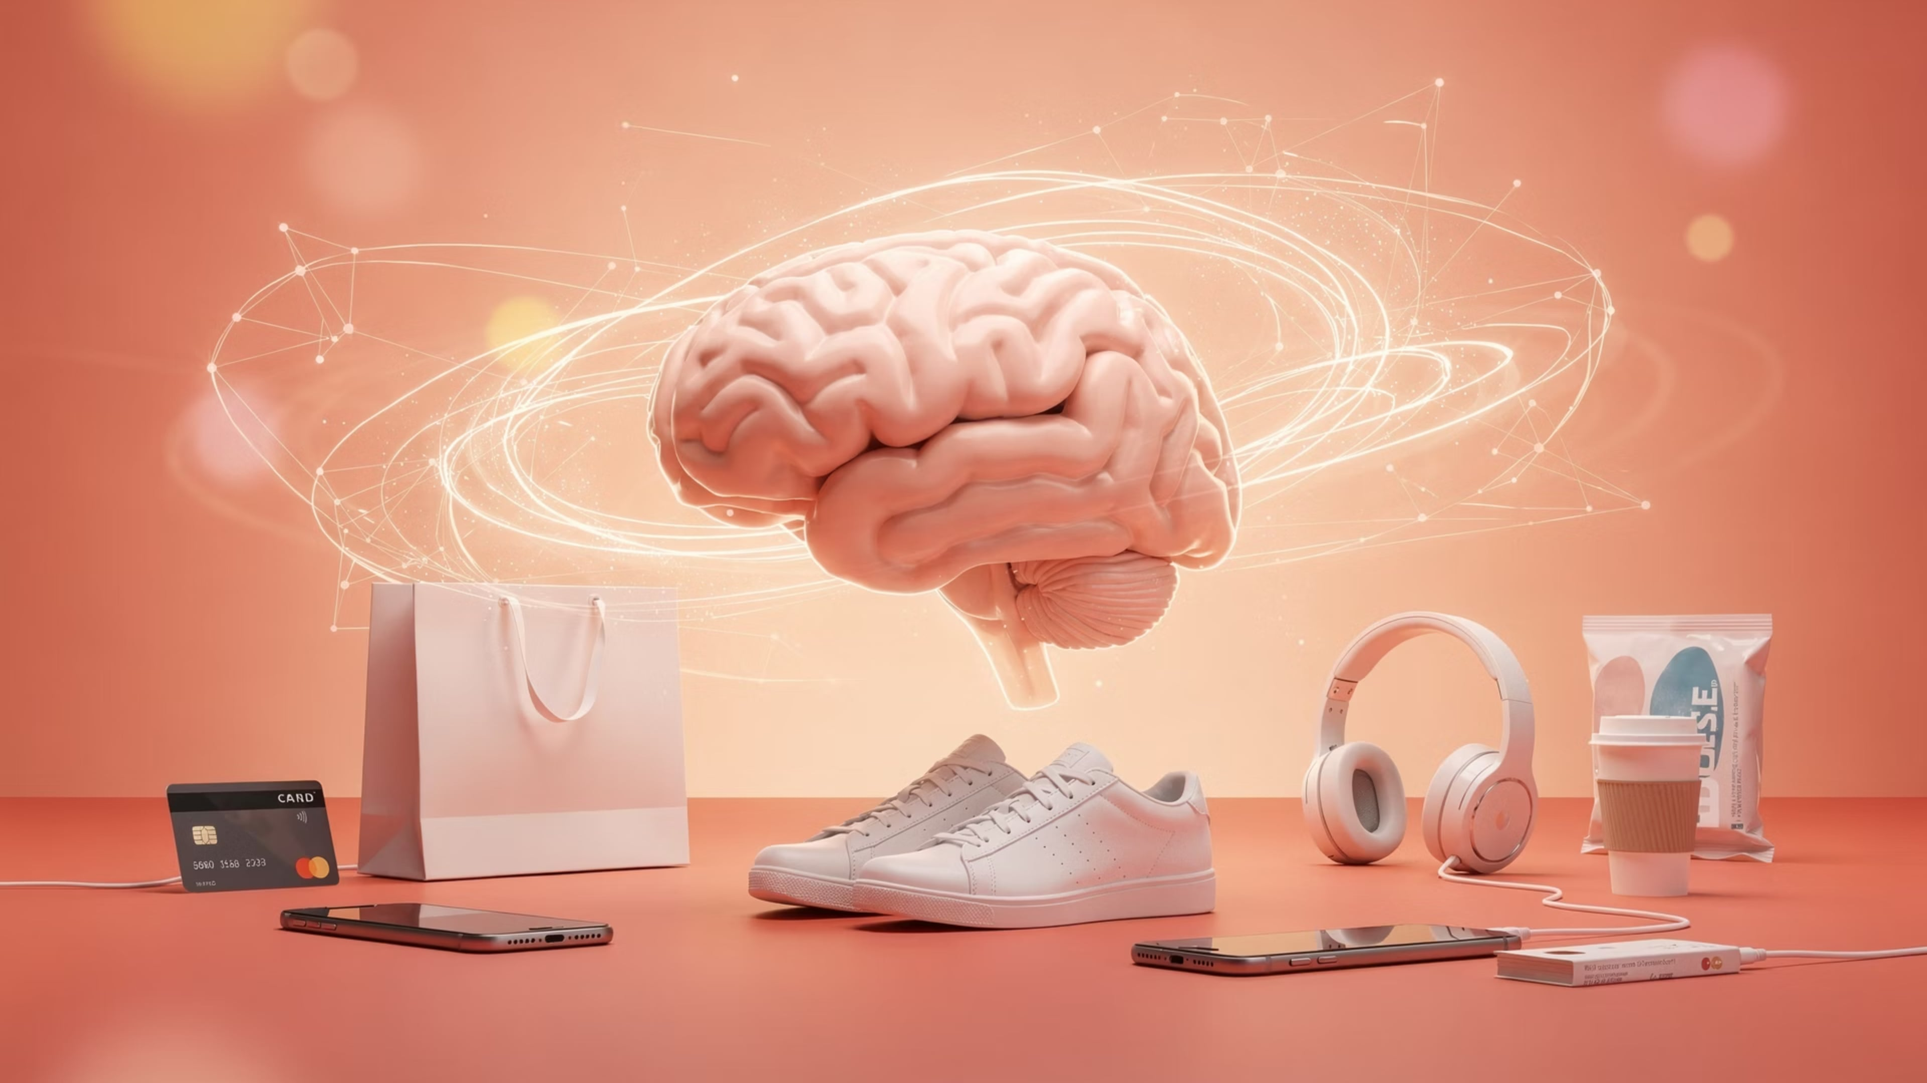




Psychological Influences on Consumer Behavior
Beyond external factors, internal psychological processes profoundly shape how consumers perceive, evaluate, and ultimately choose products and services. Understanding these core influences – perception, learning, motivation, and personality – is key to crafting effective marketing strategies that resonate with individual minds.
Perception
Learning
Consumers actively select, organize, and interpret information to form a meaningful picture of the world. This subjective process dictates how they see brands, products, and advertising, often influencing purchasing decisions more than objective reality.
Changes in an individual's behavior arising from experience. Consumers learn about products, brands, and stores through direct experience, observation, and information, leading to brand loyalty, habits, and preferences.
Motivation
Personality
Internal drives that compel individuals to satisfy specific needs. Maslow's Hierarchy categorizes these needs from basic physiological (food, water) to higher-level self-actualization, each influencing different types of purchases.
Unique psychological characteristics that lead to relatively consistent and lasting responses to one's environment. Personality traits often guide consumers toward products and brands that align with their self-concept and values.

Slide 25




Social & Cultural Influences on Consumer Behavior
Beyond individual psychology, our purchasing decisions are deeply intertwined with the social fabric around us. From the people we admire to the traditions we uphold, external forces play a critical role in shaping what we buy.
Reference Groups
Family Roles
These are groups that directly or indirectly influence an individual's attitudes or behavior. They can be membership groups (family, friends) or aspirational groups (celebrities, successful professionals). Marketers often leverage opinion leaders within these groups.
The family unit is a primary consumption influence. Different family members assume specific roles (e.g., initiator, influencer, decider, buyer, user) for various products and services, shaping household purchasing patterns.
Social Class
Culture & Subculture
Relatively permanent and homogeneous divisions in a society whose members share similar values, interests, and behaviors. Social class influences product choice, brand preference, communication styles, and even shopping habits.
Culture represents the broadest and deepest influence, encompassing shared values, beliefs, customs, and behaviors learned from society. Subcultures are distinct groups within a culture that share unique values, leading to specific consumption patterns.

Slide 26





Opinion Leaders & Word-of-Mouth Marketing
In today's interconnected world, influence often extends beyond traditional advertising. The people we trust, both in our immediate circles and online, play a pivotal role in shaping our purchasing decisions. Understanding these dynamics is crucial for effective consumer engagement.
Opinion Leaders
Influencer Marketing
These are individuals who, due to their expertise, knowledge, or personality, exert significant influence over others' attitudes or behaviors. They are trusted sources of information within their social circles, organically shaping opinions and guiding purchasing decisions.
A modern evolution of leveraging opinion leaders, this strategy involves brands collaborating with individuals (influencers) who have a dedicated following on social media or other platforms to promote products or services, tapping into their credibility and reach.
Word-of-Mouth (WOM)
eWOM (Electronic WOM)
The organic sharing of information about a product or service between individuals. Highly credible due to its personal nature, WOM remains one of the most powerful forms of persuasion, often driven by positive experiences and genuine recommendations.
The digital amplification of traditional WOM, encompassing online reviews, social media discussions, forums, and blogs. eWOM spreads rapidly, reaching wider audiences and significantly impacting brand reputation and sales on a global scale.

Slide 27
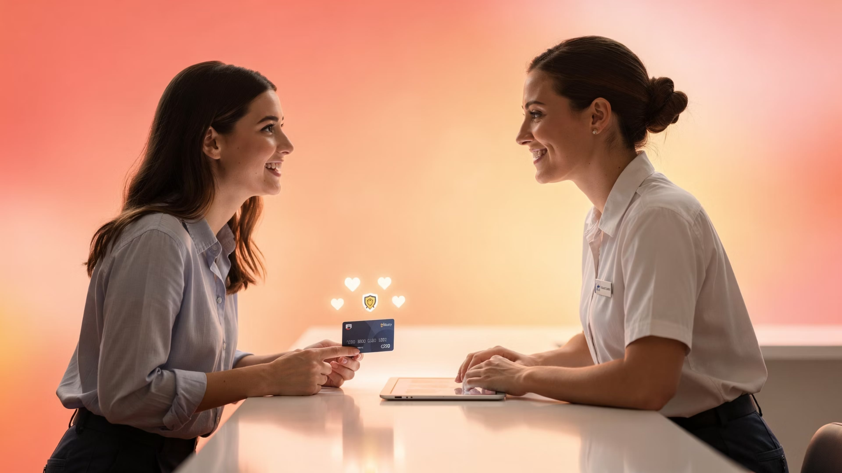




Brand Loyalty & Customer Retention
Building lasting relationships with customers is fundamental to sustainable growth. Beyond initial sales, true success lies in fostering unwavering loyalty and maximizing customer lifetime value.
Cultivating Loyalty
The Loyalty Ladder
Brand loyalty is forged through consistent value, emotional connection, and trust. It's about delivering superior product quality, exceptional service, and aligning with customer values, creating a bond that transcends mere transactions.
Customers ascend from being a 'Suspect' (aware of your brand) to a 'Prospect' (considering a purchase), then a 'First-Time Customer,' evolving into a 'Repeat Client,' and ultimately a passionate 'Advocate' who actively promotes your brand.
Understanding Switching Costs
Retention ROI
These are the financial, psychological, or effort-related costs a customer incurs when changing from one brand to another. High switching costs, whether perceived or actual, can act as a powerful barrier to defection and enhance loyalty.
Retaining existing customers is significantly more cost-effective than acquiring new ones. Loyal customers spend more, refer others, and are less price-sensitive, contributing disproportionately to profitability and long-term business health.

Slide 28
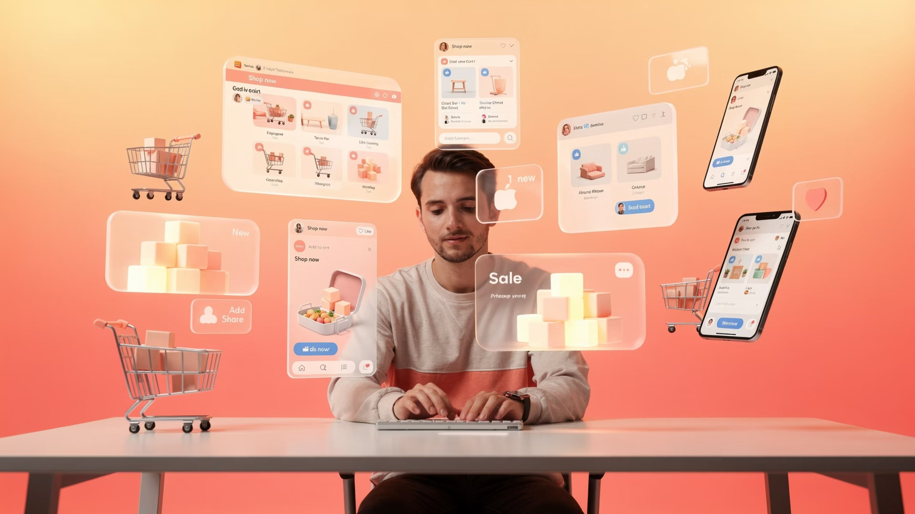





Digital & Online Consumer Behavior
The internet has fundamentally reshaped how consumers discover, research, and purchase products and services. Understanding these evolving digital behaviors is essential for businesses to thrive in today's interconnected marketplace.
Evolving Buying Process
Online Research Behavior
The traditional linear purchase funnel has transformed into a dynamic, multi-touchpoint journey. Consumers are empowered by instant access to information, reviews, and competitive pricing, making the path to purchase more complex and non-linear.
Before committing to a purchase, consumers engage in extensive online research. This includes reading detailed product reviews, comparing specifications, watching unboxing videos, and interacting with brand content across various digital platforms.
Zero Moment of Truth (ZMOT)
Mobile Shopping Dominance
Coined by Google, ZMOT is the critical online decision-making moment when consumers proactively gather information about a product or service before any direct interaction with a brand. It occurs between the initial stimulus and the actual purchase decision.
The pervasive nature of smartphones has made shopping an anytime, anywhere activity. Consumers rely on mobile devices for browsing, comparing prices, reading reviews, and completing transactions, expecting seamless and intuitive mobile-first experiences.
Rise of Social Commerce
Social commerce integrates e-commerce functionalities directly into social media platforms. It enables product discovery, engagement, and purchasing within social environments, leveraging social proof and peer recommendations to drive sales.

Slide 29
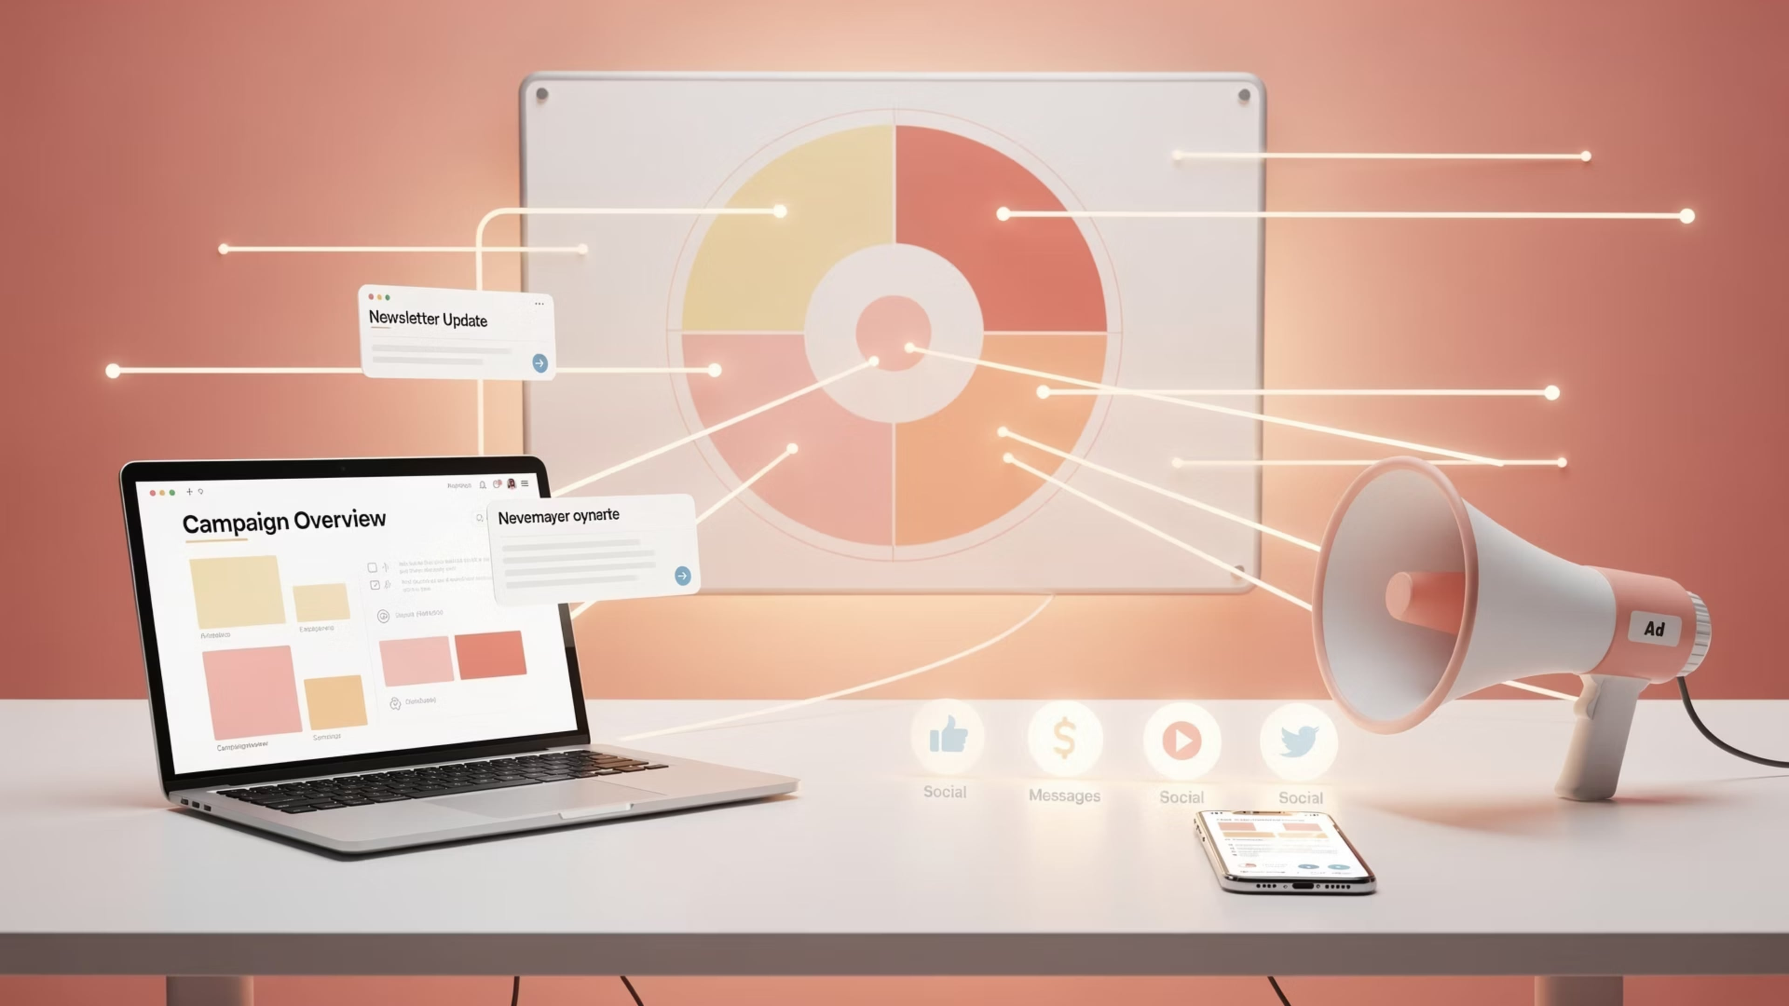
IMC Implications of Buyer Behavior
Understanding the intricacies of buyer behavior is not merely academic; it forms the bedrock of an effective Integrated Marketing Communications (IMC) strategy, guiding every decision from messaging to channel choice.
Message Timing
Channel Selection
Targeting & Segmentation
Positioning
Knowing a buyer's journey stage dictates when a message will resonate most. Awareness-stage buyers need educational content, while decision-stage buyers require compelling calls to action and proof points. Precise timing maximizes impact.
Insight into where and how buyers consume information informs optimal channel selection. Whether it's social media, email, search engines, or traditional media, connecting with customers on their preferred platforms is crucial for message delivery.
Understanding buyer needs, perceptions, and competitive alternatives enables effective brand positioning. IMC messages must clearly articulate the unique value proposition in a way that aligns with what customers truly seek and believe.
Buyer behavior analysis allows for granular targeting and segmentation. By identifying distinct groups based on demographics, psychographics, and past actions, IMC efforts can be hyper-personalized, reducing waste and increasing relevance.

Slide 30




Module 3: Summary & Key Takeaways
As we conclude Module 3, let's consolidate the core insights that illuminate the modern buyer's journey and its profound implications for marketing strategy.
Dynamic Buyer Journeys
Influencing Factors & Digital Trends
Strategic IMC Alignment
We explored how both consumer and B2B buying processes have transformed from linear funnels into intricate, multi-touchpoint experiences. The Zero Moment of Truth (ZMOT) highlights the consumer's deep digital research, while B2B decisions emphasize rational, multi-stakeholder evaluations, often influenced by complex organizational needs.
A deep understanding of buyer behavior is the bedrock for effective Integrated Marketing Communications. It dictates message timing, channel selection, targeting & segmentation, and brand positioning, ensuring our marketing efforts are relevant, impactful, and resonate precisely with our audience's needs and context.
Buyer decisions are profoundly shaped by attitudes and values, acting as internal compasses for preferences. Simultaneously, external digital trends like ubiquitous mobile shopping and the rapid ascent of social commerce have revolutionized discovery, evaluation, and purchase behaviors, demanding continuous adaptation from marketers.

Slide 31
Lecture 3: Review Questions
Let's solidify our understanding of Module 3's key concepts with these thought-provoking questions, designed to reinforce your grasp of buyer behavior and its strategic implications.
Describe the key stages of the consumer buying process and identify one marketing tactic that is most effective at each stage.
Explain the concept of "need recognition" in both functional and psychological terms, providing a real-world example for each.
Compare and contrast internal and external information search. When might a consumer rely more heavily on one over the other, and why?
How do attitudes and values influence a consumer's purchasing decisions? Provide an example of a brand successfully leveraging these factors in its marketing.
What is cognitive mapping, and how can marketers use this understanding to better position their products and guide consumer perceptions?
Differentiate between evoked, inept, and inert sets in the context of a consumer's decision-making. How can a brand strategically move from an inept set to an evoked set?
Beyond price and features, what are the primary criteria consumers use to evaluate alternatives? How can Integrated Marketing Communications (IMC) effectively address these criteria?
How does the B2B buying process fundamentally differ from the consumer buying process, particularly concerning the decision-making unit and perceived risk?
Discuss the impact of recent digital trends, such as mobile shopping, social commerce, and the Zero Moment of Truth (ZMOT), on the modern buyer's journey and traditional marketing approaches.
Explain how a deep understanding of buyer behavior influences four critical aspects of Integrated Marketing Communications: message timing, channel selection, targeting & segmentation, and brand positioning

