Slide 1

Advertising Campaign Management
Week 5 · Advertising & Integrated Marketing Communications
BY: PROF. FIDELA R. BALAJADIA

Slide 2
Lecture Learning Objectives
01
02
Advertising Theories
Expenditures & Effectiveness
Explain their role in campaign management
Understand the relationship
03
04
In-House vs. Agency
Agency Selection
When to use each approach
Criteria, roles, and process
05
06
Campaign Parameters
Creative Brief
Goals, taglines, consistency, duration
How it facilitates effective advertising

Slide 3

The Advertising Landscape
600
Ads per Day
Average person's daily exposure
∞
Media Channels
TV, radio, print, internet, social, mobile
Today's challenge: break through the clutter across multiple mediums simultaneously.

Slide 4
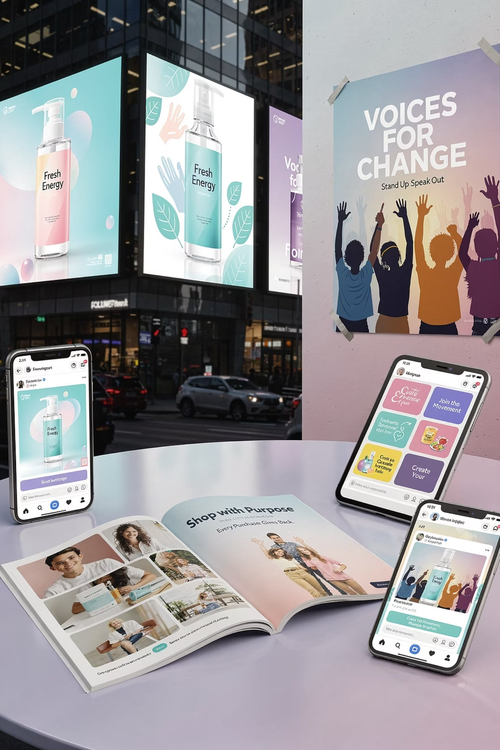







Types of Advertising
Product Advertising
Promotes specific goods or services to increase sales or adoption.
Example: A commercial for the latest smartphone model highlighting its new camera features.
Institutional Advertising
Builds goodwill and enhances a company's overall image rather than promoting specific products.
Example: A technology company showcasing its commitment to education and community development.
Advocacy Advertising
Communicates a company's stance on social, political, or environmental issues to influence public opinion.
Example: An apparel brand running ads promoting sustainable fashion practices and ethical labor.
Cause-Related Advertising
Links a company's product or service to a charitable cause, often with a promise of a donation based on sales.
Example: A coffee company stating that for every bag sold, a portion goes to support clean water initiatives.

Slide 5

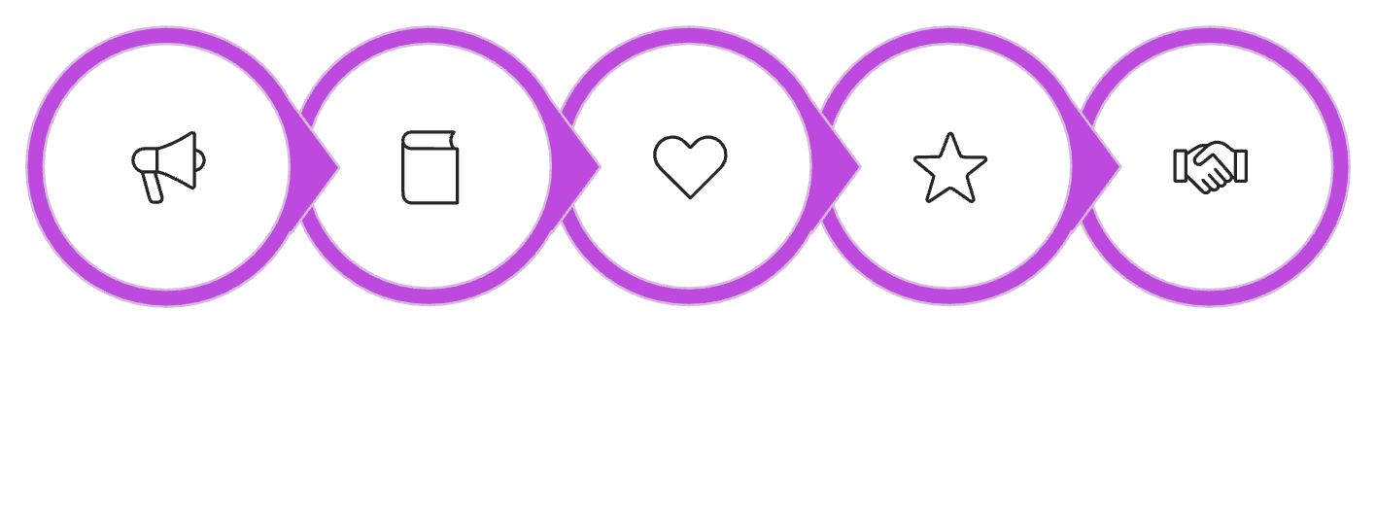
Hierarchy of Effects Model
1
Awareness
2
Knowledge
3
Liking
Awareness
Knowledge
Liking
Preference
Conviction
4
Preference
Consumers move through each stage before reaching a purchase decision. Building brand loyalty requires all six steps.
5
Conviction
6
Purchase

Slide 6
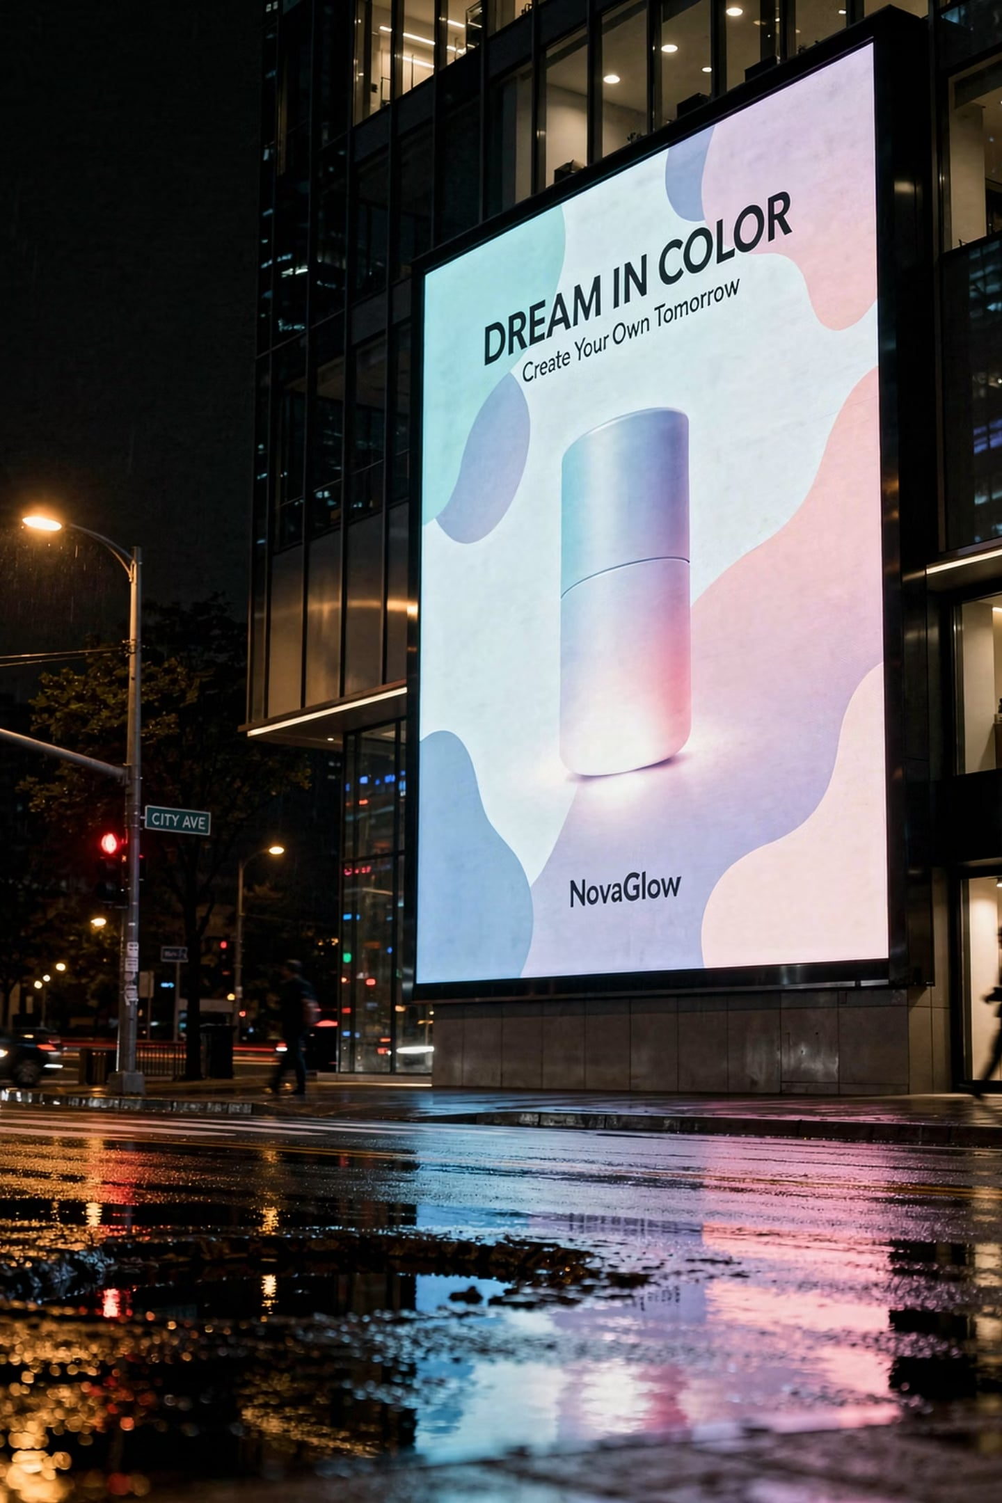


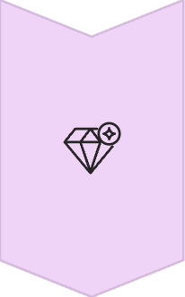
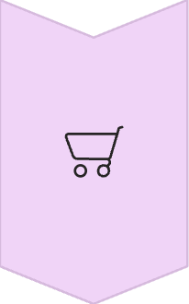
The AIDA Model: Driving Consumer Response
AIDA vs. Hierarchy of Effects
Attention
Both models propose a linear progression of consumer responses to advertising. The Hierarchy of Effects (Awareness, Knowledge, Liking, Preference, Conviction, Purchase) offers a more granular view of internal psychological stages.
The AIDA Model, while simpler, is often favored for its direct applicability to practical advertising strategy and sales funnels.
Capture the audience's initial awareness with impactful visuals or bold headlines. This is about cutting through the clutter.
Interest
Sustain engagement by providing relevant information, highlighting key benefits, or sparking curiosity through compelling content.
Desire
Cultivate a strong desire for the product or service by appealing to emotions, demonstrating value, or showcasing unique selling propositions.
Action
Motivate the consumer to take a specific, measurable step, such as making a purchase, signing up, or requesting more information.

Slide 7




Cognitive → Affective → Conative
Cognitive
Affective
Conative
Mental images, understanding — best for brand awareness & knowledge
Feelings & emotions — best for liking, preference & conviction
Intentions & behavior — best for driving purchases & action
Impulse buys and coupon-driven choices may bypass the full sequence.

Slide 8


The Elaboration Likelihood Model (ELM)
The ELM explains how attitudes are formed and changed, focusing on two distinct routes to persuasion based on audience involvement.
Central Route
Peripheral Route
Used when audience is highly involved and motivated to process information.
Focuses on strong, logical arguments and evidence.
Results in more stable, lasting attitude change.
Used when audience has low involvement or ability to process information.
Relies on peripheral cues: source attractiveness, emotional appeals, positive associations.
Results in temporary attitude change, less resistant to counter-persuasion.
Advertising design should align with the likely route consumers will take: factual for high involvement, emotional/superficial for low involvement.

Slide 9

Means-End Theory & MECCAS
The Chain
MECCAS Model
Product Attribute → Benefit → Personal Value
Example: Calcium in milk → Healthy bones → Comfortable life / Feeling wise
Moves consumers from product attributes to personal values by highlighting benefits.
Applies to B2B too — personal values like job security, wisdom, and social acceptance influence buying center decisions.

Slide 10
Advertising Expenditure Effects
Threshold Effects
Diminishing Returns
Carryover Effects
Point where advertising begins to significantly impact consumer response. Innovative products or strong brands reach it faster.
S-shaped curve: incremental ad spend yields smaller and smaller sales gains. Further spend can hurt profits.
Brand recall at purchase time — e.g., remembering Maytag when a washing machine breaks down.
Wear-Out Effects
Decay Effects
~50% of campaigns last too long. Consumers tune out or develop negative attitudes. Long-term effect is 2× short-term.
When advertising stops, consumers forget. Companies must maintain some marketing presence to keep the brand top of mind.

Slide 11




Navigating Advertising Effectiveness
Understanding how Carryover, Wear-Out, and Decay Effects impact campaign longevity and budget allocation is critical for strategic advertising.
Carryover Effects
Wear-Out Effects
Decay Effects
The continued impact of advertising on consumer response long after the campaign has ended. This builds brand equity and can sustain sales without immediate new ad spend.
When an advertisement becomes ineffective or irritating due to excessive repetition. Consumers develop negative attitudes or simply tune out the message.
The natural decline in memory of an advertisement over time when exposure stops. Without continued reinforcement, brand recall diminishes.
Implication for Planning: Requires ongoing, even if reduced, advertising presence to keep the brand top-of-mind. Budget for sustained, lower-frequency campaigns.
Implication for Planning: Justify long-term brand building investments. Don't expect immediate results; cultivate sustained memory.
Implication for Planning: Monitor audience fatigue. Plan for creative refreshes or campaign rotation to maintain engagement and prevent negative sentiment.

Slide 12
In-House vs. External Agency
In-House Advantages
External Agency Advantages
Lower costs, better brand control
Deeper product & mission knowledge
Faster production, consistent team
Apple expanded in-house from 300 → 500+
58% of ANA members now use in-house
Greater expertise & top talent access
Outside perspective, no internal bias
Cross-industry knowledge transfer
Full-service to boutique options
Specialized: media, digital, PR, social

Slide 13

Types of Advertising Agencies
Choosing the right agency partner is crucial for campaign success, depending on specific needs, budget, and desired expertise.
Full-Service Agencies
1
Offer comprehensive services: strategy, creative development, media planning/buying, PR, and digital.
Best Use: Large clients seeking integrated campaigns and end-to-end management.
Creative Boutiques
2
Specialize in innovative idea generation, copywriting, and unique visual design.
Best Use: Specific creative projects or when a distinct brand voice is needed.
Media Buying Agencies
3
Focus on optimizing media planning and purchasing across all channels (TV, print, digital).
Best Use: Clients aiming for efficient ad spend, broad reach, and favorable media rates.
Interactive Agencies
4
Experts in digital marketing: web development, SEO, social media, content, mobile.
Best Use: Businesses prioritizing online presence and digital customer engagement.
In-House Agencies
5
Internal departments managing advertising, offering cost savings and tight brand control.
Best Use: Companies needing deep product knowledge and quick, consistent communication.

Slide 14

Budget Allocation & Crowdsourcing
The 75-15-10 Rule
75%
15%
10%
Media Buys
Creative Work
Production
Smaller accounts: 50-30-20 split.
Crowdsourcing
Outsourcing creative to the public. Doritos used it for Super Bowl ads over 10 years.
Total cost ≈ same as hiring an agency, but generates fan buzz and viral engagement.

Slide 15

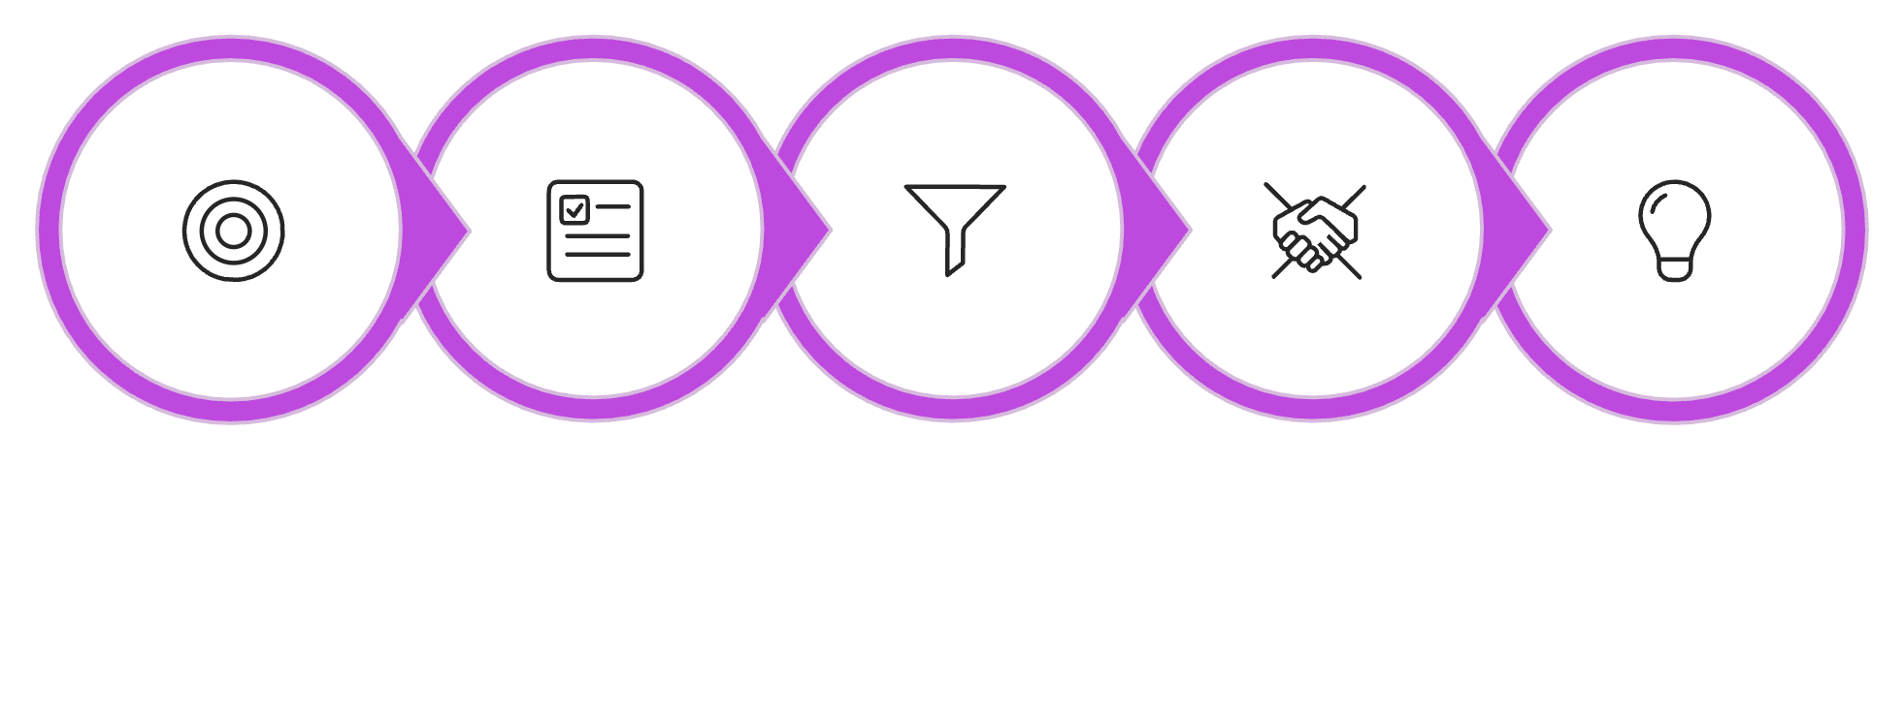
Choosing an Advertising Agency
Set Goals
Establish Criteria
Screen Agencies
Request References
Creative Pitch
Goal-setting prevents personal bias. Campbell Soup consolidated four brands — Prego, Pace, SpaghettiOs, Ready Meals — using this process.

Slide 16




Agency Selection Criteria
Agency Size
Relevant Experience
Account should matter to the agency — but not be so large its loss is devastating.
Industry knowledge without conflicts of interest. Similar industries count.
Creative Reputation
Personal Chemistry
Awards signal peer-recognized effectiveness. Strong predictor of ad quality.
Client-agency chemistry can make or break the final decision.

Slide 17

Agency Compensation Models
Selecting the right compensation model is key to fostering a productive and transparent client-agency relationship, aligning incentives for mutual success.
Commission System
Fee-Based Arrangements
Performance-Based
Traditional model where agency earns a 15% commission on media purchased. Simplistic but can incentivize higher ad spend over strategic value.
Fixed fees (hourly rates, project-based, or retainers) for services rendered. Provides budget predictability but requires clear scope definition.
Agency compensation tied directly to campaign results (e.g., sales, leads, ROI). Aligns goals, but defining measurable outcomes can be complex.
Value-Based Billing
Compensation determined by the perceived value delivered to the client, not hours or output. Fosters strategic partnership but requires trust and clear value metrics.

Slide 18

The Creative Pitch
The "Shootout"
Top 2–3 finalists present solutions to a specific problem or campaign challenge.
Arby's Case Study
Agency Fallon won by shifting focus to the meats. Customers under 35 grew from 35% → 50%.
Oscar Mayer
mcgarrybowen won by contemporizing the brand with fresh emotional connections.

Slide 19




Roles Within an Advertising Agency
Account Executive
Creative
Traffic Manager
Account Planner
Go-between for agency and client. Manages relationship, aligns IMC strategy.
Designs and develops ads. Works under pressure to produce measurable results.
Schedules agency work, coordinates props, actors, and production logistics.
Voice of the consumer. Guides long-term strategy and ensures messages reach the right audience.

Slide 20


Creative Strategy in Advertising
Creative strategy is the blueprint that guides an advertising campaign, defining how to communicate effectively to achieve specific objectives. It encompasses the core message, the executional framework, and the judicious use of appeals—be they rational, emotional, fear-based, humorous, or sex-related—to connect with the target audience and meet campaign goals.
01
02
1. Define the objective
2. Shape the message
Clarify what the campaign must achieve and who it is trying to influence.
Decide the key idea, support points, and appeal that will resonate most.
03
04
3. Choose the execution
4. Align to outcomes
Select the best way to present the message through a compelling ad format.
Make sure the creative supports the broader campaign goal and brand strategy.
Message Strategy
Executional Framework
What to say
How to say it
Rational — Uses facts, features, and proof to persuade logically.
Emotional — Connects through feelings, values, and aspirations.
Fear — Highlights a risk or problem to motivate action.
Humor — Uses wit or surprise to build attention and memorability.
Sex — Uses attraction or sensual cues to capture interest and create association.
Slice of life — Shows the product in a realistic everyday situation.
Testimonial — Uses a satisfied user or expert to lend credibility.
Demonstration — Shows exactly how the product works or solves a problem.
Fantasy — Presents an idealized, imaginative version of the benefit.
Animation — Uses motion and stylized visuals to simplify or dramatize the message.
Creative strategy ties the message and execution together so the campaign clearly supports the intended goal, whether that goal is awareness, persuasion, or action.

Slide 21


Advertising Campaign Parameters
Advertising Goals
Media Selection
Derived from overall IMC objectives
Match media habits of target market
Tagline
Consistency
Memorable phrase conveying brand uniqueness
Visual and message consistency builds long-term memory
Positioning
Campaign Duration
Consistent positioning embeds brand in cognitive map
Typical: ~6 months. Change before wear-out sets in.

Slide 22






Five Advertising Goals
Build Brand Awareness
Provide Information
Persuasion
Top of mind + top choice
Location, hours, product specs
Highlight superiority, change attitudes
Support Marketing
Encourage Action
Promotions, coupons, contests
Toll-free numbers, leads, purchases
These five goals are interconnected — emphasize one without ignoring the others.

Slide 23



Positioning Strategies in Advertising
Effective advertising defines how a brand occupies a distinct and valued place in the target consumer's mind.
1
Attribute Positioning
Highlights a specific product feature or benefit. Example: Duracell for "longer-lasting battery life."
Use/Application Positioning
2
Emphasizes how the product is used or its versatile applications. Example: Arm & Hammer Baking Soda for "baking, cleaning, and deodorizing."
User Positioning
3
Associates the product with a particular user group or lifestyle. Example: Harley-Davidson for "rugged individualists."
4
Competitor Positioning
Positions the product directly against a competitor. Example: Pepsi's "Pepsi Challenge" against Coke.
5
Benefit Positioning
Stresses the key benefit the consumer receives. Example: Volvo emphasizing "safety features."
6
Quality/Price Positioning
Highlights the product's quality level or price point. Example: Walmart for "everyday low prices.

Slide 24


Taglines & Consistency
Why Consistency Matters
"Just Do It"
"Because I'm Worth It"
Repeated visual images, headlines, and taglines move messages from short-term to long-term memory.
Nike
L'Oreal Paris — 40+ years
Variability Theory
Same ad in different environments encodes the message more deeply — reduces competitive interference.
"What's in your wallet?"
Capital One

Slide 25
The Creative Brief
Objective
Target Audience
Message Theme
Campaign goal guides design & execution
More detail = more effective creative
Unique selling point — rational or emotional
Support
Constraints
Facts that substantiate the claim
Legal, trademark, disclaimers, claims

Slide 26





Creative Brief: Key Insights
53%
27%
0%
Lack Focus
Incomplete
Perfect
Complete but unfocused briefs
Incomplete and inconsistent
Complete & focused all the time
Timing Matters
Campaigns designed in 2 months or less have the highest likelihood of being "highly effective."
Campaigns designed in 2 weeks or less are also likely to be ineffective — don't rush.
Message theme can be left-brain (rational: facts, numbers) or right-brain (emotional: images, feelings).

Slide 27
Key Terms at a Glance
Hierarchy of Effects
MECCAS
Threshold Effects
Diminishing Returns
6-step consumer purchase model
Attributes → Benefits → Personal Values
When advertising begins to impact response
Saturation point — more spend, less gain
Carryover Effects
Wear-Out Effects
Decay Effects
Crowdsourcing
Brand recall at time of purchase
Campaign becomes stale, ignored
Forgetting after advertising stops
Public creates the ad
Variability Theory
Creative Brief
Same ad, different contexts = stronger recall
Document guiding campaign production

Slide 28



Common Exam Misconceptions
AIDA vs. Hierarchy of Effects
Carryover vs. Decay Effects
AIDA (Awareness-Interest-Desire-Action) is a simplified model. The Hierarchy of Effects (6 steps) provides a more detailed breakdown of consumer progression towards purchase.
Carryover is the lingering positive memory of advertising after it stops. Decay is the rate at which brand recall diminishes once the campaign ends.
Misidentifying Agency Types
Misapplying MECCAS
Distinguish between full-service (comprehensive), specialized (e.g., digital, media buying), and in-house (client-owned) agencies based on their scope of work.
MECCAS (Means-End Conceptualization of Components of Advertising Strategy) connects product attributes to benefits and, ultimately, to deep personal values. Ensure a clear, logical chain.
Understanding these distinctions is crucial for effective advertising campaign management and strategic planning.

Slide 29
Week 5 Summary
Theory First
Understand Expenditure Dynamics
Choose the Right Structure
Hierarchy of Effects + MECCAS guide campaign development
Threshold, diminishing returns, carryover, wear-out, decay
In-house vs. agency — size, budget, and goals matter
Set Clear Parameters
Brief with Precision
Goals, media, tagline, consistency, positioning, duration
Objective, audience, message, support, constraints

Slide 30

Review Questions: Advertising Campaign Management
Describe the six stages of the Hierarchy of Effects model.
Explain the difference between carryover effects and decay effects in advertising.
What does MECCAS stand for, and how does it connect product attributes to personal values?
What is the 75-15-10 budget rule in advertising, and what does each number represent?
Name three key criteria for selecting an advertising agency.
Differentiate between the central and peripheral routes to persuasion within the Elaboration Likelihood Model (ELM).
List the five primary advertising goals.
Identify the key components that should be included in a creative brief.

