Slide 1

Advertising Design
Week 6 — Advertising & Integrated Marketing Communications
PROF. FIDELA R. BALAJADIA

Slide 2





The Advertising Design Process
From initial brief to final campaign, our structured approach ensures impactful and effective advertising.
Research & Insight
Strategy Development
Creative Concepting
Thorough analysis of market trends, consumer behavior, and competitive landscape to uncover key insights.
Defining clear objectives, identifying target audiences, and crafting a compelling core message for the campaign.
Brainstorming innovative ideas and visual themes that resonate with the target audience and achieve strategic goals.
Execution & Production
Evaluation & Optimization
Bringing the concept to life through design, copywriting, media planning, and final asset creation.
Measuring campaign performance, gathering feedback, and iterating to maximize effectiveness and ROI.

Slide 3
Lecture Learning Objectives
01
02
Message Strategies
Advertising Appeals
Enumerate strategies used in effective ad design
Explain the seven main types
03
04
Executional Frameworks
Sources & Spokespersons
Discuss their role in advertising design
Identify key decisions in spokesperson selection
🎤 SPEAKER SCRIPT — Slide 3 | (~1 min)
"Here are our four learning outcomes for today. By the end of this lecture, you should be able to: enumerate the message strategies used in effective advertising design; explain the seven main types of advertising appeals; discuss the role of executional frameworks; and identify the key decisions involved in selecting a spokesperson.
These four areas are the core pillars of advertising design. We'll move through each one in sequence. Let's start by asking a fundamental question — why does any of this matter?"

Slide 4

Why Advertising Design Matters
55%
35%
Find Ads Interesting
Influenced by Ads
~50%
Ages 18–34 Influenced
A successful campaign changes behaviors and attitudes — not just entertains.

Slide 5
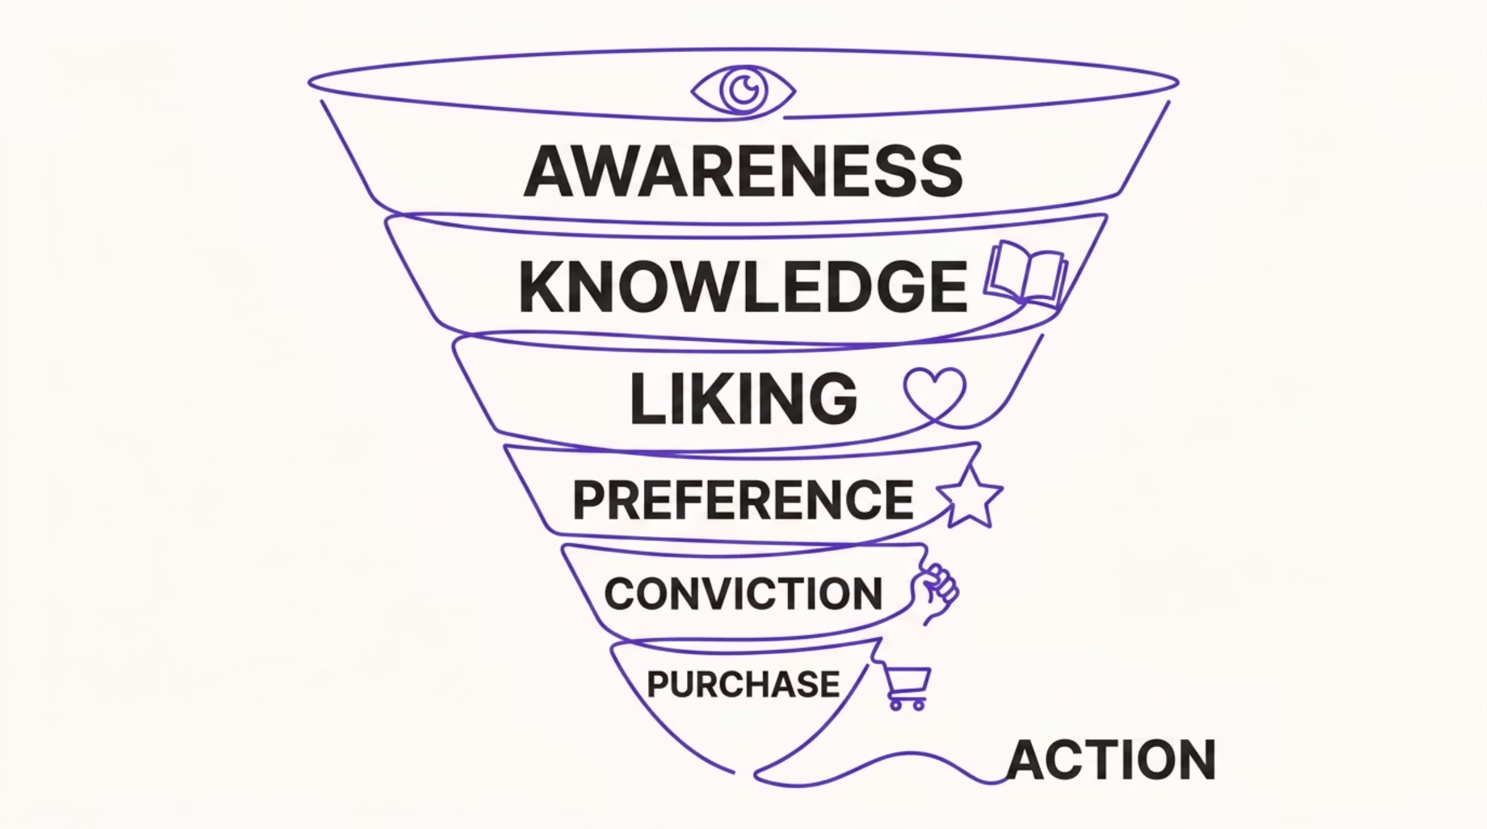
The Hierarchy of Effects Model
This foundational model outlines the sequential stages a consumer goes through from initial exposure to a brand or product to making a purchase decision.
Understanding which stage a target audience is in is crucial for selecting the most effective message strategy. Early stages focus on information and education, while later stages emphasize persuasion and action.
Notes:
SPEAKER SCRIPT — Slide 5 | (~2 min)"Before we can talk about message strategies, we need to understand the Hierarchy of Effects Model — because this is the theoretical backbone of everything we'll discuss today.The model proposes that consumers move through six sequential stages before making a purchase: Awareness, Knowledge, Liking, Preference, Conviction, and finally Purchase. Think of it as a funnel — at the top, you have a broad audience who simply knows your brand exists. As you move down, fewer people remain, but they're increasingly committed.Here's why this matters for advertising design: the stage your audience is in determines what kind of message you should send. If they've never heard of your brand, you need awareness-building. If they know you but haven't chosen you, you need persuasion. If they're ready to buy, you need a call to action.This model directly informs the three message strategies we're about to discuss. Let's go there now."

Slide 6
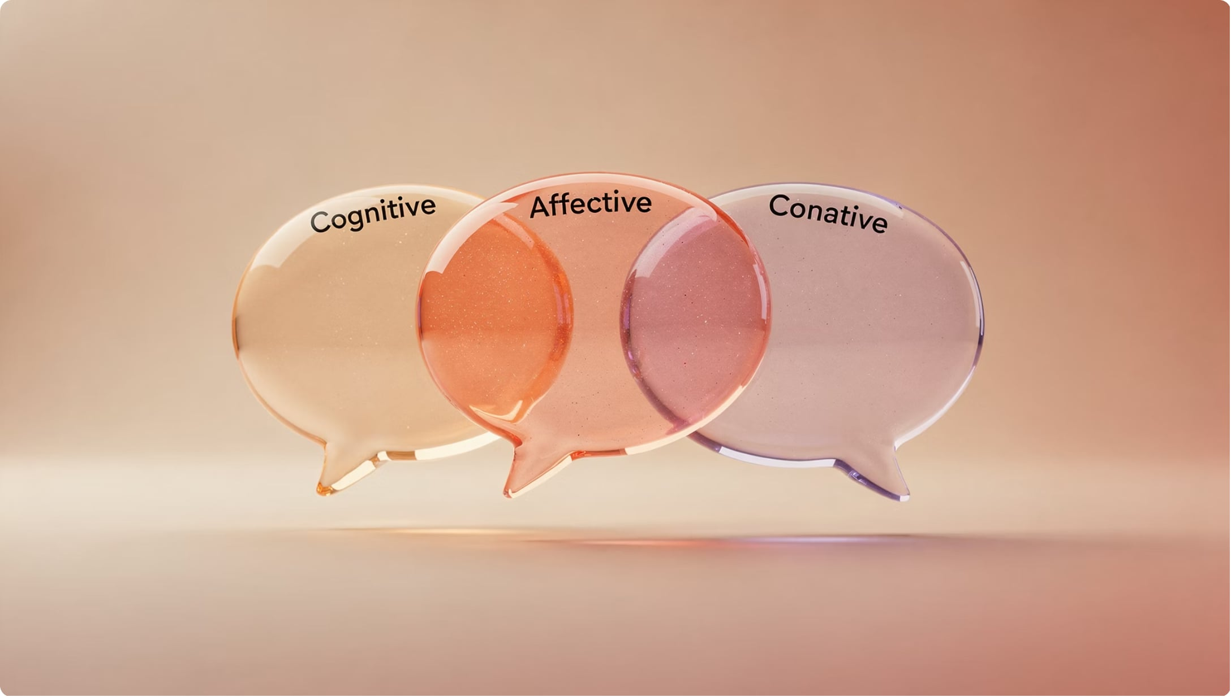
Message Strategies
Cognitive
Rational arguments, product info
Affective
Emotions and feelings
Conative
Direct consumer response

Slide 7
Cognitive Message Strategies
Generic
Preemptive
Unique Selling Proposition
Promotes benefits without superiority claim — best for market leaders (e.g., Campbell's, Intel)
Claims superiority first — competitors look like copycats (e.g., Crest "cavity fighter")
Explicit, testable claim of uniqueness — must be substantiated
Hyperbole
Comparative
Untestable claim — no substantiation needed (e.g., "America's favorite")
Direct/indirect comparison to competitor — boosts awareness but risks low believability

Slide 8
Cognitive Strategy Examples
Real-world applications of cognitive message strategies demonstrate their distinct approaches to influencing consumers.
Strategy
Brand Example
Generic
Campbell's Soup: "M'm! M'm! Good!" – Focuses on the core benefit of soup without claiming superiority.
Preemptive
Intel Inside: Dominant claim of being the essential component, making competitors seem like followers.
Unique Selling Proposition (USP)
M&M's: "Melts in your mouth, not in your hand" – A distinct, verifiable product feature.
Hyperbole
Red Bull: "Gives you wings" – An exaggerated, untestable claim for an energy drink.
Comparative
Apple (Mac vs PC): Directly compares the ease of use and design of Mac against Windows PCs.
Each example highlights how brands leverage specific cognitive tactics to build perception and communicate value.

Slide 9


Affective Message Strategies
Resonance
Connects brand to consumer memories — e.g., Subaru's FirstCarStory.com
Comfort Marketing
Vintage characters & jingles evoke nostalgia — brands: Doritos, Pepsi, Bacardi
Emotional
Elicits powerful feelings — trust, happiness, romance — builds brand loyalty

Slide 10
Resonance vs. Emotional Advertising
While both are affective strategies, they tap into different aspects of human emotion and memory.
Resonance Advertising
Emotional Advertising
Connects with consumers' deep-seated memories, experiences, or current life situations. It aims to create an internal feeling of "that's me!" or "I've been there."
Designed to elicit a powerful, immediate feeling such as joy, sadness, love, fear, or excitement. It seeks to create a strong, often short-term, emotional response.
Builds deep, relatable connections.
Often evokes nostalgia or shared human experiences.
Example: Subaru's campaigns highlighting family adventures and life stages with their cars, making the brand part of personal history.
Aims for immediate impact and attention.
Can be highly persuasive and memorable.
Example: Coca-Cola's "Share a Coke" focusing purely on happiness and connection, or charity ads using pathos to encourage donations.
Use when the product naturally integrates into the consumer's life story or represents a significant life moment, fostering long-term loyalty.
Use when needing to create strong brand association quickly, differentiate through powerful sentiment, or prompt an immediate action.

Slide 11


Conative Message Strategy
Conative ads lead directly to consumer action — calls to action, coupon redemption, limited-time offers.
Cognitive and affective responses often come after the purchase.
Conative
Cognitive
Affective
Attitude sequence: Conative → Cognitive → Affective

Slide 12







7 Types of Advertising Appeals
Fear
Humor
Sex
Music
Rational
Emotional
Scarcity

Slide 13
Choosing the Right Advertising Appeal
Selecting an effective advertising appeal requires careful consideration of the product, target audience, and campaign objectives. This guide helps match the appeal to the context.
Appeal Type
Best For
Audience Fit
Example Brand
Fear
Products/services protecting against negative outcomes (insurance, safety, health campaigns).
Those concerned about security, health, or potential risks.
LifeLock: "Protect your identity from theft."
Humor
Low-involvement products, building brand likeability, cutting through clutter.
Broad appeal, generally positive, but humor can be subjective.
Old Spice: "The Man Your Man Could Smell Like."
Sex
Fashion, beauty, personal care, products tied to attraction or confidence.
Younger demographics, those influenced by aspirational imagery.
Calvin Klein: Iconic fragrance and apparel campaigns.
Music
Enhancing mood, memorability, brand association, targeting specific demographics.
Broad, but specific genres resonate with different age groups/cultures.
Coca-Cola: Catchy jingles and songs in campaigns.
Rational
High-involvement products, complex features, B2B, informative messaging.
Analytical, practical, value-conscious consumers seeking facts.
Apple (Mac): Highlighted specs and performance.
Emotional
Building brand loyalty, creating strong brand image, cause-related marketing.
Consumers driven by feelings, those seeking connection or meaning.
Nike: Inspiring stories of athletes overcoming challenges.
Scarcity
Promoting limited editions, special offers, driving immediate action.
Impulsive buyers, FOMO-driven consumers, those seeking exclusivity.
Amazon: "Limited-time deals," "only X left in stock."
By aligning the advertising appeal with the campaign's strategic goals, brands can effectively resonate with their audience and drive desired consumer responses.

Slide 14


Fear Appeals
Why They Work
Appeal Strength
Increase viewer interest & persuasiveness
Enhance information processing
Better recall than warm, upbeat ads
Moderate fear = most effective. Too strong → anxiety → viewers tune out.
Key factors: severity, vulnerability, intrinsic/extrinsic rewards, self-efficacy, response efficacy

Slide 15

Humor & Sex Appeals
😂 Humor
💋 Sex
Cuts through clutter — ~30% of TV/radio ads
Consumers watch, laugh, and remember
Elevates mood → positive brand association
Increases attention — but lowers brand recall
Formats: subliminal, sensual, suggestive, nudity, overt, decorative models
Subtle cues now preferred over overt approaches
Best when humor connects directly to product benefits
Overt sex can generate negative brand attitudes

Slide 16

Music & Rational Appeals
🎵 Music
Gains attention, triggers memory, increases persuasiveness. Can be original jingle or familiar song.
🧠 Rational
Follows hierarchy of effects — awareness → knowledge → preference → conviction → purchase. Best in print & online.

Slide 17
Emotional & Scarcity Appeals
Emotional Appeals
Scarcity Appeals
Capture attention and create emotional attachment to the brand. Key to brand loyalty.
Common emotions: trust, happiness, romance, security, serenity, passion
Limited supply or time increases perceived value.
McDonald's McRib — limited time
General Mills USA Olympic Crunch
Music compilations — not in stores
Most creatives view emotional advertising as the key to brand loyalty.

Slide 18
Appeals in Action — Case Studies
Explore real-world examples of how different advertising appeals have been successfully implemented to connect with audiences and drive brand objectives.
Dove: Real Beauty Campaign
Geico: "Caveman" & "Aflac Duck" Campaigns
Allstate: "Mayhem" Campaign
Appeal: Emotional
Dove's campaign challenged conventional beauty standards by featuring women of diverse shapes, sizes, and ethnicities. It fostered a deep emotional connection with consumers by promoting self-acceptance and authenticity, leading to increased brand loyalty and sales.
Appeal: Fear
The "Mayhem" campaign personifies various dangers (e.g., distracted drivers, falling branches) to highlight the need for comprehensive insurance. By presenting potential, albeit humorous, negative scenarios, Allstate effectively emphasizes the importance of protection and drives home the value of their services.
Appeal: Humor
Geico consistently uses humor to make insurance, a typically dry product, memorable and engaging. Their long-running "Caveman" and "Aflac Duck" campaigns leveraged relatable, unexpected, and often absurd comedic scenarios to build brand awareness and differentiate from competitors.

Slide 19








Executional Frameworks
Animation
Slice-of-Life
Storytelling
Testimonial
Authoritative
Demonstration
Fantasy
Informative

Slide 20




Key Executional Frameworks
Animation
Slice-of-Life
Storytelling
Testimonial
Computer graphics & rotoscoping — now used in B2B too
Encounter → Problem → Interaction → Solution
30-second movie — brand at periphery, viewer draws own conclusions
Real customers = most believable. Especially effective for services.

Slide 21


More Executional Frameworks
Authoritative
Physicians, engineers, independent studies — builds credibility. Works best in print.
Demonstration
Shows how product works — effective for communicating benefits (e.g., Swiffer)
Fantasy
Lifts audience beyond reality — common in perfume/cologne. Romantic themes preferred.
Informative
Straightforward facts — common in radio. Needs eye-catching image to stand out.

Slide 22

Matching Executional Frameworks to Media
Choosing the right media channel is crucial for an executional framework to resonate with the target audience. Each framework thrives in specific environments.
Framework
Best Media Channel(s)
Why It Works
Animation
TV, Digital Video, Social Media
Versatile for complex ideas, abstract concepts, or humor. Digital allows for short, attention-grabbing animated spots.
Slice-of-Life
TV Commercials, Digital Video
Highly relatable narratives show product use in everyday situations, fostering identification and solving common problems.
Storytelling
Long-form TV, Digital Video, Podcasts, Print Articles
Engages emotions deeply, builds brand narrative, and creates lasting connections. Requires time for plot development.
Testimonial
Digital (Reviews, Social), Print, TV
Authentic customer experiences build trust and credibility. Visual and written formats effectively showcase genuine endorsements.
Authoritative
Print (Magazines, Journals), Digital (Whitepapers, Expert Blogs), TV (Expert Endorsements)
Leverages experts or data to convey credibility. Detailed formats like print and digital articles are ideal for conveying complex information.
Demonstration
TV, Digital Video (How-to Guides, Product Demos)
Visually illustrates product features, benefits, and how it solves problems. Video is optimal for showing products in action.
Fantasy
TV, Digital Visual Ads (Immersive, Cinematic)
Transports audience to an imagined world, evoking emotions and creating memorable brand associations. Best conveyed visually.
Informative
Print Ads, Digital Text-based Ads, Radio
Delivers facts, figures, and data directly. Print and digital offer space for detail, while radio provides direct auditory information.
Aligning the executional framework with the media channel optimizes impact and ensures the message is delivered effectively to consumers.

Slide 23
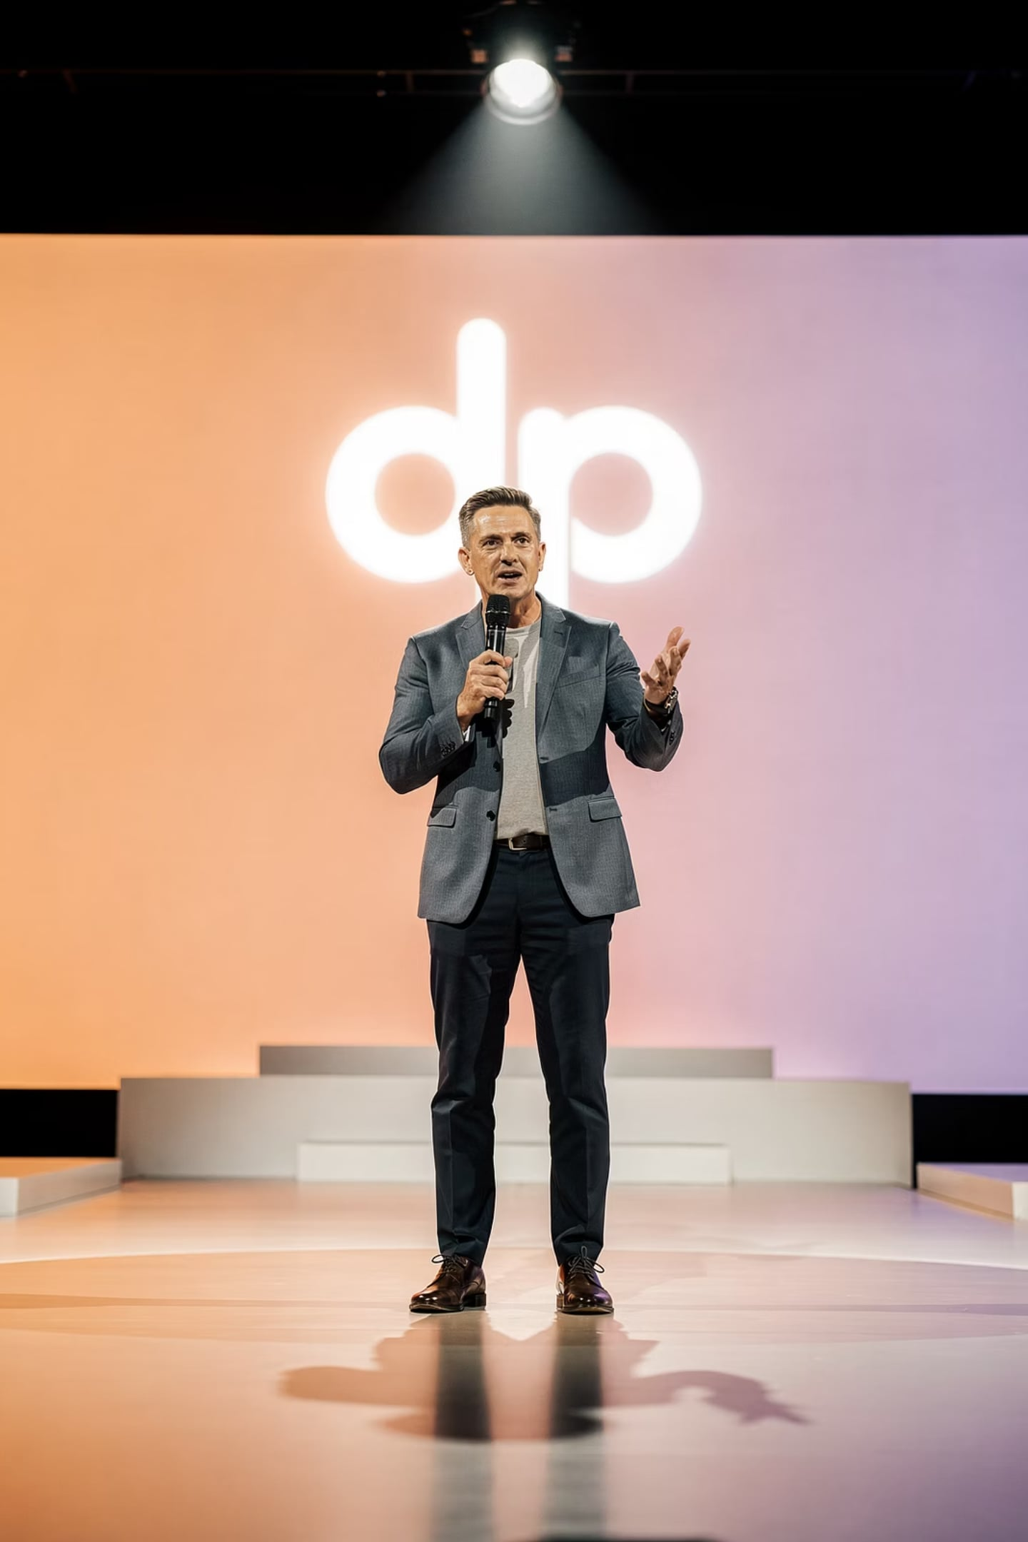
Sources & Spokespersons
Celebrity
Most common — ~6% of ads. Builds emotional bonds. 30% of 18–34 yr olds try celebrity-endorsed brands.
CEO
Visible, personable leaders become brand assets (e.g., Michael Dell)
Expert
Physicians, lawyers, financial planners — add credibility and authority
Typical Person
Paid actors or real customers — growing use as celebrity appeal wanes

Slide 24


Celebrity Endorsement Variations
Voiceovers
Celebrity voice without being shown — brings script to life
Dead Person Endorsements
Past video/image of deceased icons — e.g., Marilyn Monroe, John Lennon
Social Media
Paid promotional tweets — $200–$10,000 per message (e.g., Snoop Dogg for Toyota Sienna)

Slide 25


Risks of Celebrity Endorsements
Overexposure
When a celebrity endorses too many products, their influence can become diluted, and consumers may view their endorsements as less genuine or trustworthy, diminishing impact for each brand.
Negative Publicity
Any scandal or negative behavior by the celebrity can directly damage the brand's image. Brands must consider the celebrity's reputation risk, as their actions can quickly reflect on the products they represent.
Vampire Effect
The celebrity's powerful personality or fame can overshadow the product itself, leading consumers to remember the endorser but not the brand or its message. This "vampire effect" can dilute brand recall.
Misalignment with Brand Values
If the celebrity's public persona or personal values do not genuinely align with the brand's identity, the endorsement can seem inauthentic, confusing consumers and potentially alienating the target audience.

Slide 26












Characteristics of Effective Spokespersons
Credibility
Attractiveness
Composite of all traits — drives message acceptance
Physical & personality — helps form emotional bonds
Expertise
Similarity
Higher expertise = more persuasive
Consumers identify with relatable spokespersons
Trustworthiness
Likeability
Confidence in message — linked to likeability
Positive response drives brand affinity

Slide 27


The MECCAS Model
The Means-End Conceptual Chain in Advertising Strategy (MECCAS) model links product attributes to deep-seated consumer values, illustrating how advertising messages can be structured to resonate profoundly.
Functional Consequences
Psychosocial Consequences
Immediate benefits from using the product.
Social and emotional effects for the user.
Attributes
Values
Product features and tangible qualities.
Deep personal motivations and core drivers.
Consider running shoes: Lightweight material (Attribute) enables you to run faster and longer (Functional Consequence). This makes you feel confident and accomplished (Psychosocial Consequence), ultimately tapping into values of self-esteem and achievement (Values).

Slide 28

Putting It All Together
Appeal Type
Fear, humor, sex, music, rational, emotional, scarcity choices.
Executional Framework
Message Strategy
Animation, storytelling, testimonial, demonstration approaches.
Cognitive, affective, conative intents that guide tone.
All three elements must align — and mesh with the chosen media — for a successful campaign.

Slide 29


Ethical Considerations in Advertising Design
Navigating the complex landscape of advertising requires a deep understanding of ethical responsibilities to ensure fairness, respect, and trust with consumers.
Truthfulness and Deception
Targeting Vulnerable Audiences
Stereotyping
Advertisements must be honest and avoid misleading claims, false promises, or hidden information that could deceive consumers. Transparency is key to maintaining trust.
Avoiding harmful stereotypes is crucial. Advertising should promote diversity and inclusion, challenging traditional biases rather than reinforcing them.
Special care is needed when advertising to children, the elderly, or those in financial distress. Exploiting vulnerabilities through manipulative tactics is highly unethical.
Privacy in Digital Advertising
Social Responsibility
With pervasive data collection, advertisers must respect consumer privacy. This includes transparent data usage, clear consent, and robust protection against breaches.
Advertisements should not promote unhealthy lifestyles, environmental harm, or cultural insensitivity. Brands have a responsibility to contribute positively to society.

Slide 30

Key Takeaways
3 Message Strategies
Cognitive, Affective, Conative — each targets a different stage of the hierarchy of effects
7 Advertising Appeals
Fear, Humor, Sex, Music, Rational, Emotional, Scarcity
8 Executional Frameworks
Animation to Informative — the "how" of delivering the message
Spokesperson Credibility
Attractiveness, similarity, likeability, trustworthiness, expertise
Review Questions
How do cognitive, affective, and conative message strategies differ in the outcomes they aim to produce?
Which advertising appeals are most effective for highly involved products, and why might others fall short?
How does the choice of executional framework change the way a message is remembered or interpreted?
Which spokesperson characteristics matter most when building trust with an audience, and in what situations?
How would you match an advertising appeal to a specific target audience based on their motivations, values, or decision style?

