Slide 1
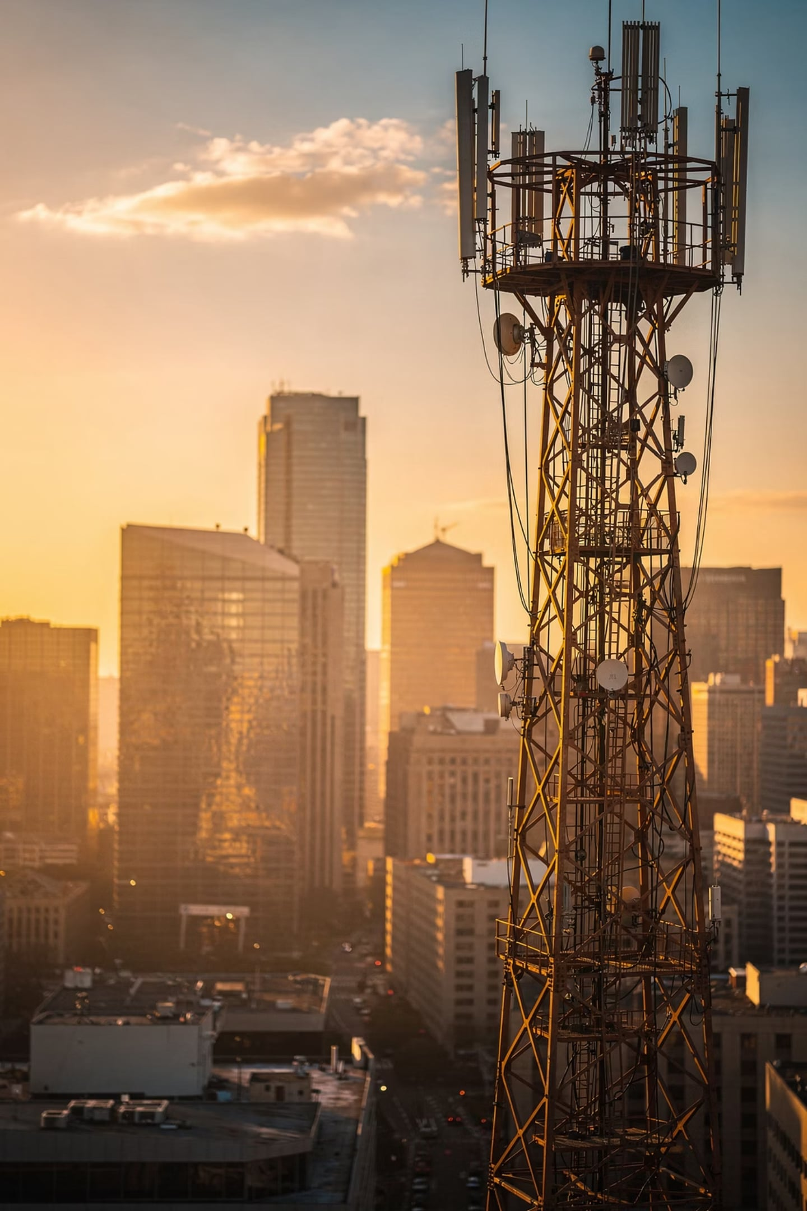
Traditional Media Channels
Lecture 7 · Advertising and Integrated Marketing Communications
BY PROF. FIDELA R. BALADJAIA

Slide 2

Module Overview: Traditional Media Channels
This module delves into the foundational channels that have shaped advertising for decades, providing a comprehensive understanding of their unique strengths and strategic applications.
Television
Radio
Print
Exploring TV's broad reach and unparalleled visual impact.
Understanding auditory engagement and local market penetration.
Analyzing newspapers, magazines, and their targeted readership.
Out-of-Home (OOH)
Media Planning
Grasping environmental advertising, from billboards to transit media.
Strategizing effective campaigns across traditional platforms.

Slide 3
Lecture Learning Objectives
01
02
03
Media Strategy
Media Planning
Advertising Objectives
Analyze and choose media for campaigns
Elements, individuals, and key terms
Primary goals and how to achieve them
04
05
Media Selection
Special Markets
Advantages, disadvantages, and the media mix
B2B and international media considerations

Slide 4

Why Media Strategy Matters
Too many ads fall unseen and unheard — like a tree falling in an empty forest.
200+ Magazines
Radio Stations
Average consumer reads only 9
Listeners tune in to only 3
TV Viewership
Prime-time ratings down 30% over a decade

Slide 5
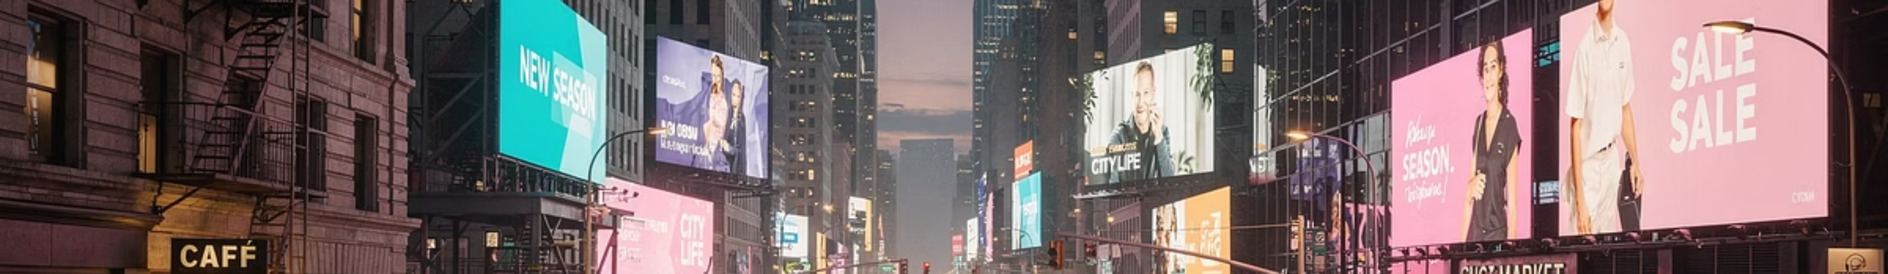




The Media Landscape: An Overview
Understanding where and how your message travels is crucial for effective advertising. The modern media landscape is broadly categorized into three distinct types.
PAID MEDIA
OWNED MEDIA
EARNED MEDIA
Direct Investment
Brand Platforms
Organic Visibility
Purchased ad placements (TV, print, digital banners, social ads). Offers control over message and audience reach.
Channels directly controlled by the brand (websites, blogs, social profiles, email lists). Builds trust and direct relationships.
Publicity gained through promotional efforts beyond paid advertising (PR, word-of-mouth, reviews, social sharing). Highly credible but less controllable.
This landscape is further divided into traditional channels (TV, Radio, Print, OOH) and digital channels (social, search, programmatic) – each with unique strengths for reaching audiences.

Slide 6
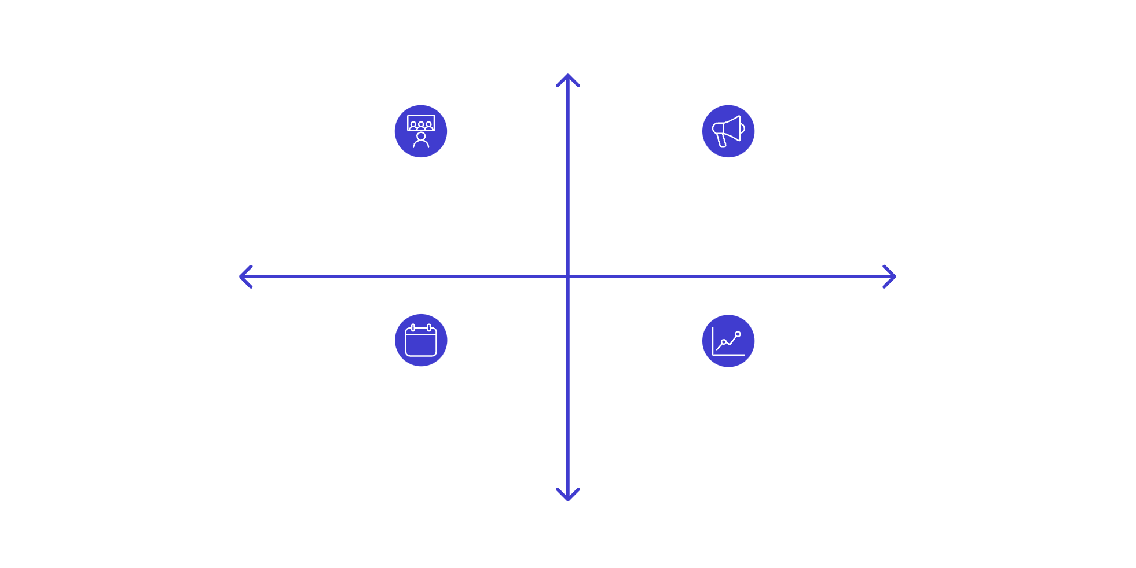

Media Planning
High Reach
What It Involves
Marketing Analysis - Audience & Insights
Advertising Analysis - Channels & Creative
Starts with target market analysis — understanding how customers make purchase decisions and what media they consume throughout the day.
High Investment
Low Investment
Media Schedule - Timing & Placements
Justification & Summary - ROI & Rationale
Low Reach
Morning
Work Hours
Evening
Radio, news shows, newspapers
Trade journals, websites, office radio
TV, magazines, leisure internet

Slide 7







The Media Plan Document
A comprehensive media plan is a critical roadmap for any successful advertising campaign, detailing how messages will reach the target audience.
Situation Analysis
Current market conditions, competitive landscape, and brand positioning.
Target Audience
Detailed profile of who we're trying to reach, including media consumption habits.
Media Objectives
Specific, measurable goals for the media campaign (e.g., reach, frequency, impact).
Media Strategy
The chosen approach to achieve objectives, including media mix and rationale.
Scheduling
Determining the timing and duration of ad placements across selected channels.
Budget Allocation
Detailed breakdown of spending per medium and activity, ensuring fiscal responsibility.

Slide 8

Media Planners vs. Media Buyers
Media Planner
Media Buyer
Formulates where and when to place ads
Matches product with market and media
Works with creatives, account executives, and buyers
Considered the heart of communications strategy at P&G and Unilever
Purchases ad space; negotiates rates and schedules
Monitors special deals and tie-ins between outlets
Spot TV prices fluctuate up to 45% for the same time slot
Timing of purchase — not agency size — drives cost differences
Bob Brennan, Leo Burnett Starcom: "In the past, 95% success was great creative, 5% great media. Now it's much closer to 50–50."

Slide 9






Advertising Terminology
Reach
Frequency
People exposed to a media vehicle at least once in a 4-week period
Average times a person is exposed to an ad within a given period
OTS
GRP
Cumulative opportunities to see an ad in a given time period
Vehicle rating × OTS — measures impact and intensity of a media plan
CPM
Continuity
Dollar cost of reaching 1,000 members of a media vehicle's audience
Continuous, pulsating, or flighting — the schedule pattern of ad placements

Slide 10
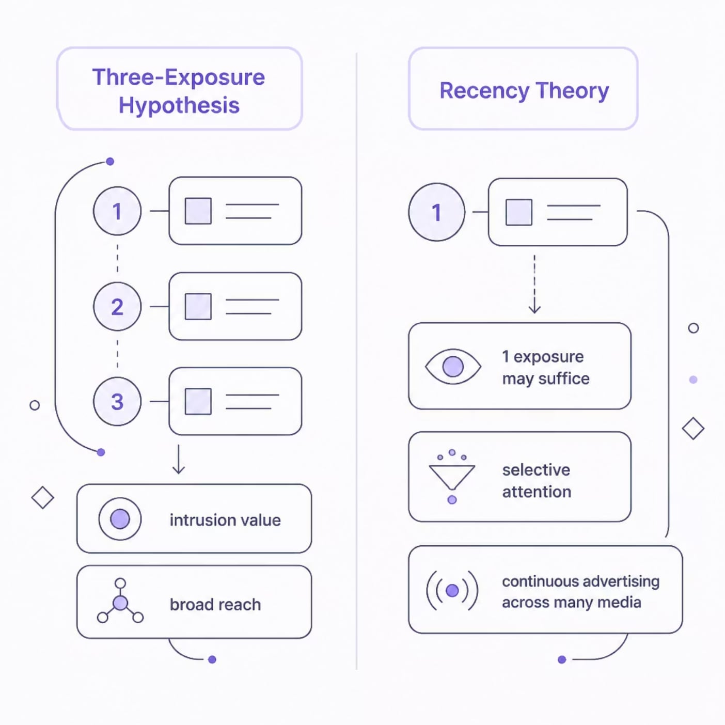
Achieving Advertising Objectives
Three-Exposure Hypothesis
Herbert Krugman: a minimum of 3 exposures needed for impact, regardless of individual needs. Intrusion value — capturing attention without voluntary effort.
Recency Theory
Consumers exhibit selective attention — one exposure may be enough if the consumer is already in the market. Advertise continuously across multiple media to catch buyers at the moment of decision.

Slide 11



Effective Reach & Frequency
Effective Reach
Effective Frequency
% of audience that must be exposed to achieve a specific objective
Number of exposures needed to achieve a particular objective
Too Few
Too Many
Fails to meet intended objectives
Wastes resources — diminishing returns
Brand recognition → maximize reach (TV, billboards, magazines). Brand recall → maximize frequency (TV, radio, newspapers).

Slide 12
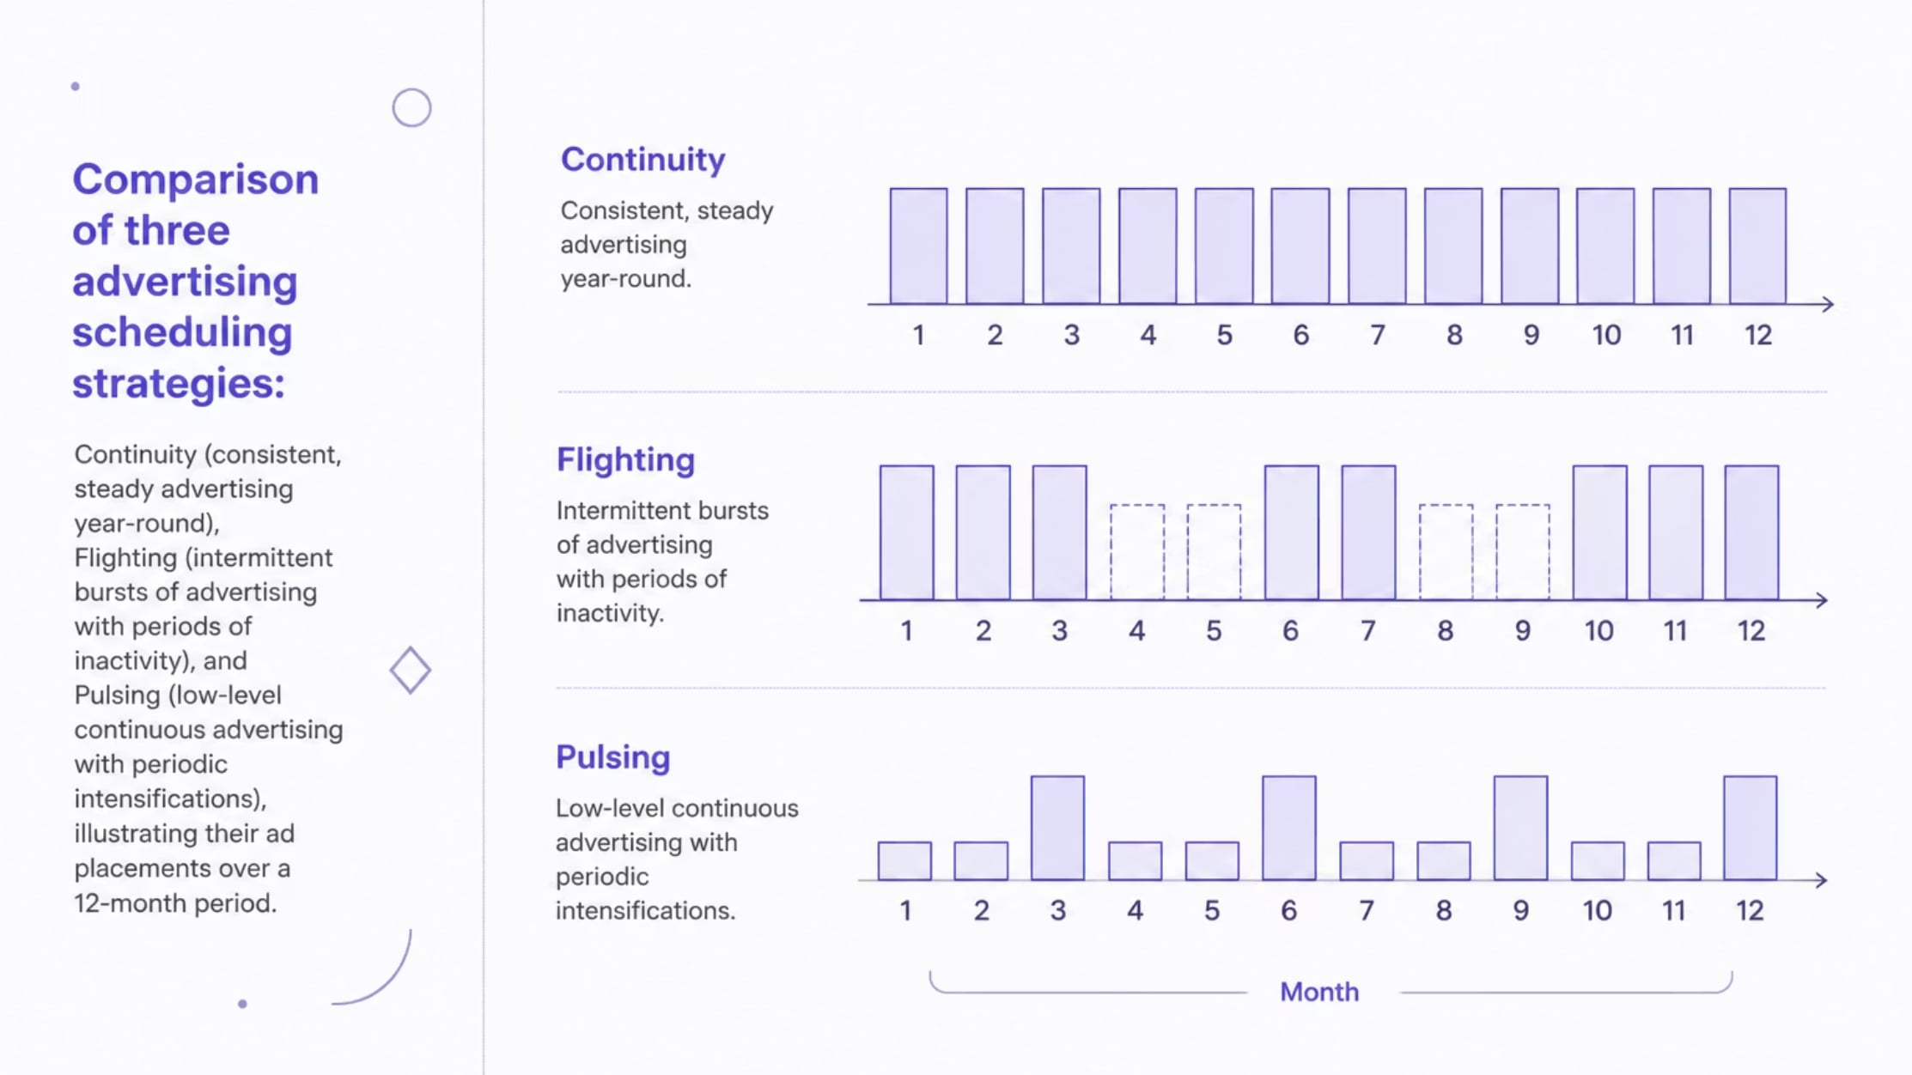

Advertising Scheduling Strategies
Crafting an effective media plan involves strategic decisions about when and how often ads are placed. There are three primary approaches to scheduling advertising over time:
Continuity
Flighting
Pulsing
Maintains a steady level of advertising throughout the campaign. Ideal for frequently purchased products with no seasonal variations.
Involves intermittent periods of heavy advertising interspersed with periods of no advertising. Best suited for products with seasonal demand.
Combines continuity and flighting, maintaining a low-level presence year-round while increasing advertising intensity during peak selling periods.

Slide 13
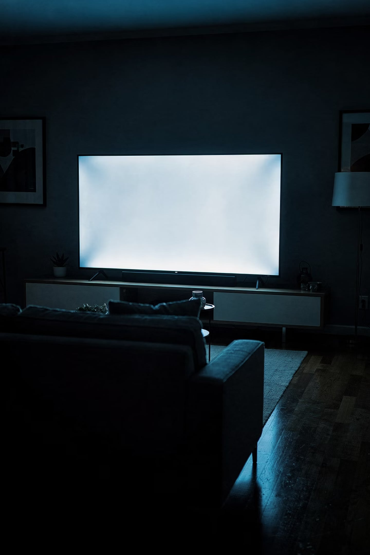
Television Advertising
Advantages
Disadvantages
Highest reach — single ad reaches millions
Low cost per contact (Super Bowl: ~$4M/30 sec, 110M+ households)
High intrusion value; creative opportunities
Segmentation via cable/specialty channels
Heavy clutter — up to 31 commercials/hour
Low recall for mid-break placements
DVRs; channel surfing
Avg. 30-sec national ad production: $358,000

Slide 14


TV Ratings, Shares & C3
Key Formulas
Dynamic & Retargeting
Rating = Households tuned in ÷ Total TV households
Share = Households tuned in ÷ Households with TV on
Example — Sunday Night Football:
17.8M ÷ 109.7M = 16.2 rating
17.8M ÷ 71M = 25 share
Dynamic Advertising
Retargeting
Follow-up video ads sent to mobile after TV viewing — sequential messaging
Targets specific subscribers using combined consumer data (e.g., Toyota → tech-savvy DirecTV users in CA)
C3 Rating
YouTube Pre-roll
Rates the actual commercial slot + viewing within 3 days. First pod position generates 28% higher awareness than mid-sequence ads.
200% higher recall for viewers who saw ad on both YouTube and TV

Slide 15

TV Advertising: Advantages & Disadvantages
Advantages
Disadvantages
Mass reach to a broad audience
Engaging sight, sound, and motion capabilities
Opportunity for strong emotional impact
Builds brand prestige and credibility
High production and media costs
Significant ad clutter and noise
Audience avoidance (zapping/zipping)
Short message life and retention

Slide 16

Radio Advertising
~80% of Americans listen to radio daily. Delivers intimate, one-on-one messages.
Advantages
Disadvantages
Promotes recall via repetition and sound
Narrow, definable target markets by format
Intimacy with DJs builds credibility
Low cost; flexible; mobile
Reaches businesses during work hours
Short exposure (15–30 sec); low attention
Difficult to reach national audiences
Duplication across stations in large markets
Information overload

Slide 17

Radio Advertising: Advantages & Disadvantages
Advantages
Disadvantages
Excellent for local targeting and community engagement
Low production and media costs compared to TV and print
Allows for high message frequency and repetition
Effective at reaching captive commuter audiences during drive times
Audio-only format limits creative possibilities (no visuals)
Fragmented audiences across many stations and formats
Often perceived as a background medium, leading to lower attention
Short exposure time for individual ads, requiring repetition

Slide 18
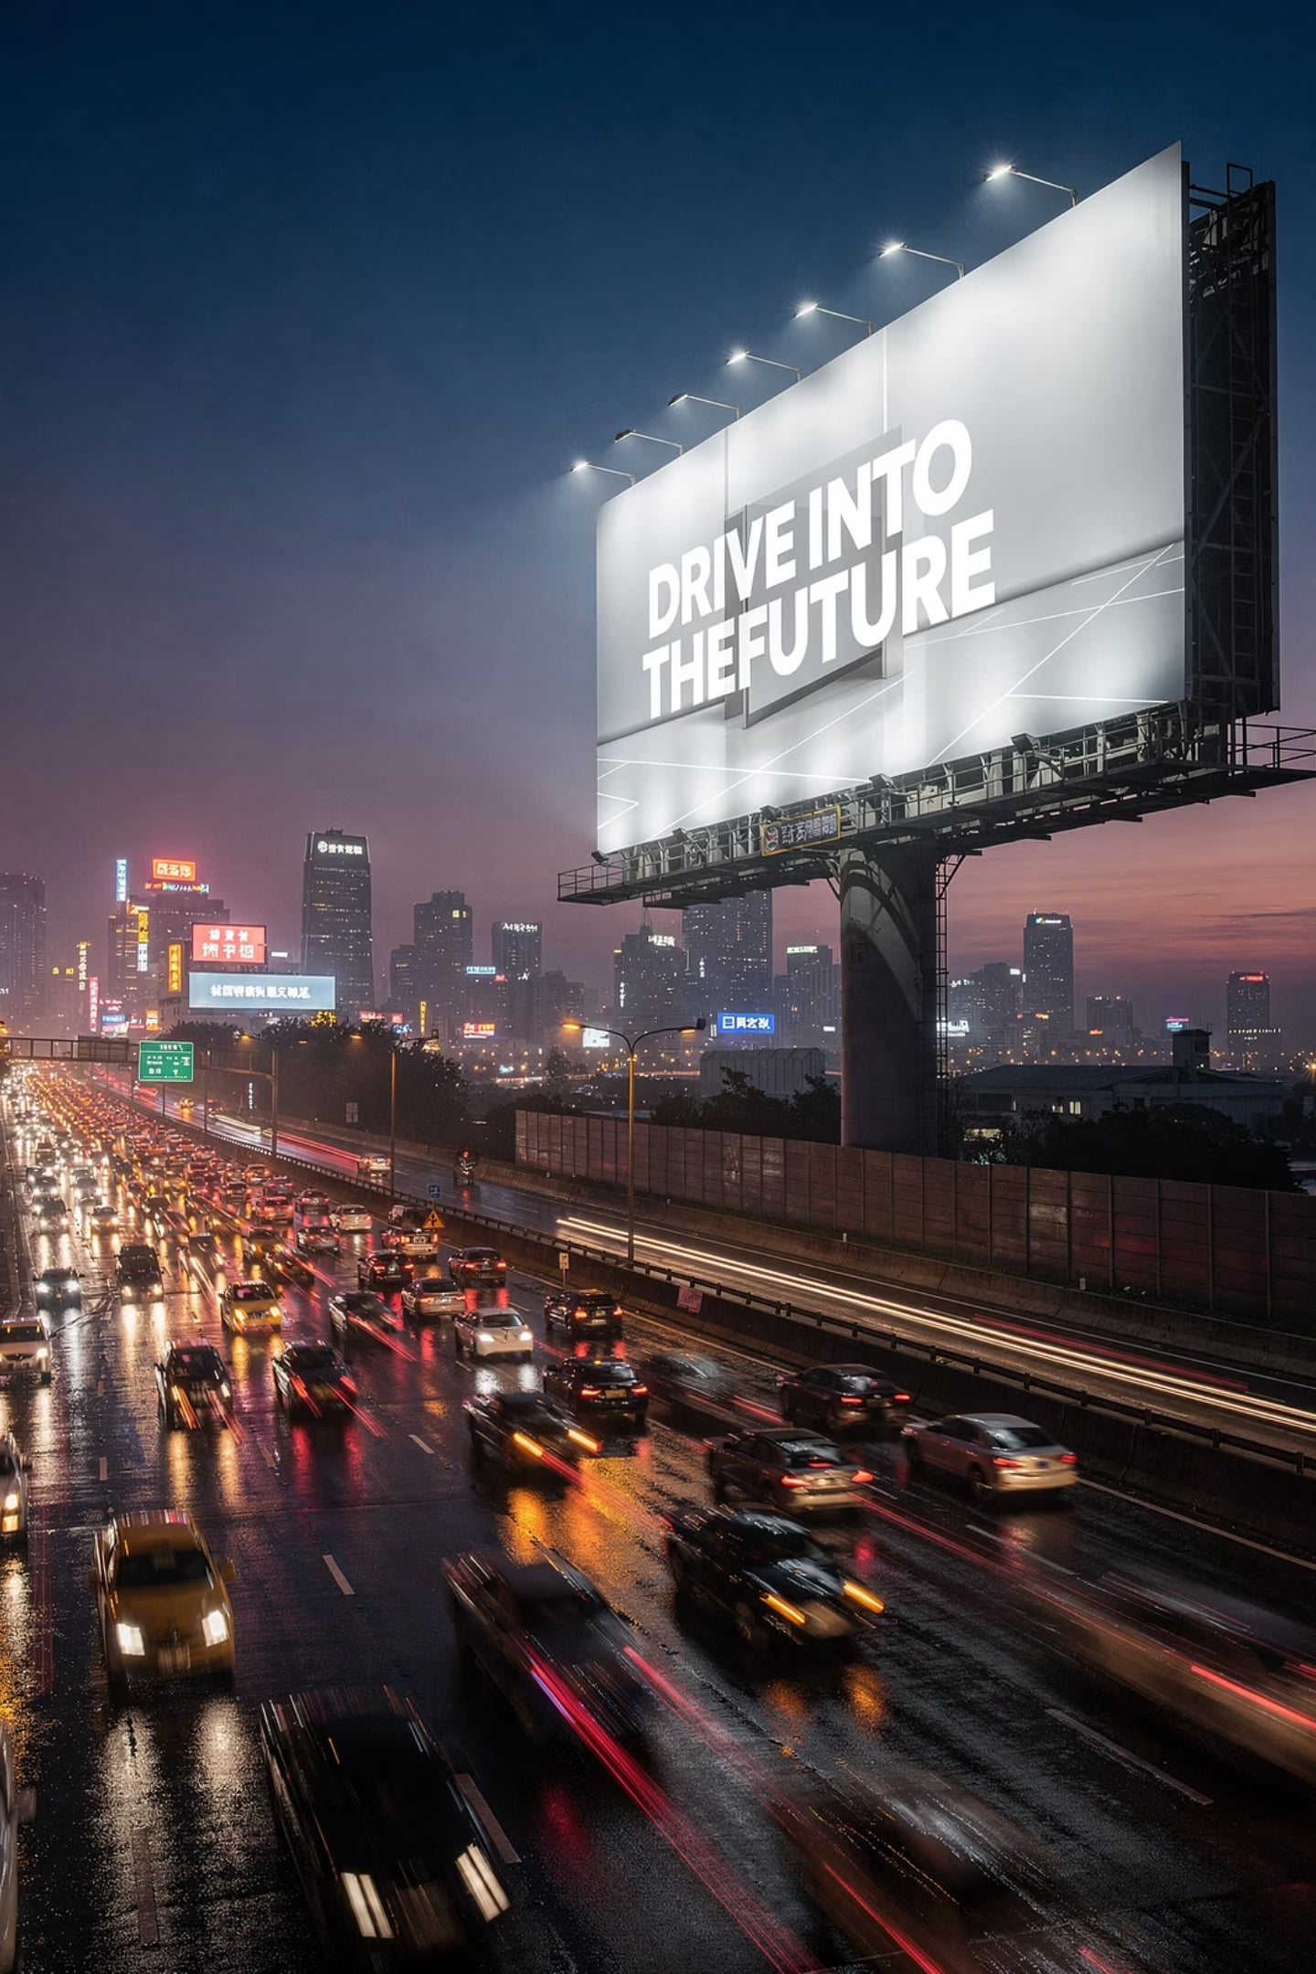
Out-of-Home Advertising
Annual OOH expenditures exceed $5.5 billion. LED and digital technology transformed the medium.
Advantages
Disadvantages
Long life; broad reach; high frequency on commuter routes
Low cost per impression
Geographic selectivity for local firms
Digital boards: on-demand message changes
Short exposure time; brief messages only
Little segmentation possible
Clutter in high-traffic areas
Rising costs in congested urban corridors

Slide 19
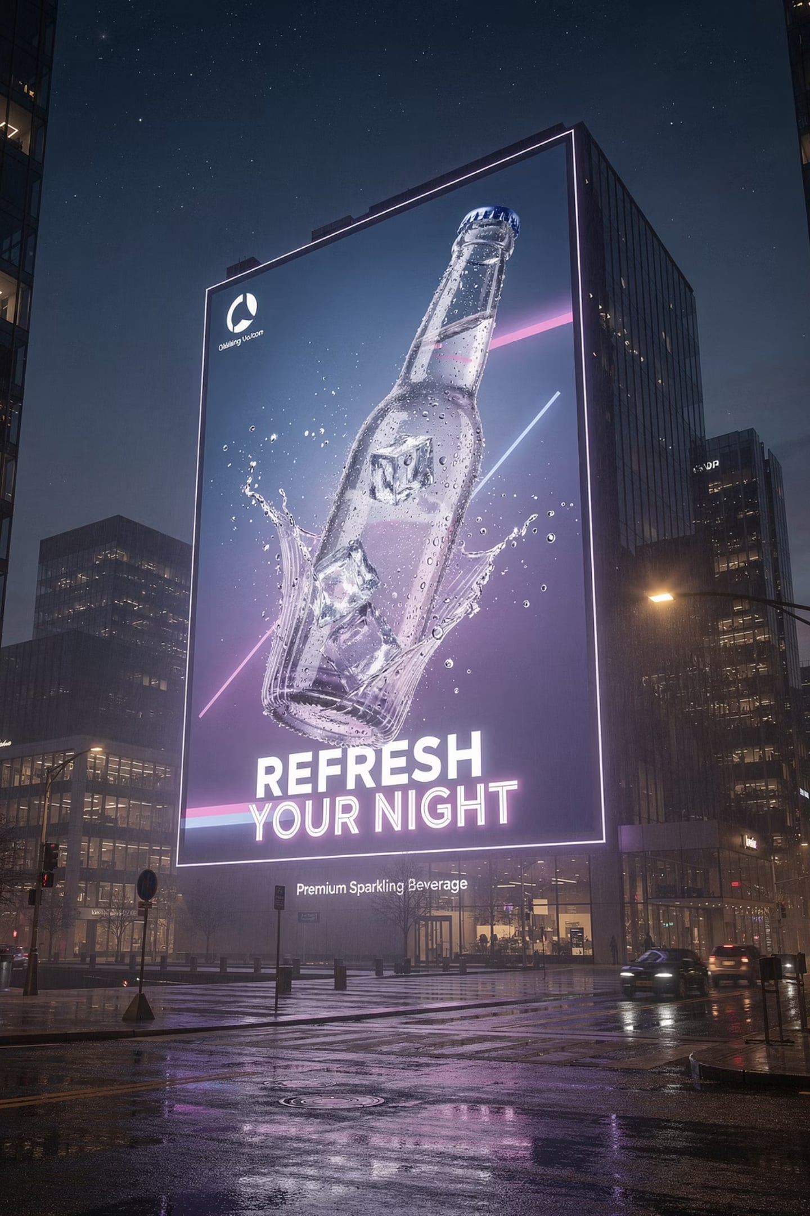




Types of Out-of-Home Advertising
Out-of-home (OOH) advertising encompasses diverse formats that reach consumers outside their homes, offering unique opportunities for brand visibility and engagement.
Billboards
Large-format displays along highways and urban areas. Includes standard, digital LED, and spectacular (custom-built) formats.
Transit Advertising
Ads on or inside public transport like buses, subways, taxis, and at transport hubs such as airports and train stations.
Street Furniture
Advertisements integrated into urban amenities like bus shelters, kiosks, newsstands, and public benches.
Place-Based Media
Ads in specific locations such as cinemas, stadiums, restaurants, malls, and health clubs, targeting captive audiences.

Slide 20

Magazine Advertising
Advantages
High market segmentation by topic
Engaged readers; longer attention to ads
High-quality color; long shelf life
Ideal for B2B — trade journals reach buying centers
Half of readers take action after seeing an ad
Disadvantages
Declining readership; high cost
Long lead time; little flexibility
Clutter

Slide 21

Newspaper Advertising
Advantages
Disadvantages
Geographic selectivity — ideal for local retailers
Short lead time; high flexibility
High credibility — most trusted source for purchase decisions
Longer copy; coupons and special-response features
Short life span; rarely re-read
Poor reproduction quality
Aging readership (avg. print reader: age 51)
Internet competition
Starbucks newspaper campaign: $545K spend → 500K store visits, 12M impressions

Slide 22
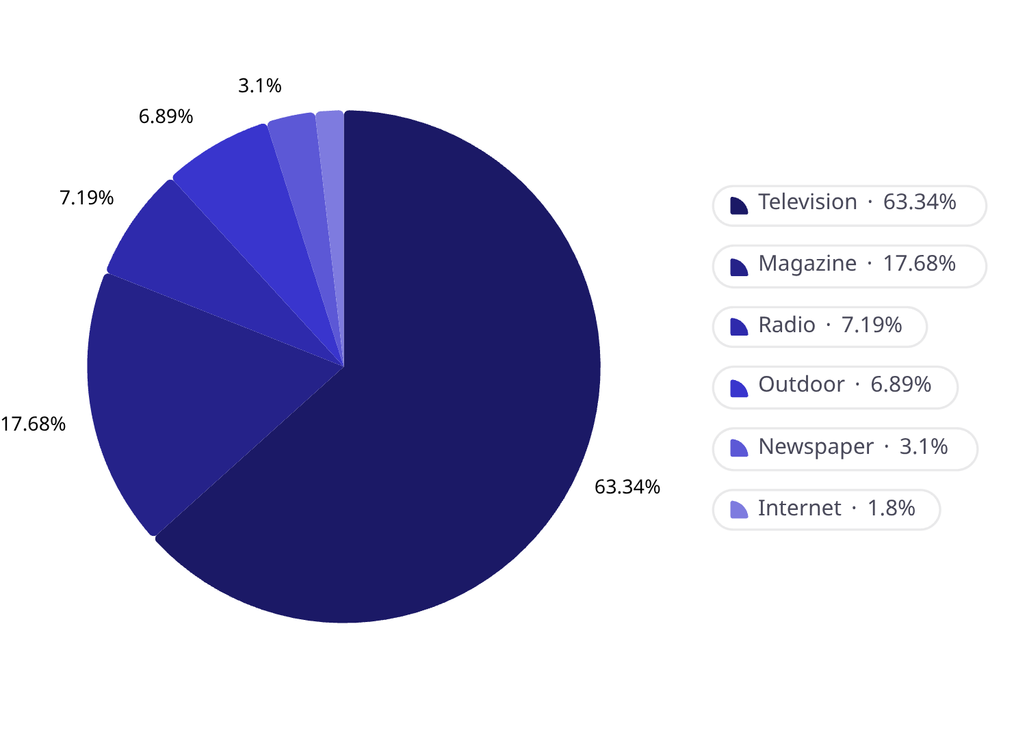

Coca-Cola Media Mix
Total U.S. ad spend: $752.1 million. Television dominates — all other media play supporting roles.
The Media Multiplier Effect
Combined impact of two or more media is stronger than either alone.
TV + Magazine
Highest ad awareness — Millward Brown
Multiple Channels
89% of B2B respondents: multi-media raises brand awareness
Unified Creative
Consistent images and copy across media strengthen brand recognition

Slide 23
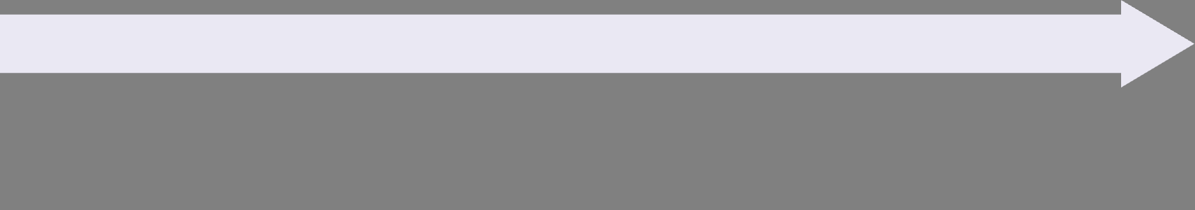

Developing Logical Media Combinations
Market Characteristics
Market Scale
Demographics
Geographic
Psychographics
Geodemographics
Media habits
Local
Regional
National
Global
Message Content
Media Choices
Television
Radio
Outdoor
Newspaper
Internet
Magazine
Direct mail
Other
Media selection flows from market scale → market characteristics → media choices → message content. No two media plans are alike.

Slide 24






Media Mix Strategy: Decision Framework
Developing an effective media mix involves a systematic evaluation of several critical factors to ensure optimal reach, impact, and return on investment.
Campaign Goals
Target Audience
Define clear objectives: brand awareness, lead generation, sales, or customer engagement. These will guide channel selection and measurement.
Understand demographics, psychographics, and media consumption habits. Where does your audience spend their time and attention?
Message Complexity
Budget & Resources
Determine if your message is simple and direct or requires detailed explanation. This influences suitability for different media types.
Assess available funds for media buys and creative production. Consider cost-per-impression and overall campaign efficiency.
Competitive Activity
Channel Combination
Analyze competitor media strategies. Identify opportunities for differentiation or areas of oversaturation to avoid.
Select a synergistic mix of channels that maximize reach, frequency, and impact, reinforcing messages across platforms.

Slide 25
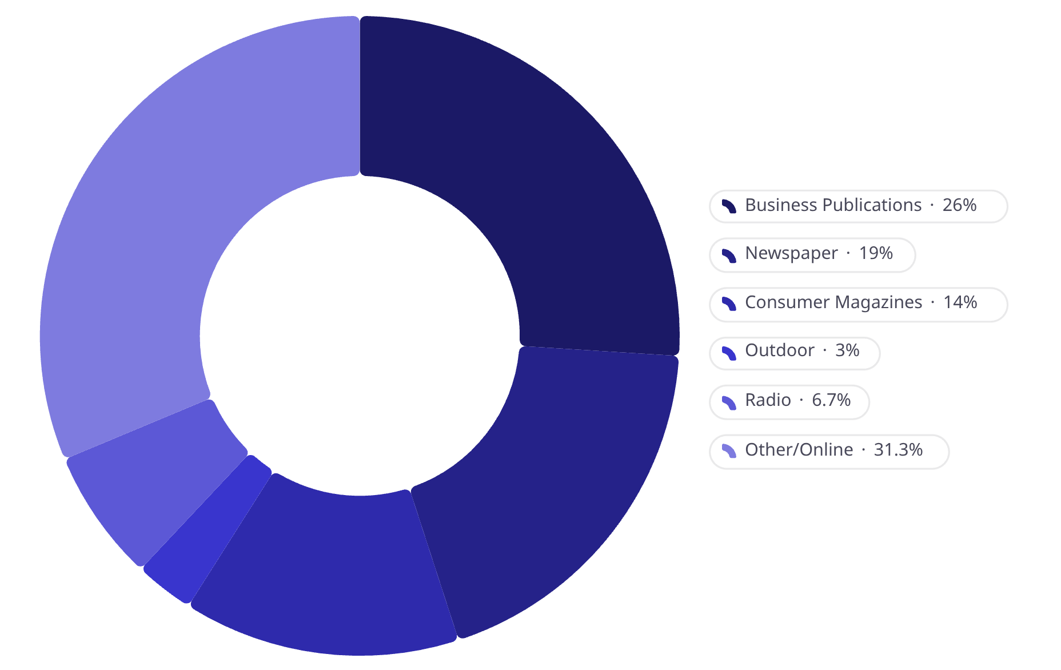
B2B Media Selection
Why B2B Uses Consumer Media
1
Decision-makers are consumers too
Same psychological techniques apply
2
Gatekeepers block workplace reach
Reach buyers at home, in car, or online
3
Clutter in trade media
Strong brand names cut through noise
B2B ad spend: $14B+ annually. Business publications now only 26% — down from ~50%.

Slide 26
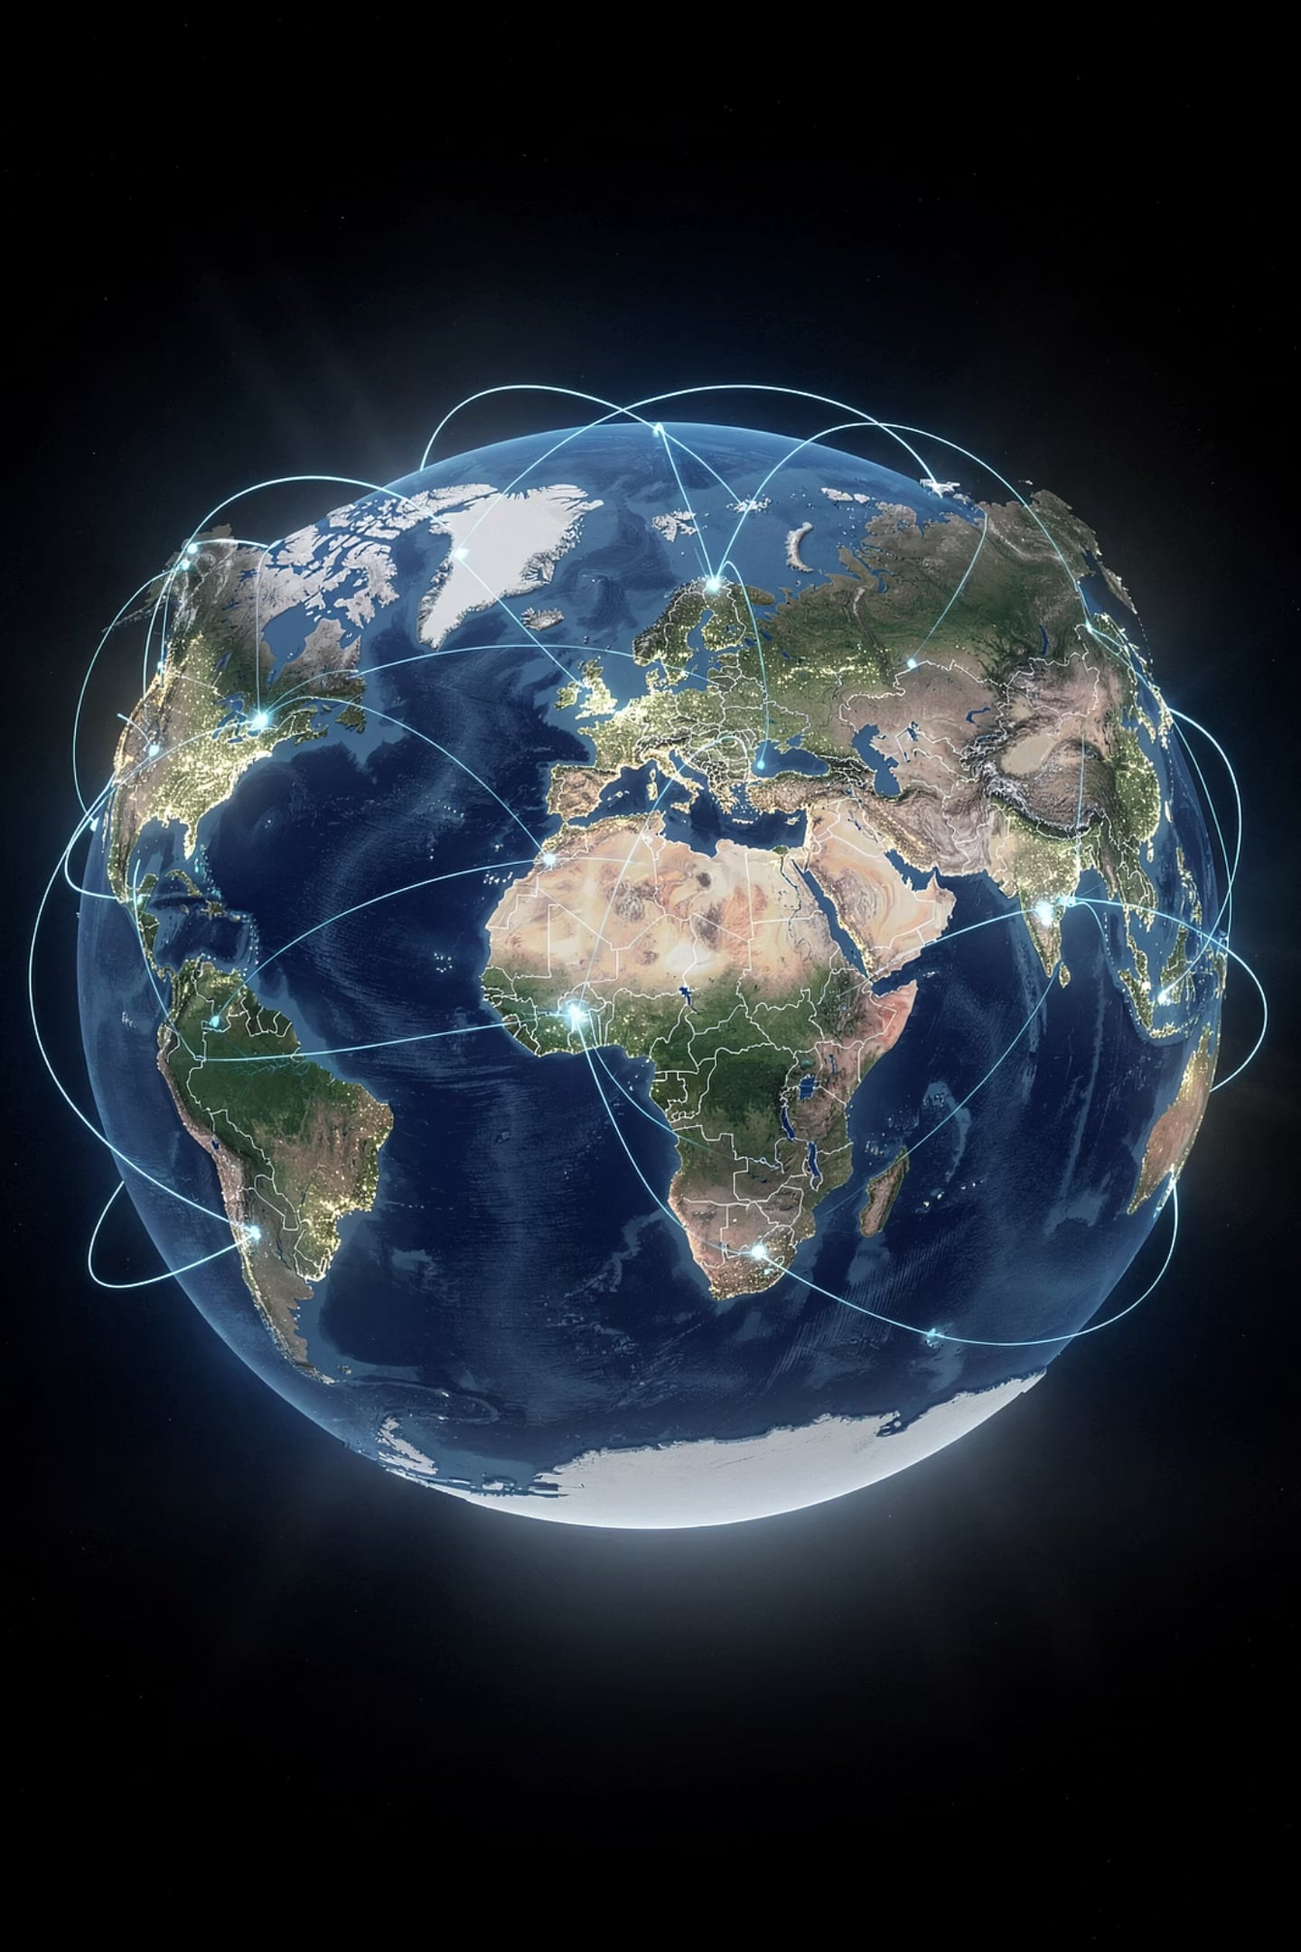

International Media Selection
Different Processes
Local Preferences
Media buying processes vary significantly by country
Media habits and preferred channels differ across markets
Same Core Goal
Choose media most effective for the target audience — universal principle
The process of media selection is fundamentally similar worldwide — the challenge is adapting to local conditions.

Slide 27
Measuring Media Effectiveness
Evaluating traditional media campaigns requires a clear understanding of key metrics to assess performance and optimize future strategies.
$15.50
200
3.5x
CPM
GRPs
ROI
Cost Per Thousand impressions, a standard for comparing media efficiency.
Gross Rating Points, indicating the total audience exposed to an ad schedule.
Return on Investment, measuring the financial gains relative to advertising spend.
75%
8%
Brand Recall
Sales Lift
Percentage of consumers who remember the ad or brand after exposure.
The increase in sales attributed directly to the media campaign's influence.

Slide 28
Key Terms at a Glance
Reach / Frequency / OTS
Exposure metrics — how many, how often, how many opportunities
GRP / CPM / CPRP
Efficiency metrics — intensity, cost per thousand, cost per rating point
Continuity
Continuous, pulsating, or flighting schedule patterns
Intrusion Value
Capturing attention without voluntary viewer effort
Recency Theory
Selective attention — one timely exposure may be enough
Media Multiplier Effect
Two or more media together outperform any single medium

Slide 29





Module Summary
Strategy First
Media strategy guides planning by aligning market, message, and medium.
Planners & Buyers
Planners shape the strategy; buyers negotiate and place the media.
Reach, Frequency, & Mix
Use the right balance of reach and frequency, and combine channels for multiplier effects.
Match the Market
TV, radio, print, and OOH each work differently, so media choices should fit the audience and market.
ANDREWS & SHIMP, 2025
CLOW & BAACK, 2021

Slide 30
Review Questions
1
How does media strategy influence the rest of the media planning process?
2
What is the difference between media planners and media buyers, and why do both roles matter?
3
How do you think about the tradeoff between reach and frequency when choosing media channels?
4
What are the main advantages and disadvantages of TV advertising compared with other traditional media?
5
How would you build a logical media mix for a campaign using TV, radio, print, and out-of-home?
6
How should media selection differ for a B2B audience versus a consumer audience?

