Slide 1

Database & Direct Response Marketing and Personal Selling
Lecture 11 · Advertising and Integrated Marketing Communications
PROF. FIDELA R. BALAJADIA

Slide 2
Learning Objectives
01
02
03
Direct Marketing
Direct Response & Direct Mail
CRM & Databases
Define, explain growth, and AI's influence
Characteristics and distinctive features
Data mining, lifetime value, telemarketing
04
05
Indirect Marketing
Personal Selling
Types, advantages, disadvantages, real examples
Role in IMC, advantages, and 7 basic steps

Slide 3


The Rise of Direct Marketing
Explosive Internet Growth
Global internet users surged, enabling direct digital access to consumers worldwide.
Unprecedented Data Availability
Advanced analytics provide deep insights into consumer behavior, preferences, and needs.
Personalization Expectations
Consumers now demand tailored messages and offers, making direct engagement crucial.

Slide 4
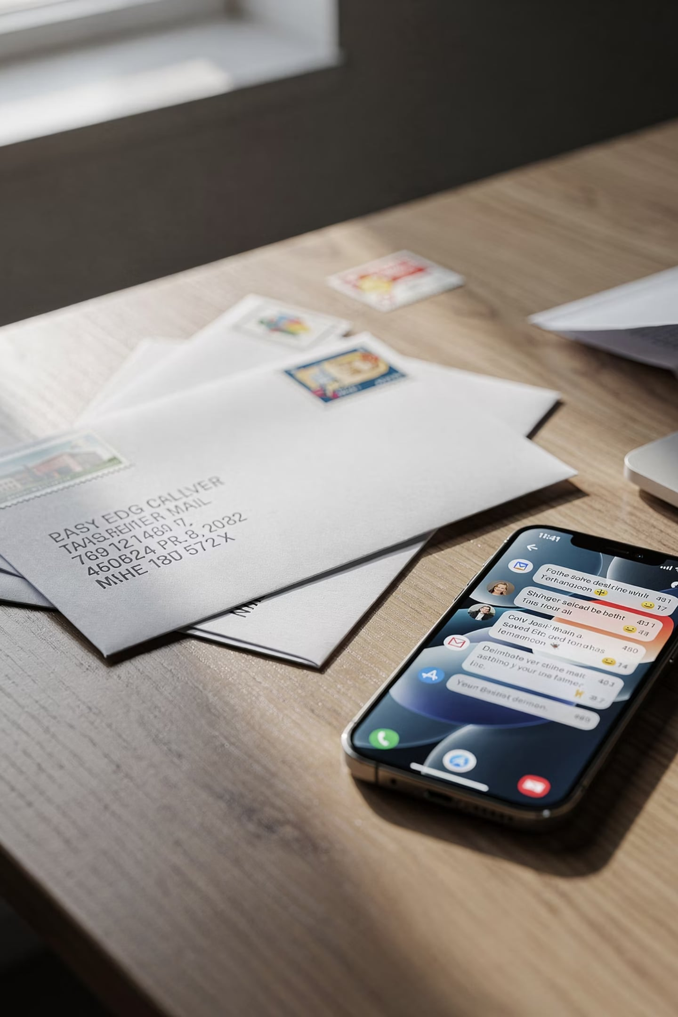
What is Direct Marketing?
An interactive system of marketing that uses one or more advertising media to effect a measurable response and/or transaction at any location. — DMA/ANA
Interactive
Personalized marketer-to-prospect communication
Multi-Media
Mail, digital, social, SMS, and more
Measurable
Responses tracked to specific customers
Anywhere
Online, phone, kiosk, mail, or in person

Slide 5





Forms of Direct Marketing
Direct Mail
Telemarketing
Direct Response TV/Radio
Physical outreach for targeted offers and campaigns.
Personalized phone calls for sales or lead generation.
Broadcast ads with immediate call-to-action.
Online & Email Marketing
Mobile Marketing
Digital campaigns via web, search, and inbox.
Reach customers on-the-go via apps and messages.

Slide 6
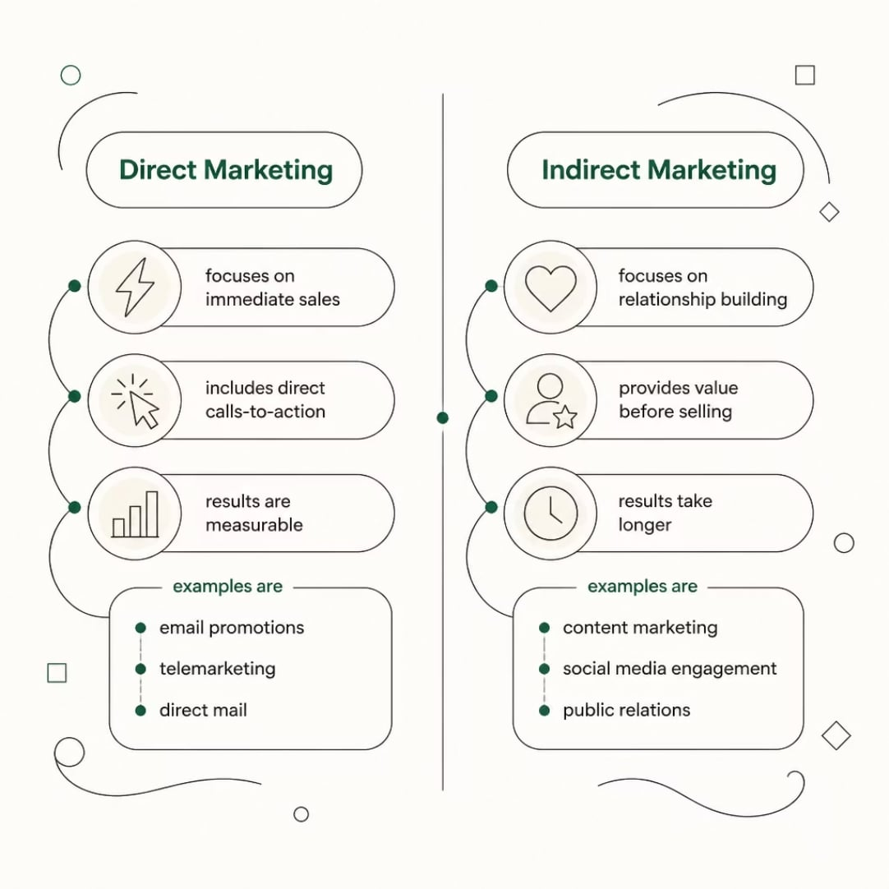

Direct vs. Indirect Marketing
Key Distinction
A pharmacy sending a coupon = Direct Marketing
A pharmacy publishing health articles = Indirect Marketing
Indirect marketing influences decisions over time by providing value, not pushing a sale.

Slide 7




Why Indirect Marketing Matters
Consumers see thousands of ads daily — many develop advertising fatigue. Indirect marketing cuts through by building genuine trust.
Builds Trust
Educational content and peer recommendations outperform ads
Long-Term Loyalty
Focuses on engagement, not just transactions
Brand Authority
Businesses become recognized experts in their field

Slide 8

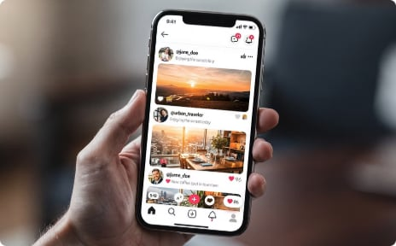

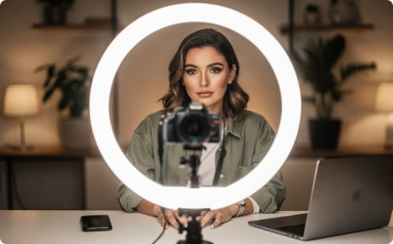


Common Types of Indirect Marketing
Content Marketing
Social Media
Word-of-Mouth
Influencer Marketing
Blogs, videos, podcasts, infographics, e-books
Health tips, customer stories, educational videos
Satisfied customers sharing positive experiences
Credible voices introducing products authentically
Public Relations
Community Building
Press releases, charity events, CSR programs
Forums, Facebook groups, brand ambassador programs

Slide 9
Indirect Marketing: Pros & Cons
Advantages
Disadvantages
Builds lasting trust and credibility
Creates long-term customer relationships
Cost-effective (content, WOM)
Strengthens brand reputation
Increases customer loyalty and advocacy
Results take months or years
Difficult to measure directly
Requires consistent content creation
Less control over WOM and user-generated content

Slide 10


Direct Response Advertising
Three Defining Features
Definite Offer
Clear, specific proposition to the prospect
Complete Information
All details needed to make a decision
Response Device
QR code, web link, coupon, or phone number
Media: TV, online, social, magazines, direct mail, SMS

Slide 11

Catalog Marketing
One of the oldest direct marketing forms, catalogs bring a curated selection of products directly to consumers.
Consumer Catalogs
Business Catalogs
Targeting individual shoppers with diverse goods.
Specialized products for B2B procurement and operations.
Specialty Catalogs
Niche markets with unique or exclusive offerings.
Catalogs offer convenience and a browsing experience. Today, digital catalogs and interactive online versions extend their reach, offering direct links and personalized content.

Slide 12
Direct Mail's 5 Distinctive Features
$38.5 billion invested annually in the U.S. alone
Targetability
Measurability
Accountability
Precisely defined audience (e.g., 200K Saab owners)
Track cost per inquiry and cost per order
Results easily demonstrated to justify budgets
Flexibility
Efficiency
Fast to produce; no constraints on form, color, or size
Lower cost vs. mass advertising through precise targeting

Slide 13
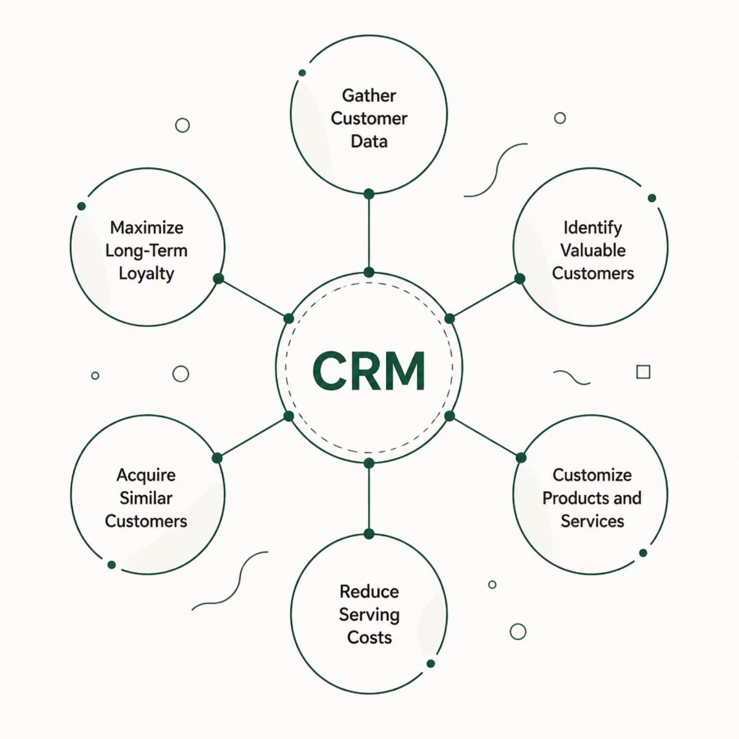
CRM & Database Marketing
CRM vs. DBM
CRM — Customer-focused; manages touchpoints to maximize loyalty, now powered by AI
DBM — Data-focused; collects, analyzes, and targets consumers with tailored messages
Common Pitfalls
Implementing CRM before customer strategy
Assuming more technology = better results
Stalking, not wooing, customers
Notes:
Speaker Notes
CRM — Customer Relationship Management — is the backbone of modern direct marketing. It's the system that collects, organizes, and activates customer data. Think of it as a living profile of every customer: what they bought, when, how often, how much they spent, what they responded to. Database marketing uses that information to identify your most valuable customers, customize your offers, and reduce service costs by anticipating needs. Amazon is the gold standard here — their recommendation engine is pure database marketing. 'Customers who bought this also bought...' — that's CRM in action, driving billions in additional revenue. But CRM is only as smart as the data going in. That's where AI and data mining come in — which is our next slide.
[~2 min | Running total: ~26 min]

Slide 14



Privacy & Ethics in Direct Marketing
Do-Not-Call Lists
CAN-SPAM Act
Respecting consumer choices for unsolicited calls.
Regulations for commercial email, clear opt-out.
GDPR
Opt-in vs. Opt-out
EU data protection, emphasizing consent & rights.
Preferred consent methods for communication preferences.
Consumer Trust
The foundation for lasting, ethical relationships.

Slide 15





AI & Data Mining in Direct Marketing
Better Targeting
Lead Scoring
Right audience, right time — even with cookie limitations
Vetting and prioritizing prospects with AI algorithms
R-F-M Analysis
Privacy Limits
Recency, Frequency, Monetary value to rank customers
Restrictions on facial recognition, deep fakes, underage data
AI aids cross-selling, upselling, forecasting, and automating repetitive tasks — but ethical boundaries apply.

Slide 16






Online & Email Direct Marketing
Harnessing digital channels for targeted and measurable campaigns.
Email Campaigns
Search Engine Marketing
Social Media Ads
Personalized messages, newsletters, and promotional offers to subscribers.
Paid ads on search results pages, driving immediate traffic and leads.
Highly targeted campaigns on platforms like Facebook, Instagram, and LinkedIn.
Retargeting
Landing Pages
Re-engaging website visitors with tailored ads across various platforms.
Dedicated pages optimized for conversion, capturing specific campaign actions.
Email campaigns boast an average 15-25% open rate and an impressive $36 ROI for every $1 spent.

Slide 17





Lifetime Value: 5 Ways to Grow It
Reduce Marcom Costs
Direct advertising more productive than mass media
Cut Direct Costs
Bypass intermediaries via direct marketing
Increase Purchase Volume
Encourage existing customers to buy more
Increase Referral Rate
Positive WOM turns customers into advocates
Increase Retention Rate
Longer relationships = greater lifetime value
Email campaigns boast an average 15-25% open rate and an impressive $36 ROI for every $1 spent.

Slide 18
Telemarketing: Outbound & Inbound
~8,850 telemarketing companies · 511,000 workers in the U.S.
Outbound
Inbound
Open new accounts
Qualify advertising leads
Service existing business and reorders
Best for dispersed, small, or routine accounts
Less suited for complex, high-level decisions
Toll-free 800 numbers (800, 844, 855, 866, 877, 888)
Take orders and handle inquiries
Express complaints or request coupons
Locate nearest dealers or outlets
SMS/texting is a modern outreach extension for current customers.

Slide 19
Measuring Direct Marketing Success
Key metrics to evaluate the effectiveness of your campaigns:
—
—
Response Rate
Cost Per Order (CPO)
Percentage of target audience that takes action.
Total campaign cost divided by number of orders generated.
—
—
Conversion Rate
Return on Investment (ROI)
Percentage of responders who complete the desired action (e.g., purchase).
Net profit generated from the campaign compared to its cost.
—
—
Customer Acquisition Cost (CAC)
Lifetime Value (LTV)
Total marketing spend to acquire one new paying customer.
Predicted revenue that a customer will generate over their relationship.

Slide 20

Alternative & "Other" Media
Brand Placements
Movies (80.5%) and TV (≈70% of placement spend) — once every 3 min in prime time
Video Game Advertising
In-game ads and advergaming — reaches hard-to-reach millennials and Gen Z
Cinema Advertising
$800M in U.S. (2023), rising to $887M (2024) — captive young audience
Yellow Pages
yellowpages.com (Thryv) — key for local businesses seeking ready-to-buy consumers

Slide 21

Personal Selling in the Promotion Mix
What Makes It Unique
Person-to-person interaction — unlike any other IMC element
High customer attention — hard to ignore face-to-face
Customized message per customer
Immediate two-way feedback
Communicates complex technical information
Demonstrates product performance live
Builds long-term buyer-seller relationships

Slide 22





Types of Sales Positions
Understanding the diverse roles within a sales force is crucial for effective strategy and management.
Order Takers
Order Getters
Missionary Salespeople
Process routine orders; can be inside (phone/online) or outside (field sales).
Proactively identify prospects and persuade new customers to buy, often involving complex negotiations.
Build goodwill and educate potential customers, influencing purchase decisions indirectly (e.g., pharmaceutical reps).
Sales Engineers
Team Selling
Possess deep technical knowledge to explain and demonstrate complex products, solving client-specific challenges.
Leverage multiple specialists (technical, financial, legal) to serve a single, high-value client account.

Slide 23




Attractive Features of a Sales Career
Job Freedom
Variety & Challenge
Minimal supervision; manage your own day
Rewarded for hard work and smart effort
Advancement
Financial Rewards
More CEOs/CMOs come from sales than any other area
Lucrative compensation tied directly to performance

Slide 24







Sales Force Management
Effective sales leadership requires strategic oversight of multiple critical areas.
Recruiting
Attracting top talent to build a strong sales team.
Training
Developing skills and knowledge for peak performance.
Motivating
Inspiring the team to achieve and exceed targets.
Compensating
Designing fair and performance-driven incentive structures.
Evaluating
Assessing performance and providing constructive feedback.

Slide 25
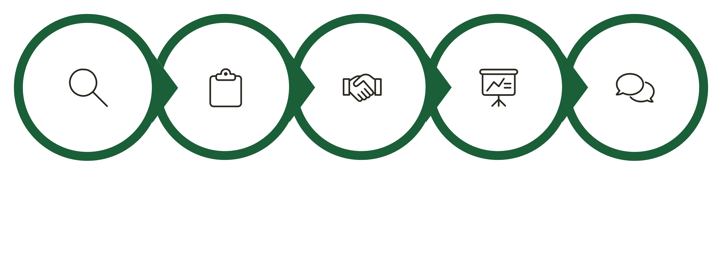
The 7 Steps of Personal Selling
Prospecting
Pre‑Approach
Approach
Presentation
Objections
Every sales role — regardless of industry — follows these universal phases from identifying prospects to reducing post-purchase anxiety

Slide 26

Steps 1–4: From Prospect to Presentation
Prospect & Qualify
Pre-Approach
Identify need, willingness, ability, and authority to buy
Research the prospect; arrange the meeting
Approach
Sales Presentation
First impression is critical — use references, gifts, or questions
Present, demonstrate, and show value using the SPIN method
SPIN Method: Situation → Problem → Implication → Need Payoff questions forge long-term relationships.

Slide 27

Steps 5–7: Close & Beyond
1
Handle Objections
Reiterate benefits; address counterarguments and resistance
2
The Close
Ask for commitment — use stories, options, incentives, or direct ask
3
Follow-Up
Reduce cognitive dissonance; suggest accessories; build future sales

Slide 28
Relationship Selling vs. Transactional Selling
Two distinct approaches to sales, each with its own focus and long-term implications for customer engagement.
Comparison Point
Relationship Selling
Transactional Selling
Primary Focus
Building long-term customer partnerships and trust
Completing a single sale, product features, and price
Time Horizon
Long-term customer lifetime value
Short-term, immediate revenue
Main Goal
Customer loyalty, repeat business, strategic advice
Maximizing individual transaction value, quick conversion
Interaction Style
Consultative, personalized, problem-solving, ongoing communication
Direct, persuasive, product-focused, one-off contact
Examples
B2B enterprise solutions, financial advisors, real estate agents
Retail goods, e-commerce, telemarketing campaigns

Slide 29


Key Takeaways
Direct Marketing
Interactive, measurable, multi-media — from mail to AI-powered digital
Indirect Marketing
Builds trust and loyalty through content, WOM, influencers, and PR
CRM & Data Mining
Lifetime value, R-F-M analysis, and AI drive smarter targeting
Personal Selling
7-step process + SPIN method = long-term buyer-seller relationships
Andrews & Shimp, IMC 11th Ed. (2025) · Clow & Baack, IMC 9th Ed. (2021)
Notes:
Speaker Notes
Let's bring it all together. Today we covered a lot of ground. Direct marketing is a powerful, measurable, and increasingly data-driven way to reach customers directly — through mail, digital, telemarketing, and more. CRM and database marketing are the engines that make personalization at scale possible. AI and data mining are transforming targeting and efficiency — but ethical boundaries matter. Indirect marketing builds the trust and brand authority that direct marketing alone can't create. And personal selling — with its 7 steps — remains the most powerful tool for complex, high-value sales. The key insight tying it all together: whether you're sending an email, making a call, or sitting across from a prospect, the goal is the same — build a relationship that creates value for both sides. That's what great marketing and great selling have in common.
[~2 min | Running total: ~57 min]

Slide 30
Review Questions: Database & Direct Response Marketing and Personal Selling
Reflect on the key concepts and applications discussed in this chapter with the following questions:
How does direct marketing fundamentally differ from traditional mass advertising, and what are its core advantages in today's increasingly data-driven market?
Beyond direct mail and email, what are some less conventional or emerging forms of direct marketing that businesses are utilizing, and how do they leverage personalization?
Describe the synergistic relationship between Customer Relationship Management (CRM) systems and database marketing. How does the integration of AI further amplify this synergy?
Provide a concrete example of how Artificial Intelligence (AI) is currently being deployed to optimize direct marketing campaigns. What potential ethical challenges might arise from such applications?
Explain why customer lifetime value (LTV) is often considered a more crucial metric for long-term business sustainability than immediate conversion rates in direct marketing efforts.
In an era dominated by digital communication, what strategic role can modern telemarketing still effectively play in a comprehensive direct marketing mix, and how has its approach adapted?
Among the seven steps of personal selling, which step do you believe is the most critical for successfully building enduring customer relationships, and elaborate on your reasoning?
Compare and contrast the primary objectives and requisite skill sets for an "order getter" versus a "missionary salesperson" within a sales force.
In what specific business contexts or industries would a transactional selling approach prove more effective than relationship selling, and conversely, where would relationship selling undeniably be superior?
Notes:
Speaker Notes
And we close with our review questions — these are excellent exam prep and discussion starters. Let's spend the last few minutes going through these together. You can answer them individually or we can discuss as a class. [Pause and invite responses for 2-3 questions, or assign as take-home reflection.] For next session, I'd encourage you to pick one brand you interact with regularly and identify: which direct marketing channels do they use? Do they practice relationship or transactional selling? How do they use data to personalize their communications? Applying these frameworks to real brands is the best way to internalize them. Thank you all — great work today. See you next lecture!
[~3 min | Running total: ~60 min ]

