Slide 1
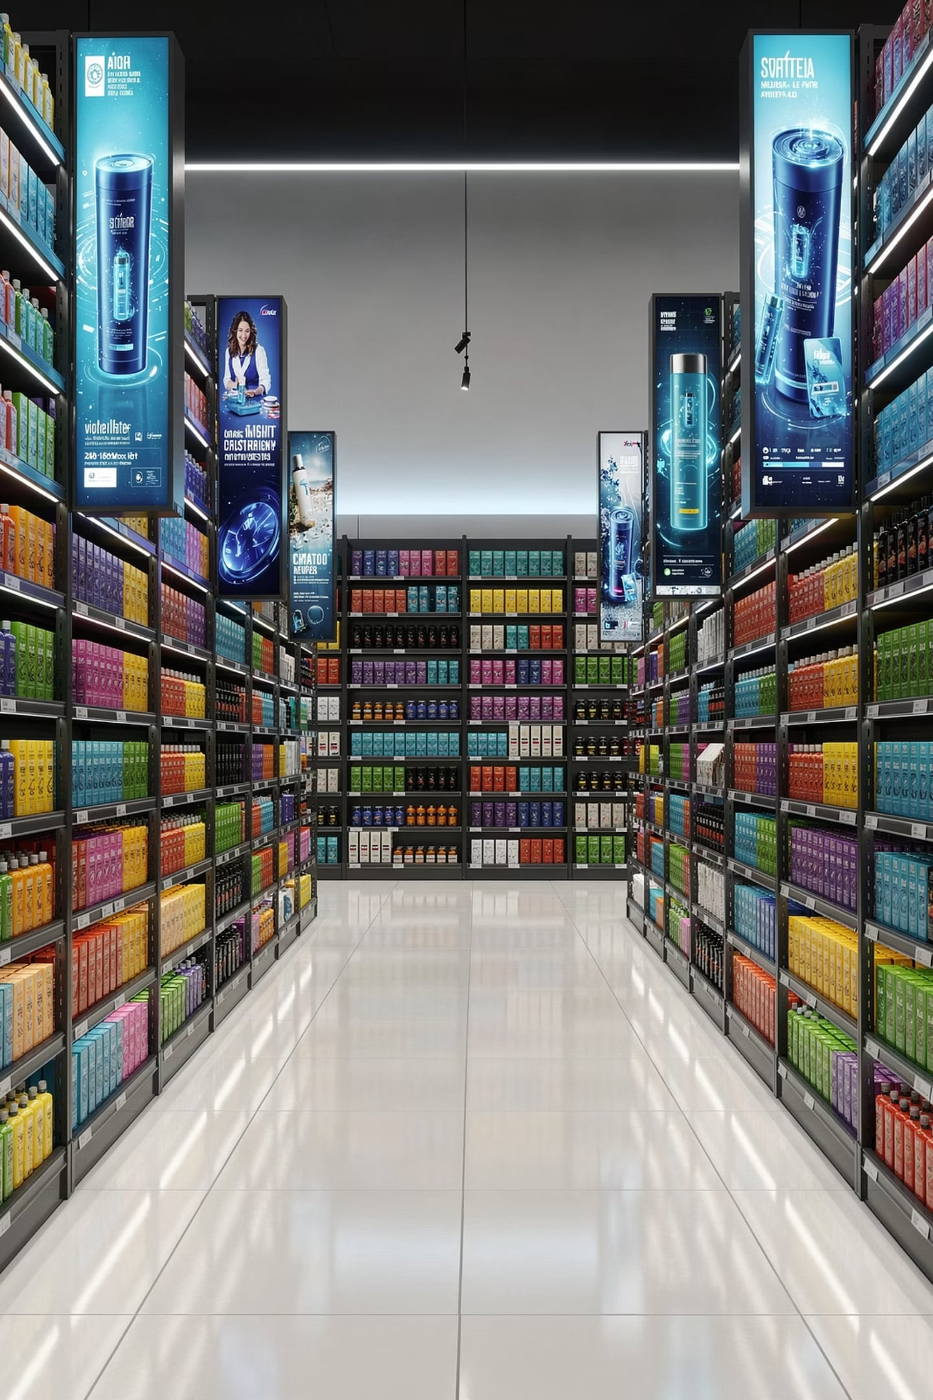
Sales Promotions
Lecture 12 · Advertising & Integrated Marketing Communications
Fidela R. Balajadia · Associate Professor 2 · University of the Assumption, Philippines

Slide 2
Learning Objectives
01
02
Nature & Purpose
Shift to Trade Promotions
Sales promotion, retail digital media networks, AI & robotics
Factors driving increased investment in trade-oriented promotions
03
04
Capabilities & Limits
Trade Allowances & Generalizations
What promotions can and cannot accomplish
Forms, objectives, and 9 empirical generalizations

Slide 3
Advertising vs. Sales Promotion: Key Differences
Advertising
Sales Promotion
Primarily focuses on building long-term brand equity, awareness, and preference. It communicates unique brand values and messages to a broad audience, fostering emotional connections over time.
Designed to stimulate immediate purchase and short-term behavioral response. It provides direct incentives or temporary value to encourage quick action and boost sales volume rapidly.
TV commercials
Magazine ads
Brand storytelling campaigns
Discounts & coupons
Contests & sweepstakes
Free samples & trials

Slide 4
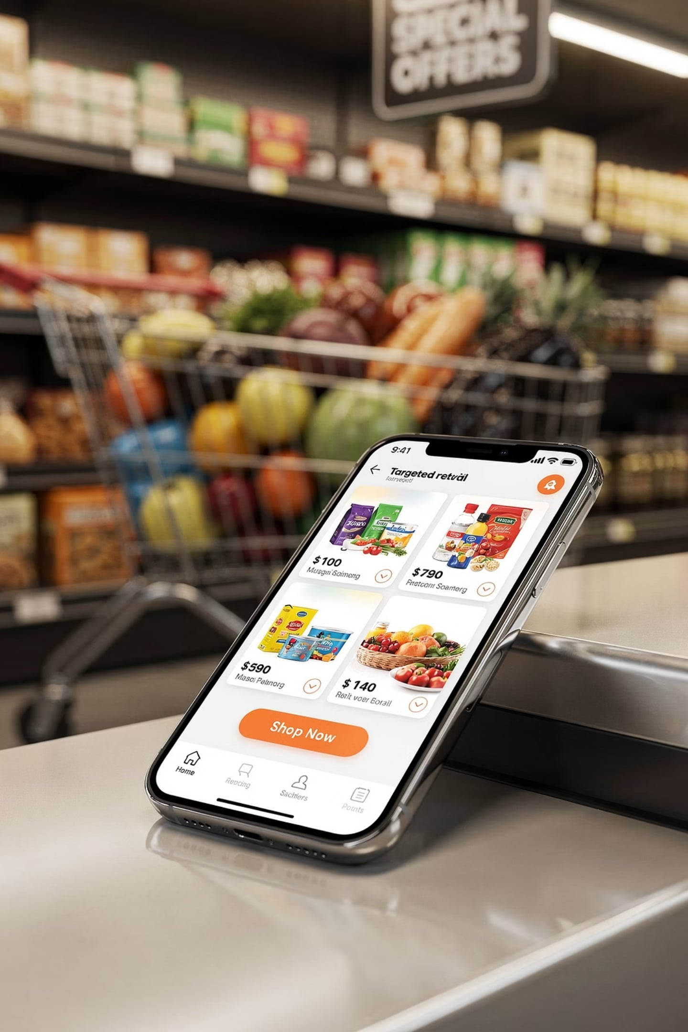
The New Landscape of Trade Promotions
Retail Digital Media Networks
Direct-to-Consumer Selling
Retailer-owned platforms delivering ads using direct shopper data — Amazon, Walmart, Instacart, eBay, Etsy
Brands bypassing retailers online — e.g., Dollar Shave Club disrupting Gillette
Old Practices Revived
Traditional slotting allowances making a comeback alongside AI & robotics

Slide 5
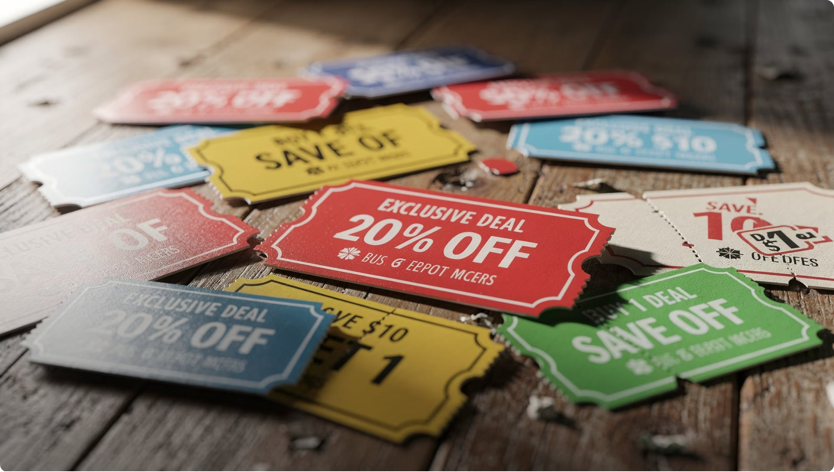

What Is Sales Promotion?
Definition
All promotional activities — excluding advertising, PR, personal selling, direct & online marketing — that stimulate short-term behavioral responses from:
Consumers
The trade (distributors, wholesalers, retailers)
The company's sales force
Promotion = urgency to act now. Advertising = long-term brand equity.

Slide 6



Three Promotion Targets
Sales Force
The Trade
Consumers
Tools & motivation to sell enthusiastically — e.g., in-store robotic arm demos, contests, bonuses
Push strategy — allowances, discounts, contests to get retailers to stock, display & advertise brands
Pull strategy — coupons, samples, premiums, flash sales, sweepstakes to drive trial & repeat purchase

Slide 7
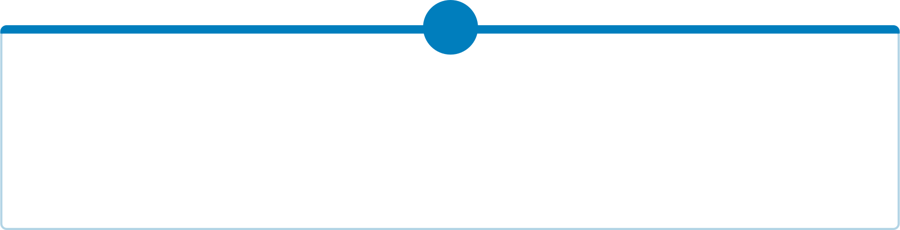


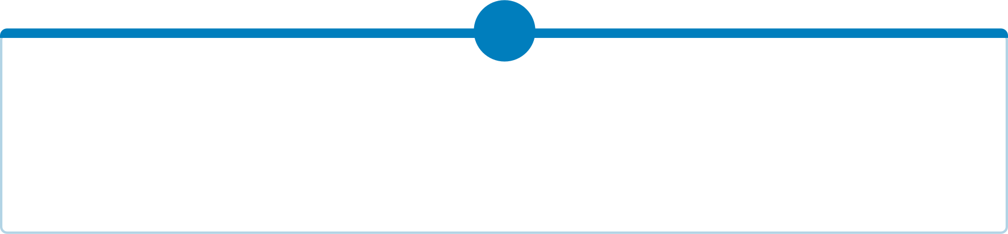




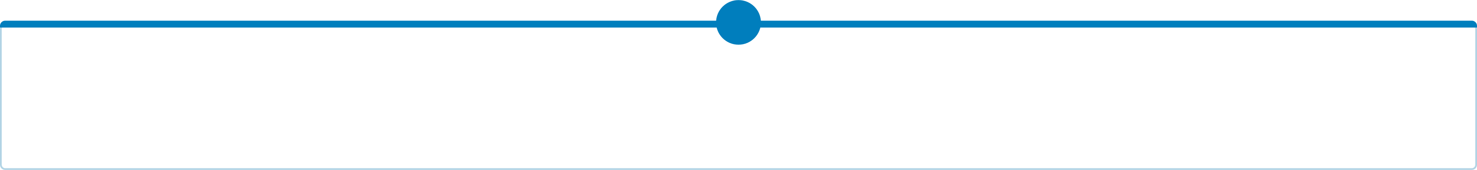

Consumer Promotions: Types & Examples
Coupons
Rebates
Certificates that entitle consumers to a reduction in price for a good or service.
Offers by the manufacturer to return a portion of the purchase price, usually after the consumer submits a form and proof of purchase.
Paper, digital, or mobile coupons
Instant discounts at checkout
Mail-in or online cash back offers
Often for higher-priced items
Samples
Contests & Sweepstakes
Giving consumers a quantity of a product or service for free or at a reduced price.
Promotional games that offer consumers the chance to win prizes.
In-store product tastings
Trial sizes of new products
Skill-based contests (e.g., photo submissions)
Chance-based sweepstakes (e.g., lucky draw)
Loyalty Programs
Price Packs
Programs designed to reward customers for their continued patronage.
Bundles of goods offered at a reduced price or containing more product for the same price.
Points-based rewards
Tiered membership benefits
Buy-one-get-one-free offers
Bonus packs with extra product volume
Premiums
Merchandise or service offered free or at a low cost as an incentive to buy a particular product.
Free toy with a meal
Branded merchandise with purchase

Slide 8
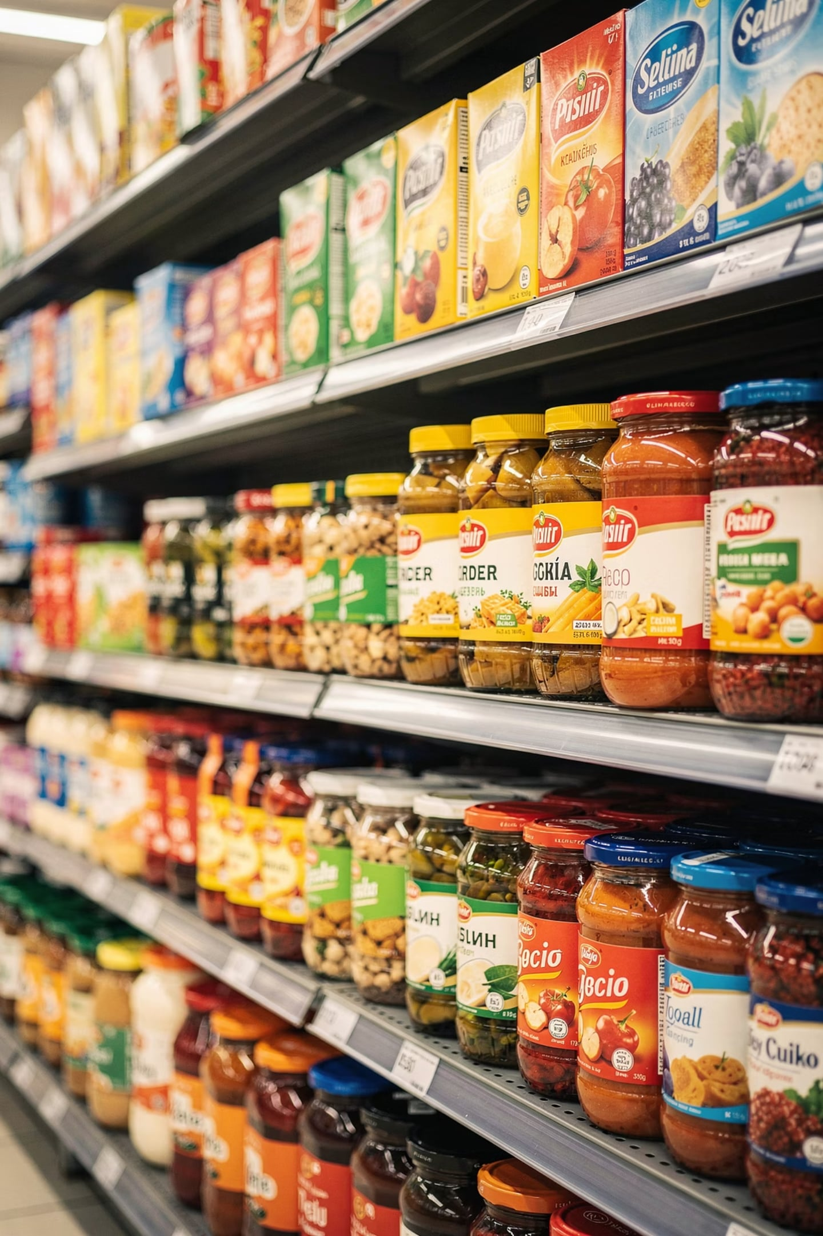


Why the Shift Toward Promotions?
Balance-of-Power Shift
Retailers gained power over manufacturers post-1980 via data & scale
Brand Parity & Price Sensitivity
Fewer distinct product differences → consumers rely on price incentives
Reduced Brand Loyalty
Consumers trained to wait for deals; switching is easy

Slide 9

More Reasons for the Shift
Splintered Mass Market
Short-Term Orientation
Consumer Responsiveness
Diverse lifestyles & fragmented media reduce mass-advertising efficiency
Brand managers rewarded quarterly → promotions generate quick sales response
Consumers value money-saving offers — especially in inflationary periods
Consumers gain utilitarian benefits (savings, reduced search costs, better quality access) and hedonic benefits (feeling smart, variety-seeking, entertainment).

Slide 10
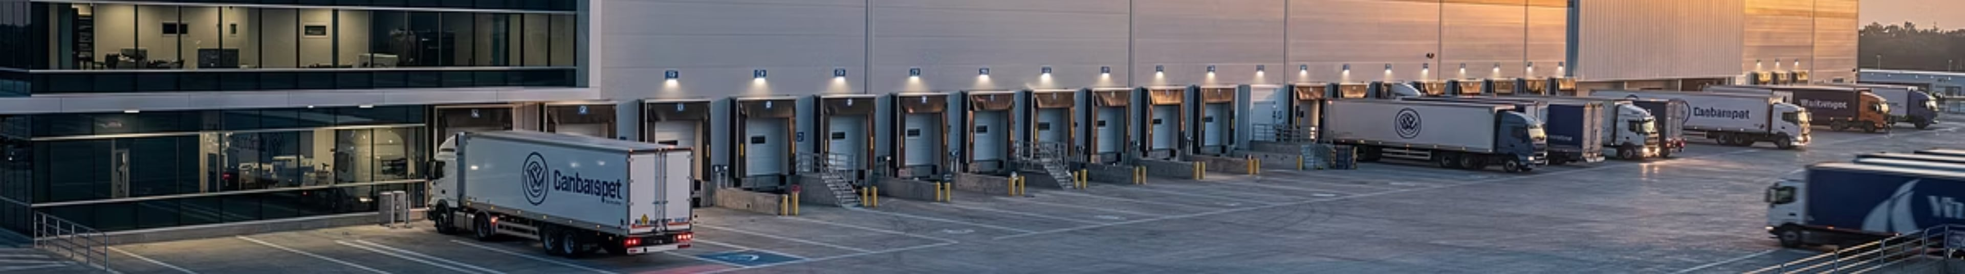
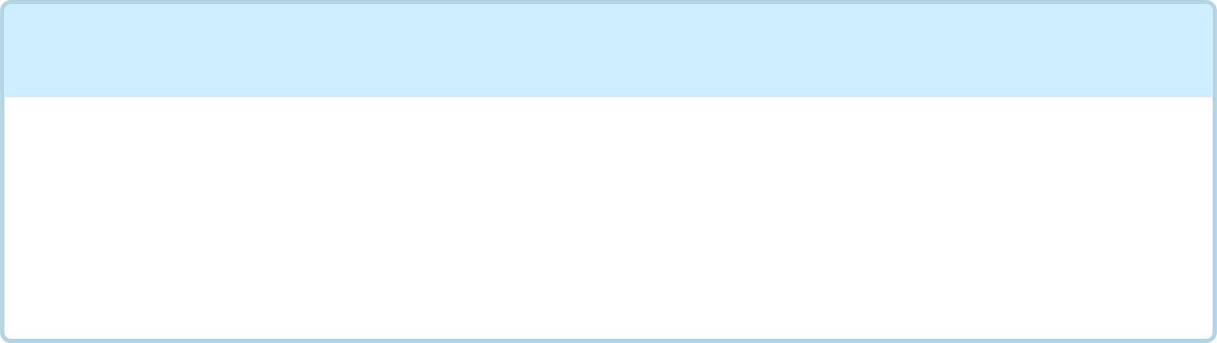
The Rise of Retailer Power
The landscape of marketing has dramatically shifted, with powerful retailers now dictating terms and influencing promotional spending like never before.
1
2
Market Consolidation
Data-Driven Demands
A few dominant retailers (Walmart, Amazon, Costco) command massive market share, creating significant leverage over manufacturers.
Retailers harness advanced data analytics to understand consumer behavior and inventory trends, using this insight to demand specific, performance-based trade promotions.
3
4
Increased Trade Spend
Gatekeepers to Consumers
Manufacturers are compelled to allocate a larger portion of their marketing budgets to trade promotions, often reducing investment in traditional consumer advertising.
Retailers serve as critical intermediaries, controlling access to both physical and digital shelves, making their collaboration indispensable for brand success.

Slide 11
What Promotions CAN Accomplish
Energize Sales Force
Invigorate Mature Brands
Stimulate enthusiasm for new, improved, or mature products
Give a "shot in the arm" to flagging sales
Launch New Products
Gain Shelf & Online Space
Encourage trade to handle new SKUs
Secure extra facings, end-caps, or digital media placements
Drive Trial & Repeat
Reinforce Advertising
Samples, coupons, flash sales encourage first purchase and loyalty
Well-coordinated promotions amplify ad & social media campaigns

Slide 12

What Promotions CANNOT Accomplish
Fix a Poor Sales Force or Weak Advertising
Promotions offer only a temporary fix — not a cure for structural problems
Create Long-Term Purchase Reasons
Repeat buying requires genuine brand satisfaction, not just deals
Reverse Permanent Decline
Only product improvements or strong advertising can revive a dying brand
Notes:
• Fix a Poor Sales Force or Weak Advertising — Promotions are just a band-aid. If your team or ads aren't working, a discount won't solve the underlying problem.
• Create Long-Term Purchase Reasons — Customers who only buy on sale aren't loyal customers. They're deal-seekers. Once a competitor offers a better deal, they're gone.
• Reverse Permanent Decline — If your product is genuinely inferior or the category is dying, discounting won't save it. You need real product improvement or strong advertising.
Key takeaway: Promotions are tactical tools, not strategic solutions. Many brand managers make the mistake of relying on them to fix structural problems. They can't.

Slide 13
Promotion Elasticity vs. Advertising Elasticity
Understanding the different sales response curves for promotions and advertising is crucial for effective marketing budget allocation.
Promotion Elasticity
Advertising Elasticity
High Short-Term Impact
Lower Short-Term Impact
Sales respond quickly and dramatically to promotional offers like discounts or flash sales.
Sales response is typically slower and more moderate, building over time rather than spiking instantly.
Low Long-Term Impact
High Long-Term Impact
Once the promotion ends, sales often revert to baseline levels, with minimal lasting effect on brand loyalty or perception.
Effectively builds brand awareness, preference, and loyalty, contributing to sustainable sales growth and market share.
Attitudinal Driver
Behavioral Driver
Aims to change consumer perceptions and attitudes towards the brand, fostering emotional connections.
Primarily influences immediate purchasing behavior, often appealing to price-sensitive buyers.

Slide 14

Dangers of Over-Promotion
Diminished Brand Image
Eroded Brand Loyalty
Reduced Consumption
Excessive deals cheapen perceived quality
Consumers buy the deal, not the brand
Obsession with promotions can distract from the product itself
Excessive promotion emphasis can undermine the very brand it is meant to support.

Slide 15
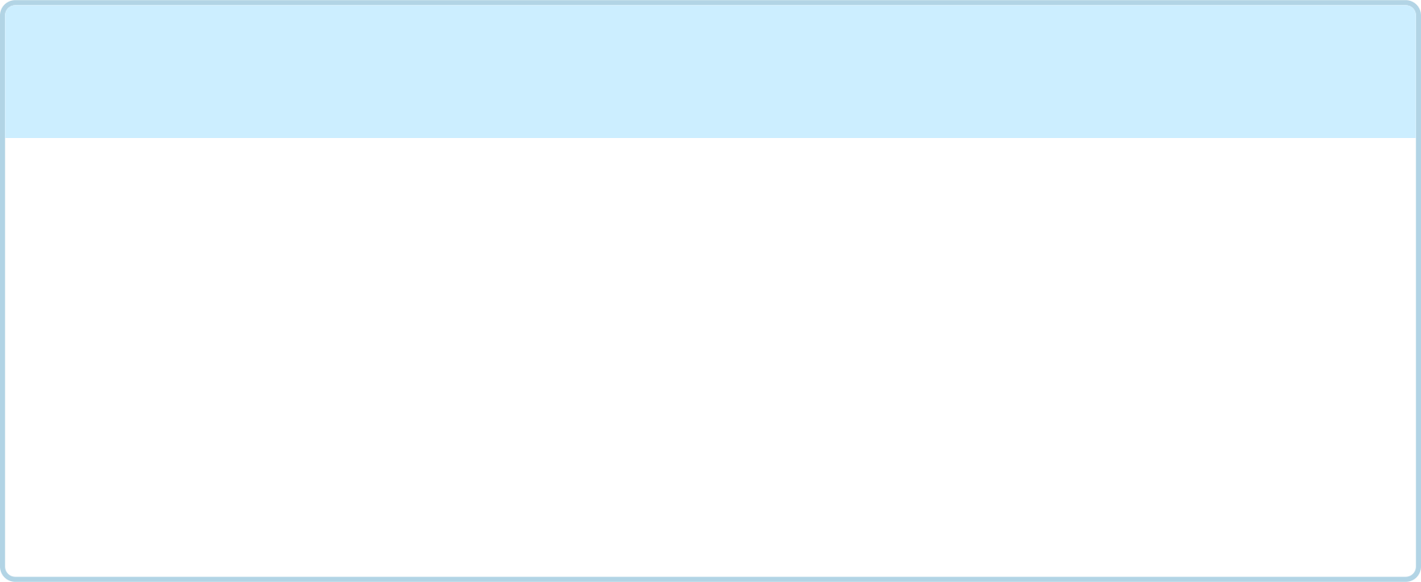
Understanding Slotting Allowances
Slotting allowances are a critical, yet often controversial, aspect of modern retail, impacting both manufacturers and consumers.
1
2
Definition: Fees for Shelf Space
Purpose: Risk & Revenue
Payments made by manufacturers to retailers to secure prime shelf space or prominent product placement within stores.
Retailers use these fees to offset the financial risk associated with stocking new products, cover handling costs, and generate additional revenue. For manufacturers, it guarantees product visibility and competitive advantage.
3
4
Impact: Cost & Barriers
Controversy: Ethics & Competition
Slotting allowances can represent a substantial financial burden, particularly for smaller brands or startups, making market entry challenging and limiting product diversity on shelves.
Critics argue they are anti-competitive, stifling innovation by favoring large brands. The debate centers on whether they are legitimate business costs or an unfair barrier to trade.

Slide 16

Trade Promotions: Scope & Objectives
Introduce new/revised products & new package sizes
Build retail inventories & maintain shelf space
Obtain off-shelf displays (in-store & online)
Counter competitive activity & reduce excess inventory
Achieve product features in retailer advertisements

Slide 17

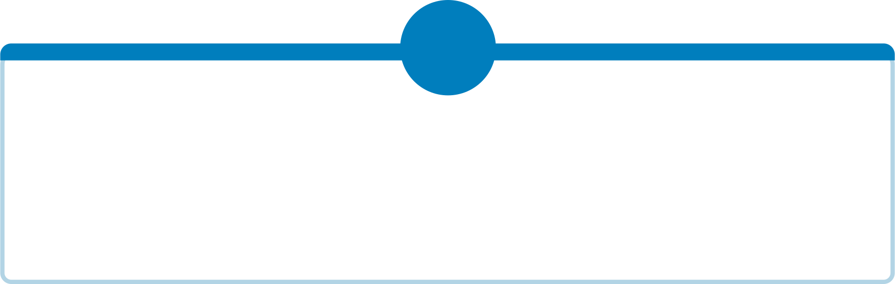
Ingredients for a Successful Trade Promotion
1
2
3
Financial Incentive
Correct Timing
Minimize Retailer Effort
Increased profit margins or sales volume for the retailer
Seasonal events, consumer promotions, or competitive offsets
Less effort = more retailer cooperation
4
5
Quick Results
Improve Retailer Performance
Immediate sales lift or store traffic increase
Better displays, merchandising methods, selling tools

Slide 18




Measuring Trade Promotion Effectiveness
Evaluating the success of trade promotions is crucial for optimizing ROI and ensuring marketing spend drives tangible results.
Baseline vs. Lift
Incremental Volume
Comparing promotional sales to a projected baseline to understand the true uplift attributable to the activity.
Quantifying the additional sales generated directly by the promotion above normal baseline sales.
Post-Event Analysis
Sell-Through Rates
A comprehensive review of all aspects post-promotion, including financial impact, retailer feedback, and operational learnings.
Analyzing the percentage of promoted inventory sold during the promotional period to gauge efficiency.

Slide 19
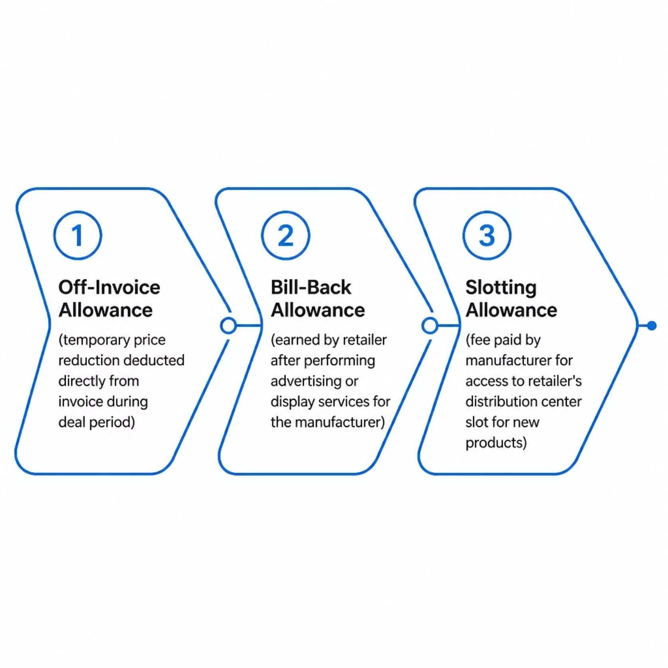
Three Major Trade Allowances
Off-Invoice
Most common — retailer deducts fixed amount from invoice during deal period
Bill-Back
Earned by performing ad or display services on behalf of the manufacturer
Slotting
Fee for warehouse/distribution center slot — typically for new product introductions

Slide 20
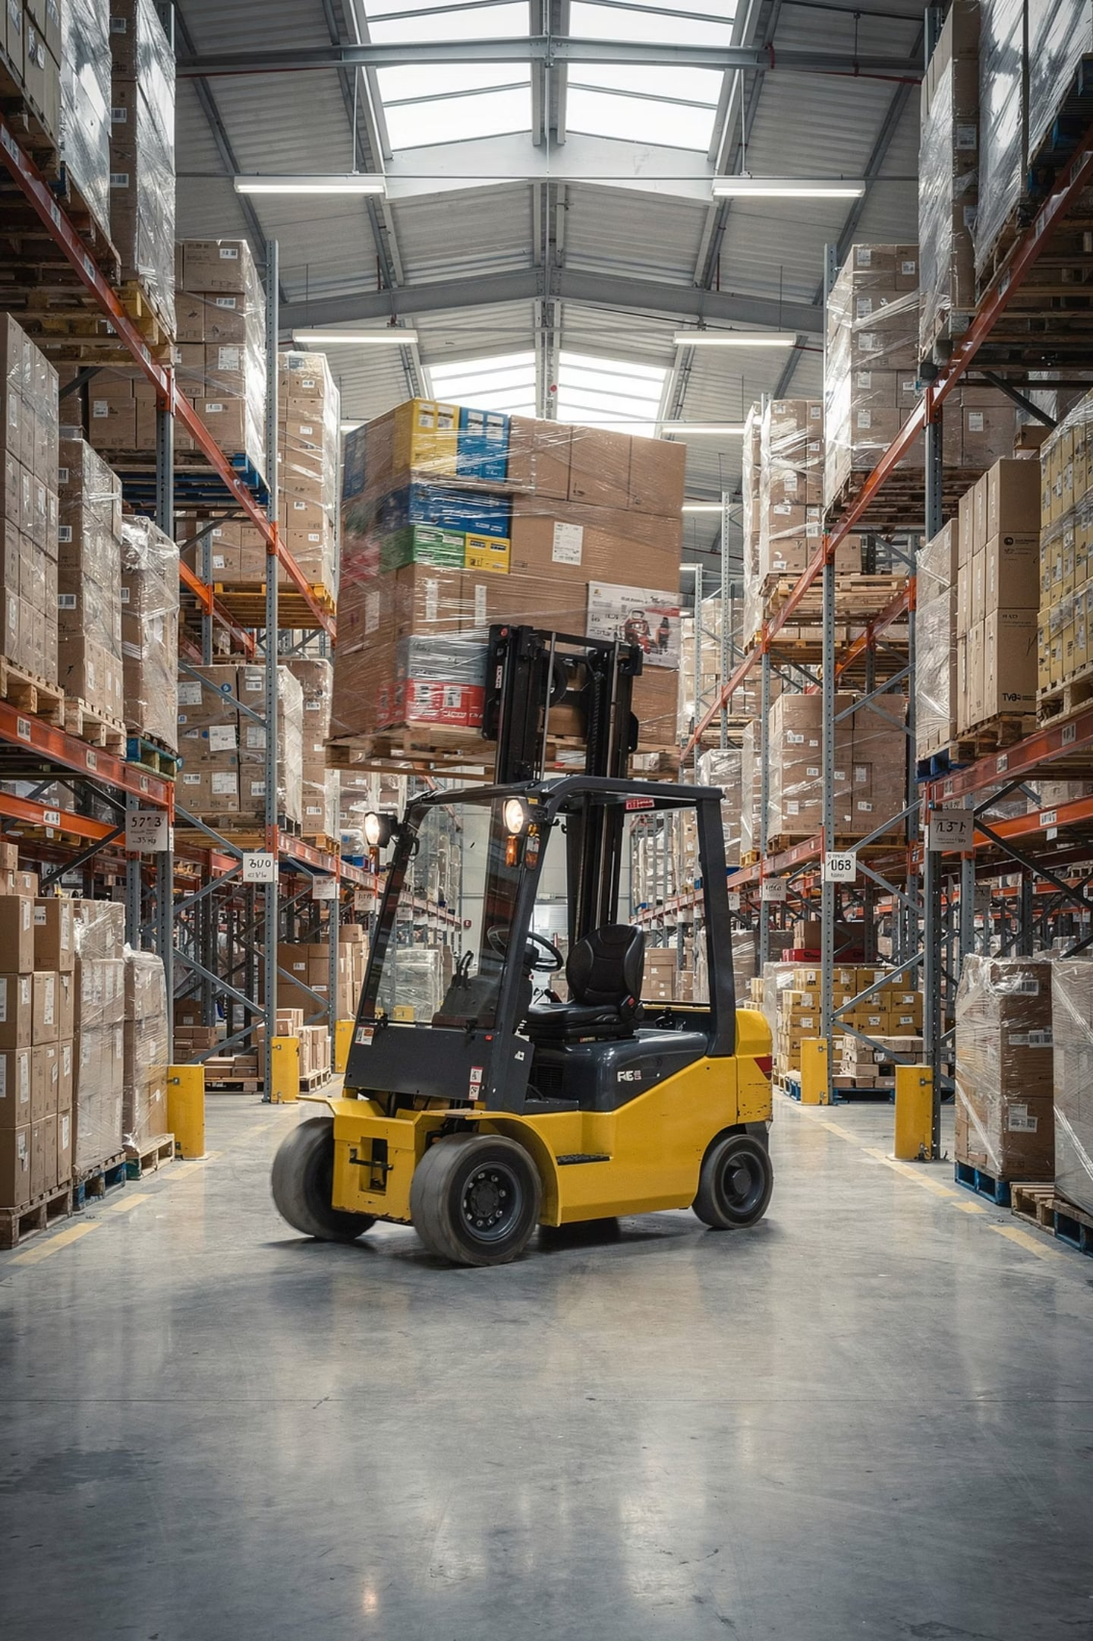
Forward Buying & Diverting
Forward Buying
Diverting
Retailers stockpile product during off-invoice deal periods — shifting future demand to the present
Retailers buy excess at deal price in one region, then resell at profit in higher-priced regions
Solutions
Category management, EDLP, and pay-for-performance (scan-down) programs help reduce both practices

Slide 21




Other Trade Promotion Tools
Cooperative Advertising
Vendor Support Programs
Manufacturer shares cost of retailer ads featuring the brand
Manufacturer provides resources to help retailers sell more effectively
Trade Contests & Incentives
Trade Shows
Competitions motivating retailers and their staff to push the brand
Industry events for launching products and building trade relationships

Slide 22
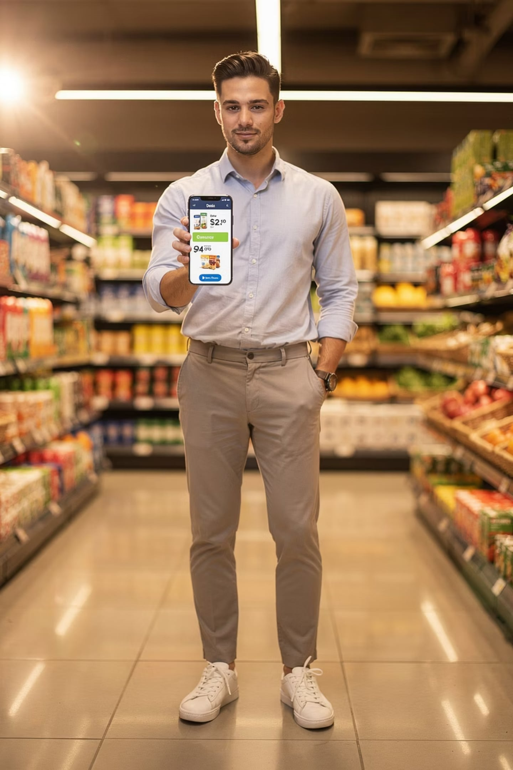
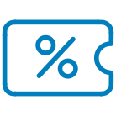



Digital & AI-Driven Promotions
Technology is transforming promotional strategies, enabling more precise targeting and personalized consumer engagement.
Personalized Digital Coupons
Delivering tailored offers directly to consumers based on their purchasing history and preferences.
AI-Powered Targeting
Utilizing artificial intelligence to identify high-value segments and predict optimal promotion timing and channels.
Retail Media Networks
Retailers leveraging their first-party data to offer advertisers targeted ad placements on their platforms.
Programmatic Trade Deals
Automating the negotiation and execution of trade promotions, optimizing terms based on real-time data and performance.

Slide 23

9 Empirical Generalizations About Promotions
Cross-Category Impact
Deal Frequency Effects
Temporary Price Spikes
Incomplete Pass-Through
Adverts Drive Traffic
These research-based conclusions guide how manufacturers and retailers design effective promotion programs.

Slide 24
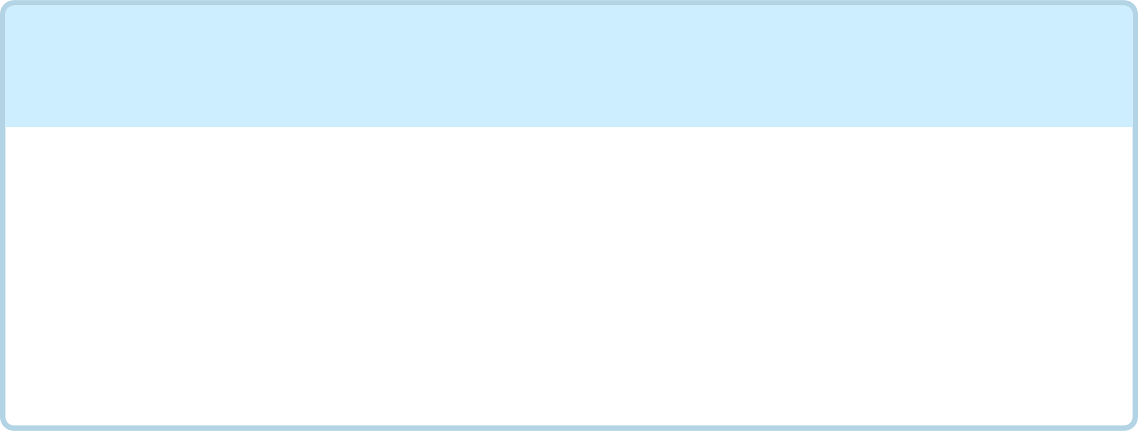
Generalizations 1–4: Price & Deal Dynamics
1
2
Short-Term Sales Spikes
Frequent Deals = Lower Spikes
Temporary price cuts substantially boost sales — but often at the expense of pre/post-period purchases
Consumers anticipate future deals → responsiveness to any single deal diminishes
3
4
Reference Price Erosion
Retailer Pass-Through <100%
Frequent deals lower consumers' price expectations for the brand
Manufacturers' trade discounts are not always passed on to consumers

Slide 25



Brand vs. Category Effects of Promotions
Promotions don't just impact sales; they can shift market dynamics. Understanding their true effect requires looking beyond immediate revenue.
Brand Switching
Category Expansion
Cannibalization
Consumers shift from competing brands to the promoted product, gaining market share from rivals.
Promotions attract new buyers to the category or encourage existing users to consume more, expanding the total market size.
The promotion draws sales away from the brand's own full-price products, potentially eroding profit margins.

Slide 26
Generalizations 5–9: Market & Competitive Effects
High-Share Brands Less Elastic
1
Market leaders gain proportionally less from deals than smaller brands
Advertised Promotions Drive Traffic
2
Consumers switch stores temporarily to chase attractive advertised deals
Ads + Displays = Synergy
3
Price deal + feature ad + special display = substantially greater sales lift
Cross-Category Effects
4
Promoting one brand affects sales in complementary and competitive categories
Asymmetric Quality Effects
5
Promoting a higher-quality brand steals switchers from lower-quality brands — not vice versa

Slide 27











Integrating Promotions with the Marketing Mix
Effective sales promotions don't operate in a vacuum. They must align seamlessly with your overall marketing strategy to avoid siloed thinking and maximize impact.
Pricing Alignment
Promotions reinforce, not undermine, the perceived value and premium positioning of your brand.
Integrated Strategy
All elements work in harmony for unified market impact.
Advertising Synergy
Promotional messages amplify and support ongoing advertising campaigns and brand narratives.
Product Lifecycle Fit
Promotions are tailored to the specific stage of the product lifecycle, from launch to maturity.
Distribution Coordination
Ensure promotional stock is available where and when consumers expect it, across all channels.

Slide 28

Key Terms to Know
Sales Promotion
Push vs. Pull Strategy
Retail Digital Media Network
Deal
Short-term incentives targeting consumers, trade, or sales force
Any promotion delivering a price reduction to consumers
Push = manufacturer → trade; Pull = consumer demand → retailer
Retailer-owned ad platform using direct shopper data
Off-Invoice Allowance
Slotting Allowance
Forward Buying / Diverting
EDLP
Fee paid for warehouse/shelf slot — especially for new products
Everyday Low Pricing — consistent low price replacing periodic deals
Temporary price reduction deducted directly from invoice
Stockpiling or reselling excess deal inventory for profit

Slide 29
Lecture 12 Summary
Nature of Promotions
Shift to Trade Promotions
Can vs. Cannot
Short-term behavioral tools targeting trade, consumers & sales force
Driven by retailer power, brand parity, loyalty decline & short-term reward structures
Promotions drive trial & shelf space — but cannot fix weak brands or build lasting loyalty
Trade Allowances
9 Generalizations
Off-invoice, bill-back & slotting — each with distinct mechanics and trade-offs
Research-backed principles guiding effective promotion design and investment

Slide 30
Review Questions: Lecture 12
1
What is the difference between consumer promotions and trade promotions? Give two examples of each.
2
Identify and explain three reasons why marketing budgets have shifted toward trade promotions over the past few decades.
3
What can sales promotions accomplish, and what are two things they fundamentally cannot do?
4
Describe the three major types of trade allowances and explain the risks associated with each.
5
What is forward buying and diverting? Why do these practices concern manufacturers?
6
What are slotting allowances? Why are they controversial?
7
Explain the concept of promotion elasticity. How does it compare to advertising elasticity in the short and long term?
8
Select any three of the nine empirical generalizations about promotions and explain their strategic implications for a brand manager.

