Slide 1

Module 1: Introduction to Strategic Business Analysis and Management Advisory Services
From record-keeper to strategic business designer — your transformation begins here.
C-AE24 Strategic Business Analysis

Slide 2

A World in Transformation
We live in an era of rapid automation and technological advancement. The accounting and business world is undergoing a profound shift — and it demands a new kind of professional.
Then
Traditional record-keeper focused on compliance and historical data
Now
Strategic business designer who actively shapes enterprise futures

Slide 3
What You Will Achieve
By completing both parts of this module, you will be equipped with five transformative capabilities.
Analyze
1
The paradigm shift from bookkeeping to business design — and where human value thrives in an automated world
Evaluate
2
The distinct yet complementary roles of CPAs and AIS professionals in driving growth and system integrity
Synthesize
3
Complex data into evidence-based stories and impactful visualizations for corporate decision-making
Define
4
The scope of Strategic Business Analysis and MAS within the Philippine business landscape
Develop
5
The personal characteristics and technical skills required to succeed as a modern business analyst

Slide 4
MODULE STRUCTURE
Two Parts, One Powerful Journey
Part 1 — Mindset & Partnership
Part 2 — Profession & Application
Formally defining Strategic Business Analysis & MAS
What an MAS consultant does day-to-day
Scope of advisory services
Skills and behavioral traits of top advisors
Moving up the economic value chain
Human intuition vs. automation
Evidence-based storytelling with data
The CPA + AIS powerhouse partnership

Slide 5



Part 1: Mindset & Partnership
Strategic Thinking
Data Storytelling
CPA + AIS Partnership
Move beyond compliance. Learn to read business environments and anticipate opportunities before they emerge.
Transform raw numbers into compelling narratives that drive executive decisions and stakeholder buy-in.
Financial stewardship meets system integrity — discover how these two roles combine to create outsized value.

Slide 6
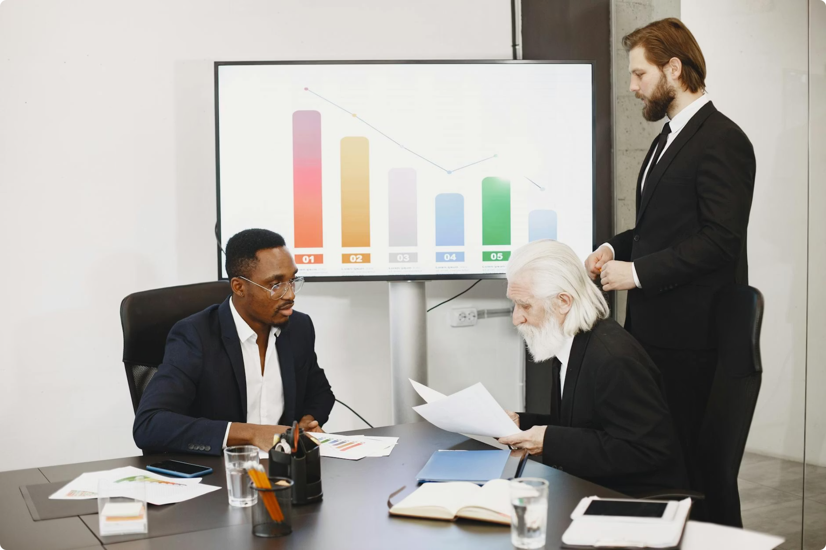
Part 2 : The Profession & Your Skills
From Concept to Practice
Part 2 brings theory to life. You will formally define MAS, understand the full scope of consultancy engagements, and map out the precise skill sets that make an advisor indispensable.
Define and scope MAS services
Learn what MAS consultants actually do
Build your personal competency roadmap

Slide 7

Grounded in the Philippine Context
Throughout both parts, concepts are anchored in the Philippine setting — local market dynamics, regulatory environments, and real-world business cases that reflect the unique opportunities and challenges facing Filipino professionals today.

Slide 8
The Economic Value Chain: Where Do You Stand?
Data Entry & Compliance
1
Automated by technology
Reporting & Analysis
2
Partially automated — human judgment adds value
Strategic Advisory
3
Distinctly human — where your career is headed
Automation reshapes the lower rungs, but strategic insight, empathy, and judgment remain irreplaceable. The goal of this module is to accelerate your climb.

Slide 9
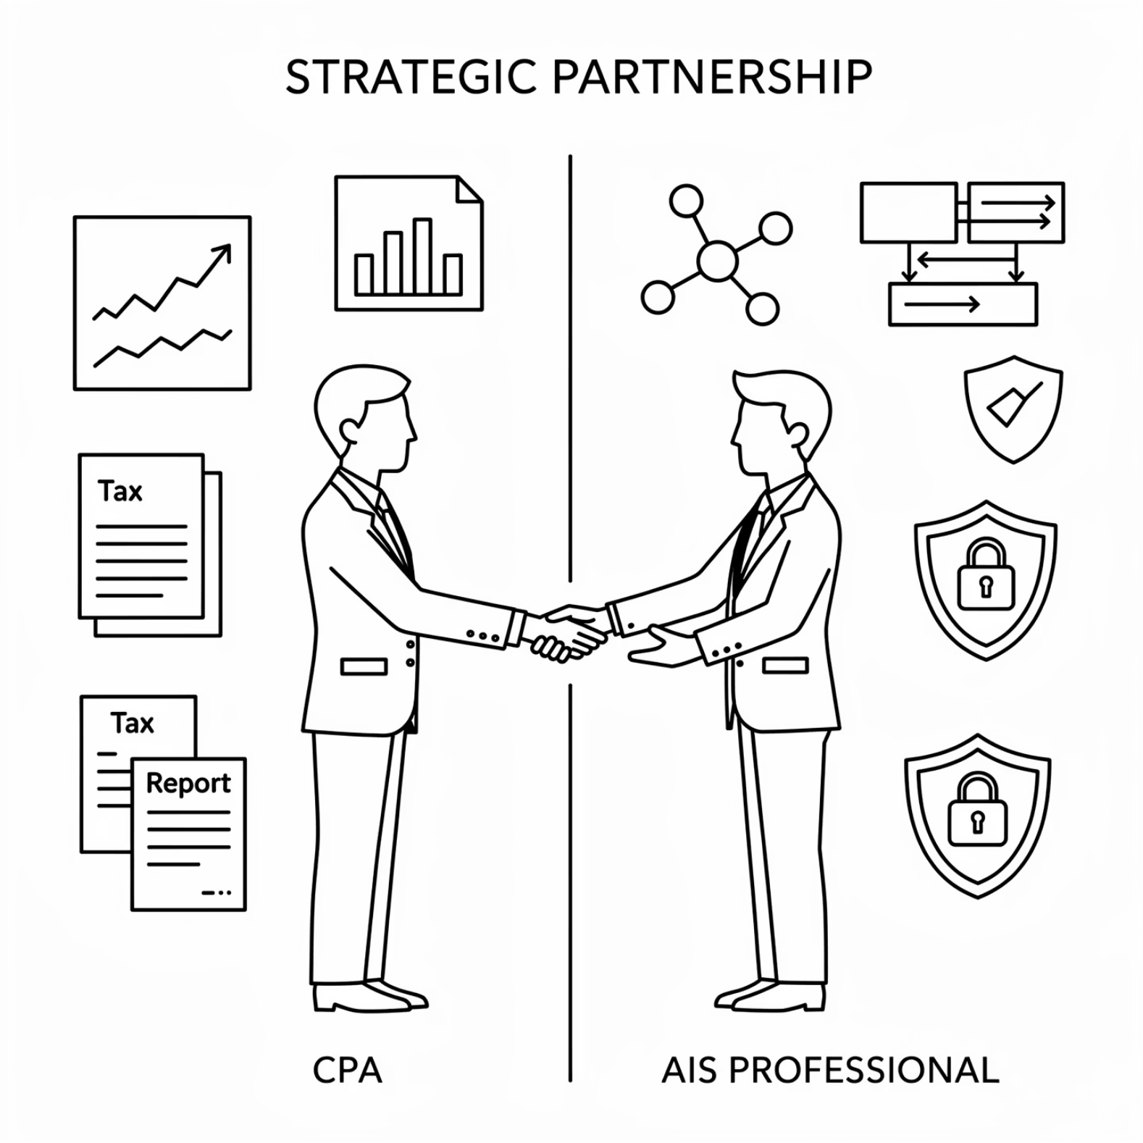

The CPA & AIS Partnership
Stronger Together
Neither role operates in isolation. CPAs bring financial acumen and client trust; AIS professionals bring system design and data reliability. Their partnership is the engine behind high-impact advisory services.

Slide 10
Critical Reflection: Anchor Your Learning
At the end of each part, pause and ask yourself:
On Mindset
On Partnership
On Skills
In what ways am I still thinking like a record-keeper? What would it look like to think like a strategic business designer in my current role?
How can I better collaborate with AIS professionals — or CPAs — to deliver more comprehensive advisory value?
Which competencies on the MAS skills map do I need to develop most urgently, and what is my first step?

Slide 11

What's Coming Next
Foundation
Standards
Application
The groundwork you lay in Module 1 is essential — it sets the stage for Module 2, where we dive into formal MAS Practice Standards, consultancy engagement stages, and the vital ethical considerations of the profession.

Slide 12


Let's Build the Future of Business Analysis Together
Bring your analytical mind and your strategic vision. The journey from accountant to trusted business advisor starts now.
Ready to begin? Proceed to Part 1: The Mindset & Roles — your first lecture awaits.

