Slide 1

The IMC Planning Process
Advertising and Integrated Marketing Communications
Week 4 — From research to budget to execution
By: Prof. Fidela R. Balajadia
Notes:
1

Slide 2

Lecture Learning Objectives:
01
02
03
Segmentation
Positioning
Objectives & Budget
Consumer & B2B target market categories
Approaches that shape IMC planning
How communications goals drive spending
04
IMC Program
Elements of a complete IMC plan
Notes:
2

Slide 3

Communications Research
The IMC process begins with research — understanding the product, the consumer, and the market.
Product-Specific
Consumer-Oriented
Key characteristics & benefits that become selling points
Context of use — anthropological, sociological, psychological
Target-Market
Identifies who will receive the campaign
Notes:
3

Slide 4


The Focus Group
A common agency tool: consumers discuss a product or brand in front of a moderator.
Insights from focus groups become crucial elements in the IMC planning process.
Agencies use focus groups when marketing teams are too close to their own products to see clearly.
Notes:
4

Slide 5

Market Segmentation
A market segment must pass four tests to be viable:
Homogenous
Similar needs, attitudes & interests within the group
Distinct
Clearly different from other segments & the general population
Large Enough
Financially viable to target with a separate campaign
Reachable
Accessible through some media or communications method
Notes:
5

Slide 6

Demographic Segmentation
Gender
Different products, features & appeals — e.g., Degree Men vs. Women
Age
Children, teens, millennials, seniors — each with distinct needs
Income
Necessities → sundry items → luxury goods as income rises
Ethnicity
$2.5 trillion in buying power; 70% say ethnicity shapes identity
Notes:
6

Slide 7
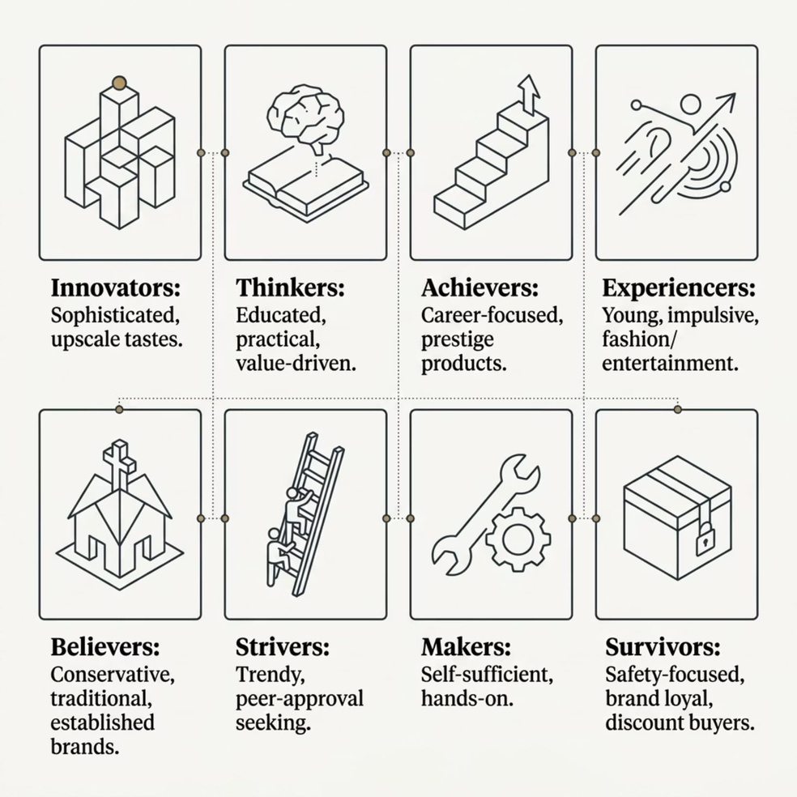
Psychographics & VALS
Psychographics reveal Activities, Interests & Opinions (AIO) — going beyond demographics.
VALS typology groups consumers into 8 segments based on resources and action-orientation.
Notes:
7

Slide 8
Generational Segmentation
Shared experiences in early adulthood shape lasting values, preferences, and responses to marketing.
Pre-Depression & Depression
1
Security, frugality, loyalty
2
Baby Boomers
Optimism, prosperity, brand trust
Gen X
3
Skepticism, independence, pragmatism
4
Millennials
Digital-native, cause-driven, multicultural
Gen Z
5
Mobile-first, value-conscious, social
Millennials earn the most advertising dollars — 4 distinct sub-segments identified by Turn research
Notes:
8

Slide 9
Geographic & Benefit Segmentation
Geo-Targeting
Benefit Segmentation
Marketing tailored to specific regions — GPS-enabled ads deliver hyper-relevant messages.
Focuses on advantages consumers receive, not who they are.
Home Depot sent snow-removal ads to East Coast consumers during a storm while other regions saw lawn care ads.
Winners
Dieters
Fitness for performance — young, career-oriented
Weight & appearance — women 35+
Geodemographic
Combines demographic + geographic + psychographic data. Used for direct mail and sampling.
Self-Improvers
Health & cost control
Notes:
9

Slide 10
Usage Segmentation
Groups consumers by how much they buy — 10–30% of customers often generate 70–90% of sales.
Non-Users
1
Awareness campaigns to attract
Light Users
2
Promotions to increase frequency
Average Users
3
Loyalty programs to deepen engagement
Heavy Users
4
Highest service level — protect & reward
Notes:
10

Slide 11





B2B Market Segmentation
Industry
NAICS coding system — e.g., Health Care (62) broken into hospitals, clinics, nursing facilities
Company Size
Large firms get outside sales; mid-size get digital outreach; small firms get email/telemarketing
Geography
Target concentrated pockets — e.g., Applied Microbiology targeting dairy farms with 1,000+ cows
Customer Value
Assign low/medium/high value using sales records — more precise than consumer segmentation
Notes:
11

Slide 12
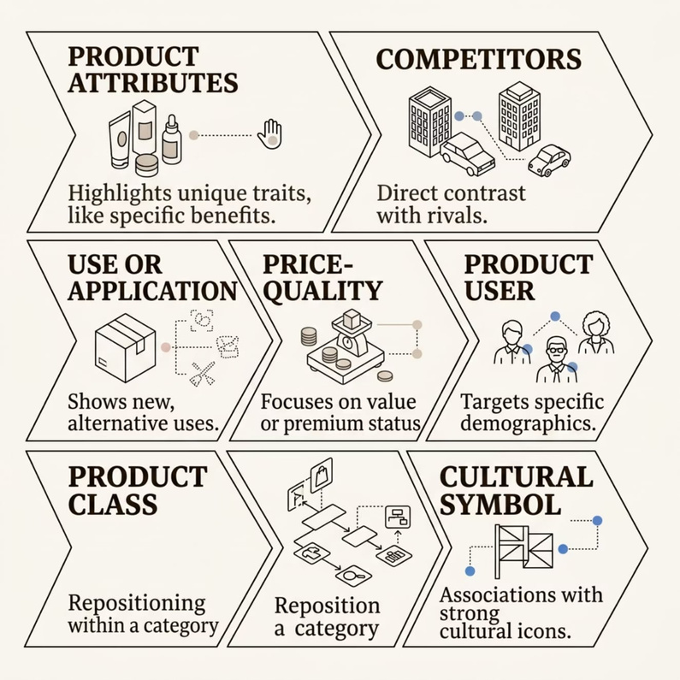
Product Positioning
Positioning = the consumer's perception of a brand relative to competitors. Marketing either reinforces or shifts that perception.
Effective positioning uses one approach — combining multiple approaches confuses customers.
A brand's position is never fixed — it can shift as markets evolve or competitors enter.
Notes:
12

Slide 13
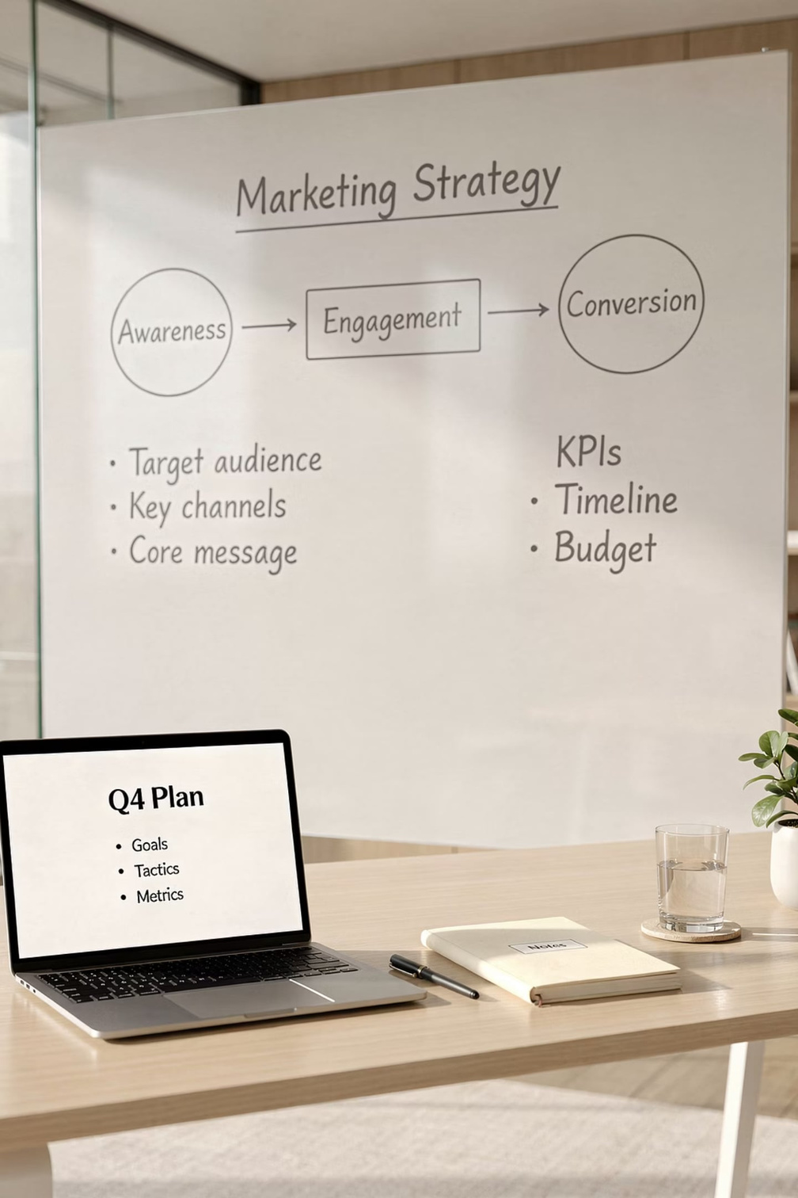
Communications Objectives
Objectives tie target markets and positioning to budget decisions and IMC components.
Build Awareness
Introduce brand to new audiences
Enhance Image
Reinforce positive brand perceptions
Stimulate Action
Drive purchases, trials, or inquiries
Build Loyalty
Retain existing customers long-term
Benchmark measures establish a baseline to assess change after a campaign.
Notes:
13

Slide 14
Communications Budgeting Methods
% of Sales
Simple but flawed — budget rises when sales rise, falls when it should increase
Meet the Competition
Match rivals' spending — doesn't guarantee market share retention
What We Can Afford
Residual budgeting — treats marketing as non-revenue-generating
Objective & Task
Best practice — cost each objective; ~50% of major firms use this
Payout Planning
Heavier early investment to build equity; lower % as brand matures
Quantitative Models
Computer simulations modeling spend vs. sales — limited to large firms
Notes:
14

Slide 15


Communications Schedules
When to Use Each
Pulsating
Flighting
Most products — steady base with holiday or seasonal spikes
Pulsating
Flighting
Seasonal products — Weight Watchers in January, retailers at Christmas
Continuous
Continuous
Durable goods — keep brand top-of-mind for "as needed" purchases
Match pacing to the message, media, and product purchase cycle.
Notes:
15

Slide 16
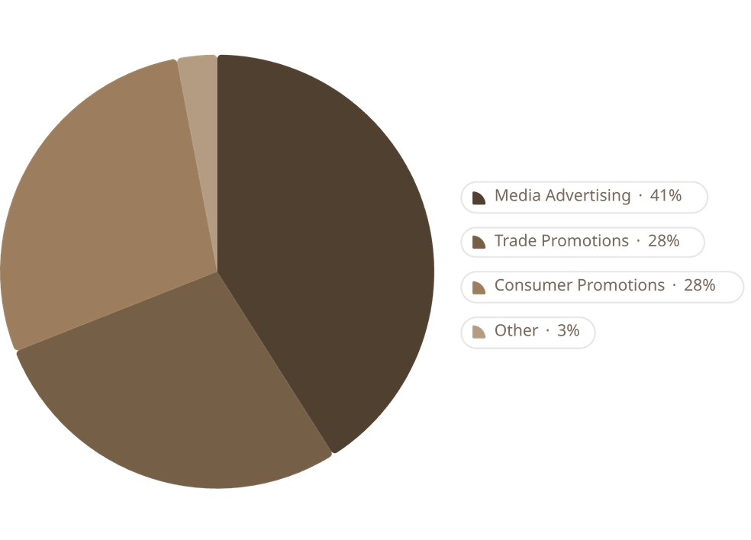
IMC Components & Budget Allocation
Key Insights
Advertising is not always the largest spend — promotions often match or exceed it.
  Consumer product makers spend more on trade promotions
  Service companies favor media advertising
  TV ranks #1 globally due to high ad costs
  Digital is the fastest-growing component
Notes:
16

Slide 17

International IMC: GIMC
Globally Integrated Marketing Communications — same strategy, locally adapted execution.
Think Globally
Act Locally
Consistent brand theme and overall message across all markets
Each subsidiary adapts implementation to language, culture & laws
Local Partners
Research and ad firms familiar with local language and culture
Notes:
17

Slide 18

Key Terms at a Glance
Research
Budgeting
Product-specific research — key selling characteristics
Consumer-oriented research — context of product use
Benchmark measure — baseline for campaign evaluation
Objective-and-task — best practice budgeting
Target-market research — campaign recipients
Focus group — moderated consumer discussion
Payout planning — advertising-to-sales ratio
Scheduling
Segmentation
Pulsating — continuous + seasonal bursts
Flighting — peak periods only
Demographics — gender, age, income, ethnicity
Psychographics — AIO patterns (VALS)
Continuous — level year-round spending
Geo-targeting — region-based appeals
Notes:
18

Slide 19
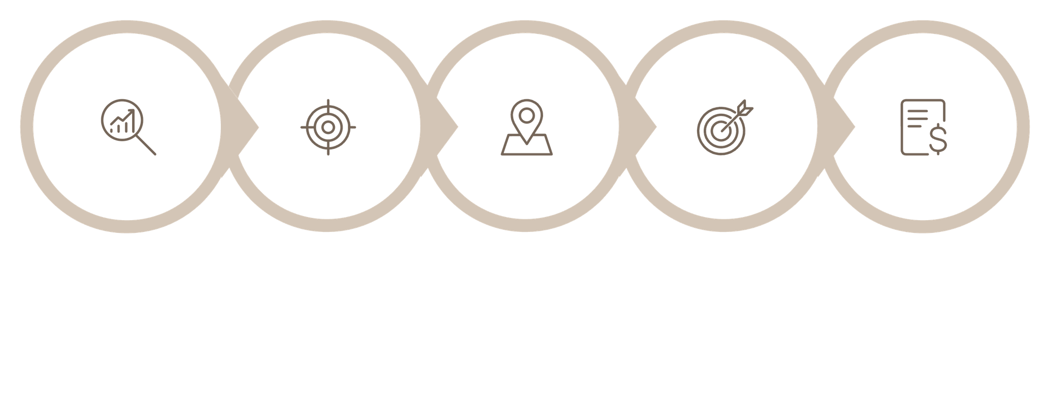
The IMC Planning Process — Full Picture
Communications Research
Segmentation & Targeting
Communications Objectives
Product Positioning
Budget & IMC Mix
Each stage informs the next — research drives segmentation, segmentation shapes positioning, positioning defines objectives, and objectives determine budget and channel mix.
Notes:
19

Slide 20
Types of Marketing Research Methods
Surveys
Observation
Quantitative data from large samples; online, phone, or mail
Watching consumer behavior in natural settings; ethnographic research
Experiments
Secondary Data
Controlled tests to measure cause-and-effect; A/B testing
Existing data from government, trade associations, or syndicated sources
Primary research is collected firsthand; secondary research uses existing data. Both are essential to a complete IMC picture.
Notes:
20

Slide 21
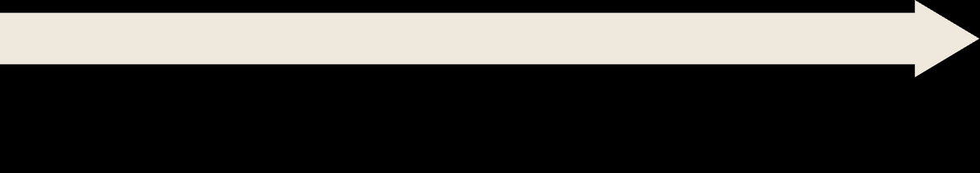

The Hierarchy of Effects Model
Knowledge
Awareness
"I understand what it does"
"I've heard of it"
Preference
Liking
"I like it more than alternatives"
"I feel positively about it"
Purchase
Conviction
"I bought it"
"I intend to buy it"
Communications objectives should target a specific stage — not all stages at once.
Notes:
21

Slide 22
Advertising vs. Other IMC Tools
Advertising
Other IMC Tools
  Paid, non-personal mass communication
  Best for: awareness, image building, reach
  High cost per execution, low cost per contact
  Examples: TV, radio, print, digital display
  Public Relations: earned media, credibility, crisis management
  Sales Promotion: short-term incentives (coupons, contests, samples)
  Direct Marketing: personalized, measurable, one-to-one
  Personal Selling: highest persuasion, highest cost per contact
  Digital/Social: interactive, targeted, real-time feedback
The power of IMC is that each tool compensates for the weaknesses of the others.
Notes:
22

Slide 23




Digital & Social Media in IMC
Precision Targeting
Real-Time Measurement
Reach specific audiences by behavior, interest, location, and device
Track impressions, clicks, conversions, and ROI instantly
Two-Way Engagement
Flexible Budgets
Consumers respond, share, and co-create brand content
From $5 boosted posts to million-dollar programmatic campaigns
"Digital is the fastest-growing IMC component — but it works best when integrated with, not isolated from, traditional channels."
Notes:
23

Slide 24
Evaluating IMC Effectiveness
01
02
Set Benchmarks
Run the Campaign
Measure awareness, attitudes, or behavior before the campaign
Execute the IMC program across all channels
03
04
Post-Campaign Measurement
Analyze & Adjust
Re-measure the same metrics after the campaign
Compare results to objectives; optimize for next cycle
Metrics to Track
Common Evaluation Tools
  Brand awareness (unaided & aided)
  Message recall
  Attitude shift
  Purchase intent
  Sales lift (where attributable)
  Pre/post surveys
  Brand tracking studies
  Digital analytics dashboards
  Sales data analysis
  Social listening tools
Notes:
24

Slide 25

Brand Positioning Maps
A positioning map is a visual tool that plots brands on two axes based on consumer perceptions
Example: Fast Food Positioning Map
A simple table showing 4 brands and their perceived positions:
  Axes represent key attributes (e.g., price vs. quality, traditional vs. innovative)
  Reveals gaps in the market where no brand currently competes
  Helps identify where repositioning may be needed
Brand
Price
Quality
McDonald's
Low
Medium
Chipotle
Medium
High
Subway
Low-Med
Medium
Five Guys
High
High
Positioning maps are built from consumer perception data — not from what the company believes about itself.
Notes:
25

Slide 26

IMC in Practice — Case Study: Nike
The IMC Challenge:
The IMC Mix:
Nike needed to maintain global brand dominance while staying relevant to younger, digitally-native consumers who are skeptical of traditional advertising.
  Advertising: High-impact TV & digital video ("Just Do It" campaigns)
  Social Media: Nike Run Club app, athlete partnerships, UGC campaigns
  PR: Cause marketing (Colin Kaepernick campaign — high risk, high reward)
  Direct: Nike app, SNKRS app, personalized email
  Sponsorship: Major sports events, athlete endorsements
The Strategy:
  Positioned on: Inspiration & athletic achievement (cultural symbol + user positioning)
  Target segments: Athletes of all levels (usage), Gen Z & Millennials (generational), aspirational achievers (psychographic)
  Objective: Maintain brand preference and drive digital engagement
Nike's IMC works because every element — from a tweet to a Super Bowl ad — reinforces the same positioning: inspiration for every athlete.
Notes:
26

Slide 27

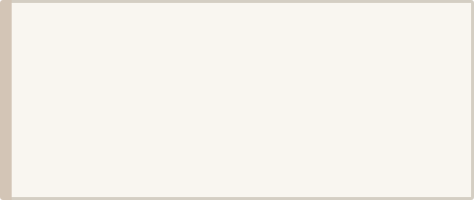

Common IMC Planning Mistakes
Skipping Research
Targeting Everyone
Assuming you know your audience without data. Fix: Always start with research.
"Our product is for everyone" = effective for no one. Fix: Define a specific, viable segment.
Inconsistent Messaging
Budget Without Objectives
Different messages across channels confuse consumers. Fix: Develop a single core message and adapt it across channels.
Spending money without knowing what you're trying to achieve. Fix: Use objective-and-task budgeting.
Ignoring Evaluation
Running campaigns without measuring results. Fix: Set benchmarks before launch; measure after.
Notes:
27

Slide 28

Ethical Considerations in IMC
Truthfulness
All claims must be accurate and substantiated. Deceptive advertising is illegal and destroys trust.
Privacy
Data collection for targeting must respect consumer privacy laws (GDPR, CCPA). Transparency is required.
Stereotyping
Demographic segmentation can reinforce harmful stereotypes. Representation matters.
Vulnerable Audiences
Special care required when targeting children, elderly, or financially vulnerable consumers.
Effective IMC and ethical IMC are not in conflict — brands that communicate honestly and respectfully build stronger, more durable relationships.
Notes:
28

Slide 29
Module 4 — Key Takeaways
Research First
Segment Precisely
Position Clearly
Product, consumer & target-market research underpin every IMC decision
Consumer (demo, psycho, geo, benefit, usage) and B2B segments must be distinct, large & reachable
One strong positioning approach beats a confusing mix
Budget Strategically
Go Global Thoughtfully
Objective-and-task is best practice; match schedule to product cycle
Consistent theme, locally adapted execution — think globally, act locally
Notes:
29

Slide 30

Module 4 — Review Questions
1
1
What are the three types of communications research, and why is each important to the IMC planning process?
2
2
What four criteria must a market segment meet to be considered viable? Give an example of a segment that fails one of these criteria.
3
3
Explain the difference between demographic and psychographic segmentation. Why is it important to use both together?
4
4
What is the VALS framework? Name three VALS segments and describe how a marketer might communicate differently to each.
5
5
A soft drink brand wants to target "everyone who is thirsty." What segmentation mistake is this, and how would you advise them to correct it?
6
6
Describe the seven positioning approaches. Which approach does Apple use, and why?
7
7
Why should communications objectives be distinct from sales objectives? Give an example of a well-written communications objective.
8
8
Compare the percentage-of-sales and objective-and-task budgeting methods. Under what circumstances would each be appropriate?
9
9
A new energy drink is launching in three countries simultaneously. What GIMC considerations should the marketing team address?
10
10
You are the IMC manager for a fitness app. Walk through the complete IMC planning process — from research to schedule — for a campaign targeting Millennials.
Notes:
30

