Slide 1
Introduction to Digital Image Processing using MATLAB
Lecture 1
What is digital Image Processing?
By
Dr. Khin Thu Zar Win
Associate Professor
Department of Mechatronic Engineering
Yangon Technological University (YTU), Myanmar.
Notes:
Hi, dear all,
Firstly, I would like to say Hello. This is the first lecture of Introduction to digital image processing using MATLAB course. this lecture will be conducted in two languages, Myanmar and English.

Slide 2
Outline of lecture
Digital Image Processing
Digital Image Representation
Neighborhoods of a Pixel
Resolution of an Image
Elements of Digital Image Processing
Application Area of Digital Image Processing
Notes:
Slide 2 shows the outline of this lecture.

Slide 3
Digital Image Processing
Image
  2D representation of 3D objects and scene
Digital Image
  Numerical representation of an object
Digital Image Processing
  Manipulation of digital image with the use of a processor/controller
      Used to improve the visual information of an image for human interpretation
      Used to process the image for machine learning
Notes:
Please go to slide 3.
In this slide, I would like to discuss about an image, digital image and digital image processing.

Slide 4
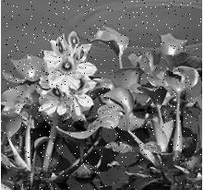

Improving Visual Information
Removing Salt and Pepper noise using median filter
Fig. 1: Image with Salt and Pepper Noise
Fig. 2: Salt and Pepper Noise Removed Image
Notes:
Slide 4 shows a digital image processing algorithm which improve the visual information of an image.
In figure 1, you can see that some black and white spots in the image. This spots are called salt and pepper noise. We can remove those noise by using median filter. The detailed algorithm of median filter will be discussed in later lecture.

Slide 5
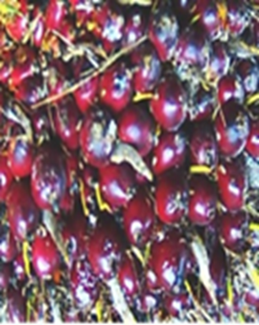
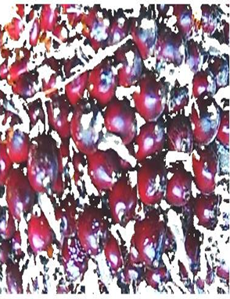
Processing for Machine Learning
Segmentation of Stem Region for Automatic Detection of the Ripeness of Oil Plum Fruits
Fig. 3: Original Image
Fig. 4: Segmented Image
Notes:
Slide 5 is the processing for machine learning which is one of the most popular application in digital image processing.
The process shown here is an research done by one of my master student. She’s tried to segment the stem region of the oil plum fruit so that the ripeness of them can be detected automically.

Slide 6
Digital Image Representation
Digital image is composed of picture elements (pixels)
Each pixel has its illumination value
Digital image representation is a matrix of NxN array of elements which value represents the illumination (brightness) values of each pixel
Here, NxN is the dimension of the image (no. of pixels)
Notes:
OK! I think you can now imaginate why we need digital image processing.
So, let’s move to some basic knowledge of digital image processing.
Please go to slide no. 6. this slide will present digital image representation.

Slide 7
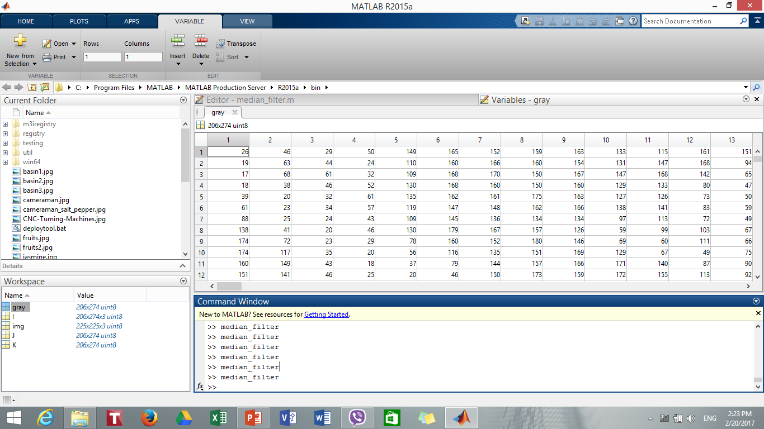
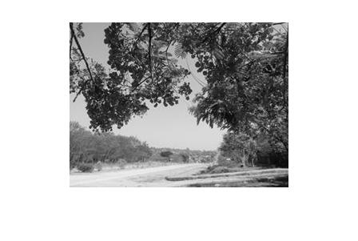
Digital Image Representation
NxN
Fig. 5: Grayscale Image
Fig. 6: Digital Image Representation of a Grayscale Image
Notes:
Slide no. 7 shows the digital image representation of a grayscale image.
You can see the a grayscale image in figure 5 and its digital representation in figure 6

Slide 8
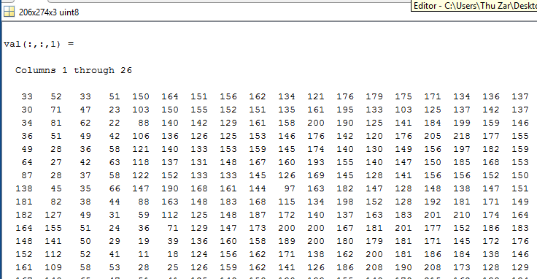
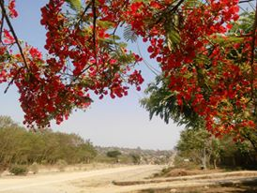
Digital Image Representation
MxNx3
Fig. 7: Color Image
Fig. 8: Digital Image Representation of a Color Image
Notes:
Slide no. 8 shows the digital image representation of a color image.
You can see the a color image in figure 7 and its digital representation in figure 8

Slide 9
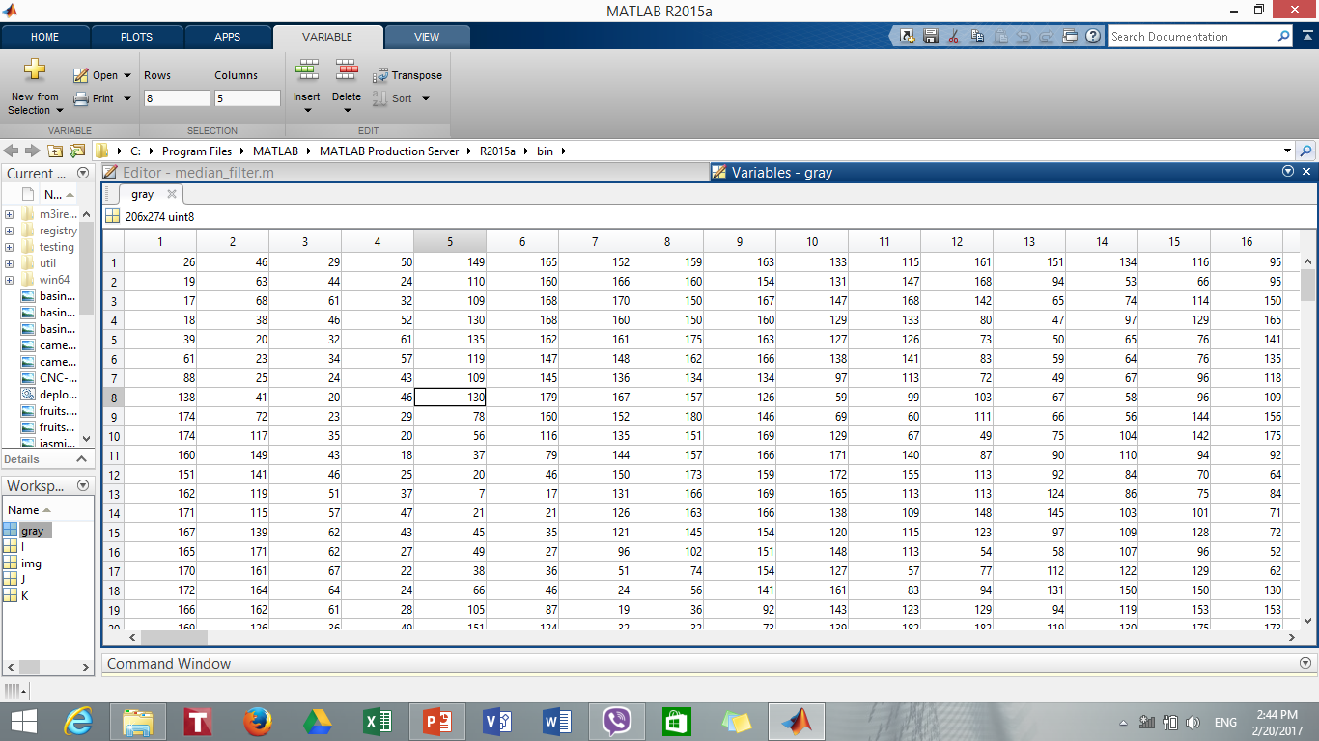
Neighborhoods of a Pixel
Neighborhoods of a pixel are pixels around its
Current Pixel
Its 3x3 Neighborhood Pixels
Notes:
Now, let’s discuss about neighborhoods of a pixel.

Slide 10
Neighborhoods of a Pixel
Pixel has four neighborhood if the neighbors exist in East, West, South and North
North
West
East
South
Notes:
You can find two terms of neighborhood in digital image processing: two neighborhood and eight neighborhood.

Slide 11
Neighborhoods of a Pixel
Pixel has eight neighborhood if the neighbors exist in East, West, South, North, North-east, North-west, South-east and South-west
North
North-west
North-east
West
East
South-west
South-east
South

Slide 12
Resolution of an Image
There are two types of resolution of an image.
They are Spatial resolution and Gray level resolution.
Spatial resolution concerns with no. of pixels in an image.
Gray level resolution depends on the no. of gray level steps for each pixel in the image.
Notes:
Slide no. 12 is about resolution of an image.

Slide 13

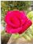
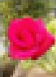
Resolution of an Image
(Spatial Resolution)
Fig. 9: Original Image
Fig. 10: Reduced spatial resolution in 1/16
Fig. 11: Reduced spatial resolution in 1/32

Slide 14
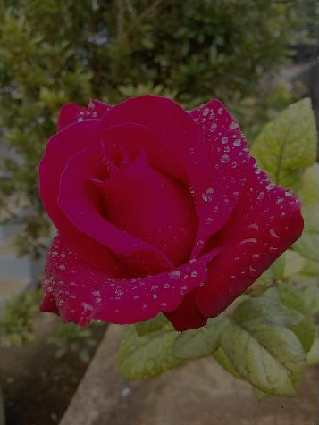
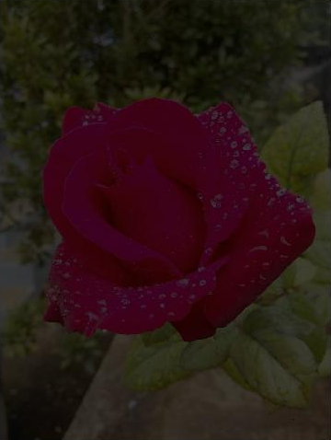
Resolution of an Image
(Gray Level Resolution)
Fig. 12: Original Image
(gray level step to 256)
Fig. 13: Reduced gray level step to 128
Fig. 13: Reduced gray level step to 64
Notes:
Now, you’ve already learnt about digital image representation.

Slide 15
Elements of Digital Image Processing
Image Acquisition
Image Storage
Image Processing
Image Representation (Display)
Image Recognition
Notes:
Then, let’s move to elements of digital image processing.
It includes 5 basic elements. They are:

Slide 16
Element 1:Image Acquisition
Image Acquisition is a process of taking images from the real world by using an image sensor.
There are many types of image sensor such as CCD camera, digital camera, camcorder, scanner, ultrasound, etc.

Slide 17
Element 2: Image Storage
Acquired images are stored to a storage device.
Usually, storage device is a computer. For some embedded quality control systems, special controller board may be used (e.g FPGA-Field Programmable Gate Array).
There are many file types with different image compression schemes while storing the images.

Slide 18
Types of Digital Image
Basically, there are three types of digital image.
They are binary image, grayscale image and color image.
There will also be some special digital image types such as volume image, range image, multispectral image, indexed image, etc. according to special image sensing device or some conversion.
Notes:
When acquiring and storing an image, you should know types digital image.

Slide 19
Types of Digital Image
(Binary Image)
In binary image, each pixel has only two values, ‘0’ or ‘1’, which represents the black or white.
‘0’ represents for black which means that there is no illumination and so it is black.
Alternatively, ‘1’ is for white with the meaning of full illumination.
To store the binary image, each pixel requires only one bit and so such kind of images are very efficient in terms of storage.

Slide 20
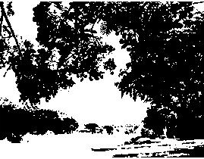
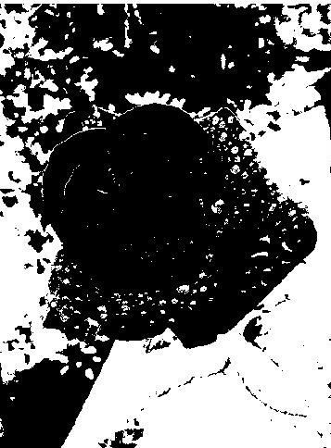
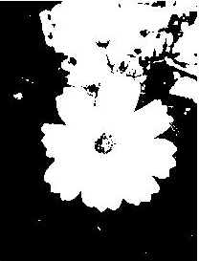
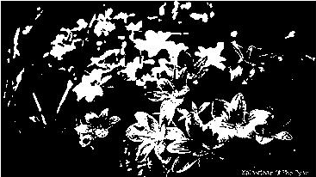
Types of Digital Image
(Binary Image)
Notes:
You can see some photos flowers and sense in binary form in slide 20.

Slide 21
Types of Digital Image
(Grayscale Image)
In grayscale image, each pixel is a shade of gray, ranges from ‘0’ (black) from ‘255’ (white)
Because of its range, each pixel can be represented by 8 bits (one byte)

Slide 22
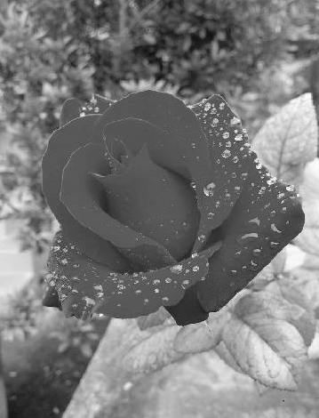
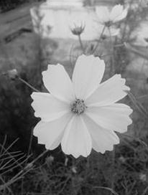
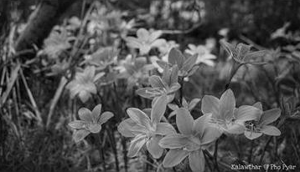
Types of Digital Image
(Grayscale Image)
Notes:
Some grayscale image are shown in slide 22.

Slide 23
Types of Digital Image
(Color Image)
In color image, each pixel has a particular color which is composed of Red, Green and Blue.
So, color images are also called RGB images.
If R, G and B has a range of 0~255, there is possible of colors of 255³=16,777,216 in an image.
To represent a color image, 3 bytes (1 byte each for R,G and B) is required in total.

Slide 24
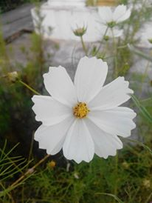
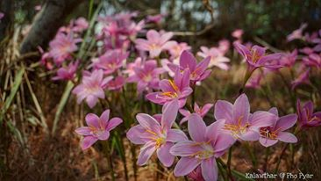
Types of Digital Image
(Color Image)
Notes:
The images at slide 24 are color images

Slide 25
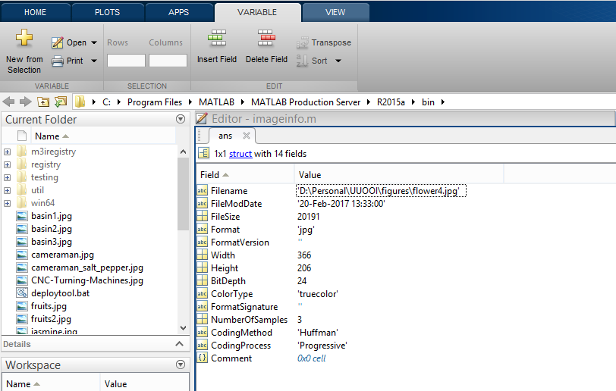
Information of an Image on MATLAB
Notes:
You can see all above information of an image by using MATLAB. This information is shown in slide 25.

Slide 26
Element 3: Image Processing
Generally, image processing tasks include pre-processing, segmentation and major processing.
Pre- processing is performing to render the resulting image more suitable for the job to follow.
Some pre-processing techniques are brightness modification, contrast adjusting and noise removing.
Segmentation is to segment the interest object and other regions of an image.
Two important segmentation tasks are thresholding and edge detection.
Notes:
The third element of digital image processing is task of processing of acquired image.

Slide 27
Element 4: Image Representation (Display)
Image representation is to display the stored data on the monitor.
There are many factors which will effect the display.
They are size of monitor, number of colors and spatial resolution.
Smaller size of the monitor, better will be the portability. But, the detail parts may be lost in sight.
The more the number of colors which can be displayed on monitor, the higher the resolution of the image can be seen.
Moreover, it is clear that high spatial resolution (no. of pixels) monitor can give a great look.
Notes:
The fourth element of digital image processing is representation or display of processed image.

Slide 28
Element 5: Image/Object Recognition
Recognition is assigning labels to objects based on their descriptors.
It resembles human’s recalling memory of known objects and things.
Recognition process is widely used in industrial quality control system and security system.
Notes:
The last element is object recognition.

Slide 29
Application Area of Digital Image Processing
Industrial Quality Control System
Medicine
Security
Agriculture
Weather forecasting
Automotive
Entertainment
Notes:
Slide 29 shows the application area of digital image processing.

Slide 30
MATLAB Fundamentals for Digital Image Processing
(Reading and Displaying an Image)
imread(‘filename’); read the image
imshow(‘filename’); display the image
A=imread(‘rose.jpg');
imshow(A);
** if your images are at other file locations rather than the MATLAB folder, the directory of that file name is needed to include.
A=imread(‘D:\Personal\UUOOI\figures\rose.jpg');
imshow(A);
Notes:
OK! The basic knowledge of digital image processing is finished here.
I would like to introduce some fundamental information about MATLAB for digital image processing before going to next lecture.
You can see from slide 30.
First of all, let’s discuss about reading and displaying an image. You can use function imread. You have to include the file name in the bracket next to the function.
** if your images are at other file locations rather than the MATLAB folder, the directory of that file name is needed to include.

Slide 31
MATLAB Fundamentals for Digital Image Processing
(Reading and Displaying an Image)
To know the size of image A, you can use
size(A)
It will give ans =
206 366 3
whos function gives more information about A
>> whos A
Name Size Bytes Class Attributes
A 206x366x3 226188 uint8
Notes:
To know the size of image A, you can use the function size
Whos function gives more information about A

Slide 32
MATLAB Fundamentals for Digital Image Processing
(Reading and Displaying an Image)
To keep the first image and output the second image, you can use the function figure
A=imread(‘rose.jpg');
B=imread(‘jasmine.jpg');
imshow(A), figure, imshow (B);

Slide 33
MATLAB Fundamentals for Digital Image Processing
(Reading and Displaying an Image)
subplot(rcn); displaying multiple image on a frame
r=no. of row, c= no. of column, n= figure number
A=imread(‘rose.jpg');
B=imread(‘jasmine.jpg');
C=imread(‘orchid.jpg');
D=imread(‘waterfall.jpg');
subplot(221); imshow(A);title(‘rose');
subplot(222);imshow(B);title(‘jasmine');
subplot(223); imshow(C); title(‘orchid');
subplot(224); imshow(D); title(‘waterfall');

Slide 34
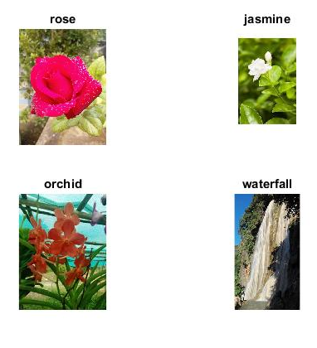
MATLAB Fundamentals for Digital Image Processing
(Reading and Displaying an Image)

Slide 35
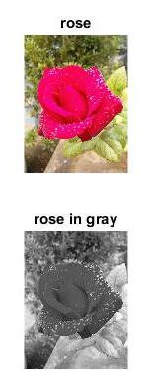
MATLAB Fundamentals for Digital Image Processing
(Converting Color Image to Grayscale Image)
rgb2gray(); converting color image to grayscale image
img = imread(‘rose.jpg');
gray = rgb2gray(img);
subplot(211); imshow(img);title(‘rose');
subplot(212); imshow(gray);title(‘rose in gray');
Notes:
Sometimes, you would like to change the color image to some other image types for the purpose of fast processing or compression.
To convert the RGB image to Grayscale image, you can use the function, rgb2gray
You can see the results in slide 35

Slide 36
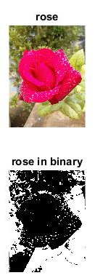
MATLAB Fundamentals for Digital Image Processing
(Converting Color Image to Binary Image)
im2bw(); converting color image to binary image
img = imread(‘rose.jpg');
BW = im2bw(img);
subplot(211); imshow(img);title(‘rose');
subplot(212); imshow(BW);title(‘rose in binary');
Notes:
To convert the RGB image to binary image, you can use the function im2bw
You can see the results in slide 36

Slide 37
Introduction to Next Lecture
Intensity Transformation

