Slide 1
Introduction to Digital Image Processing using MATLAB
Lecture 2
Intensity Transformation 1
By
Dr. Khin Thu Zar Win
Associate Professor
Department of Mechatronic Engineering
Yangon Technological University (YTU), Myanmar.

Slide 2
Outline of lecture
Basic of Intensity Transformation
Image Negative
Logarithmic Transformations
Contrast Adjustment
Bit Plane Slicing
MATLAB for intensity transformations
Notes:
Slide 2 shows the outline of this lecture.

Slide 3
Basic of Intensity Transformation
Intensity transformations are implemented in the spatial domain
The transformation techniques are operated directly on the pixels of an image
Intensity transformations are used when the intensity values of an grayscale image are needed to modify. (e.g. to make the dark pixels darker, or, light pixels lighter)

Slide 4
Basic of Intensity Transformation
In general, intensity transformation can be defined as
where, g(x,y) is output image,
f(x,y) is input image, and
T is the transformation operator.

Slide 5
Image Negative
Image negative is sometimes called inverse transformation
It reverses the light and the dark.
Image negative is useful in displaying medical images and producing negative images

Slide 6
Image Negative
Image negative can be obtained by subtracting each pixel values from maximum gray level value. i.e.
It can also be obtained by reversing (complement) the gray level

Slide 7

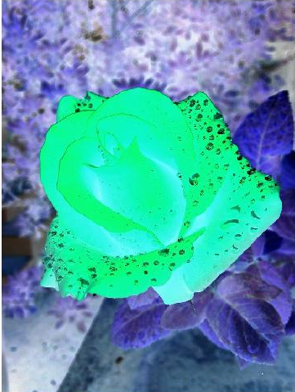
Image Negative
Original Image in color
Negative Image in color

Slide 8
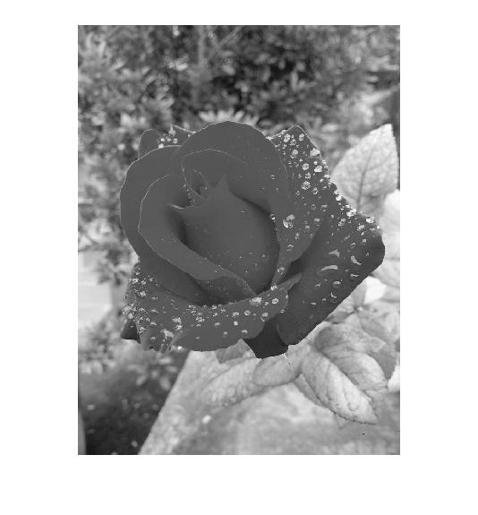
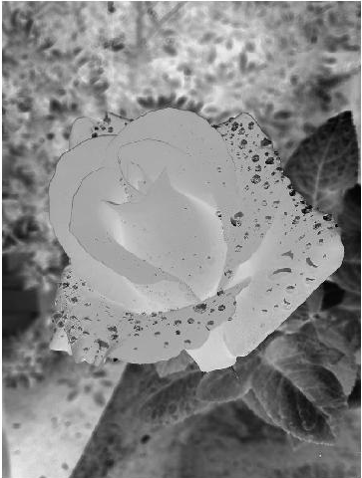
Image Negative
Original Image in grayscale
Negative Image in grayscale

Slide 9
Logarithmic Transformation
Logarithmic transformation increases the brightness value of an image.
This transform is widely used to increase the detail of lower intensity values.

Slide 10
Logarithmic Transformation
The general form of logarithmic transformation is
where, c is a constant
Brightness can be increased by increasing the constant value c.

Slide 11


Logarithmic Transformation
c = 0.1
c = 0.2

Slide 12
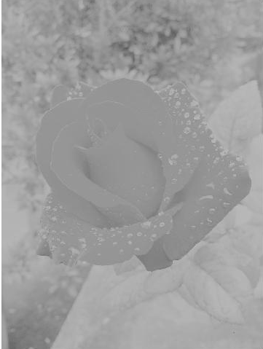

Logarithmic Transformation
c = 0.3
c = 0.5

Slide 13
Contrast Adjustment
Contrast adjustment can be done by scaling the pixels of an image with a constant value k.
It is transformed by,

Slide 14
Contrast Adjustment
If the value of k is set above 1, the contrast of the image will be increased.
It means that the bright pixels will be brighter and the dark pixels will be darker.
If the value of k is set below 1, the contrast of the image will be decreased.

Slide 15
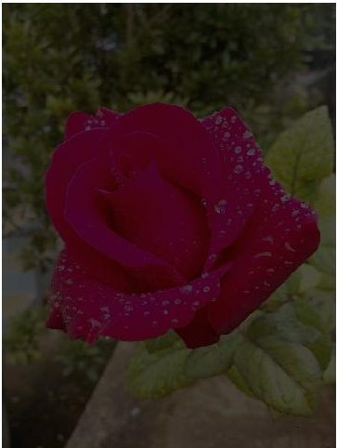
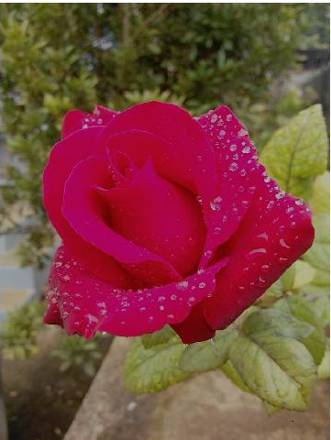
Contrast Adjustment
k = 0.3
k = 0.7

Slide 16
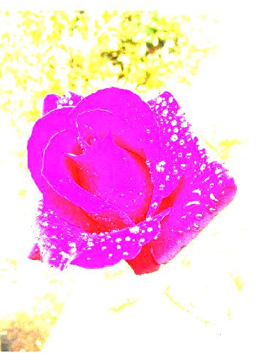
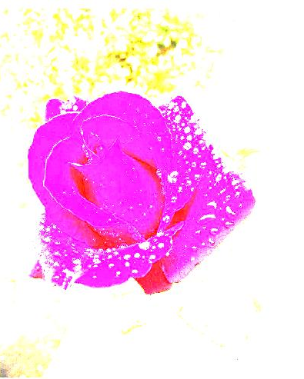
Contrast Adjustment
k = 5
k = 7

Slide 17
Bit Plane Slicing
The gray level of each pixel in digital image is composed of digital numbers.
For example, the intensity of each pixels in a grayscale image is composed of 8 bits.
The black, 0, is encoded as 0000 0000.
The white, 1, is encoded as 1111 1111.
The bit in the far left is the Most Significant Bit (MSB) and the right is Least Significant Bit (LSB).

Slide 18
Bit Plane Slicing
Each corresponding bits can be considered as its bit plane.
Bit plane slicing is representing the image with one or more bit plane.
Bit plane slicing is useful for analyzing the relative importance of each bit in the image, a process that aids in determining the adequacy of the number of bits used to quantize the image.

Slide 19
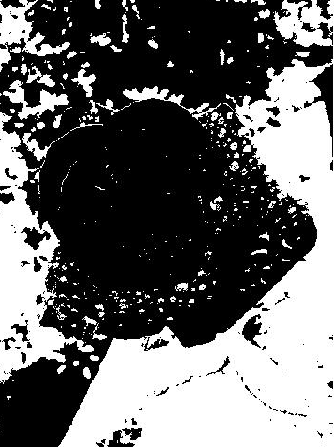
Bit Plane Slicing
Grayscale image
b₇ bit plane

Slide 20
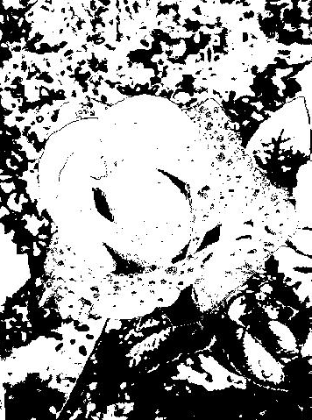
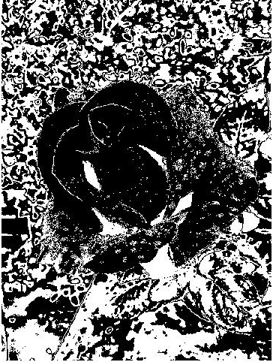
Bit Plane Slicing
b₆ bit plane
b₅ bit plane

Slide 21
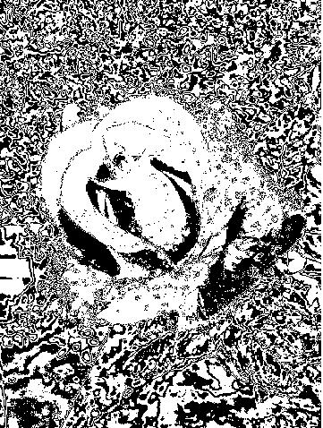
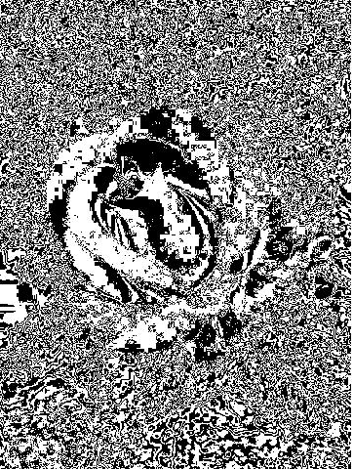
Bit Plane Slicing
b₄ bit plane
b₃ bit plane

Slide 22
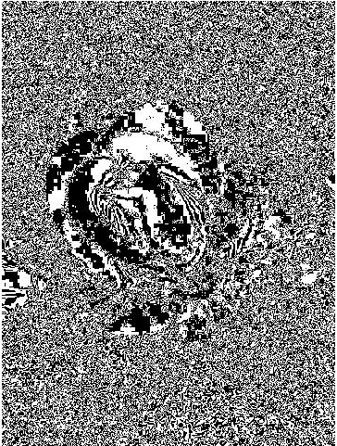
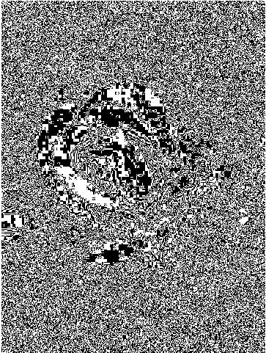
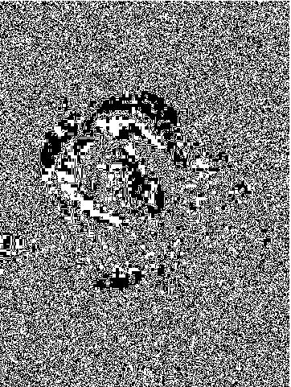
Bit Plane Slicing
b₂ bit plane
b₁ bit plane
b₀ bit plane

Slide 23
MATLAB Codes for Intensity Transformations

Slide 24
Image Negative (color images)
img = imread('D:\Personal\UUOOI\figures\rose1.jpg');
neg_img = 255-img;
com_img=imcomplement(img);
imshow(img), figure, imshow(neg_img), figure, imshow(com_img);
*** (255-img) and (imcomplement) work the same to produce the negative images

Slide 25
Image Negative (grayscale images)
I = imread('D:\Personal\UUOOI\figures\rose1.jpg');
img=rgb2gray(I);
neg_img = 255-img;
com_img=imcomplement(img);
imshow(img), figure, imshow(neg_img), figure, imshow(com_img);

Slide 26
Logarithmic Transformation
img = imread('D:\Personal\UUOOI\figures\rose1.jpg');
constant1 = .1;
constant2 = .2;
constant3 =.3;
constant4 = .5;
img1=rgb2gray(img);
I=double(img1);
log_img1 = constant1 * log10(1+I);
log_img2 = constant2 * log10(1+I);
log_img3 = constant3 * log10(1+I);
log_img4 = constant4 * log10(1+I);

Slide 27
Contrast Adjustment
img = imread('D:\Personal\UUOOI\figures\rose1.jpg');
crt_inc1= img*.3;
crt_inc2= img*.7;
crt_dec1= img*5;
crt_dec2= img*7;
imshow(crt_inc1),figure,imshow(crt_inc2),figure,imshow(crt_dec1),figure,imshow(crt_dec2);

Slide 28
Bit Plane Slicing
img = imread('D:\Personal\UUOOI\figures\rose1.jpg');
img2=double(img);
b7=mod(floor(img2/128),2);
b6=mod(floor(img2/64),2);
b5=mod(floor(img2/32),2);
b4=mod(floor(img2/16),2);
b3=mod(floor(img2/8),2);
b2=mod(floor(img2/4),2);
b1=mod(floor(img2/2),2);
b0=mod(img2,2);

Slide 29
Introduction to Next Lecture
Intensity Transformation 2

