Slide 1
Introduction to Digital Image Processing using MATLAB
Lecture 3
Intensity Transformation 2
By
Dr. Khin Thu Zar Win
Associate Professor
Department of Mechatronic Engineering
Yangon Technological University (YTU), Myanmar.

Slide 2
Outline of lecture
Histogram Processing
Histogram Equalization
Histogram Stretching
Image Arithmetic
Notes:
Slide 2 shows the outline of this lecture.

Slide 3
Histogram Processing
Histogram of an image is a graph of the number of times each graylevel occurred in the image against graylevel values.
Histograms are the basis for numerous spatial domain processing techniques.
Histogram manipulation can be used for image enhancement.

Slide 4
Histogram Processing
Histogram gives the overall intensity information of an image.
The histogram of the dark image are concentrated on the low side of the intensity scale.
Similarly, the histogram of the bright image are biased toward the high side of the scale.
For low contrast image, the histogram will be narrow and located typically toward the middle of the intensity scale.
For high contrast image, the histogram will equally spread in the graylevel.

Slide 5
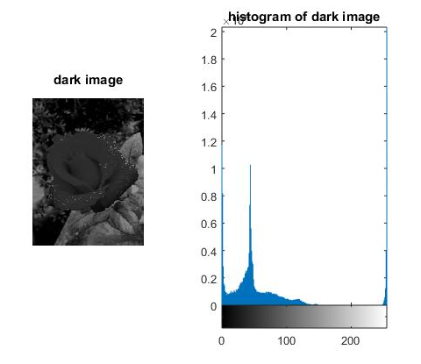
Histogram Processing

Slide 6
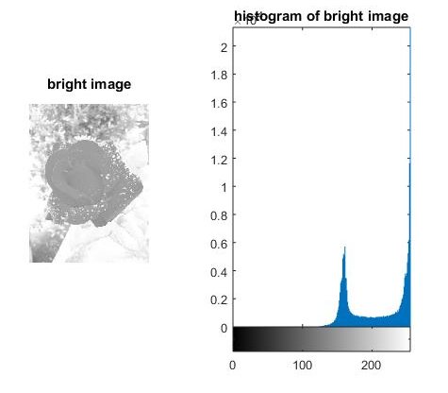
Histogram Processing

Slide 7
Histogram Equalization
Histogram equalization is the process of stretching the histogram to spread out over the graylevels of an image.
By doing the histogram equalization, the histogram of the resultant image become flat and evenly distributed.
So, the image becomes higher contrast and more visually pleased.

Slide 8
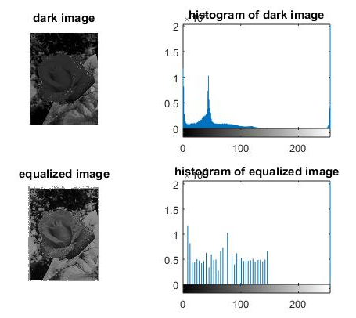
Histogram Equalization

Slide 9
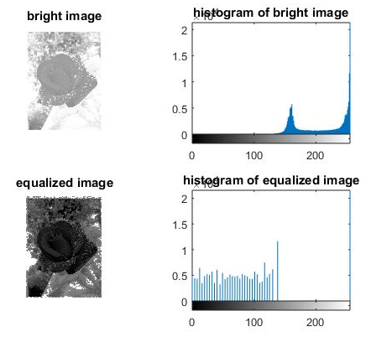
Histogram Equalization

Slide 10
Histogram Stretching (Contrast Stretching)
Histogram stretching is one of the method of enhancing contrast.
Histogram stretching increase the contrast of the image.
Difference between the histogram stretching and equalization is that stretching is linear processing and equalization is non-linear processing.

Slide 11
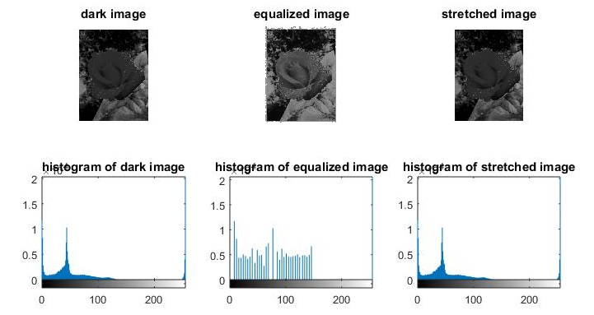
Histogram Stretching (Contrast Stretching)

Slide 12
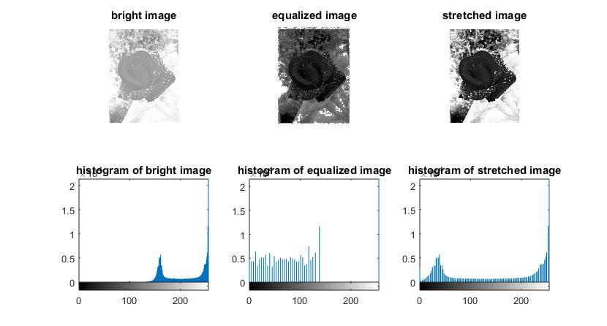
Histogram Stretching (Contrast Stretching)

Slide 13
Histogram Stretching (Contrast Stretching)

Slide 14
Image Arithmetic
Like other arithmetic operation, images can be added, subtracted, multiplied and divided.
Image arithmetic are used to combine and remove the objects to and from an image.
Image arithmetic operation are very simple like mathematical arithmetic operations.

Slide 15
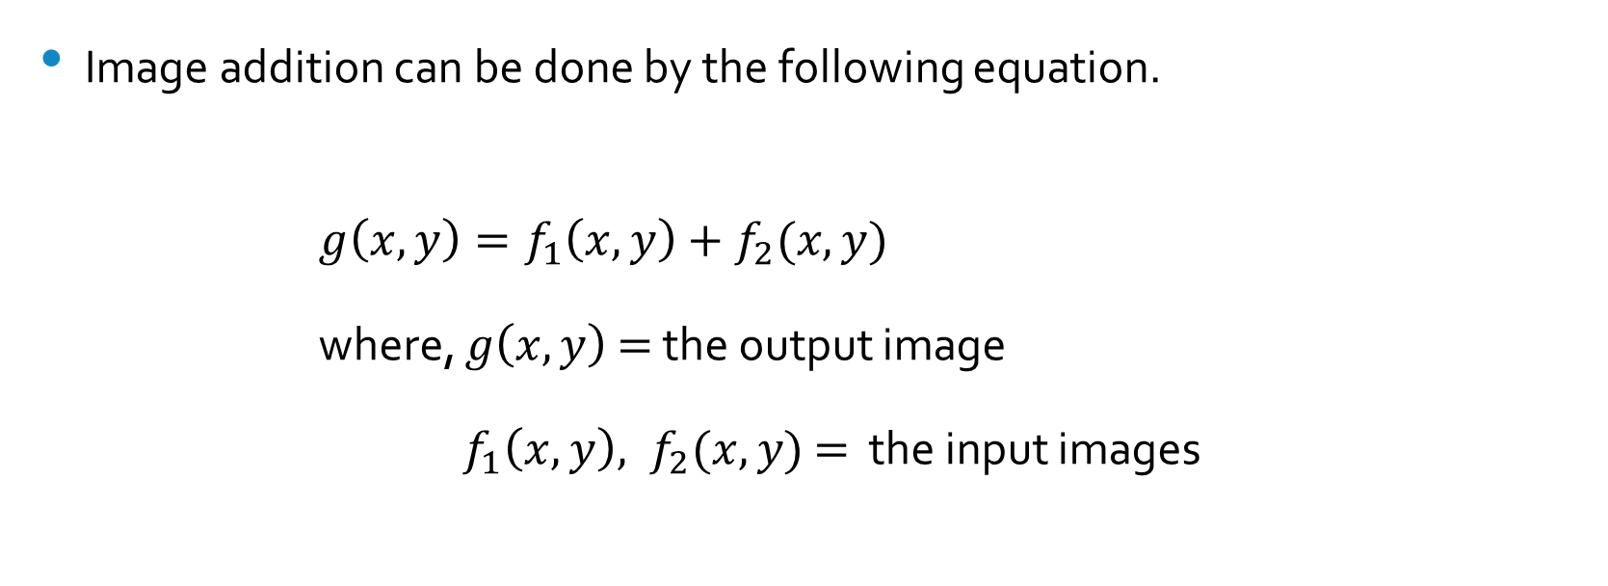
Image Arithmetic (Addition)
Image addition can be done by the following equation.
$g\left(x,y\right)=f_{1}\left(x,y\right)+f_{2}(x,y)$
where, $g\left(x,y\right)$ $=$ the output image
$f_{1}\left(x,y\right), f_{2}(x,y)$ $=$ the input images

Slide 16
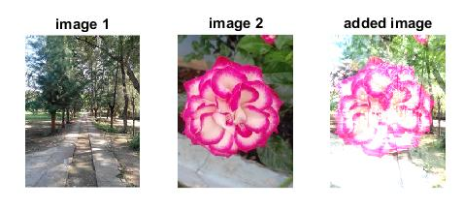
Image Arithmetic (Addition)

Slide 17
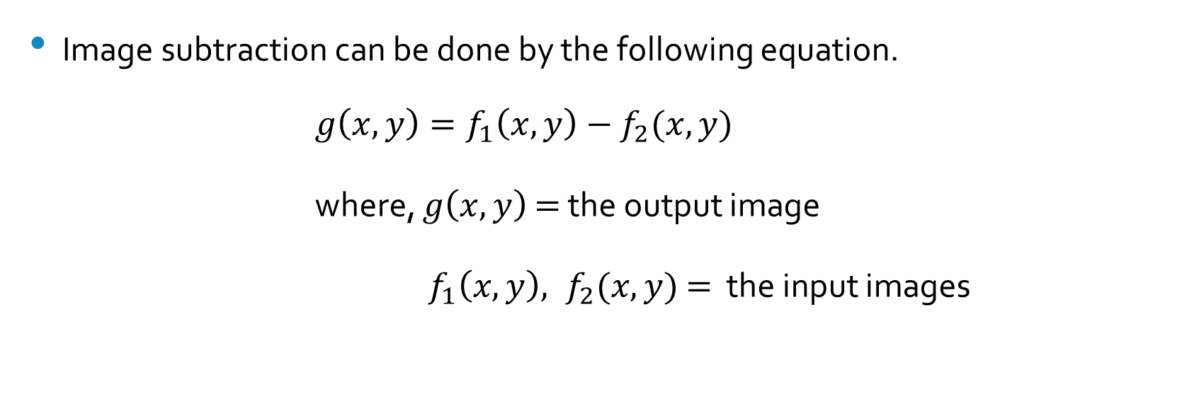
Image Arithmetic (Subtraction)
Image subtraction can be done by the following equation.
$g\left(x,y\right)=f_{1}\left(x,y\right)−f_{2}(x,y)$
where, $g\left(x,y\right)$ $=$ the output image
$f_{1}\left(x,y\right), f_{2}(x,y)$ $=$ the input images

Slide 18
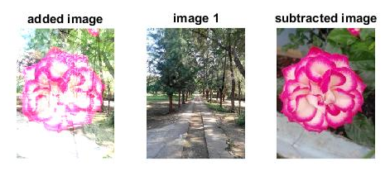
Image Arithmetic (Subtraction)

Slide 19
MATLAB Codes for Intensity Transformations

Slide 20
Histogram Processing
img = imread('D:\Personal\UUOOI\figures\rose1_brightness_increase.jpg');
gray = rgb2gray(img);
subplot(121);
imshow(gray);
title('bright image');
subplot(122);
imhist(gray);
title('histogram of bright image');

Slide 21
Histogram Equalization
img = imread('D:\Personal\UUOOI\figures\rose1_brightness_decrease.jpg');
gray = rgb2gray(img);
img_eq = histeq(gray);
figure,subplot(221),imshow(gray),title('dark image');
subplot(222),imhist(gray),title('histogram of dark image');
subplot(223),imshow(img_eq),title('equalized image');
subplot(224),imhist(img_eq),title('histogram of equalized image');

Slide 22
Histogram Stretching
img = imread('D:\Personal\UUOOI\figures\rose1_brightness_increase.jpg');
gray = rgb2gray(img);
img_eq = histeq(gray);
img_adj=imadjust(gray);
figure,subplot(231),imshow(gray),title('bright image');
subplot(232),imshow(img_eq),title('equalized image');
subplot(233),imshow(img_adj),title('stretched image');
subplot(234),imhist(gray),title('histogram of bright image');
subplot(235),imhist(img_eq),title('histogram of equalized image');
subplot(236),imhist(img_adj),title('histogram of stretched image');

Slide 23
Image Arithmetic (Addition)
img1 = imread('D:\Personal\UUOOI\figures\street.jpg');
img2 = imread('D:\Personal\UUOOI\figures\rose3.jpg');
img3 = double(img1) + double(img2);
figure,subplot(131),imshow(img1),title('image 1');
subplot(132),imshow(img2),title('image 2');
subplot(133),imshow(uint8(img3)),title('added image');

Slide 24
Image Arithmetic (Subtraction)
img1 = imread('D:\Personal\UUOOI\figures\street.jpg');
img2 = imread('D:\Personal\UUOOI\figures\rose3.jpg');
img3 = double(img1) + double(img2);
img4 = double(img3) - double(img1);
figure,subplot(131),imshow(uint8(img3)),title('added image');
subplot(132),imshow(img1),title('image 1');
subplot(133),imshow(uint8(img4)),title('subtracted image');

Slide 25
Introduction to Next Lecture
Spatial Filtering 1

