Slide 1
Introduction to Digital Image Processing using MATLAB
Lecture 4
Spatial Filtering 1
By
Dr. Khin Thu Zar Win
Associate Professor
Department of Mechatronic Engineering
Yangon Technological University (YTU), Myanmar.

Slide 2
Outline of lecture
Smoothing Spatial Filters
  Averaging or Mean Filters
  Median Filters

Slide 3
Spatial Filtering
Filtering refers to accepting (passing) or rejecting certain frequency components.
For example, a filter that passes low frequencies is called lowpass filter.
The effect of lowpass filter is to blur (smooth) the image.
This effect can be accomplished by using spatial filters (also called spatial masks, kernels, windows).

Slide 4
Spatial Filtering
A spatial filtering includes two components:
  A neighborhood of the mask
  Predefined operation
  Most of spatial filtering processes are neighborhood operation.
  The mask is moved over the image and do the predefined operation so that a new image is created.
  If the predefined operation is linear function over all pixels, then the filter is called linear filter.

Slide 5
Spatial Filtering
A liner filtering can be done by multiplying all the pixels’ grayvalue in the mask with the corresponding value of its.
Then, all these products are added.
This procedure is performed over the image.
When doing this, there may be lack of pixels to do mask for boundary pixels.
We can solve this problem by zero padding or pixel replication.

Slide 6
Smoothing Filters (Averaging Filter)
An average filter simply finds the average of the pixels contained in the neighborhood of the filter mask.
By replacing the value of every pixels in an image by the average of the intensity levels in the neighborhood defined by the filter mask, this process results in an image with reduced sharp transitions in intensities.

Slide 7
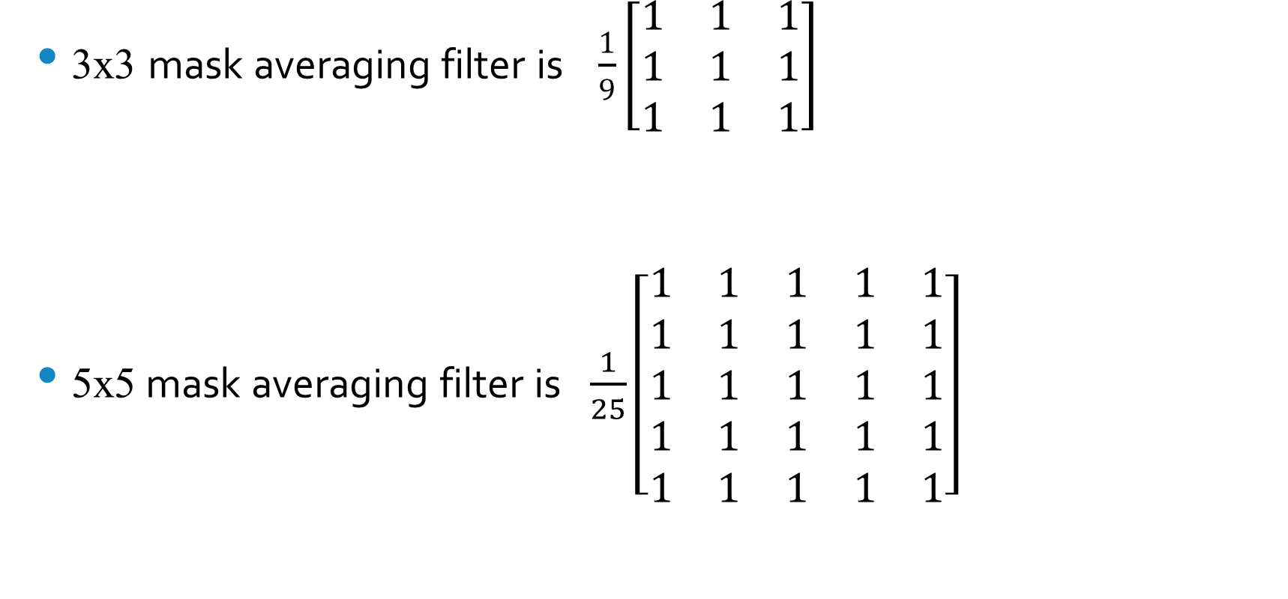
Smoothing Filters (Averaging Filter)
3x3 mask averaging filter is $\frac{1}{9}\left[\begin{matrix}1 & 1 & 1 \\ 1 & 1 & 1 \\ 1 & 1 & 1\end{matrix}\right]$
5x5 mask averaging filter is$\frac{1}{25}\left[\begin{matrix}1 & 1 & 1 & 1 & 1 \\ 1 & 1 & 1 & 1 & 1 \\ 1 & 1 & 1 & 1 & 1 \\ 1 & 1 & 1 & 1 & 1 \\ 1 & 1 & 1 & 1 & 1\end{matrix}\right]$

Slide 8
Smoothing Filters (Averaging Filter)
Average filter is used to blur an image for the purpose of getting a gross representation of object of interest such that the intensity of smaller objects bends with the background.
So, average filter can eliminate small objects from an image.

Slide 9
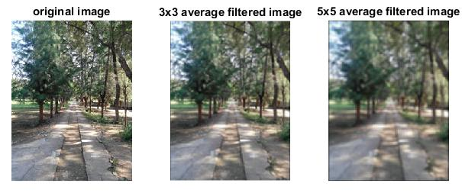
Smoothing Filters (Averaging Filter)

Slide 10
Smoothing Filters (Median Filter)
Median filters are non-linear smoothing filters.
A median filter finds the median value of the neighborhood.
All pixels in the neighborhood are sorted in ascending or descending order and then find the median value.
That median value is chosen as the pixel value of the filtered image.

Slide 11
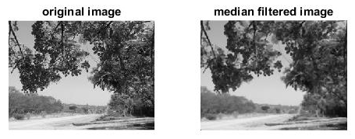
Smoothing Filters (Median Filter)

Slide 12
Smoothing Filters (Median Filter)
An image can be corrupted by the noise of black and white spot.
Those type of noise are called salt-and-pepper noise in image processing.
Salt-and-pepper noise can be eliminated by using median filter.

Slide 13
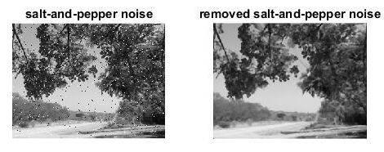
Smoothing Filters (Median Filter)

Slide 14
MATLAB Codes for Spatial Filtering

Slide 15
Smoothing Filters (Averaging Filter)
img = imread('D:\Personal\UUOOI\figures\street.jpg');
f1=fspecial('average',3);
avgfil_img=imfilter(img,f1);
f2=fspecial('average',5);
avgfil_img2=imfilter(img,f2);
figure, subplot(131),imshow(img),title('original image');
subplot(132),imshow(uint8(avgfil_img)),title('3x3 average filtered image');
subplot(133),imshow(avgfil_img2), title('5x5 average filtered image');

Slide 16
Smoothing Filters (Median Filter)
I = imread('D:\Personal\UUOOI\figures\street with rose.jpg');
gray = rgb2gray(I);
medfil_img = medfilt2(gray);
figure, subplot(121),imshow(gray),title('original image');
subplot(122),imshow(medfil_img),title('median filtered image');

Slide 17
Smoothing Filters (Median Filter)
Removing salt-and-pepper noise
I = imread('D:\Personal\UUOOI\figures\street with rose.jpg');
gray = rgb2gray(I);
J = imnoise(gray,'salt & pepper',0.02);
K = medfilt2(J);
figure, subplot(121),imshow(J),title('salt-and-pepper noise');
subplot(122),imshow(K),title('removed salt-and-pepper noise');

Slide 18
Introduction to Next Lecture
Spatial Filtering 2

