Slide 1
Introduction to Digital Image Processing using MATLAB
Lecture 5
Spatial Filtering 2
By
Dr. Khin Thu Zar Win
Associate Professor
Department of Mechatronic Engineering
Yangon Technological University (YTU), Myanmar.

Slide 2
Outline of lecture
Sharpening Spatial Filters
  Prewitt Filter
  Sobel Filter
  Laplacian Filter
  Unsharp Masking
  High Boost Filter

Slide 3
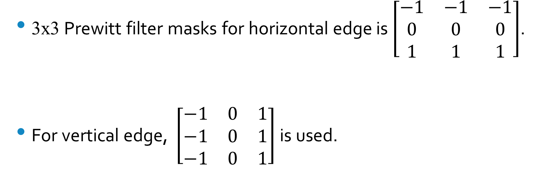
Sharpening Filters (Prewitt Filter)
3x3 Prewitt filter masks for horizontal edge is$\left[\begin{matrix}−1 & −1 & −1 \\ 0 & 0 & 0 \\ 1 & 1 & 1\end{matrix}\right]$.
For vertical edge, $\left[\begin{matrix}−1 & 0 & 1 \\ −1 & 0 & 1 \\ −1 & 0 & 1\end{matrix}\right]$ is used.

Slide 4
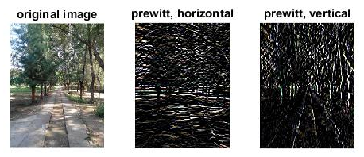
Sharpening Filters (Prewitt Filter)

Slide 5

Sharpening Filters (Sobel Filter)
3x3 Sobel filter masks for horizontal edge is$\left[\begin{matrix}−1 & −2 & −1 \\ 0 & 0 & 0 \\ 1 & 2 & 1\end{matrix}\right]$.
For vertical edge, $\left[\begin{matrix}−1 & 0 & 1 \\ −2 & 0 & 2 \\ −1 & 0 & 1\end{matrix}\right]$ is used.

Slide 6

Sharpening Filters (Sobel Filter)

Slide 7
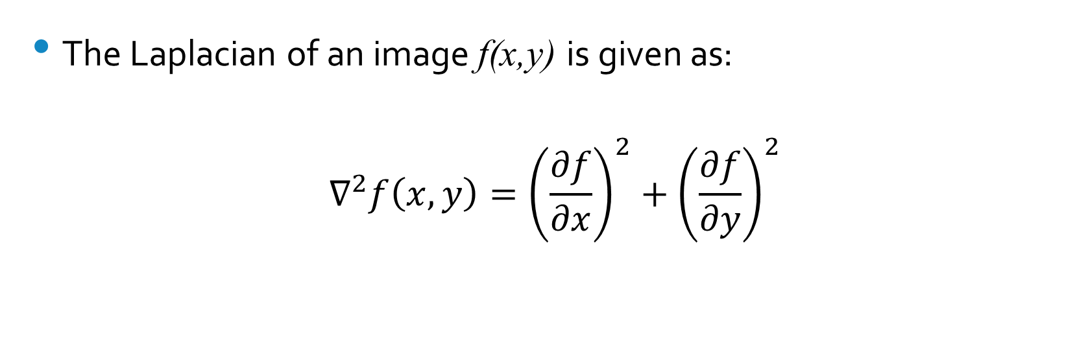
Sharpening Filters (Laplacian Filter)
The Laplacian of an image f(x,y) is given as:
$$∇^{2}f\left(x,y\right)={\left(\frac{∂f}{∂x}\right)}^{2}+{\left(\frac{∂f}{∂y}\right)}^{2}$$

Slide 8
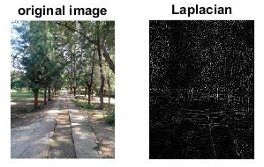
Sharpening Filters (Laplacian Filter)

Slide 9
Sharpening Filters (Unsharp Masking)
Unsharp masking consists of basic three steps.
  Blur the original image.
  Subtract the blurred image from the original (the resulting difference is called mask).
  Add the mask to the original.

Slide 10
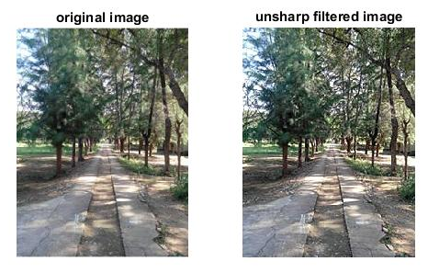
Sharpening Filters (Unsharp Masking)

Slide 11
Sharpening Filters (High Boost Filter)
High boost filter is the extension of unsharp masking.
In high boosting, the original image is multiply by a constant and add the high pass filter.

Slide 12
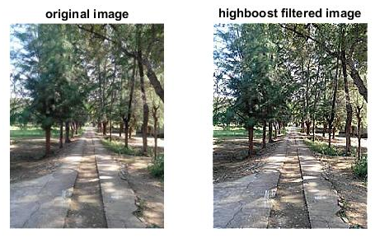
Sharpening Filters (High Boost Filter)

Slide 13
MATLAB Codes for Spatial Filtering

Slide 14
Sharpening Filters (Prewitt Filter)
img = imread('D:\Personal\UUOOI\figures\street.jpg');
f1=fspecial('prewitt');
prewittfil_img=imfilter(img,f1);
prewittfil_img2=imfilter(img,f1');
figure, subplot(131),imshow(img),title('original image');
subplot(132),imshow(prewittfil_img),title('prewitt, horizontal');
subplot(133),imshow(prewittfil_img2), title('prewitt, vertical');

Slide 15
Sharpening Filters (Sobel Filter)
img = imread('D:\Personal\UUOOI\figures\street.jpg');
f1=fspecial('sobel');
sobelfil_img=imfilter(img,f1);
sobelfil_img2=imfilter(img,f1');
figure, subplot(131),imshow(img),title('original image');
subplot(132),imshow(sobelfil_img),title('Sobel, horizontal');
subplot(133),imshow(sobelfil_img2), title('Sobel, vertical');

Slide 16
Sharpening Filters (Laplacian Filter)
img = imread('D:\Personal\UUOOI\figures\street.jpg');
f1=fspecial('laplacian');
laplacianfil_img=imfilter(img,f1);
figure, subplot(131),imshow(img),title('original image');
subplot(132),imshow(laplacianfil_img),title('Laplacian');

Slide 17
Sharpening Filters (Unsharp Mask)
img = imread('D:\Personal\UUOOI\figures\street.jpg');
unsharpfil_img=imsharpen(img);
figure, subplot(121),imshow(img),title('original image');
subplot(122),imshow(unsharpfil_img),title('unsharp filtered image');

Slide 18
Sharpening Filters (High Boost Filter)
img = imread('D:\Personal\UUOOI\figures\street.jpg');
constant = [0 0 0; 0 1 0; 0 0 0];
f1=fspecial('average',3);
hb= 3*constant-2*f1;
highboostfil_img=imfilter(img,hb);
figure, subplot(121),imshow(img),title('original image');
subplot(122),imshow(highboostfil_img),title('highboost filtered image');

Slide 19
Introduction to Next Lecture
Image Restoration

