Slide 1
Introduction to Digital Image Processing using MATLAB
Lecture 6
Image Restoration 1
By
Dr. Khin Thu Zar Win
Associate Professor
Department of Mechatronic Engineering
Yangon Technological University (YTU), Myanmar.

Slide 2
Outline of lecture
Image restoration
Salt-and-pepper noise
Removing salt-and-pepper noise
Gaussian noise
Removing Gaussian noise
Notes:
Slide 2 shows the outline of this lecture.

Slide 3
Image Restoration
Image restoration is the removal of degradation in the image because of the noise occurred during the acquisition of the image.
Noise are the visually unpleasant degradation such as out of focus blurring, or blurring due to camera motion.
Noise can be classified according to the appearance on an image.

Slide 4
Types of Noise
Salt-and-pepper noise
Gaussian noise
Speckle noise
Periodic noise

Slide 5
Salt-and-pepper Noise
Salt-and-pepper noise is randomly scattered small black and white spots on an image.
It is also called impulse noise, shot noise or binary noise.

Slide 6
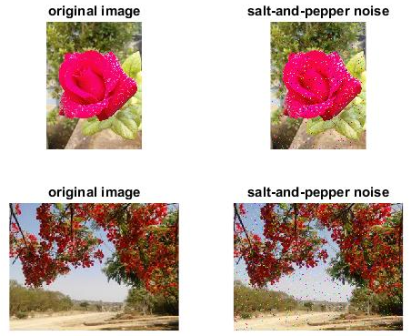
Salt-and-pepper Noise

Slide 7
Removing Salt-and-pepper Noise
Salt-and-pepper noise is can be removed by using the following filters.
  Average filter
  Median filter
  Rank-order filter

Slide 8
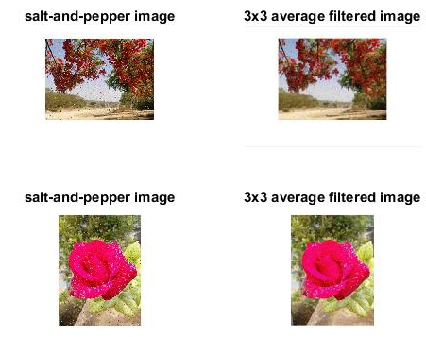
Removing Salt-and-pepper Noise
  Average filter

Slide 9
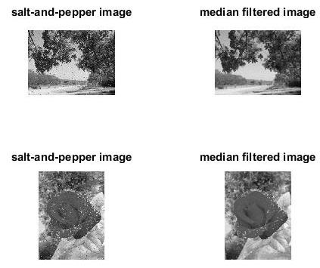
Removing Salt-and-pepper Noise
  Median filter

Slide 10
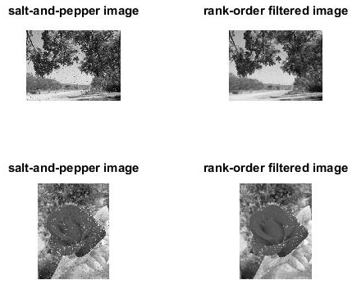
Removing Salt-and-pepper Noise
  Rank-order filter

Slide 11
Gaussian Noise
Gaussian noise is a form of white noise which is normally distributed.
White noise can be observed when watching a television which is slightly mistuned to a particular channel.

Slide 12

Gaussian Noise

Slide 13
Removing Gaussian Noise
Gaussian noise is can be removed by using the following filters.
  Average filter
  Adaptive filter (Wiener filter)

Slide 14
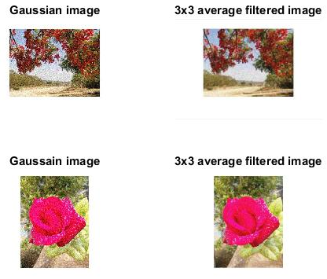
Removing Gaussian Noise
  Average filter

Slide 15
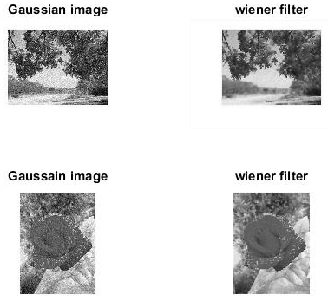
Removing Gaussian Noise
  Adaptive filter

Slide 16
MATLAB Codes for Spatial Filtering

Slide 17
Generation of Salt-and-pepper Noise
img1 = imread('D:\Personal\UUOOI\figures\rose1.jpg');
img2 = imread('D:\Personal\UUOOI\figures\street with rose.jpg');
saltnoise1 = imnoise(img1,'salt & pepper',0.02);
saltnoise2 = imnoise(img2,'salt & pepper',0.02);
figure, subplot(221),imshow(img1),title('original image');
subplot(222),imshow(saltnoise1),title('salt-and-pepper noise');
subplot(223),imshow(img2),title('original image');
subplot(224),imshow(saltnoise2),title('salt-and-pepper noise');

Slide 18
Removing Salt-and-pepper Noise (Average Filter)
img1 = imread('D:\Personal\UUOOI\figures\saltnoise1.jpg');
img2 = imread('D:\Personal\UUOOI\figures\saltnoise2.jpg');
f1=fspecial('average',3);
avgfil_img1=imfilter(img1,f1);
avgfil_img2=imfilter(img2,f1);
figure, subplot(221),imshow(img1),title('salt-and-pepper image');
subplot(222),imshow(avgfil_img1),title('3x3 average filtered image');
subplot(223),imshow(img2), title('salt-and-pepper image');
subplot(224),imshow(avgfil_img2), title('3x3 average filtered image');

Slide 19
Removing Salt-and-pepper Noise (Median Filter)
I1 = imread('D:\Personal\UUOOI\figures\saltnoise1.jpg');
I2 = imread('D:\Personal\UUOOI\figures\saltnoise2.jpg');
img1 = rgb2gray(I1);
img2 = rgb2gray(I2);
medfil_img1=medfilt2(img1);
medfil_img2=medfilt2(img2);
figure, subplot(221),imshow(img1),title('salt-and-pepper image');
subplot(222),imshow(medfil_img1),title('median filtered image');
subplot(223),imshow(img2), title('salt-and-pepper image');
subplot(224),imshow(medfil_img2), title('median filtered image');

Slide 20
Removing Salt-and-pepper Noise (Rank-order Filter)
I1 = imread('D:\Personal\UUOOI\figures\saltnoise1.jpg');
I2 = imread('D:\Personal\UUOOI\figures\saltnoise2.jpg');
img1 = rgb2gray(I1);
img2 = rgb2gray(I2);
rankfil_img1=ordfilt2(img1,3,[0 1 0; 1 1 1; 0 1 0]);
rankfil_img2=ordfilt2(img2,3,[0 1 0; 1 1 1; 0 1 0]);
figure, subplot(221),imshow(img1),title('salt-and-pepper image');
subplot(222),imshow(rankfil_img1),title('rank-order filtered image');
subplot(223),imshow(img2), title('salt-and-pepper image');
subplot(224),imshow(rankfil_img2), title('rank-order filtered image');

Slide 21
Generation of Gaussian Noise
img1 = imread('D:\Personal\UUOOI\figures\rose1.jpg');
img2 = imread('D:\Personal\UUOOI\figures\street with rose.jpg');
gaussiannoise1 = imnoise(img1,'gaussian',0.03);
gaussiannoise2 = imnoise(img2,'gaussian',0.03);
figure, subplot(221),imshow(img1),title('original image');
subplot(222),imshow(gaussiannoise1),title('Gaussian noise');
subplot(223),imshow(img2),title('original image');
subplot(224),imshow(gaussiannoise2),title('Gaussian noise');

Slide 22
Removing Gaussian Noise (Average Filter)
img1 = imread('D:\Personal\UUOOI\figures\gaussiannoise1.jpg');
img2 = imread('D:\Personal\UUOOI\figures\gaussiannoise2.jpg');
f1=fspecial('average',3);
avgfil_img1=imfilter(img1,f1);
avgfil_img2=imfilter(img2,f1);
figure, subplot(221),imshow(img1),title('Gaussian image');
subplot(222),imshow(avgfil_img1),title('3x3 average filtered image');
subplot(223),imshow(img2), title('Gaussain image');
subplot(224),imshow(avgfil_img2), title('3x3 average filtered image');

Slide 23
Removing Gaussian Noise (Wiener Filter)
I1 = imread('D:\Personal\UUOOI\figures\gaussiannoise1.jpg');
I2 = imread('D:\Personal\UUOOI\figures\gaussiannoise2.jpg');
img1 = rgb2gray(I1);
img2 = rgb2gray(I2);
adptfil_img1=wiener2(img1,[5 5]);
adptfil_img2=wiener2(img2,[5 5]);
figure, subplot(221),imshow(img1),title('Gaussian image');
subplot(222),imshow(adptfil_img1),title('wiener filter');
subplot(223),imshow(img2), title('Gaussain image');
subplot(224),imshow(adptfil_img2), title('wiener filter');

Slide 24
Introduction to Next Lecture
Image Restoration 2

