Slide 1
Introduction to Digital Image Processing using MATLAB
Lecture 10
Image Segmentation 1
By
Dr. Khin Thu Zar Win
Associate Professor
Department of Mechatronic Engineering
Yangon Technological University (YTU), Myanmar.

Slide 2
Outline of Lecture
Introduction to Image Segmentation
Single Thresholding
Double Thresholding
Choosing Threshold Values
Limitation of Thresholding
Notes:
Slide 2 shows the outline of this lecture.

Slide 3
Image Segmentation
Segmentation subdivides an image into its constituent regions or objects.
The main objective of segmentation is to extract the interested objects from the background.
Segmentation can be grouped into two: Local Segmentation and Global Segmentation.

Slide 4
Image Segmentation
Local segmentation is segmenting sub-image with small kernel on the whole image.
Global segmentation is done over the whole image.
Segmentations can be based on two categories:Thresholding and Edge Detection.

Slide 5
Thresholding
Thresholding produces the segments of pixels which have the same intensity values.
When an image contains solid object against on background, thresholding can be used to segment it.
In general, there are two types of thresholding: Single Thresholding and Double Thresholding.

Slide 6
Single Thresholding
By single thresholding, a gray scale image is turned into black and white image.
In single thresholding, a gray level threshold value, T, is chosen firstly.
Then, turn the every pixels white or black according to whether it’s gray value is greater than or less than T.

Slide 7
Single Thresholding
Single thresholding can be defined as
It means that if the gray value is greater than or equal T, then it turns into white.
Otherwise, it will turn into black.

Slide 8
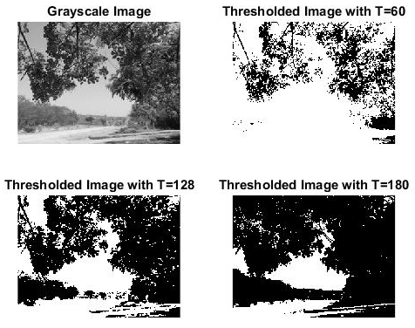
Single Thresholding

Slide 9
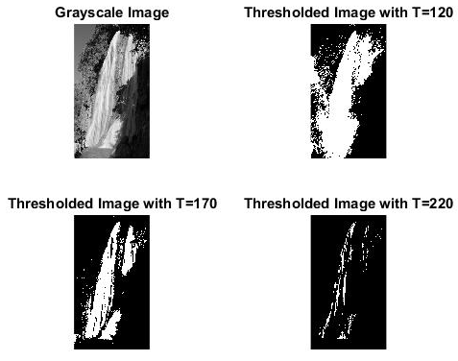
Single Thresholding

Slide 10
Double Thresholding
In double thresholding, two gray level threshold values, T₁ and T₂, are needed to choose.
Then, turn the every pixels white or black according to whether it’s gray value is between two threshold values or outside of them.

Slide 11
Double Thresholding
Double thresholding can be defined as
It means that if the gray value is between T₁ and T₂, then it turns into white.
Otherwise, it will turn into black.

Slide 12
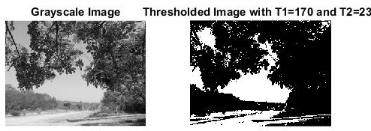
Double Thresholding

Slide 13
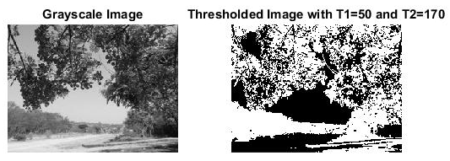
Double Thresholding

Slide 14
Choosing Threshold Values
Choosing thresholding values is very important for segmentation to get the optimum required image.
The most popular method is histogram based threshold selection.
For doing this, the histogram of the image is produced firstly.
From this histogram, the optimum threshold points are defined.

Slide 15
Limitation of Thresholding
Major limitation of thresholding is that it cannot be suited for color images.
Getting the optimum threshold point will be difficult for automatic processing.
If an image is noisy, thresholding will also lead to noisy output.

Slide 16
MATLAB Codes for Thresholding

Slide 17
Single Thresholding
img1 = imread('D:\UUOOI\figures\street with rose.jpg');
img=rgb2gray(img1);
figure, subplot(221),imshow(img),title('Grayscale Image');
subplot(222),imshow(img>60),title('Thresholded Image with T=60');
subplot(223),imshow(img>128), title('Thresholded Image with T=128');
subplot(224),imshow(img>180), title('Thresholded Image with T=180');

Slide 18
Double Thresholding
img1 = imread('D:\UUOOI\figures\street with rose.jpg');
img=rgb2gray(img1);
figure, subplot(121),imshow(img),title('Grayscale Image');
subplot(122),imshow(img>170 & img<230),
title('Thresholded Image with T1=170 and T2=230');

Slide 19
Introduction to Next Lecture
Image Segmentation 2

