Slide 1
Introduction to Digital Image Processing using MATLAB
Lecture 11
Image Segmentation 2
By
Dr. Khin Thu Zar Win
Associate Professor
Department of Mechatronic Engineering
Yangon Technological University (YTU), Myanmar.

Slide 2
Outline of Lecture
Edge Detection
Edge Detection Filters
Notes:
Slide 2 shows the outline of this lecture.

Slide 3
Detection of Discontinuities
There are three basic types of gray-level discontinuities in digital image: Point, Line and Edge.
In segmentation, we have to detect those three discontinuities.
Three basic detections are Point Detection, Line Detection and Edge Detection.

Slide 4
Edge Detection
Edge contains some of the most useful information in an image.
The points where sharp changes of intensities may cause the border lines between different objects.
Those boundaries are called edges in digital image processing.
Edge Detection is the process of finding those transition in an image.

Slide 5
Edge Detection Filters
Popular edge detecting filters are
  Roberts
  Laplacian
  Sobel
  Prewitt

Slide 6
Edge Detection Filters
Roberts
1 | 0
0 | -1
0 | 1
-1 | 0

Slide 7
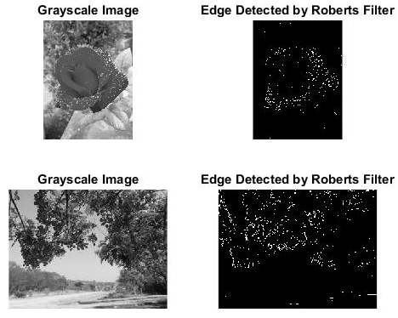
Edge Detection Filters
Roberts

Slide 8
Edge Detection Filters
Laplacian or Laplacian of Gaussian (Log)
0 | -1 | 0
-1 | 4 | -1
0 | -1 | 0
-1 | -1 | -1
-1 | 8 | -1
-1 | -1 | -1

Slide 9
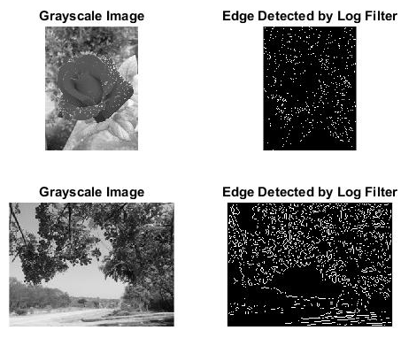
Edge Detection Filters
Laplacian or Laplacian of Gaussian (Log)

Slide 10
Edge Detection Filters
Sobel
-1 | 0 | 1
-2 | 0 | 2
-1 | 0 | 1
-1 | -2 | -1
0 | 0 | 0
1 | 2 | 1

Slide 11

Edge Detection Filters
Sobel

Slide 12
Edge Detection Filters
Prewitt
1 | 0 | -1
1 | 0 | -1
1 | 0 | -1
1 | 1 | 1
0 | 0 | 0
-1 | -1 | -1

Slide 13
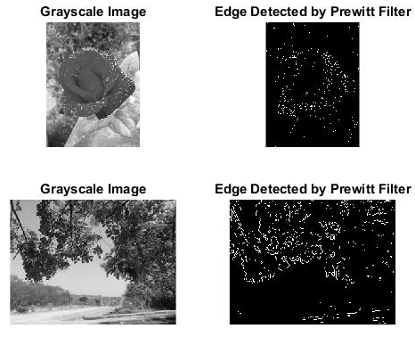
Edge Detection Filters
Prewitt

Slide 14
MATLAB Codes for Spatial Filtering

Slide 15
Edge Detection (Roberts)
img1 = imread('D:\UUOOI\figures\rose1.jpg');
img2=rgb2gray(img1);
img3=edge(img,'roberts');
img4 = imread('D:\UUOOI\figures\street with rose.jpg');
img5=rgb2gray(img4);
img6=edge(img5,'roberts');
figure, subplot(221),imshow(img2),title('Grayscale Image');
subplot(222),imshow(img3),title('Edge Detected by Roberts Filter');
subplot(223),imshow(img5), title('Grayscale Image');
subplot(224),imshow(img6), title('Edge Detected by Roberts Filter');

Slide 16
Edge Detection (Laplacian of Gaussian (Log))
img1 = imread('D:\UUOOI\figures\rose1.jpg');
img2=rgb2gray(img1);
img3=edge(img,'log');
img4 = imread('D:\UUOOI\figures\street with rose.jpg');
img5=rgb2gray(img4);
img6=edge(img5,'log');
figure, subplot(221),imshow(img2),title('Grayscale Image');
subplot(222),imshow(img3),title('Edge Detected by Log Filter');
subplot(223),imshow(img5), title('Grayscale Image');
subplot(224),imshow(img6), title('Edge Detected by Log Filter');

Slide 17
Edge Detection (Sobel)
img1 = imread('D:\UUOOI\figures\rose1.jpg');
img2=rgb2gray(img1);
img3=edge(img2,'sobel');
img4 = imread('D:\UUOOI\figures\street with rose.jpg');
img5=rgb2gray(img4);
img6=edge(img5,'sobel');
figure, subplot(221),imshow(img2),title('Grayscale Image');
subplot(222),imshow(img3),title('Edge Detected by Sobel Filter');
subplot(223),imshow(img5), title('Grayscale Image');
subplot(224),imshow(img6), title('Edge Detected by Sobel Filter');

Slide 18
Edge Detection (Prewitt)
img1 = imread('D:\UUOOI\figures\rose1.jpg');
img2=rgb2gray(img1);
img3=edge(img2,'prewitt');
img4 = imread('D:\UUOOI\figures\street with rose.jpg');
img5=rgb2gray(img4);
img6=edge(img5,'prewitt');
figure, subplot(221),imshow(img2),title('Grayscale Image');
subplot(222),imshow(img3),title('Edge Detected by Prewitt Filter');
subplot(223),imshow(img5), title('Grayscale Image');
subplot(224),imshow(img6), title('Edge Detected by Prewitt Filter');

Slide 19
Introduction to Next Lecture
Image Compression

