Slide 1
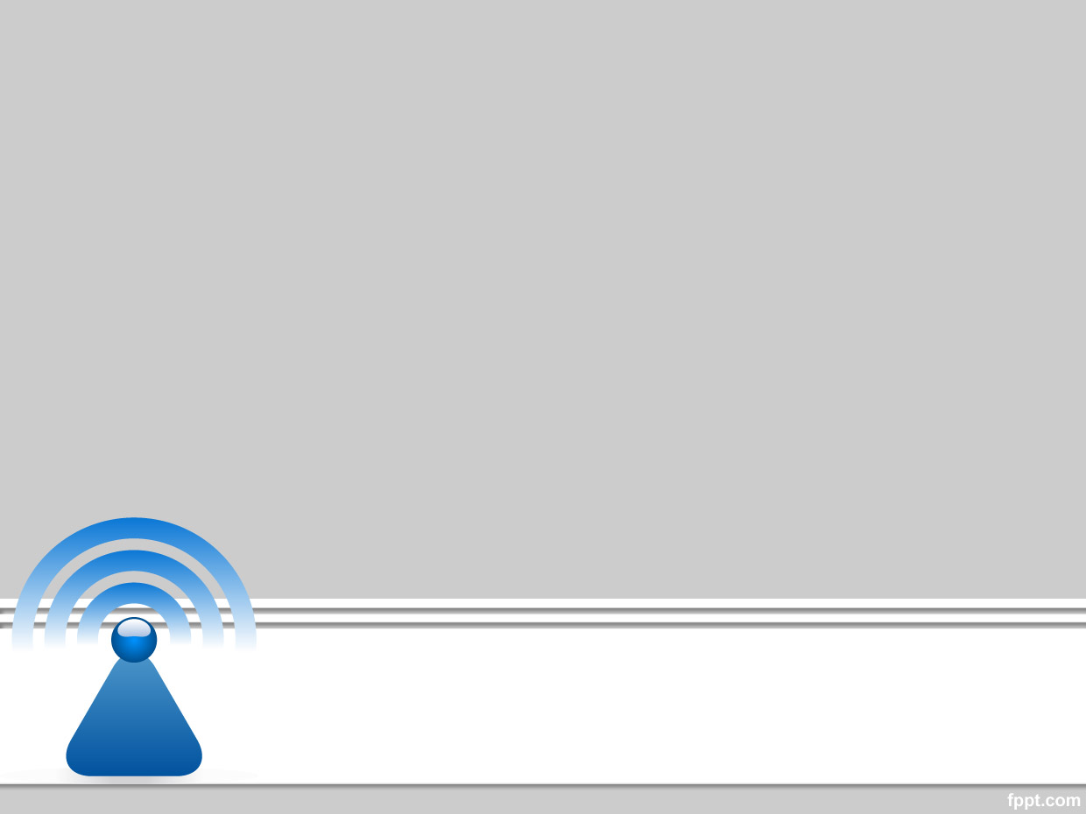
Wireless and Mobile Communication
Dr. Nyein Aye Maung Maung
Dr.Eng (Ritsumeikan University)
Computer Engineering and Information Technology Dept
Yangon Technological University

Slide 2
Course Information
Course Title
  Wireless and Mobile Communication
Description
  This course deals with the concepts of wireless and mobile communication systems, radio propagation characteristics and state-of-the-art technologies that are making wireless and mobile communication enable.

Slide 3
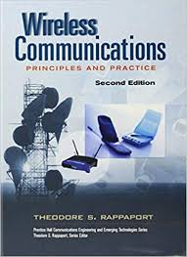

Textbook and References
Rappaport, Theodore S. Wireless communications: principles and practice. Vol. 2. New Jersey: prentice hall PTR, 1996.
Agrawal, Dharma P., and Qing-An Zeng. Introduction to wireless and mobile systems. Cengage learning, 2015.

Slide 4
Course Objectives
To help students understand system design fundamentals and factors for improving coverage and capacity of cellular systems
To promote students’ ability to analyze propagation characteristics of wireless channels and have technical know-hows to design and evaluate performance of different indoor and outdoor radio propagation models
To have a good knowledge of technical concepts such as modulation types, channel coding, equalization, antenna diversity and multiple access techniques
To understand differences between different network standards including cellular networks (GSM, 3G, 4G), WiFi, PANs, etc
To have strong technical skill on system design considerations for a given channel environment and different cellular network standards

Slide 5
Schedule of the Course
Week |  | Topic
Part I | 1 | Introduction to Wireless Communication Systems and Modern Wireless Communication Systems
 | 2 | The Cellular Concept – System Design Fundamentals
 | 3 | The Cellular Concept— Trunking and Grade of Service, Improving Coverage and Capacity
 | 4 | Mobile Radio Propagation: Large-Scale Path Loss
 | 5 | Mobile Radio Propagation: Practical Link Budget Design using Path Loss Models
 | 6 | Mobile Radio Propagation – Small-scale Fading and Multipath
Part II | 7 | Modulation Techniques: Analog Modulation Techniques
 | 8 | Modulation Techniques: Digital Modulation Techniques
 | 9 | Multiple Access Techniques
 | 10 | Channel Equalization and Antenna Diversity
 | 11 | Channel Coding
 | 12 | Wireless Networking, Systems and Standards

Slide 6
Exam and Grading System
Task | Mark
Final Exam | 80%
Practical Assignments | 10%
Tutorial | 10%
Mark | Grade
85~100 | A+
80~85 | A
70~80 | B
50~70 | C
<50 | F

Slide 7
Lecture 6
Mobile Radio Propagation
Small Scale Fading

Slide 8
Overview of Previous Lecture
Practical Link Budget Design using Path Loss Models
  Log-distance Path Loss Model
  Log-normal Shadowing Model
Outdoor Propagation Models
  Okumura Model
  Hata Model
Indoor Propagation Models

Slide 9
Outline of Class (Lecture 6)
Factors Influencing Small-Scale Fading
Doppler Effect and Doppler Shift
Impulse Response Model of a Multipath Channel
Parameters of Mobile Multipath Channels
Types of Small-Scale Fading

Slide 10
Small Scale Multipath Propagation

Slide 11
Small Scale Multipath Propagation
Three most important Fading/Multipath effects
  Rapid changes in signal strength over small travel distances or short time intervals
  Random frequency modulation due to varying Doppler shifts on different multipath signals
  Time dispersion (echoes) due to multipath propagation delays

Slide 12
Mobility in context of Fading
When the receiver is mobile
  Other objects may be mobile or stationary
  If other objects are stationary
    Motion is only due to mobile receiver
    Fading is purely a spatial phenomenon (occurs only when the mobile receiver moves)
If the mobile receiver is stationary, signal may fade due to movement of surrounding objects

Slide 13
Factors Influencing Small-Scale Fading
Multipath Propagation
  Presence of reflecting objects and scatters
    Multiple versions of the signal to arrive at the receiver with different amplitudes and time delays
    The total signal at receiver to fade or distortion
Speed of Mobile
  Causes Doppler shift at each multipath component
  Causes random frequency modulation
  Doppler shift will be positive or negative depending on where the mobile is moving toward or away from the BS

Slide 14
Factors Influencing Small-Scale Fading
Speed of Surrounding Objects
  Causes time-varying Doppler shift on the multipath components
  If surrounding objects move at a greater rate than the mobile, this effects dominate the small scale fading
    Much slower → can be ignored
  The term Coherence Time determines how static the channel is (depends on the doppler shift)
    A measure of how fast your channel is changing

Slide 15
Factors Influencing Small-Scale Fading
Transmission Bandwidth of the Signal
  Transmitted radio signal BW and BW of the multipath channel decide
    To what extent does the amplitude fluctuate
    To what extent does the signal distort
  Channel BW can be qualified by the term called Coherence Bandwidth
    A measure of the maximum frequency difference for which the signals are still strongly correlated in amplitude
Notes:
Cohrerence BW - That means suppose I sent a continuous wave at frequency f 1 and it undergoes fading. That is, the received signal strength is much lower than what I send simply because it is faded.
So I slowly increase my frequency from f 1 to f 1 + delta f. as I increase my frequency, I decrease my wavelength. Now at the receiver, what I receive and add up vectorially is different when I transmit my signal at different frequency. I keep on increasing my frequency and at a certain frequency „f 2‟, I start getting out of fade. That is, my signal is no longer faded for frequency f 2 where as it was faded for frequency f 1. That is, I have been able de-correlate the fading. So this difference f 1 - f 2 gives a rough measure of the coherence bandwidth. We will define it mathematically.

Slide 16
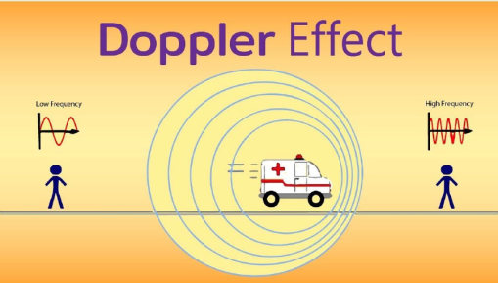
Doppler Effect
When a wave source (TX) and/or a RX is/are moving, the frequency of the received signal will not be the same as that of the transmitted signal
Moving towards each other → higher frequency than the transmitted frequency (Positive doppler shift)
Opposing each other → lower frequency than the transmitted frequency (Negative doppler shift)
f_{R} = f_{C} ± f_{D}
f_{C} = frequency of source carrier
f_{D} = Doppler shift in frequency

Slide 17
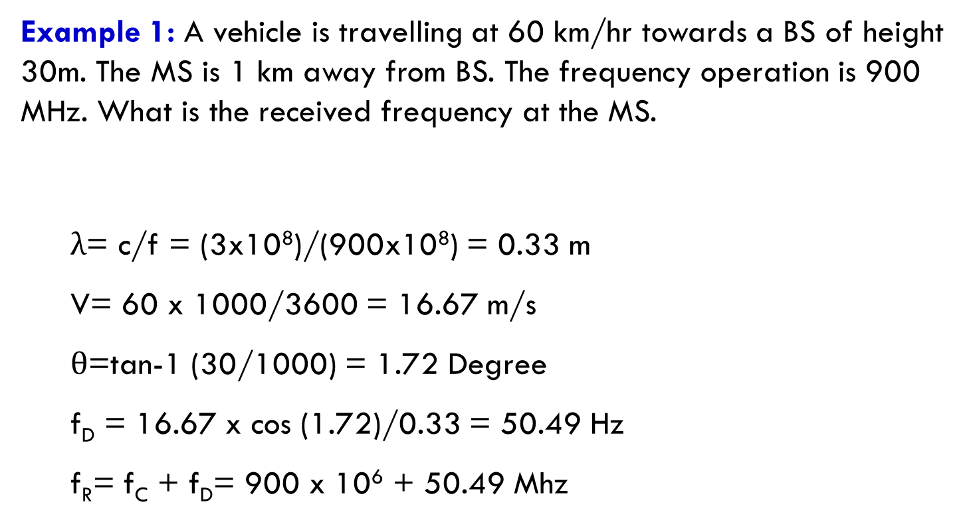
Example 1: A vehicle is travelling at 60 km/hr towards a BS of height 30m. The MS is 1 km away from BS. The frequency operation is 900 MHz. What is the received frequency at the MS.
  λ= c/f = (3x10⁸)/(900x10⁸) = 0.33 m
  V= 60 x 1000/3600 = 16.67 m/s
  $θ$=tan-1 (30/1000) = 1.72 Degree
  f_{D} = 16.67 x cos (1.72)/0.33 = 50.49 Hz
  f_{R}= f_{C} + f_{D}= 900 x 10⁶ + 50.49 Mhz

Slide 18
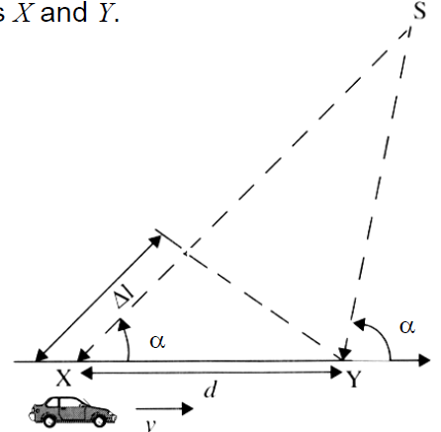

Doppler Shift
The shift in received signal frequency due to motion
Consider a mobile moving at a constant velocity v, along a path segment having length d between points X and Y
The mobile receives signals from a remote source S
The difference in path lengths traveled by the wave from source S to
the mobile at points X and Y is
where
  ∆t= time required for the mobile to travel from X to Y
  θ = angle of arrival of the wave
*Depends on relative velocity and carrier frequency

Slide 19
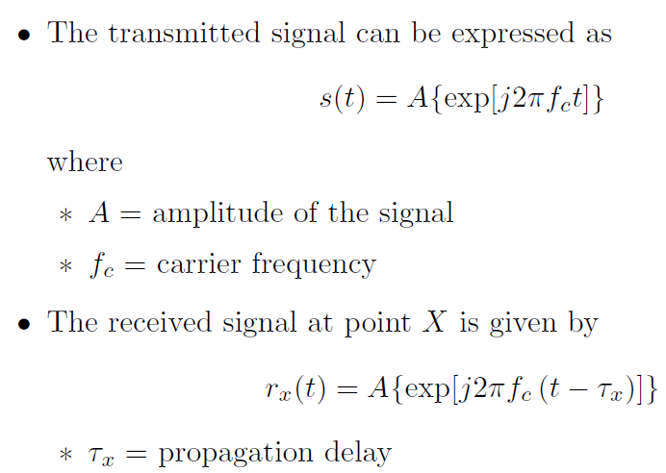

Derivation of Doppler Shift

Slide 20
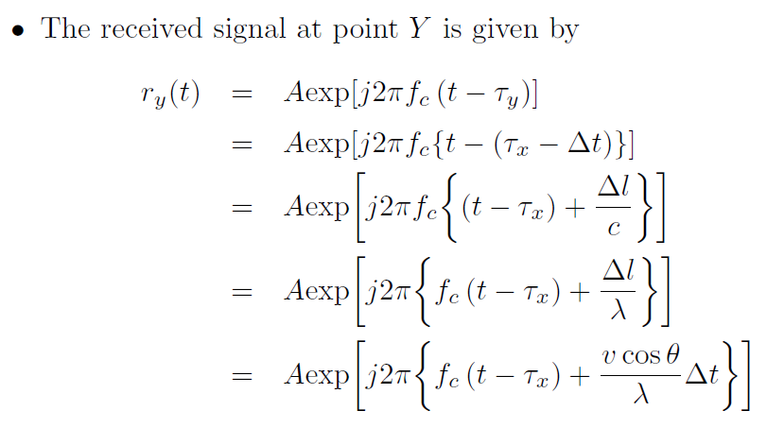


Slide 21
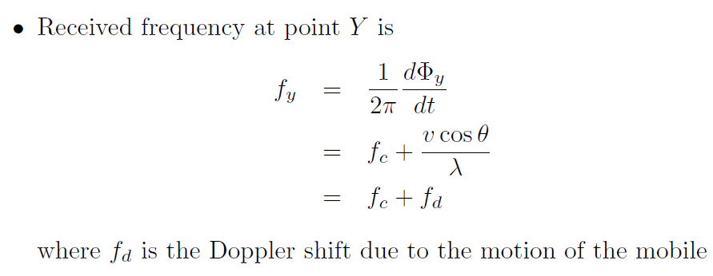
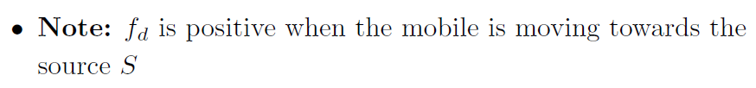

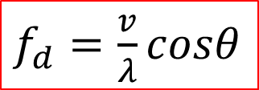
$f_{d}=\frac{v}{λ}cosθ$

Slide 22
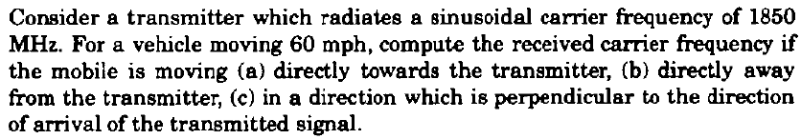
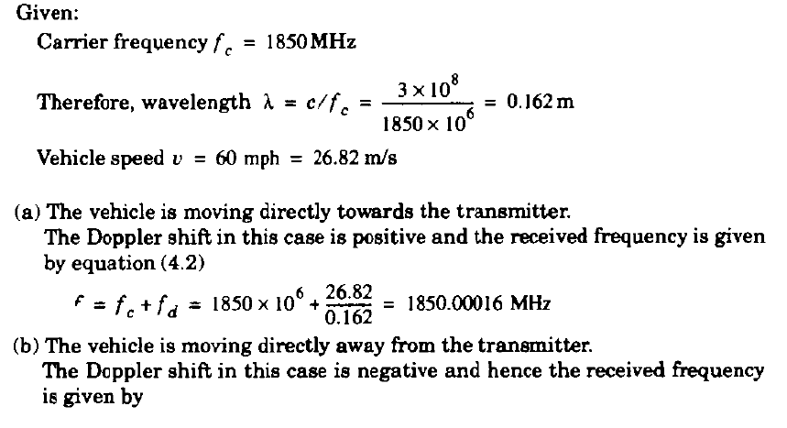
Example 2:

Slide 23
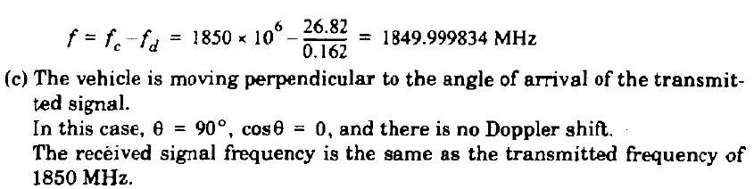

Slide 24
Delay Spread
Each multipath signal travels different path length, so the time of arrival for each path is different
A single transmitted pulse will be spread in time when it reaches the receiver
  This effect which spreads out the signal is called Delay Spread
  Leads to increase in the signal bandwidth
  Cause Inter Symbol Interference (ISI)

Slide 25
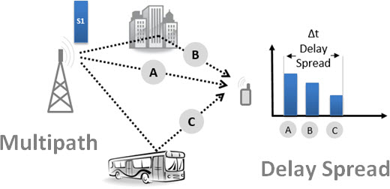
Delay Spread

Slide 26
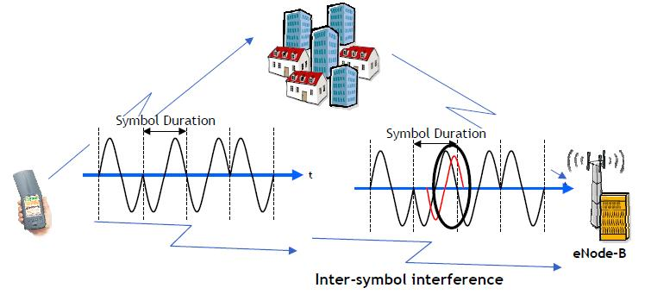
Inter Symbol Interference
If delay spread of the channel is comparable with the symbol length, we get ISI
Second multipath is delayed and is received during next symbol

Slide 27
Impulse Response Model of a Multipath Channel
Small-scale variations of a mobile radio signal can be directly related to the impulse response of mobile radio channel
  Mobile channel can be modeled as a linear filter with a time varying impulse response
    Time variation due to receiver motion in space
    Filtering is due to multipath
The impulse response is a wideband channel characterization
It contains all the information necessary to
  Simulate the channel
  Analyze the channel

Slide 28
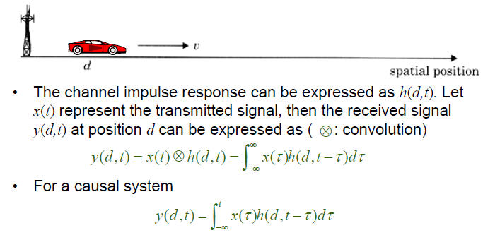
x (t) Wireless Multipath Channel y(t)
h (d,t)

Slide 29
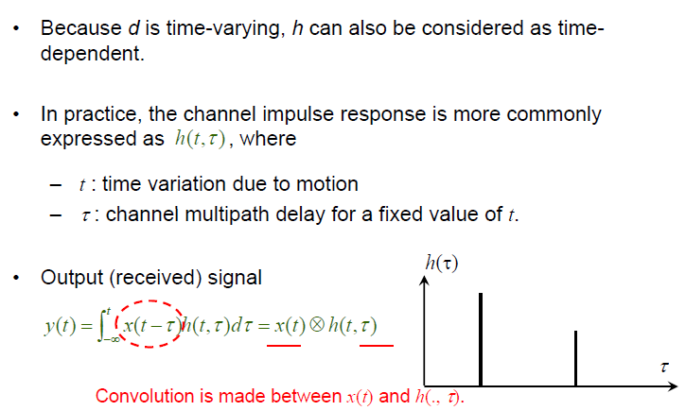

Slide 30
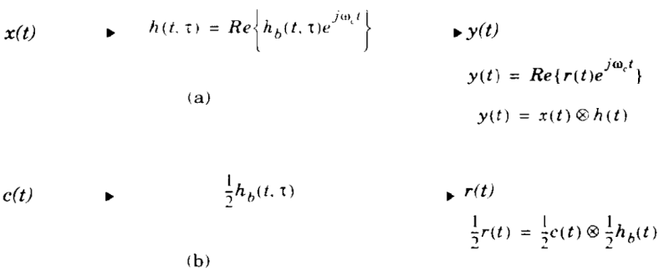


Impulse Response Models for Bandpass and Baseband Equivalent Channels
Bandpass channel
Baseband Equivalent Channel

Slide 31
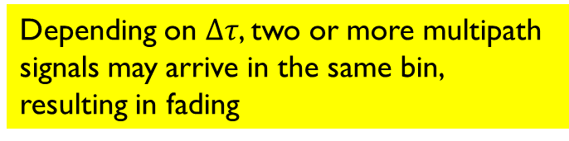





Discrete-time Impulse Response Model
Discretize the multipath delay axis into equal time delay segments called Excess Delay Bins
Depending on $Δτ$, two or more multipath signals may arrive in the same bin, resulting in fading
Excess delay ($τ$)
$${Δτ}_{}$$
$$τ_{1}$$
$$τ_{2}$$
$$τ_{N−1}$$

Slide 32

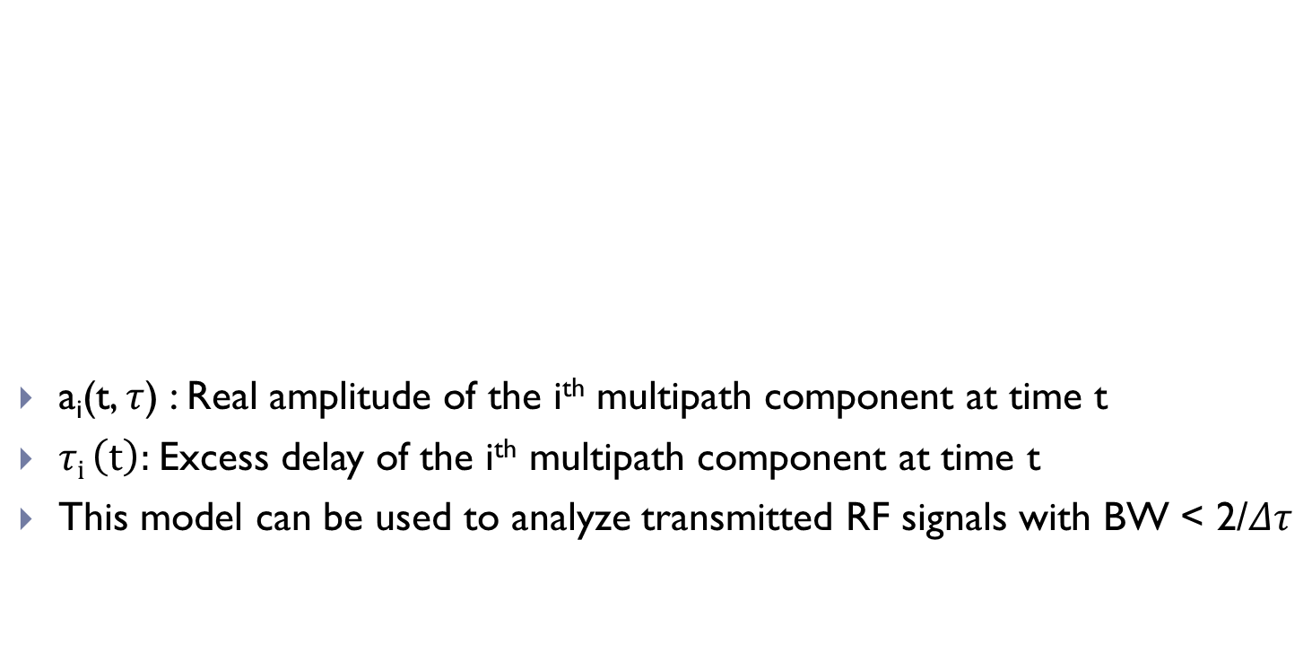
Discrete-time Impulse Response Model
a_{i}(t, $τ$) : Real amplitude of the i^{th} multipath component at time t
$τi \left(t\right):$Excess delay of the i^{th} multipath component at time t
This model can be used to analyze transmitted RF signals with BW < 2/$Δτ$
Phase term
Unit impulse function

Slide 33
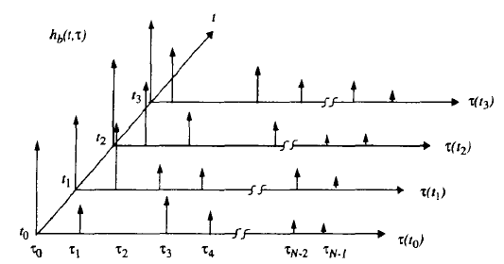
Discrete-time Impulse Response Model
An example of time varying discrete-time impulse response model

Slide 34
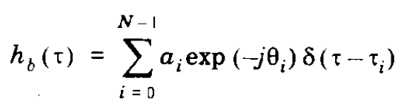
Discrete-time Impulse Response Model
If the channel impulse response is assumed to be time-invariant over small scale time or distance interval, then it may be simplified as

Slide 35
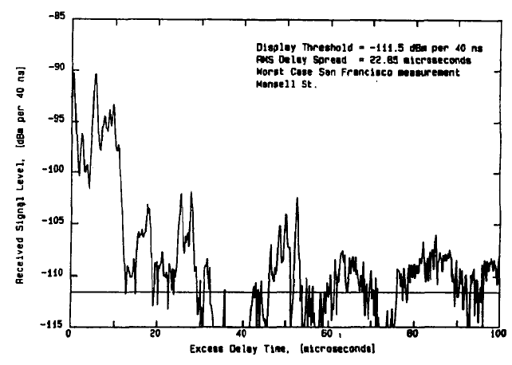
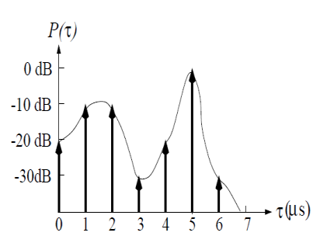
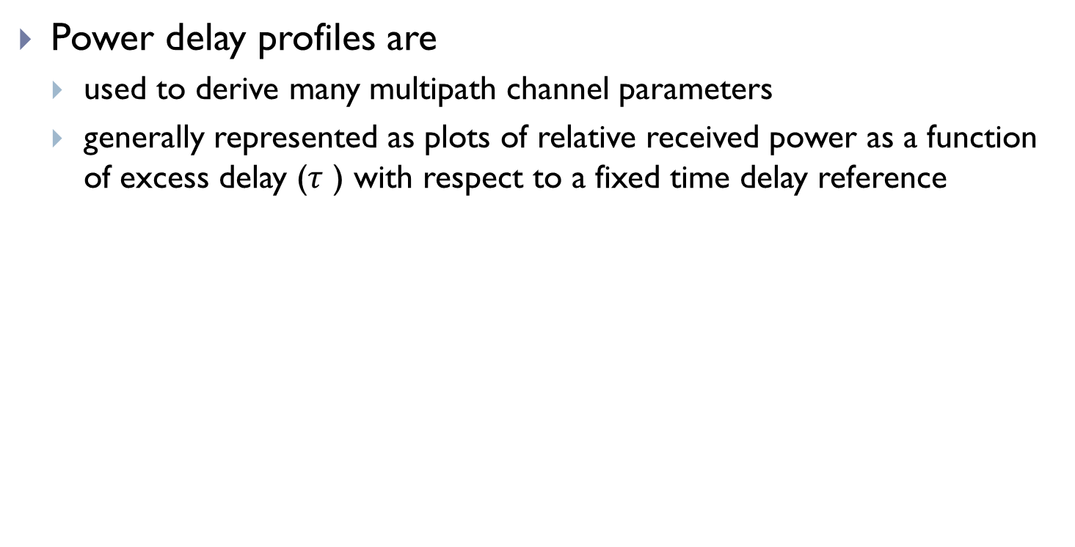
Power Delay Profile
Power delay profiles are
  used to derive many multipath channel parameters
  generally represented as plots of relative received power as a function of excess delay ($τ$ ) with respect to a fixed time delay reference

Slide 36
Parameters of Mobile Multipath Channels
Time Dispersion Parameters
Coherence Bandwidth
Doppler Spread and Coherence Time

Slide 37
1. Time Dispersion Parameters
Time dispersion parameters
  – Mean excess delay
  – RMS delay spread
  – Maximum Excess Delay (X dB)
Depends only on the relative amplitude of the multipath components.

Slide 38
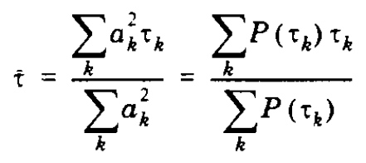
Mean Excess Delay
The first moment of the power delay profile

Slide 39
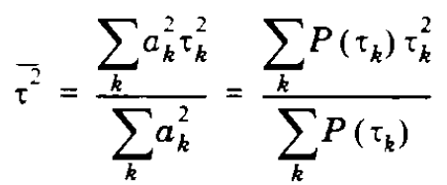

Root mean-square (RMS) delay spread
Characterizes time-dispersiveness of the channel
  Obtain from power delay profile
  Indicate delay during which the power of the received signal is above a certain value
Typical RMS delay spreads
– Outdoor: on the order of microseconds
– Indoor: on the order of nanoseconds

Slide 40
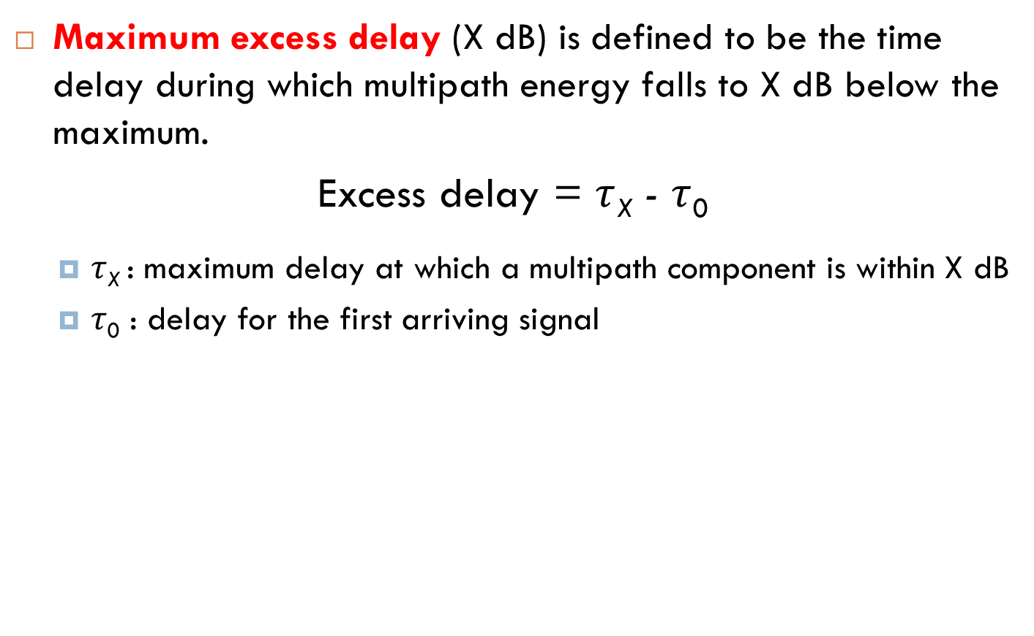
Maximum Excess Delay (X dB)
Maximum excess delay (X dB) is defined to be the time delay during which multipath energy falls to X dB below the maximum.
Excess delay = $τ$_{X} - $τ$₀
  $τ$_{X} : maximum delay at which a multipath component is within X dB
  $τ$₀ : delay for the first arriving signal
Notes:
I am talking about the strongest signal received; I take a line which is 10 dB if my X is 10 below my maximum received power. In generally it is X dB below the maximum and then find out how many reflections are there within that region. How many strong reflections are obtained till the multipath energy falls to X dB below the maximum received power? So the maximum excess delay is nothing but tau (X) - tau 0. Tau 0 represents the first marker for the received signal. Tau 0 is the first arriving signal. Tau x is the maximum delay at which a multipath component is within X dB of the strongest arriving multipath signal. Please note that the strongest arriving multipath signal necessarily doesn‟t mean it is the first one you get. You can have a much stronger reflector and no line of sight in which case may be the second or the third reflected signal is the maximum. I compare it with the maximum value. Not the first arriving value. So this maximum excess delay defines the temporal extent of the multipath that is above a particular threshold.

Slide 41
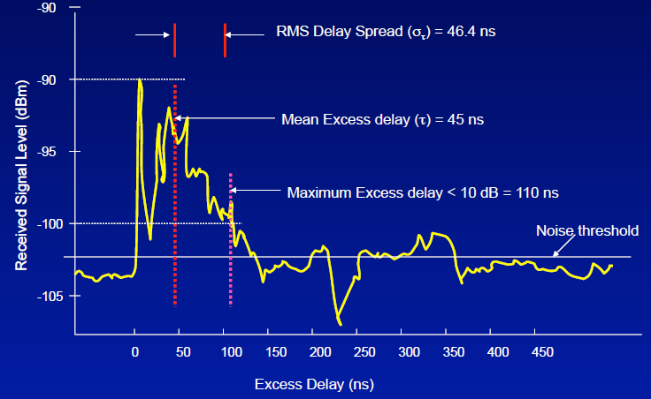
Illustration of Time Dispersion Parameters on PDF

Slide 42
Coherence Bandwidth
A statistical measure of the range of frequencies over which the channel can be considered ‘Flat’
  i.e. the channel passes all spectral components with equal gain and liner phase
Represent correlation between 2 fading signal envelopes at frequencies f1 and f2
Is a function of RMS Delay Spread

Slide 43


If we define Coherence bandwidth (B_{C}) as the range of frequencies over which the frequency correlation function is above 0.9, then
If we define Coherence bandwidth (B_{C}) as the range of frequencies over which the frequency correlation function is above 0.5, then

Slide 44
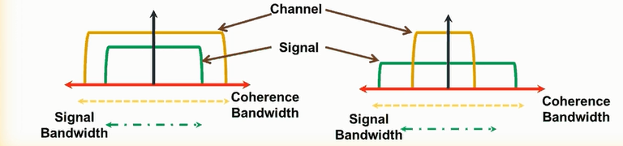
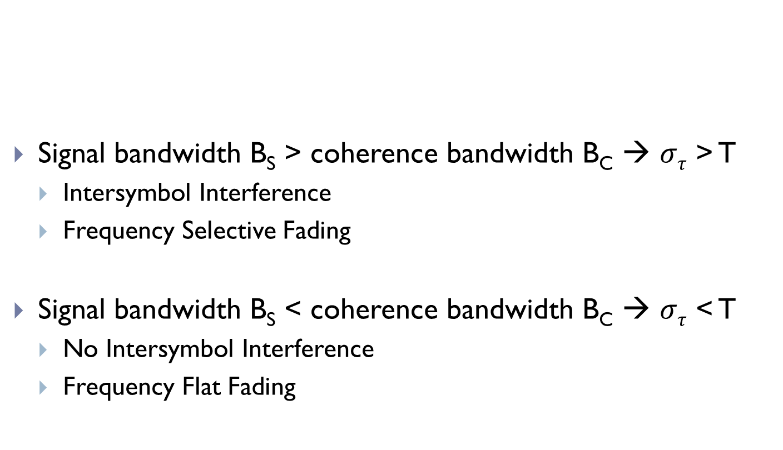
Signal bandwidth B_{S} > coherence bandwidth B_{C} → $στ$ > T
  Intersymbol Interference
  Frequency Selective Fading
Signal bandwidth B_{S} < coherence bandwidth B_{C} → $στ$ < T
  No Intersymbol Interference
  Frequency Flat Fading

Slide 45
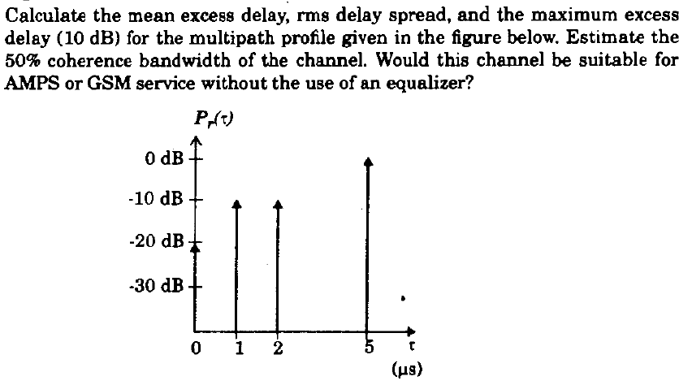
Example:
Given AMPS and GSM has signal bandwidth 30kHz and 200kHz respectively.

Slide 46
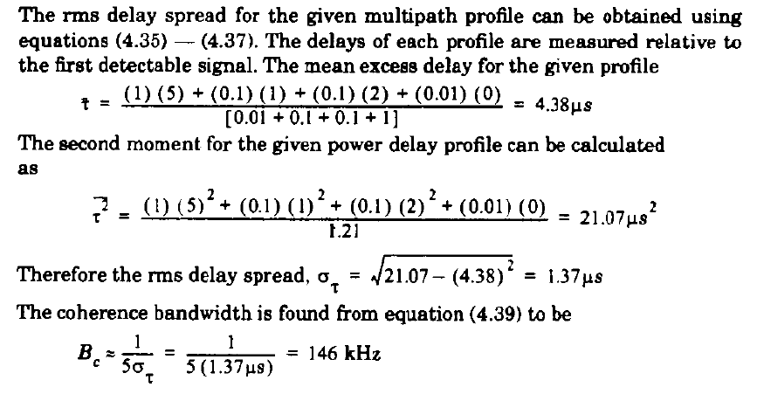

Maximum Excess Delay = 5 – 1 = 4 μs

Slide 47
Doppler Spread and Coherence Time
Delay spread and Coherence Bandwidth
  Describe only the time dispersive nature
Doppler Spread and Coherence Time
  Describe Time varying nature of the channel in a small scale region
  Caused by relative motion of transmitter and receiver

Slide 48
Doppler Spread (B_{D})
Maximum doppler shift
Describe frequency-dispersiveness of the channel or spreading of transmitted frequency due to different doppler shifts
If the baseband signal bandwidth is much greater than B_{D} , doppler spread are negligible at the receiver
  Called slow fading channel

Slide 49
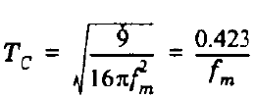
Coherence Time (T_{C})
A statistical measure of the time duration over which the channel impulse response is time-invariant
If the symbol period of the baseband signal (reciprocal of the baseband signal bandwidth is greater than the Coherence time of the channel, the channel will change during the transmission of the signal, hence there will be distortion at the receiver
f_{m} = maximum doppler shift given by v/λ
*Large coherence time → channel changes slowly

Slide 50
2) Types of Small-Scale Fading

Slide 51
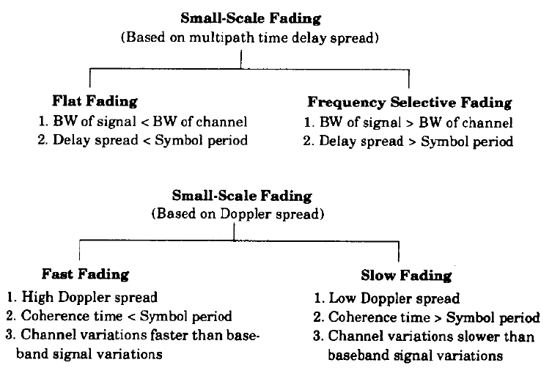

Slide 52
Fading Effects due to Multipath Time Delay Spread

Slide 53
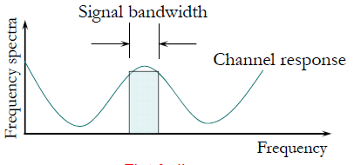


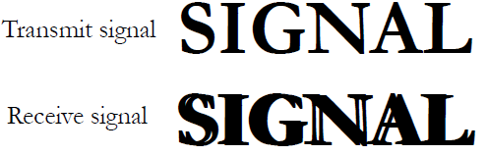
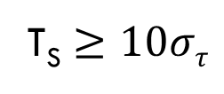
1. Flat Fading
  The wireless channel is said to be flat fading if it has constant gain and linear phase response over a bandwidth which is greater than the bandwidth of the transmitted signal
and
T_{S} $≥10στ$
When τ/T is small, i.e., τ is small and T is large, ISI is negligible

Slide 54
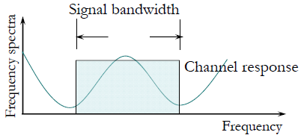

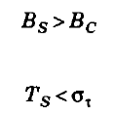
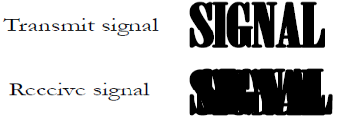

2. Frequency Selective Fading
  The wireless channel is said to be frequency selective fading if it has constant gain and linear phase response over a bandwidth which is smaller than the bandwidth of the transmitted signal
and
When τ/T is NOT small, i.e., τ is large or T is small, ISI becomes significant.

Slide 55
Fading Effects due to Doppler Spread

Slide 56


1. Fast Fading
  Depending on how rapidly the transmitted signal changes as copared to the rate of change of channel, a channel is classified as fast or slow fading
  Fast fading → channel impulse response changes rapidly within the symbol period
    i.e. Coherence time of channel is smaller than symbol period of the transmitted signal
    Causes frequency dispersion due to Doppler spreading, leading signal distortion
and

Slide 57

2. Slow Fading
  Channel impulse response changes at a rate much slower than the transmitted baseband signal
    Doppler Spread of the channel is much smaller than the signal bandwidth
    Symbol period of the transmitted signal is smaller than the coherence time

Slide 58
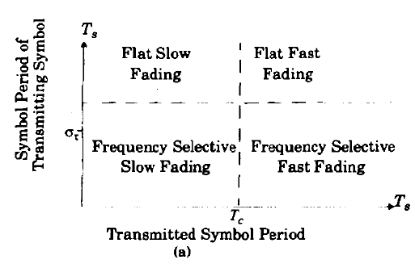
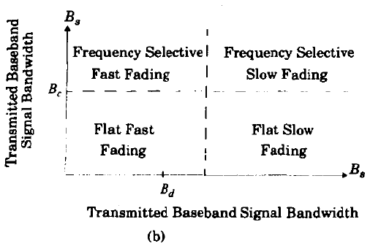
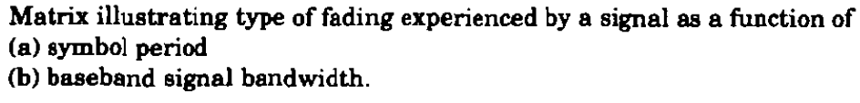

Slide 59
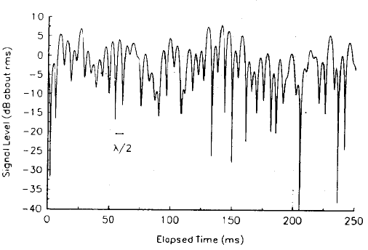
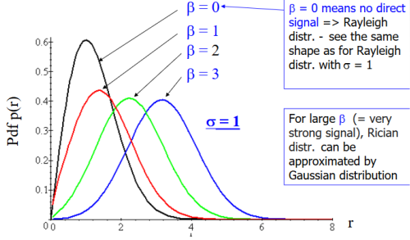
Rayleigh and Ricean Distribution
Rayleigh
Ricean
Use to describe statistical time varying nature of received envelope of a flat fading signal
No dominant stationary signal component exists
There is a dominant stationary signal component present
Ricean distribution degenerates to a Rayleigh distribution when the dominant component fades away

Slide 60
Assignments
1.Determine the maximum and minimum spectral frequencies received from a stationary GSM transmitter that has a center carrier frequency of 1950 MHz, assuming that the receiver is travelling at speeds of (a) 1 km/hr (b) 5 km/hr (c) 100 km/hr (d) 1000 km/hr.
2. If a baseband binary message with a bit rate of 100 kbps is modulated by an RF carrier using BPSK, answer the following.
Find the range of values of the rms delay spreadd of the channel such that the received signal is a flat-fading signal
If the modulation carrier frequency is 5.8 GHz, what is the coherence time of the channel, assuming a vehicle speed of 30 miles per hr.
For answer in (b), is the channel ‘fast’ or ‘slow’ fading?

Slide 61
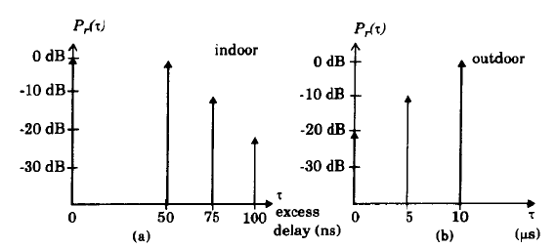
3. For the power delay profiles in Fig, estimate the 90% and 50% correlation coherence bandwidths.
4. Approximately how large can the rms delay spread be in order for a binary modulated signal with a bit rate of 25kbps to operate without an equalize? What about an 8PSK system with a bit rate of 75kbps?

Slide 62


Slide 63
Small scale fading describes the _____ fluctuations of the amplitude, phases of signal.
a) Rapid b) Slow c) Instantaneous d) Different
Fading is caused by interference.(True/False)
a) True b) False
Which of the following is not an effect caused by multipath in radio channel?
a) Rapid changes in signal strength b) Random frequency modulation
c) Power of base station d) Time dispersion
Fading does not occur when mobile receiver is stationary. State whether True or False.
a) True b) False
Doppler shift is directly proportional to __________
a) Velocity b) Height of antenna
c) Power of receiving antenna d) Power of transmitter
a a c b a

Slide 64
Signal will distort if transmitted signal bandwidth is greater than bandwidth of __________
a) Receiver b) Radio channel c) Multipath channel d) Transceiver
What is a measure of the maximum frequency difference for which signals are strongly correlated in amplitude?
a) Coherence bandwidth b) Narrow bandwidth
c) Incoherent bandwidth d) Wide bandwidth
The Doppler shift for mobile moving with constant velocity, v is given by _______
a) (v*cos θ)/λ b) v/λ c) v*cos θ d) v*λ
Doppler shift is positive if mobile is moving away from direction of arrival of the wave. State whether True or False.
a) True b) False
The time dispersive properties of wideband multipath channel are quantified by ______ and _______
a) Mean excess delay, rms delay spread b) Doppler spread, rms delay spread
c) Doppler spread, coherence time d) Mean excess delay, Doppler spread
c a a b a

Slide 65
______ and coherence bandwidth are inversely proportional to one another.
a) Rms delay spread b) Mean excess delay c) Excess delay spread d) Doppler spread
Coherence bandwidth is a statistical measure of range of frequencies over which channel is considered _______
a) Time dispersive b) Frequency selective c) Time variant d) Flat
_______ is a statistical measure of time duration over which channel impulse response is invariant.
a) Coherence time b) Doppler spread c) Mean excess delay d) Rms delay spread
a d a

Slide 66
______ leads to time dispersion and frequency selective fading.
a) Doppler spread b) Multipath delay spread
c) Time dispersive parameters d) Frequency delay spread
Spectral characteristics of the channel changes with time in flat fading. State whether True or False.
a) True b) False
Frequency selective fading does not induce intersymbol interference. State whether True or False.
a) True b) False
For fast fading channel, the coherence time of the channel is smaller than _______ of transmitted signal.
a) Doppler spread b) Bandwidth
c) Symbol period d) Coherence bandwidth
In slow fading channel, Doppler spread of the channel is much less than the ________ of baseband signal.
a) Symbol period b) Phase c) Coherence time d) Bandwidth
b b b c d

Slide 67
Next Lecture
Mobile Radio Propagation – Modulation Techniques for Mobile Radio

Slide 68
  Thank You …

