Slide 1

Wireless and Mobile Communication
Dr. Nyein Aye Maung Maung
Dr.Eng (Ritsumeikan University)
Computer Engineering and Information Technology Dept
Yangon Technological University

Slide 2
Course Information
Course Title
  Wireless and Mobile Communication
Description
  This course deals with the concepts of wireless and mobile communication systems, radio propagation characteristics and state-of-the-art technologies that are making wireless and mobile communication enable.

Slide 3
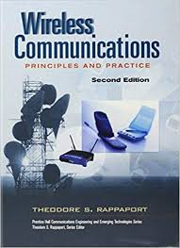
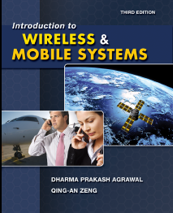
Textbook and References
Rappaport, Theodore S. Wireless communications: principles and practice. Vol. 2. New Jersey: prentice hall PTR, 1996.
Agrawal, Dharma P., and Qing-An Zeng. Introduction to wireless and mobile systems. Cengage learning, 2015.

Slide 4
Course Objectives
To help students understand system design fundamentals and factors for improving coverage and capacity of cellular systems
To promote students’ ability to analyze propagation characteristics of wireless channels and have technical know-hows to design and evaluate performance of different indoor and outdoor radio propagation models
To have a good knowledge of technical concepts such as modulation types, channel coding, equalization, antenna diversity and multiple access techniques
To understand differences between different network standards including cellular networks (GSM, 3G, 4G), WiFi, PANs, etc
To have strong technical skill on system design considerations for a given channel environment and different cellular network standards

Slide 5
Schedule of the Course
Week |  | Topic
Part I | 1 | Introduction to Wireless Communication Systems and Modern Wireless Communication Systems
 | 2 | The Cellular Concept – System Design Fundamentals
 | 3 | The Cellular Concept— Trunking and Grade of Service, Improving Coverage and Capacity
 | 4 | Mobile Radio Propagation: Large-Scale Path Loss
 | 5 | Mobile Radio Propagation: Practical Link Budget Design using Path Loss Models
 | 6 | Mobile Radio Propagation – Small-scale Fading and Multipath
Part II | 7 | Modulation Techniques: Analog Modulation Techniques
 | 8 | Modulation Techniques: Digital Modulation Techniques
 | 9 | Multiple Access Techniques
 | 10 | Channel Equalization and Antenna Diversity
 | 11 | Channel Coding
 | 12 | Wireless Networking, Systems and Standards

Slide 6
Exam and Grading System
Task | Mark
Final Exam | 80%
Practical Assignments | 10%
Tutorial | 10%
Mark | Grade
85~100 | A+
80~85 | A
70~80 | B
50~70 | C
<50 | F

Slide 7
Lecture 5
Mobile Radio Propagation
Large Scale Path-Loss (Part II)

Slide 8
Overview of Previous Lecture
Mobile Radio Propagation – Large Scale Path Loss
  Ideal Free-space Radio Propagation Model
  Three Basic Propagation Mechanisms and Related Propagation Models
    Reflection
      Two ray Ground Reflection Model
    Diffraction
      Fresnel Zone Geometry and Knife-Edge Diffraction Model
    Scattering

Slide 9
Outline of Class (Lecture 5)
Practical Link Budget Design using Path Loss Models
  Log-distance Path Loss Model
  Log-normal Shadowing Model
Outdoor Propagation Models
  Okumura Model
  Hata Model
Indoor Propagation Models

Slide 10
Practical Link Budget Design using Path Loss Models

Slide 11
Practical Link Budget
Most radio propagation models are derived using a combination of analytical and empirical models.
Empirical approach is based on fitting curves or analytical expressions that recreate a set of measured data.
Advantages:
  Takes into account all propagation factors, both known and unknown.
Disadvantages:
  New models need to be measured for different environment or frequency.

Slide 12
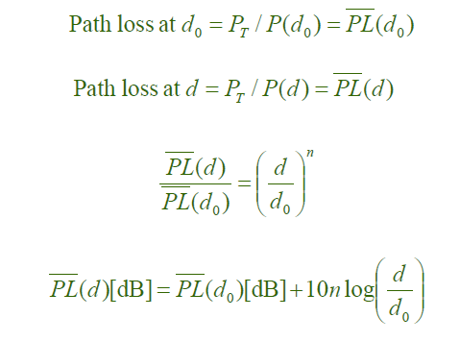
Log-distance Path Loss Model
This model if based on theory and measurements
Indicates that average received signal power decreases log normally with distance

Slide 13
Remarks
  Value of n depends on the specific propagation environment
    Eg. n=2 for free space, n=2.7 ~ 3.5 for urban areas
  Reference distance should always be far field so that near-field effects do not alter the reference path loss
  Reference distance depends on the coverage area of a particular cellular system
    In large coverage cellular systems → d₀ = 1 km
    In microcellular systems → d₀ = 100 m or 1 m
  Reference path loss is calculated using the free space path loss formula
  Limitation: same T-R separation distance gives different path loss under different surrounding environment
Notes:
Df=2d^2/lamda

Slide 14
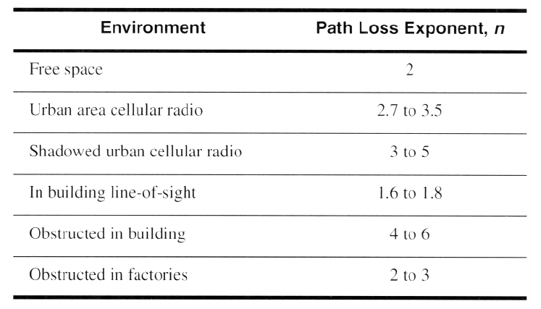
Cont’
Path Loss Exponents for Different Environments

Slide 15



Log-Normal Shadowing Model
Log-distance path loss gives only the average value of path loss.
Surrounding environment may be vastly different at two locations having the same T–R separation d.
More accurate model includes a random variable to account for change in environment.
- Zero mean Gaussian random variable (dB) with Standard deviation σ (dB)

Slide 16
Cont.
Remarks
  The values of n and σ are computed from measured data using linear regression
    the difference between the measured and estimated path loss is minimized in a mean-square sense over a wide range of measurement locations and T-R separations
  P_{r}(d) is also a random variable with a normal distribution in dB about the distance dependent mean

Slide 17
Cont.
Scatter plot of measured data and corresponding MMSE Path Loss Models

Slide 18


Probability of RSS Level Above/Below a Threshold
The probability that the received signal level (in dB power unit) will exceed a certain value γ can be calculated from the cumulative density function as
The probability that the received signal level will be below γ can be calculated from

Slide 19
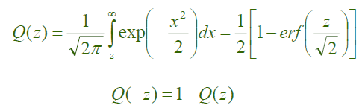
Cont’
Q Function – Q (z)
  Q function or error function (erf) can be used to determine the probability that the received signal will exceed (or fall below) a particular level.
*Matlab has erf function.

Slide 20
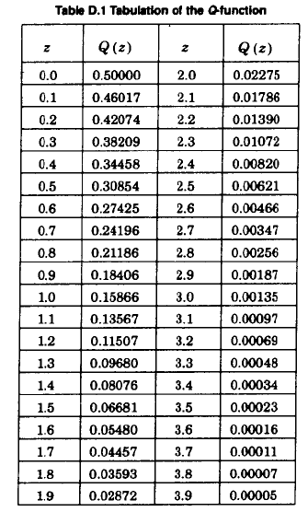
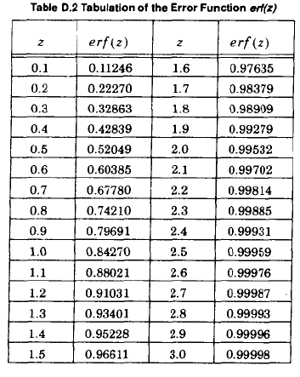

Slide 21
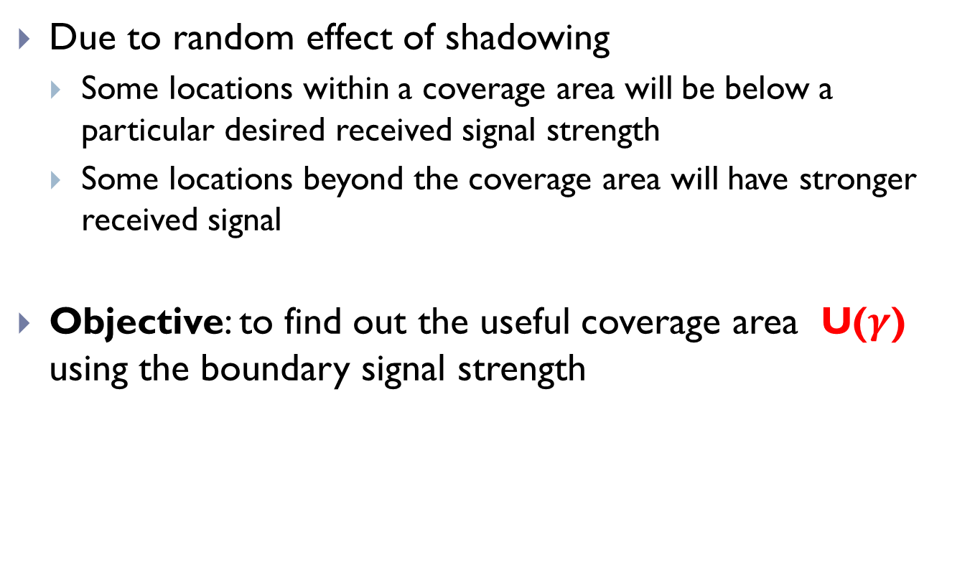
Percentage of Coverage Area
Due to random effect of shadowing
  Some locations within a coverage area will be below a particular desired received signal strength
  Some locations beyond the coverage area will have stronger received signal
Objective: to find out the useful coverage area U($γ$) using the boundary signal strength

Slide 22
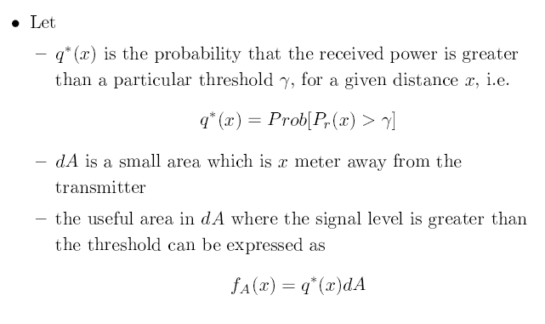

Slide 23
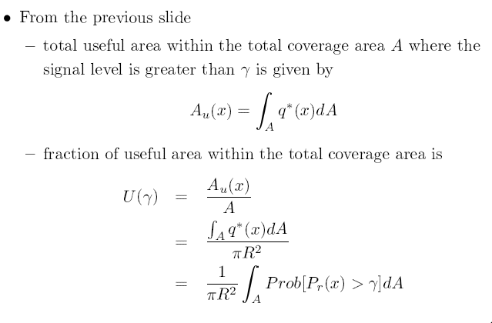

Slide 24
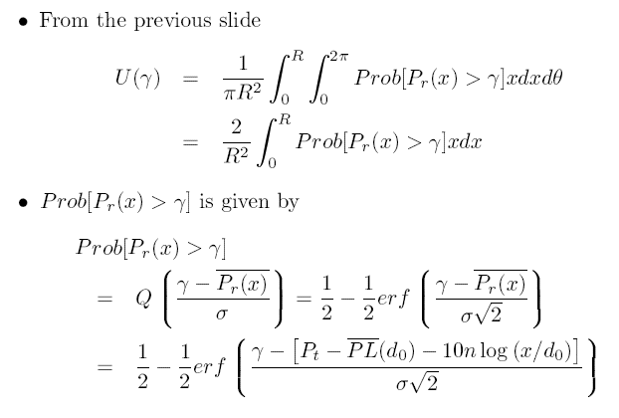

Slide 25
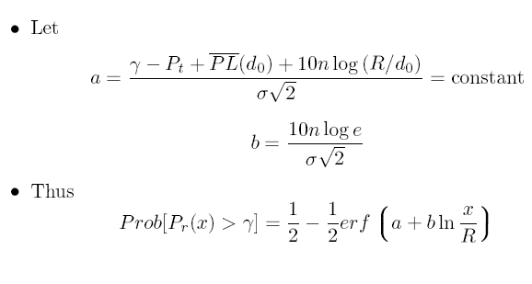

Slide 26
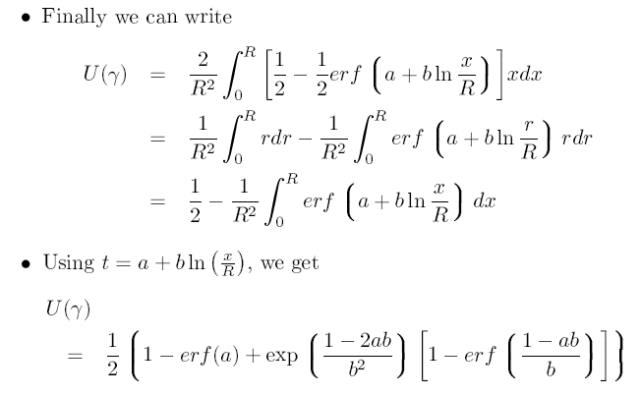

Slide 27
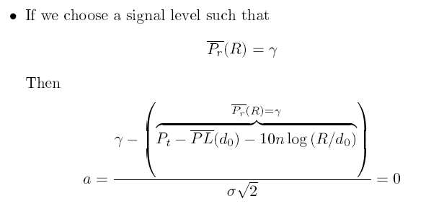


Slide 28
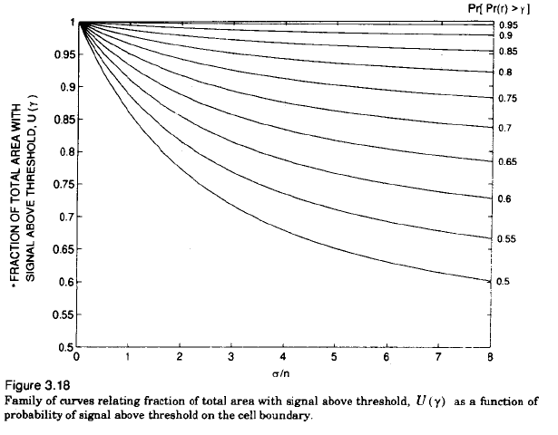

Slide 29
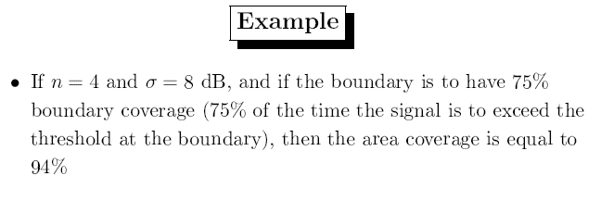
Cont’

Slide 30
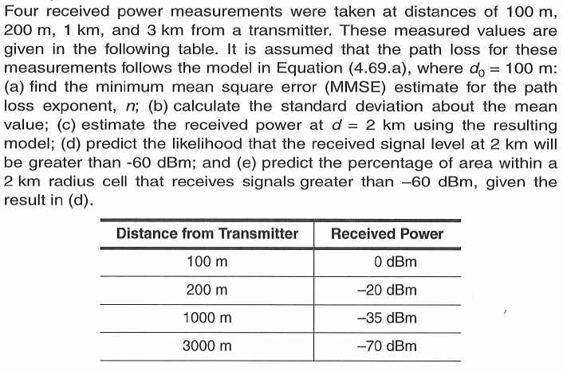
Example:
4.69 (a)

Slide 31
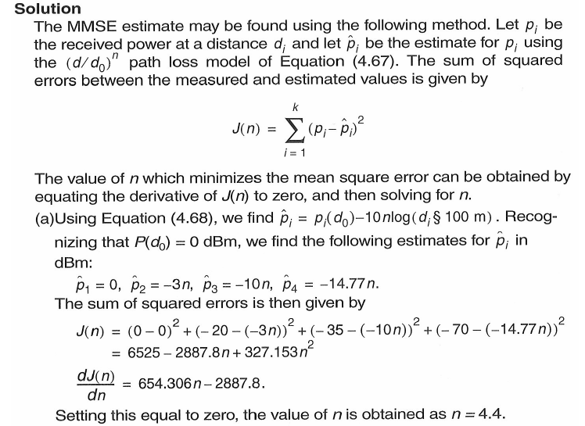

Slide 32
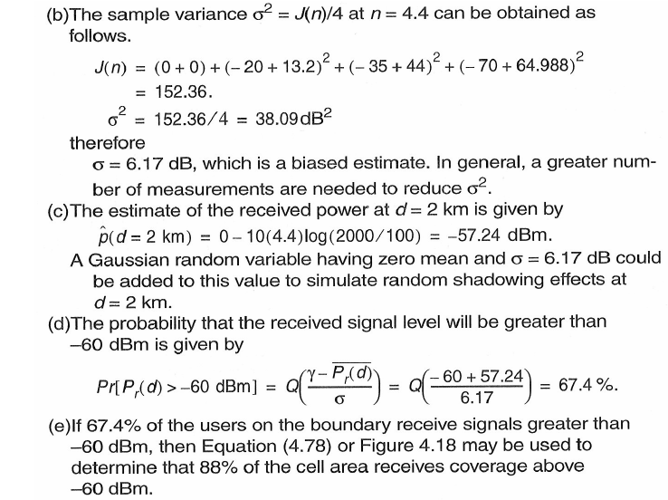

Slide 33
(2) Outdoor Propagation Models

Slide 34
Outdoor Propagation Models
Okumura Model
  This model gives a median attenuation relative to free space
  To determine path loss using Okumura’s model
    Determine the free space path loss between the points of interest
    Add the value of A_{mu}(f,d) along with the correction factors
  Applicable for
    150 MHz~1920MHz frequency range
    1 to 100 km T-R separation distance
    30 ~ 1000m Antenna Heights

Slide 35
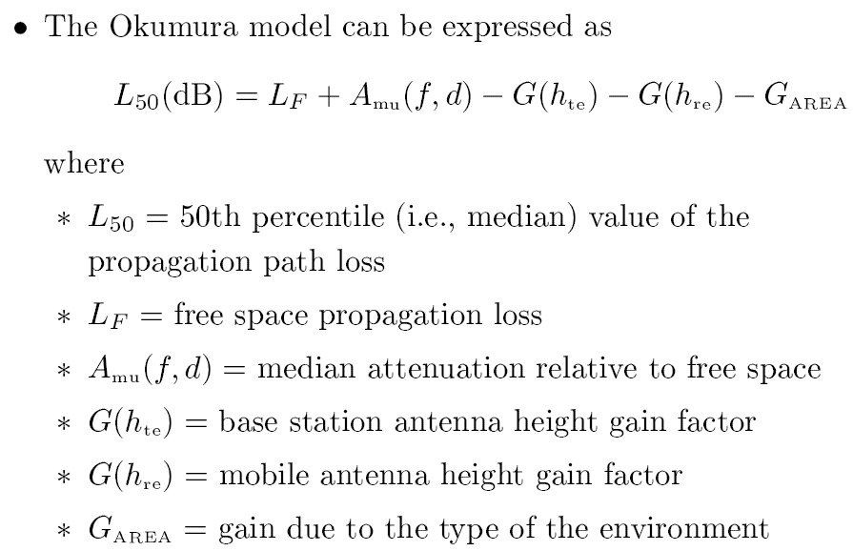
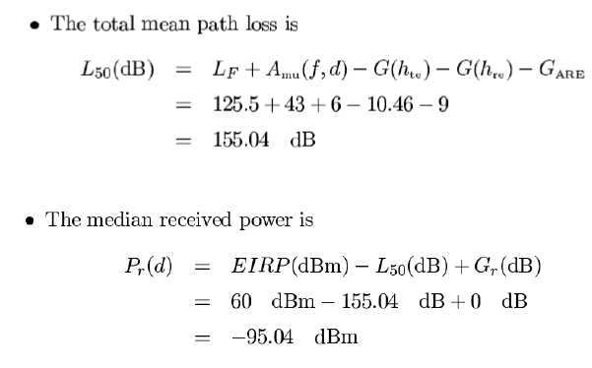

Slide 36
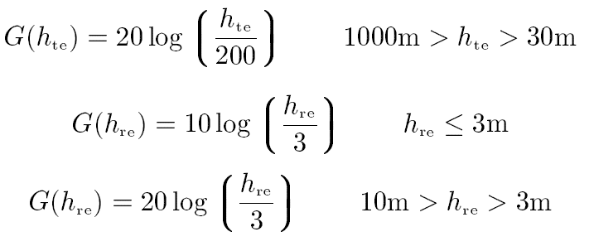
Cont’
Advantages
  Simplest and the best in terms of accuracy
  Very practical and fairly good in urban and suburban areas
Disadvantages
  It responds slowly to rapid changes in terrain → Not good in rural areas

Slide 37
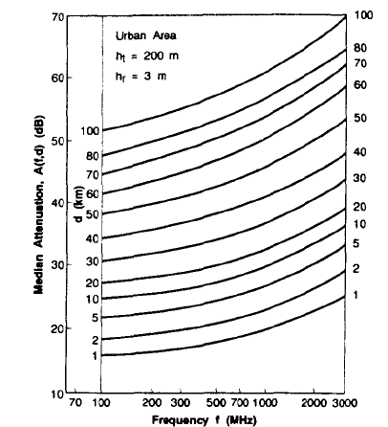
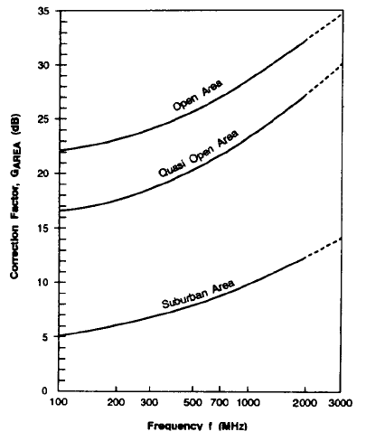
A_{mu} over quasi-smooth terrain Correction factor G_{AREA} for different terrain

Slide 38

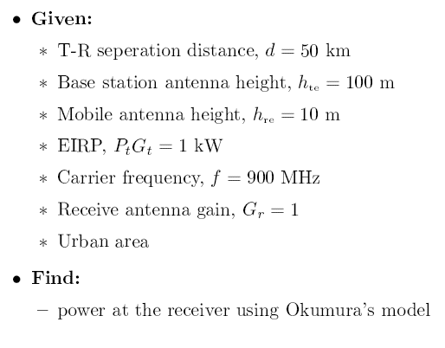
Example:

Slide 39
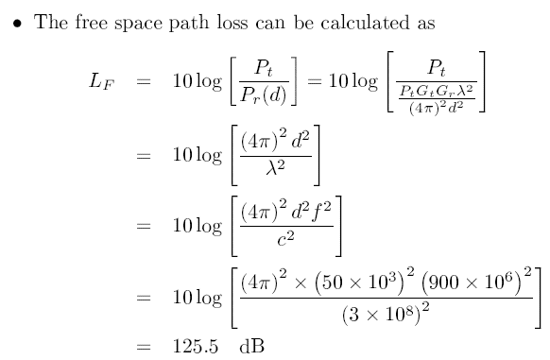
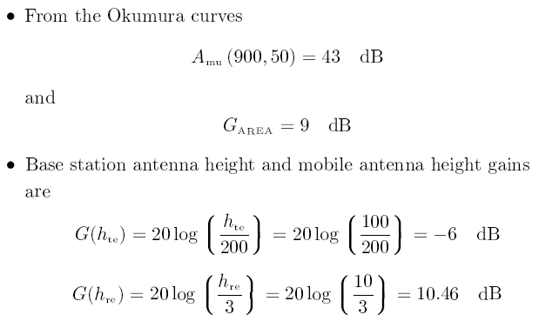

Slide 41
2. Hata Model
Hata model is an empirical formulation of the graphical path loss data provided by Okumura
It is valid from 150 MHz to 1500 MHz
It presents the urban area propagation loss as a standard formula and supplied correction equations for application to other simulations

Slide 42
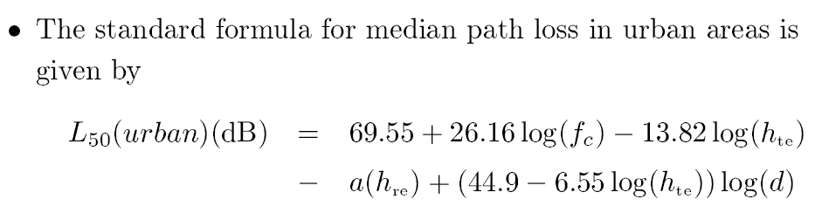
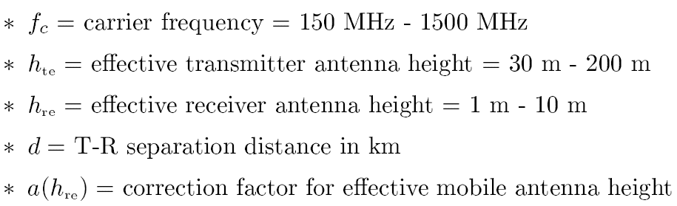
Cont’

Slide 43
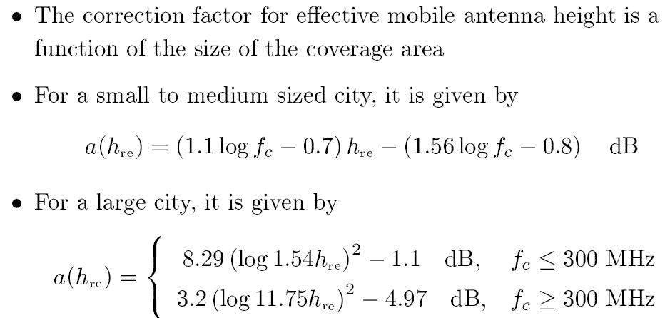
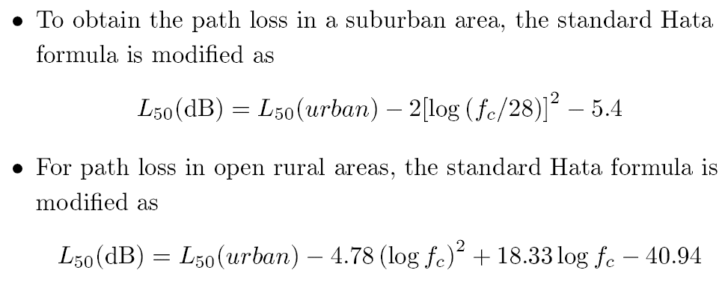

Slide 44
Remarks
Predictions of Hata model compare very closely with the original Okumura model as long as d exceeds 1 km
Hata model is well suited for large cell mobile systems, but not personal communications systems (PCS) which have cells in the order of 1km radius

Slide 45


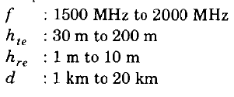
Extended Hata Model (PCS Extension)
Proposal to extend Hata’s model to 2GHz

Slide 46
(3) Indoor Propagation Models

Slide 47
Indoor Propagation Model
Indoor radio channel differs from the traditional mobile radio channel in two aspects
  The distances covered are much smaller
  The variability of the environment is much greater for a much smaller range of T-R separation distances
Propagation within buildings is strongly influenced by specific features such as
  the layout of the building
  The construction materials
  The building type

Slide 48
Cont.
Indoor radio propagation is dominated by the same mechanisms as outdoor
  Reflection
  Diffraction
  Scattering
Signal levels vary greatly depending on whether
  Interior doors are open or closed inside a building
  Where antennas are mounted
    For example, antennas mounted at desk level in a partition room receive vastly different signals than those mounted on the ceiling

Slide 49
Partition Losses (Same Floor)
Buildings have a wide variety of partitions and obstacles which form the internal and external structure
Two types of partitions are
  Hard Partitions: Partitions that are formed as part of the building structure
  Soft Partitions: Partitions that may be moved and which do not span to the ceiling
Partitions vary widely in their physical and electrical characteristics, making it difficult to apply general model to specific indoor installations

Slide 50
Partition Losses (Between Floors)
Losses between floors of a building are determined by
  External dimensions and materials of the building
  Type of construction used to create the floors
  External surroundings
Even the number of windows in a building and the presence of tinting can impact the loss between floors.

Slide 51
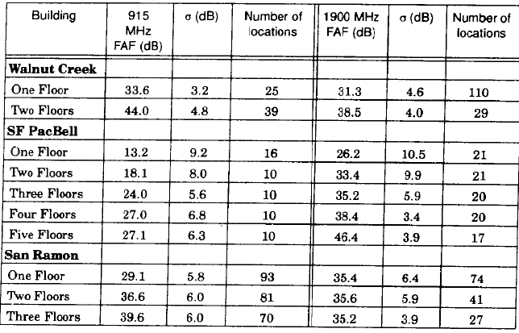
Floor Attenuation Factors (FAF)

Slide 52


Log-Distance Path Loss Model
Indoor path loss follows distance power law
  The value of n depends on surroundings and building type
  is a normal random variable in dB with standard deviation of ϭ dB

Slide 53
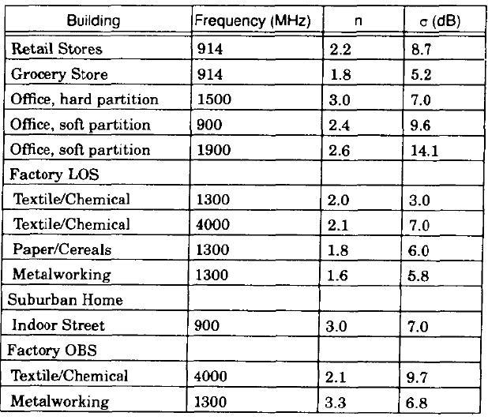
Path loss exponent and standard deviation in different buildings

Slide 54

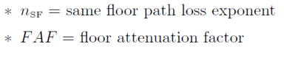
Attenuation Factor Model (Seidel Model)
An in-building propagation model that includes the effect of building type as well as the variations caused by obstacles
More flexible than log-distance model
Reduces standard deviation between measured and predicted path loss as compared to when only a log-distance model
Attenuation factor model is given by
where

Slide 55

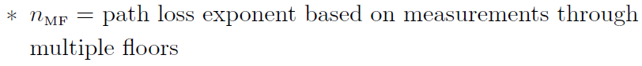

Modifications to Attenuation Factor Model
FAF may be replaced by an exponent which already considers the effects of multiple floor separation
Free space plus linear path attenuation model
  In-building path loss model obeying frees-pace plus additional loss factor

Slide 56
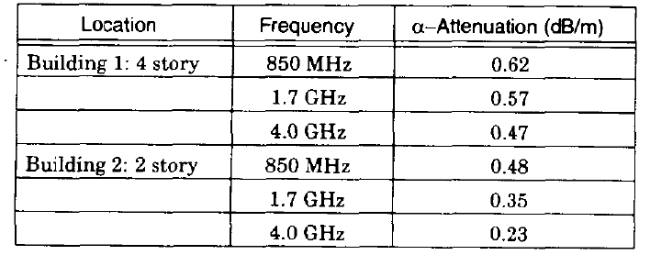
Free space plus linear path attenuation model

Slide 57


Slide 58
Propagation model that characterize rapid fluctuation is called _________
a) Hata model b) Fading model c) Large scale propagation model d) Okumura model
Free space propagation model is to predict ______
a) Received signal strength b) Transmitted power c) Gain of transmitter d) Gain of receiver
Path loss in free space model is defined as difference of ________
a) Effective transmitted power and gain b) Effective received power and distance between T-R
c) Gain and received power d) Effective transmitter power and receiver power
What is the dimension of object as compared to wavelength of propagating wave when reflection occurs?
a) Large b) Small c) Same d) Very small
When does the wave propagating from one medium to another gets partially reflection and partially transmitted?
a) Both mediums have same electrical properties
b) Both mediums have different electrical properties
c) Both mediums have same magnetic properties
d) Both mediums have different magnetic properties
Answer: b a d a b

Slide 59
What is the case of reflection, in course of second medium being a perfect dielectric?
a) Loss of energy during absorption
b) Total energy reflected back to first medium
c) No loss of energy in absorption
d) Total energy transmitted into second medium
What is the case of reflection, in course of second medium being a perfect conductor?
a) Loss of energy during absorption
b) Total energy reflected back to first medium
c) Partly transmission and reflection
d) Total energy transmitted into second medium
The plane of incidence contains only incident rays. State True or False.
a) True b) False
Diffraction occurs when radio path between Tx. And Rx. Is obstructed by ________
a) Surface having sharp irregularities. b) Smooth irregularities
c) Rough surface d) All types of surfaces
Difference between the direct path and the diffracted path is called _______
a) Average length b) Radio path length c) Excess path length
d) Wavelength
Answer: c d b a c

Slide 60
Scattered waves are produced at ________
a) Rough surface b) Shadowed region c) Smooth surface d) Horizon
A surface is considered rough if protuberance is ______ than critical height.
a) Equal b) Less c) Greater d) No relation
Empirical approach is based on fitting curve or analytical expressions. State whether True or False.
a) True b) False
Average received signal power decreases __________ with distance.
a) Exponentially b) Logarithmically c) Two times d) Four times
Which of the most widely used model for signal prediction in urban areas?
a) Ericsson Multiple Breakpoint Model b) Log distance path loss model
c) Okumura model d) Attenuation factor model
Answer: a c a b c

Slide 61
Okumura model is applicable for distances of _________
a) 1 m to 10 m b) 1 km to 100 km c) 100 km to 1000 km d) 10 km to 10000 km
The Hata model is empirical formulation of which model?
a) Okumura model` b) Longley- Rice model c) Durkin’s model
d) Walfisch and Bertoni model
Hata model is well suited for _________
a) Personal communication system b) Large cell mobile radio system
c) Small cell mobile radio system d) Every mobile radio system
Answer: b a b

Slide 62
Assignments

Slide 63
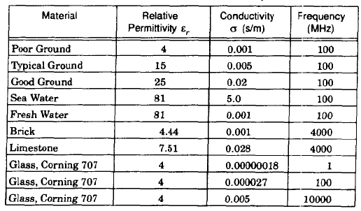
If P_{t}=10W, G_{t}=0dB, G_{r}= 0 dB and f_{c}=900MHz, find P_{r} in watts at a free space distance of 1km.
2. Find the reflection coefficients for typical ground, brick, limestone, glass and water from data given in the following table at an incident angel of 30 degree. Assume lossless dielectric and Present your answers in a table.

Slide 64

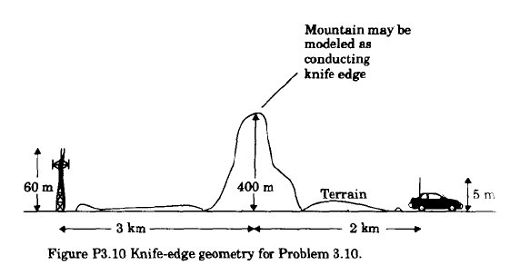
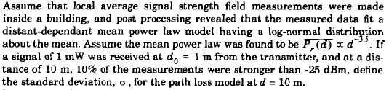
3.
4.

Slide 65
5. If a 900 MHz cellular transmitter has an EIRP of 100 W and the AMPS receiver uses a 0dB gain antenna, find the percentage of time that the received signal level at a distance of 10 km from the transmitter will be greater than -94.2 dBm. Assume n=4, standard deviation of 8 dB and d₀=1 km.
6. Four received power measurements were taken at distances of 100m , 200m, 1 km and 2 km from a transmitter w. The measured values at these distances are 0 dBm, -25 dBm, -35 dBm and -38 dBm, respectively. It is assumed that the path lsos fro these measurements follows the log-normal shadowing model where d₀= 100,
Find the MMSE estimate for the path loss exponent n.
Calculate the standard deviation of shadowing about the mean value.
Estimate the received power at d=2 km using the resulting model.
Predict the likelihood that the received signal level at 2 km will be greater than -35 dBm.
7. Given the following parameters for a two-ray model, find the radius of the circular coverage area for which the percentage of useful service area is 90% with a received signal that is equal to or greater than -90 dBm.
- path loss exponent = 4, standard deviation = 8 dB, transmit power = 1 kW, transmit antenna height = 90 m, transmit antenna gain = 1,receive antenna height = 2.5 m, receive antenna gain = 0.9.
EIRP = PtGt

Slide 66
Next Lecture
Mobile Radio Propagation – Small Scale Fading

Slide 67
  Thank You …

