Slide 1

Wireless and Mobile Communication
Dr. Nyein Aye Maung Maung
Dr.Eng (Ritsumeikan University)
Computer Engineering and Information Technology Dept
Yangon Technological University

Slide 2
Course Information
Course Title
  Wireless and Mobile Communication
Description
  This course deals with the concepts of wireless and mobile communication systems, radio propagation characteristics and state-of-the-art technologies that are making wireless and mobile communication enable.

Slide 3
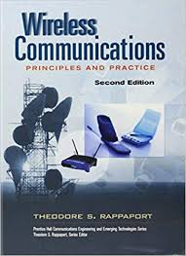
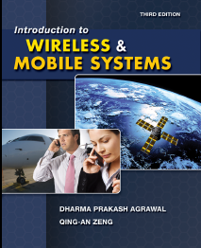
Textbook and References
Rappaport, Theodore S. Wireless communications: principles and practice. Vol. 2. New Jersey: prentice hall PTR, 1996.
Agrawal, Dharma P., and Qing-An Zeng. Introduction to wireless and mobile systems. Cengage learning, 2015.

Slide 4
Course Objectives
To help students understand system design fundamentals and factors for improving coverage and capacity of cellular systems
To promote students’ ability to analyze propagation characteristics of wireless channels and have technical know-hows to design and evaluate performance of different indoor and outdoor radio propagation models
To have a good knowledge of technical concepts such as modulation types, channel coding, equalization, antenna diversity and multiple access techniques
To understand differences between different network standards including cellular networks (GSM, 3G, 4G), WiFi, PANs, etc
To have strong technical skill on system design considerations for a given channel environment and different cellular network standards

Slide 5
Schedule of the Course
Week |  | Topic
Part I | 1 | Introduction to Wireless Communication Systems and Modern Wireless Communication Systems
 | 2 | The Cellular Concept – System Design Fundamentals
 | 3 | The Cellular Concept— Trunking and Grade of Service, Improving Coverage and Capacity
 | 4 | Mobile Radio Propagation: Large-Scale Path Loss
 | 5 | Mobile Radio Propagation: Practical Link Budget Design using Path Loss Models
 | 6 | Mobile Radio Propagation – Small-scale Fading and Multipath
Part II | 7 | Modulation Techniques: Analog Modulation Techniques
 | 8 | Modulation Techniques: Digital Modulation Techniques
 | 9 | Multiple Access Techniques
 | 10 | Channel Equalization and Antenna Diversity
 | 11 | Channel Coding
 | 12 | Wireless Networking, Systems and Standards

Slide 6
Exam and Grading System
Task | Mark
Final Exam | 80%
Practical Assignments | 10%
Tutorial | 10%
Mark | Grade
85~100 | A+
80~85 | A
70~80 | B
50~70 | C
<50 | F

Slide 7
Lecture 4
Mobile Radio Propagation
Large Scale Path-Loss

Slide 8
Overview of Previous Lecture
Cellular Concept
  Trunking and Grade of Service
  Improving Coverage and Capacity in Cellular Systems
    Cell Splitting
    Cell Sectoring
    Micro cell zone concept
    Repeaters

Slide 9
Outline of Class (Lecture 4)
  Ideal Free-space Radio Propagation Model
  Three Basic Propagation Mechanisms and Related Propagation Models
    Reflection
      Two ray Ground Reflection Model
    Diffraction
      Fresnel Zone Geometry and Knife-Edge Diffraction Model
    Scattering
Quiz

Slide 10
Lecture Objectives
To discuss the basic philosophy of propagation prediction applicable to cellular systems
To identify and explore key propagation modes and their signal decay characteristics
To discuss the multi-path propagation environment, its effects, and a method of avoiding deep fades
To survey key available statistical propagation models and become familiar with their basic inputs, processes, and outputs
To understand application of statistical confidence levels to system propagation prediction
To review and gain familiarity with general measurement and propagation prediction tools available commercially

Slide 11
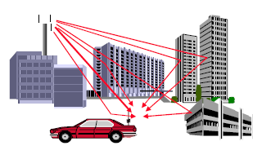
(1) Mobile Radio Propagation

Slide 12
Introduction
The mobile radio channel places fundamental limitations on the performance of a wireless communication system
The wireless transmission path may be
  Line of Sight (LOS)
  Non line of Sight (NLOS)
Radio channels are random and time varying
Modeling radio channels have been one of the difficult parts of mobile radio design and is done in statistical manner
When electrons move, they create EM waves that can propagate through space.
By using antennas we can transmit and receive these EM wave
Microwave, Infrared visible light and radio waves can be used

Slide 13
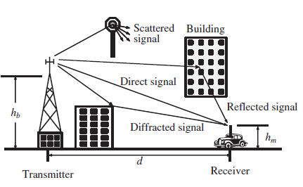
Radio Wave Propagation
Free Space Propagation: Transmitter and receiver have a clear, unobstructed LOS path between them.
Reflection: Large buildings, earth surface
Diffraction: Obstacles with dimensions in order of wavelength
Scattering: Foliage, lamp posts, street signs, walking pedestrian, etc.
Notes:
The mechanisms behind electromagnetic wave propagation are diverse, but can generally be attributed to reflection, diffraction, and scattering. Most cellular radio systems operate in urban areas where there is no direct line-of-sight path between the transmitter and the receiver, and where the presence of high-rise buildings causes severe diffraction loss. Due to multiple reflections from various objects, the electromagnetic waves travel along different paths of varying lengths. The interaction between these waves causes multipath fading at a specific location, and the strengths of the waves decrease as the distance between the transmitter and receiver increases.

Slide 14
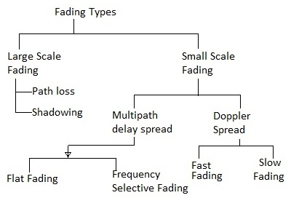
Multipath Fading
Fading occurs due to reflections, refraction and scattering

Slide 15
Multipath Fading (cont.)
First Path
Echo path
(case 1)
Echo path (case 2)
Constructive addition (case 1)
Destructive addition (case 2)
Notes:
As a mobile moves over very small distances, the instantaneous received signal strength may fluctuate rapidly giving rise to small-scale fading. The reason for this is that the received signal is a sum of many contributions coming from different directions, as described in Chapter 5. Since the phases are random, the sum of the contributions varies widely; for example, obeys a Rayleigh fading distribution. In small-scale fading, the received signal power may vary by as much as three or four orders of magnitude (30 or 40 dB) when the receiver is moved by only a fraction of a wavelength. As the mobile moves away from the transmitter over much larger distances, the local average received signal will gradually decrease, and it is this local average signal level that is predicted by large-scale propagation models

Slide 16
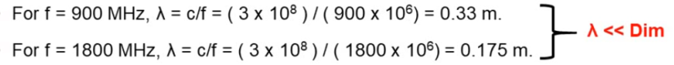
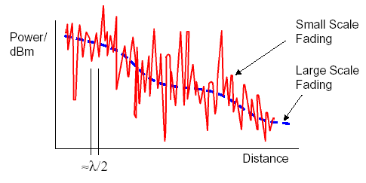
Large-scale and Small-scale Fading
Small scale fading is concerned with rapid fluctuation of RSS over very short distance and short time
  The distance between small scale fades is on the order of λ/2
Large scale fading concern with large fluctuation

Slide 17
Radio Propagation Model
Predict the average received signal strength (RSS) at a given distance from the transmitter
Propagation Models
  large-scale propagation models characterize signal strength over large T-R separation distances
  small-scale or fading models: characterize the rapid fluctuations of the received signal strength over very short travel distances or short time durations

Slide 18
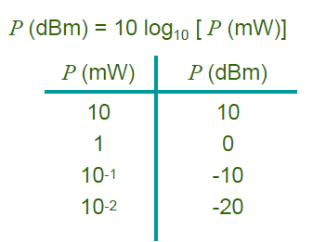
Units of Received Signal Strength
The standard unit of power is Watt, but dBm is more commonly used.
Minimum usable signal strength to be received at a base station is typically between -90 dBm -100 dBm

Slide 19
(2) Large Scale Path Loss

Slide 20
Large Scale Path Loss Models
Ideal Free-space Radio Propagation Model
Propagation Models based on Three Basic Propagation Mechanisms
  Reflection
  Diffraction
  Scattering

Slide 21
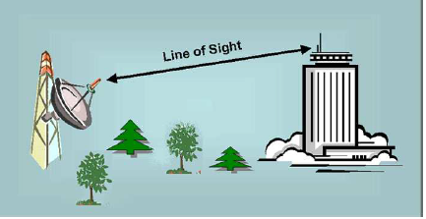
(1) Friis Free Space Propagation Model
A clear, unobstructed Line-of-sight path between TX and RX
  Satellite communication, Microwave Line-of-sight (Point-to-point)
The free space model predicts that received power decays as a function of the T-R separation distance raised to some power.

Slide 22
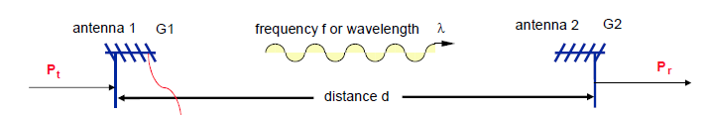

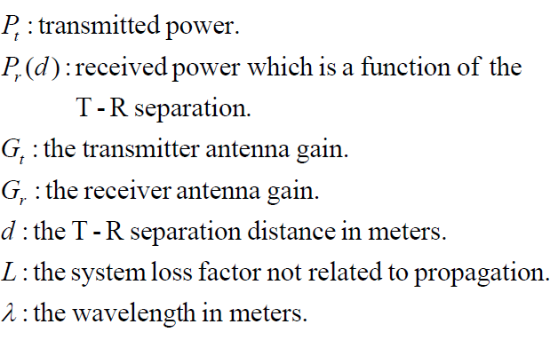

*L=1 indicates no loss in the system hardware.
A_{e}: The effective aperture which is related to the physical size of the antenna

Slide 23


Cont.
Path loss: signal attenuation as a positive quantity measured in dB,
  is defined as the difference (in dB) between the effective transmitted power and the received power,
  may or may not include the effect of antenna gains.
  or
(includes antenna gains)
(not include antenna gains)
Notes:
Log 1/A=-log A

Slide 24

Cont.
Free space model or Friis Free Space Model is an effective for predicting received power of ‘d’ which are far field of transmitting antenna
What is Far Field?
  The region of the transmitting antenna, beyond far distance d_{f} which is related to largest linear dimension of the Tx antenna aperture and carrier wavelength
D → largest physical linear dimension of the antenna
d_{f} >> D; d_{f} >> λ

Slide 25
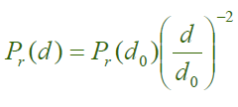
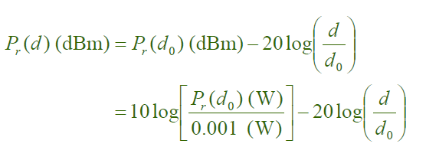
Cont.
With a reference distance d₀ and reference power at d₀
Modified free space equation is
d₀ is typically chosen to be 1 m in indoor environment and 100 m or 1 km in outdoor environments.
the path loss exponent n=2 in free space
where d >= d₀ >= d_{f}

Slide 26
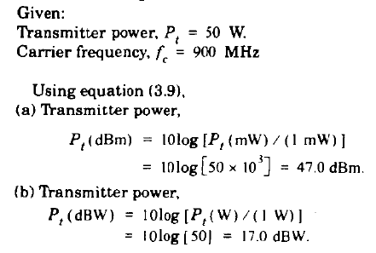
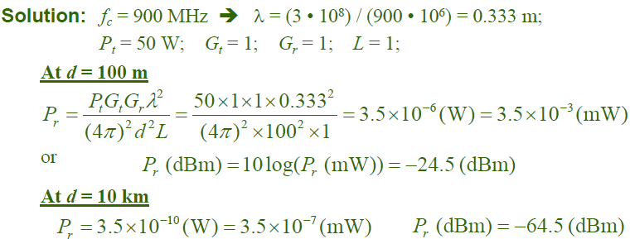
Example 1. If a transmitter produces 50W of power, express the transmit power in units of (a) dBm and (b) dbW. If this power is applied to a unity gain antenna with 900 MHz carrier frequency, find the received power at a free space distance of 100 m from the antenna. What is the received power at 10 km? Assume unity gain for the receiver antenna.
dBm - This is a power expressed in decibels relative to one milliwatt.
dBW - This is a power expressed in decibels relative to one watt.

Slide 27
(3) Propagation Models based on Three Basic Propagation Mechanisms

Slide 28
Propagation Mechanisms
Reflection occurs when a propagating electromagnetic wave impinges on an object which has very large dimensions as compared to wavelength e.g. surface of earth , buildings, walls
Diffraction occurs when the radio path between the transmitter and receiver is obstructed by a surface that has sharp irregularities(edges)
Scattering occurs when medium has objects that are smaller or comparable to the wavelength (small objects, irregularities on channel, foliage, street signs etc)
  For smooth surfaces → EM waves are reflected;
  For rough surfaces → EM waves are scattered;
  For edges of surfaces → EM waves are diffracted

Slide 29
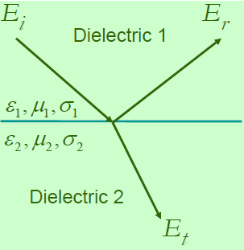
1. Reflection
When a radio wave propagating in one medium impinges upon another medium having different electrical properties, this wave is partially reflected and partially transmitted
If the plane wave is incident on a perfect dielectric,
  Part of the energy is transmitted into the 2nd medium and some is reflected back into the 1st medium, and no loss of energy in absorption
If the second medium is a perfect conductor
  all incident energy is reflected back into the 1st medium without loss of energy
Permittivity ε
Permeability μ
Conductivity σ
Notes:
Conductor – copper , etc
Dielectric – wood, rubber

Slide 30
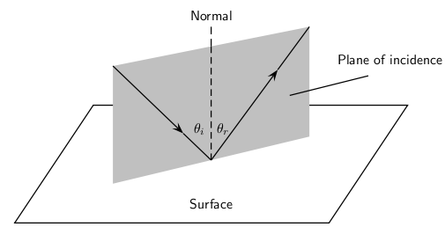
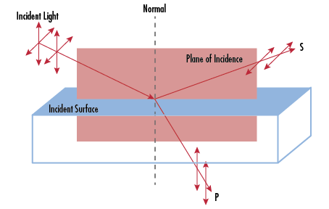
Reflection from Dielectric
Electric field intensity of the reflected and transmitted waves are related to the incident wave in the medium of origin through the Fresnel Reflection Coefficient (Γ)
Reflection Coefficient depends on the wave polarization, angle of incidence and the frequency of propagating wave
Notes:
Gamma

Slide 31
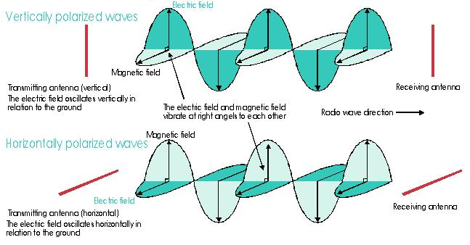
Vertical and Horizontal Polarization

Slide 32
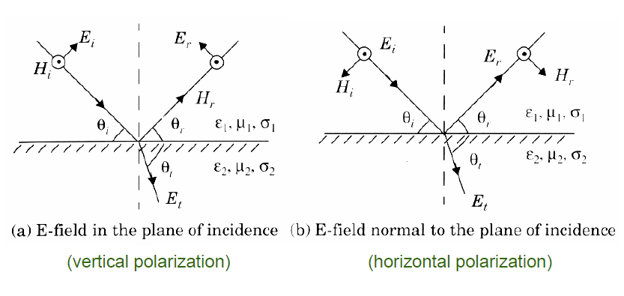
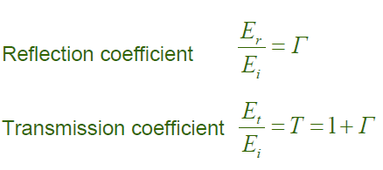
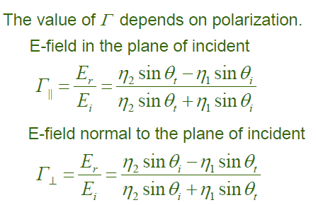
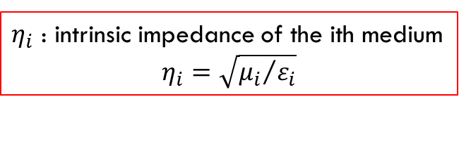
E-field polarization parallel with plane
E-field polarization perpendicular with plane
$η_{i}$ : intrinsic impedance of the ith medium
$$η_{i}=\sqrt{{μ_{i}}/{ε_{i}}}$$
Notes:
eta

Slide 33
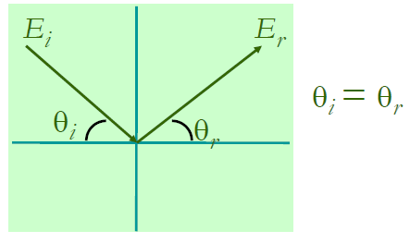
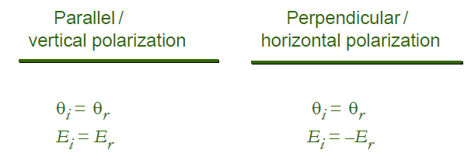
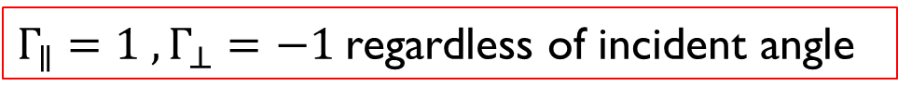
Reflection from Perfect Conductor
Electromagnetic wave cannot pass through a perfect conductor
  A plane wave incident on a conductor has all of its energy reflected
  Electric field at the surface must be equal to zero
  Reflected wave must be equal in magnitude to the incident wave
$Γ_{∥}=1 , Γ_{⊥}=−1$regardless of incident angle

Slide 34
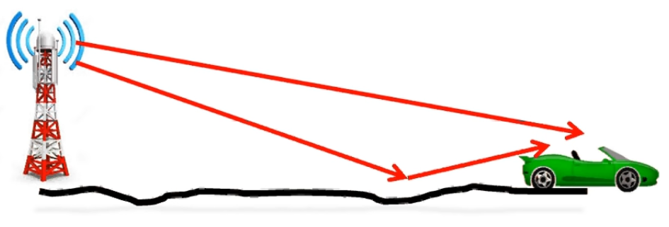
Ground Reflection 2-Ray Model
LOS
Reflected

Slide 35
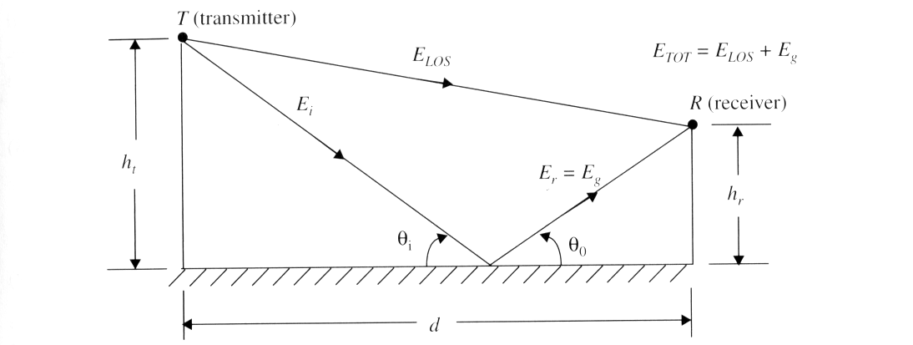



Ground Reflection 2-Ray Model
For all d >> 20 h_{t}h_{r}/$λ$ or d>> 10 (ht+hr)

Slide 36
2. Diffraction
Diffraction allows radio signals to propagate around the curved surface of the earth, beyond the horizon, and to propagate behind obstructions.
  Caused by the propagation of secondary wavelets into a shadowed region.
  Sum of the electric field components of all the secondary wavelets in the space around the obstacle.
Excess path length ( ∆ ): the difference between the direct path and the diffracted path.
  A function of height and position of the obstruction, as well as the transmitter and receiver location.

Slide 37
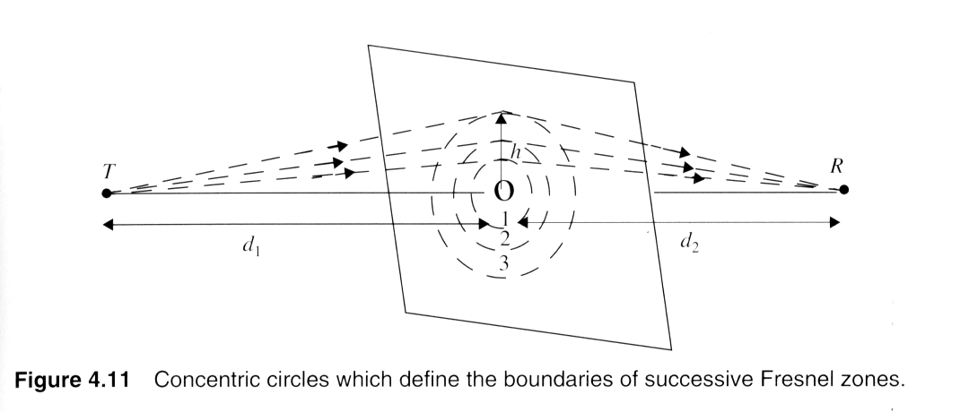

Fresnel Zone
  Due to obstacles in transmission path, a family of ellipsoids can be constructed between TX and RX by joining all the points for which the excess path delay (∆) is an integer multiple of half wavelengths (nλ/2)
    If obstruction does not block the 1st zone, diffraction effects may be neglected
    As long as 55% of fresnel zone is clear, minimal diffraction loss
r_{n} = Radius of n^{th} Fresnel Zone Circle

Slide 38
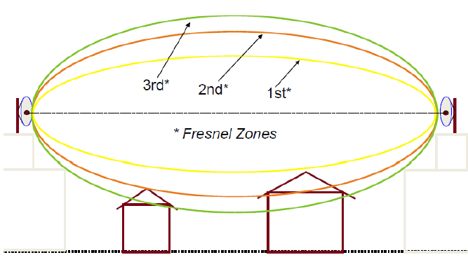
Cont.
Illustration of Fresnel Zones

Slide 39
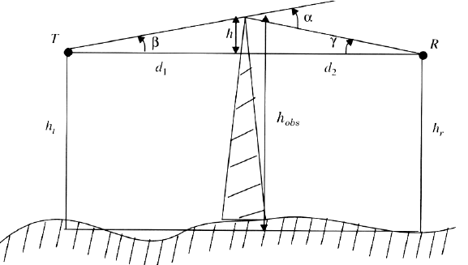
Fresnel Zone Geometry

Slide 40
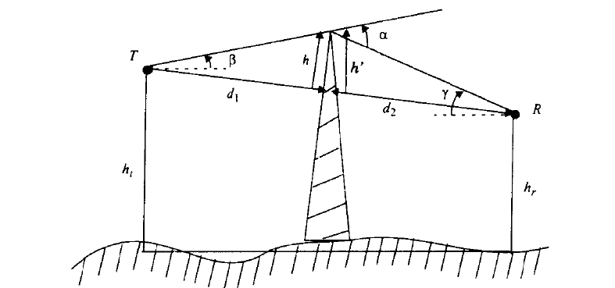
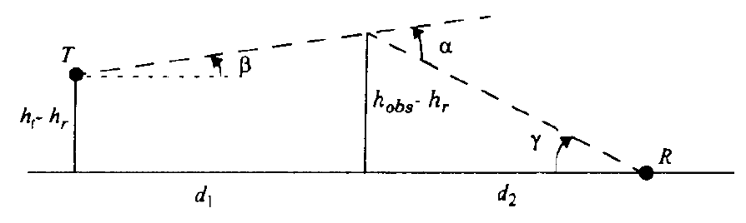

Slide 41
Knife-edge Diffraction Model
Estimating the signal attenuation caused by diffraction of radio waves over hills and buildings is essential in predicting the field strength in a given service area.
As a starting point, the limiting case of propagation over a knife edge gives good in sight into the order of magnitude diffraction loss.
When shadowing is caused by a single object such as a building, the attenuation caused by diffraction can be estimated by treating the obstruction as a diffracting knife edge

Slide 42




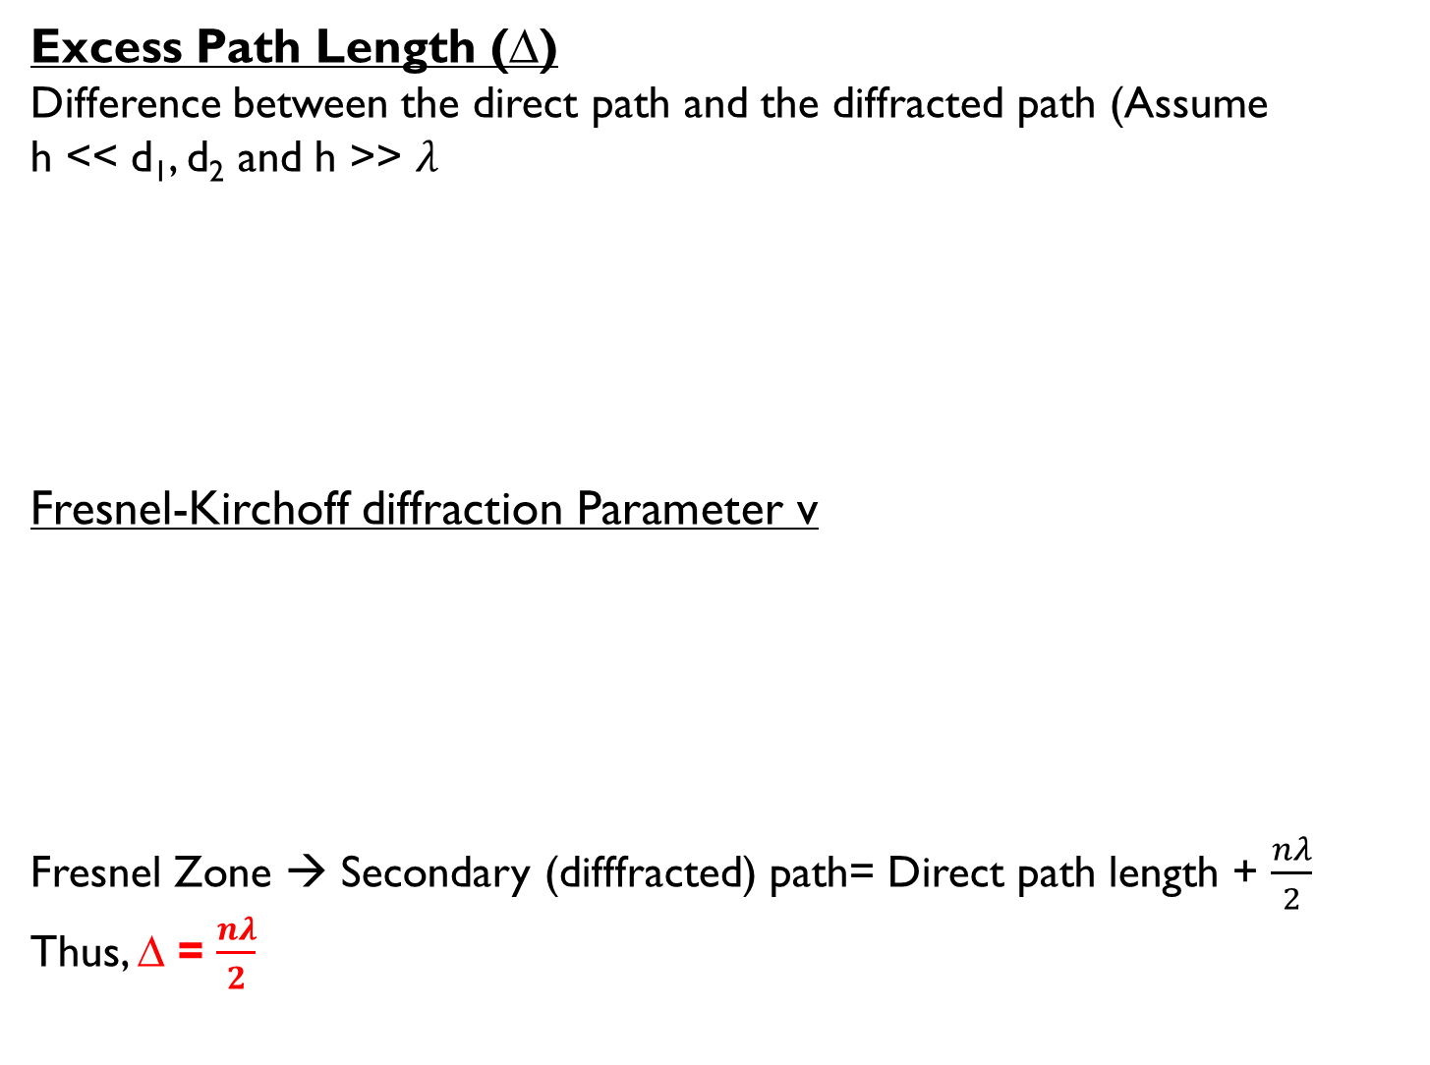
Excess Path Length (∆)
Difference between the direct path and the diffracted path (Assume
h << d₁, d₂ and h >> $λ$
Fresnel-Kirchoff diffraction Parameter v
Fresnel Zone → Secondary (difffracted) path= Direct path length + $\frac{nλ}{2}$
Thus, ∆ = $\frac{nλ}{2}$

Slide 43
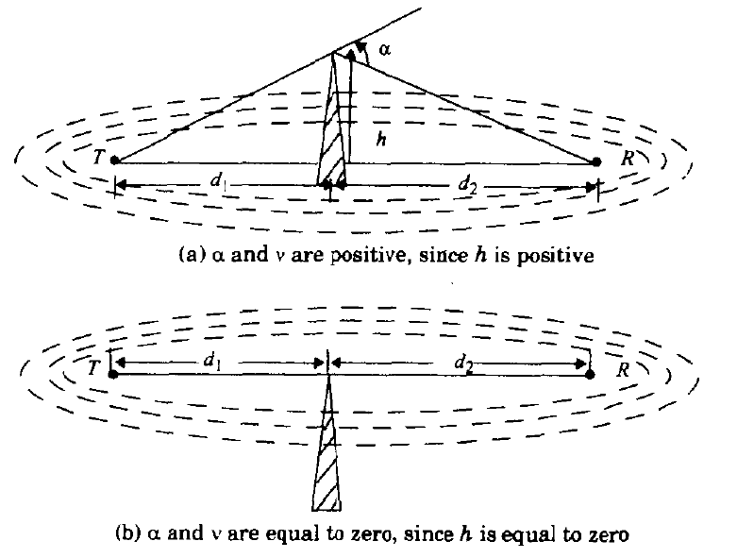
Fresnel Zones for Different Knife-Edge Diffraction Scenarios

Slide 44
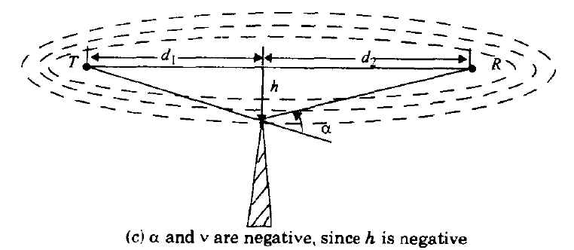
Fresnel Zones for Different Knife-Edge Diffraction Scenarios

Slide 45

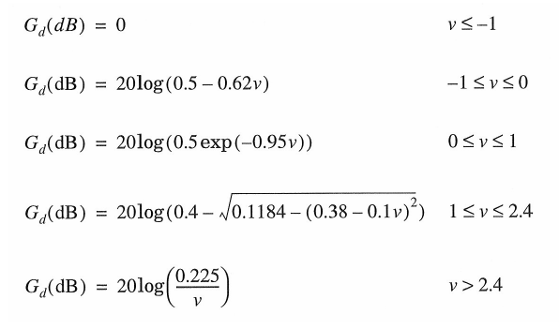
Diffraction Gain (G_{d}(dB))
An Approximate numerical solution

Slide 46
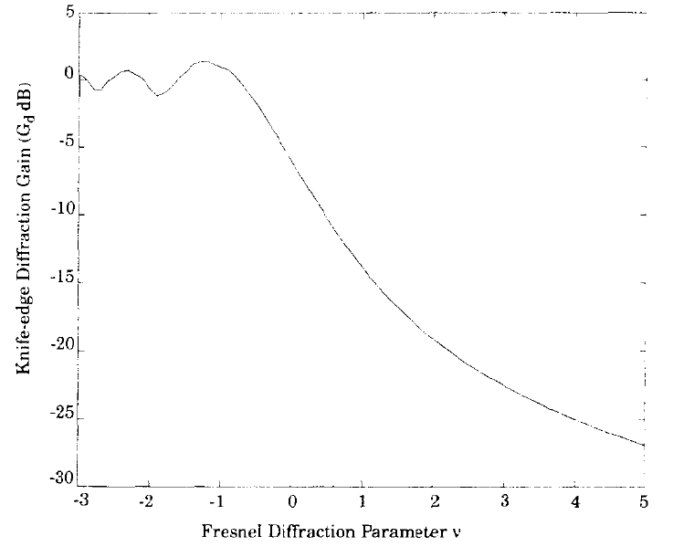
Diffraction Gain (G_{d}(dB))
Graphical Calculation
Knife-edge Diffraction Gain as a function of Fresnel Diffraction Parameter

Slide 47
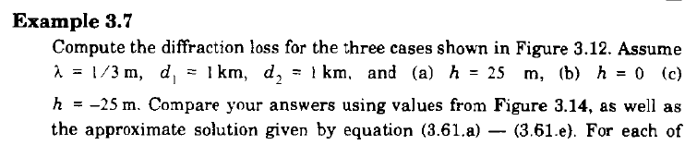
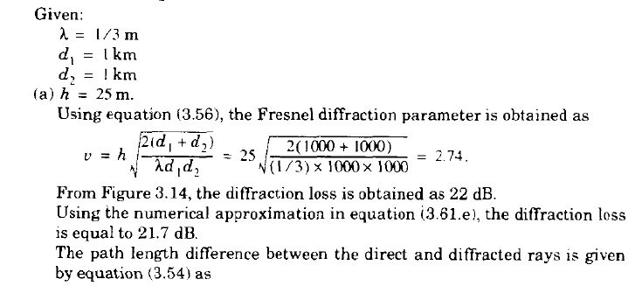
Example 2.

Slide 48
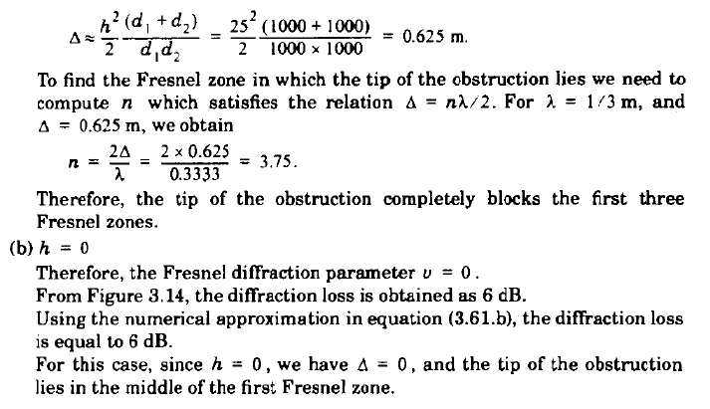

Slide 49
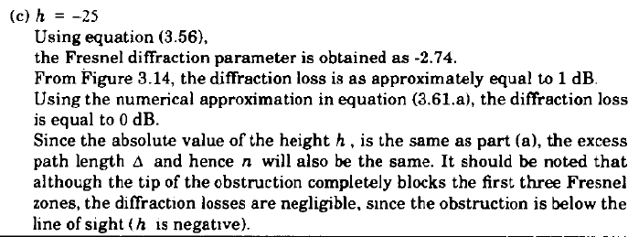

Slide 50
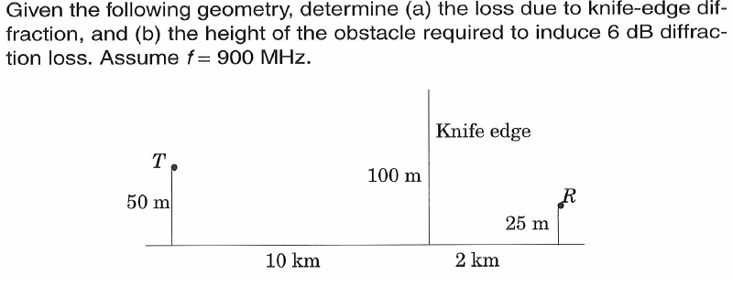
Example 3.

Slide 51
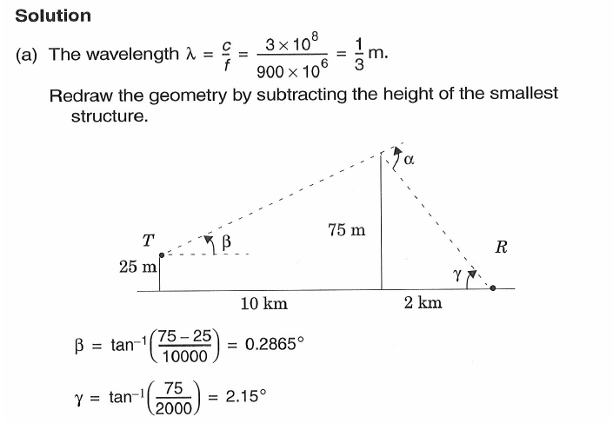

Slide 52
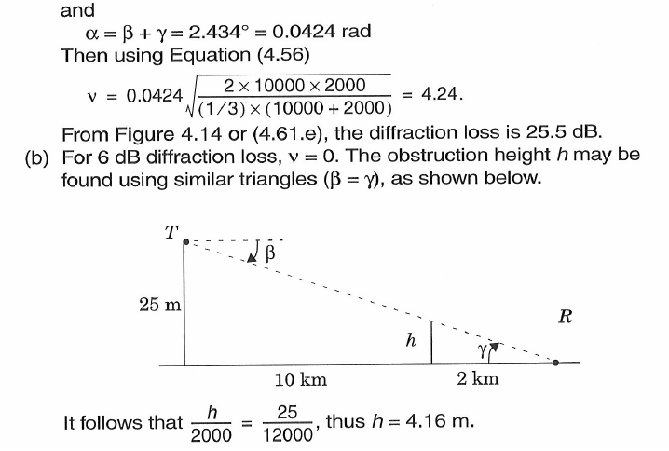

Slide 53
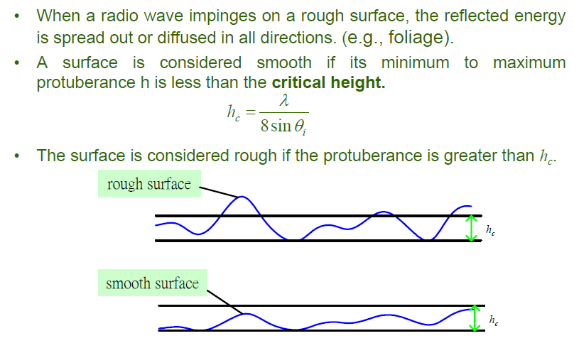
Scattering
When a radio wave impinges on a rough surface, the reflected energy is spread out or diffused in a ll directions.
A surface is considered smooth if its minimum to maximum protuberance h is less than the critical height.
The surface is considered rough if the protuberance is greater than h_{c}.

Slide 54
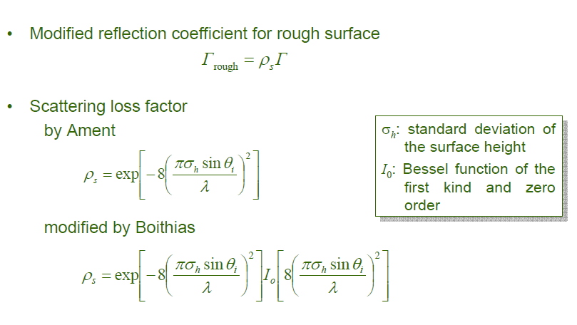

Slide 55
Next Lecture
Mobile Radio Propagation – Large Scale Path Loss Model
  Practical Link Budget Design using Path Loss Models
    Log-distance Path Loss Model
    Log-normal Shadowing Model
  Outdoor Propagation Models
    Okumura Model
    Hata Model
  Indoor Propagation Models

Slide 56
  Thank You …

