Slide 1
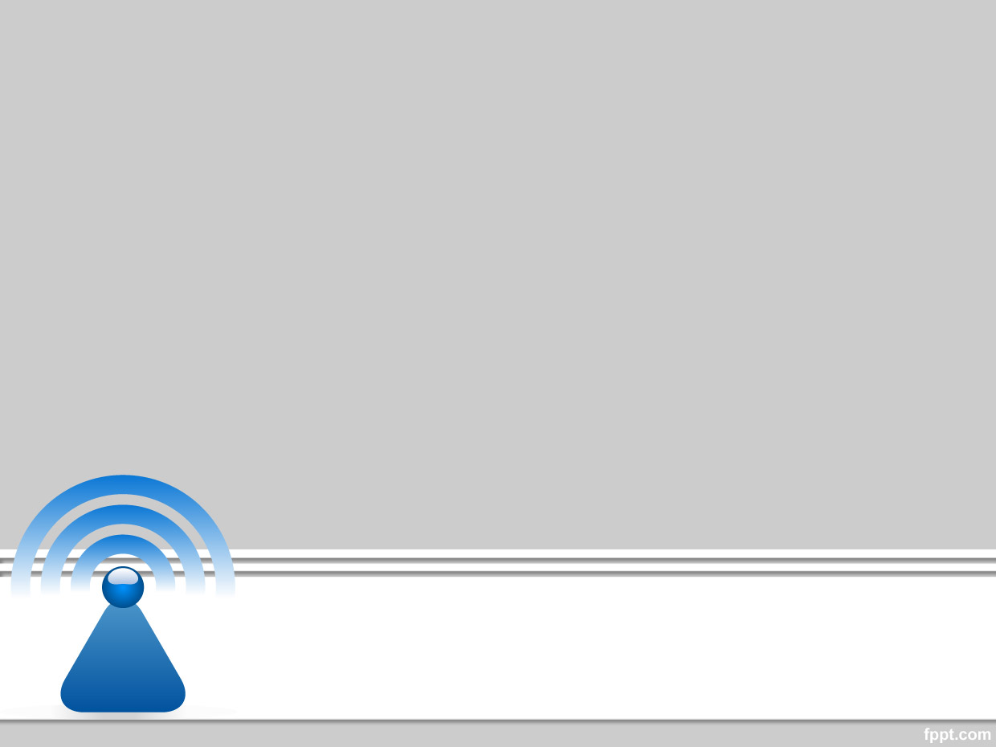
Wireless and Mobile Communication
Dr. Nyein Aye Maung Maung
Dr.Eng (Ritsumeikan University)
Computer Engineering and Information Technology Dept
Yangon Technological University

Slide 2
Course Information
Course Title
  Wireless and Mobile Communication
Description
  This course deals with the concepts of wireless and mobile communication systems, radio propagation characteristics and state-of-the-art technologies that are making wireless and mobile communication enable.

Slide 3
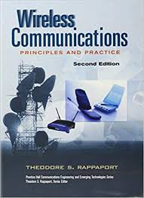
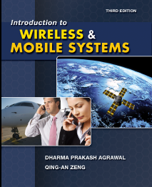
Textbook and References
Rappaport, Theodore S. Wireless communications: principles and practice. Vol. 2. New Jersey: prentice hall PTR, 1996.
Agrawal, Dharma P., and Qing-An Zeng. Introduction to wireless and mobile systems. Cengage learning, 2015.

Slide 4
Course Objectives
To help students understand system design fundamentals and factors for improving coverage and capacity of cellular systems
To promote students’ ability to analyze propagation characteristics of wireless channels and have technical know-hows to design and evaluate performance of different indoor and outdoor radio propagation models
To have a good knowledge of technical concepts such as modulation types, channel coding, equalization, antenna diversity and multiple access techniques
To understand differences between different network standards including cellular networks (GSM, 3G, 4G), WiFi, PANs, etc
To have strong technical skill on system design considerations for a given channel environment and different cellular network standards

Slide 5
Schedule of the Course
Week |  | Topic
Part I | 1 | Introduction to Wireless Communication Systems and Modern Wireless Communication Systems
 | 2 | The Cellular Concept – System Design Fundamentals
 | 3 | The Cellular Concept— Trunking and Grade of Service, Improving Coverage and Capacity
 | 4 | Mobile Radio Propagation: Large-Scale Path Loss
 | 5 | Mobile Radio Propagation: Practical Link Budget Design using Path Loss Models
 | 6 | Mobile Radio Propagation – Small-scale Fading and Multipath
Part II | 7 | Modulation Techniques: Analog Modulation Techniques
 | 8 | Modulation Techniques: Digital Modulation Techniques
 | 9 | Multiple Access Techniques
 | 10 | Channel Equalization and Antenna Diversity
 | 11 | Channel Coding
 | 12 | Wireless Networking, Systems and Standards

Slide 6
Exam and Grading System
Task | Mark
Final Exam | 80%
Practical Assignments | 10%
Tutorial | 10%
Mark | Grade
85~100 | A+
80~85 | A
70~80 | B
50~70 | C
<50 | F

Slide 7
Lecture 3
Cellular Concept

Slide 8
Overview of Previous Lecture
Cellular Concept – System Design Fundamentals
  Basic Cellular Concept
  Frequency Reuse
    Channel capacity
    Forming a cluster
  Channel Assignment Strategies
    Fixed and Dynamic
  Handoff Strategies
    Handoff Threshold, Types of Handoff, Practical Handoff Consideration
  Interference and System Capacity
    Co-channel Interference (CCI)
    Adjacent Channel Interference (ACI)

Slide 9
Outline of Class (Lecture 3)
Cellular Concept
  Trunking and Grade of Service
  Improving Coverage and Capacity in Cellular Systems
Quiz

Slide 10
(1) Trunking and Grade of Service

Slide 11
Trunking
Allow a large number of users to share the relatively small number of channels in a cell
  by providing access to each user, on demand, from a pool of available channels
Allocate each user per call basic
A small number of channels can accommodate large number of random users.
    Telephone companies use trunking theory to determine number of circuits required.
    Trunking theory is about how a population can be handled by a limited number of servers.

Slide 12
Trunking Theory
Measure of traffic intensity
  one Erlang represents the amount of traffic intensity carried by a channel that is completely occupied. For example, a radio channel that is occupied for 30 minutes during an hour carries 0.5 Erlang of traffic.
Grade of Service (GOS)
  Measure of ability of the user to access a trunked system during the busiest hour during a week, month or year. GOS is typically given as the probability of call blocking, or the likelihood of a call experiencing a delay greater than a certain queuing time.

Slide 13
Terminologies
Term | Definition
Traffic Intensity (A) | Measure of channel time utilization (average channel occupancy in Erlangs) Eg. channel occupied 30 minutes in an hour → 0.5 Erlang
Grade of Service (GOS) | Measure of congestion (Probability that a call is being blocked (Erlang B) or being delayed (Erlang C))
Set-Up Time | The time required to allocate a trunked radio channel
Blocked Call | Call that cannot be completed at time of request due to congestion. Also referred to as Lost Call
Holding Time (H) | Average duration of typical call
Load | Traffic intensity across the entire trunked radio system
Request Rate (λ) | Average number of call requests per unit time

Slide 14
Traffic Measurement (Erlangs)
For User: Traffic intensity per user – A_{u}
For System : For U users, total offered traffic intensity A
For Channel : For C channels trunked system, traffic intensity per channel, A_{c}
H : the average duration of a call
λ : the average number of call requests per unit time for each user
A_{u} = λH
A = UA_{u}
A_{c} = UA_{u} ⁄ C

Slide 15
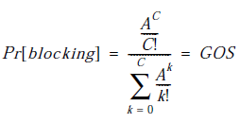
Types of Trunked Systems
(1) Blocked Calls Cleared
  No setup time
  Channel Available → Intermediate access
  Channel Not Available → Block
  Probability that a call is blocked (a measure of GOS) –Erlang B Formula

Slide 16
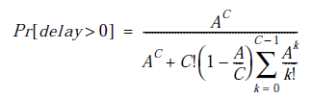


Types of Trunked Systems (cont)
(2) Blocked Calls Delayed
  Provide a queue for blocked calls
  Delay call requests until the channel becomes available
  Probability that a call is delayed –Erlang C Formula
  Probability that the delayed call is forced to wait more than t seconds
  Average delay D for all calls in a queued system

Slide 17
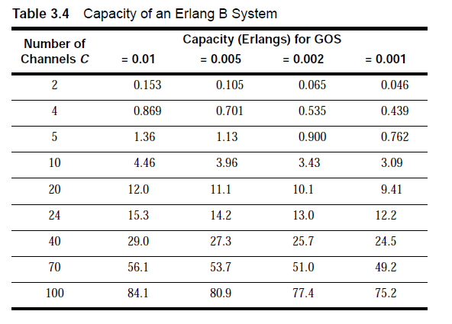
Capacity of an Erlang B System

Slide 18
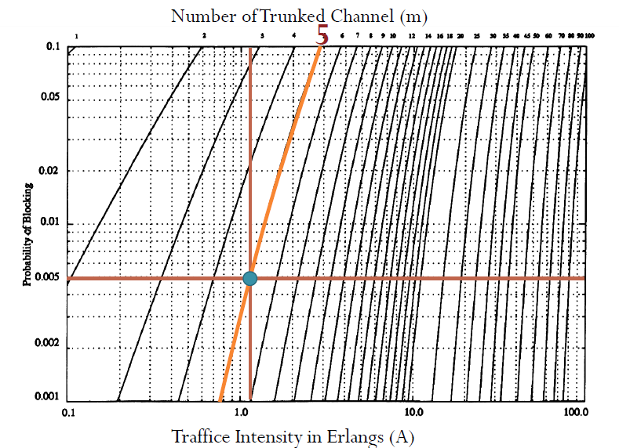
Erlang B Chart

Slide 19
Example 1: How many users can be supported for 0.5% blocking probability for the following number of trunked channels in a blocked calls cleared system? (a) 1, (b) 5, (c) 10, (d) 20, (e) 100. Assume each user generates 0.1 Erlangs of traffic.
Required GOS = 0.5%, A_{u}=0.1
C=1, U=?
GOS=0.5% → From Erlang B table, A = 0.005
A = UA_{u} → U = 0.05
C=5, U=?
GOS=0.5% → From Erlang B table, A = 1.13
A = UA_{u} → U = 11
C=10, U=?
GOS=0.5% → From Erlang B table, A = 3.96
A = UA_{u} → U = 39
C=20, U=?
GOS=0.5% → From Erlang B table, A = 11.10
A = UA_{u} → U = 110
C=100, U=?
GOS=0.5% → From Erlang B table, A = 80.9
A = UA_{u} → U = 809

Slide 20
Example 2
An urban area has a population of two million residents. Three competing trunked mobile networks (systems A, B, and C) provide cellular service in this area. System A has 394 cells with 19 channels each, system B has 98 cells with 57 channels each, and system C has 49 cells, each with 100 channels. Find the number of users that can be supported at 2% blocking if each user averages two calls per hour at an average call duration of three minutes. Assuming that all three trunked systems are operated at maximum capacity, compute the percentage market penetration of each cellular provider.
System A
  GOS=2%, C=19, U=?
  A_{u} = λH = 2 × (3/60) = 0.1 Erlangs
  From Erlang B chart, A=12.3
  Therefore, total number of users supported per cell is
  U=A/ A_{u} = 123
  Total number of cells=394, thus total number of subscribers that can be supported by
  system A is 123x394=48462.

Slide 21
System B
  GOS=2%, C=57, U=?
  A_{u} = λH = 2 × (3/60) = 0.1 Erlangs
  From Erlang B chart, A=46.8
  Therefore, total number of users supported per cell is
  U=A/ A_{u} = 468
  Total number of cells=98, thus total number of subscribers that can be supported by
  system A is 468x98=45864.
System C
  GOS=2%, C=100, U=?
  A_{u} = λH = 2 × (3/60) = 0.1 Erlangs
  From Erlang B chart, A=88
  Therefore, total number of users supported per cell is
  U=A/ A_{u} = 880
  Total number of cells=49, thus total number of subscribers that can be supported by
  system A is 880x49=43120.
Percentage Market penetration of each system
  Total population = 2000000
System A → 48462/200000 = 2.4%
System B → 45864/200000 = 2.3%
System C → 43120/200000 = 2.2%

Slide 22
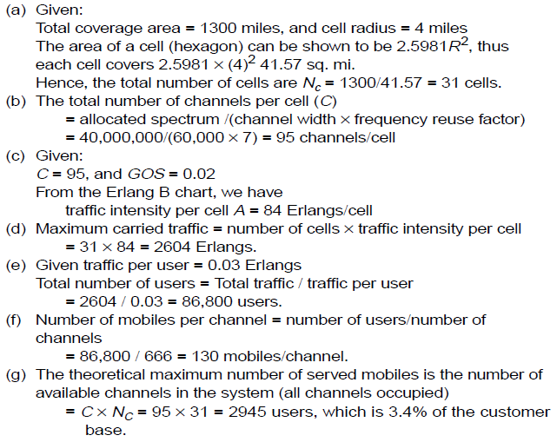

Example 3 A certain city has an area of 1,300 square miles and is covered by a cellular
system using a seven-cell reuse pattern. Each cell has a radius of four miles and the city is allocated 40 MHz of spectrum with a full duplex channel bandwidth of 60 kHz. Assume a GOS of 2% for an Erlang B system is specified. If the offered traffic per user is 0.03 Erlangs, compute (a) the number of cells in the service area, (b) the number of channels per cell, (c) traffic intensity of each cell, (d) the maximum carried traffic, (e) the total number of users that can be served for 2% GOS, (f) the number of mobiles per unique channel (where it is understood that channels are reused), and (g) the theoretical maximum number of users that could be served at one time by the system.
area$=\frac{3\sqrt{3}}{2}R^{2}$

Slide 24
Example 4
A hexagonal cell within a four-cell system has a radius of 1.387 km. A total of 60 channels are used within the entire system. If the load per user is 0.029 Erlangs, and λ = 1 call/hour, compute the following for an Erlang C system that has a 5% probability of a delayed call:
How many users per square kilometer will this system support?
(b) What is the probability that a call will be delayed for more than 10 seconds?
Given:
Cell radius, R = 1.387 km
Area covered per cell is 2.598 × (1.387)2 = 5 sq km
Number of cells per cluster = 4
Total number of channels = 60
Therefore, number of channels per cell = 60 / 4 = 15 channels.
From Erlang C chart, for 5% probability of delay with C = 15,
traffic intensity = 9.0 Erlangs.
number of users = total traffic intensity / traffic per user
= 9.0/0.029 = 310 users
= 310 users/5 sq km
= 62 users/sq km

Slide 25
(b) Given λ = 1
holding time H = Au/λ = 0.029 hour = 104.4 seconds.
  The probability that a delayed call will have to wait longer than 10 s is
  Pr [delay >t |delay]= exp(–(C – A)t /H)
  = exp(–(15 – 9.0)10/104.4)
  = 56.29%
(Given Pr [delay >0] = 5% = 0.05
Probability that a call is delayed more than 10 seconds,
Pr [delay >10] = Pr [delay >0]Pr [delay >t |delay]
= 0.05 x 0.5629 = 2.81%

Slide 26
(2) Improving Coverage and Capacity

Slide 27
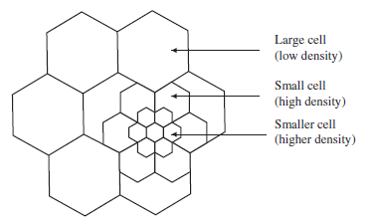
Cell Splitting
The process of subdividing a congested cell into smaller cells, each with its own base station and a corresponding reduction in antenna height and transmitter power
Increases the capacity since it increases the number of times the channels are reused.

Slide 28
Cell Splitting (cont’)
The area covered by a circle with radius R is four times the area covered by the circle with radius R/2
The number of cells is increased four times
The number of clusters the number of channels and the capacity in the coverage area are increased
Cell Splitting does not change the co-channel re-use ratio Q =D/R

Slide 29



Transmit Power of New Cells
New cells are smaller, so the transmit power of the new cells must be reduced
How to determine the transmit power?
  The transmit power of the new cells can be found by examining the received power at the new and old cell boundaries and setting them equal
P_{r}(at the old cell boundary) is proportional to
P_{r}(at the new cell boundary) is proportional to
If n=4,
P_{t1} = transmit power of larger cell
P_{t2}= transmit power of smaller cell

Slide 30
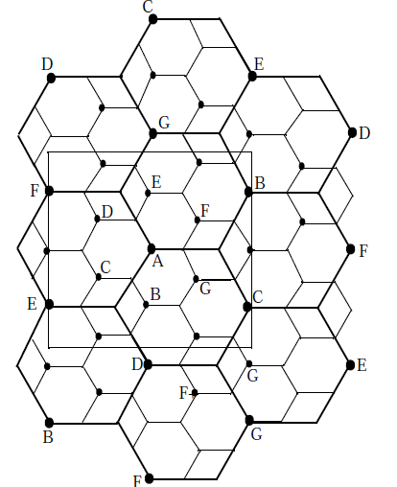
Example 5
Consider Figure 3.9. Assume each base station uses 60 channels, regardless of cell size. If each original cell has a radius of 1 km and each microcell has a radius of 0.5 km, find the number of channels contained in a 3 km by 3 km square centered around A under the following conditions:
(a) without the use of microcells; (b) when the lettered microcells as shown in Figure 3.9 are used; and (c) if all the original base stations are replaced by microcells. Assume cells on the edge of the square to be contained within the square.

Slide 31
(a) without the use of microcells:
Targeted area contains five base stations.
One BS=60 channels →
Total number of channels = 5 × 60 = 300 channels.
(b) with the use of the lettered microcells:
Number of lettered microcells around BS A= 6
Therefore, the total number of base stations in the square area =5 + 6 = 11.
One BS=60 channels →
Total number of channels =11 × 60 = 660 channels.
This is a 2.2 times increase in capacity when compared to case (a).
(c) if all the base stations are replaced by microcells:
Total BS=17 in the square region
One BS=60 channels →
Total number of channels =17 × 60 = 1020 channels.
This is a 3.4 times increase in capacity compared to case (a).
Theoretically, if all cells were microcells having half the radius of the original cell, the capacity increase would approach four.

Slide 32
Cell Sectoring
Sectoring is a technique for decreasing co-channel interference and thus increasing system performance by using directional antennas
  Replace the omni-directional antenna at each base station by three (or six) sector antennas of 120 (or 60) degrees opening
    Ex. With no sectoring, suppose m = 18 channels/cell
    With 120o sectoring, we have 6 channels/sector
    With 60o sectoring, we have 3 channels/sector
    Can support the same number of users per cell
  Each sector can be considered as a new cell, with its own (set of) frequency channel(s)
  Reduce co-channel interference
    A given cell will receive interference and transmit with only a fraction of the available co-channel cells
    CCI depends on the amount of sectoring used

Slide 33
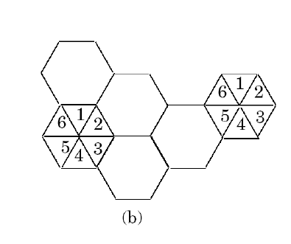
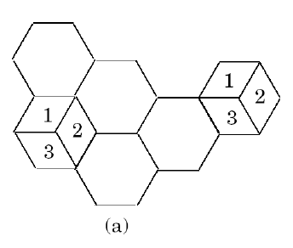

Cell Sectoring
Analysis: mobile in center cell will experience interference from only 2 cells (not 6). Alternatively, try to reduce the reuse factor. Sectoring entails reduced trunking efficiency.

Slide 34
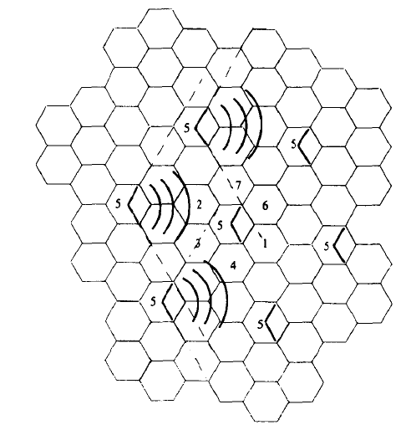
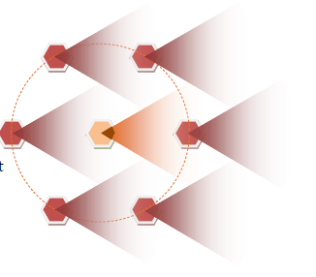
Cell Sectoring
Illustration of how 120 Degree and 60 Degree Sectoring reduces CCI

Slide 35
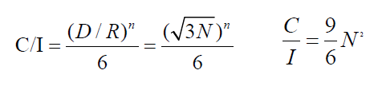

Example of Cell Sectoring
With omin directional antennas
if n=4 →
For N = 7, we obtain C/I = 18.7 dB.
With 120 degree sectoring
For N = 7 and with 3 sectors, we get C/I = 23.4dB.
Power dB = 10 log (Power in W)

Slide 36
Limitations of Sectoring
Increased number of antennas at BS
Decrease in trunk efficiency
Reduce coverage area and thus increase handoffs

Slide 37
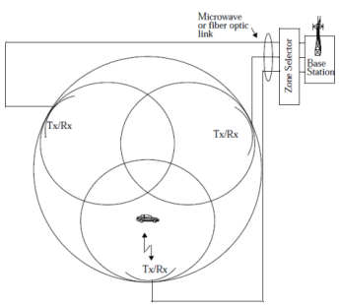
A Microcell Zone Concept
A solution to the problem of increased load on the switching and control link elements due to increased number of hand-offs when sectoring is employed.
It is based on a micro-cell concept for 7-cell reuse
    Each zone site is connected to a single BS and share the same radio equipment
    Zones are connected to the single BS by coaxial cable, fiber-optic cable or microwave link
    Multiple zones and a single BS make up a cell

Slide 38
Advantages
Less handoff
  It retains the same channel when mobile moves from zone to another
  No handoffs is required at the MSC
Less CCI
  A large BS is replaced by several low powered zone transmitters
Increase capacity without degrading the trunking efficiency

Slide 39
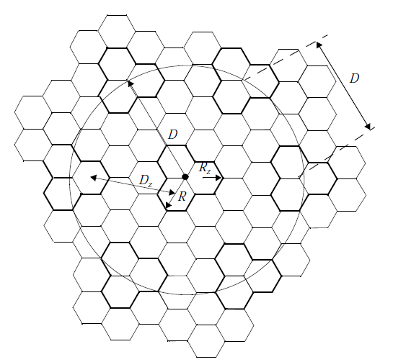
Capacity Improvement with Sample Scenario
Let
-Each hexagon : one zone
-A group of 3 zones : one cell
-Rz: Zone radius
-R: Cell radius
-D ≈ 3R
Thus,
-Co-channel reuse ratio D/R =3
-Since D/R=3, N=3
Thus,
Cluster size reduce from N=7 to 3

Slide 40
Repeaters for Range Extension
Repeaters are radio re-transmitters used to provide coverage for hard-to-reach areas, such as within buildings or in valleys or tunnels
Repeaters are bidirectional. Upon receiving signals from base station, then amplifies and reradiates the base station signals to the specific coverage region. Also it will send signals to the serving base station.
The repeaters do not add capacity to the system-it simply serves to reradiate the base station signal into specific locations

Slide 41
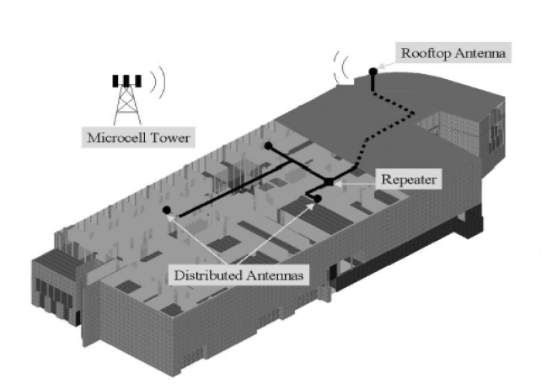
Repeaters for Range Extension

Slide 42
Summary
The fundamental concepts of handoff, frequency reuse, trunking efficiency, and frequency planning have been presented.
The S/I in a wireless propagation channel, along with the specific performance of the air interface in an interference environment, limits the frequency reuse factor of a system, which limits the number of channels within the coverage area.
The trunking efficiency limits the number of users that can access a trunked radio system.
Trunking is affected by the number of available channels and how they are partitioned in a trunked cellular system. Trunking efficiency is quantified by the GOS.
Finally, cell splitting, sectoring, and the zone microcell technique are all shown to improve capacity by increasing S/I in some fashion.
The overriding objective in all of these methods is to increase the number of users within the system.
The radio propagation characteristics influence the effectiveness of all of these methods in an actual system.

Slide 43


Slide 44
Round I
What is the concept for accommodating a large number of users in a limited radio spectrum?
a) Grade of service b) Trunking c) Multiplexing d) Multitasking
On termination of call, the occupied channel is not returned to the pool of available channels in trunking. State whether True or False.
a) True b) False
What is the unit for the measure of traffic intensity?
a) Meters b) Henry c) Ohm d) Erlang
What is the measure of the ability of user to access a trunked system during the busiest hour?
a) Trunking b) Grade of Service (GOS) c) Multiplexing d) Sectoring
GOS is typically given as a likelihood that a ________
a) Call is in progress b) Channels are busy
c) Call is blocked d) Channel are free
Answer : b b d b d

Slide 45
Round II
Average duration of a typical call is called
a) Holding time b) Dwell time c) Set up time d) Run time
Traffic intensity offered by each user is the product of
a) Set up time and holding time b) Call request rate and holding time
c) Load and holding time d) Call request rate and set up time
Blocked calls delayed formula is also known as _______
a) Erlang A b) Erlang B c) Erlang C d) Erlang D
Which of the following techniques do not help in expanding the capacity of cellular system?
a) Sectoring b) Scattering c) Splitting d) Microcell zone concept
________ uses directional antennas to control interference.
a) Sectoring b) Cell splitting c) Repeaters
d) Micro cell zone concept
Answer : a b c b a

Slide 46
Round III
_______ allows an orderly growth of cellular system.
a) Sectoring b) Scattering c) Cell splitting d) Micro cell zone technique
Which of the following increases the number of base stations in order to increase capacity?
a) Cell splitting b) Sectoring
c) Repeaters d) Micro cell zone concept
The process of subdividing a congested cell into smaller cells is called
a) Cell splitting b) Sectoring c) Micro cell technique d) Repeaters
Cell splitting do not maintain the minimum c-channel reuse ratio. State whether True or False.
a) True b) False
Sectoring increases SIR (Signal to Interference Ratio). State True or False.
a) True b) False
Answer : c a a b a

Slide 47
Round IV
Which of the following has range extension capability?
a) Sectoring b) Repeaters c) Scattering d) Micro cell zone concept
Which of the following is not an advantage of micro cell zone technique?
a) Reduced co channel interference b) Improved signal quality
c) Increase in capacity d) Increasing number of base stations
In a micro cell zone concept, when a mobile travels from one zone to another within the cell, it retains the same _________
a) Power level b) Base station c) Channel d) Receiver
Answer : b d c

Slide 48
Assignments
Problems: 3.4, 3.5, 3.7,3.8, 3.10, 3.11, 3.12, 3.13, 3.15, 3.26, 3.27, 3.28, 3.29

Slide 49
Next Lecture
Mobile Radio Propagation – Large Scale Path Loss Model
  Ideal Free-space Radio Propagation Model
  Three Basic Propagation Mechanisms and Related Propagation Models
    Reflection
    Diffraction
    Scattering

Slide 50
  Thank You …

