Slide 1
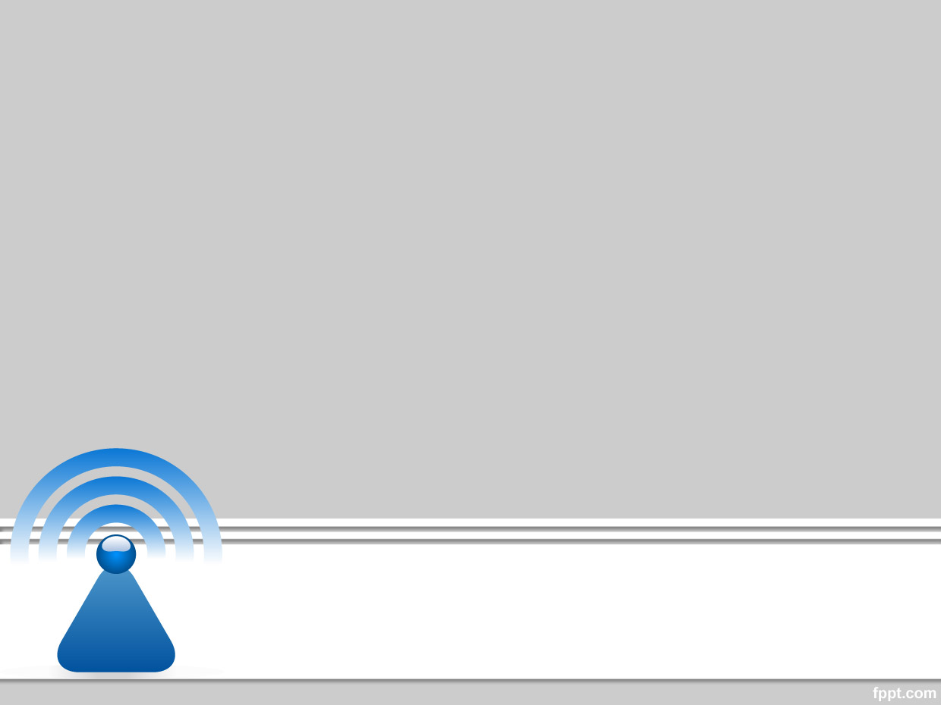
Wireless and Mobile Communication
Dr. Nyein Aye Maung Maung
Dr.Eng (Ritsumeikan University)
Computer Engineering and Information Technology Dept
Yangon Technological University

Slide 2
Course Information
Course Title
  Wireless and Mobile Communication
Description
  This course deals with the concepts of wireless and mobile communication systems, radio propagation characteristics and state-of-the-art technologies that are making wireless and mobile communication enable.

Slide 3
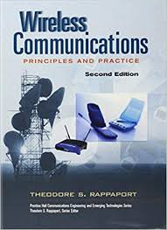
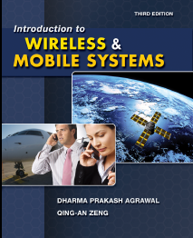
Textbook and References
Rappaport, Theodore S. Wireless communications: principles and practice. Vol. 2. New Jersey: prentice hall PTR, 1996.
Agrawal, Dharma P., and Qing-An Zeng. Introduction to wireless and mobile systems. Cengage learning, 2015.

Slide 4
Course Objectives
To help students understand system design fundamentals and factors for improving coverage and capacity of cellular systems
To promote students’ ability to analyze propagation characteristics of wireless channels and have technical know-hows to design and evaluate performance of different indoor and outdoor radio propagation models
To have a good knowledge of technical concepts such as modulation types, channel coding, equalization, antenna diversity and multiple access techniques
To understand differences between different network standards including cellular networks (GSM, 3G, 4G), WiFi, PANs, etc
To have strong technical skill on system design considerations for a given channel environment and different cellular network standards

Slide 5
Schedule of the Course
Week |  | Topic
Part I | 1 | Introduction to Wireless Communication Systems and Modern Wireless Communication Systems
 | 2 | The Cellular Concept – System Design Fundamentals
 | 3 | The Cellular Concept— Trunking and Grade of Service, Improving Coverage and Capacity
 | 4 | Mobile Radio Propagation: Large-Scale Path Loss
 | 5 | Mobile Radio Propagation: Practical Link Budget Design using Path Loss Models
 | 6 | Mobile Radio Propagation – Small-scale Fading and Multipath
Part II | 7 | Modulation Techniques: Analog Modulation Techniques
 | 8 | Modulation Techniques: Digital Modulation Techniques
 | 9 | Multiple Access Techniques
 | 10 | Channel Equalization and Antenna Diversity
 | 11 | Channel Coding
 | 12 | Wireless Networking, Systems and Standards

Slide 6
Exam and Grading System
Task | Mark
Final Exam | 80%
Practical Assignments | 10%
Tutorial | 10%
Mark | Grade
85~100 | A+
80~85 | A
70~80 | B
50~70 | C
<50 | F

Slide 7
Lecture 2
Cellular Concept
System Design Fundamentals

Slide 8
Outline of Class (Lecture 2)
Cellular Concept – System Design Fundamentals
  Frequency Reuse
  Channel Assignment Strategies
  Handoff Strategies
  Interference and System Capacity
Quiz

Slide 9
(1) Cellular Concepts- Introduction

Slide 10
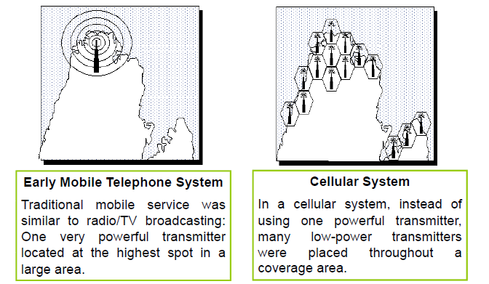
Old Mobile Systems & Cellular Systems

Slide 11
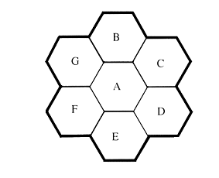
Cellular Concept
Single Cell
  Large coverage
  Single high power transmitter
M Small Cells
  Small coverage
  Multiple low power transmitters
S Channels = S simultaneous Users
Capacity=S
Total Channels = S
Cluster size =N cells
K channels per cell : K=S/N
Capacity= N x K

Slide 12
(2) Frequency Reuse

Slide 13
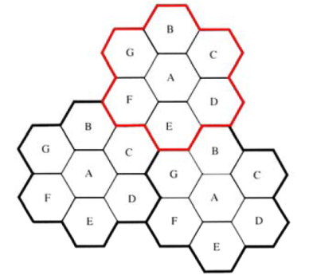
Frequency Reuse
The design process of selecting and allocating channel groups for all of the cellular base stations within a system is called frequency reuse or frequency planning
Neighboring cells will interfere to each other
Assign base stations in adjacent cells channel groups which contain completely different channels than neighboring cells
Cells labeled with same letter use the same group of channels

Slide 14
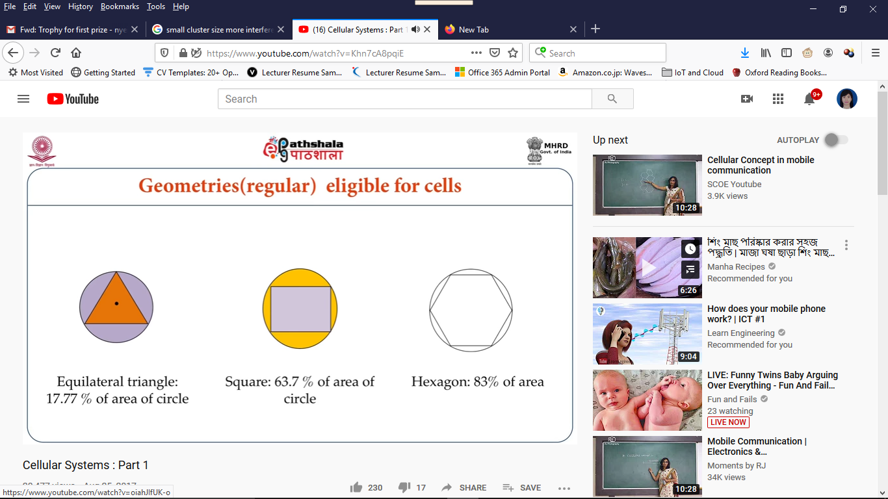
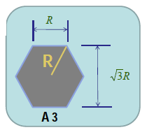
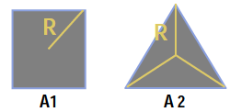
Why Hexagonal Cell?
Hexagonal cell shape is conceptual and is the simplistic model of the radio coverage for each base station
Two factors: (1) Coverage Area (2) Less Overlap Area
  cover an entire region without overlap and with equal area

Slide 15
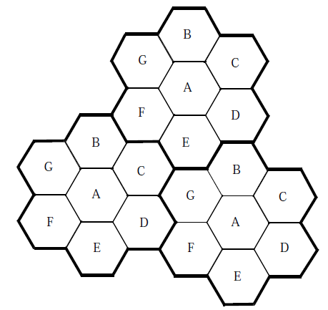
Capacity of a Cellular System
S = Total number of duplex channel
N= Total number of cells (in a cluster)
K = Total channels per each cell
K=S/N
M= Total number of clusters
C = Total Capacity
C=MS
Total capacity directly proportional to number of clusters
N=7, M=3
Three 7-cell clusters

Slide 16
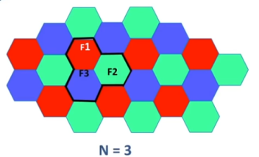

Capacity versus Interference on
Cluster Size
Decrease N for More Capacity: If Cluster Size, N, is decreased while cell size remains fixed, more clusters are required to cover the area (M increases). Therefore, Capacity increases.
Increase N for Less Interference: On the other hand, if N is increased (large cluster size) means that co-channels are now farther than before, and hence we have will have less interference.

Slide 17
Forming a Cluster
Cluster Size N (Number of Cells per Cluster)
  To connect without gaps between adjacent cells, the number of cells per cluster N can only have values which satisfy the following equation
  Example: When i = 2, j = 1
    N = 4 + 2 + 1 = 7
  Commonly used cluster size N = 4, 7, 12.
where i and j are positive integers

Slide 18
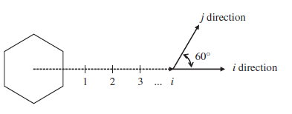
Forming a Cluster (cont.)
Finding Co-channel Neighbors
  Method 1
    Move i cells along any chain of hexagons
    Turn 60 degrees counter-clockwise and move j cells

Slide 19
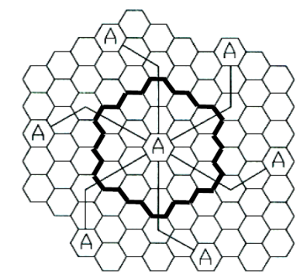
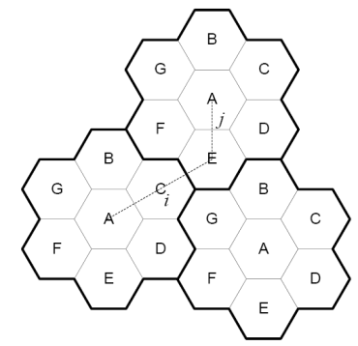
Forming a Cluster (cont.)
Method 1 (cont.)
N=19, i=3 , j=2
(N=7, i=2, j=1)

Slide 20
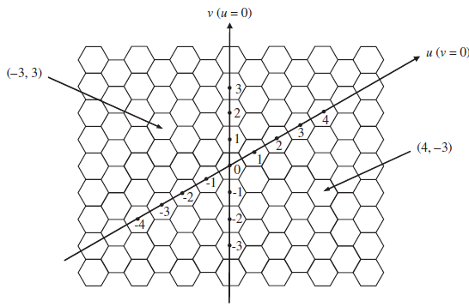


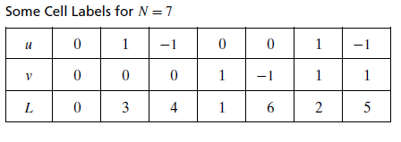
Forming a Cluster (cont.)
Method 2
  Use u and v coordinate plane
  Only for those case where j=1
  Obtain the label L for the cell whose center is at (u, v)
u and v coordinate plane

Slide 21
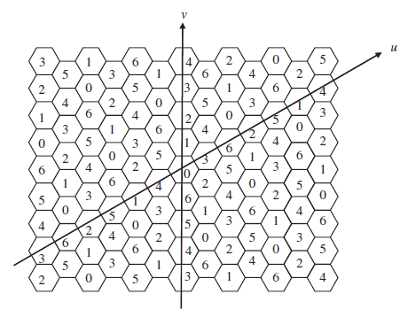
Forming a Cluster (cont.)
Method 2 (cont.)
  Example: Cell Labels for N=7

Slide 22
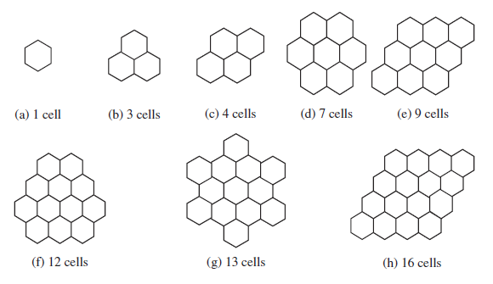
Common Reuse Patterns

Slide 23
Example 3.1 If a total of 33 MHz of bandwidth is allocated to a particular FDD cellular telephone system which uses two 25 kHz simplex channels to provide full duplex voice and control channels, compute the number of channels available per cell if a system uses (a) four-cell cluster, (b) seven-cell cluster, and (c) 12-cell cluster. If 1 MHz of the allocated spectrum is dedicated to control channels, determine an equitable distribution of control channels and voice channels in each cell for each of the three systems.
Total bandwidth = 33 MHz
Channel bandwidth = 25 kHz × 2 simplex channels = 50 kHz/duplex channel
Total available channels = 33,000/50 = 660 channels
(a) For N = 4,
total number of channels available per cell = 660/4 ≈ 165 channels.
1 MHz spectrum for control channel → 20 total control channels
Thus, Each cell has 5 control channels and 160 voice channels

Slide 24
(b) For N = 7,
total number of channels available per cell = 660/7 ≈ 95 channels.
1 MHz spectrum for control channel → 20 total control channels
4 cells with 91 voice channels, 3 cells with 92 voice channels, 1 control channel per cell
(c) For N = 12,
total number of channels available per cell = 660/12 ≈ 55 channels.
1 MHz spectrum for control channel → 20 total control channels
Thus, 8 cells with 53 voice channels, 4 cells with 54 voice channels, 1 control channel per cell

Slide 25
(3) Channel Assignment Strategies

Slide 26
Channel Assignment Strategies
Objective
  To minimize interference
  To improve capacity
Two Types of Assignment Strategies
  Fixed Channel Allocation Strategy
  Dynamic Channel Allocation Strategy

Slide 27
(1) Fixed Channel Allocation
Each cell is allocated a predetermined set of voice channels
Any call attempt within the cell can only be served by the unused channels in that particular cell
If all the channels in that cell are occupied, the call is blocked and the subscriber does not receive service
Strategy - borrowing strategy
  A cell is allowed to borrow channels from a neighboring cell if all of its own channels are already occupied and it does not disrupt or interfere with any of the calls in progress in the donor cell.
  Advantages: Disadvantages:
    Less load on MSC Blocking may happen
    Simple

Slide 28
(2) Dynamic Channel Allocation
Voice channels are not allocated to different cells permanently. Instead, each time a call request is made, the serving base station requests a channel from the MSC.
MSC allocates a channel to the requested cell following an algorithm
Dynamic channel assignment reduce the likelihood of blocking, which increases the trunking capacity of the system
  Advantage
    Increased channel utilization and decreased probability of a blocked call
  Disadvantage
    Storage and computational load on MSC

Slide 29
(4) Hand Off Strategies

Slide 30
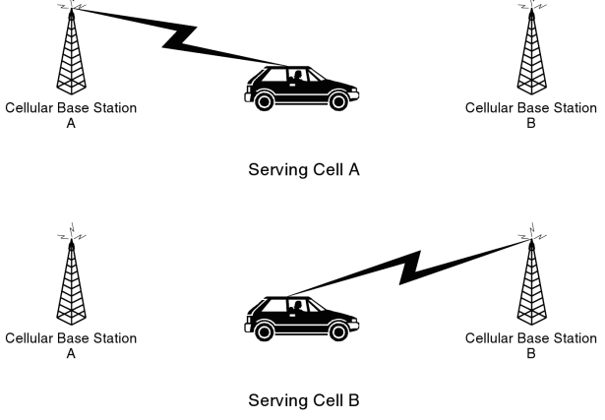
Handoff or Handover
Ability of a subscriber to maintain a call while moving within the network (without the subscriber noticing any changes)
Handoff can take place between
    two sectors of the same BSC
    two BSCs
    two MSC of same operator
    two networks (different operators) called inter-network handoff which is not supported in some systems for billing reasons

Slide 31
Handoff Strategies
Desired Behavior:
  Prioritize Hand off to new call initiation
  Successful transfer of call
  Hand off should be as infrequent as possible
  Hand off should be imperceptible (very slight)
Hand off Threshold Power Level (P_{r handoff})
  There is a minimum power level of the signal at BS for acceptable voice quality. (-90 to –100 dBm).
  Hand off Threshold is defined ∆ dBm above this level, so that the system has time to process hand off.

Slide 32
Margin ∆ needs to be neither too small, nor too large
Too small → too short time to perform handoff, The call may be dropped in the meanwhile.
Too large → unnecessary handoff burden. Hand off becomes more frequent, and occurs even when Power is at the acceptable level.

Slide 33
Network Controlled Handoff
Signal Strength Measurements are made by base stations and supervised by MSC.
Each base station constantly monitors power levels of its reverse voice channels, which tells the relative location of the user.
Reverse Signal Strength Indicators: Power levels of all the calls in a cell.
Locator Receiver: A spare receiver at each BS which is used to measure power levels of users in neighboring cells which appear to be in need of Handoff
Both these pieces of information are passed to MSC for hand off decision.

Slide 34
Mobile Assisted Handoff (MAHO)
Mobile station continually measures power levels of surrounding Base Stations and reports these measurements to the serving Base Station.
Hand off is initiated when power level from BS of neighboring cell exceeds that of the current cell, for certain time, or by a certain level
MAHO method ensures faster hand off since burden of MSC is shared by Mobile Stations
MAHO is particularly suited for Micro-Cellular Systems.

Slide 35
Prioritizing Hand off
(1) Guard Channel Concept
Reserve some channels exclusively for hand off--- do not use them for call initiation.
Advantage
  Increased probability of successful hand off.
Disadvantage
  Lower capacity because of less number of channels for call initiation
Suitable with Dynamic Channel Allocation

Slide 36
Prioritizing Hand off
(2) Queuing of Handoff
Decreases the probability of forced termination of a call due to lack of available channels.
Trade off between the “probability of forced termination” and “total carried traffic”. i.e,
“Probability of forced termination” decreases at the cost of reduced Total Carried Traffic.
Queuing is possible because of the time available between the Threshold power level and the Hand off power level.
Delay Time and Queue Size are related to service area.
Queuing doesn’t guarantee zero probability of call drop.

Slide 37
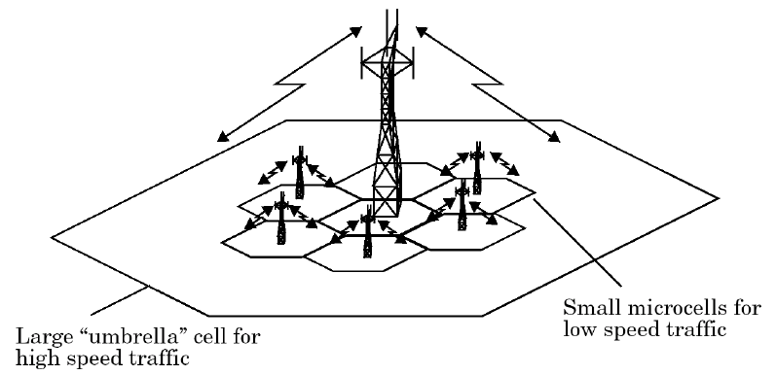
Practical Hand Off Strategies
The UMBRELLA CELL Concept: Large and Small cells are co-located
  Large area coverage for high speed users and small area coverage for low speed users
A High speed user converting into a low speed user may be switched to smaller micro-cell by the Base Station, without MSC intervention.
  Minimizes the number of hand offs for high speed users,
  Provides additional micro-cell users for pedestrians.

Slide 38
(5) Interference and System Capacity

Slide 39
Interference
A major limiting factor in the performance of cellular radio systems
Sources of interference:
    1. Mobile Stations
    2. Neighboring Cells
    3. The same frequency cells
    4. Non-cellular signals in the same spectrum
Urban areas usually have more interference, because of:
  a) Greater RF Noise Floor,
  b) More Number of Mobiles
  Types
    1. Co-Channel Interference (CCI)
    2. Adjacent Channel Interference (ACI)

Slide 40
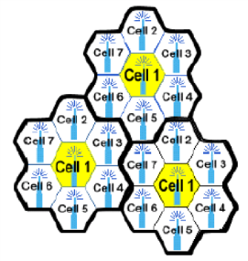
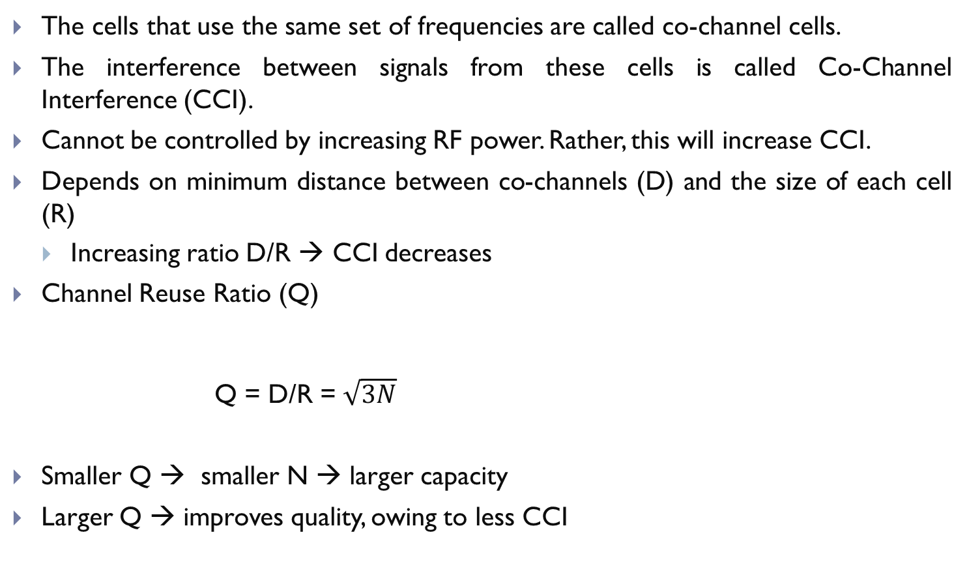
Co-Channel Interference and
System Capacity
The cells that use the same set of frequencies are called co-channel cells.
The interference between signals from these cells is called Co-Channel Interference (CCI).
Cannot be controlled by increasing RF power. Rather, this will increase CCI.
Depends on minimum distance between co-channels (D) and the size of each cell (R)
  Increasing ratio D/R → CCI decreases
Channel Reuse Ratio (Q)
Q = D/R = $\sqrt{3N}$
Smaller Q → smaller N → larger capacity
Larger Q → improves quality, owing to less CCI
Reuse distance (D)

Slide 41
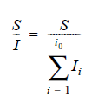

Signal to Interference Ratio
Signal-to-interference ratio (SIR or SI)
The signal strength at distance d from a source is
:i₀ be the number of co-channel interfering cells
i.e, received signal power is inversely related to n^{th} power of the distance where n = path loss exponent

Slide 42
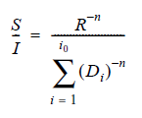
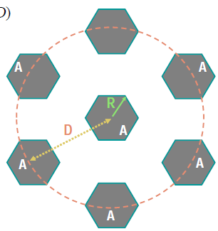

SIR for Equidistant Case (D_{i} = D)
When transmit power and path loss exponent of each base station is the same
Considering only the first layer of interfering cells,
D_{i} is the distance of the i^{th} interferer from the mobile

Slide 43
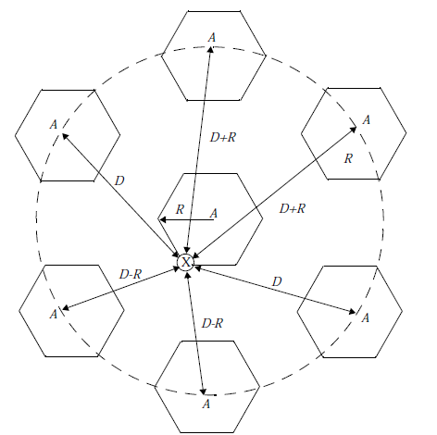


Worst Case Design
7 Cell Reuse Pattern (N=7)
Q=D/R and S/I in terms of co-channel
reuse ratio

Slide 44
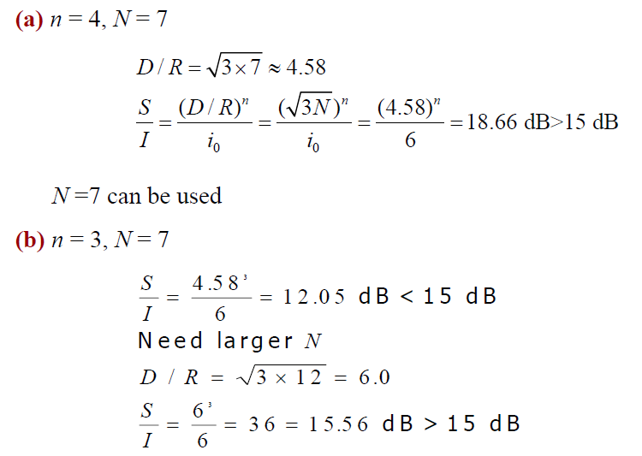
Example 3.2 If a signal-to-interference ratio of 15 dB is required for satisfactory forward
channel performance of a cellular system, what is the frequency reuse factor and cluster size that should be used for maximum capacity if the path loss exponent is (a) n = 4, (b) n = 3? Assume that there are six co-channel cells in the first tier, and all of them are at the same distance from the mobile. Use suitable approximations.

Slide 45
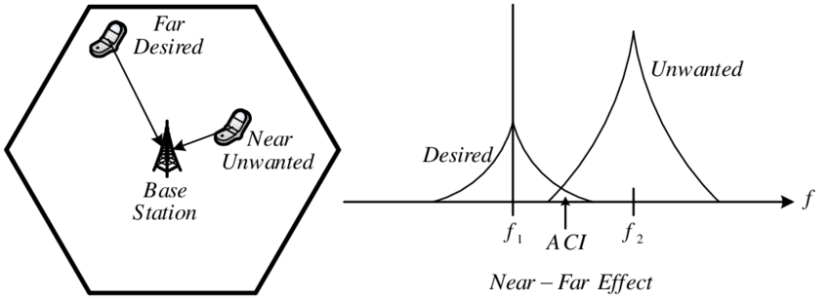
Adjacent Channel Interference
Interference from channels that are adjacent in frequency,
The primary reason for that is Imperfect Receive Filters which cause the adjacent channel energy to leak into your spectrum.
Problem is severer if the user of adjacent channel is in close proximity, called Near-Far Effect

Slide 46
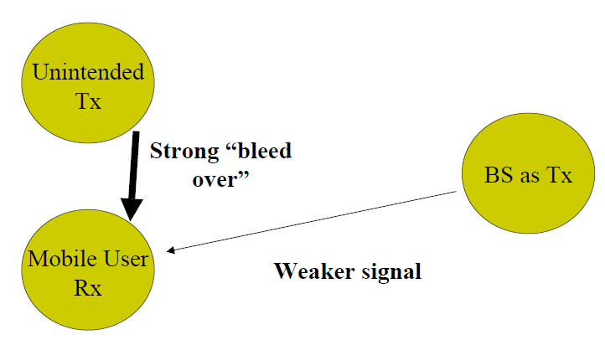
Near-Far Effect: Case 1
The Mobile receiver is captured by the unintended, unknown transmitter, instead of the desired base station

Slide 47
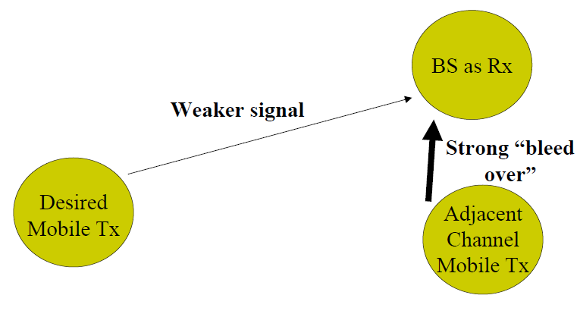
Near-Far Effect: Case 2
The Base Station faces difficulty in recognizing the actual mobile user, when the adjacent channel bleed over is too high.

Slide 48
Minimization of ACI
(1) Careful Filtering
(2) Better Channel Assignment Strategy
Channels in a cell need not be adjacent: For channels within a cell, Keep frequency separation as large as possible.
Sequentially assigning cells the successive frequency channels.
Also, secondary level of interference can be reduced by not assigning adjacent channels to neighboring cells.
For tolerable ACI, we either need to increase the frequency separation or reduce the passband BW.

Slide 49


Slide 50
Round I
1. Cellular concept replaces many low power transmitters to a single high power transmitter. (True or False)
a) True b) False
2. Why neighbouring stations are assigned different group of channels in cellular system?
a) To minimize interference b) To minimize area c) To maximize throughput
d) To maximize capacity of each cell
3. What is frequency reuse?
a) Process of selecting and allocating channels b) Process of selection of mobile users
c) Process of selecting frequency of mobile equipment d) Process of selection of number of cells
4. What is the main reason to adopt hexagon shape in comparison to square and triangle?
a) Largest area b) Simple design c) Small area d) Single directional
5. For a cellular system, if there are N cells and each cell is allocated k channel. What is the total number of available radio channels, S?
a) S=k*N b) S=k/N c) S=N/k d) S=k^{N}
Answer: b , a, a, ,a ,a

Slide 51
Round II
1.What is a cluster in a cellular system?
a) Group of frequencies b) Group of cells
c) Group of subscribers d) Group of mobile systems
2.What is a frequency reuse factor for N number of cells in a system?
a) N b) N² c) 2*N d) 1/N
3.Capacity of a cellular system is directly proportional to _____
a) Number of cells b) Number of times a cluster is replicated
c) Number of Base stations d) Number of users
4.A spectrum of 30 MHz is allocated to a cellular system which uses two 25 KHz simplex channels to provide full duplex voice channels. What is the number of channels available per cell for 4 cell reuse factor?
a) 150 channels b) 600 channels c) 50 channels d) 85 channels
5.In fixed channel assignment strategy, each cell is allocated a predetermined set of _______
a) Voice channels b) Control channels c) Frequency d) base stations
Answer: b, d, b, a, a

Slide 52
Round III
What happen to a call in fixed channel strategy, if all the channels in a cell are occupied?
a) Queued b) Cross talk c) Blocked d) Delayed
2.What is a borrowing strategy in fixed channel assignments?
a) Borrowing channels from NB cell b) Borrowing channels from neighbouring cluster
c) Borrowing channels from same cell d) Borrowing channels from other BS in same cell
3.Dynamic channel assignment reduces the likelihood of blocking in comparison to fixed channel assignment. State whether True or False.
a) True b) False
4.What is the drawback of dynamic channel assignment?
a) Decrease channel utilization b) Increase probability of blocked call
c) Cross talk d) Increase storage and computational load on system
5.What are co-channel cells?
a) Cells having different base stations b) Cells using different frequency
c) Cells using adjacent frequency d) Cells using same frequency
Answer: c, a, a, d, d

Slide 53
Final Round
Co-channel interference is a function of ______
a) Radius of cell b) Transmitted power
c) Received power d) Frequency of mobile user
2. Co-channel reuse ratio is define by ______
a) Q=D*R b) Q=D/R
c) Q=D^R d) Q=1/R
3. Co-channel ratio in terms of cluster size is defined as ______
a) √(3N) b) N c) 3N d) √N
4. Which of the following problem occur due to adjacent channel interference?
a) Blocked calls b) Cross talk c) Near-far effect d) Missed calls
Answer: a, b , a , c

Slide 54
Next Lecture
Trunking and Grade of Service
Improving Coverage and Capacity in Cellular Systems

Slide 55
  Thank You …

